Slide 1
TALENT MANAGEMENT & DEVELOPMENT - III
PHRi

Slide 2
Training Program Development
Training Implementation
Kirkpatrick Training Evaluation Model
Training Transfer
Trends for Employee Training
Outsourced Training
Learning Management System
Training Need Analysis

Slide 3
Learning Management System (LMS)
Learning Management System (sometimes also called "Course Management System", "Pedagogical Platform", "E-Learning Platform") is a software system that delivers courseware plus e-tutoring over the Internet.
A learning management system (LMS) allows you to create, distribute and track training anywhere, on any device.

Slide 4
Choice of LMS
As with most software, there’s no “one size fits all, best” LMS
Is it easy to use?
Does it offer reporting?
How many learners can you invite?
Can you create individual learning tracks?
What course and media formats does the LMS support?

Slide 5
Training Program Development
Training Implementation
Kirkpatrick Training Evaluation Model
Training Transfer
Trends for Employee Training
Outsourced Training
Learning Management System
Training Need Analysis

Slide 6
Training Need Analysis
Training needs are identified on the basis of organisational analysis, job analysis and individual analysis.
Course content are to be planned on the basis of training needs.
Training needs are those aspects necessary to perform the job in an organisation in which employee is lacking attitude/aptitude, knowledge, skill.

Slide 7

Training Needs Assessment

Slide 8
Assessment Process
Gather data to identify needs.
Determine needs that can be met by training interventions.
Propose solutions.(Training is not a solution for employee relations problems such as poor morale, lack of motivation, or lack of ability to learn.)
Calculate potential cost of training interventions.
Choose and implement the training.

Slide 9
Types of Assessments
Organizational Assessment - Identifies the knowledge, skills, and abilities employees will need in the future.
Task Assessment - Compares job requirements with employee knowledge and skills to identify are as needing improvement through job analysis.
Individual Assessment - Focuses on individual employees and how they perform their jobs, usually determined through performance appraisal or review.

Slide 10
Question # 1
Once the data of training needs analysis has been gathered, the next step is to:.
Report the needs that training can and cannot meet.
Develop the objectives for the training program.
Propose a series of solutions for customer service problems.
Decide whether to develop or buy the training program.

Slide 11
Answer # 1
Option A

Slide 12
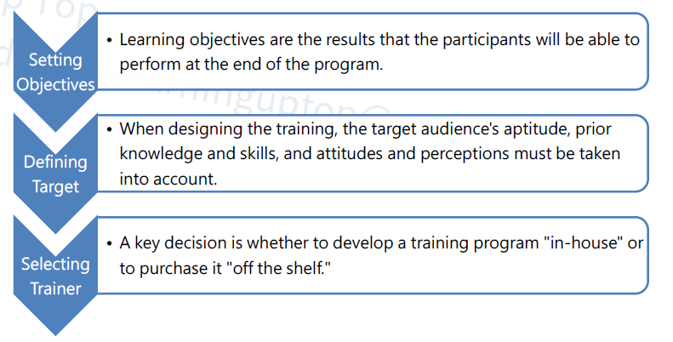
Training Design

Slide 13
Training Program Development
Training Implementation
Kirkpatrick Training Evaluation Model
Training Transfer
Trends for Employee Training
Outsourced Training
Learning Management System
Training Need Analysis

Slide 14

Training Program Development

Slide 15
Question # 2
One well-recognized advantage of on-the-job training is:.
a) Supervisors' expertise in conducting job-specific instruction.
b) The incorporation of unplanned activities in the learning situation.
c) The ability to fit the learning to the trainee.
d) The ability to expand the learning to a more developmental focus.

Slide 16
Answer # 2
Option C

Slide 17
Types of Training Program
Vestibule Training - It is a method in which trainees learn on the actual or simulated equipment they will use on the job, but are trained off the job. It can be considered a combination of onand off-the-job training.
Virtual training - A trainer in a central location teaches groups of employees at remote locations via television hookups.
Electronic Performance Support Systems (EPSS) - The systems are sets of computerized tools and displays that effectively automate and integrate training, documentation, and phone support, thus enabling individuals to provide support that’s faster, cheaper, and more effective than the traditional methods.

Slide 18
Types of Training
Blended Learning - It is a planned approach to learning that includes a combination of methods such as classroom, e-learning, self-paced study, and performance support such as job aids or coaching.
Cross training occurs when people are trained to do more than one job—theirs and someone else’s. For the employer, the advantages of cross training are flexibility and development.

Slide 19
Orientation and On-boarding
Orientation and on boarding refers to the process of new employee assimilation, which often lasts up to six months or a year. The programs smooth the adjustment phase by introducing new employees to others, lessening feelings of isolation, and providing a better understanding of the organization, expectations, and future opportunities for personal growth and development.

Slide 20
E-Learning
E-learning is the delivery of formal and informal training and educational materials, processes, and programs via the use of electronic media. E-learning includes Web based learning, computer-based training (CBT), and virtual classrooms.
E-learning can be synchronous or asynchronous:
Synchronous learning is when participants interact together in real time.
Asynchronous learning is when participants access information at different times and in different places.

Slide 21
Question # 3
A major concern with e-Learning is that:.
a) Retention of learned material is affected by the speed with which the learner progresses through the course.
b) Trainees will discontinue other learning experiences critical to job performance.
c) It is more costly than other training methodologies.
d) It provides too much flexibility because of self-pacing.

Slide 22
Answer # 3
Option A

Slide 23
Question # 4
The HRCI is adding five new stamping machines, which are identical in design and operation to 20 stamping machines currently operated by 20 machine operators and 20 assistant machine operators. The operators for the new equipment will be selected from the pool of current assistant machine operators. Which of the following is the most cost effective instructional method for training the new operators?.
a) Classroom-based lecture
b) E-learning from the vendor
c) Structured on-the-job training
d) Simulation-based training

Slide 24
Answer # 4
Option C

Slide 25
Training Program Development
Training Implementation
Kirkpatrick Training Evaluation Model
Training Transfer
Trends for Employee Training
Outsourced Training
Learning Management System
Training Need Analysis

Slide 26
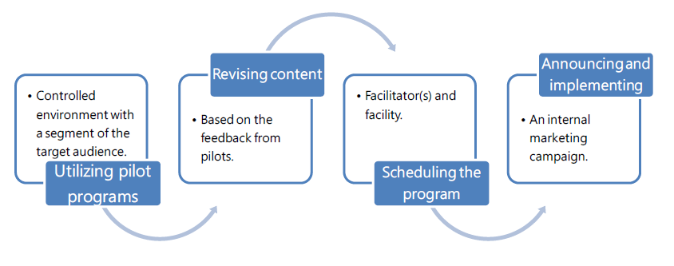
Training Implementation

Slide 27
Training Implementation
Utilizing pilot programs - A pilot program involves offering the program initially in a controlled environment with a segment of the target audience, and evaluating the sequencing of content.
Revising content - Based on the feedback provided by the pilot audience, now is the time to make adjustments to the program prior to final delivery.

Slide 28
Training Implementation
Scheduling the program involves paying attention to the target audience, the intended learning outcomes, the deadlines for completion, whether regular work hours or evenings and weekends are required, participation at a distance, etc. Selecting qualified facilitator(s) and selecting a facility are also important factors to consider.
Announcing and implementing the program - An effective way to increase interest in an upcoming training program is to launch an internal marketing campaign. Giving participants a preview of the topics and agenda creates interest

Slide 29
Training Program Development
Training Implementation
Kirkpatrick Training Evaluation Model
Training Transfer
Trends for Employee Training
Outsourced Training
Learning Management System
Training Need Analysis

Slide 30
Kirkpatrick's 4 Levels of Training Evaluation
The Kirkpatrick Model of Evaluation, first developed by Donald Kirkpatrick in 1959, is the most popular model for evaluating the effectiveness of a training program. The model includes four levels of evaluation, and as such, is sometimes referred to as 'Kirkpatrick's levels" or the "four levels.“
The four levels are:
Reaction.
Learning.
Behavior.
Results.

Slide 31

Training Evaluation Model

Slide 32

Kirkpatrick's 4 Levels of Training Evaluation

Slide 33
Kirkpatrick's 4 Levels of Training Evaluation
Level 1: Reaction :Reaction data captures the participants' reaction to the training experience. Specifically, it refers to how satisfying, engaging, and relevant they find the experience.
Level 2: Learning : This data tells us whether or not the people who take the training have learned anything. Specifically, it helps you answer the question: "Did the training program help participants learn the desired knowledge, skills, or attitudes?".

Slide 34
Kirkpatrick's 4 Levels of Training Evaluation
Level 3 Behaviour : data tells us whether or not people are behaving differently on the job as a consequence of the training program. Since the purpose of corporate training is to improve performance and produce measurable results for a business, this is the first level where we are seeing whether or not our training efforts are successful.
Level 4 Performance :data is the most valuable data covered by the Kirkpatrick model; it measures how the training program contributes to the success of the organization as a whole. This refers to the organizational results themselves, such as sales, customer satisfaction ratings, and even return on investment (ROI)

Slide 35
Training Program Development
Training Implementation
Kirkpatrick Training Evaluation Model
Training Transfer
Trends for Employee Training
Outsourced Training
Learning Management System
Training Need Analysis

Slide 36
Training Transfer
Training transfer is performing certain activities before, during, and after training sessions that enable employees to more effectively and quickly apply the skills learned in training on the job. Training transfer is the goal when employees are involved in any internal or external training activity, session, seminar, or on-the-job training.

Slide 37
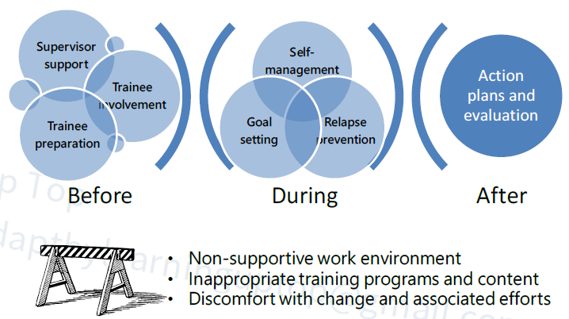
Training Transfer

Slide 38
Barriers of Training Transfer
Interference from immediate (work) environment
Non-supportive organizational culture
Impractical training programs
Irrelevant training content
Discomfort with change and associated efforts
Separation from inspiration or support of the facilitator
Poorly defined/delivered training
Pressure from peers to resist changes
Newly learned behaviors are not valued or modeled by participant's manager(s)

Slide 39
Training Program Development
Training Implementation
Kirkpatrick Training Evaluation Model
Training Transfer
Trends for Employee Training
Outsourced Training
Learning Management System
Training Need Analysis

Slide 40
MOOCs (Massive Online Open Courses)
Massive Online Open Course, or MOOC, refers to a free online course available to a mass audience. MOOCs are a recent development in distance education. Courses are generally education-based programs stemming from colleges and universities, although they do not provide degrees or credits to students.

Slide 41
Gamification
Gamification is the process of applying gaming designs and concepts to learning or training scenarios in order to make them more engaging and entertaining for the learner.
In game-based learning events, learners compete directly against one or more individuals or participate individually in an interactive experience that rewards learning performance in some way.

Slide 42
Difference - Training and Development
Employee Development Techniques
Stages in Career Development
Career Management Systems
Career Planning Points
Career Transitions

Slide 43
Employee Development
Development refers to learning activities and experiences that help employees grow and prepare for the future.
Development often involves voluntary learning that is not tied directly to the employee’s current job.
Training, on the other hand, is related to the current job and is typically required.
Development prepares employees for other positions and increases their ability to move into jobs that may not yet exist.
Development is especially important for senior managers and employees with leadership potential.

Slide 44
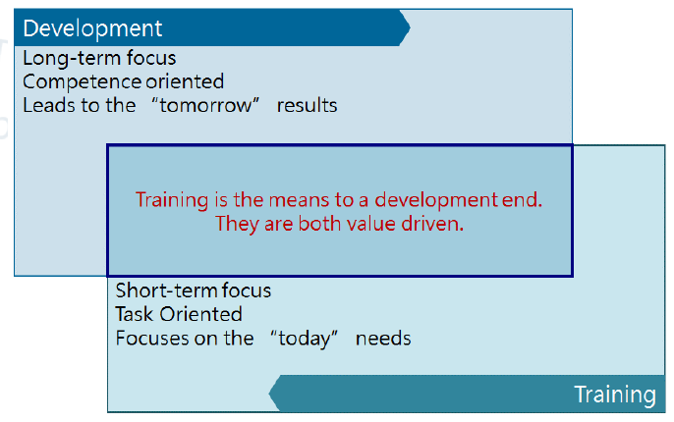
Differences Between Employee Training and Development

Slide 45
Differences Between Employee Training and Development
Development is accomplished through systematic training, learning experiences, work assignments, and assessment efforts.
Training is the acquisition of knowledge, skills and competencies as a result of teaching.
Development teaches how to become more productive and effective at work and at the company.
Training provides the skill and development maximizes it.

Slide 46
Question # 1
Replacement planning is based on an organization's ability to :
a) find candidates with development potential.
b) identify the best available candidate for a job
c) plan specific goals and assignments for individuals.
d) test candidates' potential early in their careers.

Slide 47
Answer # 1
Option B
The key phrase "for a job" identifies the correct answer. Replacement planning focuses on finding a person who could move into a key job in the organization. Planning specific goals and assignments for individuals, finding candidates with developmental potential, and testing candidates early in their careers are all hallmarks of succession planning.

Slide 48
Difference - Training and Development
Employee Development Techniques
Stages in Career Development
Career Management Systems
Career Planning Points
Career Transitions

Slide 49
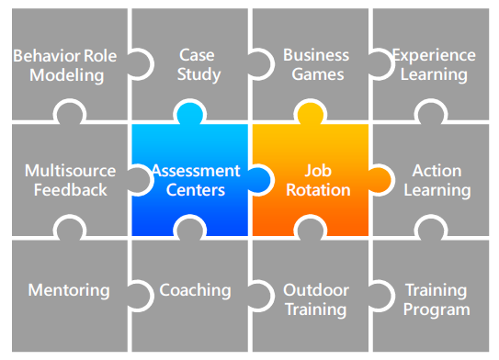
Employee Development Techniques

Slide 50
1. Behavior Role Modeling
The method uses a combination of demonstration (or videotape) and role playing to enhance interpersonal skills. Small group so of trainees observe someone demonstrate how to handle a particular type of interpersonal problem, then they practice the behavior in a role play and get nonthreatening feedback.

Slide 51
2. Case Study
Cases are descriptions of events in an organization and used in a variety of ways in courses to develop management skills, such as practice analytical and decision making skills. The benefits of using case study are to increase understanding about situations managers encounter and effective managerial behavior.

Slide 52
3. Business Games and Simulations
Simulations require trainees to analyze complex problems and make decisions. After decisions are made, trainees usually receive feedback about what happened as a result of their decision. Business games can be used also to assess training needs, the success of prior training, or the validity of a manager’s mental model for a particular decision situation.

Slide 53
4. Learning from Experience
Much of the management skill essential for effective leadership is learned from experience rather than from formal learning programs. Appropriate values and behaviors can be learned from competent superiors who provide positive role models to emulate.
Growth and learning are greater when job experiences are diverse as well as challenging. It is beneficial for managers to have early experience with a wide variety of problems that require different leadership behavior and skills.

Slide 54
5. Multi Source Feedback
This approach is called by various names, including 360-degree feedback and multirater feedback. This approach can be used for variety of purposes, but the primary use is to assess the strengths and developmental needs for individual managers
360-degree feedback is the process of appraising performance by collecting evaluations from all the way around the employee, i.e., from subordinates, peers, customers, the manager, and his/herself.

Slide 55
6. Assessment Center (AC)
The assessment center (AC) refers to a process involving multiple raters or assessors on multiple exercises or activities.The entire process is usually conducted off-site. Outcomes include identifying managerial potential in terms of personality characteristics, administrative skills, and interpersonal skills; and identifying employees with team skills. Exercises may include:
Leaderless group discussion
Role plays
Personality, interest and ability tests

Slide 56
7. Special Assignment
Special assignments include managing a new project or start-up operation, serving as the department representative on a cross-functional team, chairing a special task force to plan a major change or deal with serious operational problem, developing and conducting a training program for the organizational unit, and assuming responsibility for some administrative activities previously handled by the boss.
Research show that diverse, challenging assignments early in one’s career facilitated career advancement.

Slide 57
8. Job Rotation
Managers who are assigned to work in a variety of different functional subunits of the organization for periods of time can learn about the unique problems and processes in different subunits and the interdependencies among different parts of the organization. Also, it provides managers the opportunity to develop a large network of contact.

Slide 58
9. Action Learning
The emphasis is on developing cognitive and interpersonal skills rather than technical knowledge. The managers meet periodically with a skilled facilitator to discuss, analyze, and learn from their experiences.

Slide 59
10. Mentoring
Mentoring is a relationship in which a more experienced manager helps a less experienced protégé; the mentor is usually at a higher managerial level and is not the protégé’s immediate supervisor. Mentors can facilitate adjustment, learning, and stress reduction during difficult job transitions, while mentors may also benefit from the experience, because it is likely to increase their job satisfaction and help them develop their own leadership skills

Slide 60
11. Executive Coaching
Having a coach provides the unusual opportunity to discuss issues and try out ideas with someone who can understand them and provide helpful, objective feedback and suggestions, while maintaining strict confidentiality. Executive coaching is especially useful in conjunction with techniques that provide information about developmental needs but do not directly improve skills. The person who provides the coaching may be external or internal consultant.

Slide 61
12. Outdoor Challenge Program
The methods, often called outdoor training, involve physical activities performed by a group of people in an outdoor setting. An experienced facilitator conducts the activities, provides coaching and encouragement, and helps participants understand the link between their experiences in an activity and organization life. The perceptions of teamwork and individual problem solving increased for participants, especially when intact groups were used.

Slide 62
13. Personal Growth Programs
These programs usually involve strong emotional experiences and are more likely than most training programs to have a lasting effect on participants, which are designed to improve self-awareness and overcome inner barriers to psychological growth and development of leadership competencies. The net effect of personal growth programs that encourage people to find a better balance between their work and personal life may be to reduce commitment to the organization.

Slide 63
14. Succession Planning
It is a dynamic, ongoing process of systematically identifying, assessing, and developing leadership talent pool to contribute to the achievement of future strategic goals.
Succession planning is a strategy that targets long-range needs and focuses on the cultivation of talent to satisfy those needs, such as changes in strategy, market environment and retirement. Succession planning is proactive and attempts to ensure the continuity of leadership by cultivating talent from within the organization through planned development activities

Slide 64
Employee Development Techniques
Off-site training - It is often selected for multiday programs; a hotel or conference center could be used. The novelty of a new environment can help make participants more alert and involved.
Tuition reimbursement programs -These are sometimes offered by organizations to support employees' education and development. Most companies require that the program attended by the employee directly pertain to their job responsibilities.

Slide 65
Question # 2
In which training method are videotapes frequently used to illustrate how managers function in various situations?
a) Behaviour modelling.
b) Business games.
c) Lecture discussions.
d) Mentoring.

Slide 66
Answer # 2
Option A
In behaviour modelling trainees observe a supervisor role-play in a common work situation. Because situations presented are typical of those encountered, trainees are able to relate it to their own jobs.

Slide 67
Question # 3
What is a frequent criticism of using assessment centers in organizations?.
a) Problems with establishing validity.
b) Potential is high for adverse impact.
c) Cost of developing and administering.
d) Problems with the self-fulfilling prophecy.

Slide 68
Answer # 3
Option C
ACs are costly to develop and administer. Much time and cost is put into creating the exercise, training, assessor, and administering the AC

Slide 69
Difference - Training and Development
Employee Development Techniques
Stages in Career Development
Career Management Systems
Career Planning Points
Career Transitions

Slide 70
Career Development
Careers have been described as a sequence of positions held within an occupation. A career has also been described in the context of mobility within an organization. Finally, a career has been described a characteristic of the employee whose career consists of different jobs, positions, and experiences. As a result, career could be considered as the pattern of work-life experiences.
Protean Career refers a career that is frequently changing based on both changes in the person’s interests, abilities, and values and changes in the work environment. Compared to the traditional career, employees take major responsibility for managing their careers.
Plateaued careers are situations in which the employee, due to anyone of many different factors, is unable to advance further within the organization or, possibly, within the selected industry. An individual's career may reach a plateau for a wide variety of reasons.

Slide 71
Career Development
Career development is the process by which employees progress through a series of stages, each characterized by a different set of developmental tasks, activities, and relationships. Career development consists of two processes-career planning and career management.
Career planning are actions and activities that individuals perform to give direction to their work life.
Career Management is the process through which employees become aware of their own interests, values, strengths, and weaknesses; obtain information about job opportunities within the company; identify career goal; establish action plans to achieve career goals
Career Path is the line of job progression along which an employee typically moves during his or her tenure with a company.

Slide 72
Career Development
Career without boundaries views a manager as having many possible trajectories for a career, and many are across organizational boundaries.
Portfolio career are built around a collection of skills and interests and are self-managed. Portfolio careers are usually built around a collection of skills and interests, though the only consistent theme is one of career self-management. With a portfolio career you no longer have one job, one employer, but multiple jobs and employers within one or more professions.
Authentic career refers to people achieve a high level of personal insight and use this to follow a “true-to-self” career. The Authentic Career is about finding and living the authentic self. It brings us back to the things we might have once been told by a well-meaning friend or a self-help lecture. It makes real and fleshes out exactly what we need to do to work through core issues of our identity and find our "true bliss" in the workplace.

Slide 73

Stages in Career Development

Slide 74
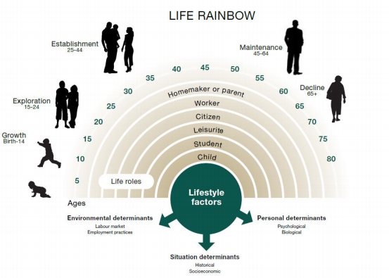
Donald Super’s Self Concept

Slide 75
Super’s - Career Development Theory
The career development process is unique to every person.
Factors like gender, ethnicity, ability, personality, socioeconomic status, family, geography, and opportunity all, to varying degrees, play a part in the development of one’s career path.
At the foundation of Super’s theory lie life stages, vocational tasks, and self concept.

Slide 76
1. Exploration Stage
In this stage, individual attempt to identify the type of work that interests them. They consider their interests, values, and work preferences, and they seek information about jobs, careers, and occupations form co-worker, friends, and family members. Therefore they can begin pursuing the needed education or training. From the company’s perspective, orientation activities are necessary to help new employees get as comfortable as possible with their new jobs and co-workers.

Slide 77
2. Establishment Stage
In this stage, individuals find their place in the company, make an independent contribution, achieve more responsibility and financial success, and establish a desirable life-style. Employee need to become more actively involved in career planning activities, while the company needs to develop policies that help balance work and non-work roles.

Slide 78
3. Maintenance Stage
In this stage, the individual is concerned with keeping skills up to date and being perceived by others as someone who is still contributing to the company. A major issue for company is how to keep employees in the maintenance stage from plateauing and ensure that employees’ skills do not become obsolete.

Slide 79
4. Disengagement Stage
In this stage, individuals prepare for a change in the balance between work and nonwork activities, while maintain self-esteem. Some may be forced to leave due to downsizing or merger; others may leave because of their interest, values, or abilities, and then back to the exploration stage. For the company’s perspective, the major career management activities in this stage are retirement planning and outplacement.

Slide 80

Super’s Career Development Stages

Slide 81
Question # 4
Which is describing a situation in which Firm occupational goals are set and an individual conducts more explicit career?.
a) Exploration stage
b) Establishment stage
c) Maintenance stage
d) Disengagement stage

Slide 82
Answer # 4
Option C
In maintenance stage, the individual is concerned with keeping skills up to date and being perceived by others as someone who is still contributing to the company. A major issue for company is how to keep employees in the maintenance stage from plateauing and ensure that employees’ skills do not become obsolete.

Slide 83
Difference - Training and Development
Employee Development Techniques
Stages in Career Development
Career Management Systems
Career Planning Points
Career Transitions

Slide 84
Career Management System
Individuals are actively involved in career management activities, but the emphasis is on the organization providing development programs and opportunities that align with its interests, such as staffing and succession planning.
Career management focuses on the organization and concerns itself with identifying future staffing needs, matching organizational needs with individual abilities, and designing appropriate career development programs and paths.

Slide 85

Career Management Process

Slide 86
Career Management Process
Self-assessment refers to the use of information by employees to determine their career interests, values, aptitudes, and behavioral tendencies.
Reality Check refers to the information employees receive about how the company evaluates

Slide 87
3. Goal Setting
Goal setting refers to the process of employees developing short- and long-term career objectives. These goals usually relate to desired positions, level of skill application, work setting, or skill acquisition. These goals are usually discussed with the manager and written into an individual development plan (IDP).

Slide 88
Individual Development Plan
An individual development plan (IDP) is a tool to assist employees in career and personal development. Its primary purpose is to help employees reach short and long-term career goals, as well as improve current job performance. An IDP is not a performance evaluation tool or a one-time activity. It should be looked at like a partnership between the employee and the supervisor. It involves preparation and continuous feedback. Many agencies require IDPs for for new and current employees. It is encouraged throughout many organizations.

Slide 89
4. Action Planning
Action planning involves employees determining how they will achieve their shortand long-term career goals. Action plans may involve enrolling the training courses and seminars, conducting informational interview, or applying for job openings with the company.

Slide 90
Difference - Training and Development
Employee Development Techniques
Stages in Career Development
Career Management Systems
Career Planning Points
Career Transitions

Slide 91
Career Planning Points
Career planning focuses on the individual, who assesses personal abilities and interests, evaluates career paths, and plans personal career goals. Choosing a career determines how much money you'll make, how much you'll work each week, where you'll live, when you can retire.
The career planning process has four components: (1) Self Assessment, (2) Career Exploration, (3) Career Identification, and (4) Action Plan.

Slide 92
3. Career Identification
Career planning process is when selected just one occupation, among the many you've considered. During this step -
Identify the occupation that is most interested
Make few alternatives to fall back on if the first choice doesn't pan out.
Identify all the requirements (e.g. education, costs, etc.) for entering your chosen career field.

Slide 93
4. Create an Action Plan
The action plan is a road map that takes you from choosing a career to finding your first job all the way to achieving your long-term career goals.
Identify your short-term and long- term goals,
Identify education and training requirements
Develop a job search strategy
Identify potential employers
Create a resume, compose cover letters
Prepare for job interviews.

Slide 94
Question # 5
Which of the following best describes career planning?
a) A deliberate process through which someone becomes aware of personal skills, interests, knowledge, and motivations and establishes action plans to attain specific career goals.
b) The lifelong series of activities that contribute to a person's career exploration, establishment, success, and fulfillment
c) A process of helping employees to better understand and develop their career skills and interests and to use these skills and interests most effectively.
d) The process of advising, counseling, and guiding subordinates as they maneuver through their long-term career plans.

Slide 95
Answer # 5
Option A
The actions and activities that individuals perform to give direction to their work life (goals) are called career planning.

Slide 96
Difference - Training and Development
Employee Development Techniques
Stages in Career Development
Career Management Systems
Career Planning Points
Career Transitions

Slide 97
Job Loss
Job loss as a career transition has been most associated with downsizing, mergers, and acquisitions. Losing a job is a stressful event in one’s career, frequently causing depression, anxiety, and nervousness. The financial implications and the effects on family can be extreme as well. Yet the potential for job loss continues to increase for many individuals, and effectively addressing their concerns should be considered in career transition decision making.

Slide 98
Retirement Issues
Career development for people toward the ends of their careers may be managed in a number of ways. Phased-in retirement, consulting arrangements, and callback of some retirees as needed all act as means for gradual disengagement between the organization and the individual.
Early retirement often occurs as a result of downsizings and organizational restructurings.

Slide 99
Talent Development
Replacement vs. Succession Planning vs. Talent Management
A Positions and A Players
Managing High Performers and High Potentials

Slide 100
Replacement Planning
Replacement planning is the process of identifying short-term and long-term emergency backups to fill critical positions or to take the place of critical people. Short- term replacement planning focuses on finding backups while a critical person is out for a short time, such as on vacation or out sick. Long-term replacement planning focuses on finding backups to fill critical positions or to fill in for critical people when they become absent for long periods, or perhaps even forever, as a direct result of a death, disability, sudden resignation, or other sudden loss (such as being held hostage).

Slide 101
Succession planning
Succession planning is different from replacement planning. It does not focus on finding internal backups from within departments; rather, it examines the needs by level (such as the move from middle to senior manager). All talent at each level is ”pooled”. Talent pools are thus defined as all people who are considered promotable to the next level up on the organization chart regardless of department.

Slide 102
Succession planning
When need is great – such as may occur when all members of a group (like senior executives) are at or near retirement age – then a special focus may be placed on accelerating the development of the talent pool. Such a group, targeted for faster development, is called an acceleration pool.

Slide 103
Question # 1
Which of the following is most characteristic of succession planning?
a) It focuses on issues likely to occur in the short term of approximately one to three years
b) It is initiated as soon as it is clear a senior executive is leaving.
c) It focuses on long-term issues.
d) Local requirements are given the highest priority.

Slide 104
Answer # 1
Option C
Although the two overlap in practice, succession planning takes a longer and broader view than replacement planning, which focuses on the relatively short term.

Slide 105
Talent management
Talent management moves beyond succession planning. Although a term that has been variously defined, talent management is often defined as a process of “attracting the best people, developing the best people, and retaining the best people”. It is that threefold, integrated focus that distinguishes talent management from succession planning.

Slide 106

Replacement vs. Succession Planning vs. Talent Management

Slide 107
Replacement Planning
Replacement Planning is a process of identifying short-term or long-term backups so that organizations have people who can assume responsibility for critical positions during emergencies. Individuals identified as ‘replacements’ are not promised promotions; rather, they are prepared to the point where they can assume a critical position long enough for the organization’ leaders to do a proper internal and external search for a permanent replacement

Slide 108
Succession Planning
Succession Planning, which focuses on developing a pool of people to consider for promotion, or Talent Management, which focuses on attracting, developing, deploying and retaining the best people. Using a case study approach, this article describes how one organization used replacement planning as a means to raise and consider important issues as a starting point for the eventual implementation of succession planning.

Slide 109
Question # 2
What is the difference between replacement planning and succession planning?.
a) Replacement planning has a long-term focus; succession planning has a short-term focus.
b) Replacement planning focuses on developing back-ups for key positions; succession planning develops a pool of candidates capable of filling several assignments.
c) Replacement planning is based on a very formal development plan; succession planning is more informal and is usually based on oral discussions between manager and employee.
d) Replacement planning focuses on mid-level positions; succession planning focuses on executive-level positions.

Slide 110
Answer # 2
Option B
Replacement planning is focused on a single functional area and on finding back-up candidates who are ready to assume a position within the short term, usually 12 months. Succession planning focuses on developing a pool of talented employees who will be capable of filling a variety of positions within the long term, usually 12 to 36 months .Replacement planning can be done at all levels, not just for mid-level executives. Generally speaking, replacement planning is more informal than succession planning.

Slide 111
Talent Management
Replacement vs. Succession Planning vs. Talent Management
A Positions and A Players
Managing High Performers and High Potentials

Slide 112
A Positions and A Players
Mark A. Huselid, Richard W. Beatty, and Brian E. Becker publish a paper on Harvard Business Review. They argued that, given the financial and managerial resources needed to attract, select, develop, and retain high performers; companies simply can’t afford to have A players in all positions. Rather, they argued that the firms with the right talent win. Businesses need to adopt a portfolio approach to workforce management, placing the very best employees in strategic positions, good performers in support positions, and eliminating nonperforming employees and jobs that don’t add value.

Slide 113

Strategic Workforce Management

Slide 114
Identifying Your A Positions
From HR view, the most important positions are those held by the most highly skilled, hardest-working employees, exercising the most responsibility and operating in the most challenging environments.
As per Economists, the most important jobs are those held by the most highly paid employees.

Slide 115
Identifying Your A Positions
Its disproportionate importance to a company’s ability to execute some part of its strategy.
The wide variability in the quality of the work displayed among the employees in the position.
Wal-Mart’s low-cost strategy, requires state-of-the-art logistics, information systems, and a relentless managerial focus on efficiency and cost reduction.
What jobs are critical to employing those capabilities in the execution of the strategy

Slide 116
Identifying Your A Positions
A job must meet the dual criteria of strategic impact and performance variability if it is to qualify as an A position.
B positions are those that are either indirectly strategic through their support of A positions
C positions are those that play no role in furthering a company’s strategy, have little effect on the creation or maintenance of value—and may, in fact, not be needed at all.

Slide 117
Managing Your A Positions
Evaluation –
Through a series of ten leadership attributes—such as the abilities to form partnerships with clients and to take strategic risks—each of which is measured on a four-point scale delineated with clear behavioural benchmarks. Individuals assess themselves on these attributes and are also assessed by others, using 360-degree feedback.

Slide 118
Managing Your A Positions
Development
More than $450 million of the $750 million that spent annually on employee development is targeted at either fostering hot skills (both today’s and those expected to be tomorrow’s) or the development of people in key positions. A senior-level executive devotes all of his time to programs designed to develop the executive capabilities of people in these jobs

Slide 119
Managing Your A Positions
Compensation - the best-performing employees get raises roughly three times as high as those received by the simply strong performers
Succession -build bench strength for each of its key positions, in part by investing heavily in feeder jobs for those roles. People in these feeder positions are regularly assessed to determine if they are “ready now,” “one job away,” or “two jobs away” from promotion into the strategically important roles.

Slide 120
Question # 3
A high-performing manager is interested in promotion to an executive-level position. However, the company does not have an employee who is ready to move into the manager's position. The manager has indicated that it may be time to look at outside opportunities What action will BEST meet the needs of both the employee and the company?.
a) Promote the manager immediately and appoint an acting manager.
b) Enroll the manager in executive training while searching for a replacement.
c) Agree on an acceptable time frame for promotion.
d) Hire a temporary manager until a new manager is found

Slide 121
Answer # 3
Option B
This option best meets the needs of the employee and the organization. It gives the employee a tangible sense of progress and gives the company time to find an effective replacement.

Slide 122
Talent Development
Replacement vs. Succession Planning vs. Talent Management
A Positions and A Players
Managing High Performers and High Potentials

Slide 123
High Performers
High performers stand out in any organization. High-performers give immediate return on investment, with estimates averaging from more than 50% additional value, to as much as a 100% increase in productivity over average performers. They consistently exceed expectations, and are management’s go-to people for difficult projects because they have a track record of getting the job done. They’re great at their job and take pride in their accomplishments, but may not have the potential (or the desire) to succeed in a higher-level role or to tackle more advanced work.

Slide 124
High Potentials (HiPo)
High-potentials are typically defined as those demonstrating high-level contributions, organizational values, potential to move up to an identified position within a given timeframe, and potential to assume greater responsibility. Few organizations codify the attributes and competencies they value in their ideal employees–which means that managers don’t know precisely what to look for to assess potential. As a result, most managers focus exclusively on performance, and that can be a problem.

Slide 125

Assessing Performance vs. Potential

Slide 126

Development Strategies for High Performers and High Potentials

Slide 127
High Performers with High Potential
Efforts should be made and strategies devised to hold onto those employees for as long as possible. Ensure that managers are aware of who these individuals are, how to make sure that they are properly engaged and satisfied in their roles, and what positions they are primed to grow into.

Slide 128
High Performers without Potential or High Potentials without Performance
Employees in these categories are special cases. They are either all performance or all potential. One-on-one meetings with the employee should be conducted to assess their level of engagement and historical data should be revisited to locate possible trends or recent dips in performance or potential.

Slide 129
Question #
What is the first step a company must take to develop high-potential employees?
Implement career planning and feedback
Establish a mentoring or coaching program
Identify competencies and training needs
Require job rotation and formal education

Slide 130
Answer #
Option C
The first step in any HR function is to identify competencies and training needs and that is the key to a successful department. To complete a needs analysis you should first identify any competencies and training needs. After that you would implement, establish and require.

Slide 131
Questions

