Slide 1
Exploratory Data analysis
Vishnuprasad Nagadevara
nagadev@iimb.ac.in

Slide 2

Date | Topic | Time (IST) | Case/ Dataset
Sunday, April 27, 2025 | Introduction Exploratory Data Analysis - Understanding data through visualization and interpretation - Presenting results through different visualization tools | 1500Hrs. | Dataset: Boston Housing
Sunday, May 4, 2025 | Linear Regression - Correlation and regression. Interpretation of Regression coefficients - Goodness of fit measures | 1500Hrs. | Case: Alcoholic Beverages, Ch. 6
Sunday, May 11, 2025 | Multivariate Regression Techniques - Regression with multiple independent variables. Interpretation of coefficients and goodness of fit measures - Model Selection - Categorical variables | 1500Hrs. | Case: United Technologies of India
Sunday, May 18, 2025 | Logistic Regression - Nominal Dependent variable - estimating the coefficients - Interpretation of coefficients | 1500Hrs. | Case: Edserve
Saturday, May 24, 2025 | Logistic Regression - Diagnostics - concept of confusion matrix - sensitivity analysis - ROC Curve | 1500Hrs. | Case: Edserve
Sunday, May 25, 2025 | Time Series Analysis and Forecasting - Simple forecasting methods - Simple Exponential smoothing - Holt's and Winter's Methods | 1500Hrs. | Datasets: TBA
Sunday, June 1, 2025 | Time Series Analysis and Forecasting - Regression analysis for forecasting - Seasonal Variables | 1500Hrs. | Dataset: Jewellery Sales Case: Yahoo! Acquires Tumblr

Slide 3

Expected to have knowledge of …
Normal Distribution
t – distribution
Degrees of freedom
Confidence Intervals
Hypothesis Test
Concept of p-value
F - distribution

Slide 4

Introduction
A picture is worth a thousand words
In the case of numbers, data visualization and numerical summarization are
  powerful tools to explore data
  an effective way to present results
Data Visualization techniques are primarily used in the preprocessing portion of the data mining process

Slide 5

Why Data visualization?
Visualization techniques are useful for variable derivation and selection:
Help determine which variables to include in the analysis and which might be redundant.
Help in determining appropriate bin sizes, should binning of numerical variables be needed (e.g., income / age levels)
Create new – appropriate variables
Help in combining categories as part of the data reduction process
Primary Purpose: Data Exploration; data reduction, variable creation and reporting results

Slide 6

Data Exploration
Data exploration and Graphical exploration support free-form exploration for understanding
Data structure,
Cleaning the data (e.g., identifying unexpected gaps or “illegal” values),
Identifying outliers,
Discovering initial patterns (e.g., correlations among variables and surprising clusters),
Generating interesting questions.
Providing insights

Slide 7
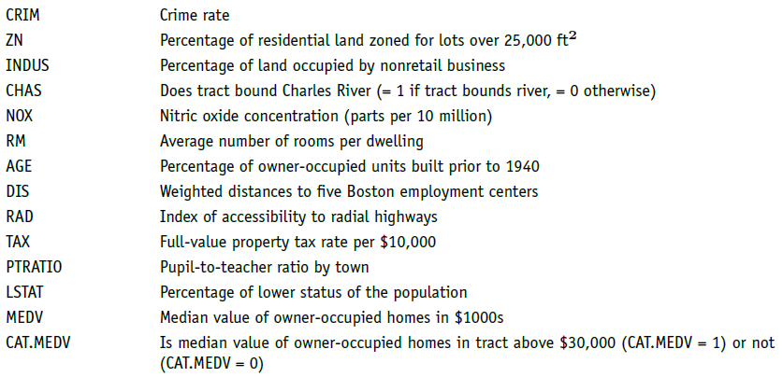
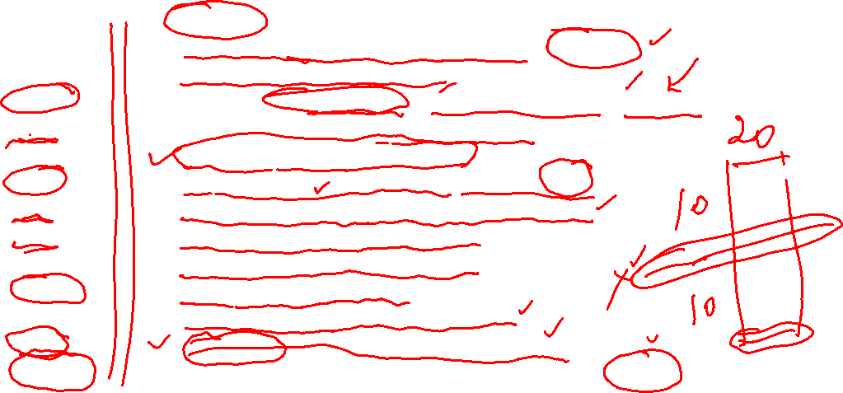
Boston House Data (dataset:BostonHousing)
Notes:
The Boston Housing dataset was originally published by Harrison and Rubinfeld in “Hedonic prices
and the demand for clean air”, Journal of Environmental Economics & Management, vol. 5, p. 81–102,
1978.

Slide 8
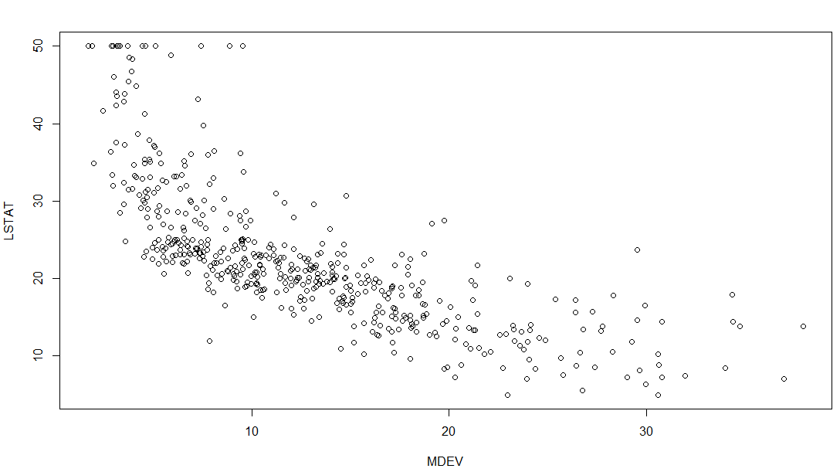
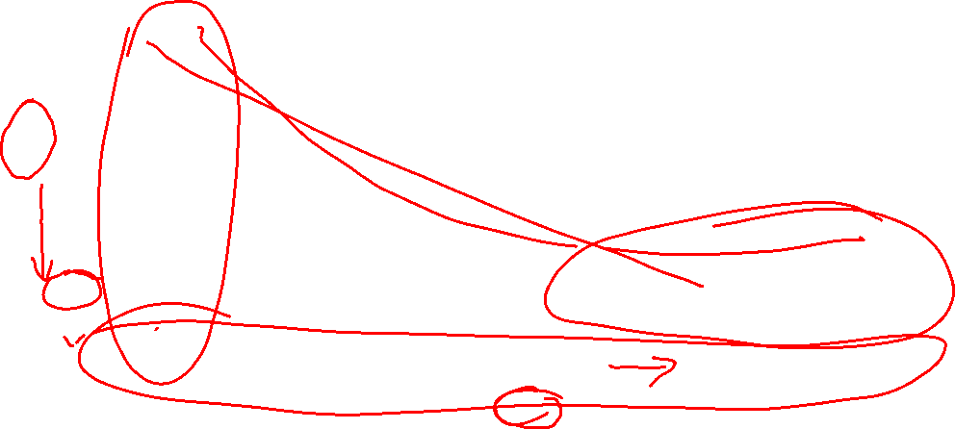
Scatter Plot

Slide 9
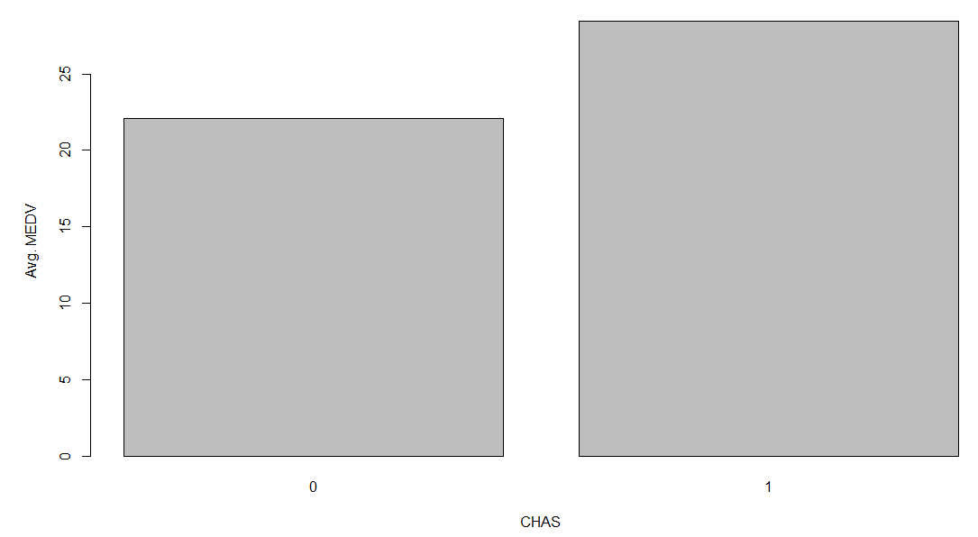
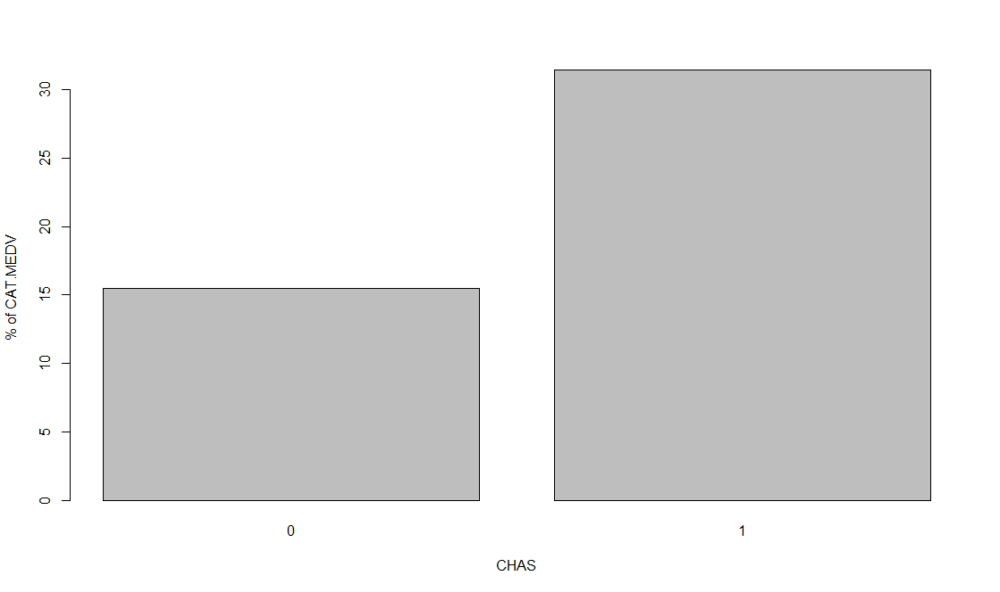
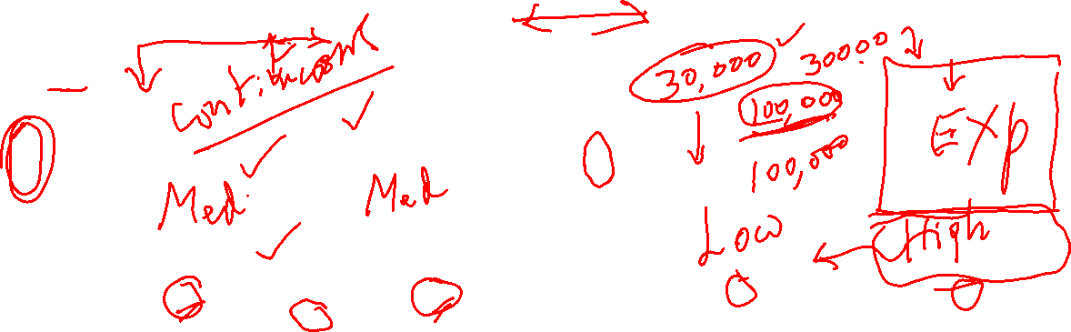
Medv vs. cat.medv (plotted against CHAS)

Slide 10
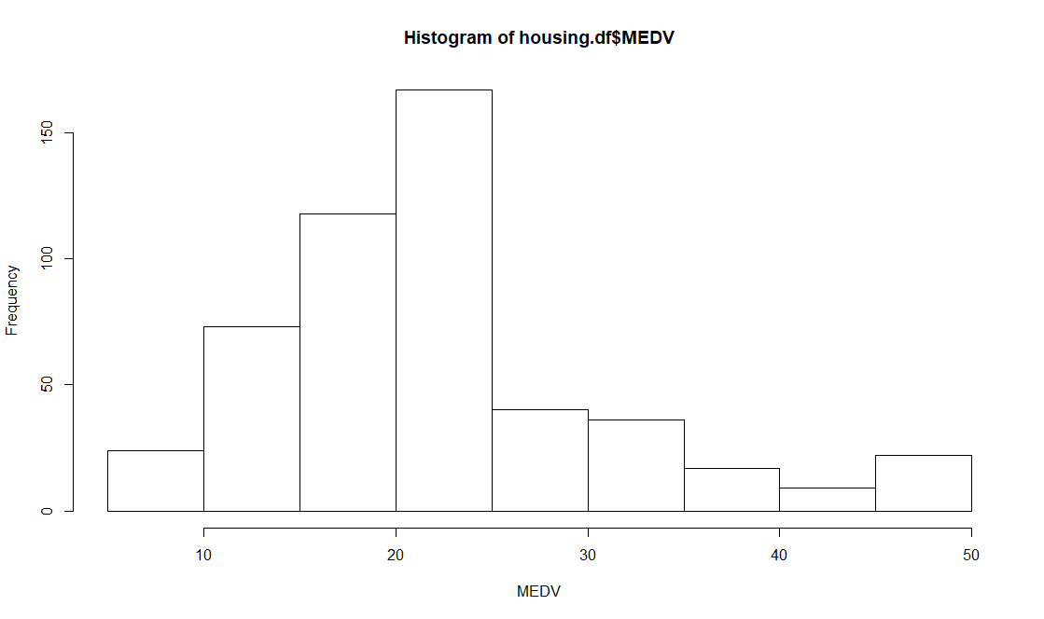
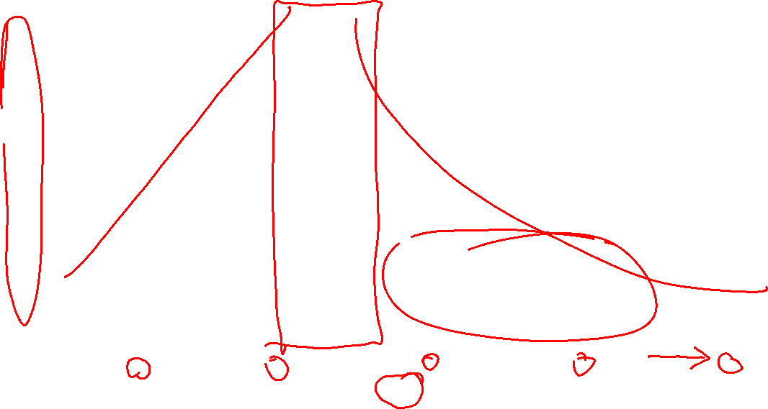

Slide 11
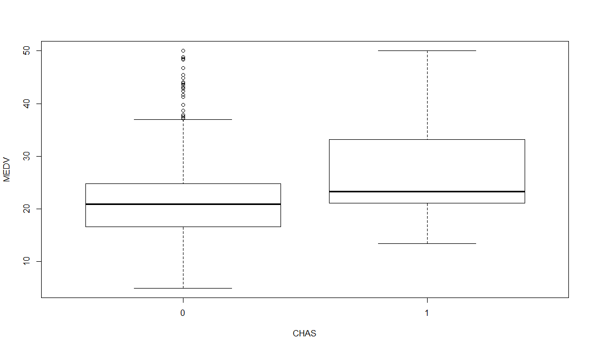
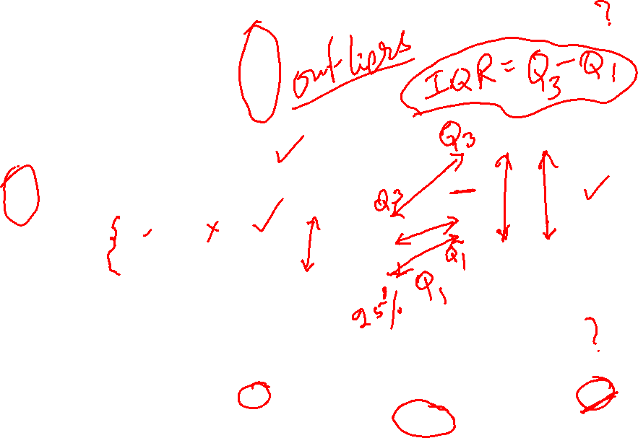

Slide 12
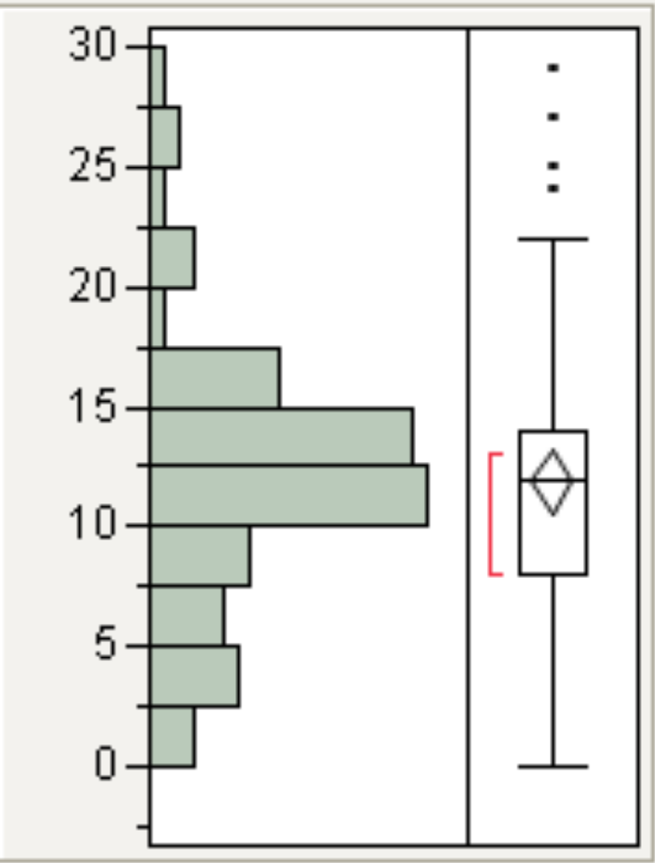
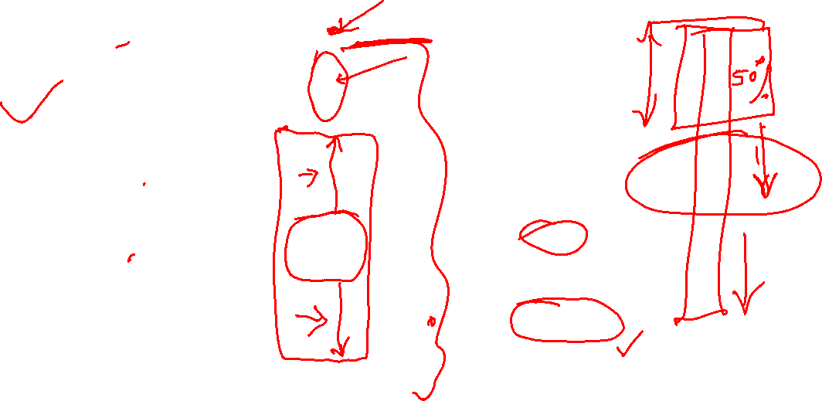
Box Whisker Plot
Outliers
3rd Q + 1.5 IQR
3rd Quartile
Confidence Diamond
Median
1st Quartile
Shortest half
1st Q – 1.5 IQR

Slide 13
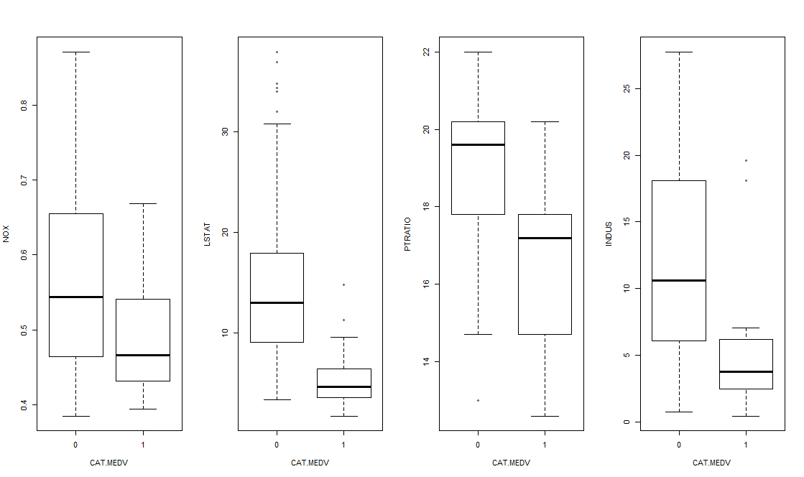
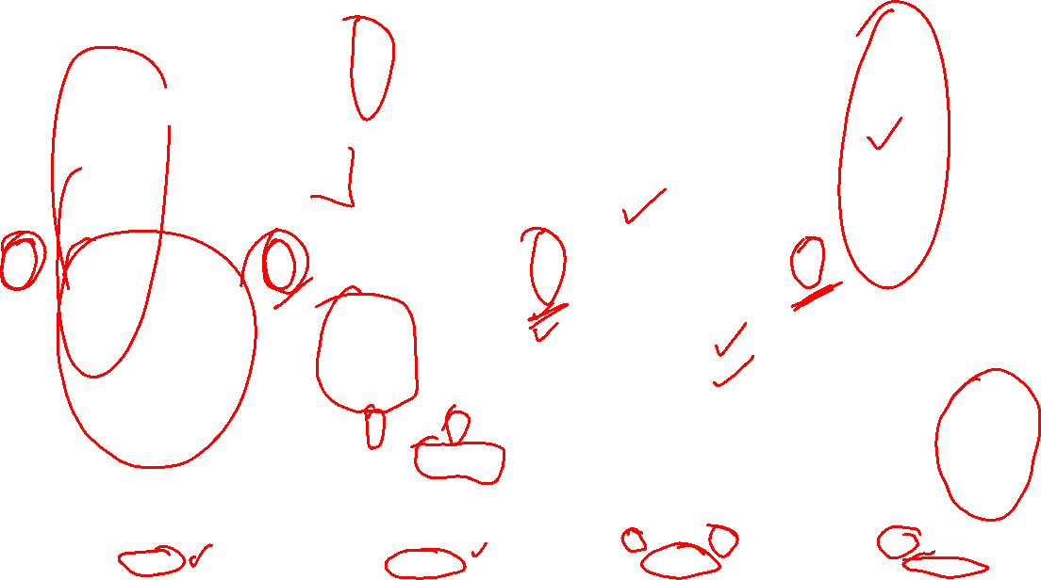

Slide 14
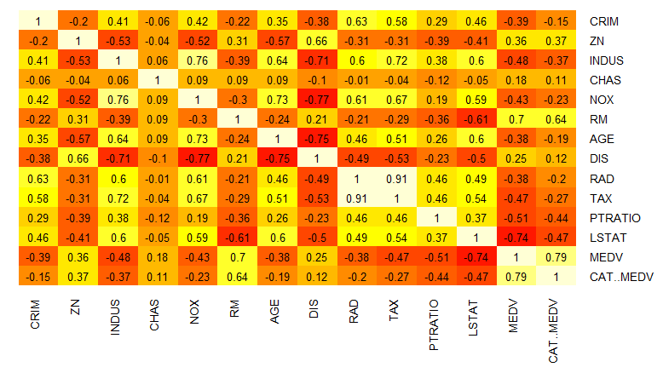

HEATMAP

Slide 15
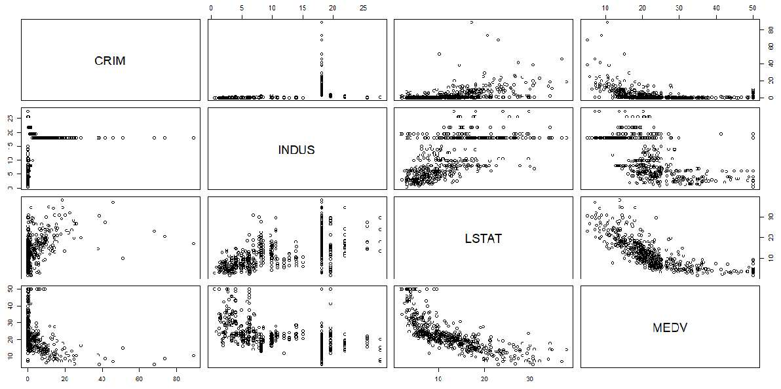
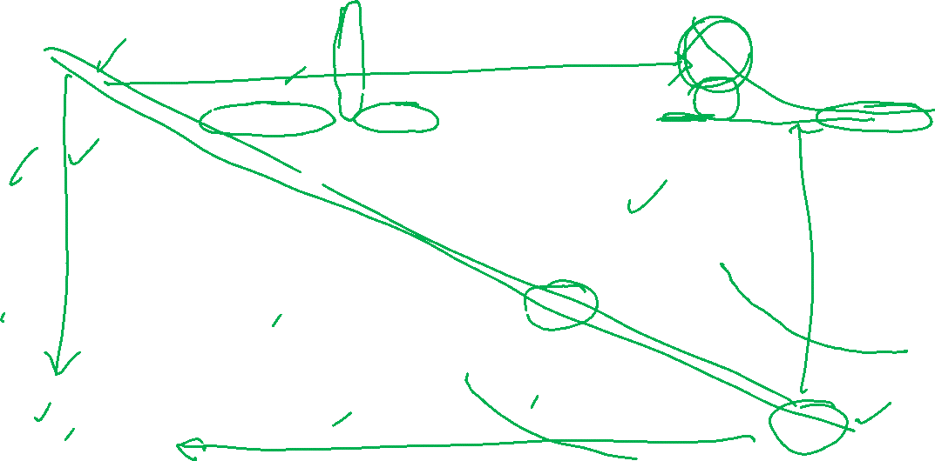
Using plot()

Slide 16
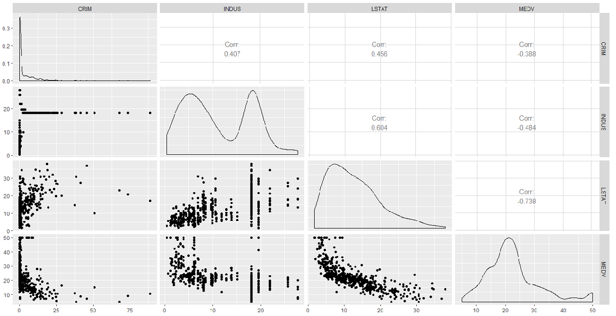
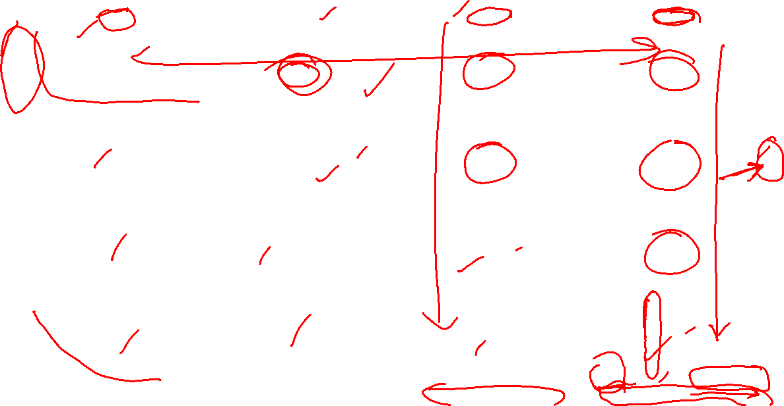
Using Ggally ggpairs()

Slide 17
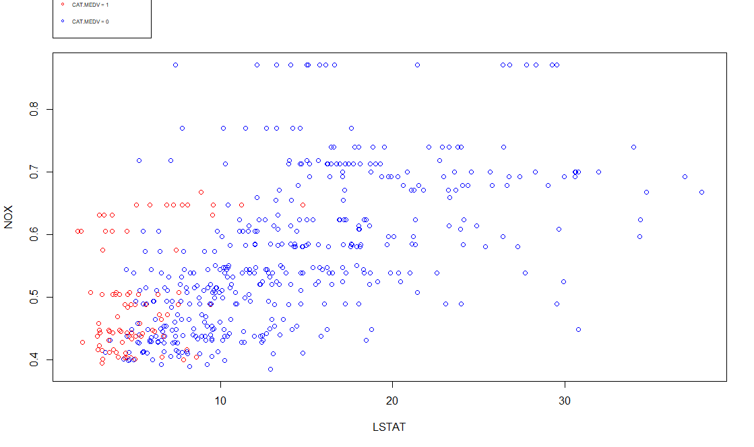
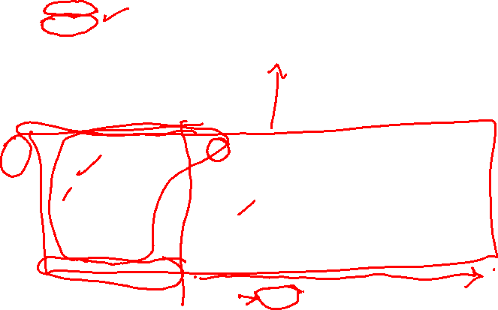
Plot with three variables

Slide 18
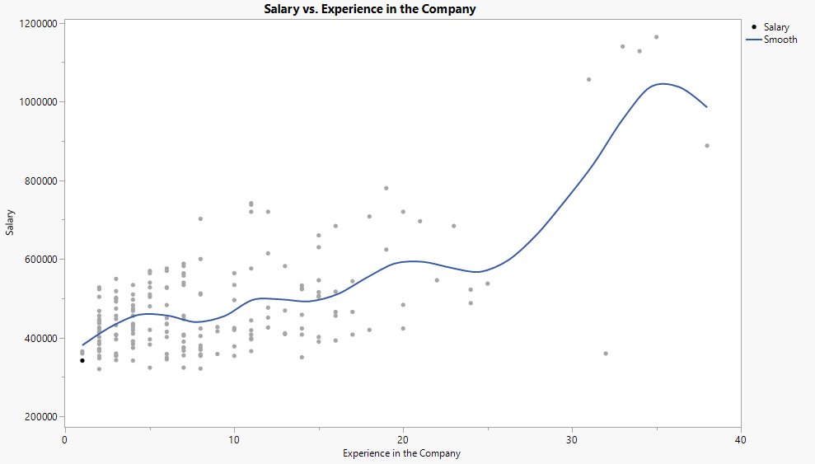

All Observations

Slide 19
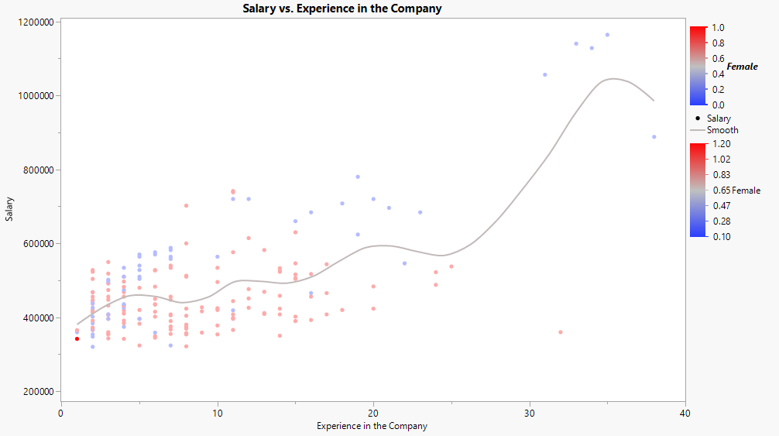

Separating by Gender
Male
Female

Slide 20
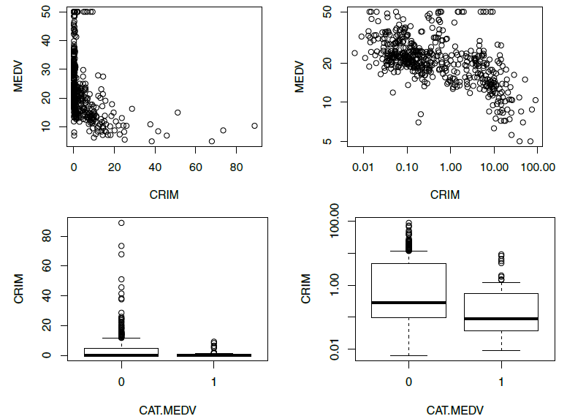

Data Transformation logs

Slide 21
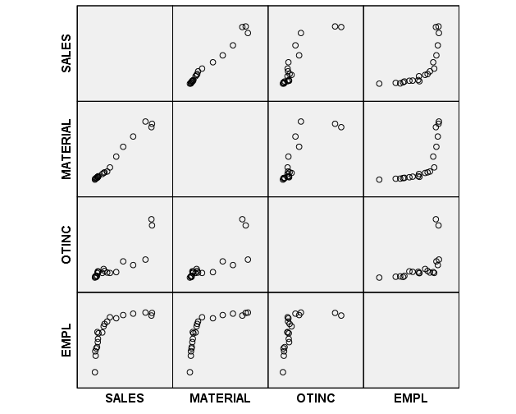


Slide 22
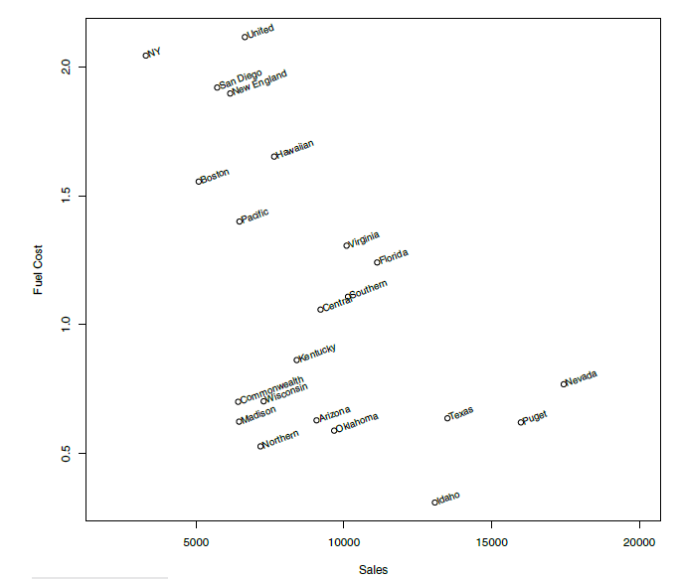

Sales Vs. fuel cost – utility companies

Slide 23
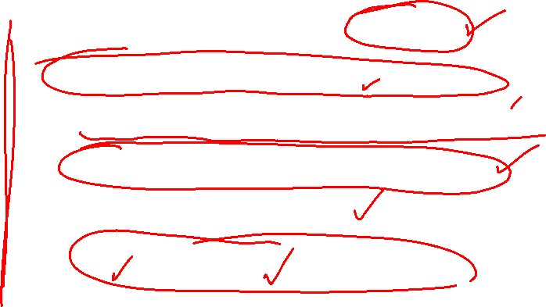
Reporting Results
Dendrograms (hierarchical clustering)
Network charts (social network analysis)
Tree charts (classification and regression trees)
Receiver operating characteristic (ROC)
Lift charts for classification
Profile plots and heatmaps (clustering)

Slide 24
Questions?

