Slide 1
Module 2A: Strategies and Tools for Digital Marketing
Session 15,16, 17: Search Engine Marketing
Executive Certificate Program in Digital Marketing & Analytics
Dr. Sakshi Aggarwal
sakshia@iimamritsar.ac.in

Slide 2
Getting Started
Search ads vs. Display ads vs. Search Engine Optimization
SEO vs. SXO

Slide 3
How Search Engines Read a Web Page?
Search engines visit the website’s homepage → follow links to your other internal pages → read the source code (in HTML) from top to bottom and interpret meaning of the page by LSI (Latent Semantic Indexing) method {Crawling}
They take a copy of the page to their server and store it {Caching or Indexing}
Repeat the process for other similar pages.
Tally the similar pages with their algorithm mainly in 3 heads- Web structure, Content, and Popularity. Store the result in search index.
Show the relevant results in ranked order against that search keyword in SERP.

Slide 4
How Frequently Does Googlebot Crawl a Webpage?
It depends on the frequency of updating the website.
If a website is updated regularly with high quality content, the crawling frequency is more, and thus the website will get to see a change in the SERP ranking sooner.
One indexed page can come in rank for 3-6 similar keywords. So more the number of indexed pages, better the chance of ranking in more keywords and thus getting more traffic to your website. That’s why regularly updating the website with great quality unique content is highly recommended.

Slide 5
Anatomy of SERP
Regional vs. Universal search
Software: Hotspot Shield (for shielding/masking IP address)
Google Instant: Suggestions are based from past 3 months Google historic data plus your personalized search.
1-25 lakh search results: about 3-4 months of dedicated SEO techniques implementation
25 l – 1 Cr search results: 4-6 months
1Cr – 5 Cr: 6-8 months
Above 5 Cr: Approx 1 year
Google search ads
Google places for business (free service by Google) - Map listing
Search snippets (10 organic search snippets) – Title/ Permalink URL/ Meta description
Click through rate (CTR)
Site links
Rich snippets
Knowledge graph (famous/good media coverage)
Google answer box

Slide 6
Incognito Window for Checking Search Ranks
Incognito browser: private mode of browsing, real identity is not revealed, will get generic search results.
Personal browsing: when set up the browser with email id – personalized results.

Slide 7
Keyword Research
Keyword: string, word(s), phrase, sentence that your potential consumers will use on search engines to find your type of business.
Broad Keyword: Single or double word, generic in nature, volume/competition is huge.
Long-tail Keyword: Three or more word, specific – narrows down the search results. Whosoever is searching with this type of keyword- highly interested, therefore better chance of conversion. Volume/competition is less. Easier to get it ranked high in SERP.

Slide 8
Keyword Research - Steps
Manual research: open a webpage, read, find out the topic, business and the probable words used by potential customers
Primary/Focus keyword
Related keywords – synonyms of keywords, related services
Entity keywords – nature of business
Local keywords – location
Combine all these (a, b, c and d) to form long tail keywords for home page.

Slide 9
Keyword Research - Steps
II. Google instant
III. Competitor search
IV. Related search
V. Google Adwords Keyword Planner
(adwords.google.com)
→ Focus keywords with moderate to high search volume per month and low to medium competition.

Slide 10
Assignment (25 minutes)
Do proper keyword research for a website.

Slide 11
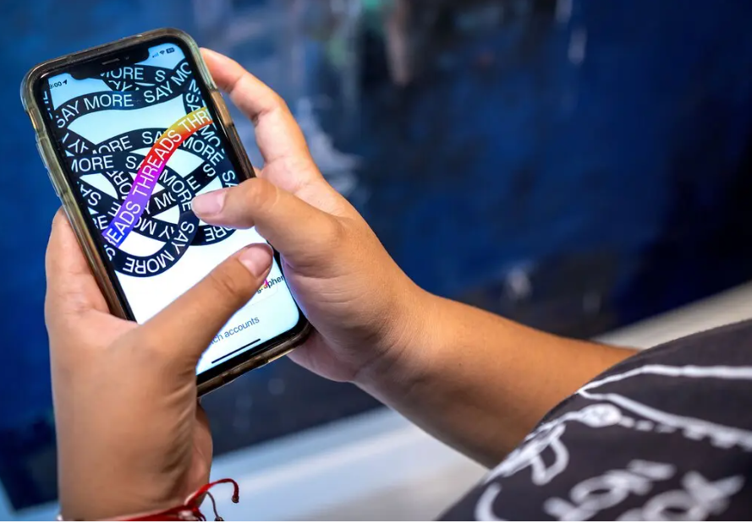
https://www.nytimes.com/2023/07/06/technology/threads-downloads-twitter.html
https://tech.hindustantimes.com/tech/news/threads-app-first-impressions-the-good-the-bad-and-yes-theres-ugly-too-71688743937805.html#google_vignette
https://www.businesstoday.in/technology/news/story/threads-app-a-high-risk-bet-says-instagram-head-adam-mosseri-388838-2023-07-08

Slide 12
On- Page SEO
Website structure and Website content
SEO Content Writing
Scan able (white space, font size, amount of text)
< 300 words – thin content
> 2500 words – too much for the user
Unique ( smallseotools.com, copyscape.com)
Well researched
Variety of content
E.g. Copyblogger
Do not over optimize your content.

Slide 13
Keyword Density, Consistency, and Proximity
Keyword Density: number of times the focal keyword has been repeated in the content.
Single word – less than 7%
Double word – less than 4%
Long tail word – 1-2%
Keyword consistency: should be present in all important elements of the page – title tag, permalink url, meta description, headings and subheadings, all the paragraphs.
Keyword proximity: positioning of keywords and related words.

Slide 14
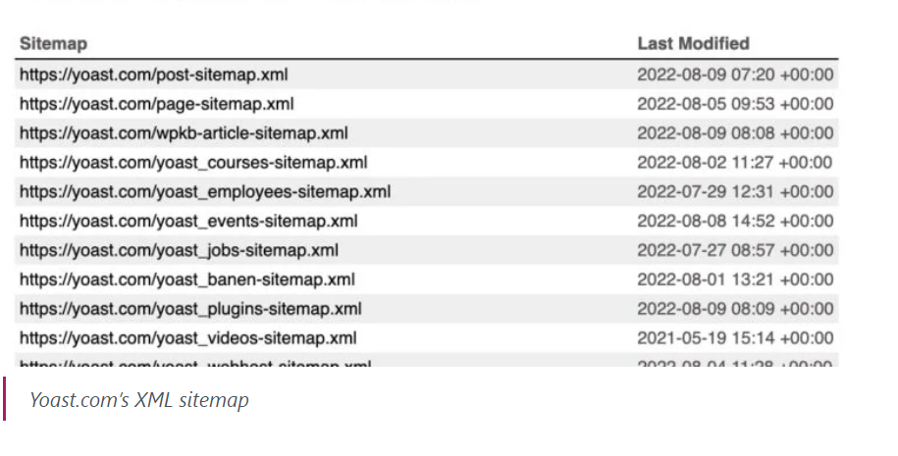
On-Page SEO
XML sitemap: a file that lists a website's essential pages, making sure Google can find and crawl them all.
https://smallseotools.com/xml-sitemap-generator/

Slide 15
On-Page SEO
Robots.txt file: The robots. txt page tells search engines which pages you DO NOT want crawled and indexed.
Canonical Tag: helps Google and other search engines understand which pages have original content and which pages are duplicates.
Alt attribute Tag on Images: provides alternative information for an image if a user for some reason cannot view it.
Schema mark up: code that helps search engines to understand your content and better represent it in the search results.

Slide 16
SEO Audit Tools
seoptimer.com
iwebchk.com
nibbler.silktide.com

Slide 17
Off Page SEO
Links
Internal links
External/Outbound links
Back Links
Mentions
No Follow and Do Follow links (20-80)
Homepage back link and Deep link (60-40)

Slide 18
Building Links
Competitor search
Social Networking Sites
Social Bookmarking Sites
Blogging Sites
Wiki Sites
RSS Submission Sites

Slide 19
Best Practices – Link Building
Get quality back links.
Relevance of the websites.
Not use same anchored text for getting back links.
Freshness of back links.
---------------------------------------------------------------------------
Page Authority
Domain Authority
(opensiteexplorer.org)

