Slide 1
Financial Modelling using R
(Technical Analysis – using R)
Prof. M S Jawed

Slide 2
Technical Analysis
Technical analysis is based on a completely different approach compared to Fundamental Analysis (based on “value” of a company or asset) and
Technical Analysts also called as Chartists are more focused on the price movement and volumes of the asset in the market and don’t believe on the existence of “value”
Attempts to exploit stock price patterns for profit.
Assumes prices adjust slowly to the information
Technical analysis clashes with the EMH
Technical Analysts forecast the direction of movement of prices through the study of past market data, primarily price and volume.

Slide 3
Technical analysis is based on three assumptions
The market discounts everything.
Price moves in trends.
History tends to repeat itself.

Slide 4

Basic Chart Elements
Line Chart
Bar Chart
Candlestick Chart

Slide 5
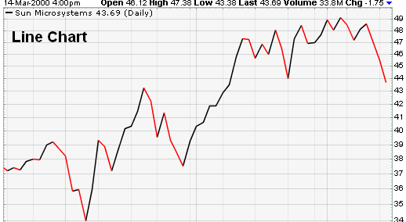
Line Chart

Slide 6
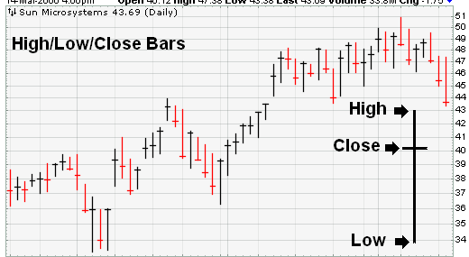
Bar Chart

Slide 7
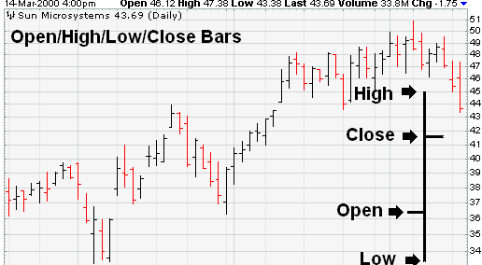
Bar Chart

Slide 8
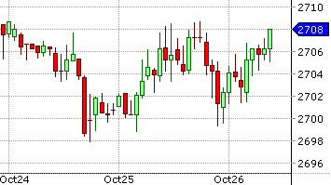
Candlestick Chart

Slide 9
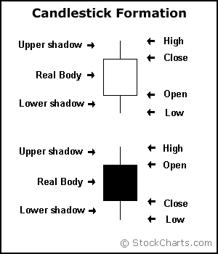
What is a Candlestick?
Hollow candlesticks, where the close is greater than the open, indicate buying pressure.
Filled candlesticks, where the close is less than the open, indicate selling pressure.
The long thin lines above and below the body represent the high/low range and are called “shadows” (also referred to as “wicks” and “tails”).

Slide 10
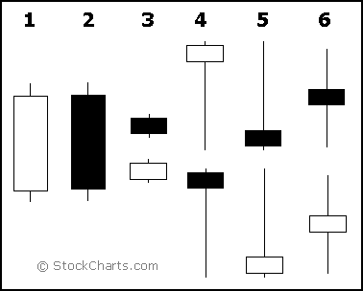
Technical Analysis using Candlestick Charts
Long white candlesticks indicate that the Bulls controlled the ball (trading) for most of the game.
Long black candlesticks indicate that the Bears controlled the ball (trading) for most of the game.
Small candlesticks indicate that neither team could move the ball and prices finished about where they started.
A long lower shadow indicates that the Bears controlled the ball for part of the game, but lost control by the end and the Bulls made an impressive comeback.
A long upper shadow indicates that the Bulls controlled the ball for part of the game, but lost control by the end and the Bears made an impressive comeback.
A long upper and lower shadow indicates that the both the Bears and the Bulls had their moments during the game, but neither could put the other away, resulting in a standoff.

Slide 11
General Principals to follow to analyzing a standalone Candlestick chart
Buy strength and sell weakness
Be flexible with patterns (verify and quantify)
Look for prior trend

Slide 12

Marubozu
It violates rule 3
Buy around the closing price of a bullish marubozu
  Keep the low of the marubozu as the stoploss
Sell around the closing price of a bearish marubozu
  Keep the high of the marubozu as the stoploss
An aggressive trader can place the trade on the same day
Risk averse traders: trade on the next day after ensuring, it obeys rule -1
One should avoid trading during an extremely small (below 1% range) or long candle (above 10% range).

Slide 13

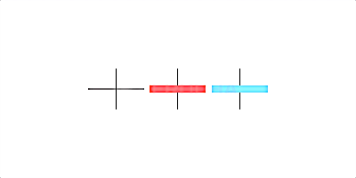
The Spinning Tops & Dojis
Conveys indecision in the market with both bulls and bears being in equal control
At the top end of the rally
  either the bulls are taking a pause before they can resume the uptrend further or the bears are preparing to break the trend.
At the bottom end of the rally
  either the bears are taking a pause before they can resume the down trend further or the bulls are preparing to break the trend

Slide 14

Paper Umbrella
length of the lower shadow should be at least twice the length of the real body.
If appears at the bottom end of a downward rally, it is called the ‘Hammer’.
  bullish pattern: look at buying opportunities when it appears
  The low of the hammer acts as the stop loss price trade
If appears at the top end of an uptrend rally, it is called the ‘Hanging man’
  bearish pattern: look at selling opportunities when it appears
  The high of the hanging man acts as the stop loss price for the trade

Slide 15

Shooting Star
length of the upper shadow should be at least twice the length of the real body.
bearish pattern - appears at the top end of the trend.
Look at shorting opportunities when a shooting star appears
  The high of the shooting star will be the stop loss price for the trade.

Slide 16
Trends
Uptrend: Higher Lows and Higher Highs
Downtrend: Lower Highs and Lower Lows
Trading with the trend or against the trend?
Timing
Duration
What is Support & Resistance?

Slide 17
Indicators
Lagging, Leading & Confirming Indicators
  Lagging (Moving Averages)
    Indicators of support & Resistance
    SMA/EMA
    Long term – generally stronger

Slide 18
Indicators
Lagging, Leading & Confirming Indicators
  Leading
    RSI – Relative Strength Indicators
      (Oversold vs Overbought levels: 30 to 70)
      RSI = 100 – [100 / ( 1 + (Average of Upward Price Change / Average of Downward Price Change ) ) ]
    MACD – Moving Average Convergence Divergence line
      The MACD also has a zero line to indicate positive and negative values. The MACD has a positive value whenever the 12-period EMA is above the 26-period EMA and a negative value when the 12-period EMA is below the 26-period EMA

Slide 19
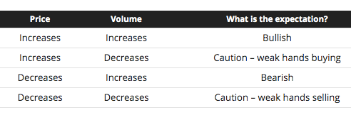
Indicators
Lagging, Leading & Confirming Indicators
  Confirming
    Trading Volume
    Dollar Volume
    Bullish & Bearish Volume trends & indicators

Slide 20
Trading Strategy with SMA
Predicting stock returns?
At Daily level <Short horizons>
A simple strategy is based on Moving Averages (not in time when market is range bound)
  Calculate moving average of prices over 20-day - Fast Moving Average
  Calculate moving average of prices over 50-day - Slow Moving Average
Look for the signals when Fast and Slow moving averages cross
  If Fast Moving Average crosses Slow Moving Average from below – Buy signal
  If Fast Moving Average crosses Slow Moving Average from top – Sell signal

Slide 21

Code for R
library(quantmod)
getSymbols("INFY.NS",from='2015-01-01')
chartSeries(INFY.NS,type='candlesticks‘,theme=‘white’)
addSMA(n=50,col='red’)
addSMA(n=20,col=’blue')
addVo() # to confirm price trend
addRSI() # and see if it confirms, what SMA follows?

Slide 22
Putting them all together in one command…
chartSeries(NIFTY.NS, subset='2016-05-18::2017-01-30',theme=chartTheme('white',up.col='green',dn.col='red'),TA=c(addBBands(n=20,sd=2,),addSMA(n=50,col="blue"),addSMA(n=10,col="black"),addRSI(n=14)))
zoomChart("last 2 week") # zoom in
zoomChart() # zoom out

