Slide 1
Quantitative Analytics tools for financial decisions
Prof. M Shameem Jawed
Indian Institute of Management Visakhapatnam

Slide 2
Prof. M Shameem Jawed
Associate Professor, IIM Visakhapatnam
Education, Background & Pedagogical Excellence
  Alumnus of IIM Indore with an FPM (Ph.D.) in Finance & Accounting
  Formerly Consultant at SunGard (now FIS) & Assistant Prof. in Finance at MDI.
  Trained twice at Harvard Business School in participant-centered learning and case study methodologies
  1,500+ hours of teaching experience at Post-Graduate, Doctoral, and executive education levels
Teaching & Research Interests
  Corporate Finance | Financial Analytics & Trading Strategies | Cost Management | Corporate Governance | Startup-Finance and Valuation | Behavioural Finance
Academic & Entrepreneurial Leadership
  Chair Positions Held (Past & Present): PGPMCI (DBM/MBA) | MGNF | Entrepreneurship Development
  Founding Director, IIMV FIELD & AIC FIELD
  Established the first incubator at IIMV in 2018, leading it to incubate 180+ startups as of date
  Key sponsors: MSDE, DST, NITI Aayog, MeitY, NSRCEL (IIMB), MTAR, NBCC, S2Tech, among others

Slide 3
Quantitative Analytics tools for financial decisions
Session 1: Introduction to R for Financial Data Analysis
Overview of R and RStudio; Basic data types and structures in R; Data handling & manipulations; Introduction to data frames, lists, functions, Loops & Conditional Statements
Session 2: Data Visualization Techniques in R
Introduction to ggplot2 for data visualization, Creating and customizing basic plots (line, bar, scatter), Advanced visualization techniques for financial data, Introduction to interactive plots with plotly
Fundamentals of hypothesis testing in finance, Types of tests: t-test, chi-square test, and F-test, Application of hypothesis testing using R, Interpreting results in the context of financial data
Session 4: Regression Analysis in Finance
Introduction to linear regression models, Multiple regression analysis and its assumptions, Application of regression models to financial data, Diagnostic tests and model evaluation
Session 3: Hypothesis Testing for Financial Data

Slide 4
Quantitative Analytics tools for financial decisions
Session 5: Hands-On Regression Analysis Using R
Practical session on implementing regression models in R, Estimation and interpretation of CAPM Beta, Case study: Regression analysis applied to stock returns, Model evaluation and refinement using diagnostic tests
Session 6: Understanding Time Series Data in Finance
Introduction to time series data and its characteristics, Stationarity, seasonality, and trends, Autocorrelation and partial autocorrelation functions (ACF and PACF), Introduction to time series forecasting
Session 7: Managing Time Series Data in R
Creating and manipulating time series objects in R, Handling date and time data in financial datasets, Implementing basic ARIMA models for forecasting, Practical examples of financial time series analysis
Session 8: Advanced Time Series Modeling with ARIMA
Deep dive into ARIMA model components (AR, MA, I), Model selection, estimation, and validation, Forecasting financial time series using ARIMA, Case studies and practical applications in finance

Slide 5
History of R?
The R statistical programming language
Initially written by Ross Ihaka and Robert Gentleman at Dep. of Statistics of U’ of Auckland, New Zealand during 1990s.
Since 1997: International R-core team ~15 people & 1000s of code writers and statisticians happy to share their libraries! AWESOME!
Free open-source package and efficient bug tracking, and fixing system supported by the user community
Many statistical functions are already built-in, and the language is very powerful for writing programs.
Started by Bell Labs

Slide 6
History of R?
R : An integrated suite of libraries / packages
Covers wide variety of Statistical and graphical functions
Open source, freely available
Where to get R? : Go to www.r-project.org
For windows system make sure to uncheck the 32 bit option under the custom install if you are using a 64 bit OS
Select Custom set up and choose “SDI” option during installation

Slide 7
What is R?
R is an interpreted computer language
Possible to interface procedures written in C, C+ etc for efficiency and to write additional primitives; System commands can be called from within R
For data manipulation, statistics, and graphics and is made up of
operators (+ - <- * %*% …) for calculations on arrays & matrices
large, coherent, integrated collection of functions
facilities for making unlimited types of publication quality graphics
user written functions & sets of functions (packages); 1200+ contributed packages so far & growing

Slide 8
What is R?
“Open source”…that just means you don’t have to pay for it, right?
No, more than that…
Provides full access to algorithms and their implementation.
Gives you the ability to fix bugs and extend software
Provides a forum allowing researchers to explore and expand the methods used to analyze data
Most of R is written in… R! This makes it quite easy to see what these functions are and do.

Slide 9
Why R?
Advantages of using R
Fast and free. State of the art: Statistical researchers provide their methods as R packages. SPSS and SAS are years behind R!
2nd only to MATLAB for graphics.
Active user community
Excellent for simulation, programming, computer intensive analyses, etc.
Forces you to think about your analysis.
Interfaces with database storage software (SQL)
Disadvantages of using R
@ start - steep learning curve, minimal GUI.
No commercial support; figuring out correct methods or how to use a function on your own can be frustrating.
Easy to make mistakes and not know.
Data prep & cleaning can be messier & more mistake prone in R vs. SPSS or SAS

Slide 10
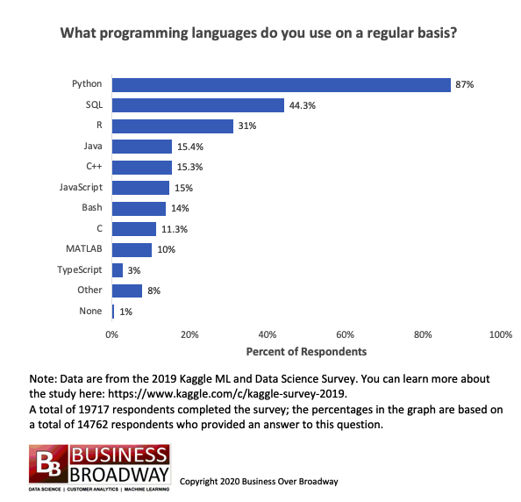
Why R in Finance? Trend over the last decade.

Slide 11
Getting Started with R…
https://cran.r-project.org/
https://posit.co/download/rstudio-desktop/

Slide 12
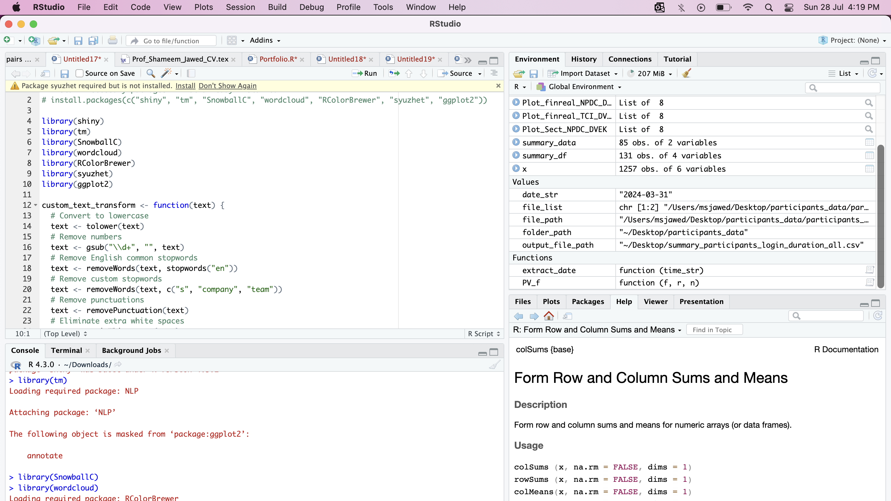
3
1
2
4

Slide 13
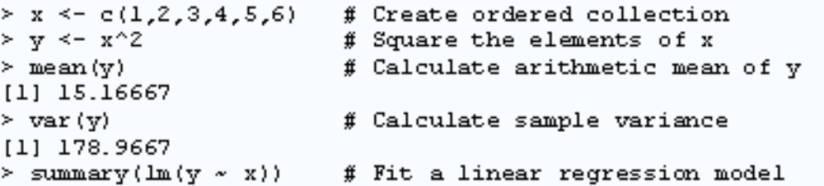
R Programming
Question on learning ?
  Only solution is to explore and practice
  Don’t be intimidated
What do you mean by a program?
  A list of instructions together with any fixed information required to carry out the instructions : Logical, ordered steps
  Of course, you need this programming if you want to have ‘enough’ flexibility / customization
Let’s see some basic R commands to run a regression: How simple!!

Slide 14
R syntax basics : Vectors, Lists
vector: an ordered collection of data of the same type
> a = c(1,2,3)
> a*2
[1] 2 4 6
Example: prices of all stocks traded on NSE on a given day: a vector of 1000 values. Other vector types: character strings, logical
list: an ordered collection of data of arbitrary types.
> doe = list(symbol=“ACC",price=200)
> doe$symbol
[1] “ACC“
> doe$price
[1] 200
Typically, vector elements are accessed by their index (an integer), list elements by their name (a character string).

Slide 15


Types of Data in R
The basic data object is a vector of elements of type:
  numeric numbers - either floating point or integer
  character each element is a character string
  logical each element is TRUE or FALSE
  matrix 2d data table of same data type
  data.frame rectangular data table, elements can be any type of data type
  ts time series (xts)
Special values/data
  NA for missing data
  Inf for infinity
  pi value of pi
  NaN

Slide 16

Common Operators
Arithmetic operators
x + y
x – y
x * y
x / y
x ^ y
x %% y
Comparison & logical
< ,<=,>,>=
== -equal
!= -not equal
!x -logical NOT
& logical AND
| logical OR

Slide 17

Let’s jump into the World of R…!

Slide 18
Basic session on R
Working Directory is a ‘default’ folder from where you would like to keep / store / retrieve data files.
  Set / Change Working Directory in R Studio
  Session-> Set Working Directory->select the folder
  Or else, write a command: setwd("E:/smp/R")
  [setwd(“~/desktop/R”]
  To include a comment (the one that you don’t want make it as part of the code), use the symbol #
  # your comment
R is case sensitive
  2+2
  log(10)
  x <- round(rnorm(10,mean=20,sd=5)) # simulate a vector x, that takes 10 values, generated from a normal distribution with mean 20 and sd 5. Round off the values before assigning to vector x.
  mean(x)
  m <- mean(x)
  m

Slide 19
Basic session on R
# calculating standard deviation of x
  x- m
  (x - m)^2
  sum((x - m)^2)
  sqrt(sum((x - m)^2)/9)
  sd(x)
Indexing: R has several useful indexing mechanisms:
  a[5] single element
  a[5:7] several elements
  a[-6] all except the 6th
  a[b>200] logical index
  X=rnorm(500,mean=10,sd=5)
  t.test(x,mu=10)
  Y=2+4*X+rnorm(500)
  Reg1=lm(Y~X)

Slide 20
Assign and generate data
“->” or “=” operator is used to assign data
x<-1:10 #will assign sequence 1 to 10 to x
y=seq(1,10,3) # sequence 1,4,7,10
z=seq(from=3, to=8, length=11)
rep(5,7) #identical values
matrix(data = NA, nrow = 3, ncol = 4) #generate a matrix
matrix(x, 3, 3, byrow=F)
dat<-scan() #read data from command line
data frame: is used to represent the typical data table– like a spreadsheet.
  It is a rectangular table with rows and columns; data within each column has the same type (e.g. number, text, logical), but different columns may have different types.
Usages : as.data.frame(), data.frame

Slide 21
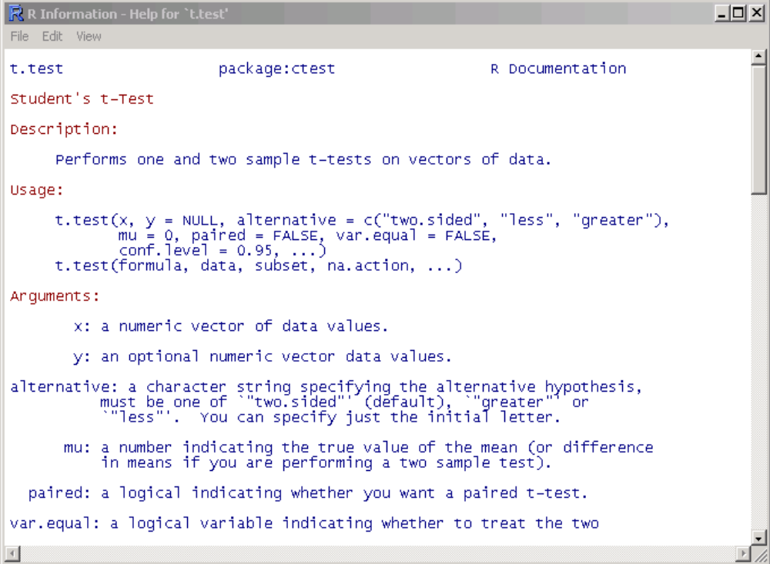
Getting help in R
Details about a specific command whose name you know (input arguments, options, algorithm, results):
>? t.test
or
>help(t.test)

Slide 22

Now Let’s go deeper with some special data types in R…!

Slide 23

Vectors (one dimensional arrays)
c() – combine function
  Numeric_vector <- c(1, 2, 3, 4)
  Character_vector <- c(“a”, “b”, “c”)
  Boolean_vector <- c(TRUE, FALSE, FALSE) or c(T, F, F)
Vector of numeric data type can be added, subtracted, multiplied, etc
  Create two numeric vectors and perform the following
    Add them
    Multiply 10 to 1st vector and subtract it from the result

Slide 24
Vectors (one dimensional arrays)
You can also assign names to your vector element
  Stock_returns_ACC <- c(-1.2, 1 , 2.3, 2, -3.2)
  names(Stock_returns_ACC ) <- c(“M”, “T”, “W”, “Th”, “F”)
  Weekly_ret <- sum(Stock_returns_ACC )
  # How many days did I get a ret >1%
    Stock_returns_ACC >1
    sum(Stock_returns_ACC >1);
  #what is my return on the 3rd day?
    Stock_returns_ACC[3]
  #what is my return on the 1st three days?
    Mid_week_ret_ACC <- Stock_returns_ACC[c(1:3)]

Slide 25
Matrix two-dimensional arrays
matrix() function
x_matrix <- matrix(1:9, byrow=TRUE, nrow=3)
#Naming the matrix
  rownames(x_matrix) <- C(“r1”, “r2”, “r3”)
  colnames((x_matrix) <- C(“c1”, “c2”, “c3”)
rowSums(); colSums(); colMeans(), rowMeans()
#Adding another row or column to a defined matrix
  cbind(); rbind()
  #lets add the rows and create a separate column in the 3x3 matrix at hand)
Selection of Matrix elements e.g. matrix_name[row, col]
  x_matrix[2, 2:3]; x_matrix[, 2]; x_matrix[1,]
#what would be the value of
  2*x_matrix

Slide 26
Data frames two-dimensional Objects
# You may use console or code to import data…
  File->import datasets->from csv….etc
read.table(file=“file_name”, sep=“”, stringAsFactors=FALSE)
    #let’s load the ratios data and assign it to data1
  #Let’s have a quick look of the data
    View(data1)
    head(data1); tail(data1)
    str(data1)

Slide 27
Data frames two-dimensional Objects
# Can we create data frames through code?
  data.frame(vector1, vector2, vector3, ….)
  # lets create one – “MSJ_students” with 10 EMBA students
  [Roll# (1 to10), name, age, FATS, CA, dislike_faculty(T/F)]

Slide 28
Data frames…
# You may use the matrix method of data frame element(s) selection
  MSJ_students[1, 2]; MSJ_students[1:5, 2:3]; MSJ_students[, -2];
  #Only name’s column ?
    MSJ_students[, 2] or MSJ_students[, “name”] or MSJ_students$name

Slide 29
Data frames…
  All those students who dislike me??
    MSJ_students[dislike_faculty, “name”]
      Or
    subset(MSJ_students, dislike_faculty); subset(MSJ_students[“name”], dislike_faculty)
  # Can you arrange the students as per their FATS grades?
    MSJ_students$name[order(MSJ_students[“FATS”])]

Slide 30
Lists
a collection of arrays of various size and type
  list() function
  Let’s create a list using the following
    Vect<-c(1, 2, 34, 5, 6, 7)
    Mat<-matrix(1:12, bycol=TRUE, nrow=4)
    MSJ_students
    Our_list <- list(Vect, Mat, MSJ_students)

Slide 31
Lists
# You may also give name to the components of your list
  Our_list <- list(Name1 = Vect, Name2 = Mat, Name3 = MSJ_students)
        Or
  Names(Our_list)<-c(“name1”, “name2”, “name3”)
#Selecting element from list (3rd list component MSJ… and 5-8th rows in the names column)
  Our_list[[3]][2, 5:8]

Slide 32
Loops in R
for loop
  for(variable in sequence) { expr }
  e.g.,
While loop
while(condition) { expr }
break; next
  The apply() family of functions (to be discussed later)

Slide 33
E.g. Loops in R
Use while loop to calculate the Product of all numbers from 50 to 100.
  Using while loop
  Using for loop
Take a 3x3 matrix and then replace the diagonal elements by 1.
  use for loop for the same..
Assume the following cash flow of an investment of 1000 at t=0, for 4 years project are: 600, 300, 200, 100
  Calculate the payback period, and
  NPV

Slide 34
Functions in R
Built in Functions
  Pre-loaded
    mean(); sd(); length(); head(); print(); ls(); rm(); plot() etc.
  Via packages
    install.packages(“packagex”) and load using
    library() or require()
User-Defined Functions (Custom functions)
>john_fun <- function(arg1, arg2) {
#bla bla
#body
return (value)
}
Let’s write the present value function…

Slide 35
Functions in R
Let’s write the present value function, with three arguments – CF, Int, Yrs
Write a function to calculate the mean, sd, Cov of any given return vector
  If the user does not pass cost of capital (assume it to be 10%)
  If the interest rate is –ve throw a warning msg but execute
  If the vector is non-numeric then throw a suitable error msg.

Slide 36
Conditional Statements
If statement
if(condition) { expr }
If-Else Statement
if(condition) { expr1 } else { expr2 }
Nested if-else Statement
if(condition1) { expr1 } else if(condition2) { expr2 } else { expr3 }
ifelse(x > y, 1, 0) ???

Slide 37
Example: conditional statements
Let’s insert a conditional statement in our PV() function for checking if the number of periods are not negative.
Write a function f(x,y) that returns grade using test score x and exam score y.
• If x+y is no less than 90 and y is no less than 40, then grade is A+.
• If x+y is no less than 80 but less than 90, then grade is A.
• If x+y is no less than 70 but less than 80, then grade is A-.
• If x+y is less than 70, then grade is B+.

