Slide 1
Financial Modelling Module
Prof. M Shameem Jawed
Indian Institute of Management Visakhapatnam

Slide 2
Prof. M Shameem Jawed
Associate Professor, IIM Visakhapatnam
Education, Background & Pedagogical Excellence
  Alumnus of IIM Indore with an FPM (Ph.D.) in Finance & Accounting
  Formerly Consultant at SunGard (now FIS) & Assistant Prof. in Finance at MDI.
  Trained twice at Harvard Business School in participant-centered learning and case study methodologies
  1,500+ hours of teaching experience at Post-Graduate, Doctoral, and executive education levels
Teaching & Research Interests
  Corporate Finance | Financial Analytics & Trading Strategies | Cost Management | Corporate Governance | Startup-Finance and Valuation | Behavioural Finance
Academic & Entrepreneurial Leadership
  Chair Positions Held (Past & Present): PGPMCI (DBM/MBA) | MGNF | Entrepreneurship Development
  Founding Director, IIMV FIELD & AIC FIELD
  Established the first incubator at IIMV in 2018, leading it to incubate 180+ startups as of date
  Key sponsors: MSDE, DST, NITI Aayog, MeitY, NSRCEL (IIMB), MTAR, NBCC, S2Tech, among others

Slide 3
Financial Modelling Module
Session 1: Introduction to R for Financial Modeling
Overview of R and Rstudio ; Basic data structures and types in R; Writing and executing R scripts; Loops, Functions & Conditional Statements
Session 2: Introduction to Regression Analysis in R
Basic multiple regression on financial data using R, some applications in Finance. Introduction to Quantmod, extracting data using yahoo finance.
Session 3: Data Visualization Essentials Using R
Introduction to ggplot2; Creating basic plots: line, bar, and scatter plots; Customizing plots for financial data presentation; Introduction to plotly for interactive visualizations
Session 4: Introduction to Technical Analysis Using R
Overview of technical analysis principles; Implementing basic indicators: Moving Averages, RSI, MACD; Analyzing historical price data using R

Slide 4
History of R?
The R statistical programming language
Initially written by Ross Ihaka and Robert Gentleman at Dep. of Statistics of U’ of Auckland, New Zealand during 1990s.
Since 1997: International R-core team ~15 people & 1000s of code writers and statisticians happy to share their libraries! AWESOME!
Free open-source package and efficient bug tracking, and fixing system supported by the user community
Many statistical functions are already built-in, and the language is very powerful for writing programs.
Started by Bell Labs

Slide 5
History of R?
R : An integrated suite of libraries / packages
Covers wide variety of Statistical and graphical functions
Open source, freely available
Where to get R? : Go to www.r-project.org
For windows system make sure to uncheck the 32 bit option under the custom install if you are using a 64 bit OS
Select Custom set up and choose “SDI” option during installation

Slide 6
What is R?
R is an interpreted computer language
Possible to interface procedures written in C, C+ etc for efficiency and to write additional primitives; System commands can be called from within R
For data manipulation, statistics, and graphics and is made up of
operators (+ - <- * %*% …) for calculations on arrays & matrices
large, coherent, integrated collection of functions
facilities for making unlimited types of publication quality graphics
user written functions & sets of functions (packages); 1200+ contributed packages so far & growing

Slide 7
What is R?
“Open source”…that just means you don’t have to pay for it, right?
No, more than that…
Provides full access to algorithms and their implementation.
Gives you the ability to fix bugs and extend software
Provides a forum allowing researchers to explore and expand the methods used to analyze data
Most of R is written in… R! This makes it quite easy to see what these functions are and do.

Slide 8
Why R?
Advantages of using R
Fast and free. State of the art: Statistical researchers provide their methods as R packages. SPSS and SAS are years behind R!
2nd only to MATLAB for graphics.
Active user community
Excellent for simulation, programming, computer intensive analyses, etc.
Forces you to think about your analysis.
Interfaces with database storage software (SQL)
Disadvantages of using R
@ start - steep learning curve, minimal GUI.
No commercial support; figuring out correct methods or how to use a function on your own can be frustrating.
Easy to make mistakes and not know.
Data prep & cleaning can be messier & more mistake prone in R vs. SPSS or SAS

Slide 9
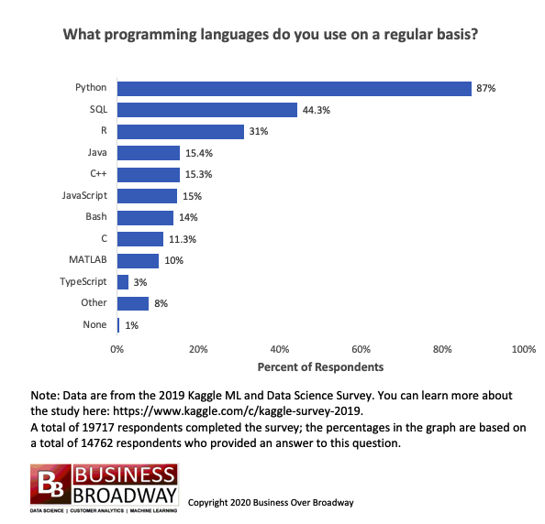
Why R in Finance? Trend over the last decade.

Slide 10
Getting Started with R…
https://cran.r-project.org/
https://posit.co/download/rstudio-desktop/

Slide 11
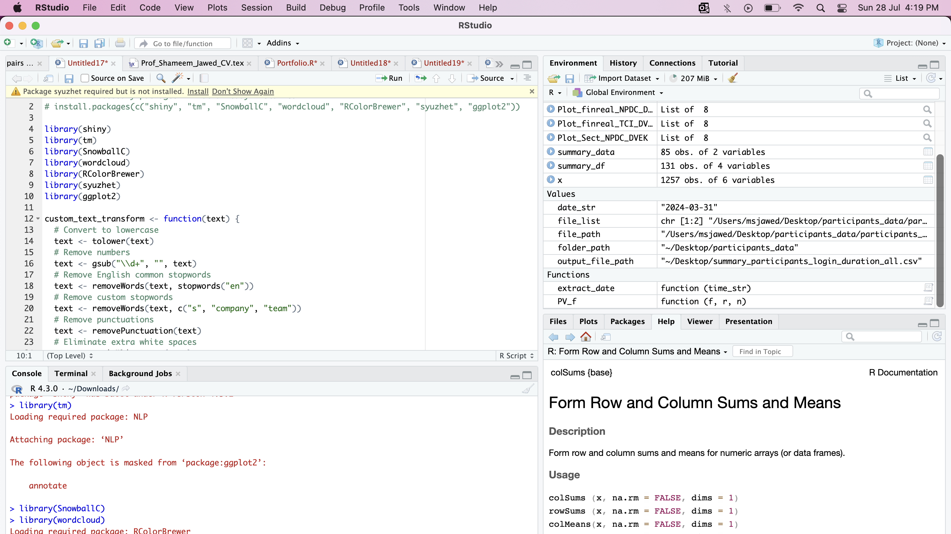
3
1
2
4

Slide 12
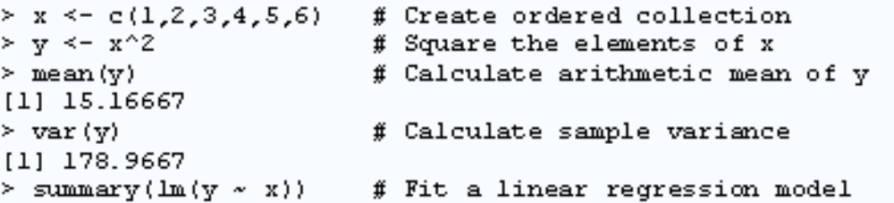
R Programming
Question on learning ?
  Only solution is to explore and practice
  Don’t be intimidated
What do you mean by a program?
  A list of instructions together with any fixed information required to carry out the instructions : Logical, ordered steps
  Of course, you need this programming if you want to have ‘enough’ flexibility / customization
Let’s see some basic R commands to run a regression: How simple!!

Slide 13
R syntax basics : Vectors, Lists
vector: an ordered collection of data of the same type
> a = c(1,2,3)
> a*2
[1] 2 4 6
Example: prices of all stocks traded on NSE on a given day: a vector of 1000 values. Other vector types: character strings, logical
list: an ordered collection of data of arbitrary types.
> doe = list(symbol=“ACC",price=200)
> doe$symbol
[1] “ACC“
> doe$price
[1] 200
Typically, vector elements are accessed by their index (an integer), list elements by their name (a character string).

Slide 14


Types of Data in R
The basic data object is a vector of elements of type:
  numeric numbers - either floating point or integer
  character each element is a character string
  logical each element is TRUE or FALSE
  matrix 2d data table of same data type
  data.frame rectangular data table, elements can be any type of data type
  ts time series (xts)
Special values/data
  NA for missing data
  Inf for infinity
  pi value of pi
  NaN

Slide 15

Common Operators
Arithmetic operators
x + y
x – y
x * y
x / y
x ^ y
x %% y
Comparison & logical
< ,<=,>,>=
== -equal
!= -not equal
!x -logical NOT
& logical AND
| logical OR

Slide 16

Let’s jump into the World of R…!

Slide 17
Basic session on R
Working Directory is a ‘default’ folder from where you would like to keep / store / retrieve data files.
  Set / Change Working Directory in R Studio
  Session-> Set Working Directory->select the folder
  Or else, write a command: setwd("E:/smp/R")
  [setwd(“~/desktop/R”]
  To include a comment (the one that you don’t want make it as part of the code), use the symbol #
  # your comment
R is case sensitive
  2+2
  log(10)
  x <- round(rnorm(10,mean=20,sd=5)) # simulate a vector x, that takes 10 values, generated from a normal distribution with mean 20 and sd 5. Round off the values before assigning to vector x.
  mean(x)
  m <- mean(x)
  m

Slide 18
Basic session on R
# calculating standard deviation of x
  x- m
  (x - m)^2
  sum((x - m)^2)
  sqrt(sum((x - m)^2)/9)
  sd(x)
Indexing: R has several useful indexing mechanisms:
  a[5] single element
  a[5:7] several elements
  a[-6] all except the 6th
  a[b>200] logical index
  X=rnorm(500,mean=10,sd=5)
  t.test(x,mu=10)
  Y=2+4*X+rnorm(500)
  Reg1=lm(Y~X)

Slide 19
Assign and generate data
“->” or “=” operator is used to assign data
x<-1:10 #will assign sequence 1 to 10 to x
y=seq(1,10,3) # sequence 1,4,7,10
z=seq(from=3, to=8, length=11)
rep(5,7) #identical values
matrix(data = NA, nrow = 3, ncol = 4) #generate a matrix
matrix(x, 3, 3, byrow=F)
dat<-scan() #read data from command line
data frame: is used to represent the typical data table– like a spreadsheet.
  It is a rectangular table with rows and columns; data within each column has the same type (e.g. number, text, logical), but different columns may have different types.
Usages : as.data.frame(), data.frame

Slide 20
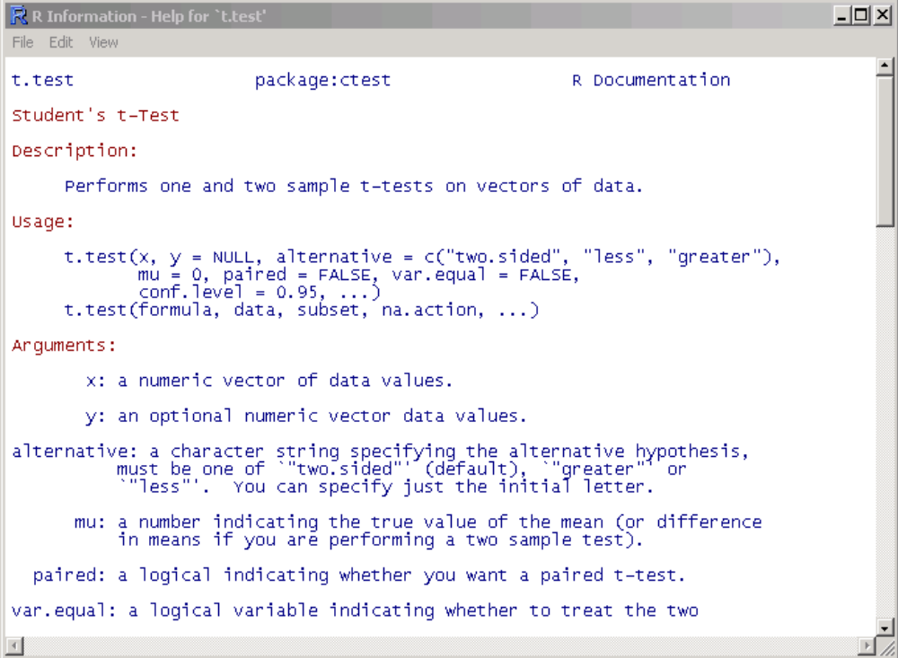
Getting help in R
Details about a specific command whose name you know (input arguments, options, algorithm, results):
>? t.test
or
>help(t.test)

Slide 21

Now Let’s go deeper with some special data types in R…!

Slide 22

Vectors (one dimensional arrays)
c() – combine function
  Numeric_vector <- c(1, 2, 3, 4)
  Character_vector <- c(“a”, “b”, “c”)
  Boolean_vector <- c(TRUE, FALSE, FALSE) or c(T, F, F)
Vector of numeric data type can be added, subtracted, multiplied, etc
  Create two numeric vectors and perform the following
    Add them
    Multiply 10 to 1st vector and subtract it from the result

Slide 23
Vectors (one dimensional arrays)
You can also assign names to your vector element
  Stock_returns_ACC <- c(-1.2, 1 , 2.3, 2, -3.2)
  names(Stock_returns_ACC ) <- c(“M”, “T”, “W”, “Th”, “F”)
  Weekly_ret <- sum(Stock_returns_ACC )
  # How many days did I get a ret >1%
    Stock_returns_ACC >1
    sum(Stock_returns_ACC >1);
  #what is my return on the 3rd day?
    Stock_returns_ACC[3]
  #what is my return on the 1st three days?
    Mid_week_ret_ACC <- Stock_returns_ACC[c(1:3)]

Slide 24
Matrix two-dimensional arrays
matrix() function
x_matrix <- matrix(1:9, byrow=TRUE, nrow=3)
#Naming the matrix
  rownames(x_matrix) <- C(“r1”, “r2”, “r3”)
  colnames((x_matrix) <- C(“c1”, “c2”, “c3”)
rowSums(); colSums(); colMeans(), rowMeans()
#Adding another row or column to a defined matrix
  cbind(); rbind()
  #lets add the rows and create a separate column in the 3x3 matrix at hand)
Selection of Matrix elements e.g. matrix_name[row, col]
  x_matrix[2, 2:3]; x_matrix[, 2]; x_matrix[1,]
#what would be the value of
  2*x_matrix

Slide 25
Data frames two-dimensional Objects
# You may use console or code to import data…
  File->import datasets->from csv….etc
read.table(file=“file_name”, sep=“”, stringAsFactors=FALSE)
    #let’s load the ratios data and assign it to data1
  #Let’s have a quick look of the data
    View(data1)
    head(data1); tail(data1)
    str(data1)

Slide 26
Data frames two-dimensional Objects
# Can we create data frames through code?
  data.frame(vector1, vector2, vector3, ….)
  # lets create one – “MSJ_students” with 10 EMBA students
  [Roll# (1 to10), name, age, FATS, CA, dislike_faculty(T/F)]

Slide 27
Data frames…
# You may use the matrix method of data frame element(s) selection
  MSJ_students[1, 2]; MSJ_students[1:5, 2:3]; MSJ_students[, -2];
  #Only name’s column ?
    MSJ_students[, 2] or MSJ_students[, “name”] or MSJ_students$name

Slide 28
Data frames…
  All those students who dislike me??
    MSJ_students[dislike_faculty, “name”]
      Or
    subset(MSJ_students, dislike_faculty); subset(MSJ_students[“name”], dislike_faculty)
  # Can you arrange the students as per their FATS grades?
    MSJ_students$name[order(MSJ_students[“FATS”])]

Slide 29
Lists
a collection of arrays of various size and type
  list() function
  Let’s create a list using the following
    Vect<-c(1, 2, 34, 5, 6, 7)
    Mat<-matrix(1:12, bycol=TRUE, nrow=4)
    MSJ_students
    Our_list <- list(Vect, Mat, MSJ_students)

Slide 30
Lists
# You may also give name to the components of your list
  Our_list <- list(Name1 = Vect, Name2 = Mat, Name3 = MSJ_students)
        Or
  Names(Our_list)<-c(“name1”, “name2”, “name3”)
#Selecting element from list (3rd list component MSJ… and 5-8th rows in the names column)
  Our_list[[3]][2, 5:8]

Slide 31
Loops in R
for loop
  for(variable in sequence) { expr }
  e.g.,
While loop
while(condition) { expr }
break; next
  The apply() family of functions (to be discussed later)

Slide 32
E.g. Loops in R
Use while loop to calculate the Product of all numbers from 50 to 100.
  Using while loop
  Using for loop
Take a 3x3 matrix and then replace the diagonal elements by 1.
  use for loop for the same..
Assume the following cash flow of an investment of 1000 at t=0, for 4 years project are: 600, 300, 200, 100
  Calculate the payback period, and
  NPV

Slide 33
Functions in R
Built in Functions
  Pre-loaded
    mean(); sd(); length(); head(); print(); ls(); rm(); plot() etc.
  Via packages
    install.packages(“packagex”) and load using
    library() or require()
User-Defined Functions (Custom functions)
>john_fun <- function(arg1, arg2) {
#bla bla
#body
return (value)
}
Let’s write the present value function…

Slide 34
Functions in R
Let’s write the present value function, with three arguments – CF, Int, Yrs
Write a function to calculate the mean, sd, Cov of any given return vector
  If the user does not pass cost of capital (assume it to be 10%)
  If the interest rate is –ve throw a warning msg but execute
  If the vector is non-numeric then throw a suitable error msg.

Slide 35
Conditional Statements
If statement
if(condition) { expr }
If-Else Statement
if(condition) { expr1 } else { expr2 }
Nested if-else Statement
if(condition1) { expr1 } else if(condition2) { expr2 } else { expr3 }
ifelse(x > y, 1, 0) ???

Slide 36
Example: conditional statements
Let’s insert a conditional statement in our PV() function for checking if the number of periods are not negative.
Write a function f(x,y) that returns grade using test score x and exam score y.
• If x+y is no less than 90 and y is no less than 40, then grade is A+.
• If x+y is no less than 80 but less than 90, then grade is A.
• If x+y is no less than 70 but less than 80, then grade is A-.
• If x+y is less than 70, then grade is B+.

Slide 37
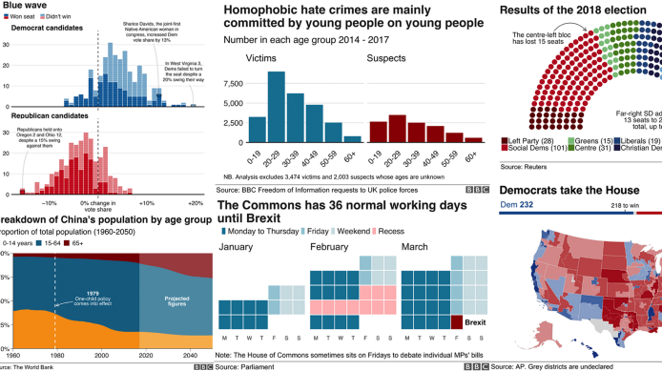
Data Visualization Essentials

Slide 38
Importance of Financial Data Visualization
  Clarity and Accessibility: Simplify complex data.
  Enhanced Presentation: Make reports more engaging.
  Improved Storytelling: Guide audiences through the data.
  Pattern Recognition: Identify trends and opportunities.
  Efficiency: Enhance decision-making and forecasting.

Slide 39
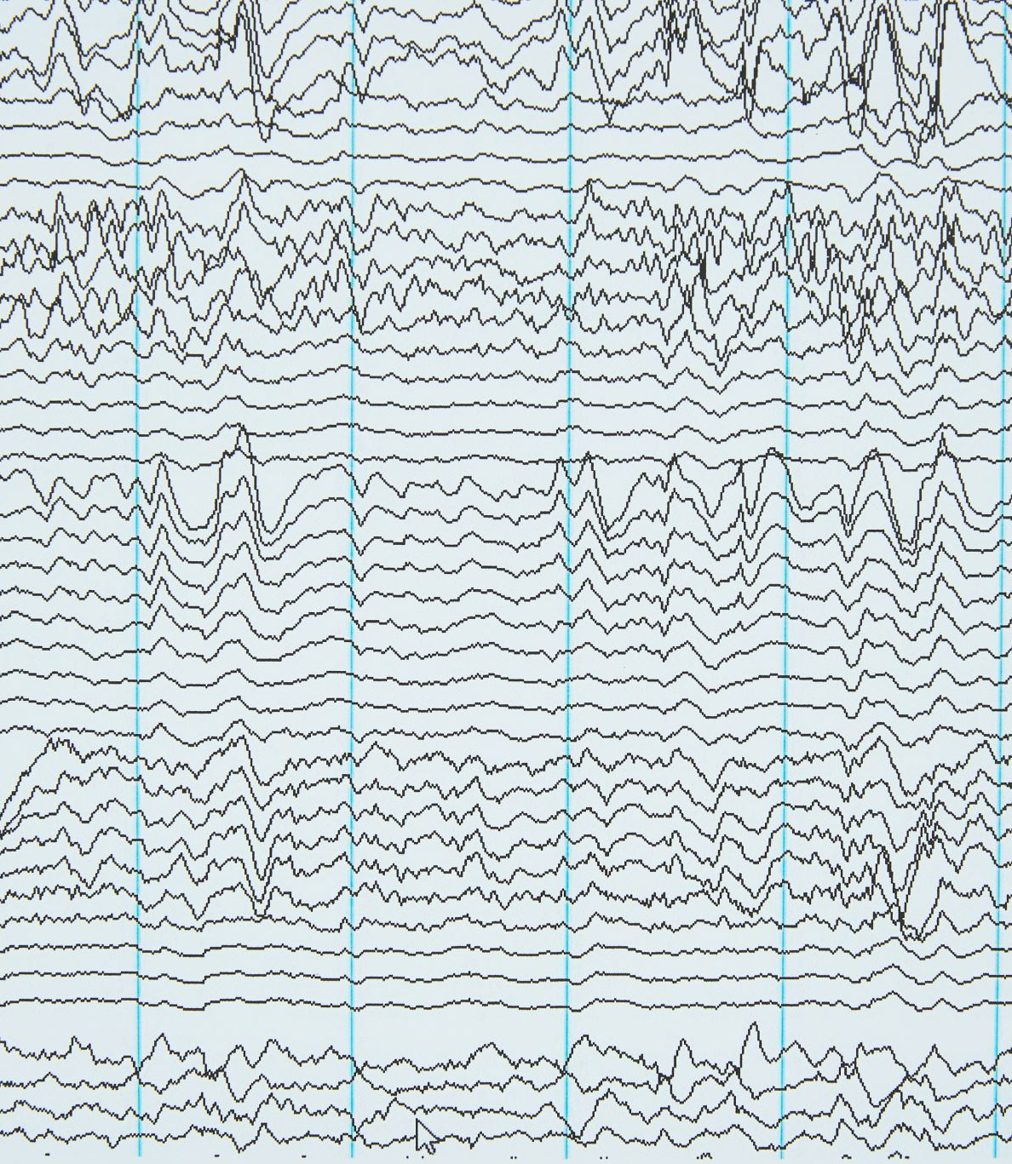
Key Visualization Techniques
Line Charts for Time-Series Analysis
Heatmaps for Correlation Analysis
Bar Charts for Comparative Analysis
Bubble Charts for Multivariate Data
Scatter Plots for Correlation & Regression
Word Clouds for Textual Data Analysis

Slide 40
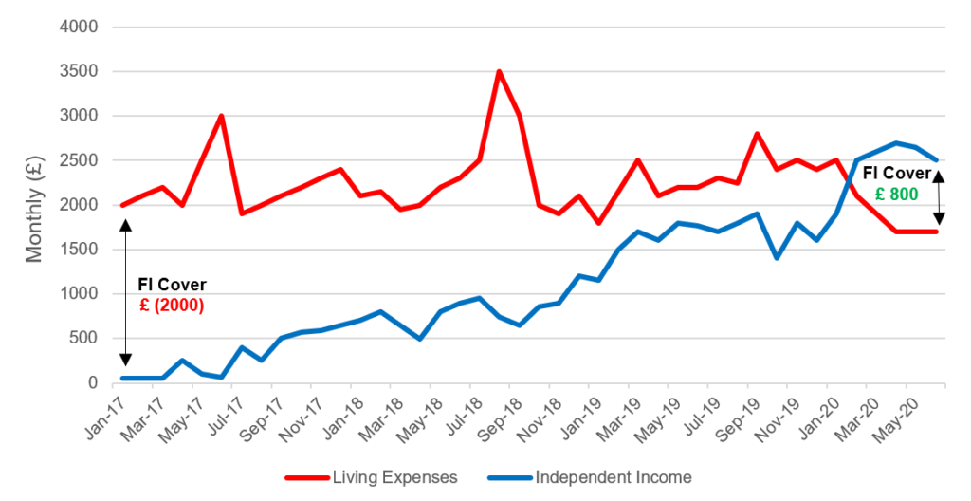
Line Charts & Time-Series Analysis
Track changes over time.
Ensure clarity and accuracy.
Avoid clutter; enhance with comments and trendlines.
Ideal for visualizing sales, revenue, asset prices, like data…

Slide 41
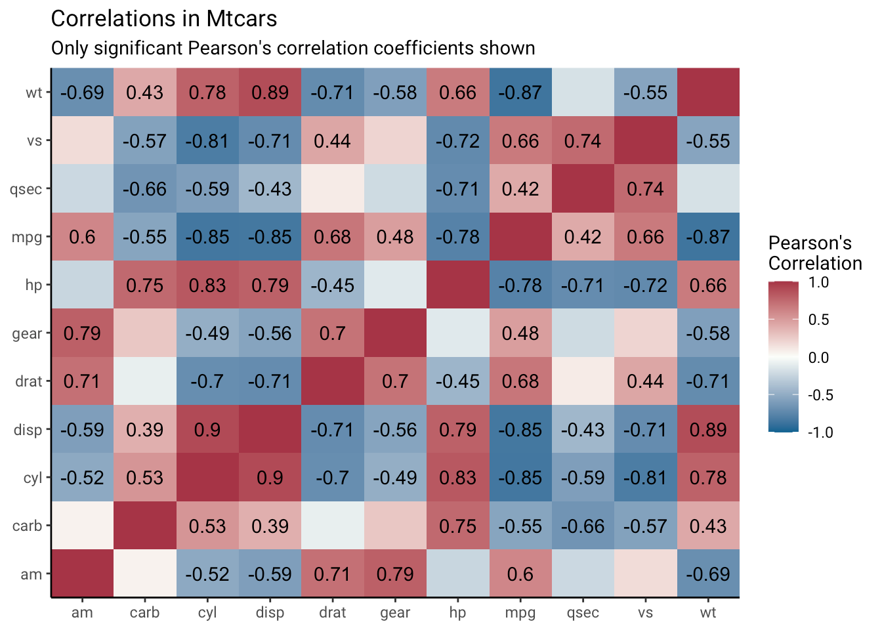
Heatmaps & Correlation Analysis
Analyze relationships and identify patterns.
Effective for large datasets.
Visually express correlations.
Combine with other visualizations for deeper insights.

Slide 42

Bar Charts for Comparative Analysis
Use for clear comparisons between datasets.
Variations: Single, Dual, Component charts.
Label axes and use distinct colors/patterns.
Applications: Sales data, customer satisfaction, marketing campaigns.

Slide 43
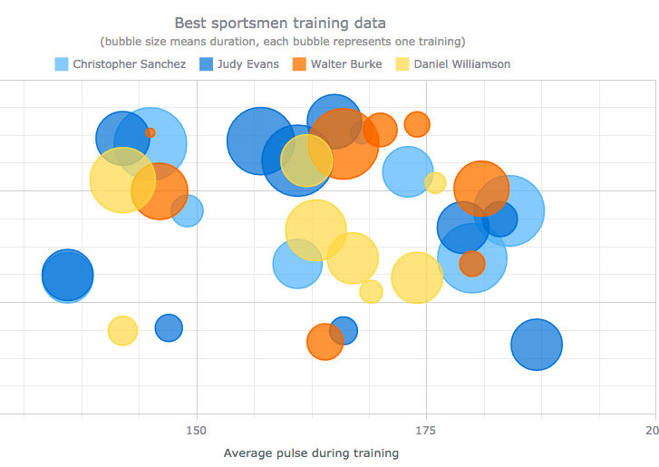
Bubble Charts for Multivariate Data Visualization
Represent up to four dimensions.
Use size and color to convey additional information.
Ideal for analyzing expansion opportunities.
Example: Market size, growth rate, investment amount.

Slide 44
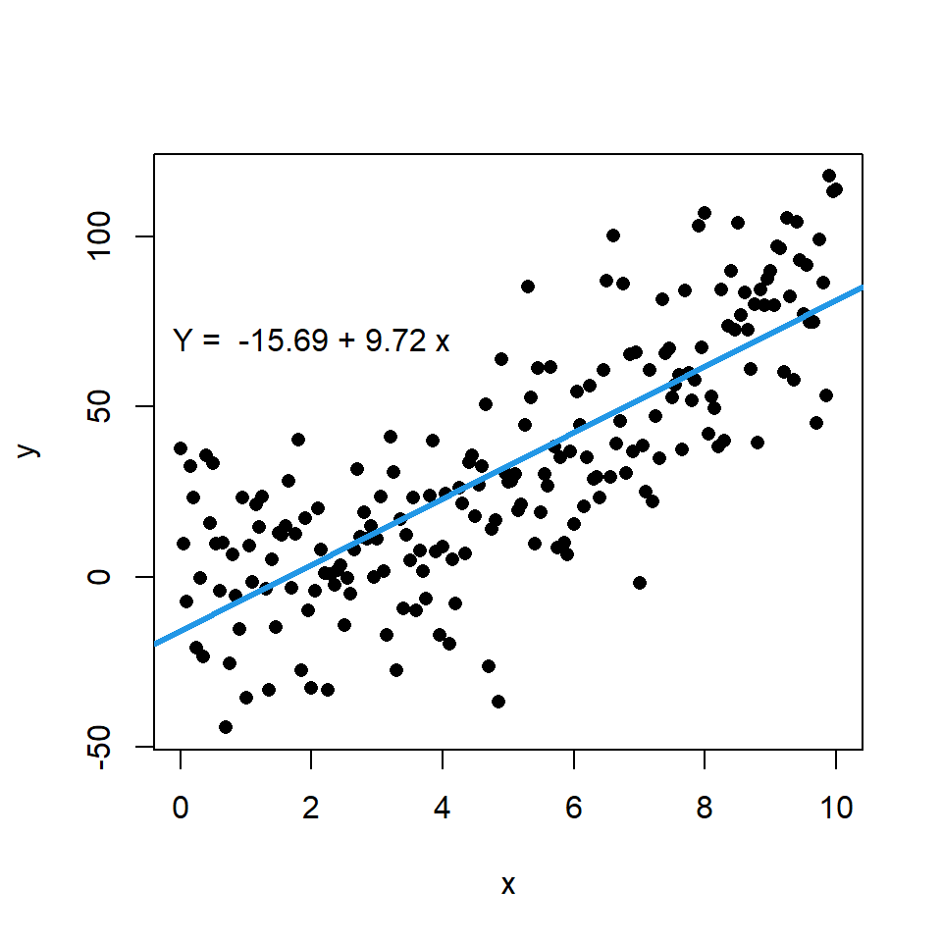
Scatter Plots for Correlation & Regression Analysis
Visualize the relationship between two variables.
Identify patterns, trends, correlations.
Use regression lines to summarize relationships.
Interpret direction, strength, and correlation coefficient.

Slide 45

Word Clouds for Textual Data Visualization
Capture the essence of large text datasets.
Highlight the most frequent words and concepts.
Create an engaging visual summary of textual content.
Identify key themes and topics quickly.
Useful for exploring text data and generating insights.

Slide 46
Factors
Categorical variable types; factor()
  gender_x <- c(“M”, “F”, “F”, “M”, “M”, “M”)
  Factor_gender_x <- factor(gender_x)
#we can also define order
  Temp <- c(“high”, “medium”, “high”, “low”, “high”)
  Factor_Temp <- factor(Temp, order=TRUE, levels=c(“high”, “medium”, “low”)
  summary() function –
    summary(Factor_Temp)

