Slide 1
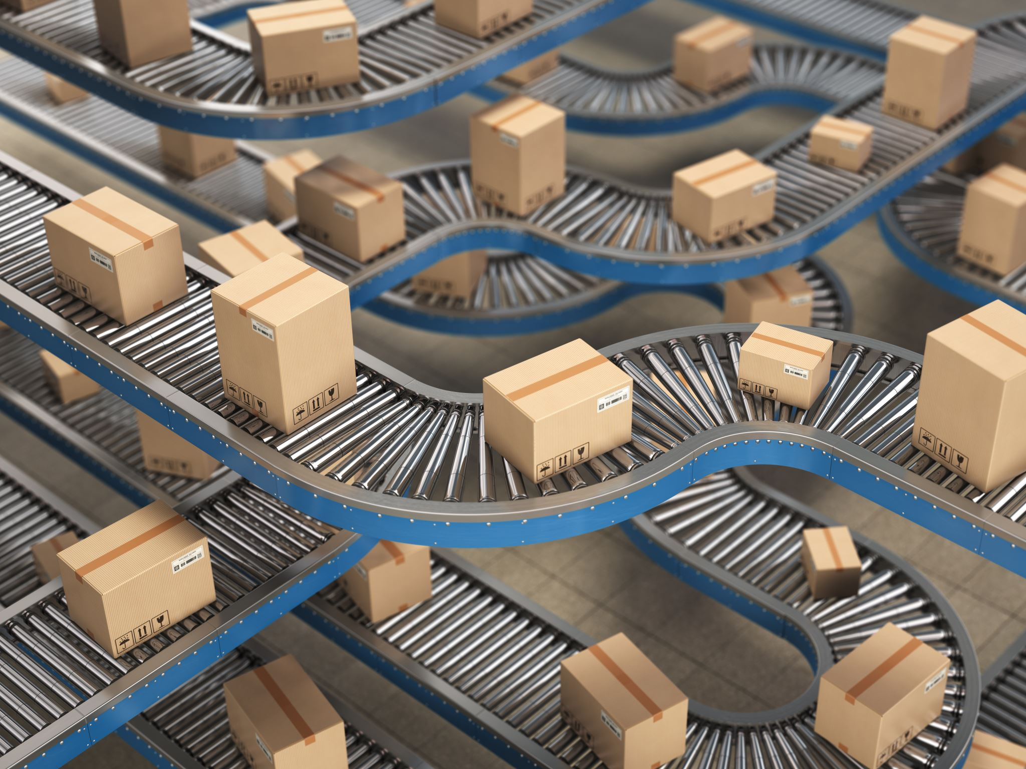
Achieving Strategic fit in a supply chain and Supply Chain Drivers and Metrics

Slide 2
What Is Operations and Supply Chain Management?
The design, operation, and improvement of the systems that create and delivery the firm’s primary products and services
Operations and supply chain management (OSCM) is
  A functional field of business
  Clear line management responsibilities
  Concerned with the management of the entire production/delivery system

Slide 3
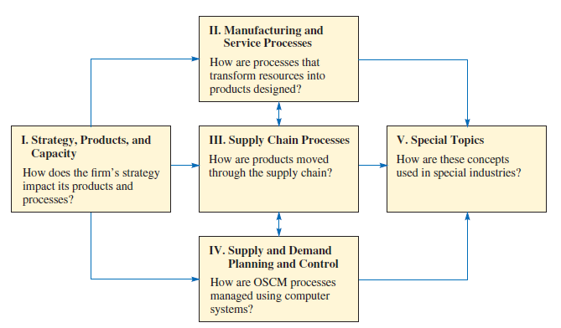
Considerations in different part of decision-making

Slide 4
Operations and Supply Chain Terms
Operations
Supply Chain
Manufacturing and service processes used to transform resources into products
Processes that move information and material to and from the firm

Slide 5
Process Activities
Planning – processes needed to operate an existing supply chain
Sourcing – selection of suppliers that will deliver the goods and services needed to create the firm’s product
Making – producing the major product or service
Delivering – logistics processes such as selecting carriers, coordinating the movement of goods and information, and collecting payments from customers
Returning – receiving worn-out, excess, and/or defective products back from customers

Slide 6
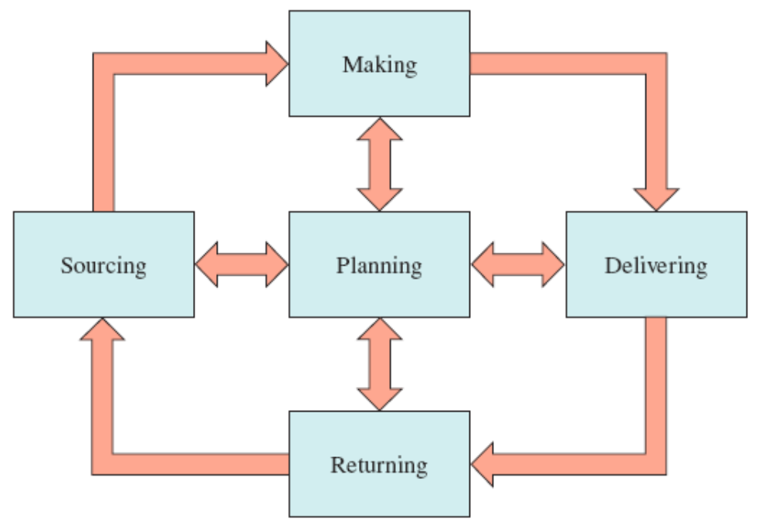
Supply Chain Processes
Exhibit 1.3

Slide 7
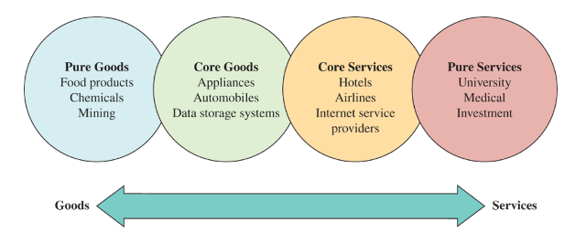
The Goods-Services Continuum
Goods are physical items produced by business organization
Services are activities that provide some combinations of time, location, form and psychological value

Slide 8
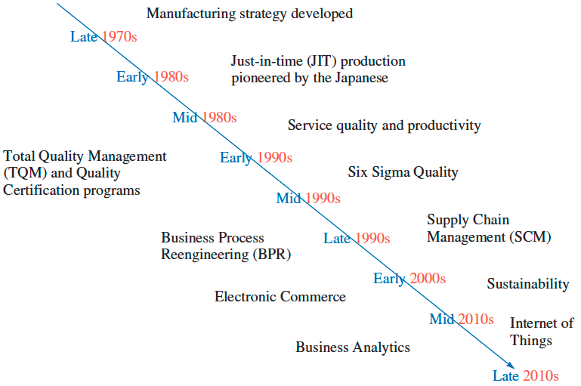
Timeline Depicting When Major OSCM Concepts Became Popular
Exhibit 1.5

Slide 9
The Major Concepts that Define the OSCM Field
Manufacturing strategy paradigm
Lean manufacturing, JIT, and TQC
Service quality and productivity
Total quality management and quality certification
Business process reengineering
Six sigma quality
Supply chain management
Electronic commerce
Sustainability and the triple bottom line
  Business strategy that includes social, economic and environmental criteria
Business analytics

Slide 10
Current Issues in Operations and Supply Chain Management
Uncertainty in global tariffs and regulations
Difficulty in hiring and keeping employees
Adapting to change in business technology and infrastructure

Slide 11
Efficiency, Effectiveness, and Value
Efficiency – doing something at the lowest possible cost
Effectiveness – doing the right things to create the most value for the company
Value – quality divided by price
  Quality – the attractiveness of the product, considering its features and durability

Slide 12
How Does Wall Street Evaluate Efficiency?
Earnings growth is largely a function of profitability
Profits can be increased through higher sales or lower cost
Highly efficient firms usually do well during recessions
Benchmarking – a process in which one company studies the processes of another company (or industry) to identify best practices

Slide 13
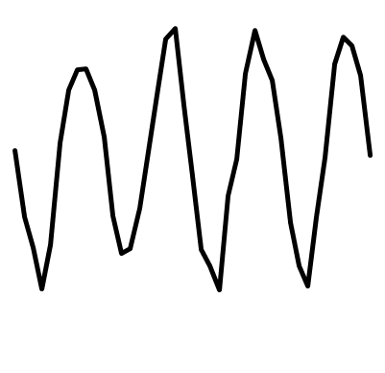

Supply chain demand and variability
Over the long run the average inflow to a firm must equal the average outflow
However, the volatility of the inflow can differ substantially from the volatility of the outflow
Firm
Outflow (sales)
Inflow
Firm
Outflow (sales)
Inflow

Slide 14
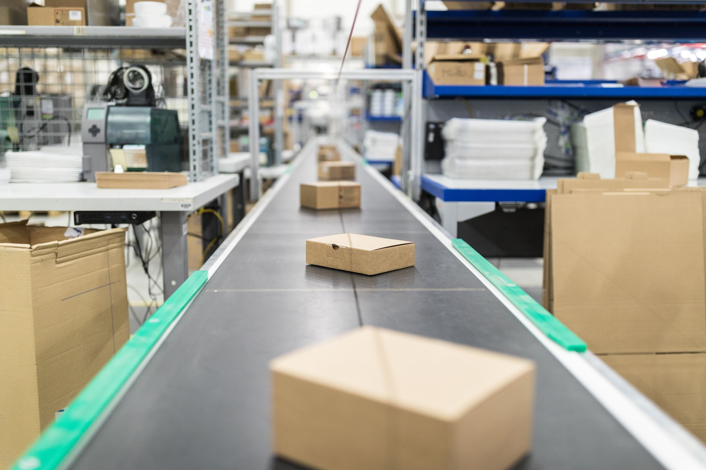
What is a Supply Chain?
Flow of products and services from:
  Raw materials manufacturers
  Intermediate products manufacturers
  End product manufacturers
  Wholesalers and distributors and
  Retailers
Connected by transportation and storage activities
Integrated through information, planning, and integration activities
Cost and service levels

Slide 15
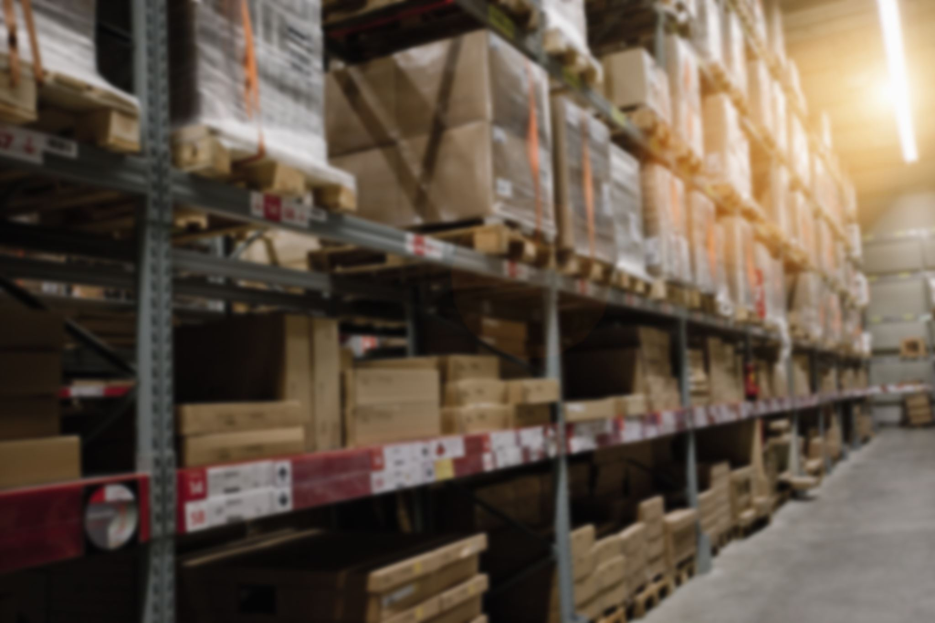
What Is Supply Chain Management?
Supply chain management is a set of approaches utilized to efficiently integrate suppliers, manufacturers, warehouses, and stores, so that merchandise is produced and distributed at the right quantities, to the right locations, and at the right time, in order to minimize system wide costs while satisfying service level requirements.

Slide 16

Two Other Formal Definitions
The design and management of seamless, value-added process across organizational boundaries to meet the real needs of the end customer
Institute for Supply Management
Managing supply and demand, sourcing raw materials and parts, manufacturing and assembly, warehousing and inventory tracking, order entry and order management, distribution across all channels, and delivery to the customer
The Supply Chain Council

Slide 17





SCM Definition
Material Flow
Converter
Retailer
Supplier
Distributor
Source
Converter
Consumers
Supplier
Distributor
End-User
Value-Added Services
Funds/Demand Flow
Information Flow
Reuse/Maintenance/After Sales Service Flow

Slide 18
The Objective of a Supply Chain (1 of 3)
Maximize net value generated
Supply Chain Surplus = Customer Value − Supply Chain Cost

Slide 19

The Objective of a Supply Chain
(2 of 3)
Example: a customer purchases a wireless router from Best Buy for $60 (revenue)
Supply chain incurs costs (convey information, produce components, storage, transportation, transfer funds, etc.)
Difference between $60 and the sum of all of these costs is the supply chain profitability
Supply chain profitability is total profit to be shared across all stages of the supply chain
Success should be measured by total supply chain surplus, not profits at an individual stage

Slide 20
The Objective of a Supply Chain
(3 of 3)
Customer is the only source of revenue
Sources of cost include flows of information, products, or funds between stages of the supply chain
Effective supply chain management involves the management of supply chain assets and product, information, and fund flows to grow the total supply chain surplus

Slide 21

Supply Chain Planning (1 of 2)
Definition of a set of policies that govern short-term operations
Fixed by the supply configuration from strategic phase
Goal is to maximize supply chain surplus given established constraints
Starts with a forecast of demand in the coming year

Slide 22

Supply Chain Planning (2 of 2)
Planning decisions:
  Which markets will be supplied from which locations
  Planned buildup of inventories
  Subcontracting
  Inventory policies
  Timing and size of market promotions
Must consider demand uncertainty, exchange rates, competition over the time horizon in planning decisions

Slide 23

Supply Chain Operation
Time horizon is weekly or daily
Decisions regarding individual customer orders
Supply chain configuration is fixed and planning policies are defined
Goal is to handle incoming customer orders as effectively as possible
Allocate orders to inventory or production, set order due dates, generate pick lists at a warehouse, allocate an order to a particular shipment, set delivery schedules, place replenishment orders
Much less uncertainty (short time horizon)

Slide 24
Process Views of a Supply Chain
Cycle View: The processes in a supply chain are divided into a series of cycles, each performed at the interface between two successive stages of the supply chain.
Push/Pull View: The processes in a supply chain are divided into two categories, depending on whether they are executed in response to a customer order or in anticipation of customer orders. Pull processes are initiated by a customer order, whereas push processes are initiated and performed in anticipation of customer orders.

Slide 25
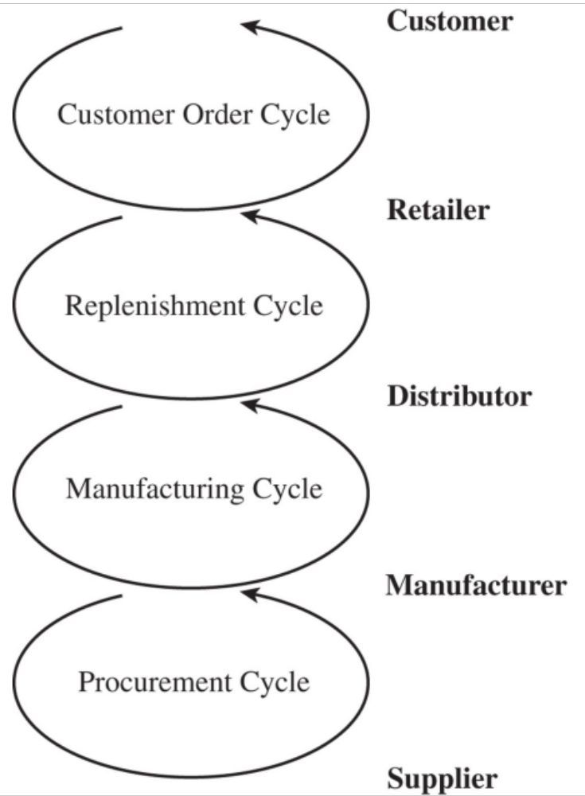
Cycle View of Supply Chain Processes (1 of 2)
Figure 1-3 Supply Chain Process Cycles
Notes:
The supply chain is a concatenation of cycles with each cycle at the interface of two successive stages in the supply chain. Each cycle involves the customer stage placing an order and receiving it after it has been supplied by the supplier stage.
One difference is in size of order. Second difference is in predictability of orders - orders in the procurement cycle are predictable once manufacturing planning has been done.
This is the predominant view for ERP systems. It is a transaction level view and clearly defines each process and its owner.

Slide 26
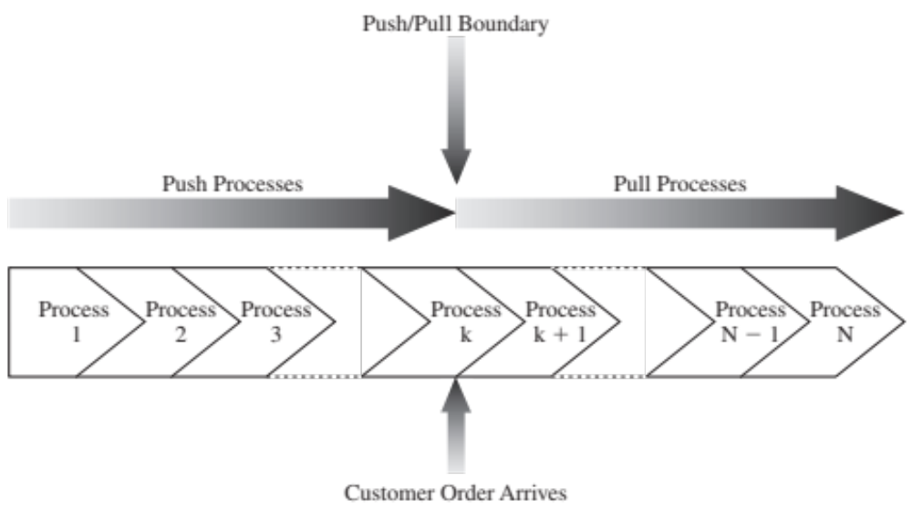
Push/Pull View of Supply Chains
Notes:
In this view processes are divided based on their timing relative to the timing of a customer order. Define push and pull processes.
They key difference is the uncertainty during the two phases.
Give examples at Amazon and Borders to illustrate the two views

Slide 27
Supply Chain Macro Processes
Supply chain processes discussed in the two views can be classified into
  1. Customer Relationship Management (C R M):
  all processes at the interface between the firm and its customers
  2. Internal Supply Chain Management (I S C M):
  all processes that are internal to the firm
  3. Supplier Relationship Management (S R M):
all processes at the interface between the firm and its suppliers

Slide 28
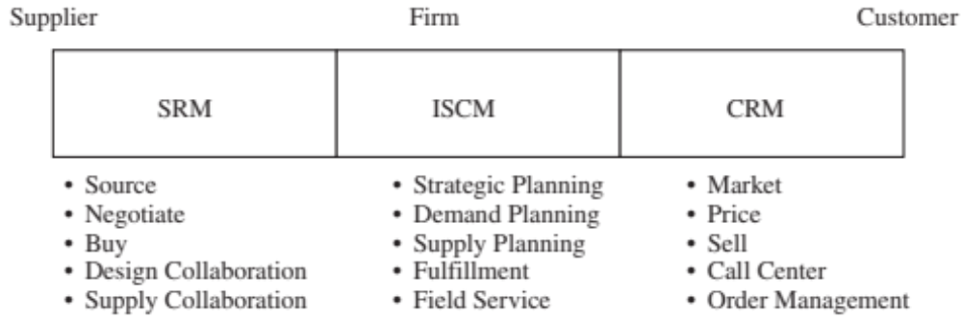
Supply Chain Macro Processes

Slide 29
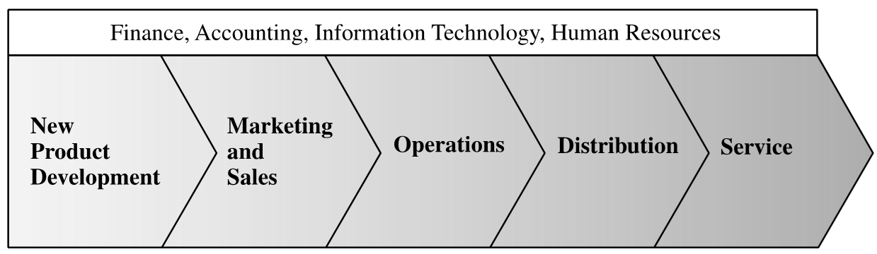
The Value Chain
The Value Chain in a Company

Slide 30

Achieving Strategic Fit (1 of 2)
Strategic fit – competitive and supply chain strategies have aligned goals
A company may fail because of a lack of strategic fit or because its overall supply chain design, processes, and resources do not provide the capabilities to support the desired strategy

Slide 31

Achieving Strategic Fit (2 of 2)
The competitive strategy and all functional strategies must fit together to form a coordinated overall strategy. Each functional strategy must support other functional strategies and help a firm reach its competitive strategy goal.
The different functions in a company must appropriately structure their processes and resources to be able to execute these strategies successfully.
The design of the overall supply chain and the role of each stage must be aligned to support the supply chain strategy.

Slide 32
How Is Strategic Fit Achieved?
Understanding the customer and supply chain uncertainty
Understanding the supply chain capabilities
Achieving strategic fit

Slide 33
Step 1: Understanding the Customer and Supply Chain Uncertainty (1 of 2)
Quantity of product needed in each lot
Response time customers are willing to tolerate
Variety of products needed
Service level required
Price of the product
Desired rate of innovation in the product

Slide 34

Step 1: Understanding the Customer and Supply Chain Uncertainty (2 of 2)
Demand uncertainty – uncertainty of customer demand for a product
Implied demand uncertainty – resulting uncertainty for only the portion of the demand that the supply chain plans to satisfy based on the attributes the customer desires

Slide 35
Customer Needs and Implied Demand Uncertainty
Customer Need | Causes Implied Demand Uncertainty to …
Range of quantity required increases | Increase because a wider range of the quantity required implies greater variance in demand
Lead time decreases | Increase because there is less time in which to react to orders
Variety of products required increases | Increase because demand per product becomes less predictable
Required service level increases | Increase because the firm now has to handle unusual surges in demand
Rate of innovation increases | Increase because new products tend to have more uncertain demand
Number of channels through which product may be acquired increases | Increase because the total customer demand per channel becomes less predictable
Table 2-1 Impact of Customer Needs on Implied Demand Uncertainty

Slide 36
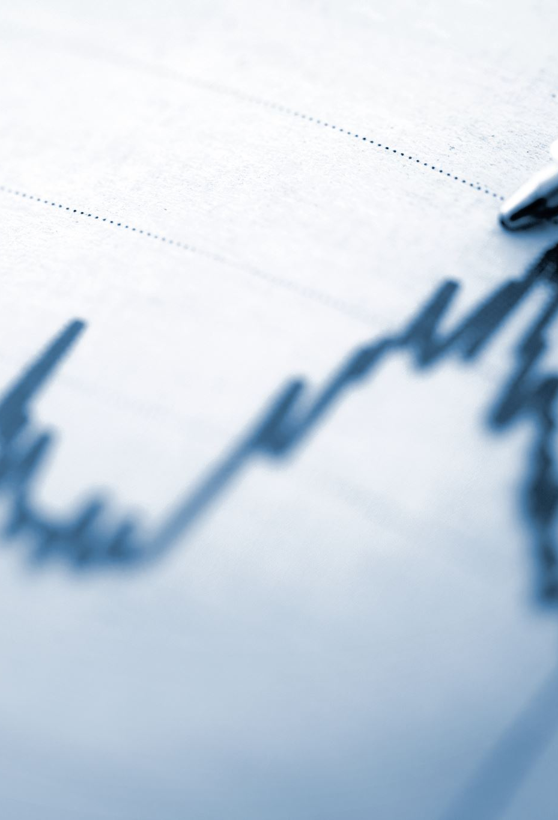
Implied Uncertainty and Other Attributes (1 of 2)
Products with uncertain demand are often less mature and have less direct competition. As a result, margins tend to be high.
Forecasting is more accurate when demand has less uncertainty.
Increased implied demand uncertainty leads to increased difficulty in matching supply with demand. For a given product, this dynamic can lead to either a stockout or an oversupply situation.
Markdowns are high for products with greater implied demand uncertainty because oversupply often results.

Slide 37
Implied Uncertainty and Other Attributes (2 of 2)
Blank | Low Implied Uncertainty | High Implied Uncertainty
Product margin | Low | High
Average forecast error | 10% | 40% to 100%
Average stockout rate | 1% to 2% | 10% to 40%
Average forced season-end markdown | 0% | 10% to 25%
Table 2-2 Correlation Between Implied Demand Uncertainty and Other Attributes

Slide 38
Impact of Supply Source Capability
Supply Source Capability | Causes Supply Uncertainty to...
Frequent breakdowns | Increase
Unpredictable and low yields | Increase
Poor quality | Increase
Limited supply capacity | Increase
Inflexible supply capacity | Increase
Evolving production process | Increase
Table 2-3 Impact of Supply Source Capability on Supply Uncertainty

Slide 39
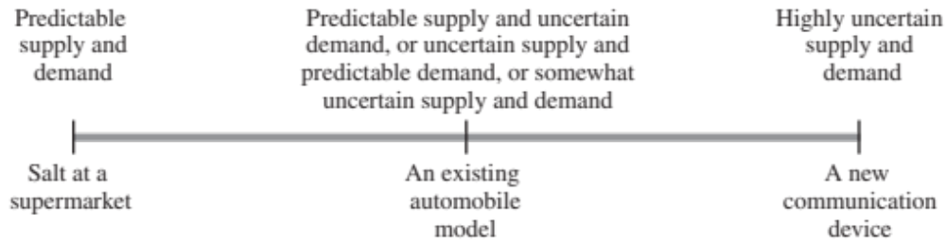
Implied Uncertainty (Demand and Supply) Spectrum
Figure 2-2 The Implied Uncertainty (Demand and Supply) Spectrum

Slide 40

Step 2: Understanding Supply Chain Capabilities (1 of 2)
How does the firm best meet demand?
Supply chain responsiveness is the ability to
  Respond to wide ranges of quantities demanded
  Meet short lead times
  Handle a large variety of products
  Build highly innovative products
  Meet a high service level
  Handle supply uncertainty

Slide 41
Step 2: Understanding Supply Chain Capabilities (2 of 2)
Responsiveness comes at a cost
Supply chain efficiency is the inverse to the cost of making and delivering the product to the customer
The cost-responsiveness efficient frontier curve shows the lowest possible cost for a given level of responsiveness

Slide 42
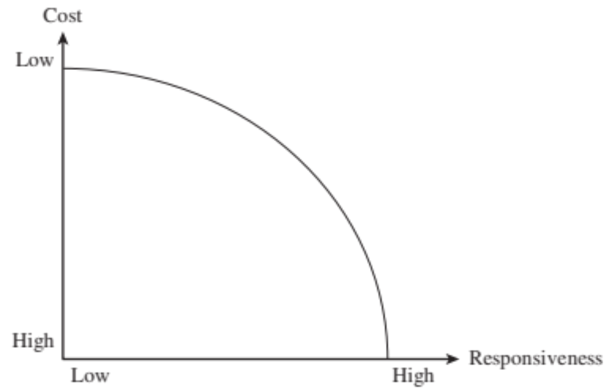
Cost-Responsiveness Efficient Frontier

Slide 43
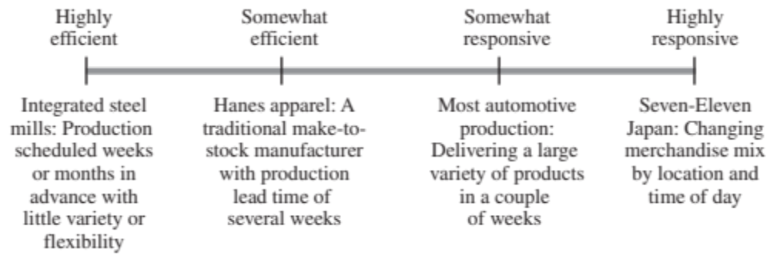
Responsiveness Spectrum
Figure 2-4 The Responsiveness Spectrum

Slide 44
Step 3: Achieving Strategic Fit
Ensure that the degree of supply chain responsiveness is consistent with the implied uncertainty
Assign roles to different stages of the supply chain that ensure the appropriate level of responsiveness
Ensure that all functions maintain consistent strategies that support the competitive strategy

Slide 45
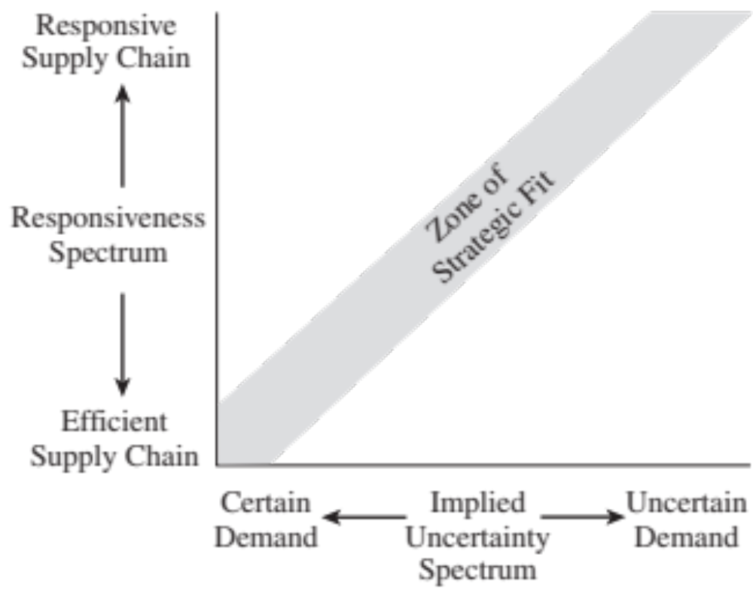
Zone of Strategic Fit

Slide 46
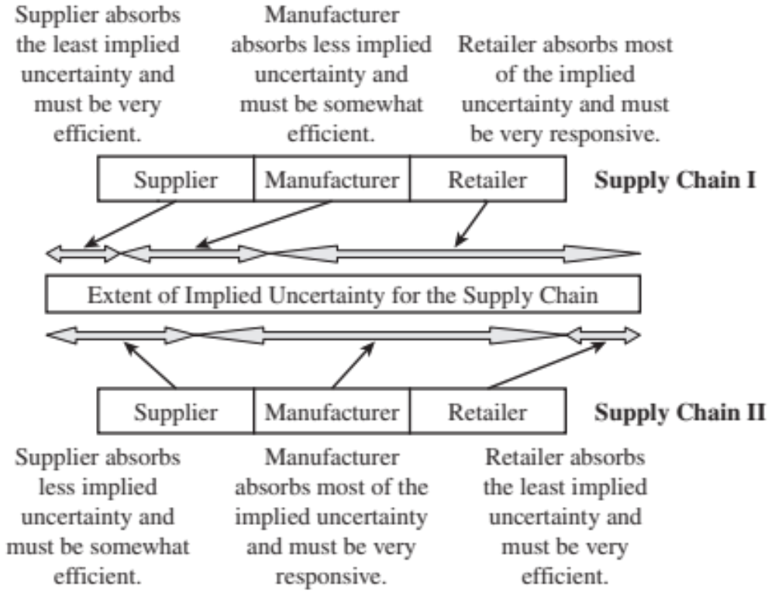
Roles and Allocations

Slide 47
Demand Management: Customer Order Decoupling Points
Long
Low
Engineer-
to-order (ETO)
Make-to-order
(MTO)
Lead
Time
Assemble-
to-order
(ATO)
Volume
Make-
to-stock
(MTS)
Short
High
Suppliers
Raw
materials
Work-in-process
parts and components
Finished
goods
Decoupling Point
47

Slide 48
Efficient and Responsive Supply Chains
Blank | Efficient Supply Chains | Responsive Supply Chains
Primary goal | Supply demand at the lowest cost | Respond quickly to demand
Product design strategy | Maximize performance at a minimum product cost | Create modularity to allow postponement of product differentiation
Pricing strategy | Lower margins because price is a prime customer driver | Higher margins because price is not a prime customer driver
Manufacturing strategy | Lower costs through high utilization | Maintain capacity flexibility to buffer against demand/supply uncertainty
Inventory strategy | Minimize inventory to lower cost | Maintain buffer inventory to deal with demand/supply uncertainty
Lead-time strategy | Reduce, but not at the expense of costs | Reduce aggressively, even if the costs are significant
Supplier strategy | Select based on cost and quality | Select based on speed, flexibility, reliability, and quality

Slide 49
Tailoring the Supply Chain
Achieve strategic fit while serving many customer segments with a variety of products across multiple channels
Requires sharing operations for some links in the supply chain, while having separate operations for other links

Slide 50
Changes over Product Life Cycle (1 of 2)
  Beginning stages
  Demand is very uncertain, and supply may be unpredictable
  Margins are often high, and time is crucial to gaining sales
  Product availability is crucial to capturing the market
  Cost is often a secondary consideration

Slide 51
Changes over Product Life Cycle (2 of 2)
  Later stages
  Demand has become more certain, and supply is predictable
  Margins are lower because of an increase in competitive pressure
  Price becomes a significant factor in customer choice

Slide 52

Summary
Strategic fit requires all functions within a firm and stages in the supply chain to target the same goal, aligned with customer needs.
A lack of strategic fit between competitive and supply chain strategies can lead to actions that do not meet customer needs.
  This misalignment reduces supply chain surplus.
  It decreases supply chain profitability.

Slide 53
Summary contd..
To achieve strategic fit:
  Understand Customer Needs and Supply Capabilities:
    Identify the needs of the customers being served.
    Assess the capabilities of all supply sources.
    Use this information to determine the implied uncertainty the supply chain must absorb.
  Understand Supply Chain Capabilities:
    Evaluate the supply chain’s efficiency and responsiveness.
  Ensure Consistency:
    Ensure supply chain responsiveness matches customer needs, supply capabilities, and implied uncertainty.
  Tailor the Supply Chain:
    Customize the supply chain to supply a variety of customers with many products through different channels.
Tailoring is essential for achieving strategic fit in diverse customer and product scenarios.

Slide 54
Supply Chain Levers
Five basic levers to deal with uncertainty
  Capacity, combination of excess capacity and flexible capacity
  Inventory, one of the most common levers used in practice to deal with uncertainty
  Time, combination of speedy supply and the willingness of customers to wait
  Information, appropriate information can help a supply chain reduce uncertainty
  Price, prices of products and services that vary over time

Slide 55
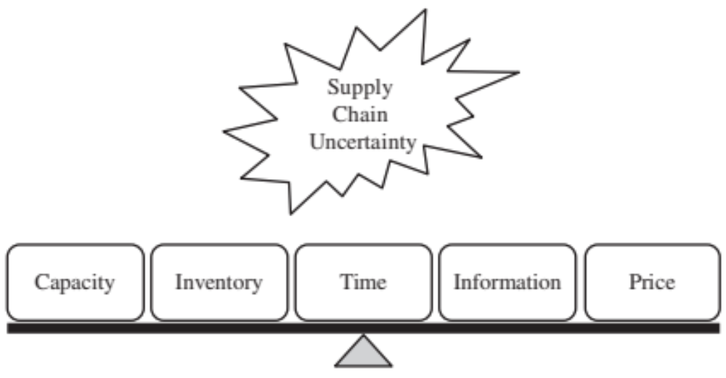
Supply Chain Uncertainty

Slide 56
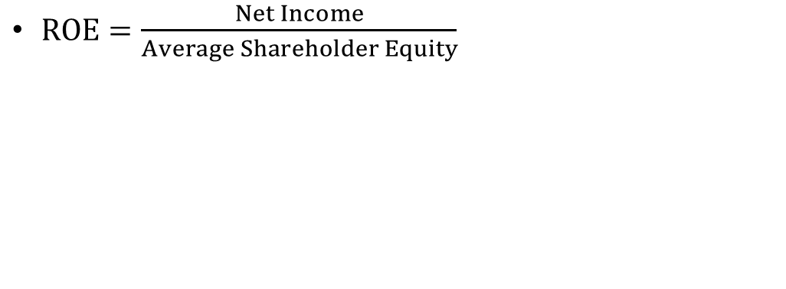
Financial Measures of Performance (1 of 7)
From a shareholder perspective, return on equity (R O E) is the main summary measure of a firm’s performance
$ROE=\frac{Net Income}{Average Shareholder Equity}$

Slide 57
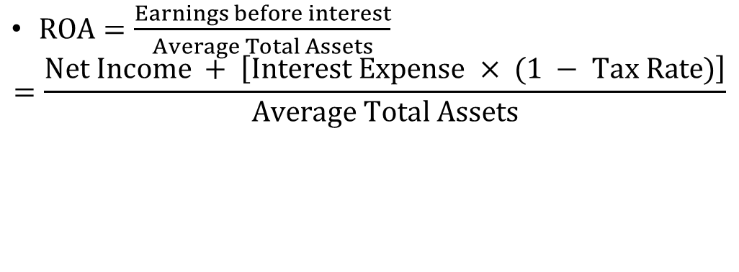
Financial Measures of Performance (2 of 7)
Return on assets (R O A) measures the return earned on each dollar invested by the firm in assets
$ROA=\frac{Earnings before interest}{Average Total Assets}$
$=\frac{Net Income + \left[Interest Expense × (1 − Tax Rate)\right]}{Average Total Assets}$

Slide 58
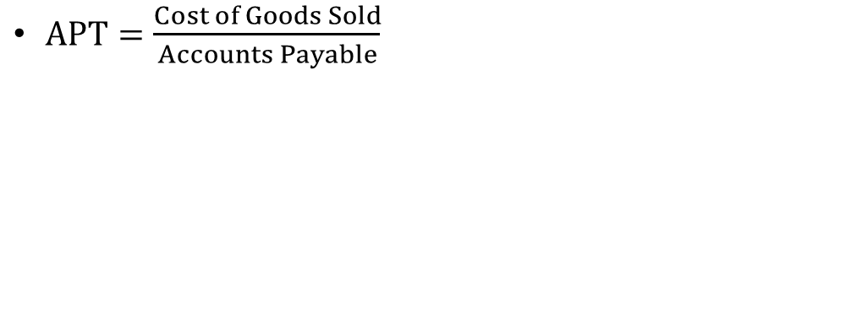
Financial Measures of Performance (3 of 7)
An important ratio that defines financial leverage is accounts payable turnover (A P T)
$APT=\frac{Cost of Goods Sold}{Accounts Payable}$

Slide 59
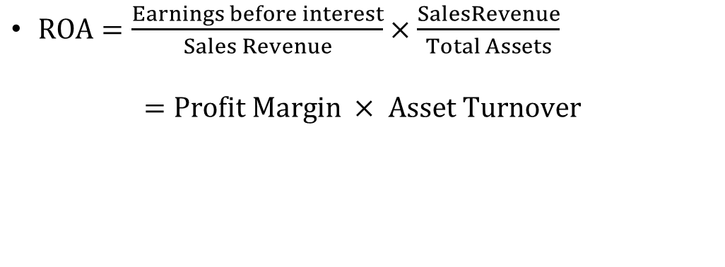
Financial Measures of Performance (4 of 7)
R O A can be written as the product of two ratios – profit margin and asset turnover
$ROA=\frac{Earnings before interest}{Sales Revenue}×\frac{SalesRevenue}{Total Assets}$
$$=Profit Margin × Asset Turnover$$

Slide 60
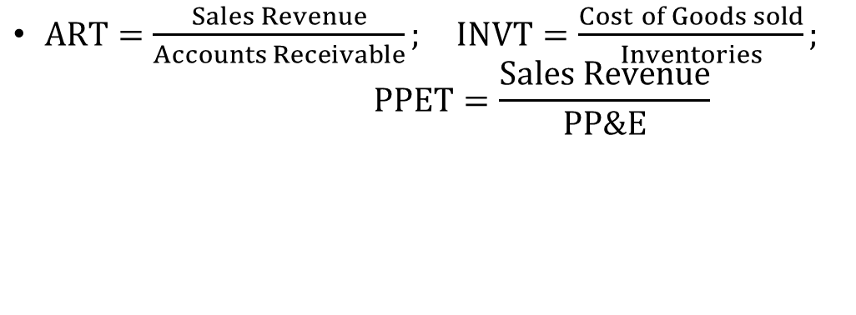
Financial Measures of Performance (5 of 7)
Key components of asset turnover are accounts receivable turnover (A R T); inventory turnover (I N V T); and property, plant, and equipment turnover (P P E T)
$ART=\frac{Sales Revenue}{Accounts Receivable}; INVT=\frac{Cost of Goods sold}{Inventories};$
$PPET=\frac{Sales Revenue}{PP\&E}$

Slide 61
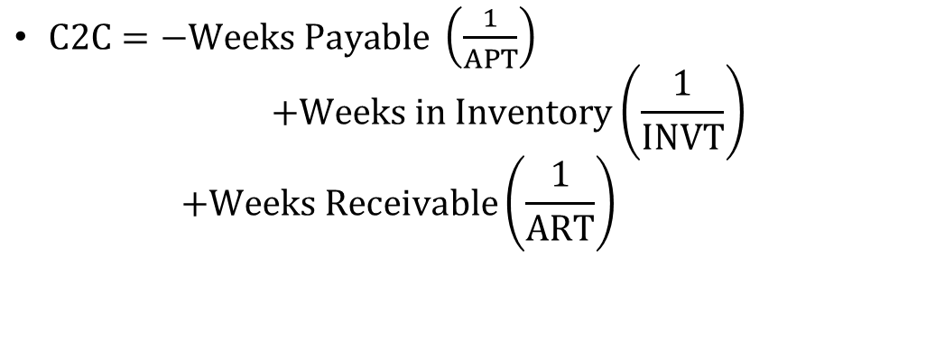
Financial Measures of Performance (6 of 7)
Cash-to-cash (C2C) cycle roughly measures the average amount time from when cash enters the process as cost to when it returns as collected revenue
$C2C=−Weeks Payable \left(\frac{1}{APT}\right)$
$+Weeks in Inventory\left(\frac{1}{INVT}\right)$
$+Weeks Receivable\left(\frac{1}{ART}\right)$

Slide 62
Financial Measures of Performance (7 of 7)
To measures not part of financial statements
  Markdowns: discounts required to convince customers to buy excess inventory
  Lost sales: represent customer sales that did not materialize because of the absence of products the customer wanted to buy

Slide 63
Summary
The key financial metrics of firm performance include return on equity; return on assets; accounts payable turnover; profit margin; asset turnover; accounts receivable turnover; inventory turns; property, plant, and equipment turns; cash-to-cash cycle; and S G & A / revenue. Markdowns and lost sales are two important financial measures of supply chain performance that are not recorded in financial statements.

Slide 64
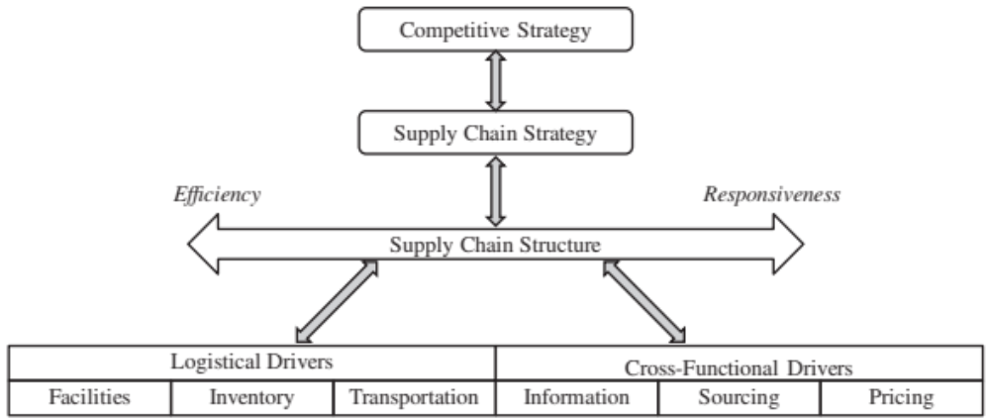
Framework for Supply Chain Decisions (1 of 2)
Figure 3-1 Supply Chain Decision-Making Framework

Slide 65
Framework for Supply Chain Decisions (2 of 2)
Logistical Drivers
Facilities
Inventory
Transportation
Cross-Functional Drivers
Information
Sourcing
Pricing
Interactions determine overall supply chain performance

Slide 66
Drivers of Supply Chain Performance (1 of 2)
Facilities
  The physical locations in the supply chain network where product is stored, assembled, or fabricated
Inventory
  All raw materials, work in process, and finished goods within a supply chain
Transportation
  Moving inventory from point to point in the supply chain

Slide 67
Drivers of Supply Chain Performance (2 of 2)
Information
  Data and analysis concerning facilities, inventory, transportation, costs, prices, and customers throughout the supply chain
Sourcing
  Who will perform a particular supply chain activity
Pricing
  How much a firm will charge for the goods and services that it makes available in the supply chain

Slide 68
Facilities (1 of 6)
Role in the supply chain
  Production sites and storage sites
  Increase responsiveness by increasing the number of facilities, making them more flexible, or increasing capacity

Slide 69
Facilities (2 of 6)
  Tradeoffs between facility, inventory, and transportation costs
    Increasing number of facilities increases facility and inventory costs, decreases transportation costs and reduces response time
    Increasing the flexibility or capacity of a facility increases facility costs but decreases inventory costs and response time

Slide 70
Facilities (3 of 6)
Components of facilities decisions
  Capability
    Flexible, dedicated, or a combination of the two
    Product focus or a functional focus
  Location
    Where a company will locate its facilities
    Centralize for economies of scale, decentralize for responsiveness
    Consider macroeconomic factors, quality of workers, cost of workers and facility, availability of infrastructure, proximity to customers, location of other facilities, tax effects

Slide 71
Facilities (4 of 6)
  Capacity
    A facility’s capacity to perform its intended function or functions
    Excess capacity – responsive, costly
    Little excess capacity – more efficient, less responsive
  Demand Allocation
    Markets each facility will serve
    Revisited as conditions change

Slide 72
Facilities (5 of 6)
  Facility-Related Metrics
    Capacity
    Utilization
    Processing/setup/down/idle time
    Quality losses
    Production cost per unit
    Theoretical flow/cycle time of production
    Actual average flow/cycle time

Slide 73
Facilities (6 of 6)
    Product variety
    Volume contribution of top 20 percent SKU's and customers
    Average production batch size
    Production service level

Slide 74
Inventory (1 of 3)
Role in the Supply Chain
  Mismatch between supply and demand
  Exploit economies of scale
  Reduce costs
  Improve product availability
  Affects assets, costs, responsiveness, material flow time

Slide 75
Inventory (2 of 3)
Overall Trade-Off
  Increasing inventory generally makes the supply chain more responsive
  A higher level of inventory facilitates a reduction in production and transportation costs because of improved economies of scale
  Inventory holding costs increase

Slide 76
Inventory (3 of 3)
  Material flow time, the time that elapses between the point at which material enters the supply chain to the point at which it exits
  Throughput, the rate at which sales occur
  Little’s law
    I=FR*FT
  where
  I = Inventory, FR =Flow Rate, FT = Flow Time

Slide 77

Components of Inventory Decisions (1 of 4)
Cycle Inventory
  Average amount of inventory used to satisfy demand between supplier shipments
  Function of lot size decisions
Safety Inventory
  Inventory held in case demand exceeds expectations
  Costs of carrying too much inventory versus cost of losing sales

Slide 78
Components of Inventory Decisions (2 of 4)
Seasonal Inventory
  Inventory built up to counter predictable variability in demand
  Cost of carrying additional inventory versus cost of flexible production
Level of Product Availability
  The fraction of demand that is served on time from product held in inventory
  Trade off between customer service and cost

Slide 79
Components of Inventory Decisions (3 of 4)
Inventory-Related Metrics
  C 2 C cycle time
  Average inventory
  Inventory turns
  Products with more than a specified number of days of inventory
  Average replenishment batch size

Slide 80
Components of Inventory Decisions (4 of 4)
  Average safety inventory
  Seasonal inventory
  Fill rate
  Fraction of time out of stock
  Obsolete inventory

Slide 81
Transportation (1 of 5)
Role in the Supply Chain
  Moves inventory between stages in the supply chain
  Affects responsiveness and efficiency
  Faster transportation allows greater responsiveness but lower efficiency
  Also affects inventory and facilities
  Allows a firm to adjust the location of its facilities and inventory to find the right balance between responsiveness and efficiency

Slide 82
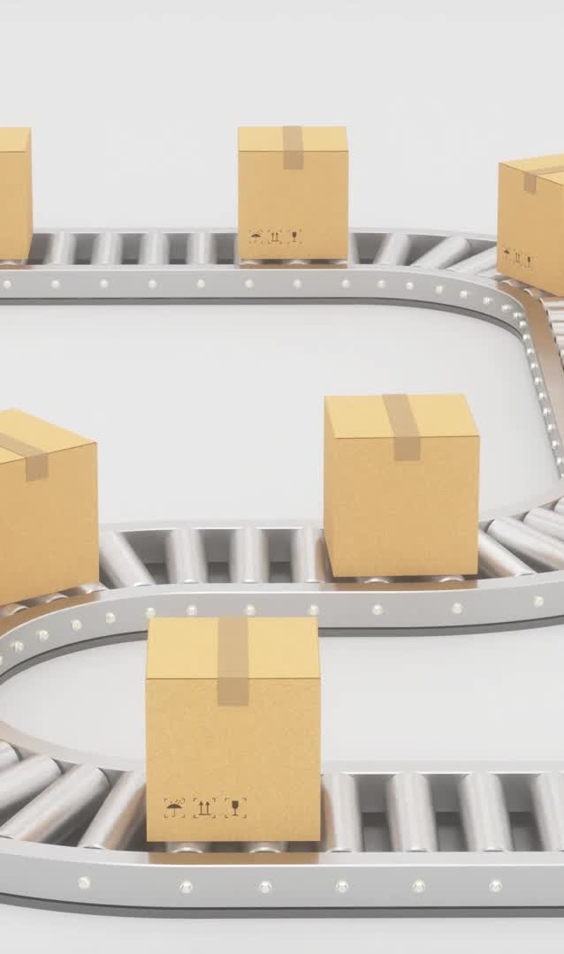
Transportation (2 of 5)
Components of Transportation Decisions
  Design of transportation network
    Modes, locations, and routes
    Direct or with intermediate consolidation points
    One or multiple supply or demand points in a single run

Slide 83
Transportation (3 of 5)
  Choice of transportation mode
    Air, truck, rail, sea, and pipeline
    Information goods via the Internet
    Different speed, size of shipments, cost of shipping, and flexibility

Slide 84
Transportation (4 of 5)
  Transportation-Related Metrics
    Average inbound transportation cost
    Average income shipment size
    Average inbound transportation cost per shipment
    Average outbound transportation cost
    Average outbound shipment size
    Average outbound transportation cost per shipment
    Fraction transported by mode

Slide 85
Transportation (5 of 5)
Overall Trade-off: Responsiveness Versus Efficiency
  The cost of transporting a given product (efficiency) and the speed with which that product is transported (responsiveness)
  Using fast modes of transport raises responsiveness and transportation cost but lowers the inventory holding cost

Slide 86

Information (1 of 2)
Role in the Supply Chain
  Improve the utilization of supply chain assets and the coordination of supply chain flows to increase responsiveness and reduce cost
  Information is a key driver that can be used to provide higher responsiveness while simultaneously improving efficiency

Slide 87
Information (2 of 2)
Role in the Competitive Strategy
  Improves visibility of transactions and coordination of decisions across the supply chain
  Right information can help a supply chain better meet customer needs at lower cost
  More information increases complexity and cost of both infrastructure and analysis exponentially while marginal value diminishes
  Share the minimum amount of information required to achieve coordination

Slide 88

Components of Information Decisions (1 of 3)
Demand Planning
  Best estimate of future demand
  Include estimation of forecast error
Coordination and Information Sharing
  Supply chain coordination, all stages of a supply chain work toward the objective of maximizing total supply chain profitability based on shared information
  Critical for success

Slide 89

Components of Information Decisions (2 of 3)
Sales and Operations Planning (S & O P)
  The process of creating an overall supply plan (production and inventories) to meet the anticipated level of demand (sales)
  Can be used to plan supply chain needs and project revenues and profits

Slide 90

Components of Information Decisions (3 of 3)
Information-Related Metrics
  Forecast horizon
  Frequency of update
  Forecast error
  Variance from plan
  Ratio of demand variability to order variability

Slide 91
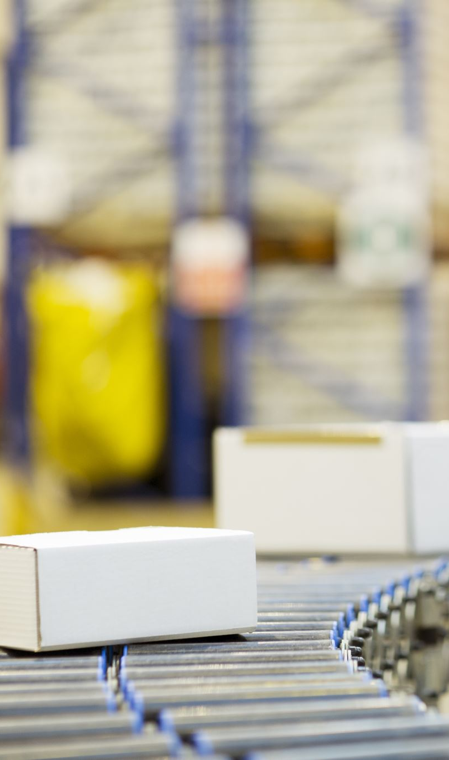
Sourcing (1 of 2)
Role in the Supply Chain
  Set of business processes required to purchase goods and services
  Will tasks be performed by a source internal to the company or a third party
  Should increase the size of the total surplus to be shared across the supply chain

Slide 92

Sourcing (2 of 2)
Role in the Competitive Strategy
  Sourcing decisions are crucial because they affect the level of efficiency and responsiveness in a supply chain
  Outsource to responsive third parties if it is too expensive to develop their own
  Keep responsive process in-house to maintain control

Slide 93
Components of Sourcing Decisions (1 of 3)
In-House or Outsource
  Perform a task in-house or outsource it to a third party
  Outsource if it raises the supply chain surplus more than the firm can on its own
  Keep function in-house if the third party cannot increase the supply chain surplus or if the outsourcing risk is significant

Slide 94

Components of Sourcing Decisions (2 of 3)
Supplier Selection
  Number of suppliers, criteria for evaluation and selection
Procurement
  Obtain goods and service within a supply chain
  Goal is to decrease total cost of ownership and increase supply chain surplus

Slide 95
Components of Sourcing Decisions (3 of 3)
Sourcing-Related Metrics
  Days payable outstanding
  Average purchase price
  Range of purchase price
  Average purchase quantity
  Supply quality
  Supply lead time
  Percentage of on-time deliveries
  Supplier reliability

Slide 96
Pricing
Role in the Supply Chain
  Pricing determines the amount to charge customers for goods and services
  Affects the supply chain level of responsiveness required and the demand profile the supply chain attempts to serve
  Pricing strategies can be used to match demand and supply
  Objective should be to increase firm profit

Slide 97

Components of Pricing Decisions (1 of 3)
Pricing and Economies of Scale
  The provider of the activity must decide how to price it appropriately to reflect economies of scale
Everyday Low Pricing Versus High-Low Pricing
  Different pricing strategies lead to different demand profiles that the supply chain must serve

Slide 98
Components of Pricing Decisions (2 of 3)
Fixed Price Versus Menu Pricing
  If marginal supply chain costs or the value to the customer vary significantly along some attribute, it is often effective to have a pricing menu
  Can lead to customer behavior that has a negative impact on profits

Slide 99
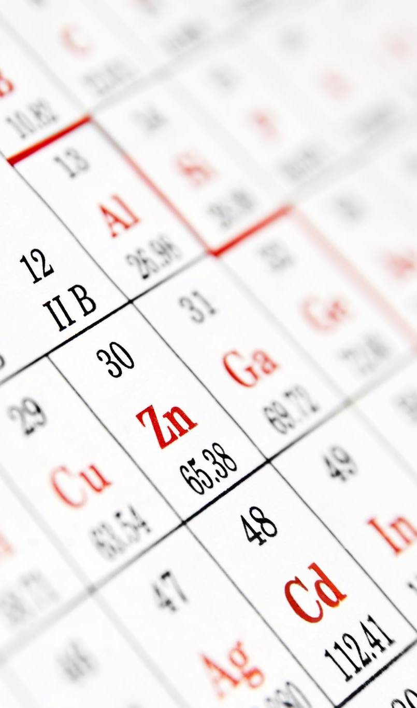
Components of Pricing Decisions (3 of 3)
Pricing-Related Metrics
  Profit margin
  Days sales outstanding
  Incremental fixed cost per order
  Incremental variable cost per unit
  Average sale price
  Average order size
  Range of sale price
  Range of periodic sales

Slide 100
Conclusion
Supply Chain Strategies
Efficient Supply Chains: Focus on cost reduction and high resource utilization. Suitable for stable and predictable demand environments.
Responsive Supply Chains: Aim to be flexible and responsive to changes in demand. Suitable for uncertain and dynamic demand environments.
Agile Supply Chains: Combine the attributes of both efficiency and responsiveness to react to market changes quickly.

Slide 101
Conclusion contd..
Supply Chain Drivers
Facilities: Physical locations where products are manufactured or stored. Key decisions: location, capacity, and flexibility.
Inventory: Management of materials and finished goods. Key decisions: order size, replenishment cycle, and safety stock.
Transportation: Mode of transport and routes taken. Key decisions: cost vs. speed, mode selection, and route optimization.
Information: Flow of data across the supply chain. Key decisions: real-time data, transparency, and demand forecasting.
Sourcing: Procurement of materials and services. Key decisions: supplier selection, contract terms, and risk-sharing.
Pricing: Strategy for pricing products and services. Key decisions: dynamic pricing, discount policies, and customer segmentation.

