Slide 1


Outsourcing: Make vs Buy decisions in Supply chains
Session III
Instructor: Prof. Harpreet Kaur, IIM Amritsar

Slide 2
Nursery Rhyme
For want of a nail the shoe was lost
For want of a shoe the horse was lost
For want of a horse the rider was lost
For want of a rider the battle was lost
For want of a battle the kingdom was lost
And all for the want of a horseshoe nail
Production Delays of Boeing’s 787 Dreamliner
Horsemeat Scandal
Harmful dyes in fabrics
Toyota’s Product recalls

Slide 3
Focus
Sourcing decisions and purchasing activities serve to link a company with its upstream supply chain partners
Sourcing decisions –
High level, often strategic decisions regarding which products or services will be provided internally and which will be provided by external supply-chain partners.
Procurement –
The activities associated with identifying needs, locating and selecting suppliers, negotiating terms, and following up to ensure supplier performance.

Slide 4

Key considerations in sourcing process
  Will the third party increase the supply chain surplus relative to performing the activity in-house?
  To what extent do risks grow upon outsourcing?
  Are there strategic reasons to outsource?

Slide 5
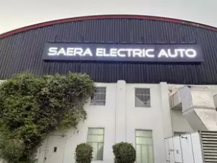



Strategic Factors in Sourcing
Support for the business strategy
Improve firm focus
Support for the business strategy
Improve firm focus

Slide 6




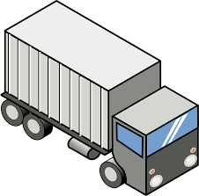
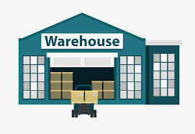
How Do Third Parties Increase the Supply Chain Surplus?
Pros
Capacity aggregation
Inventory aggregation
Transportation aggregation
Warehousing aggregation
Procurement aggregation
Information aggregation
Receivables aggregation
Relationship aggregation

Slide 7
Factors Influencing Growth of Surplus by a Third Party
Scale
  Large scale it is unlikely that a third party can achieve further scale economies and increase the surplus
Uncertainty
  If requirements are highly variable over time, third party can increase the surplus through aggregation
Specificity of assets
  If assets required are specific to a firm, a third party is unlikely to increase the surplus

Slide 8
Growth in Surplus by Third Party as a Function of Scale, Uncertainty, and Specificity
Blank | Blank | Specificity of Assets Involved in Function (Low) | Specificity of Assets Involved in Function (High)
Firm scale
Blank |  |  | No
Demand uncertainty for firm |  | (Medium)
Blank |  |  | (Medium)

Slide 9
Risks of Using a Third Party
Broken internal process
Underestimation of the cost of coordination
Reduced customer/supplier contact
Loss of internal capability and growth in third-party power
Leakage of sensitive data and information
Ineffective contracts
Loss of supply chain visibility
Negative reputational impact

Slide 10



Examples of Successful Third-Party Suppliers
Without Flextronics, there would be no Xbox - only the idea of it. "Microsoft has a ton of money, but if they had to build factories, they wouldn't have done this project," says Flextronics chair and CEO Michael Marks. "If guys like us didn't exist, guys like Microsoft wouldn't do a hardware product. The risk would be too high."
Magna Steyr has so far produced more than 3.65 million vehicles, 29 models including Mercedes-Benz G-Class, BMW 5 Series, BMW Z4, Toyota GR Supra, Jaguar I-PACE and Jaguar E-PACE for nine different OEMs.

Slide 11
Framework for Make/Buy decisions
Dependency on capacity
Dependency on Knowledge

Slide 12
Quoted price or Total Cost of Ownership?
Mistake to focus only on quoted price
Total cost of ownership (T C O)
  Includes all supply chain costs of sourcing from a particular supplier
Three “buckets”
  Acquisition costs
  Ownership costs
  Post-ownership costs

Slide 13
Acquisition costs
Performance Category | Category Components | Quantifiable?
Acquisition Costs | Blank | Blank
Supplier price | Labor, material, and overhead | Yes
Supplier terms | Net payment terms, delivery frequency, minimum lot size, quantity discounts | Yes
Taxes and duties | All tariffs and compliance costs | Yes
Delivery costs | All transportation costs from source to destination, packaging costs | Yes
Incoming quality costs | Cost of inspection, defectives, and rework | Yes
Management costs | Cost of managing and planning the purchase | Difficult

Slide 14
Ownership Costs
Performance Category | Category Components | Quantifiable?
Ownership Costs | Blank | Blank
Inventory costs | Supplier inventory, including raw material, in process and finished goods, in-transit inventory, finished goods inventory in supply chain | Yes
Warehousing cost | Warehousing and material handling costs to support additional inventory | Yes
Manufacturing costs | Cost of manufacturing associated with the sourced part | Yes
Production quality costs | Impact of sourced part on finished product quality | Difficult
Cycle time costs | Impact of sourced part on production cycle time | Yes

Slide 15
Post ownership cost
Performance Category | Category Components | Quantifiable?
Post-Ownership Costs | Blank | Blank
Reputation | Reputation impact of quality problems | No
Warranty and product liability costs | Warranty and product liability costs associated with sourced part | Difficult
Environmental costs | Environmental costs affected by sourced part | Difficult
Supplier capabilities | Replenishment lead time, on-time performance, flexibility, information coordination capability, design coordination capability, supplier viability | To some extent

Slide 16
Designing a Sourcing Portfolio: Tailored Sourcing
Options with regard to whom and where to source from
  Will the source be cost efficient or responsive
Tailor supplier portfolio based on a variety of product and market characteristics

Slide 17
Designing a Sourcing Portfolio: Tailored Sourcing
Factors Favoring Selection of a Responsive or Low-Cost Source
Blank | Responsive Source | Low-Cost Source
Product life cycle | Early phase | Mature phase
Demand volatility | High | Low
Demand volume | Low | High
Product value | High | Low
Rate of product obsolescence | High | Low
Desired quality | High | Low to medium
Engineering/design support | High | Low

Slide 18
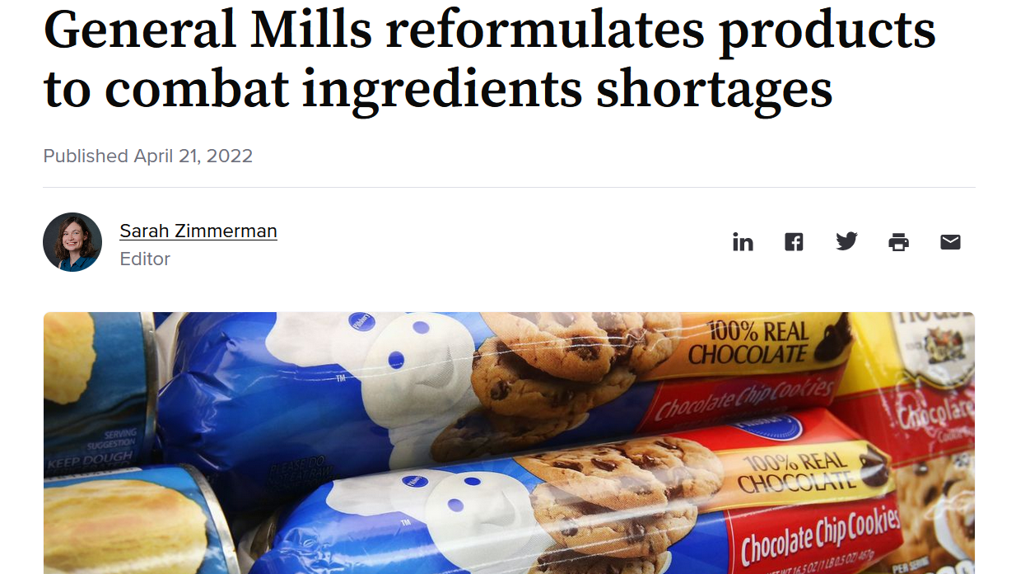
Kraljic’s supply matrix
High
Bottleneck items (Distinctives)
*Supplier’s technology critical
*Difficult to substitute
*Unique requirements
*Engineering Items
Ensure Supply
Strategic items (Criticals)
*Unique specifications
*Supplier’s technology critical
*Difficult to substitute
*Unique specifications
Form long-term partnerships
Supply Risk
Non-critical items (Generics)
*Many suppliers available
*Easy-to-find substitute products
*Office Items, MRO
Simplify and Automate
Leverage items (commodities)
*Large volume purchases
*can find substitutes, many suppliers available
*Basic Production, Packaging items
*Logistics Services
exploit purchasing power & minimize cost
Low
Low
Purchase Value
High

Slide 19
Typology of Buying Decision
Low
Purchasing Department Dominant
Engineering
Dominant
Commercial
Uncertainty
Cross Functional
Decision
Finance And Admn Dominant
High
Low
High
Product Complexity

Slide 20
The Purchasing Process
Needs identification
Description
No
Is there a preferred supplier?
Supplier identification
and evaluation
Yes
Supplier selection
Purchase order preparation
Follow up and expediting
Order
cycle
Receipt and inspection
Invoice clearance & payments
Records maintenance

Slide 21
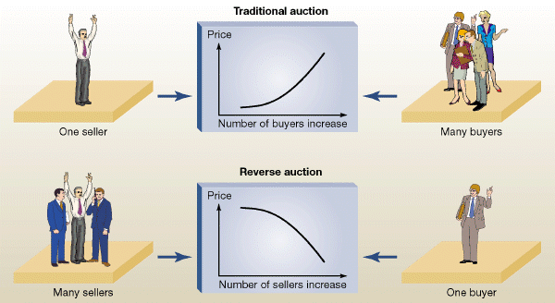

Slide 22
Sourcing Strategies
Single sourcing –
The buying firm depends on a single company for all or nearly all of an item or service
Multiple sourcing –
The buying firm shares its business across multiple suppliers
Cross sourcing –
Using a single supplier for a certain part or service and another supplier with the same capabilities for a similar part
Dual sourcing –
Using two suppliers for the same purchased product or service
Notes:
Cross sourcing has the advantage of providing for a backup supplier in case the primary supplier cannot provide the required volume.
Dual sourcing is typically split 70% – 30% so that the dominant supplier will lose business if performance suffers.

Slide 23
Why supplier selection?
Any manufacturing company these days spends roughly half its revenue to purchase goods and services
New product/ technology
Streamline production process
Labor cost & Import/Export regulations in home country
Supply disruption risk
Other business goals: Supplier diversity

Slide 24
NO BEST WAY….
Supplier selection is highly subjective varying from
    company to company
    product to product
    process to process
It also depends on the type of sourcing decisions

Slide 25
TYPES OF SOURCING DECISIONS
Production materials and components
Indirect materials
Capital purchases (e.g., Machinery)
Intellectual property (e.g., Software)
Services.

Slide 26
SUPPLIER SELECTION
Identify
Evaluate
Outsource

Slide 27
Business Model
Competitive strategy
Strategic
Supply base optimization/ Evaluations
Tactical
Operational
Order Management to suppliers &Lot sizing

Slide 28
Screening Process
Reference checks
Financial status checks
Surge capacity availability
Indications of supplier quality
Ability to meet specifications
Involve internal customer

Slide 29
“Strategic match”
Compatibility in near future.
Selection should not only be on past performance but also be on anticipated future capabilities.

Slide 30

SUPPLY BASE OPTIMIZATION
How many suppliers a purchaser will maintain?
Relying on smaller but more competent group of suppliers
Eliminating suppliers who are not capable of achieving performance objectives.
It is a continuous process, replacing good suppliers with better ones.
This calls for the need to develop the supplier evaluation and performance measurement system

Slide 31
TRADE-OFFs
BENEFITS OF SUPPLY BASE REDUCTION
RISKS ASSOCIATED WITH REDUCED SUPPLY BASE
OPTIMIZED APPROACH

Slide 32
Direct sourcing doesn’t necessarily reduce costs
Truck assembly part
Labor and space intensive process
Tires
Assembly plant
Wheel
Ship in small quantities on just in time basis
Overall efficiency is increased
Total cost is reduced
Tires
Additional supplier
Assembly plant
Wheel

Slide 33
EVALUATING SUPPLIERS
To evaluate if the supplier in the supplier-base truly add value?
Process Based
Auditing supplier’s site
Assessing level of capabilities at supplier’s end
Demanding certifications at supplier’s end
Performance Based
Accessing supplier performance on set of criteria
After-the-fact Evaluation

Slide 34
Supplier selection criteria
1. On-time delivery
2. Technical capabilities;
3. Consistent quality
4. Reasonable/low price
5. Good past performance record
6. Ability to maintain volume flexibility to withstand sudden variations in demand
7. Presales and post-sales support
8. Ability to provide his buyers tracking facilities to track the progress of supply.
9. Industrial certifications such as ISO and TUV;
10. Proactive to develop a healthy relation with his buyers.

Slide 35
Decision Making in Supplier Selection
Expert judgment
S₁
S₂
Set of Criteria
S₃
Record Data
S₄
S₅

Slide 36
Categorical Method
Categorizing each supplier’s performance in certain areas and assigning a grade
Good (+)
Neutral (0)
Unsatisfactory (-)

Slide 37
 | Cost | Product Quality | Delivery time | After sales Support | Variety | Total
S₁ | + | - | 0 | 0 | + | +
S₂ | + | + | 0 | + | - | 2+
S₃ | - | + | 0 | + | 0 | +
S₄ | 0 | 0 | 0 | + | 0 | +
S₅ | - | + | - | + | - | -
S₆ | + | + | + | + | 0 | 4+
S₇ | 0 | - | - | + | 0 | -
S₈ | 0 | + | - | + | 0 | +
S₉ | 0 | + | + | + | + | 4+
S₁₀ | - | - | - | + | - | 3-
S₁₁ | 0 | - | - | + | 0 | -
S₁₂ | + | + | - | 0 | + | 2+
S₁₃ | + | + | + | 0 | + | 4+
S₁₄ | + | - | + | 0 | - | 0
S₁₅ | - | 0 | 0 | 0 | + | 0

Slide 38
 | Cost | Product Quality | Delivery time | After sales Support | Variety | Total
S₁₆ | + | - | + | + | 0 | 2+
S₁₇ | 0 | + | + | + | 0 | 3+
S₁₈ | - | 0 | - | 0 | 0 | 2-
S₁₉ | - | - | - | + | - | 3-
S₂₀ | 0 | - | + | + | + | 2+
S₂₁ | + | + | - | - | - | -
S₂₂ | + | + | + | + | - | 3+
S₂₃ | + | - | - | 0 | 0 | -
S₂₄ | - | + | + | - | + | +
S₂₅ | - | + | 0 | + | + | 2+
S₂₆ | - | - | - | 0 | - | 4-
S₂₇ | + | + | - | - | - | -
S₂₈ | + | - | 0 | 0 | 0 | 0
S₂₉ | 0 | + | - | + | + | 2+
S₃₀ | - | 0 | + | + | + | 2+

Slide 39
Sources of information
Current Suppliers
Third party auditors
Information databases
Internet searches
Indirect Information
Trade journals/
directories
Sales Representatives
Trade shows

Slide 40
MCDM problem: The case of Innovation outsourcing
In February 2017, a purchasing manager for General Motors Company (GM) needed to come up with a sourcing proposal to source e-boost modules, which were required to support the enhanced 2020 Chevrolet Bolt Electric Vehicle and the new 2020 Chevrolet Bolt Autonomous Vehicle.
GM had four possible international suppliers to choose from. Each supplier had its pros and cons in terms of price, product development capability, and the architectural nature of the braking system.
GM wanted to be a disrupter to the autonomous vehicle industry.
Its top priorities were public safety and defect-free quality. In order to continue to maintain the market leadership position, GM wanted to retain the intellectual property of the e-boost modules.
Which supplier would best meet the needs of the company?

Slide 41
SUPPLIER SELECTION AND ORDER ALLOCATION
Formulating Mathematical models

Slide 42
Single-item, Multi-Supplier
D Demand
SC_{J} Supplier capacity with supplier J
PC_{J} Unit item cost offered by supplier J
OC_{J} Ordering cost associated with supplier J
Q_{J} Quantity ordered from supplier J
Y_{J} Binary variable takes 1 if order is given to supplier J else 0

Slide 43
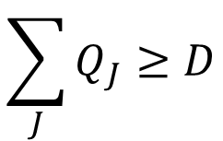
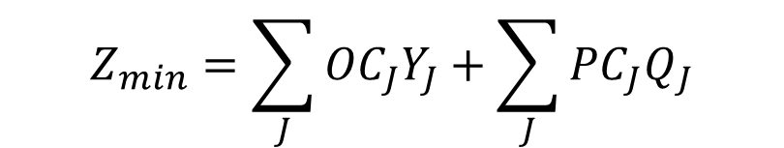



$$Z_{min}=\sum_{J}{{OC}_{J}Y_{J}}+\sum_{J}{{PC}_{J}Q_{J}}$$
$$\sum_{J}{Q_{J}≥D}$$
$$Q_{J}≤{SC}_{J}Y_{J} ∀J$$
$$Q_{J} is integer ∀j$$
$$Y_{J} ∈\{0,1\} ∀j$$

Slide 44
Multi-item, multi-supplier
D_{I} Demand of item I
SC_{IJ} Supplier capacity with of item I with supplier J
PC_{IJ} Unit item cost of item I offered by supplier J
OC_{IJ} Ordering cost for item I associated with supplier J
Q_{IJ} Quantity of item I ordered from supplier J
Y_{IJ} Binary variable takes 1 if order for item I is given to supplier J else 0

Slide 45
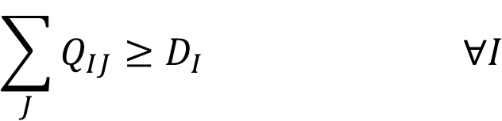
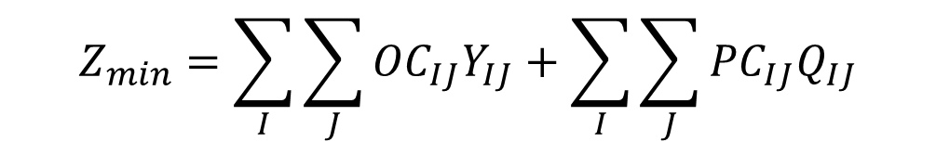



$$Z_{min}=\sum_{I}{\sum_{J}{{OC}_{IJ}Y_{IJ}}}+\sum_{I}{\sum_{J}{{PC}_{IJ}Q_{IJ}}}$$
$$\sum_{J}{Q_{IJ}≥D_{I}} ∀I$$
$$Q_{IJ}≤{SC}_{IJ}Y_{IJ} ∀I,J$$
$$Q_{IJ} is integer ∀I,J$$
$$Y_{IJ} ∈\left\{0,1\right\} ∀I,J$$

Slide 46
Multi-period, single-item, multi-supplier
D_{T} Demand in time period T
SC_{TJ} Supplier capacity with supplier J in period T
PC_{J} Unit item cost offered by supplier J
OC_{J} Ordering cost associated with supplier J
Q_{TJ} Quantity ordered from supplier J in period T
Y_{TJ} Binary variable takes 1 if order is given to supplier J in period T else 0

Slide 47

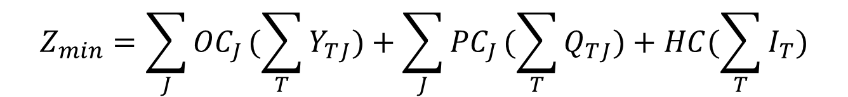



$$Z_{min}=\sum_{J}{{OC}_{J}}(\sum_{T}{Y_{TJ}})+\sum_{J}{{PC}_{J}}(\sum_{T}{Q_{TJ})}+HC(\sum_{T}{I_{T})}$$
$$I_{T−1}+\sum_{J}{Q_{TJ}−I_{T}≥D_{T}} ∀T$$
$$Q_{TJ}≤{SC}_{TJ}Y_{TJ} ∀T,J$$
$$Q_{TJ} is integer ∀T,J$$
$$Y_{TJ} ∈\left\{0,1\right\} ∀T,J$$

Slide 48
Multi-period, multi-item, multi-supplier
D_{TI} Demand in of item I in time period T
SC_{TIJ} Supplier capacity of item I with supplier J in period T
PC_{TIJ} Unit item cost of item I offered by supplier J in period T
OC_{TIJ} Ordering cost associated with supplier J in period T
HC_{TI} Holding cost of item I in period T
I_{TI} Inventory carried for item I in period T
Q_{TIJ} Quantity ordered from supplier J in period T
Y_{TIJ} Binary variable takes 1 if order is given to supplier J in period T else 0

Slide 49
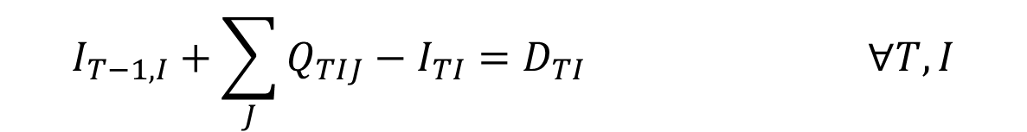
$$Z_{min}=\sum_{T}{\sum_{I}{\sum_{J}{{OC}_{TIJ}}}}Y_{TIJ}+\sum_{T}{\sum_{I}{\sum_{J}{{PC}_{TIJ}}}}Q_{TIJ}+\sum_{T}{\sum_{I}{{HC}_{TI}I_{TI}}}$$
$$I_{T−1,I}+\sum_{J}{Q_{TIJ}−I_{TI}=D_{TI}} ∀T, I$$
$$Q_{TIJ}≤{SC}_{TIJ}Y_{TIJ} ∀T,I,J$$
$$Q_{TIJ} ,I_{TI} are integer ∀T,I,J$$
$$Y_{TJ} ∈\left\{0,1\right\} ∀T,I, J$$

