Slide 1
Session Details and Requirements Tableau
Executive Development in Data Visualization

Slide 2
Session Details and Requirements
Session Details :
Discussion on importance of visualization and tips of effective visualization
Overview of Tableau application and its features
  Hands on Exercise
  Requirements
  Tableau should be installed before the session (Instruction provided in following slides)
  Everyone has to do the exercise along with the instructor

Slide 3
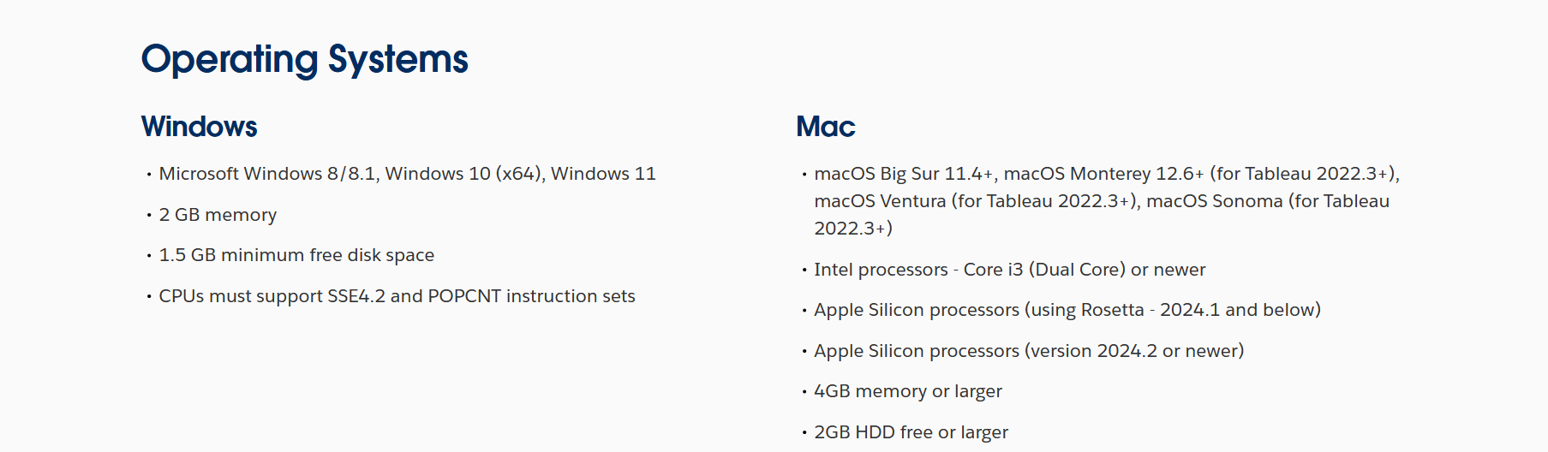
Supported Operating Systems

Slide 4
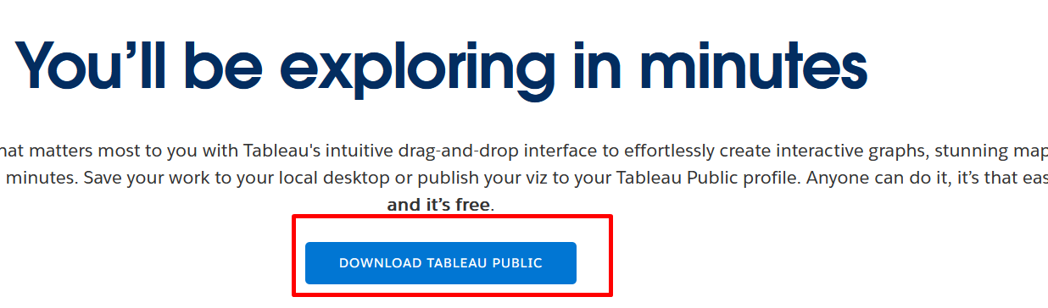
Tableau Installation
  Download and install Tableau Public
    Download and install the latest version of Tableau Public from
    https://www.tableau.com/products/public/download
    Click on Download Tableau Public

Slide 5
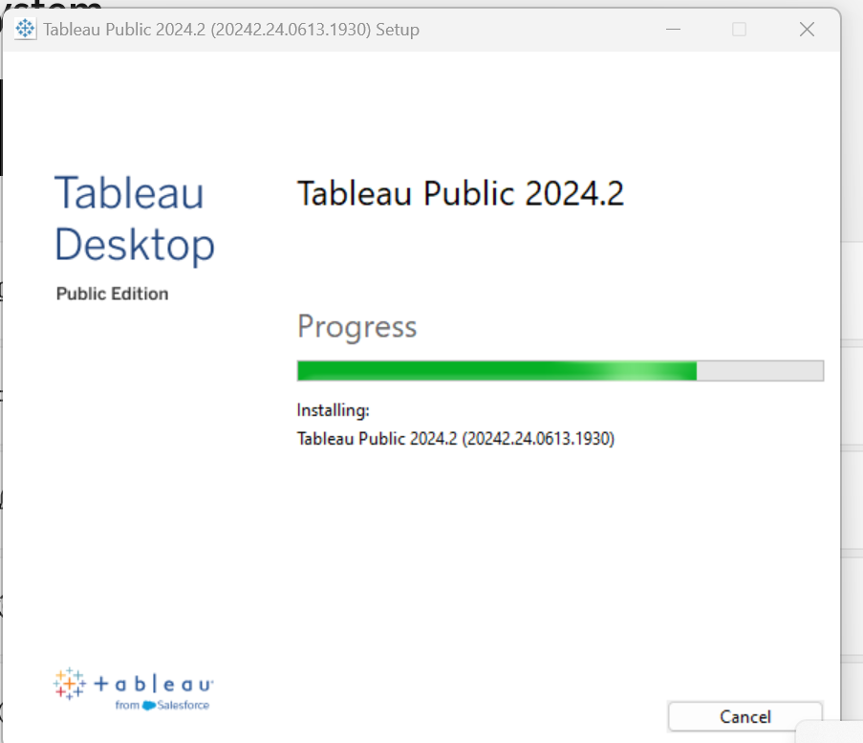
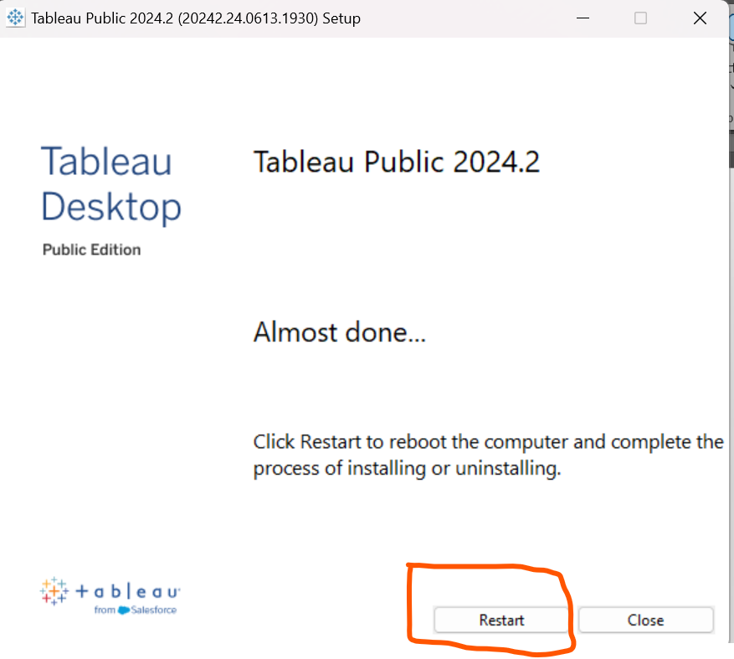
Tableau Installation
Run the EXE installer and follow the setup steps.
Restart your machine and its done

