Slide 1
Session Details and Requirements
Executive Development in Data Visualization

Slide 2
Session Details and Requirements
Session Details :
Discussion on importance of visualization
Overview of PowerBI application and its features
Hands on Exercise on Netflix streaming data (data is shared along with this ppt)
  Requirements
  PowerBI should be installed before the session (Instruction provided in following slides)
  Everyone has to do the exercise along with the instructor

Slide 3
Supported Operating Systems
Windows 10, Windows Server 2012 R2, Windows Server 2012, Windows 8, Windows 8.1, Windows Server 2016, Windows Server 2019, Windows 11
Microsoft Power BI Desktop is available for 32-bit (x86) and 64-bit (x64) platforms.
Microsoft Power BI Desktop requires Internet Explorer 10 or greater and PowerBI services can be accessed on latest version of almost all the web browsers like Firefox and Chrome
**PowerBI Desktop is Not Available for Mac

Slide 4
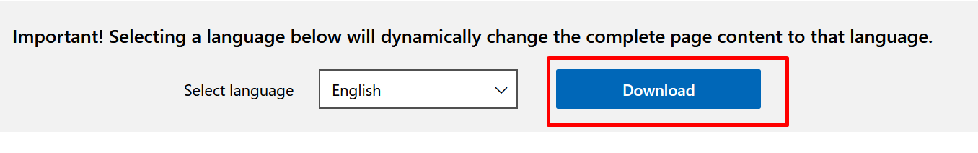
PowerBI Installation
  Download and install Power BI Desktop
    Download and install the latest version of Power BI Desktop from
    https://www.microsoft.com/en-us/download/details.aspx?id=58494
    Click on Download

Slide 5
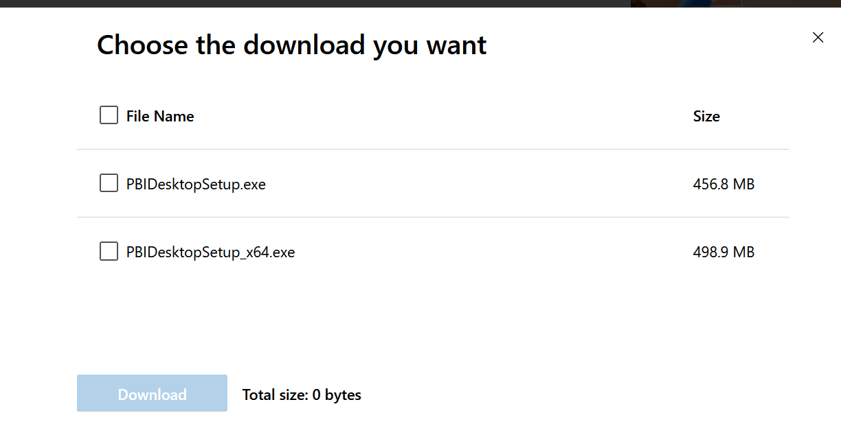
PowerBI Installation
Download the version of Power BI Desktop that matches the architecture (x86 or x64) of your Windows OS
Run the EXE installer and follow the setup steps.

