Slide 1
Understanding
Brand Positioning

Slide 2
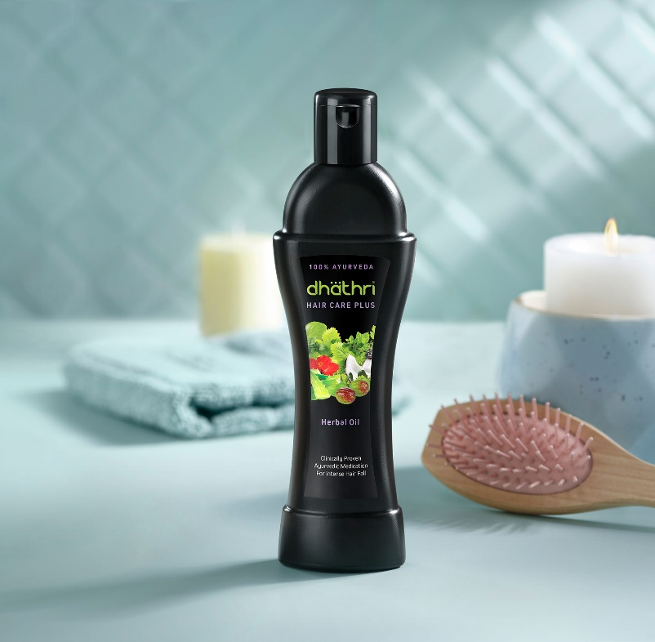

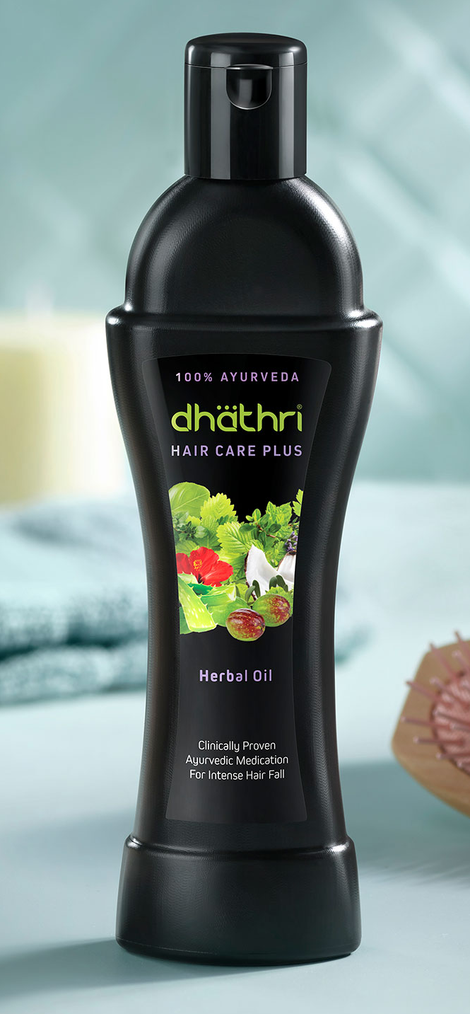
Dhathri Ayurveda
Dhathri Ayurveda introduced as a consumer brand in 2003 after its hair oil product generated huge demand. Today, Dhathri Ayurveda is a popular South Indian brand of Ayurvedic products with a gross merchandise value of up to Rs 8 crore per month.
Dhathri has over 100 products in the personal care and beauty segment.
Competition from Himalaya Herbals, Khadi Natural, Vaadi Herbals, Indulekha, Parachute, and Biotique

Slide 3
Hair Care Products | Dhathri Hair Care Herbal Oil | Dhathri Hair Care Plus Herbal Oil | Dhathri Daily Hair Oil | Dhathri Anti Dandruff Oil | Dhathri Neelibhrigadi Keram | Dhathri Hair Protector
Size |  | High Market value/Flagship product/ fastest selling product
Geography | South India | South India | South India | Kerala | Kerala | Kerala
Form | Liquid | Liquid | Liquid | Liquid | Liquid | Cream
Functional | Promotes hair growth Maintains healthy hair | Control intense hair fall, Strengthens hair | Moisturizes hair Non-greasy | Relieves dandruff Alleviates itching | Nourishing Promotes regrowth Repairs damage | Prevents dryness Non-sticky Nourishing
Emotional | No chemicals/100% Herbal | Premium than Dhathri Hair Care Herbal Oil | Substitutable to normal oil / Regular use | Dandruff problems | Kerala’s own / 100% herbal / black hair | Fight against baldness
Price point | 100 ml: Rs. 195 | 100 ml: Rs. 275 | 90 ml: Rs. 95 | 100 ml: Rs. 150 | 100 ml: Rs. 95 | 50 gm: Rs. 376
Target Group | Women | Women | Women | Men & Women | Women | Men & Women

Slide 4
“A position that takes into consideration not only a company’s own strengths and weaknesses, but those of its competitors as well.” (Ries & Trout, 2001)
“Positioning is not what you do to a product. Positioning is what you do to the mind of the prospect. That is, you position the product in the mind of the prospect.” (Ries & Trout, 2001)

Slide 5
Brand Building Components
Brand Positioning Model: How to establish competitive advantage in consumers in the market place.
Brand resonance Model: Resonating with the above, reinforcement, intense transactions leading to loyalty.
Brand value Model: Tracing the value creating process, financial impact of expenses and investment in creating loyalty

Slide 6
Brand Positioning
The act of designing the company’s offer and image so that it occupies a distinct and valued place in the target customer’s mind.
Finding a location in consumer’s mind
Facilitates marketing strategy
  In defining a brand
  Uniqueness
  Similarity on competition- Points of parity- “no reason-why not”
  Differentiation on competition- Points of differentiation- “ reason why”
  Reason to buy

Slide 7
STP
B2B
Nature of goods
Kind
Where used
Type of Buy
Buying conditions
Purchase location
Who buys
Type of Buy
Demographic
Type of org
No of employees-SME, MSME
No pf Production workers
Annual Sales
No of establishments
Targeting
  Is it critical?
  How- Broad-Fusion-Fine
  Trade offs
Segmentation
  Behavioral - User, Usage, Usage, Benefit, Loyal
  Demographic - Age, Income etc
  Psychographic - VAL, Opinions
  Geographic – Regional, National, International

Slide 8
Membership-POP-POD
What is the competitive context? With which product category should the brand be associated?
Critical in establishing
  Attribute listing and clear communication (BMW) The ultimate driving machine- Performance & Luxury
  Leverage equity of Another Equity
  Redefine the relationship
Straddling Positions
Updating Positioning
Laddering-Growth –expansion
Reactive
  Do nothing/ Defensive / Offensive

Slide 9
Key characteristics of Good positioning
Sustain with time and future proof
  What a brand is and what it could be
Aspirational
Room to grow and improve
Points of parity- critical
Consumer points of view

Slide 10
Most important
Relevance is priority #1. Customers must find the brand appealing. If not, the brand won’t make it into the consideration set, regardless of how differentiated or credible it is.
Differentiation is critical and the key driver of positioning success. The brand must be unique vs. competitive offerings.
Credible and attainable is the final measure. If you cannot credibly provide the offering, the customer is left with an empty promise.

Slide 11

Positioning strategies
Positioning based on product characteristics
Using product characteristics or benefits as a positioning strategy associates your brand with a particular feature beneficial to customers.
Brands consistently communicate a unique benefit or characteristic of the product with consumers.
https://www.youtube.com/watch?v=_0E-ZVBtmcM

Slide 12
Positioning basis price
In house brand
Identified segments
Penetration- Entry Strategy

Slide 13
Positioning based on quality or luxury
Often the price and quality of a product align, certainly in the consumer's mind, as the high price is often associated with high quality.
However, positioning a product based on its high quality or ‘luxury’ is different from positioning based on price.
No Price- But Desire communication
Does not men quality, Out come of long-term brand luxury positioning strategies---Mercedes in India

Slide 14
Positioning based on product use or application
Fitness
Weight reduction
Dental Services
Facial beauty

Slide 15
Positioning based on the competition
Competitor based positioning focuses on using the competition as a reference point for differentiation.
Brands highlight a key difference their product/service offers in their marketing to make it seem favorable and unique compared to other marketplace options. The product or service becomes unique.
Brand extension with newer benefits

Slide 16
Positioning
USP?

