Slide 1
PLC - Concepts

Slide 2
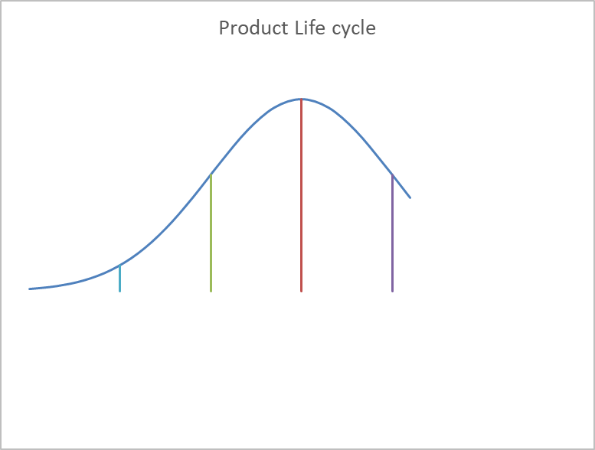
The Concept
1960’s –Gaining Importance
Value/Qty
Time

Slide 3
Characteristics Intro Growth Maturity Decline
Sales Low Fast Slow to Decline Decline
Customers Early Adopters Spread-Mass Spread-Mass Laggards
Competitors Few Growing Me too’s flocking Takeovers/Push
Cash Flows Negative Moderate High Low
Key Actionables Intro Growth Maturity Decline
Strategy Mkt Expand Penetration Defend Share Productivity
Mktg focus Awareness Brand Preference Loyalty Image-??
Promotions
Pricing
Product

Slide 4
Dimethoate
KL

Slide 5
Hexaconazole
KL

Slide 6
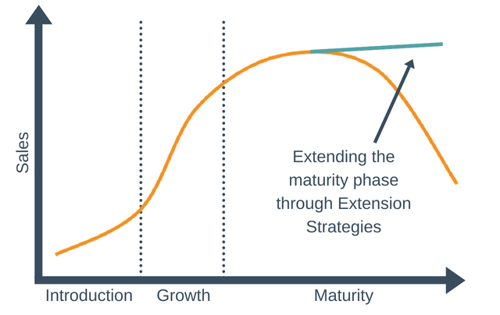
Product extensions

Slide 7



Innovations for user convenience
Increasing competition & choices to customers made product managers to customize the product offerings / Building convenience
Building convenience: Saaf/ Saafilizer
  SAAF itself was an innovation that came as an offshoot of farmer practice
  Eventually, it was observed that famers were using it as soil application along with fertilisers
  This gave birth to SAAFILIZER
  SAAFILIZER gr was a further innovation done keeping user convenience in mind

Slide 8
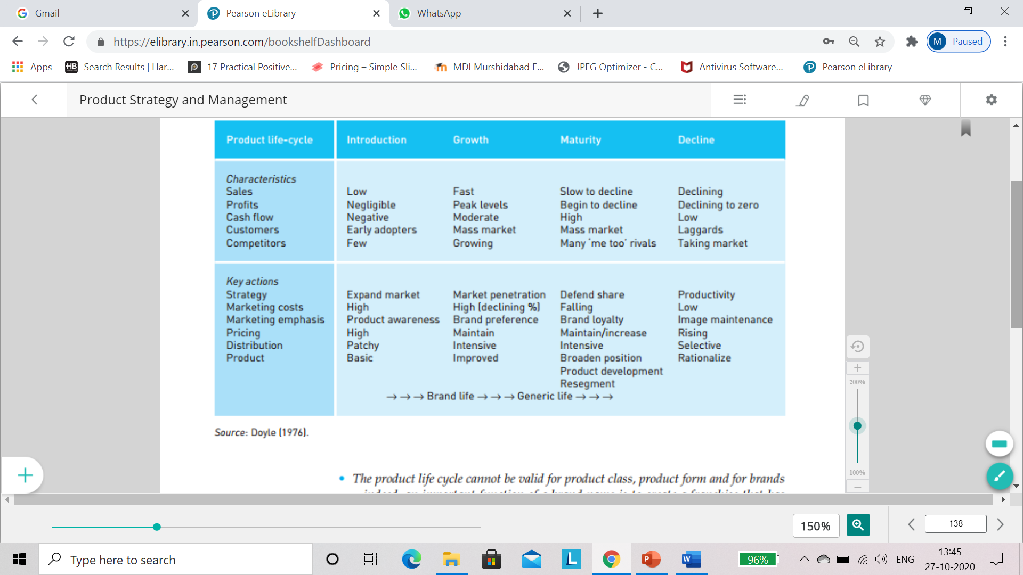

Slide 9
Extended
Life cycle
Gestation
Time to Market- Mckinsey Study 1990
PLC-5 years
Growth-15%
Price erosion- 12%
6 month delay within budget though will erode 50% profit potential
Budget over run, but on time…4% impact to profit potential
Saturation
Extended Maturity
Pricing value erosion- Double edged- leverage Vs erosion
Me tooos….Top 3-4 control markets-Erosions
Gestation
Launch-Introduction
Growth
Maturity
Saturation
Decline
Elimination/ Withdrawal
Introduction delays
Capacity
Bugs
Distribution-Placement
Decline
Impact on large players-last
Extinction
Exit barriers –will drag it longer
TCO- concept kicks in at consumer level
Growth
Push & Pull factors
Dissonance
Associations
Objects of Desire
Decline
Impact on large players-last
Extinction
Exit barriers –will drag it longer
TCO- concept kicks in at consumer level
Maturity
Tapered growth
Gains through competing shares
No category development or substitute applications
Differentiation kicking in..Value adds like Plus, advanced etc

