Slide 1
The Value of Common Stocks

Slide 2
Stocks &
Stock Market
Primary Market
Market in which shares are first sold to the investors.
Secondary Market
Market in which already issued securities are traded by investors.

Slide 3
Stocks & Stock Market
Market order : buy or sell order at best market price
Limit order : buy or sell order at a stated price
Dividend - Periodic cash distribution from the firm to the shareholders
VALUATION MULTIPLES
P/E Ratio - Price per share divided by earnings per share
P/B Ratio – Price per share divided by book value per share

Slide 4
Factor | P/E Ratio | P/B Ratio
What it Measures | Earnings-based valuation | Asset-based valuation
Best for | Profitable, growth companies | Asset-heavy businesses
Common Sectors | Tech, FMCG, services, banking | Banks, real estate, manufacturing
Useful When | Earnings are stable and positive | Company has significant tangible assets
Limitations | Cannot be used for loss-making firms | Not useful for asset-light companies

Slide 5
Stock Price Information
https://www.moneycontrol.com/india/stockpricequote/refineries/relianceindustries/RI
https://www.moneycontrol.com/india/stockpricequote/computers-software/tataconsultancyservices/TCS

Slide 6
Valuation by Comparable Multiples
 | Year | Sales (Rs. Cr) | BV | EPS | Price Date | Price | PE
Hero Motocorp | Mar-18 | 32,230.49 | 589.29 | 183.17 | 02-Nov-18 | 2892.60 | 15.79
Scooters India | Mar-18 | 15,129.66 | 60.63 | 14.27 | 02-Nov-18 | 554.40 | 38.85
Atul Auto | Mar-18 | 555.98 | 100.00 | 22.18 | 02-Nov-18 | 360.00 | 16.23
 |  |  |  |  | Average |  | 23.62
Bajaj Auto | Mar-18 | 25,164.92 | 660.19 | 148.6 | Price |  | 3510.43
Source: https://www.moneycontrol.com/stocks/data-bank/standalone/auto-2-3-wheelers.html

Slide 7
Comparable Multiples Method
It gives an estimate of the value assuming that the firm that we are considering is similar to the other firms in the industry.
Since profitability and growth opportunities may be different for different firms in the same industry, this will help us get to a possible range of values for the given firm.
The value that is obtained using industry P/E, P/B or other multiples will give us a range of possible values, but will require effort to narrow down this range.
Valuation by comparables is most useful when you don’t have a stock price, example for pricing IPOs or acquisition of an unlisted firm.

Slide 8
How Common Stocks are Valued
Discounted Cash Flow (DCF) Formula
  Value of a stock = present value of future cash flows

Slide 9
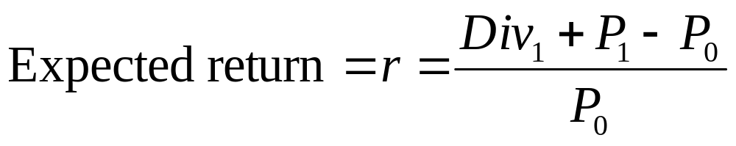
How Common Stocks are Valued
Expected Return
  Percentage yield forecast from specific investment over time period
  Sometimes called market capitalization rate
Expected Return= Dividend Yield + Capital Appreciation

Slide 10
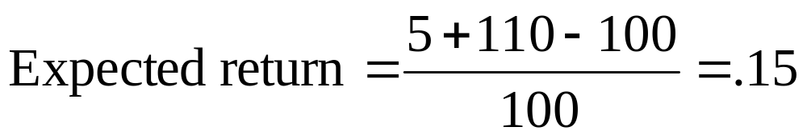
How Common Stocks are Valued
Example
  Ashok Leyland sells for Rs.100 per share today; they are expected to sell for Rs.110 in one year. What is expected return if dividend in one year is forecasted to be Rs.5.00?

Slide 11
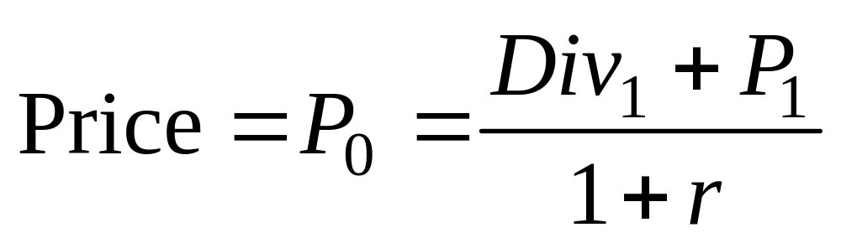
How Common Stocks are Valued
Price of share of stock is present value of future cash flows
For a stock, future cash flows are dividends and ultimate sales price

Slide 12
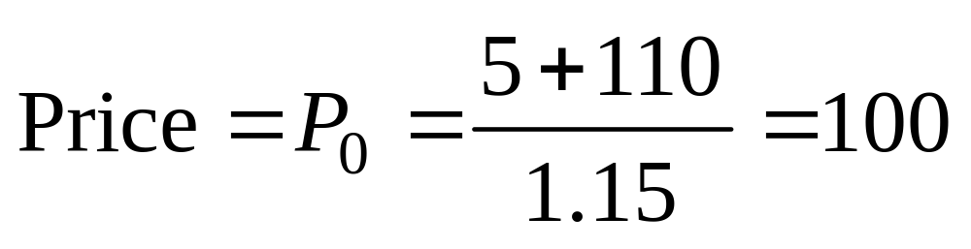
How Common Stocks are Valued
Example
  Ashok Leyland price

Slide 13
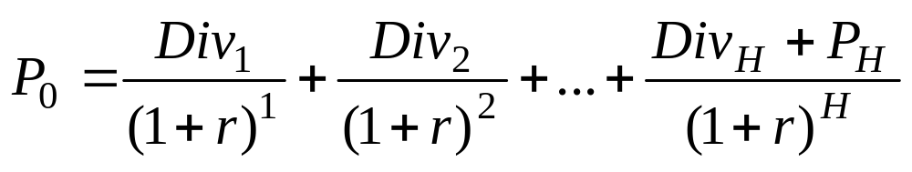
How Common Stocks are Valued
Dividend Discount Model
  Computation of today’s stock price: share value equals present value of all expected future dividends
    H: Time horizon for investment

Slide 14
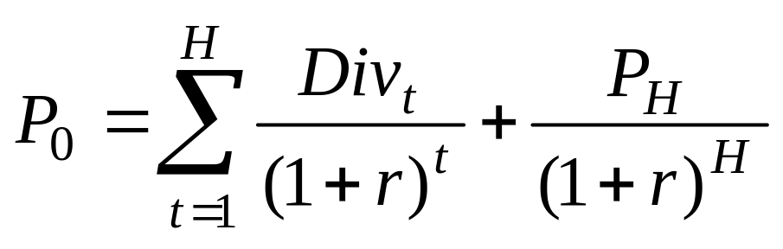
How Common Stocks are Valued
Modified Formula

Slide 15
How Common Stocks are Valued
Example
  Ashok Leyland forecasted to pay Rs. 5.00 dividend at end of year 1 and Rs. 5.50 dividend at end of year 2. End-of-second-year stock will be sold for Rs.121. Discount rate is 15%. What is the price of stock?
  Div1 = 5.00 Rs
  Div2= 5.50 Rs
  P2=121 Rs.
  R=15%

Slide 16
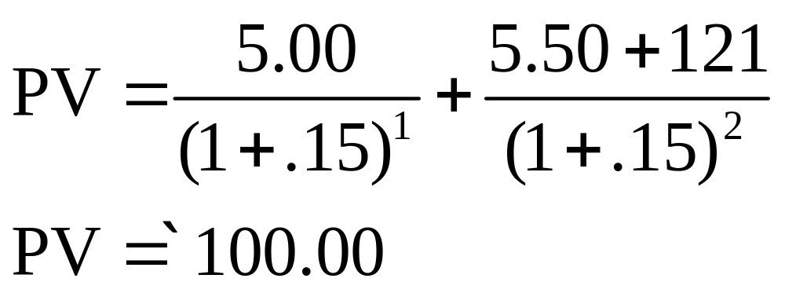

Slide 17
How Common Stocks are Valued
 | Expected Future Values |  | Present Values
Horizon Period (H) | Dividend (DIVt) | Price (Pt) | Cumulative Dividends | Future Price | Total
0 |  | 100.00 |  |  | 100
1 | 5.00 | 110.00 | 4.35 | 95.65 | 100
2 | 5.50 | 121.00 | 8.51 | 91.49 | 100
3 | 6.05 | 133.10 | 12.48 | 87.52 | 100
4 | 6.66 | 146.41 | 16.29 | 83.71 | 100
10 | 11.79 | 259.37 | 35.89 | 64.11 | 100
20 | 30.58 | 672.75 | 58.89 | 41.11 | 100
50 | 533.59 | 11739.09 | 89.17 | 10.83 | 100
100 | 62639.15 | 1378061.23 | 98.83 | 1.17 | 100
Dividends increase at 10% per year, compounded; Capitalization rate is 15%

Slide 18
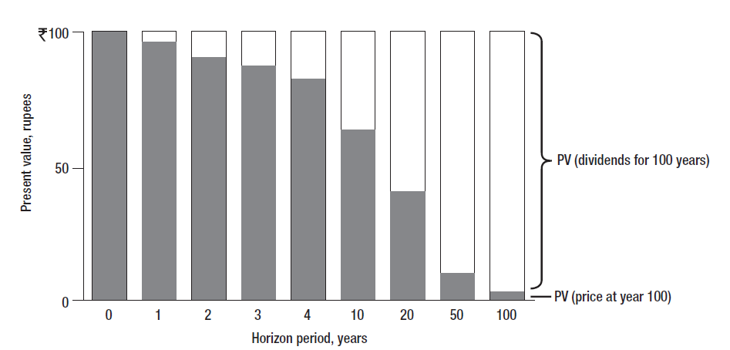
How Common Stocks are Valued
As you increase investment horizon, the present value of the future price declines and the present value of the stream of dividends increases.

Slide 19
How Common Stocks are Valued
Example
  XYZ Company will pay dividends of Rs.3, Rs.3.24, and Rs.3.50 over next three years. After three years, stock sells for Rs.94.48. What is the price of stock given 12% expected return?

Slide 20
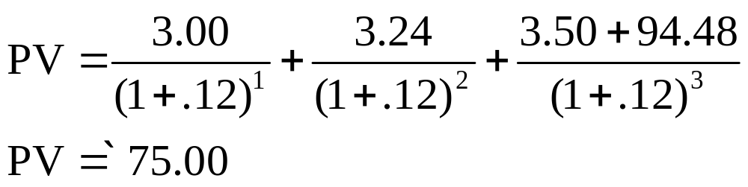

Slide 21
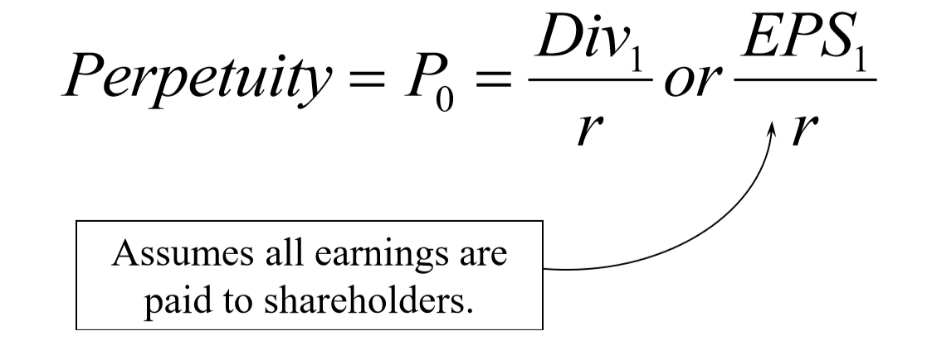
How Common Stocks are Valued
If we forecast no growth, and plan to hold out stock indefinitely,
we will then value the stock as a PERPETUITY.

Slide 22
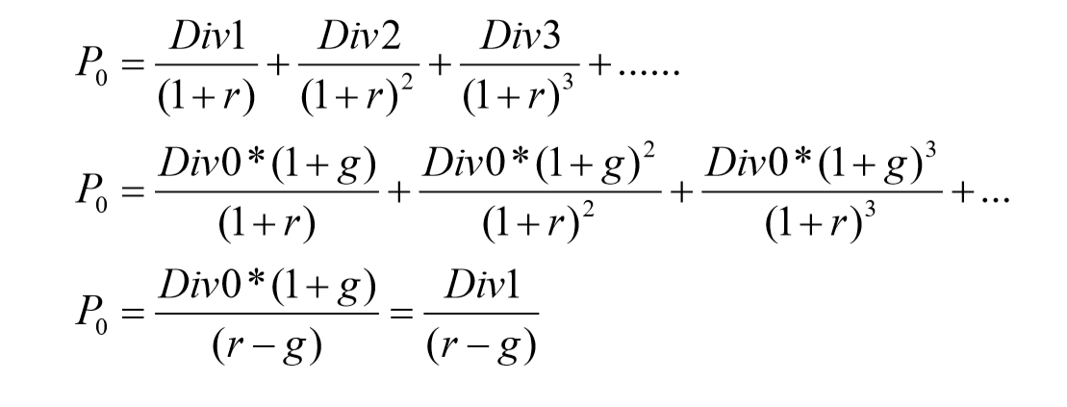
Constant Growth DDM(Gordon Growth Model).
- A version of the dividend growth model in which dividends grow at a constant rate
Please note: This model assumes constant growth rate, g < r.

Slide 23
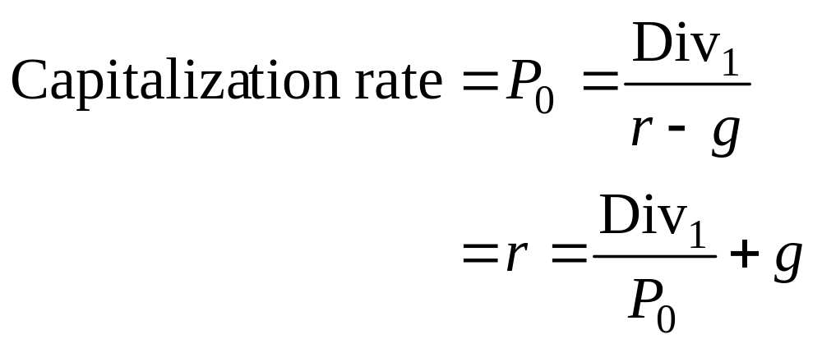
How Common Stocks are Valued
Market Capitalization Rate
  Estimated using perpetuity formula
  Also called cost of equity capital

Slide 24
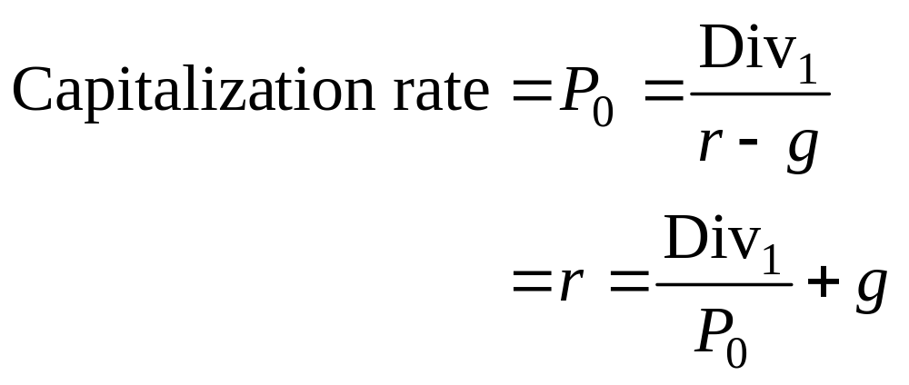
Example
If a stock is selling for $100 in the stock market, dividend in next period is expected to be $3, dividends in future are expected to grow at a constant growth rate for ever, and the market capitalization rate is 12%, what might the market be assuming about the growth in dividends?
The market is assuming the dividend will grow at 9% per year, indefinitely

Slide 25
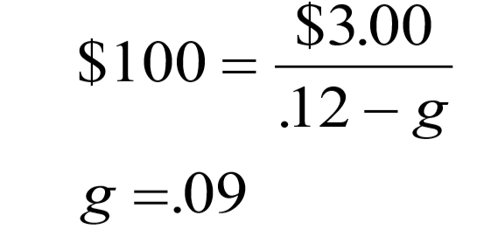

Slide 26
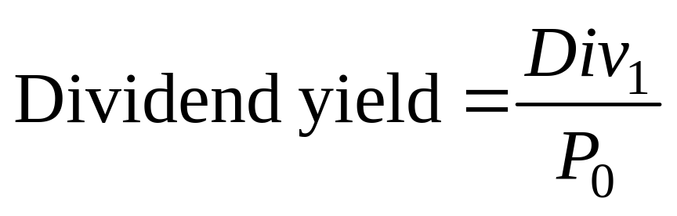
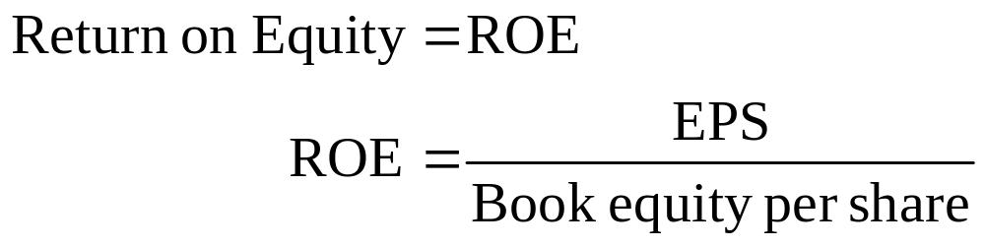
Return Measurements

Slide 27
How Common Stocks are Valued
Payout Ratio - Fraction of earnings paid out as dividends
Plowback Ratio - Fraction of earnings retained by the firm
Dividend Growth Rate
  Derived by applying return on equity to percentage of earnings reinvested in operations
    g = return on equity × plowback ratio
If a firm elects to pay a lower dividend, and reinvest the funds, the stock price may increase because future dividends would be higher assuming that the firm is investing in positive NPV projects.

Slide 28
DCF Models with Two Stages of Growth
Growth Tech Inc., is a firm with Div₁=$0.50 and P₀ = $50.
The firm has plowed back 80% of earnings and has had a ROE of 25%.
Dividend growth rate = ROE x plowback ratio = 25% x 80% = 20%
Will future long term growth rate remain 20% forever?
Implied r = 0.5/50 + 20% = 21%
Eventually ROE will decline and the plowback ratio will also decline as profitability and growth opportunities for the firm decline.
To address this issue, we try to model such firms with 2 stages or 3 stages of growth.

Slide 29
Forecast Earnings and Dividends
Year | 1 | 2 | 3 | 4 | 5
Book Equity | 10.00 | 12.00 | 14.40 | 15.55 | 16.80
EPS | 2.50 | 3.00 | 2.30 | 2.49 | 2.69
ROE | 25% | 25% | 16% | 16% | 16%
Payout ratio | 0.20 | 0.20 | 0.50 | 0.50 | 0.50
Dividends per share | 0.50 | 0.60 | 1.15 | 1.24 | 1.34
Growth rate of dividends |  | 20% | 92% | 8% | 8%
P₀ = Div₁/(1+r) + Div₂/(1+r)² + (Div₃ + P₃)/(1+r)³
P₃ = Div₄/(r-g) = 1.24/(r-8%)
P₀ = 0.5/(1+r) + 0.6/(1+r)² + 1.15/(1+r)³ + (1.24/(r-0.08))/ (1+r)³ = 50
Solving for r, we get : r = 9.9%, much lower than 21%.

Slide 30
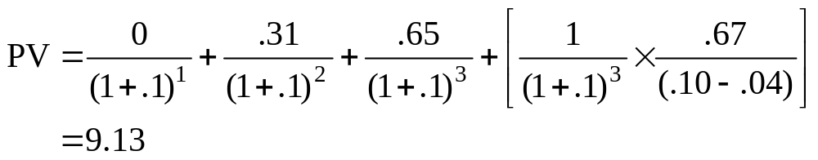
Non-constant growth
  Phoenix pays dividends in three consecutive years of 0, .31, and .65. Year-4 dividend is estimated at .67 with perpetuity growth at 4%. With 10% discount rate, what is stock price?

Slide 31
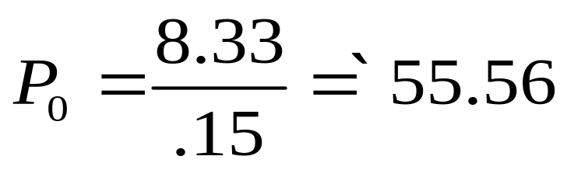
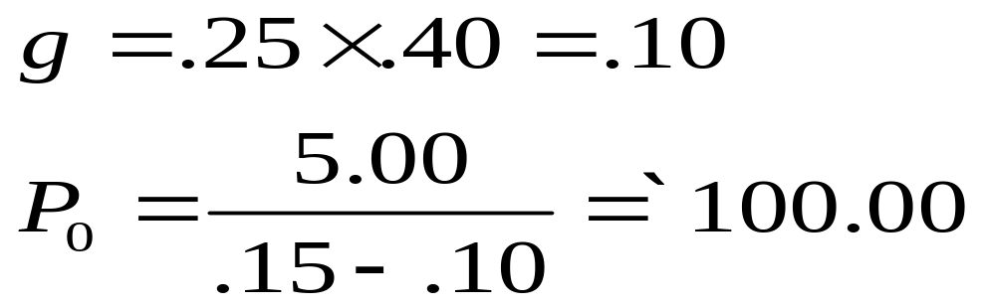
Example
  Company plans Rs. 8.33 dividend next year (100% of earnings). Investors will get 15% expected return. Instead, company plows back 40% of earnings at firm’s current return on equity of 25%. What is the stock value before and after plowback decision?
No Growth
With Growth

Slide 32
Example (Continued)
  Stock price remains at Rs.55.56 with no earnings plowed back
  With plowback, price is Rs. 100.00
  Difference is called present value of growth opportunities (PVGO)

Slide 33
Stock Price and Earnings Per Share
Present Value of Growth Opportunities (PVGO)
  Net present value of firm’s future investments
  If all EPS paid out as dividends, expected return, r = Div₁/P₀ = EPS₁/P₀
  P₀ = Div₁/r = EPS₁/r
  If firm has +ve NPV investment opportunity, then P₀ = EPS₁/r + PVGO
  Growth firms are those with PVGO being a significant proportion of their current stock price
  PRICE OF SHARE = PRICE WITHOUT GROWTH + PVGO

Slide 34
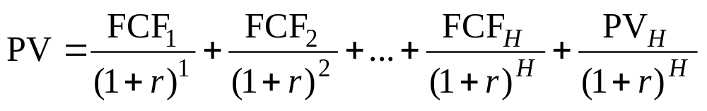
Valuing a Business
Valuing a Business or Project
  Usually computed as discounted value of FCF to valuation horizon (H)
  Valuation horizon sometimes called terminal value and calculated like PVGO
PV (free cash flows)
PV (horizon value)

