Slide 1
New Product Development
- Check & Balances

Slide 2

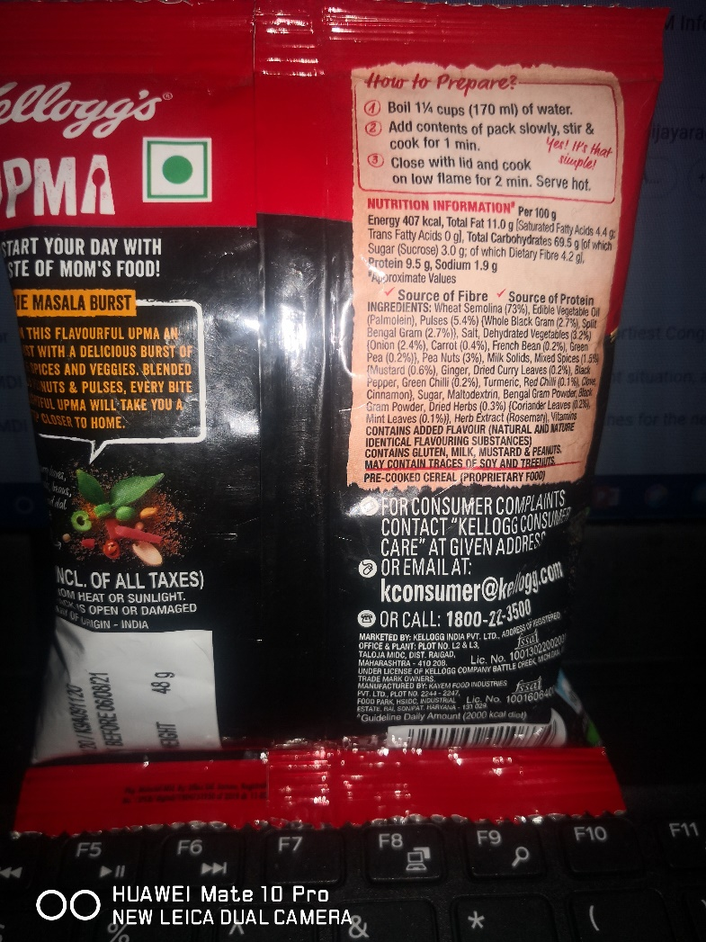

Slide 3
Discussion- Assignment
Visit Wework website and analyse the actions of the organisation and actions it is taking to get back in the business. Also do a search on Co-Working as a category. A page write up with relation to concepts of marketing learnt in the past years
https://www.wework.com/ideas/worklife/returning-to-the-office-how-wework-is-making-it-happen

Slide 4
Booze, Allen & Hamilton- BAH Model
Company Objectives
Exploration
Screening
Business Analysis
Development
Testing
Commercialisation
Product Success

Slide 5
Stage Gate model
-Revenue-Sustain & grow
-New Customers
-Existing customer-Reactive / Proactive
-Gaps in market
-Being Contemporary
Discovery
Gate 1-Idea Screen
Scoping
Building Business case
Development
Testing & Validation
Launch
Post launch
Gate 2
2nd Screen
Gate 3
Go to Development
Gate 4
Go to Testing
Gate 5
Launch

Slide 6
Testing – Concept and Product
Idea generation & Screening
Concept Testing
Customer Acceptance
Preference
Frequency
Barriers
Accepted level of appeal
Attractiveness
Features
Commercialization
Profiling mkt-Buying patterns
Need gap
Concept

Slide 7
Objectives –Customer needs and Preferences
Basic Needs Cleaning
Articulated Needs Cleaning & Sanitizing
Exciting Needs Cleaning, Sanitizing and a fragrance feel

Slide 8
Product-Focus of an exchange process
Potential
Augmented
Expected
Basic
Core

Slide 9
Product Testing
Key concerns
Realism
Sensitivity-Enabler Vs Disabler
Validity
  Examine fit
  Comparison
  Assessment- Scope of Improvement
  Evaluation effect of changes on preferences & mix
  Testing- Advertising, Selling & Packaging

