Slide 1
Innovation and Competitor Strategies
Session 4
Deepika Gupta
Asst Professor
IIM Visakhapatnam

Slide 2
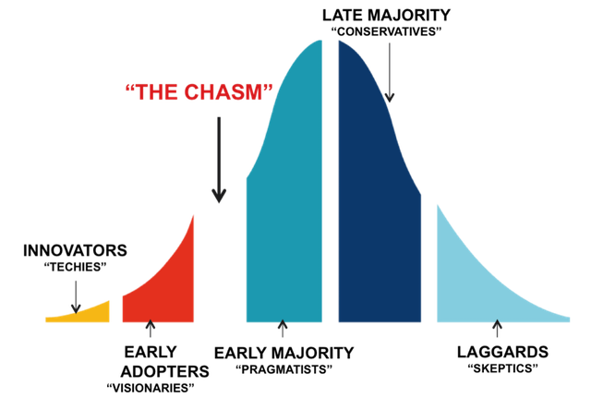
Innovation chasm
The chasm is the gap between early adopters (visionaries) and early majority (pragmatists), which make up the start of the mainstream market. This is the most difficult market to capture and often where most technologies fail to make progress.
Also called Trough of Disillusionment or The Struggle
Source: https://alyjuma.com/the-chasm/

Slide 3
Crossing the chasm
Catch 22 situation
Rethink about market approach – segmentation, differentiation, positioning, distribution and pricing
Pick a beachhead and build momentum
Dominate with whole product thinking – expand your product (Apple)
Compare and contrast with current options (Sharepoint and Dropbox)
Find solutions to questions on
  Mission clarity and importance
  Mission completion
  Integration
  Openness
  Jointness
  Timing

Slide 4
Why Competitor strategies?
The need for planning
Competitive reactions
Maintaining competitiveness

Slide 5
Strategies
PESTLE analysis
SWOT/ TOWS analysis
Porter’s five forces
Ansoff Growth Vector Matrix
BCG Growth Share Matrix

Slide 6
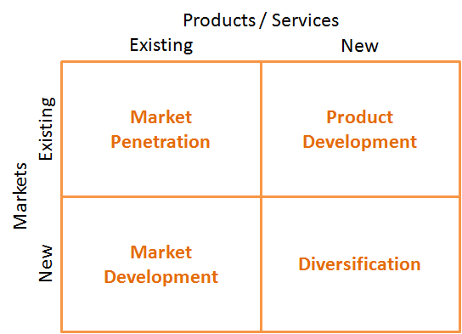
Ansoff Growth Vector Matrix

Slide 7

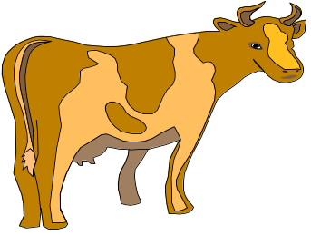

BCG Growth Share matrix
Earnings: low, unstable, growing
Cash flow: negative
Strategy: analyze the
potential to
develop the
business
into a “star”
Earnings: high stable, growing
Cash flow: neutral
Strategy: invest for
growth
?
HIGH
Annual real rate of market growth (%)
Earnings: low, unstable
Cash flow: neutral or negative
Strategy: divest
Earnings: high stable
Cash flow: high stable
Strategy: milk
LOW
LOW
HIGH
Relative market share
Copyright © 2019 John Wiley & Sons, Inc.
Notes:
44

Slide 8
Strategic alliances
Fall of go-it-alone strategy – where individual firms were competing against each other
Rise of octopus strategy – strategic alliances – strategic power resides in sets of firms acting together – importance of trust
Forms of strategic alliances
  Licensing
  Supplier relations
  Joint ventures
  Outsourcing
  Collaborations
  R&D consortia
  Industry clusters
  Innovation network

Slide 9
Octopus strategy - IBM
IBM
Toshiba to develop LCD technology
Microsoft to develop software
Siemens to develop memory technology
Hewlett-Packard to develop operating system for workstations
Cisco Systems to develop security systems
Real Networks to develop online digital services
Infineon to develop microchip technology

Slide 10
Open innovation
New model of innovation
In this model, firm is not the main source of innovation
But develops innovative products or approaches collaboration with users or individuals outside the firm
Inspired by open source software
Involves online open innovation communities and platforms
Henry Chesbrough is the major proponent of open innovation
It is a paradigm that firms can use external and internal ideas and look to advance their technologies.

Slide 11
Models of open innovation
Product platforming
Idea competitions
Customer immersions
Collaborative product design and development
Innovative networks

Slide 12
Open innovation approach
Basic research
New product development
Current market and business model
Internal research projects
Technology in-licensing
Technology acquisition
Venture investing
External research project

Slide 13
Standard vs Open Innovation Model
 | Standard R&D Model | Open Innovation
Boundaries of knowledge creation process | Clearly defined | Undefined
Participants | Experts | Anyone
Spatial dimensions | Geographically concentrated | Unbounded, virtual
Temporal dimension | Long say 3-5 years | Short say 3-6 months
Nature | Organizational process, negotiation based | Distributed virtual process
Hierarchy | Very hierarchical | No hierarchy, self selection based
Control | High control on knowledge produced | Low control on knowledge produced
Resources | Heavy resources | Relatively light resources
Legal aspects | Contractual relationships and clear IP regime | Minimal online consent contracts and unclear IP regime

Slide 14
Strategies in mature markets
Offensive strategies (based on technology newness)
  Remerchandizing
  New use
  Reformulation
  Product improvement
  Market extension
  Product line extension
Defensive strategies - involves incentives to intermediaries and end users (price cuts, promotions etc.) which reinforce customer loyalty and make the market less attractive to new entrants.
Recycle -involve attempts to reposition the product, usually with a new market segment, so as to initiate a new growth cycle.
Stretching and harvesting strategies usually involve some form of reformulation or product line extension

Slide 15
Service innovation … different from physical products?
Intangibility
Inseparability
Variability
Perishability
Impossibility of ownership

Slide 16
Schools of thought
First school of thought - Products and services are two faces of the same coin and the principles and practices of marketing are equally applicable to both
Second school of thought – do not subscribe to above and claims that they are important and significant differences between products and services such that they require separate marketing approach
Third school of thought – the basic principles apply to both but that the distinctive nature of services calls for extended marketing mix comprising of 7Ps – that is, 4Ps of Product, Price, Place and Promotion plus Process, Physical evidence and People

Slide 17
Service as a process
Service as a process
Services are co-produced by consumers
Services are perishable
Services are intangible
Services are produced and consumed simultaneously
Services are heterogenous

Slide 18
Types of services
Business to Business
Business to Customers
Internal firm services
Public services
Not for profit services
Any other

Slide 19
Company’s strategic service vision
James Heskett developed a framework for formulating a strategic service vision
This framework comprises of four basic elements
  Target market – identify market segments, dimensions of segmentation
  Service concept – design, delivery and marketing of deliverables
  Operating strategy – operations, allocating resources, quality and cost control
  Service delivery system – role of people, procedure, equipment, technology and system capacity

Slide 20
Use of innovative capabilities
These support service vision
Defined as comprehensive set of characteristics of an organization that facilitate and support its innovative strategies
Capabilities such as technology, knowledge, processes and experience exist at both corporate and business unit levels
Burgelman, Kosnik and de Poel propose an innovative capability audit framework to evaluate such capabilities based on five dimensions
  Resource availability and allocation
  Capacity to evaluate competitor’s innovative capabilities
  Capacity to understand technological development
  Structural and cultural context
  Strategic management capacity

Slide 21
Service Innovation process – Sequential model
Idea generation
Formulation of new service objective/ strategy
Evaluation
Idea screening
Concept testing
Realisation
Service design and testing
Process and system design and testing
Idea generation
Concept development
Business analysis
Project authorization
Marketing programme design and testing
Personnel training
Service testing and plot run
Test marketing
full-scale launch
Post-launch review

Slide 22
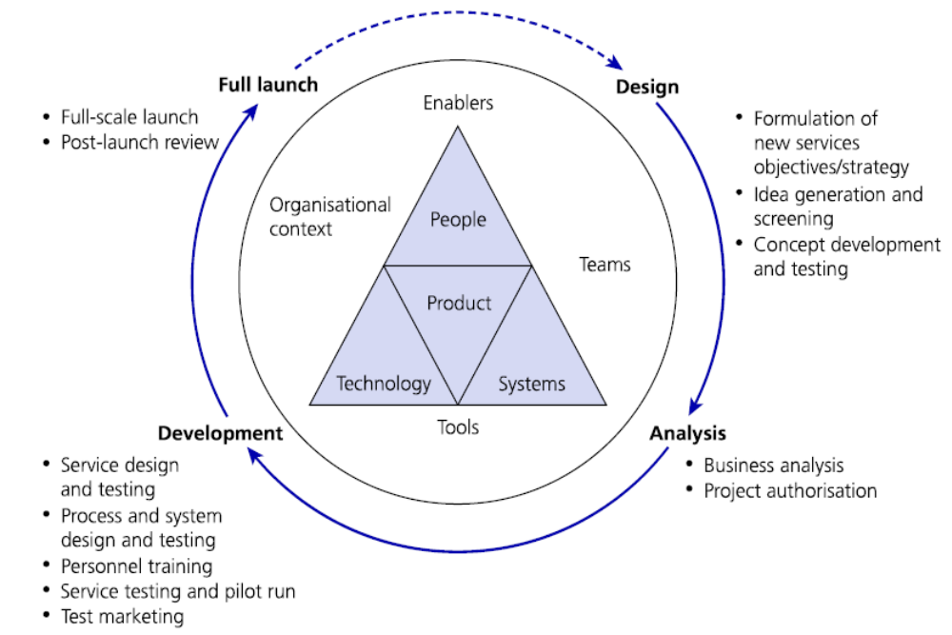
New service development cycle

Slide 23
Categories of service innovations
Process innovation – for efficiency improving for customer Eg: self-service for customer to create value
Brand innovation – for differentiation Eg: free after sales services for premium products
Experience innovation – for newness to customers Eg: new type of holiday packages
Social innovation – for better world. Eg: free food packets to workers
Business model innovation – for scaling up, profitability and sustainability Eg: charging for new articles on internet
Behaviour innovation – new behavioural pattern of customers Eg: various services through smartphones changed customer behaviour

Slide 24
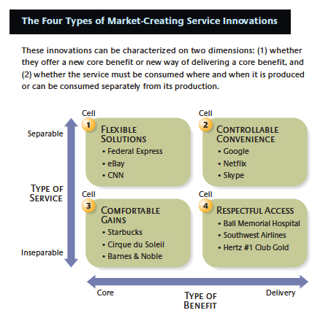

Slide 25
Nine drivers of market creating service innovations
Scalable business model
Customer-experience management
Employee performance investment
Continuous operational innovations
Brand differentiation
Innovative champion
Superior customer benefit
Affordability
Continuous strategic innovation

Slide 26
Link for reading book…..
Paul Trott – Innovation management and new product development
  https://ftp.idu.ac.id/wp-content/uploads/ebook/ip/BUKU% 20MANAJEMEN%20INOVASI/Innovation%20Management%20and%20New%20Product%20Development%20(%20PDFDrive%20).pdf

Slide 27
Thank you !!

