Slide 1
Valuing Bonds

Slide 2
Basics
What is debt?
  It is a financial claim.
Who issues it?
  The borrower of funds
    For whom it is a liability
Who holds it?
  The lender of funds
    For whom it is an asset

Slide 3
Basics (Cont…)
Difference between debt and equity?
  Debt does not confer ownership rights
  It is merely an IOU
    A promise to pay interest at periodic intervals (contractual obligations)
    And to repay the principal at a pre-specified maturity date.
  It usually has a finite life span
    Borrowers are required to make payments irrespective of their financial performance
Interest payments to be made before any dividends for equity holders.
    In the event of liquidation, the claims of debt holders must be settled first

Slide 4
Fixed Income Securities
Bonds and debentures are termed as Fixed Income Securities
  Once the rate of interest is set at the onset of the period for which it is due
    It is not a function of the profitability of the firm
  Failure to pay the promised interest will tantamount to default

Slide 5
Basics (Cont…)
Bonds may be secured or unsecured
  Unsecured debt securities are termed as Debentures in the US
  Unsecured means no specific assets have been earmarked as collateral
  Secured debt requires the firm to earmark specific assets as collateral
  Secured debt holders enjoy priority from the standpoint of payments

Slide 6
Basics (Cont…)
Debt securities may be negotiable or non-negotiable
  Negotiable securities can be traded in the secondary market
    Can be endorsed by one party in favor of another
  Examples of non-negotiable debt securities
    National savings certificates
    Conventional Time or Fixed deposits

Slide 7
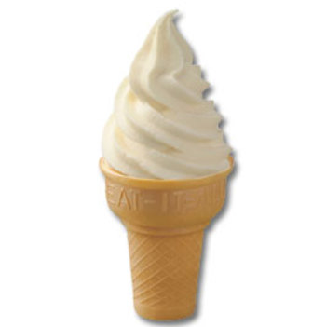
Plain Vanilla & Bells and Whistles
The most basic form of a bond is called the Plain Vanilla version.
More complicated versions are said to have
`Bells and Whistles’ attached.

Slide 8
Bond Terminology
  Face Value
  It is the principal value underlying the bond
    It is the amount payable by the borrower to the last holder at maturity
    It is the amount on which the periodic interest payments are calculated
Term to Maturity
  It is the time remaining in the life of the bond
    It represents the length of time for which interest has to be paid as promised
    It represents the length of time after which the face value will be repaid

Slide 9
Bond Cash Flows, Prices, and Yields
  Coupon
    The coupon payment is the periodic interest payment that has to be made by the borrower.
    The coupon rate when multiplied by the face value gives the dollar value of the coupon.
Consider a bond with a face value of $1000. The coupon rate is 8% per annum paid annually. So, the bond holder will receive
1000 x 0.08= $80 annually.

Slide 10
Bond Cash Flows, Prices, and Yields
Yield to Maturity (YTM)
  the rate of return for an investor if he buys the bond at the prevailing market price and holds it till maturity.
At any point in time the YTM may be
  Greater than
  Less than or
  Equal to the Coupon Rate
YTM is the IRR of a bond

Slide 11
Value of a Bond
A bond holder gets a stream of contractually promised payments.
The value of the bond is the value of this stream of cash flows.
However, you cannot simply add up cash flows arising at different points in time.
  Cash flows have to be discounted before being added.

Slide 12
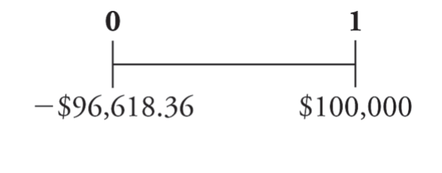
Zero-Coupon Bonds
Does not make coupon payments
Sells at a discount (a price lower than face value), so they are also called pure discount bonds
Treasury Bills are U.S. government zero-coupon bonds with a maturity of up to one year.
Eg: Suppose that a one-year, risk-free, zero-coupon bond with a $100,000 face value has an initial price of $96,618.36.
Although the bond pays no “interest,” your compensation is the difference between the initial price and the face value.

Slide 13
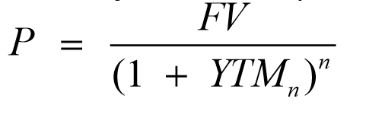
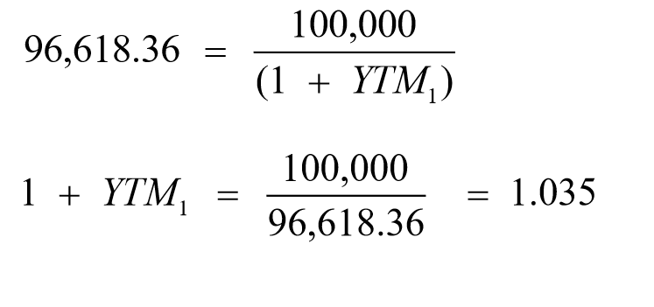
Zero-Coupon Bonds
Yield to Maturity – The discount rate that sets the present value of the promised bond payments equal to the current market price of the bond.
Price of a Zero-Coupon bond
YTM for the one year zero coupon bond is 3.5%

Slide 14
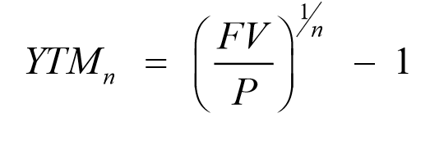
Zero-Coupon Bonds
Yield to Maturity of an n-Year Zero-Coupon Bond

Slide 15
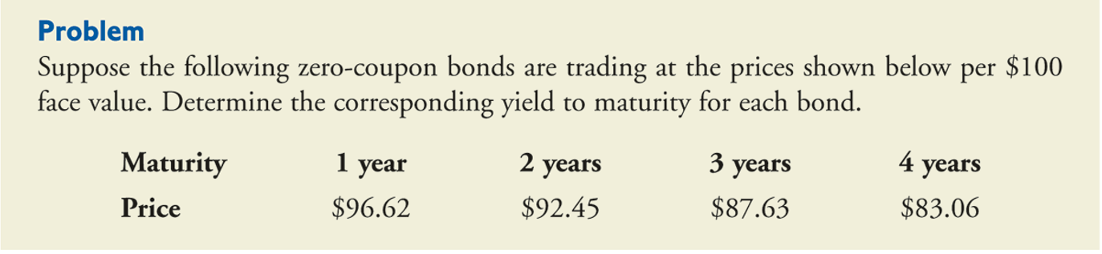
Yields for Different Maturities

Slide 16
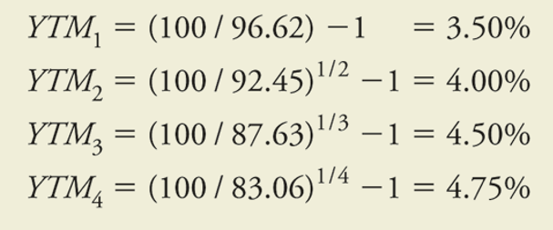
Yields for Different Maturities

Slide 17
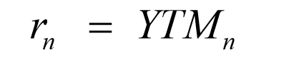
Zero-Coupon Bonds
Risk-Free Interest Rates
A default-free zero-coupon bond that matures on date n provides a risk-free return over the same period.
Thus, the Law of One Price guarantees that the risk-free interest rate equals the yield to maturity on such a bond.
Risk-Free Interest Rate with Maturity n

Slide 18
Coupon Bonds
Coupon Bonds
  Pay face value at maturity
  Pay regular coupon interest payments
  Notes
  coupon security with original maturities of 1–10 years
  Bonds
  coupon security with original maturities over 10 years

Slide 19
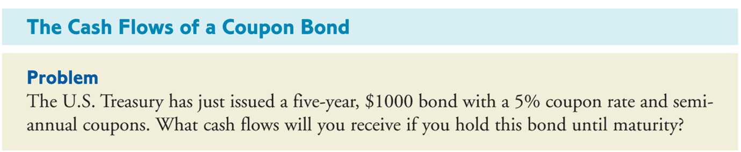
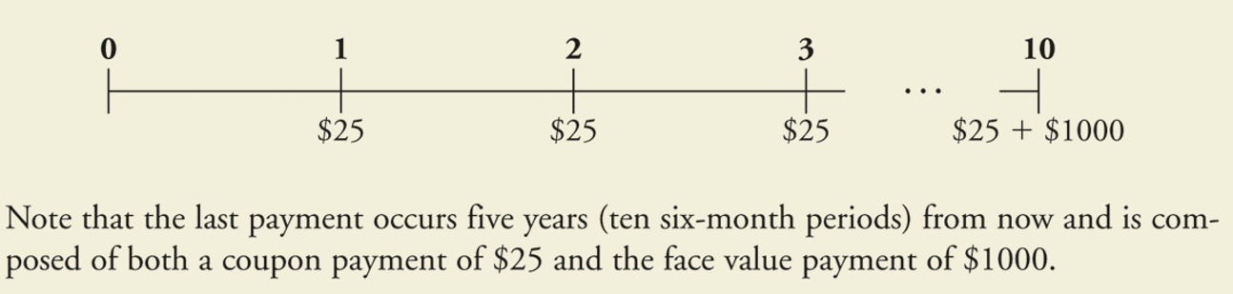
Example

Slide 20
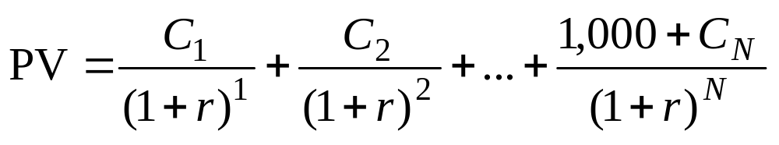
Using the Present Value Formula to Value Bonds

Slide 21
Par, Discount & Premium Bonds (Cont…)
If the yield were to equal the coupon
  The bond would sell at PAR
  Such bonds are called PAR Bonds
If the yield is less than the coupon
  The price will exceed the face value.
  Such bonds are called Premium Bonds

Slide 22
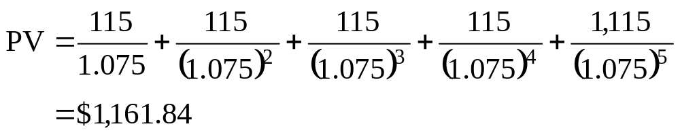
Using the Present Value Formula to Value Bonds
Example
  What is the value of the following bond? An IBM bond pays $115 every December for five years. In December 2024, it pays an additional $1,000 and retires the bond. The bond is rated AAA. YTM is 7.5%.

Slide 23
Using the Present Value Formula to Value Bonds
Another Example: Japan
  In July 2020 you purchase 200 yen of bonds in Japan which pay an 8% coupon every year. If the bond matures in 2025 and the YTM is 4.5%, what is the value of the bond?

Slide 24
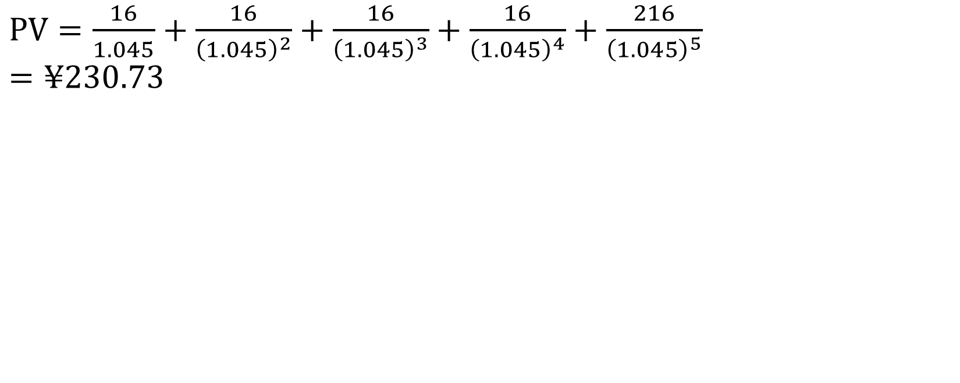
$\text{PV}=\frac{16}{1.045}+\frac{16}{{\left(1.045\right)}^{2}}+\frac{16}{{\left(1.045\right)}^{3}}+\frac{16}{{\left(1.045\right)}^{4}}+\frac{216}{{\left(1.045\right)}^{5}}$
$=¥230.73$

Slide 25
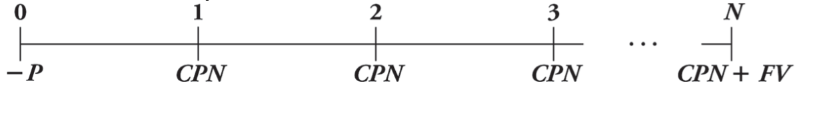
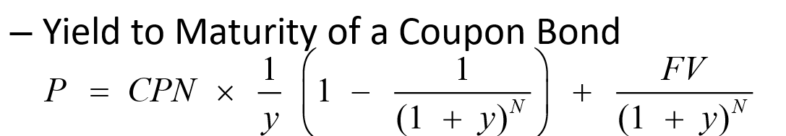
Coupon Bonds
Yield to Maturity – The YTM is the single discount rate that equates the present value of the bond’s remaining cash flows to its current price.

Slide 26
Example
Computing the yield to maturity of a coupon bond
Consider the five-year, $1000 bond with a 5% coupon rate and semi annual coupons. If this bond is currently trading for a price of $957.35, what is the bond’s yield to maturity?

Slide 27
Par, Discount & Premium Bonds
If the price is less than the face value
  Such a bond is called a Discount Bond
    It is trading at a discount from the face value.
The reason is that
  The yield is greater than the coupon

Slide 28
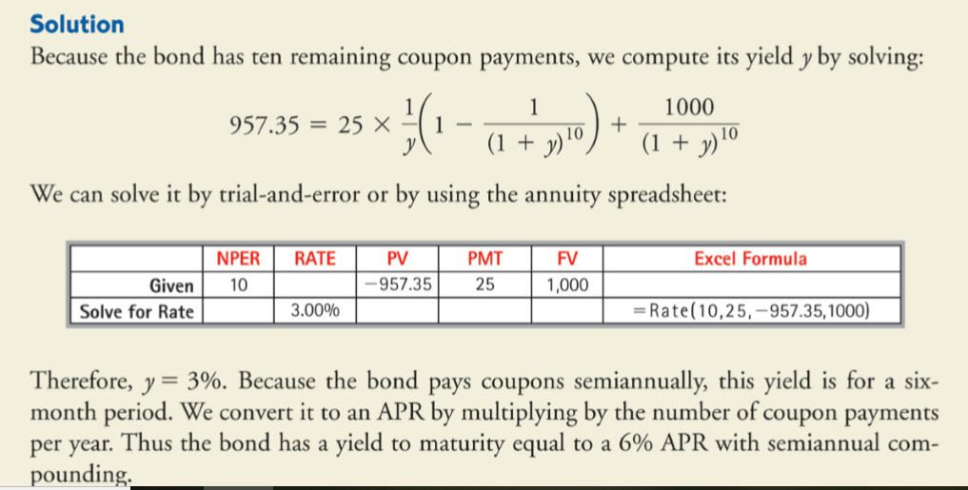

Slide 29
Example
Consider the five-year, $1000 bond with a 5% coupon rate and semi annual coupons. If the YTM is 6.30% (expressed as an APR with semi annual compounding). What price is the bond trading now?
Note that 6.30% APR is equivalent to a semi-annual rate of 3.15%.
P = 944.98

Slide 30
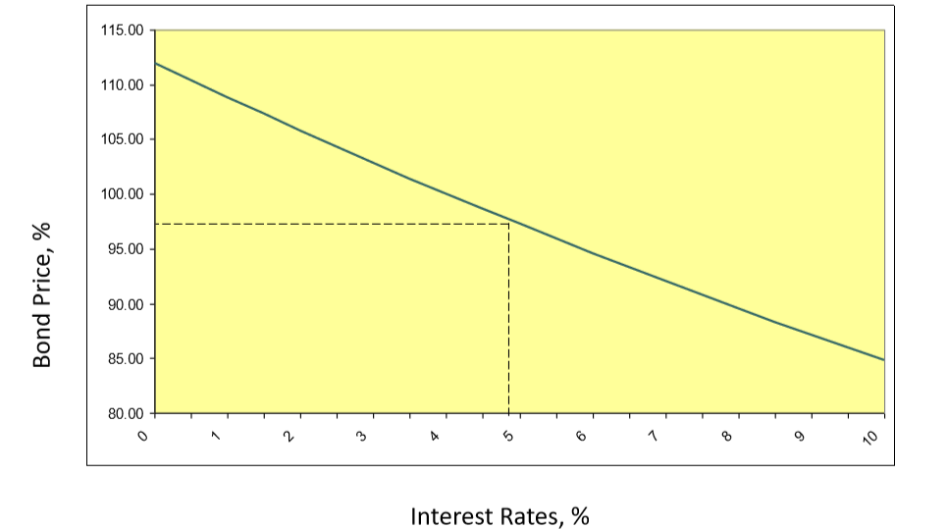
Bond Prices and Interest Rates

Slide 31
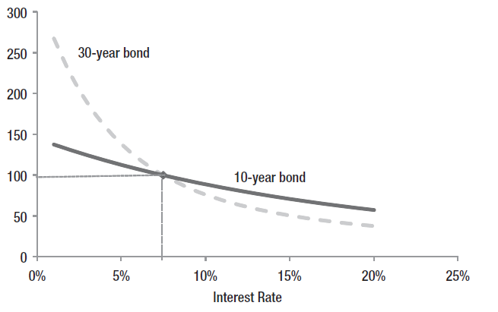
Maturity and Prices

Slide 32
Corporate Bonds
Callable bonds
  Can be repurchased before the maturity date
Convertible bonds
  Can be exchanged for shares of the firm’s common stock
Puttable Bonds
  Give the holder an option to retire or extend the bond
Floating-rate bonds
  Have adjustable coupon rate

Slide 33
Floating Rate Bonds
For Plain Vanilla bonds the specified coupon rate is valid for the life of the bond.
In the case of Floaters the rate is reset at the beginning of every period
  The rate will vary directly with the benchmark
  Eg: The rate on a Floater is specified as LIBOR + 50 b.p.
  If LIBOR rises, the rate will increase, whereas if LIBOR falls it will decrease

Slide 34
Callable Bonds
The issuer has the right to call back the bond prematurely.
  They buy back from the holders before maturity by paying the face value.
The option is with the issuer, and so it has to pay a price
  This price will manifest itself as a lower price for the bond as compared to a Plain Vanilla Bond.
  Thus buyers of callable bonds demand a higher yield

Slide 35
Callable Bonds (Cont…)
When will a callable bond be recalled?
  When interest rates or required yields are falling.
  The issuer can call back the bonds and issue fresh bonds with a lower coupon
  In such a scenario holders would like to hold on
  They are getting a higher rate of interest.

Slide 36
Callable Bond (Cont…)
In practice when a bond is recalled, the issuer will pay the lender a Call Premium
  This is normally half-year’s or one year’s coupon
  The call premium acts as a sweetener
    That is it makes such bonds more attractive to potential investors.

Slide 37
Puttable Bonds
The bondholder has the right to return the bond prematurely, and take back the face value.
  The option is with the bondholders and hence they have to pay an option premium.
    This will manifest itself as a higher bond price
    As compared to that of an otherwise similar plain vanilla bond.

Slide 38
Puttable Bonds (Cont…)
When will such a put option be exercised?
  When interest rates are rising.
  Holders can return the bonds and buy fresh bonds with a higher coupon
  At such times the issuers would prefer that the holders hold on to the bonds.

Slide 39
Puttable Bonds (Cont…)
The price at which a bond can be put by the holder acts as a floor price
  In a rising rate environment
Since the holders can always surrender the bonds at this price
  They will never sell at a lower price.

Slide 40
Convertible Bonds
They grant the holder the right to convert the bond into a predetermined # of shares
  It is a Plain Vanilla corporate bond with a call option to buy the common stock of the issuer.
The number of shares receivable on conversion is called
  The Conversion Ratio.
The conversion privilege may extend for all or only a portion of the bond’s life.
  The conversion ratio may also decline over time.
  The conversion ratio is adjusted proportionately for stock splits and stock dividends.

Slide 41
10-Year Government Bond Yields
Last 5 years of 10-year bond yields for the selected countries:
Country | 2020 | 2021 | 2022 | 2023 | 2024
United States | 0.92% | 1.52% | 3.88% | 4.18% | 4.23%
Canada | 0.73% | 1.42% | 3.29% | 3.37% | 3.27%
Brazil | 7.72% | 10.80% | 12.51% | 12.5% | 12.8%
Mexico | 5.76% | 7.4% | 8.82% | 9.14% | 10.01%
United Kingdom | 0.34% | 1.0% | 3.66% | 4.21% | 4.17%
Australia | 0.98% | 1.75% | 3.66% | 3.97% | 4.51%
New Zealand | 0.89% | 1.80% | 3.75% | 4.05% | 4.56%
Hong Kong | 0.45% | 1.60% | 3.15% | 3.25% | 3.14%
Singapore | 0.84% | 1.68% | 3.08% | 3.22% | 3.22%
India | 5.85% | 6.45% | 7.33% | 7.18% | 6.94%
Source: https://www.bloomberg.com/markets/rates-bonds

Slide 42
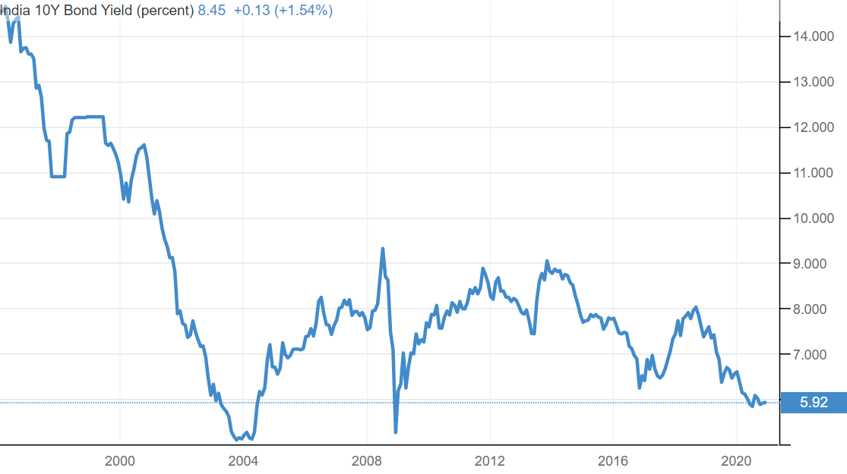
India Government Bond 10Y
https://tradingeconomics.com/india/government-bond-yield

Slide 43
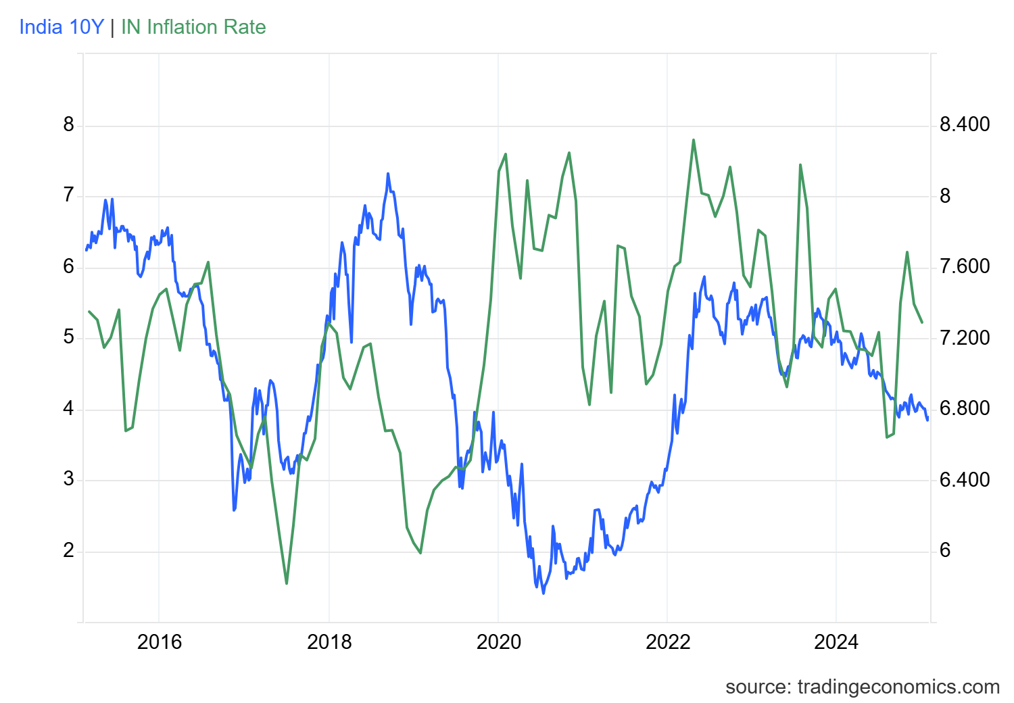

Slide 44
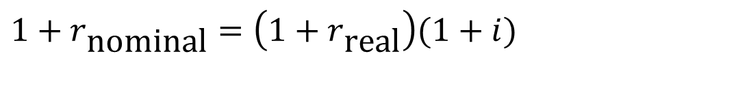
Debt and Interest Rates
Real r = Nominal r - expected inflation (approximation)
Real r is theoretically somewhat stable
Inflation has large variation.
The Term Structure tells us the cost of debt of different maturities
$$1+r_{\text{nominal}}=\left(1+r_{\text{real}}\right)(1+i)$$

Slide 45
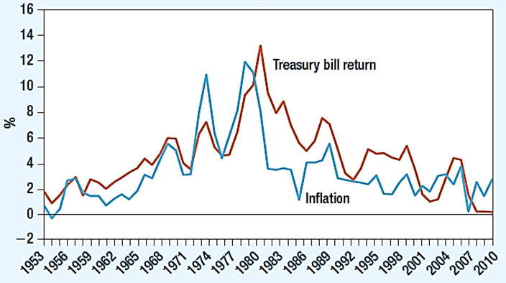
US Govt. Bills vs. Inflation

Slide 46
The Risk of Default
Corporate Bonds and Default Risk
  Payments promised to bondholders represent best-case scenario
  Most bonds’ safety judged by bond ratings

Slide 47
Prices and Yields of Sample of Corporate Bonds – One year to maturity.
Issuer | Coupon | Maturity | Rating | Price | Yield to Maturity
Johnson & Johnson | 6.73 | 2023 | AAA | 118.721 | 0.324
Walmart | 1.75 | 2019 | AA | 99.996 | 2.449
http://finra-markets.morningstar.com/BondCenter/Default.jsp

Slide 48
Corporate Bonds - India
Symbol | Coupon Rate | YTM | Face Value | LTP | Maturity Date
HUDCO (AAA) | 7.69 | 5.30 | 1,000 | 1,260.00 | 15-Mar-31
ERFL (AA) | 9.25 | 14.39 | 1,000 | 888.80 | 22-Mar-28
https://www.nseindia.com

Slide 49
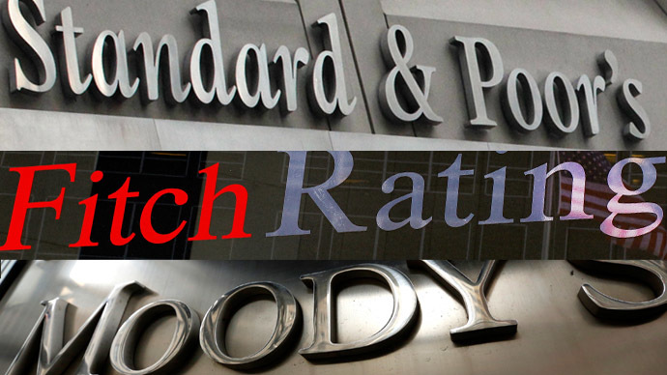
Bond Ratings
The highest-quality bonds are rated triple A.
Bonds rated triple B or above are investment grade.
Lower rated bonds are called high-yield, or junk, bonds.

Slide 50
Questions
1. A bond has a quoted price of $ 1,080.42. It has a face value of $1,000, a semiannual coupon of $30, and a maturity of five years. What is current yield (Annual coupon / Price)? & What is its yield to maturity?
2. KG Ltd issued a bond with a face value of $100, coupon rate 8% which has a maturity of 22 years, bond makes a semiannual payment, if the YTM is 9% what will be its price today?
3. You buy a zero-coupon bond at the beginning of the year that has a face value of $1,000, a YTM of 6.3%, and 25 years to maturity. If you hold the bond for the entire year, how much in interest income will you have to declare on your tax return? Assume semiannual compounding.

Slide 51
Questions
4. Bond of Magnum ltd has the following features.
Par value: 100
Coupon rate: 14%
Years to maturity: 6 years.
What happens to the value of Magnum’s bond when the required rate of return is 14%,16% and 12%?
5. An 8% five-year bond yields 6%. If this yield to maturity remains unchanged, what will be its price one year hence? Assume annual coupons payments are constant and face value of $100.

Slide 52
Jaguar Land Rover PLC: Bond Valuation
What factors might have enabled JLR to raise new debt at less than half the coupon rate of interest in 2015, compared with the debt raise in 2011?
Compute the amount at which existing bondholders might be willing to surrender their holdings?

