Slide 1
Frameworks for product managers, analytical attribute approaches, sales forecasting and financial analysis including qualitative techniques
Session 3
- Prof Deepika Gupta
IIM Visakhapatnam

Slide 2
Finding and solving customers’ problems
Problem based ideation – helps to generate concepts
Getting customers involved is difficult
Sources for needs and problems of stakeholder
  Internal records – sales reports, call reports, customer feedback, complaint files etc
  Direct inputs from technical and marketing departments
  Problem analysis – generate list of key problems with current product currently in use, then group and prioritize these to help product development address most important problems (reverse brainstorming procedure)
    Can be done by going to experts, through published sources, stakeholder contacts by interviewing and focus groups, through observations and role playing techniques
  Scenario analysis – think of scenario, study it for problems, evaluate and then try to solve them

Slide 3
Scenario Analysis
Extending present to see what it will look like in the future
Leaping into the future through leap studies
  These can be static or dynamic
  Eg: (1) More people to work at home; so telecommuting and video conferencing will largely replace in-person business meetings.
  (2) Supplies of petroleum will shrink and prices will rise; by 2050, electricity demand will multiply.
  Certain questions to be answered: What new products do each of these forecasts suggest? Do any of them suggest any changes in the new product development process? Do any of them seem too far-fetched to believe?
Wild cards study – assess likelihoods of occurrence of identified events and investigate the threats or new product opportunities ?
  Eg: No-Carbon Policy: Global warming may cause governments to put high taxes on fossil fuels, shifting demand to alternative sources of energy. This changes the allocation of R&D investment toward alternative energy, possibly causes new “energy-rich” nations to emerge, and ultimately may lead to a cleaner environment for everyone.

Slide 4
Scenario analysis
Guidelines for good scenario analysis
  Know the now
  Keep it simple
  Careful while selecting group members
  Do an 8 to 10 years projection (now usually 4 to 5 years projections)
  Periodically summarize progress
  Combine factors causing changes
  Check fit and consistency at the end

Slide 5
Solving the problems
Group creativity – group synergies
Brainstorming – can be computer assisted
Disciplines panel – assemble experts from different disciplines and discuss the problems
Using props, imitating nature

Slide 6
Product/service attribute
Product/ service is a bundle of attributes
Attributes can be
  Features
  Functions
  Benefits – uses, users, used with, used where etc

Slide 7
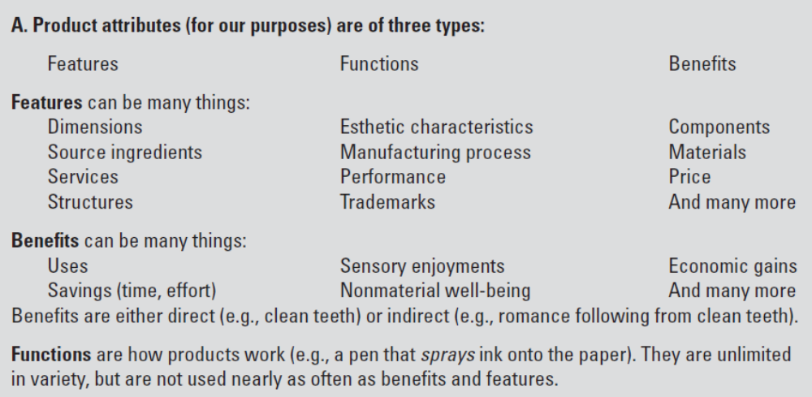
Product attributes….

Slide 8
Analytical attribute techniques
Create new product concepts by
  Changing one or more of its current attributes
  Adding attributes
Desirability of these concepts if developed into new products
Attribute analysis techniques
  Quantitative
  Qualitative

Slide 9
Various available options
Depth Interviews
Focus Groups
Expert Judgements
Beta Tests
Qualitative
Quantitative
Standard Surveys
Concept Tests
Perceptual Maps
Conjoint Analysis
Product Use Test
Pre-Test Market
Test Market
Electronic Test Market
Pre-prototype stage Post-Prototype stage

Slide 10
Maps - attribute analysis techniques
Gap analysis – make a gap map to find open spaces (white spaces)
Types of gap maps:
  Determinant gap maps – managerial expertise and judgement to plot products on a map
  Perpetual gap maps – manager uses customer attribute ratings (AR)
    Factor analysis
    Cluster analysis
    Snake plots
    Scree plot and eigenvalues
  Perpetual gap maps – manager uses overall similarities from users
    Multi-dimensional scales

Slide 11
Finding white spaces
Both
Herbal and
Non herbal
Group
Dabur India
Nature of
product
Group
HUL,
Cadbury,
Ponds etc
Non- Herbal
Generic Group
Pal,
Sri Sri
Herbal
Product price
Low
High

Slide 12
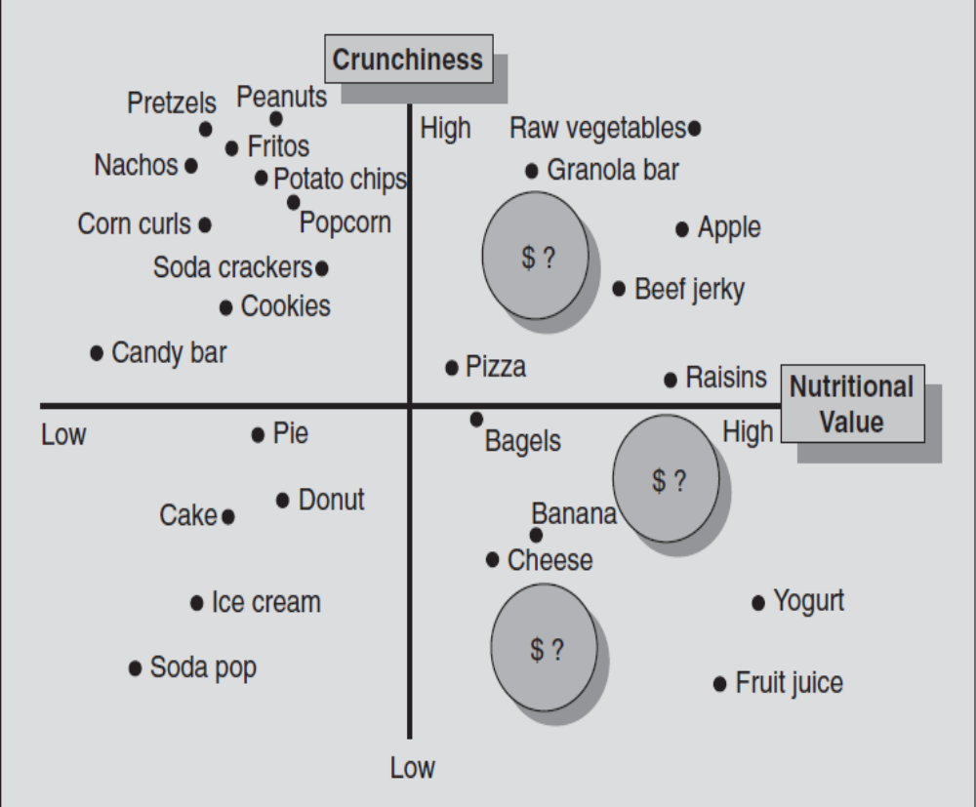
Quantitative attribute analysis techniques…
Determinant Gap Map
Determinant gap maps – managerial expertise and judgement to plot products on a map.. .
Example of snack products

Slide 13
Quantitative attribute analysis techniques
Perpetual gap maps – manager uses customer attribute ratings (AR) asking buyers to tell what attributes they believe products have, done using Likert type Scales
  Factor analysis - a statistical technique to reduce number of attributes to small number of underlying dimensions (also called factors) to serve as axes of the perpetual map.
  Snake plots
  Scree plot and eigenvalues
  Cluster analysis – used to group individual respondents together into benefit segments based on their preferences

Slide 14
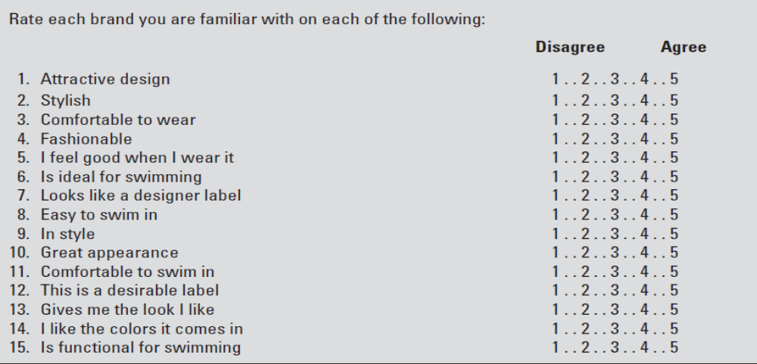
Attribute perceptions questionnaire

Slide 15
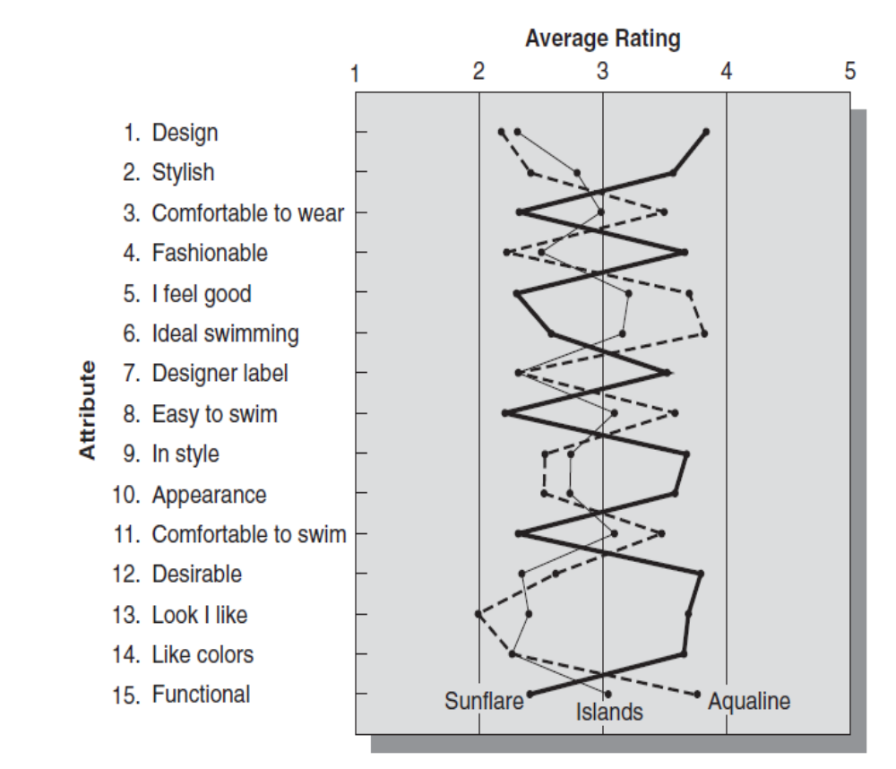
Quantitative attribute analysis techniques...snake plot
Refers to snakelike shape of lines that join the points
It reveals useful information
Known about customer preference using just the factors

Slide 16
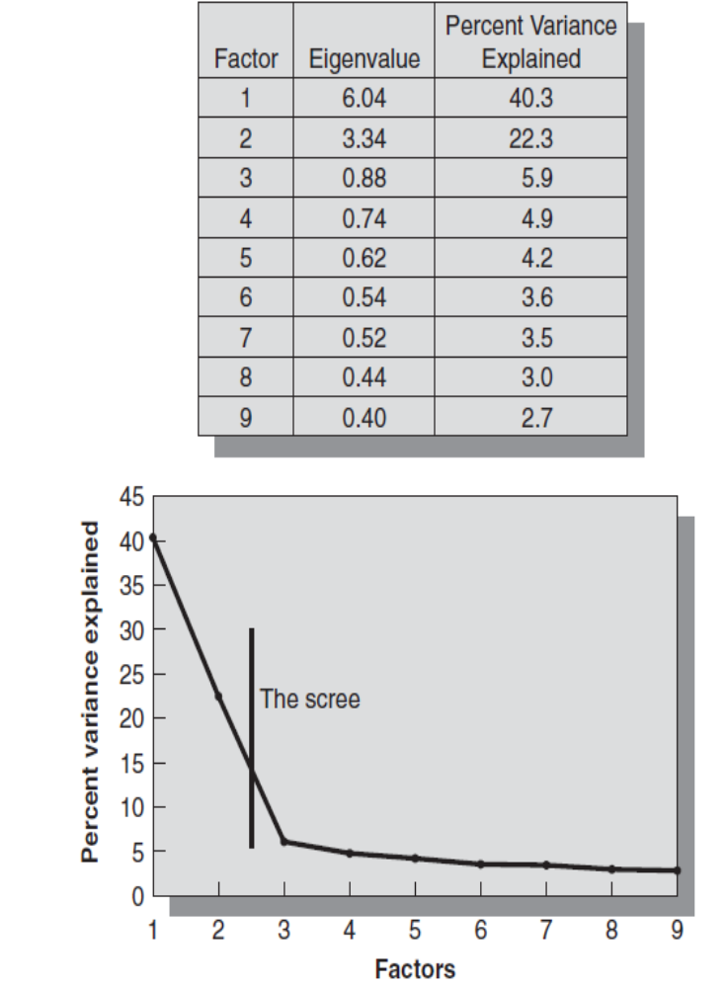
Quantitative attribute analysis techniques.. Scree plot and eigenvalues
Need to understand how many underlying
factors to retain in the model
Need to use scree test
It is a pile of rocks at the foot of a mountain
The cut off is made at the scree
A useful statistic called eigenvalue for each
factor that is mathematically related to amount
of variance explained
Rule of thumb is to keep factors whose
eigenvalues are greater than 1

Slide 17
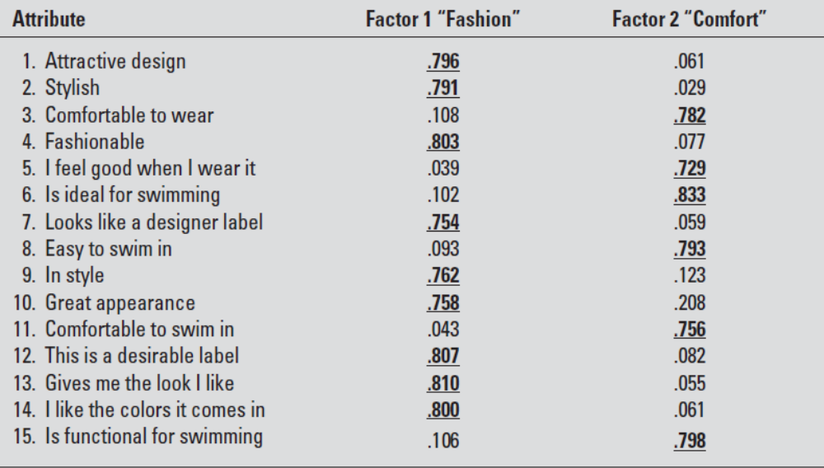
Quantitative attribute analysis techniques.. Factor analysis
Calculate factor loading matrix
Shows correlation of original set of attributes to their underlying factors
We can also calculate
regression weights that
relate attribute scales to
the factor scores
These estimates are
used to perpetual maps

Slide 18
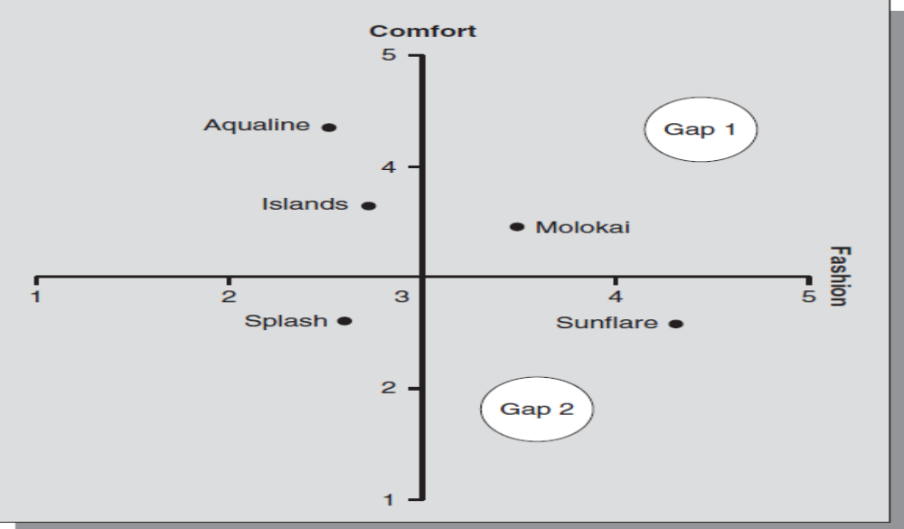
Quantitative attribute analysis techniques… perpetual maps using AR

Slide 19
Quantitative attribute analysis techniques
Perpetual gap maps – manager uses overall similarities (OS) from users
  Sometimes consumers make purchase decisions using attributes they cannot identify
  These are phantom attributes – eg for cologne not sure how to use attributes other than brand image or aesthetics and difficult to verablize
  Du Pont sold filler material for pillows and wanted to find the best type and form of filler to enhance its sales to pillow manufacturers.
  So the fi rm created many different types of pillows and then gave them to consumers three at a time, along with the question, “Which two are most similar, or which one is least like the other two?”
  Use Likert type scale and find similarity or dissimilarity ratings.
  Multidimensional (MDS) scaling also used to develop perpetual map from similarities data

Slide 20
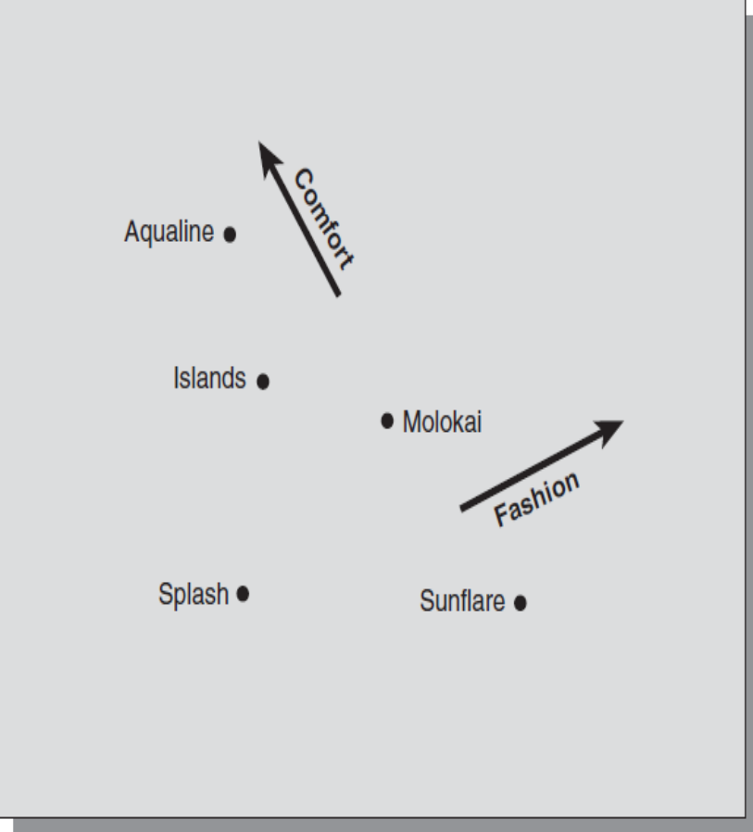
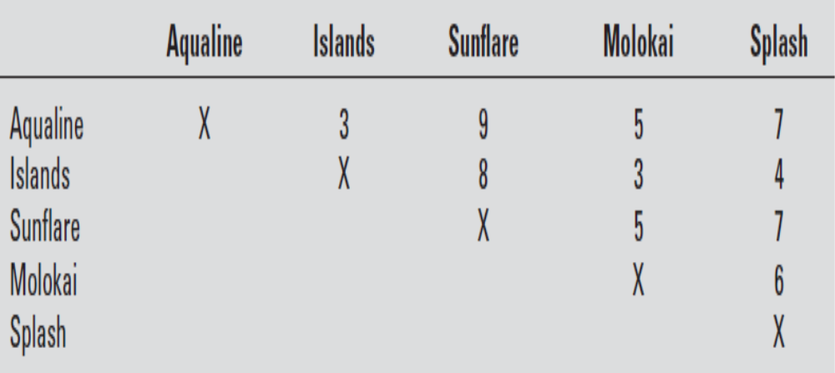
Quantitative attribute analysis techniques
Dissimilarity matrix
OS Perpetual map

Slide 21
Contd..
Trade off analysis – also called conjoint analysis
ANOVA and MANOVA techniques
Regression analysis

Slide 22
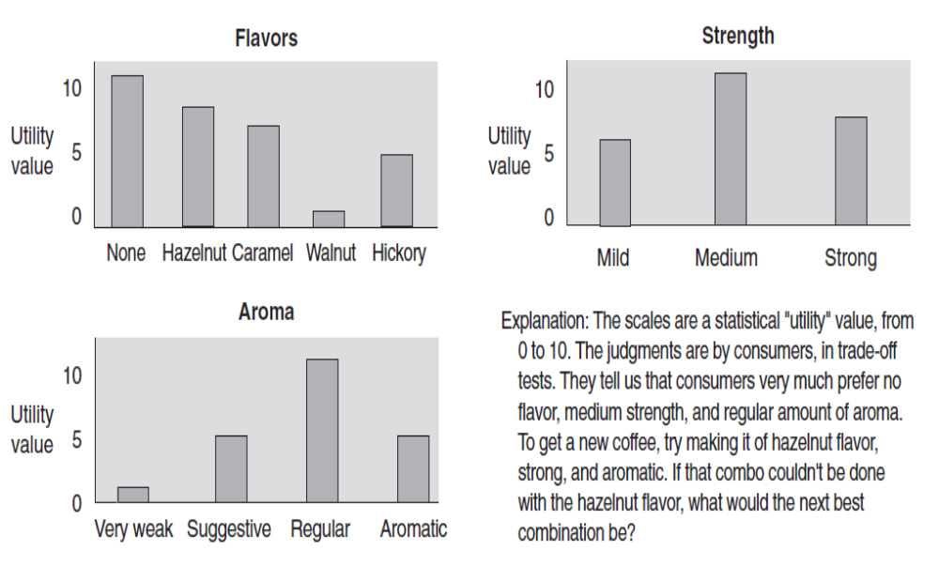
Contd..
Trade off analysis – also called conjoint analysis
Get factor utility scores… eg: Coffee

Slide 23
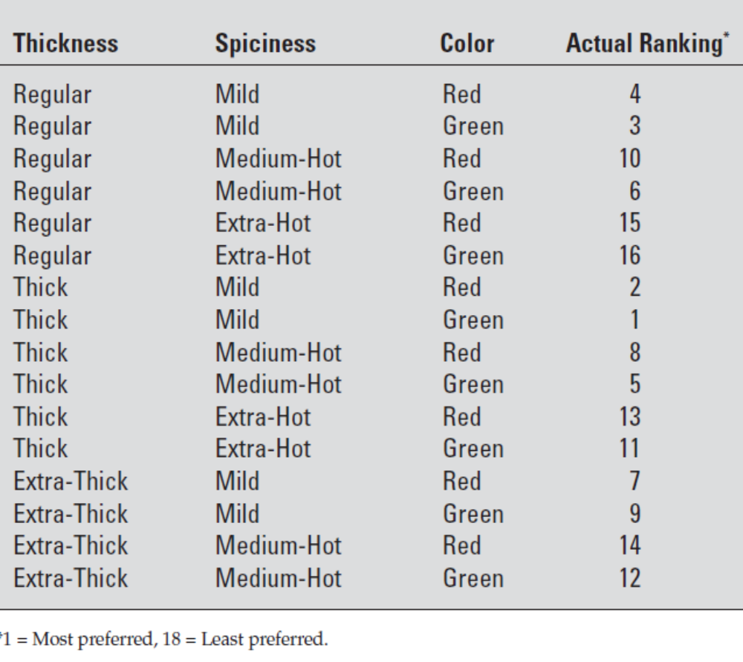
Conjoint analysis…
Say there are 3 attributes for salsas – spiciness (mild, medium hot and extra hot), colour (red or green), thickness (regular, thick and extra-thick)
So we have 3 x 2 x 3 = 18 different types of combinations
Preference rankings of one respondent
Uses monotone analysis of variance (MANOVA) – to find pattern within rank order data

Slide 24
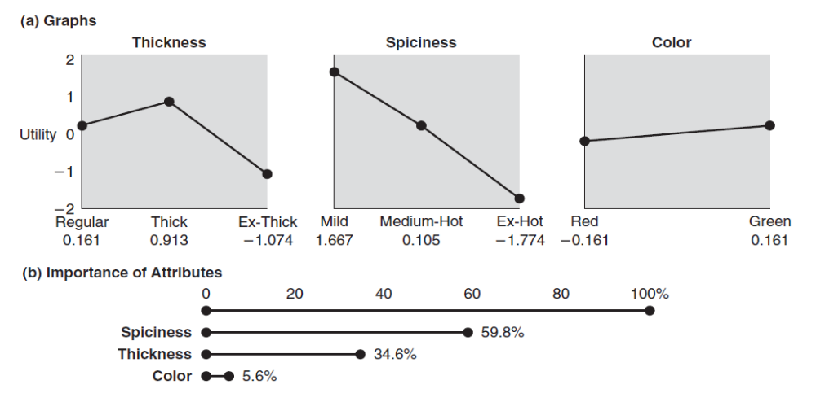
Conjoint analysis… contd..

Slide 25
Qualitative techniques
Collect data through depth interviews, focus groups and expert judgements
Use various techniques
Dimensional analysis – listing all physical features of product type
Checklists
  Can it be adapted?
  Can it be modified?
  Can it be combined with anything?
  Can something be substituted?
  Can it be magnified?
  Can it be minified?
  Can it be rearranged in some way?

Slide 26
Contd…
Relationships analysis – respondent to find relationships among dimensions
  Two dimensional matrix
  Morphological (multi dimensional) matrix
Analogy – use analogous situation, which is often difficult. Meet four criteria
  It should be vivid and have definite life of its own
  It should be full of concrete images
  It should be a happening – a process of change or activity
  It should be a well known activity and easy to visualise and describe

Slide 27
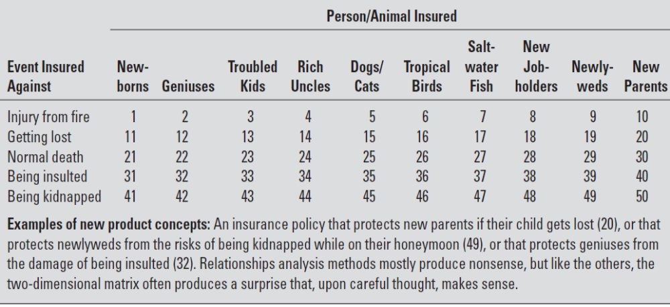
Two dimensional matrix (new insurance products)

Slide 28
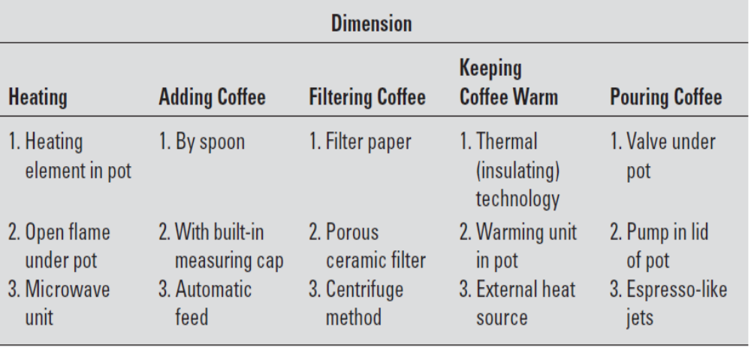
Multidimensional matrix for new coffee maker

Slide 29
Other commonly used attribute analysis techniques
Simple regression
Multiple regression
Econometric analysis
Simple time series
Advanced time series
Jury of executive opinion
Scenario analysis
Delphi analysis

Slide 30
New product forecasting strategies
 | Current Product technology |  | New Product technology
 | Type of Innovation | Type of forecasting | Type of Innovation | Type of forecasting
Current Market | Cost reductions, Process improvements | Sales analysis | Line extension | Product line analysis, life cycle analysis
New Market | New market or new product uses | Customer analysis, market analysis | New to the world or new to the firm | Scenario or what if analysis

Slide 31
Basic financial concepts for sales forecasting
Unit sales (expected)
Revenues (net sales value)
Production costs – fixed and variable
Direct marketing costs
Incremental profits (expected)
Target costing
Payback period
Discounted cash flow
Sensitivity analysis
Cannibalization assessment
Break even analysis

Slide 32
Measuring customer response
To estimate quantity of product expected to be sold during a time period is Q = N x A x P where
  N = number of potential customers expected to make purchase during the time period
  A = fraction of potential customers for which product is available and customers are aware of the product
  P = probability that the product is purchased if available and P in turn is estimated based on customer response of buying definitely or probably

Slide 33
Example
A company sells scooters and has sold at the rate of 1,50,000 units per year. It sells product through a single distributor accounting for 25% of sales in this category. A concept test with factory manager shows that a definitely would buy fraction of 30% and probably would buy fraction of 20%, Based on experience the company estimates these to be 40% and 20% calibrated. Find the estimated quantity of the new concept test to be sold per year?
P = C(definitely) x F (definitely) + C(probably) x F (probably) = 0.4 x 0.3 + 0.2 x 0.2 = 0.16
Q = 150000 x 0.25 x 0.16 = 6000 units/ year

Slide 34
Sales forecasting and financial analysis
Forecast sales through purchase intentions – probability
Forecast sales through ATAR model
  ATAR – Awareness Trail Availability Repeat Model
  Market Share (MS) = T X R x AW x AV
  Profit contribution = Potential x MS (that is, AW x T X AV x R) x margin
    Where T = trail rate
    R = repeat purchase rate
    AW = percent awareness
    AV = percent availability

Slide 35
ATAR model …. solve
Calculate estimated market share when
  Repeat purchase rate = 0.636
  Awareness = 90%
  Availability = 67%
  16% of the market is aware of the product and is available and shall try it at least once
So the long term market share (MS) = T X R x AW x AV = 0.16 x 0.636 x 0.9 x 0.67 = 6.14%
If total number of overall market sales is 10,00,000 units, then the long run sales are estimated to be 10,00,000 *6.14% = 61,400 units
If the company has the potential to sell 1 lac units and the estimated profit margin of 25%, the profit contribution = Potential x MS x margin = 1,00,000 x 0.0614 x 0.25 = $ 1,535 (approx.)

Slide 36
ATAR model calculations with switching model
We know that Repeat purchase rate, R, can be obtained by analogy to similar products for which such data are available.
It can also be calculated using a switching model
Let R(s) = proportion of customers who will switch to the new product when it becomes available
R(r) = proportion of customers who repeat purchase of the product
Switching model estimates long run repeat purchase rate = R(t) = R(s)/[1+R(s)-R(r)]
If R(s) = 0.7 and R(r) = 0.6 then R(t) = 0.7/[1+0.7-0.6] = 0.636
Then use the ATAR model as above

Slide 37
ATAR model…to what-if analysis
The accuracy of the forecast depends on validity of the measures
Data availability and data precision are essential for forecasting models
In the above example, availability is assumed to be 67%
If the data is not precise, the actual availability can be given in a Range of 40-80%
So, What-if analysis is to be done and the market share forecast falls in the range of 3.66-7.33% (using the above formula)
This represents the worst and best case scenarios

Slide 38
Variations of ATAR model
When awareness is not relevant – TAR model – when push marketers target distributors/retailers in order to get their products successfully placed in store, they rely on retailers to sell their products. Awareness is taken to be 100% for ATAR model
When availability is not relevant – ATR model – when direct channel and online firms are less concerned with access to retailers and wholesalers – as they sell directly to end consumers. Availability is taken to be 100% for ATAR model
When repeat/rebuy is not relevant – ATA model – when durable products are occasionally brought by target market. In short term there is no sense of repeat/rebuy purchases. Repeat/rebuy is taken to be 0% and average purchase quantity is taken to be 1 for ATAR model

Slide 39
Forecasting for product diffusion
Diffusion of innovation – process by which innovation spread within a market, over time and over categories of adopters
Diffusion model used for durable goods is Bass Model – estimates sales of product class at a future time t
  s(t) = pm + (q-p) Y(t) – (q/m) (Y(t))square
  Where p = initial trial probability
  q = diffusion rate parameter
  m = total number of potential buyers
  Y(t) = total number of purchases by time t

Slide 40
Bass model example…
A company is assessing the viability of new product – a combination of coffee maker- miniature convention oven with the data:
Long run potential for this product is 2,50,00,000 households
For similar small household appliances the company has sold in the past, initial trial probability is 0.04 and diffusion rate parameter is typically close to 0.3
Peak sales will occur in about 4 years from now
The total product category sales during that year will be a little over 4 million units.
So, estimated sales of this new product at a future time t = s(t) = pm + (q-p) Y(t) – (q/m) (Y(t))square
Sales estimate for new product = 0.04 * 2,50,00,000 + (0.3-0.04)*40,00,000 – 0.3/2,50,00,000 *(40,00,000)square = 18,48,000

Slide 41
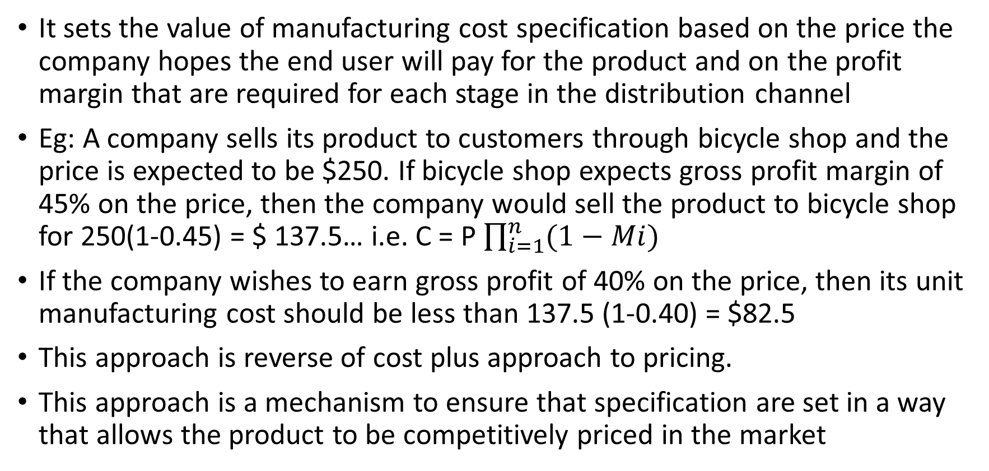
Target costing
It sets the value of manufacturing cost specification based on the price the company hopes the end user will pay for the product and on the profit margin that are required for each stage in the distribution channel
Eg: A company sells its product to customers through bicycle shop and the price is expected to be $250. If bicycle shop expects gross profit margin of 45% on the price, then the company would sell the product to bicycle shop for 250(1-0.45) = $ 137.5… i.e. C = P $\prod_{i=1}^{n}{(1−Mi)}$
If the company wishes to earn gross profit of 40% on the price, then its unit manufacturing cost should be less than 137.5 (1-0.40) = $82.5
This approach is reverse of cost plus approach to pricing.
This approach is a mechanism to ensure that specification are set in a way that allows the product to be competitively priced in the market

Slide 42
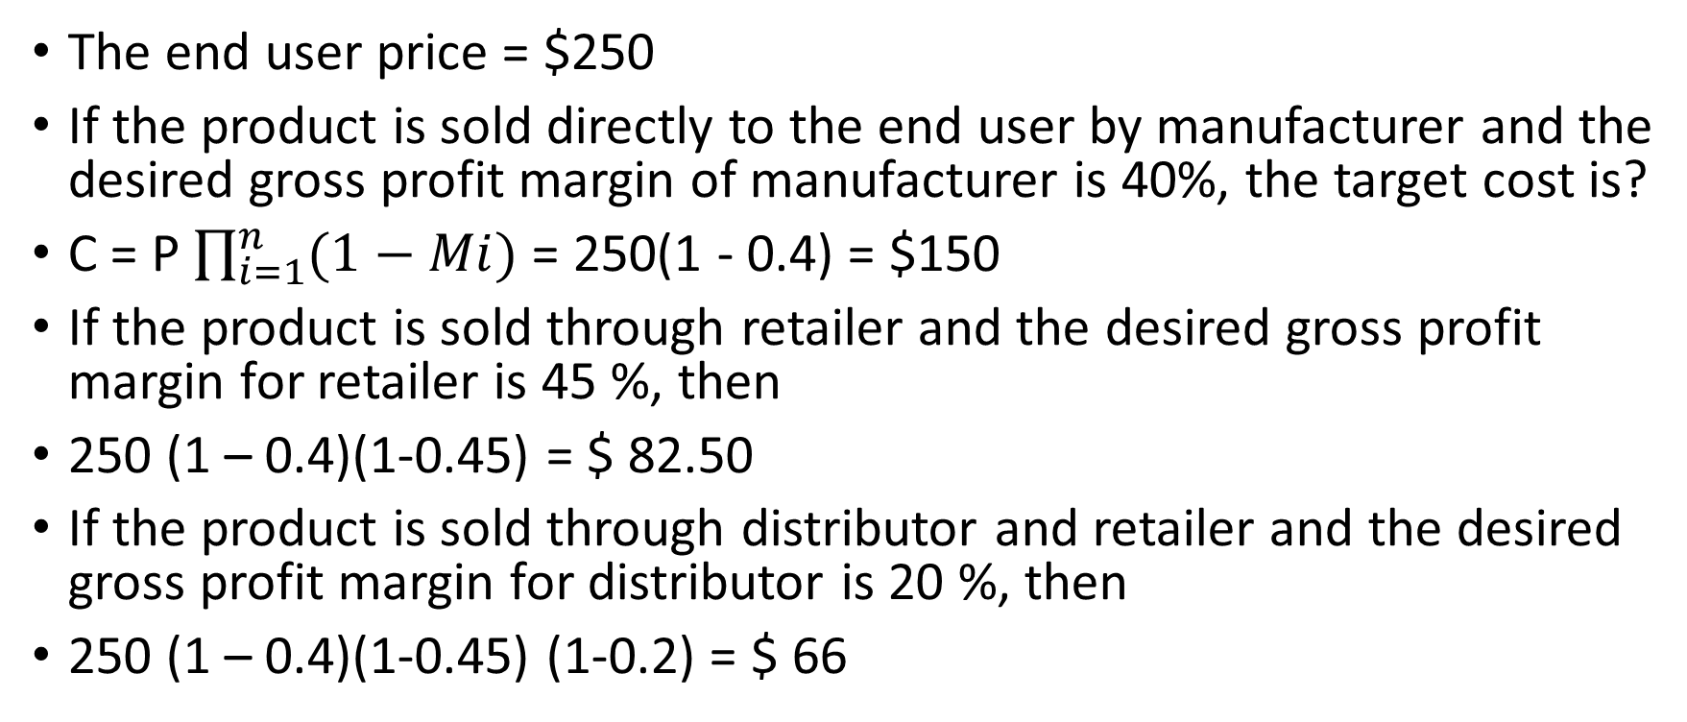
Target costing…solve
The end user price = $250
If the product is sold directly to the end user by manufacturer and the desired gross profit margin of manufacturer is 40%, the target cost is?
C = P $\prod_{i=1}^{n}{(1−Mi)}$ = 250(1 - 0.4) = $150
If the product is sold through retailer and the desired gross profit margin for retailer is 45 %, then
250 (1 – 0.4)(1-0.45) = $ 82.50
If the product is sold through distributor and retailer and the desired gross profit margin for distributor is 20 %, then
250 (1 – 0.4)(1-0.45) (1-0.2) = $ 66

Slide 43
Sensitivity analysis
Sensitivity analysis alters certain parts of input data and have impact on new product’s profitability
Market segment total customers 12,00,000
% of those who became aware = 50% = 6,00,000
% of those who try the product = 60% = 3,60,000
% of those who will repeat = 40% = 1,44,000
Average number of repeats per annum = 30
Number of bottles purchased in Year 1 = 43,20,000
Unit cost per bottle is $2 and the cost of bottles in Year 1 = $86,40,000
Production costs = $ 49,84,000
Direct marketing costs = $ 2,00,000
So incremental profits = 86,40,000 – (49,84,000 + 2,00,000) = $ 34,56,000

Slide 44
Sensitivity analysis contd…
Suppose, the price to consumer was $2.99 but previous experience suggested that competitors might react to the new product by lowering their price forcing the developers to lower prices by say 0.50p, so the price to consumer shall be $2.49 having knock-on effect on the factory price that is lowered to $1.50, so the incremental profits are
Unit sales = 43,20,000 @ Rs.1.50 = $64,80,000
Less: Production costs = ($49,84,000)
Less: Direct marketing costs = ($ 2,00,000)
So, incremental profits = $12,96,000

Slide 45
Sensitivity analysis contd…
The profit of $ 12,96,000 is lower than $ 34,56,000 but the volumes remain the same and the new wine might establish itself in the long run.
Now suppose, the company decides not to match the lower price but spend more on distribution and advertising, the sensitivity analysis can make the following alternations:
The unit sales are now estimated to be 28,80,000 units
Unit sales = 28,80,000 @ Rs.2 = $57,60,000
Less: Production costs = ($34,56,000) (for reduced volume)
Less: Direct marketing cos ($ 3,00,000) (more promotion)
So, incremental profits = $20,04,000

Slide 46
Cannibalization assessment
Occurs when new product competes with existing product and a percentage of new product’s sales are taken from the existing product’s sales
Eg: A cheese producer wishes to introduce milder form of traditional cheddar cheese because market research shows declining sales for mature cheddar.
 | New Cheddar (in $) | Old Cheddar (in $)
Unit selling price | 1.5 | 1.6
Unit variable cost | 0.8 | 1
Unit contribution | 0.7 | 0.6

Slide 47
Cannibalization assessment contd…
Every time a new cheddar block is sold at the expense of old one, the company will lose 10 p
If new cheddar is expected to sell 2 million units and 1 million units is expected to be diverted from the old cheddar(which was itself expected to sell 2 million units also) what will the effect be on the overall contribution of this brand of cheddar?
The total loss due to cannibalization = 10,00,000 * $0.1 = $ 1,00,000
The new cheese will sell further 10,00,000 units at a contribution of $0.7 thus generating = $ 7,00,000
So the net financial gain for the brand is $6,00,000

Slide 48
Break even analysis
Help to decide (a) how much product to make? (b) how much to charge ? So that there is no profit and no loss
Break even units = total fixed costs/ contribution per unit
A small manufacturer of cosmetics has patented a formula for powdered skin cleanser. This will sell at $3 per pack. The variable cost is $1 per unit and total fixed cost is $ 20,000
So break even units = 20,000/ (3-1) = 10,000 units
In terms of sales turnover, the formula is Total Fixed Costs/ Cont margin where contribution margin = (S-VC)/S that is (3-1)/3 = 66.67%
So break even turnover = 20,000/ 66.67% = $30,000….approx

Slide 49
SCAMPER Framework for great business idea
It is designed to help coming with fresh ideas for product, service or process.
Starts with something that already exists and subject to 7 areas of questioning
S - SUBSTITUTE
Other properties?
Other people?
C-
COMBINE
One product with another?
A-
ADAPT
To a different context?
Other time/place?
Other feelings/attitudes?
Purposes/objectives?
Talents/resources?
Steps/activities
Using borrowed feature?
Using ideas outside your field?
To another market/ situation?
M – MODIFY/ MAGNIFY
Features/stores?
Physical qualities?
Size/duration/pricing?
Frequency?
P- PUT TO ANOTHER USE
For other users?
To solve other problems?
Using the by-products?
To work elsewhere?
E-
ELIMINATE
How to simplify?
What are non-essentials?
Make it smaller?
Reduce cost/time/ effort?
R- REVERSE/ REARRANGE
Interchange components?
Use another order?
Reverse everything?
Exchange roles?

Slide 50
Creativity method - CATWOE
Designed by Checkland and Scholes, Soft Systems Methodology in Action in 1990
Method is applied to system that contains the problem
Describes human activity and its processes performed by customers and actors, controlled by owners and occurs within an environment
C – Customers of the system – people who benefit or suffer from processes of system
A – Actors – people who shall carry out main activities for what the system was defined
T- Transformation process – what system does to give something useful to actors in the end
W- World view – context in which system is placed
O – Owners – people who control the system and do whatever they wish to do
E- Environmental constraints – ethical limits, financial constraints, regulations, limitations etc.

