Slide 1
Session 3
Association Between Variables: Correlation, Covariance

Slide 2
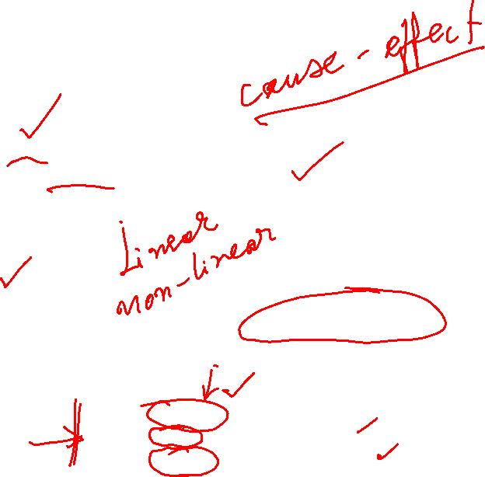
Managerial Decisions
What is the relationship between price and demand for our product?
By how much should we reduce the price of our product?
Should I increase the compensation to increase retention?
What is the relationship between Compensation and Attrition?
What is the relationship between return of this portfolio and the market?
How much should we invest in advertising?
How much should I invest in this portfolio?
What is the relationship between Advertising Expenditure and PBT?
  The direction of the relationship?
  The form of the relationship?
  The strength of the relationship?
Notes:
Today, we are going to look at decisions that hinge upon certain relationships between key variables. Take for instance, should I reduce the price of my product. I face a trade-off, reducing price means getting less on the product. The only reason that I am willing to do this is to increase demand. But then the question becomes, how much will demand increase when I reduce the price? In other words, what is the relationship between demand and price. Is it positive, negative? Is it linear, nonlinear? Is it strong weak?

Slide 3
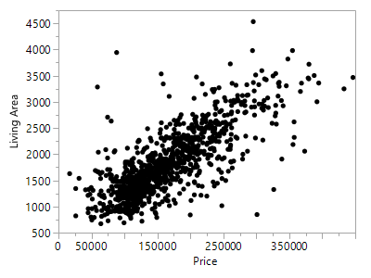
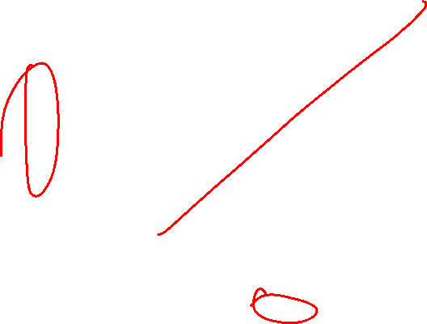
Example: House Prices Vs. Living Area
Dataset: House Prices
What can we say about the relationship between House Prices and Living Area?
Notes:
An alumnus who wants to start a business on “luxury services”. There is a tradeoff, few households with a lot of income but they might be willing to spend more compared to those with less income. So you are interested in understanding the relationship between spending and income. The dataset is on LMS.
What can you say?
1. Look for trend 2. Look for the shape of the trend 3. Look for clustering around the trend 4. Look for outliers and understand.

Slide 4
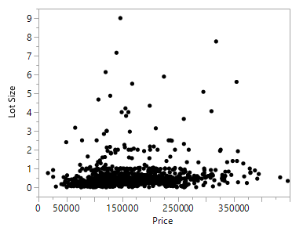
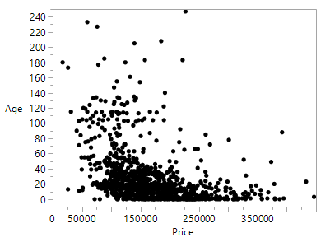
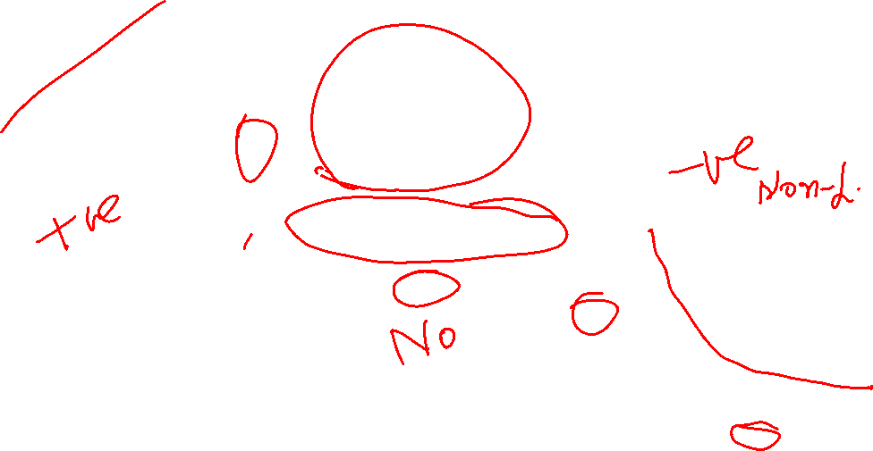
Scatter Plots
Dataset: House Prices

Slide 5
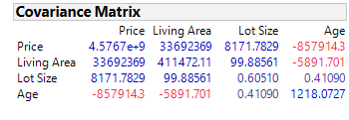
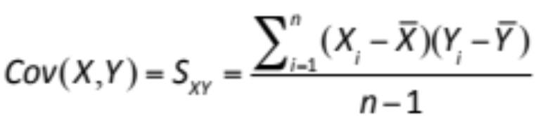
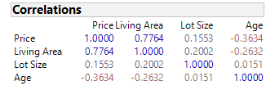
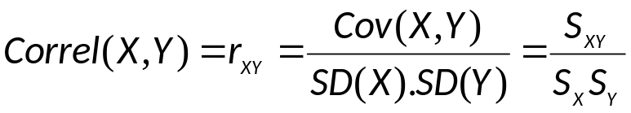
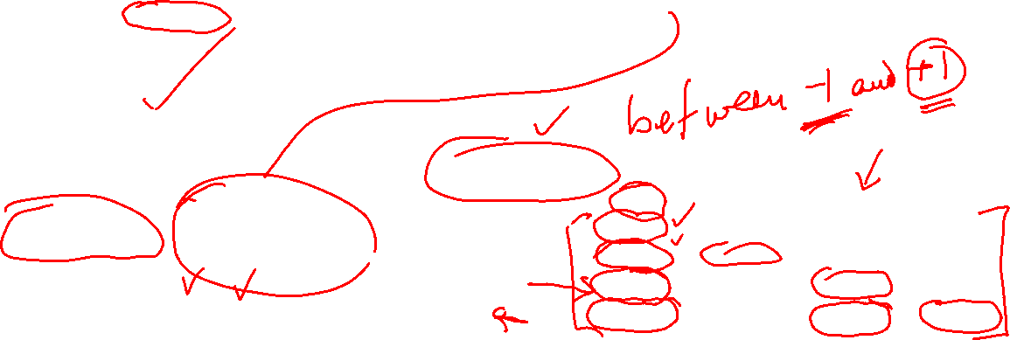
Covariance and Correlation

Slide 6
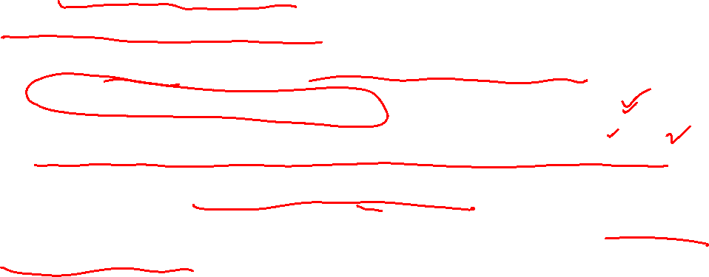
Covariance
The sign of covariance can be used to understand the direction of relationship between two variables
Random variables with zero covariance are uncorrelated
  All independent variables are uncorrelated
  All uncorrelated variables are not independent
It is difficult to establish the strength of the relationship using covariance because it depends on the unit of measurement
Notes:
There are two reasons why covariance might be highly positive. One is that many points have X higher than Xbar and Y higher than Ybar. The other is that X itself has a lot of variation so X-Xbar is very high or very low. In other words, strength of the relationship cannot be captured through covariance because of its reliance on the actual magnitude of the random variable.

Slide 7
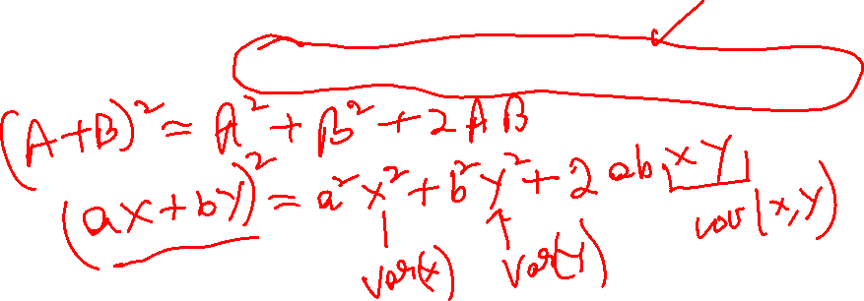
Portfolio Management
Construct W = aX + bY ; a, b are any constants; X, Y are two random variables
  Mean: E[W] = aE[X] + bE[Y]
  Variance: Var[W] = a²Var[X] + b²Var[Y] + 2abCov[X,Y]
The variance of the combination increases or decreases depending on the sign of the covariance term (+ or -)
Can be used to optimize portfolio

Slide 8
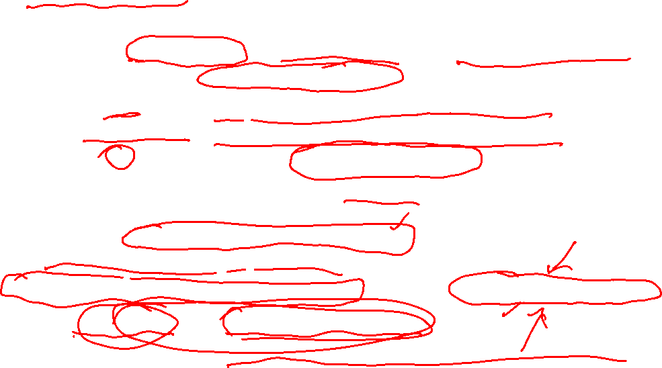
Correlation
Correlation is dimensionless - it is standardized using standard deviations
  It always takes a value between -1 and 1
  Close to +1 implies a linear relationship with a positive slope
  Close to -1 implies a linear relationship with a negative slope
  Close to 0 implies that there is no linear relationship
Correlation describes the direction and strength of the relationship but cannot readily used for “predictive” purposes
  e.g. If the annual salary goes up by a $1000, how much do we expect the entertainment spending to change?
Correlation is not the same as causation; can result from “lurking” variables
  e.g. Fire damage and number of fire fighters
Correlation captures the association between two variables at a time
Cause-effect relationship is captured by Regression
Notes:
Correlation compensates for the shortcomings of the covariance measure. It normalizes the covariance using the standard deviation of each random variable. Now, the resulting measure can vary between -1 and 1. Now we can decipher the strength as well s direction of relationship. Interpret values of correlation.
There are a fewthings we need to be aware of. First, that correlation cannot be used for predictive purposes. The other is the possibility of lurking variables. You see an association, which is not causation. Let me give you two examples – height and hair length. If I were to get these numbers for a random sample in India, what do you think we will see? A negative correlation. Does this mean that greater height reduces the hair length? Is there a biological reason for it? No, it is just that the gender has not been considered here, which is the lurking variable. Men tend to be longer than women in India and they also tend to keep shorter hair. Lastly, correlation is only pairwise. What if I wanted a framework that could be extended to multiple variables at the same time, especially when I put back the lurking variable? For this purpose, we look for framework that is more general.

Slide 9
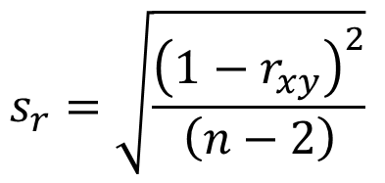
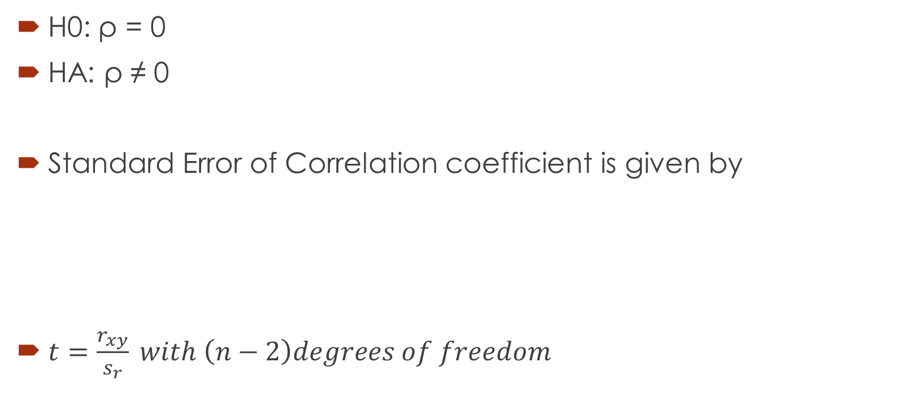
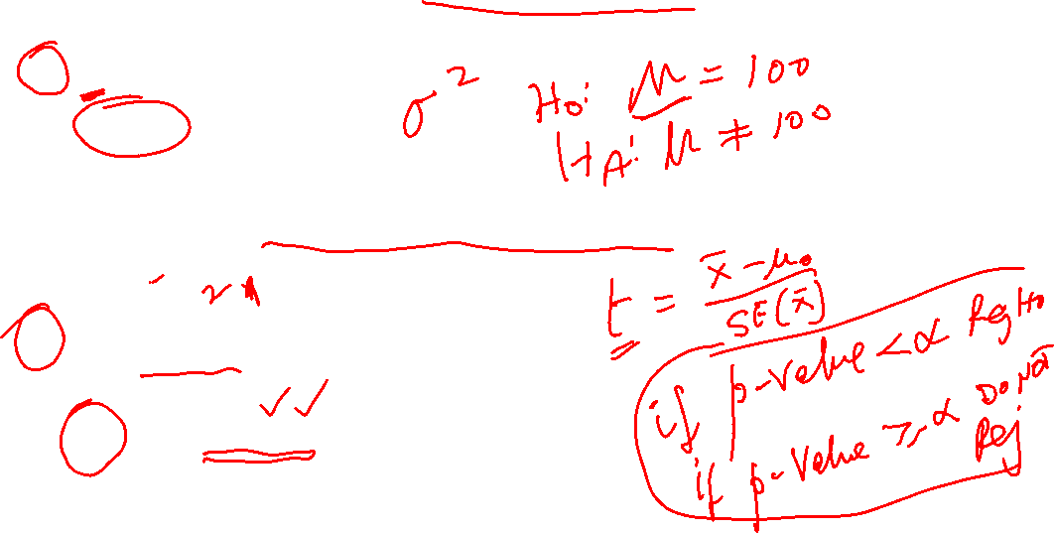
Hypothesis Test - Correlation
H0: ρ = 0
HA: ρ ≠ 0
Standard Error of Correlation coefficient is given by
$t=\frac{r_{xy}}{s_{r}} with \left(n−2\right)degrees of freedom$
$${s_{r}=\sqrt{\frac{{\left(1−r_{xy}\right)}^{2}}{\left(n−2\right)}}}_{ }$$

Slide 10
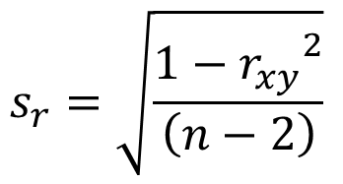
Hypothesis Test - Correlation
H0: ρ = 0
HA: ρ ≠ 0
Standard Error of Correlation coefficient is given by
$t=\frac{r_{xy}}{s_{r}} with \left(n−2\right)degrees of freedom$
$${s_{r}=\sqrt{\frac{{1−r_{xy}}^{2}}{\left(n−2\right)}}}_{ }$$

Slide 11
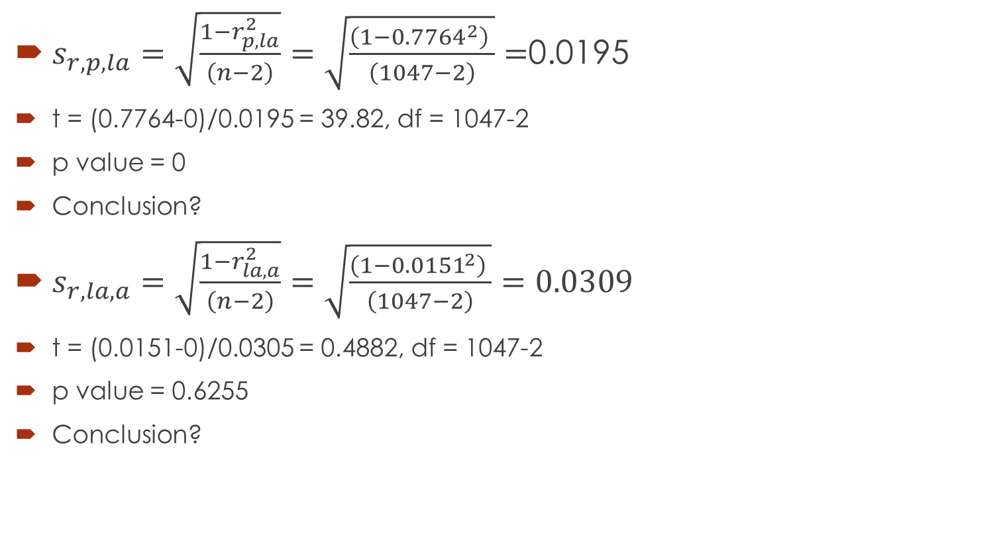
Example
$s_{r,p,la}=\sqrt{\frac{1−r_{p,la}^{2}}{\left(n−2\right)}}=\sqrt{\frac{{\left(1−{0.7764}^{2}\right)}^{ }}{\left(1047−2\right)}}=$0.0195
t = (0.7764-0)/0.0195 = 39.82, df = 1047-2
p value = 0
Conclusion?
$s_{r,la,a}=\sqrt{\frac{1−r_{la,a}^{2}}{\left(n−2\right)}}=\sqrt{\frac{{\left(1−{0.0151}^{2}\right)}^{ }}{\left(1047−2\right)}}=0.0309$
t = (0.0151-0)/0.0305 = 0.4882, df = 1047-2
p value = 0.6255
Conclusion?

Slide 12

Regression Analysis

Slide 13
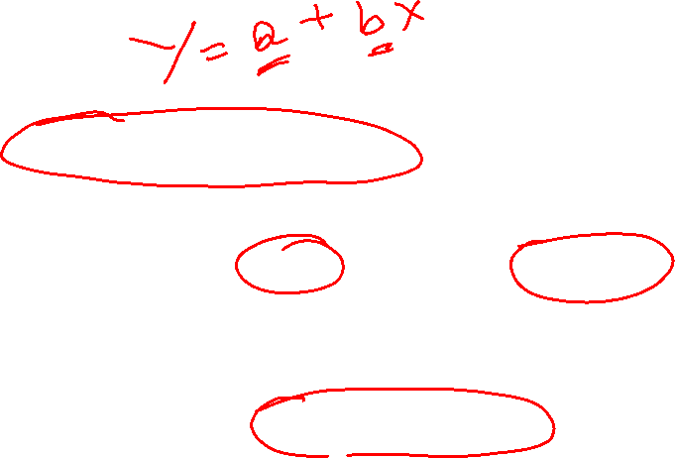
Learning Objectives
How to estimate a linear fit?
How to interpret the slope and the intercept of the fitted line?
How to quantify the goodness of fit?

Slide 14
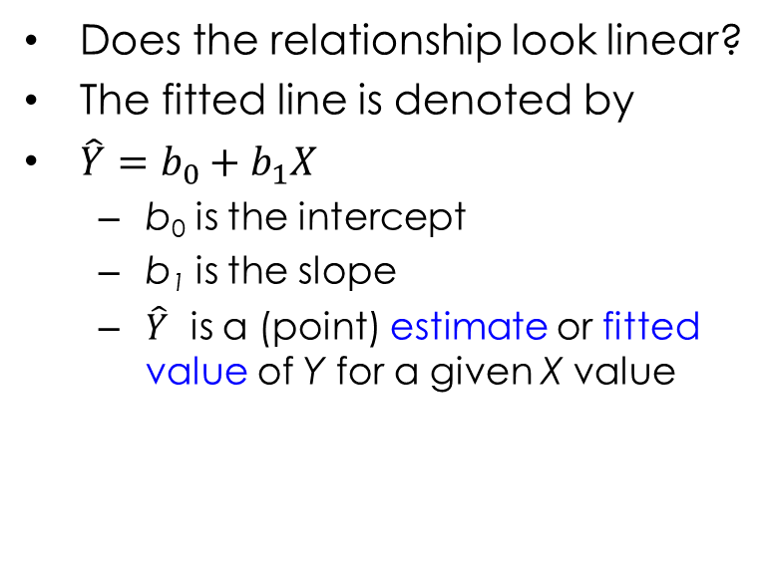
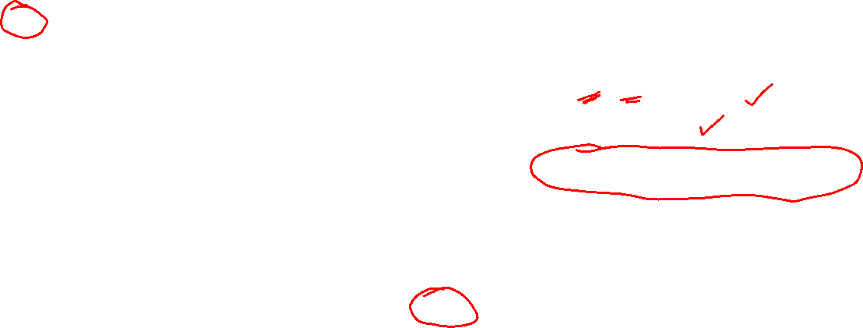
Linear Fit: Beyond Correlation
PBT
Does the relationship look linear?
The fitted line is denoted by
$\hat{Y}=b_{0}+b_{1}X$
  b₀ is the intercept
  b₁ is the slope
  $\hat{Y}$ is a (point) estimate or fitted value of Y for a given X value
AdEx

Slide 15
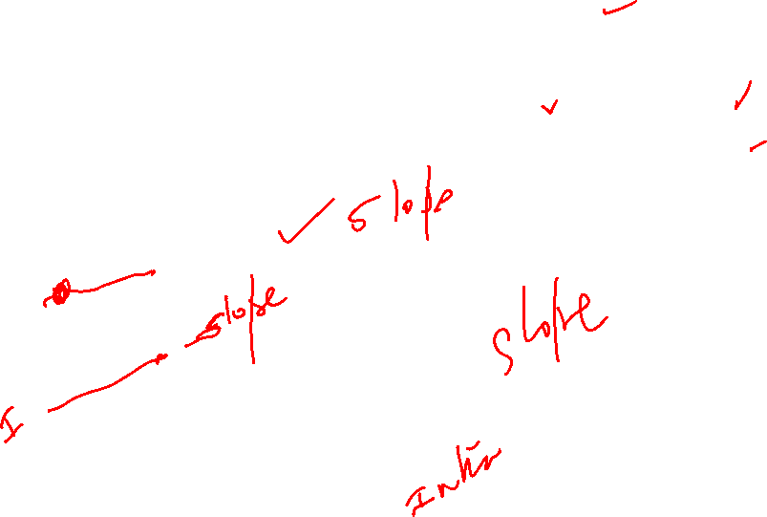
PBT
AdEx

Slide 16

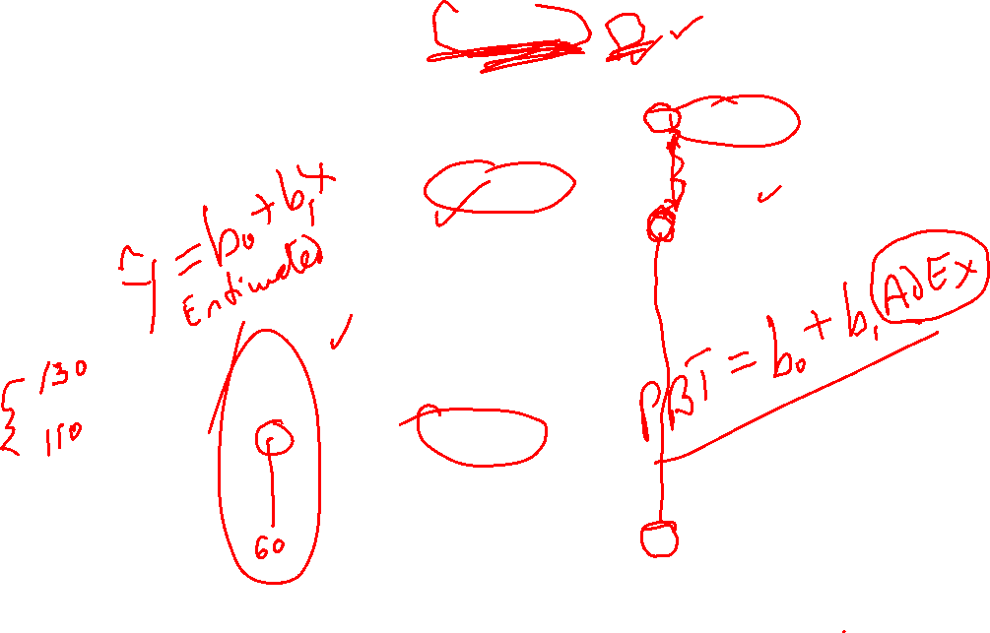

$$Y_{i}=b_{0}+b_{1}X_{i}+e_{i}$$
PBT
Observed
Deviation
Estimated
Estimated
$${\hat{Y}}_{i}=b_{0}+b_{1}X_{i}$$
Deviation
Observed
AdEx

Slide 17
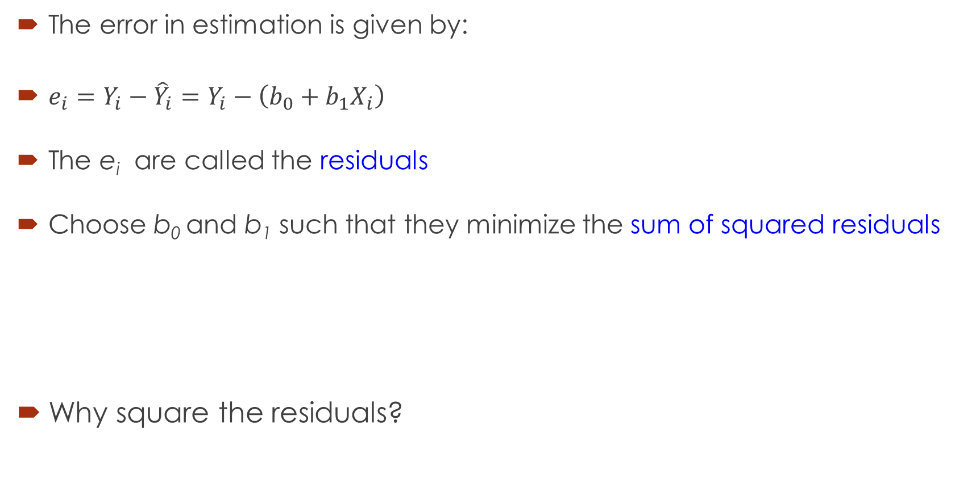
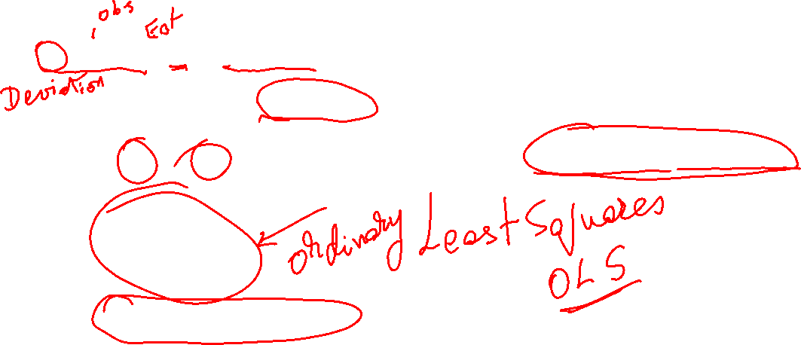
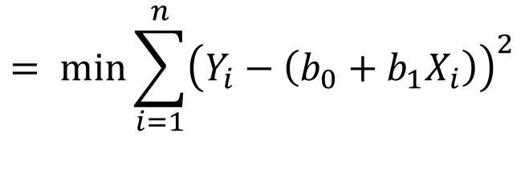
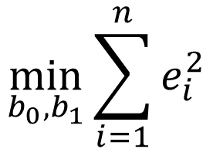
Choosing the Right Line
The error in estimation is given by:
$e_{i}=Y_{i}−{\hat{Y}}_{i}=Y_{i}−\left(b_{0}+b_{1}X_{i}\right)$
The e_{i} are called the residuals
Choose b₀ and b₁ such that they minimize the sum of squared residuals
Why square the residuals?
$$\min_{b_{0},b_{1}}{\sum_{i=1}^{n}{e_{i}^{2}}}$$
$$= min{\sum_{i=1}^{n}{{\left(Y_{i}−\left(b_{0}+b_{1}X_{i}\right)\right)}^{2}}}$$

Slide 18
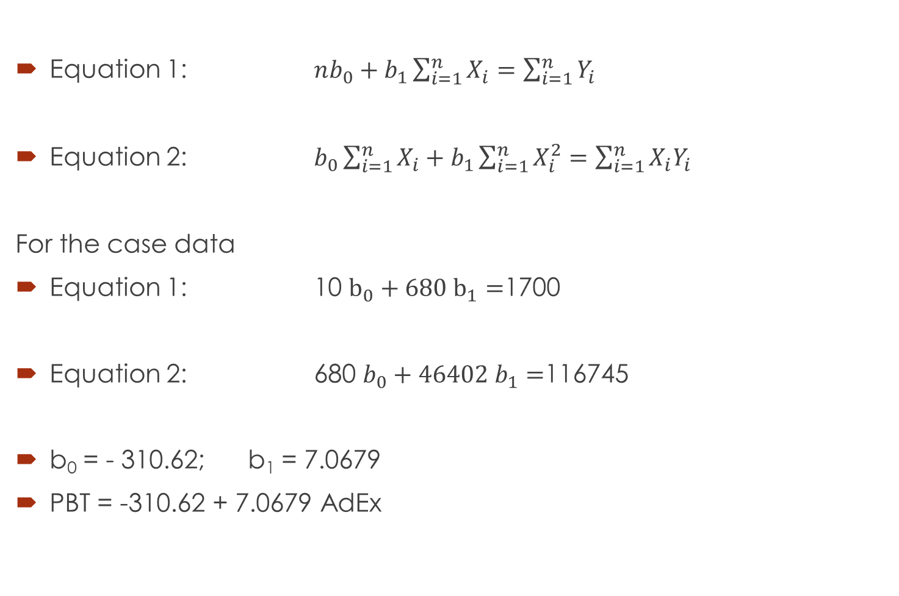

Normal Equations
Equation 1: $nb_{0}+b_{1}\sum_{i=1}^{n}{X_{i}}=\sum_{i=1}^{n}{Y_{i}}$
Equation 2: $b_{0}\sum_{i=1}^{n}{X_{i}}+b_{1}\sum_{i=1}^{n}{X_{i}^{2}}=\sum_{i=1}^{n}{X_{i}Y_{i}}$
For the case data
Equation 1: 10 $b_{0}+680 b_{1}=$1700
Equation 2: 680 $b_{0}+{46402 b}_{1}=$116745
b₀ = - 310.62; b₁ = 7.0679
PBT = -310.62 + 7.0679 AdEx
Interpretation of b₀ and b₁

Slide 19
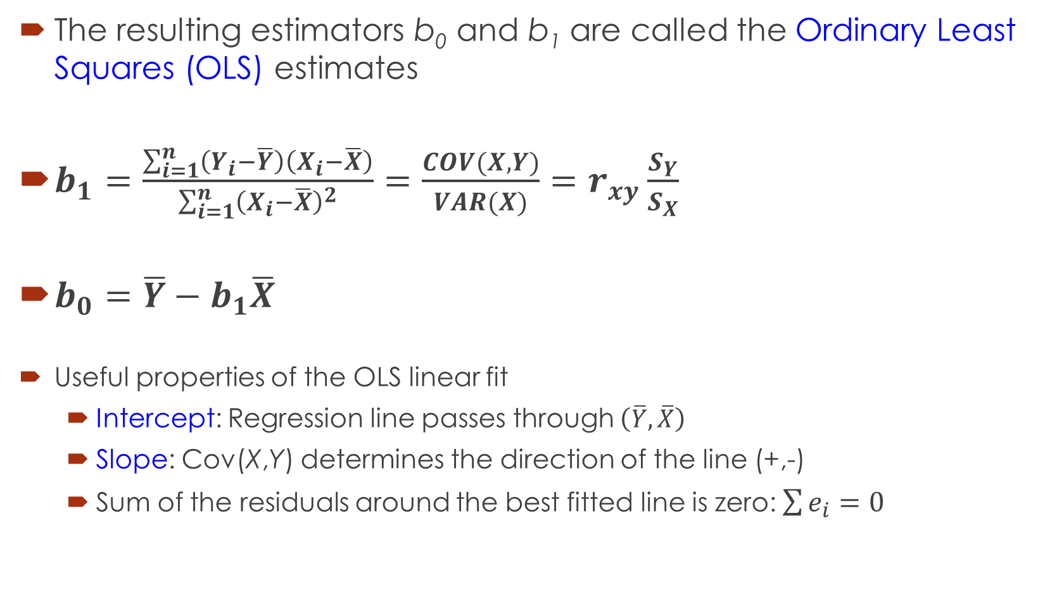
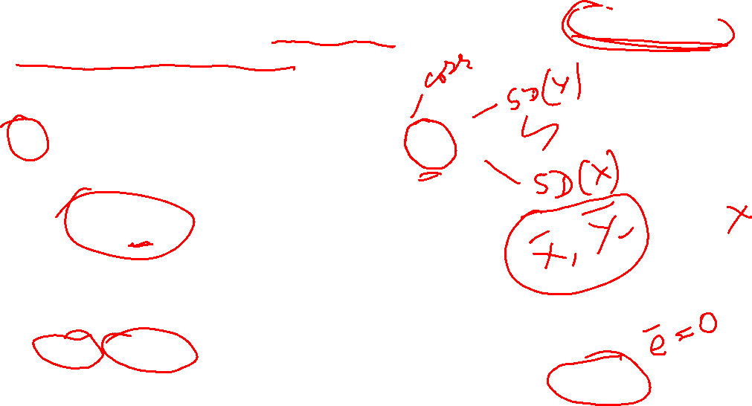
Ordinary Least Squares
The resulting estimators b₀ and b₁ are called the Ordinary Least Squares (OLS) estimates
$b_{1}=\frac{\sum_{i=1}^{n}{\left(Y_{i}−\overline{Y}\right)\left(X_{i}−\overline{X}\right)}}{\sum_{i=1}^{n}{{\left(X_{i}−\overline{X}\right)}^{2}}}=\frac{COV(X,Y)}{VAR(X)}=r_{xy}\frac{S_{Y}}{S_{X}}$
$b_{0}=\overline{Y}−b_{1}\overline{X}$
Useful properties of the OLS linear fit
  Intercept: Regression line passes through $\left(\overline{Y},\overline{X}\right)$
  Slope: Cov(X,Y) determines the direction of the line (+,-)
  Sum of the residuals around the best fitted line is zero: $\sum{e_{i}=0}$
What happens if X and Y are standardized values?

Slide 20
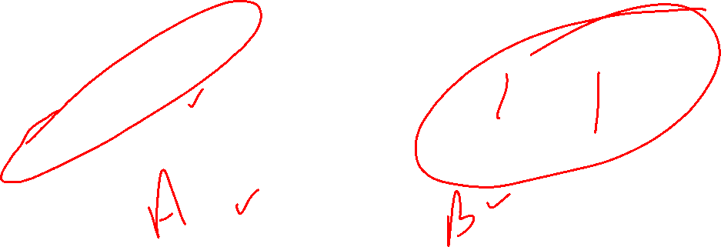
How Good is the Model Fit?

Slide 21
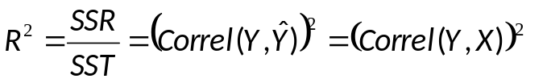
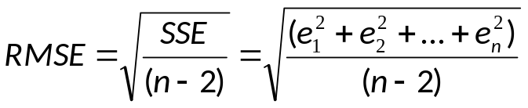



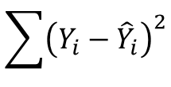

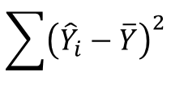

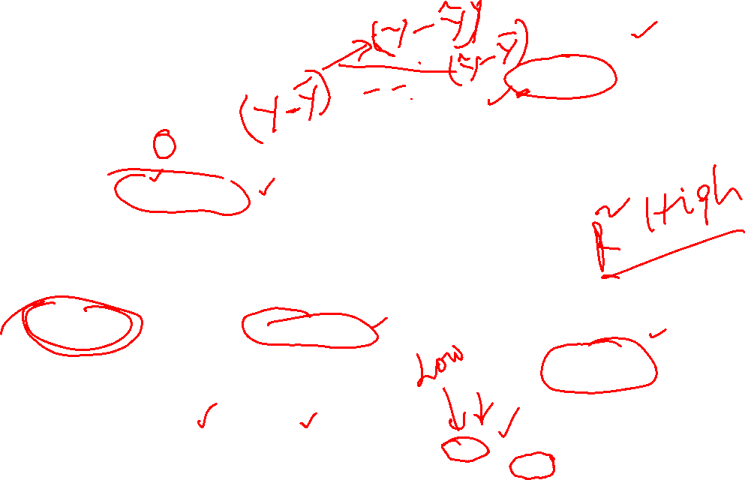

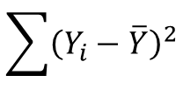
How Good is the Model Fit?
$${\hat{Y}}_{i}=−310.62+7.0679X_{i}$$
PBT
$${(X}_{i},Y_{i})$$
$$e_{i}={(Y}_{i}−{\hat{Y}}_{i})$$
$$\overline{Y}$$
$$({\hat{Y}}_{i}−{\overline{Y}}_{})$$
$${\hat{Y}}_{i}=b_{0}+b_{1}X_{i}$$
AdEx
Sum of Squares Total (SST)
Sum of Squares Regression (SSR)
+
Sum of Squares Error (SSE)
=
$$\sum{{\left(Y_{i}−\overline{Y}\right)}^{2}}$$
$$\sum{{\left({\hat{Y}}_{i}−\overline{Y}\right)}^{2}}$$
$$\sum{{\left(Y_{i}−{\hat{Y}}_{i}\right)}^{2}}$$
=
+
df

Slide 22
Use Excel

Slide 23
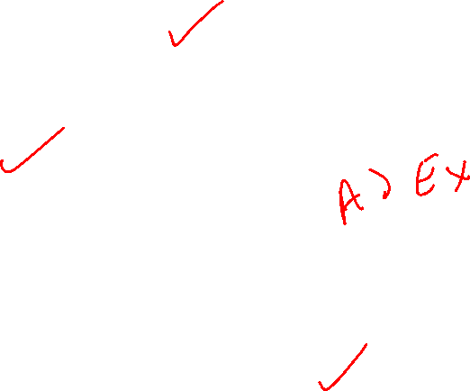
 | Coefficients | Standard Error | t Stat | P-value | Lower 95% | Upper 95%
Intercept | -310.6173 | 62.9636 | -4.9333 | 0.0011 | -455.8115 | -165.4230
Advertising Expenditure | 7.0679 | 0.9243 | 7.6466 | 0.0001 | 4.9364 | 9.1994
Regression Statistics
Multiple R | 0.9379
R Square | 0.8796
Adjusted R Square | 0.8646
Standard Error | 11.7646
Observations | 10
ANOVA
 | df | SS | MS | F | Significance F
Regression | 1 | 8092.75 | 8092.75 | 58.47 | 6.04E-05
Residual | 8 | 1107.25 | 138.41
Total | 9 | 9200.00

Slide 24
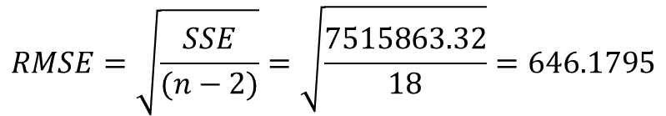

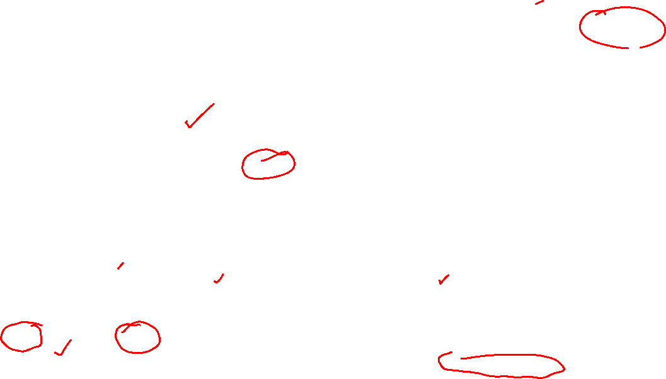
Obtaining Model Fit from Excel Output
$$RMSE=\sqrt{\frac{SSE}{(n−2)}}=\sqrt{\frac{7515863.32}{18}}=646.1795$$
Regression Statistics
Multiple R | 0.9307
R Square | 0.8662
Adjusted R Square | 0.8588
Standard Error | 646.1795
Observations | 20
ANOVA
 | df | SS | MS | F | Significance F
Regression | 1 | 48674530.5 | 48674530 | 116.6 | 2.7102E-09
Residual | 18 | 7515863.32 | 417548
Total | 19 | 56190393.8
$$R^{2}=\frac{SSR}{SST}=\frac{48674530.5}{56190393.8}=0.8662$$
PBT = 639.22 + 0.069 Sales ➔ UTI Data
Approximately 86% of the variation in PBT is explained by variation in Sales

Slide 25
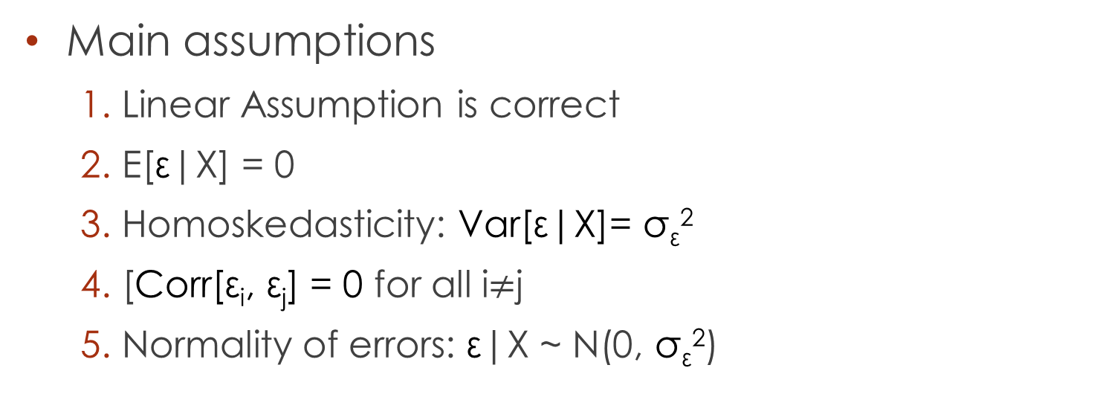
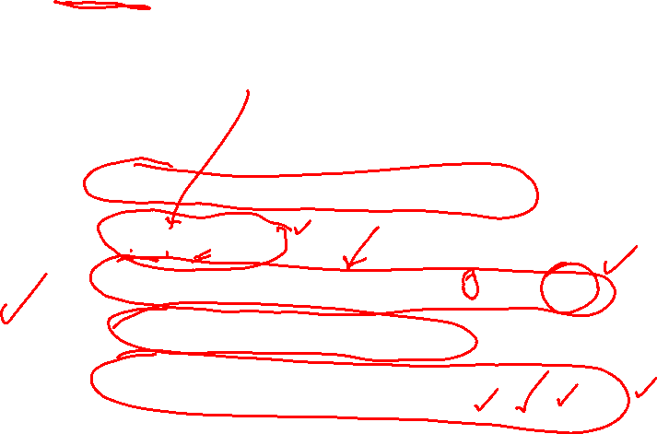
SLR Assumptions
Main assumptions
  Linear Assumption is correct
  E[ε|X] = 0
  Homoskedasticity: Var[ε|X]= σ_{ε}²
  [Corr[ε_{i}, ε_{j}] = 0 for all i$≠$j
  Normality of errors: ε|X ~ N(0, σ_{ε}²)

Slide 26
Questions?

