Slide 1
Quantitative Analytics tools for financial decisions
Session – 3 & 4
M Shameem Jawed

Slide 2
Quick Recap
Introduction to Module
Introduction to R & R-Studio
Installing and loading packages.
Data assignments, and manipulations – use of some generic functions etc.
Data types in R – Vectors, Matrix, Data Frames, Lists
Loops, conditional statements, and functions in R
Data Visualization

Slide 3
Agenda for today
Introduction to Hypothesis testing, Regression Analysis

Slide 4
Empirical Questions…
  Are our stock markets efficient? If so, how long the market will take time to become efficient?
  Do CAPM holds good in Indian context?
  What kind of lead-lag relations hold between spot and futures markets?
  Building a model that captures Indian stock market volatility dynamics
  Does index futures introduction destabilize spot market?
  Does the type of settlement matter? Move from Cash settlement to Physical settlement.
  Are Indian markets integrated with world markets / asian markets?
  Does stock split / bonus improves investor wealth?
  Measuring and forecasting volatility (stock / bonds)
  Determinants of bond credit ratings / default prediction

Slide 5
To answer such questions / issues, first we need data…
Data of what type?
Qualitative data vs Quantitative data
  Nominal, Ordinal, Ratio scales
  Conversion of Quantitative data to Qualitative data ?
Cross sectional Vs Time series Vs Panel data
Knowing the type of data is necessary to select a technique to be used
Correlation – concept checker?
  A research study reported that there is a correlation of -0.69 between the type of IPO (fixed price or book building) of 100 recently listed firms and returns of the first day of listing.
  Comment on usefulness of this correlation.

Slide 6
Understanding p-values
Quantifies the extent to which the sample data support or contradict the claim stated in the H₀
  Probability that the null is true.
The smaller the p-value, the more convincing the evidence is against the null hypothesis
Probability of getting a statistic that is more extreme under H₀
If p-value is less than 0.05 [t-stat is approx. 2] then you will reject Null hypothesis.

Slide 7
Why Regression?
Hypothesis Testing just concludes Null is accepted or rejected….don’t comment on the reasons or source of the difference.
Regression Analysis
  Is concerned with describing and evaluating the relationship between a given variable and one or more other variables.
  Is an attempt to explain movements in a variable by reference to movements in one or more variables.
  Estimating and/or predicting the (population) mean or average value of the
dependent variable on the basis of the known or fixed values of independent variables

Slide 8
Why Regression?
How Asset Returns vary with level of Market Risk?
Is PE or EPS a good predictor of annual returns in a stock?
Does board independence explain the variance in firm’s RoE?
Do women on corporate boards add value to the firm?
How can one measure the long run relationship between stock price and dividends?

Slide 9
Simple Regression Model
Explaining asset returns (y) in terms of level of market risk (x)
Points to be noted:
  There is never an exact relationship between two variables
  What is the functional relationship between x and y
  How can we ensure that we are capturing a ceteris paribus relationship, assuming that we desire so?
  Consider the following:
Two-Variable Linear Regression model
Dependent variable
y = β₀ + β₁x + u
Error term
Independent
Intercept parameter
variab
le
Slope Para
meter

Slide 10
Example
Long term relationship between stock prices and dividends
The regression equation explaining stock prices in N industries over T time periods is given as:
^{P}it ^{= β}1it ^{+ β}2it ^{d}it
ε_{it}
^{P}it
^{d}it
^{ε}it
Stock price index of ith industry at t-th period Dividend per share paid by ith industry at time t
Stochastic disturbance term , with different assumptions

Slide 11
Regression versus Correlation
Regression
The dependent variable (y) and the independent variable(s) (x’s) very differently.
The y variable is assumed to be random or “stochastic”, i.e. to have a probability distribution.The x variables are, however, assumed to have fixed (“non-stochastic”) values in repeated samples.
Correlation
If we say y and x are correlated, it means that we are treating y and x in a completely symmetrical way. Cor (x,y)=Cor(y,x)

Slide 12
Specification of Regression
Unavailability of data Poor proxy variables
Vagueness of underlying theory

Slide 13
Regression – Finance applications
Regression slope parameter is estimated as the ratio of covarince(X,Y) to Variance(X)
Do you recall CAPM ?
  Remember how do you estimate Market Beta
  Nothing but the slope in the regression of stock returns on market returns
Do you recall Hedge ratio?
  Objective to have a Hedge ?
Suppose you have an investment in spot market, and you would like to hedge your spot position. Where do you invest?
  Take opposite position in Futures. A short position in Futures market.
  How much in futures? Hedge ratio will define that.

Slide 14
Regression – Hedging…
Let's define SpotReturns SR_{t} ; FutureReturns FR_{t} ;
Spot StdDev 𝜎_{𝑠} ; Futures StdDev 𝜎_{𝑓 ;} Covariance : 𝜎_{𝑠𝑓}
Portfolio would be: SR_{t} – h*FR_{t ;} h is unknown hedge ratio
Minimize portfolio variance to get hedge ratio
V(SR-hFR) = v(SR)+h².v(FR)-2. h.Cov(FR, SR)
Min. wrt h…

Slide 15
Regression
Regression decomposes Y into Expected and Unexpected components.
Assumption:
  Unexpected (error) component need to be completely random.
Characterization of randomness <Assumption>
  Zero mean,No Autocorrelation, Constant variance and follows normal distrn
Regression has two objectives:
  To explain the variation in dependent variable with the help of independent variables
    [Eg: Need to complete the project / task]
  To assess the relative contribution of each independent variable in explaining the variation in dependent variable
    [Eg: Contribution of each member in the group towards completion of the project / tast]
  Let’s Look at the assumptions more closely…

Slide 16
Assumptions of Regression model

Slide 17
Assumptions
Linearity of the model (correct fn form, additive)
Exogeneity (No omitted variable bias)
Mean of residual = 0; Normality of residuals (Optional if large data)
Const. variance of Error (Homoscedasticity)
Independence of Error terms (No-autocorrelation)
Absence of serious multicollinearity
Variability in Xs >0
The X variables and residuals are uncorrelated

Slide 18
Assumption 1
Linear regression model.
The regression model is linear in the parameters
This does not rule out the possibility of a polynomial regression equation like
Y = β + β X + β X + ε
2
i 0 1 2
i

Slide 19
Assumption 2
X values are fixed in random sampling
Values taken by the regressor X are considered fixed in repeated samples.
More technically, X is assumed to be non-stochastic.

Slide 20
Assumption 3
Zero mean value of disturbance u_{i}.
Given the value of X, the mean, or expected, value of the random disturbance term u_{i} is zero.
Technically, the conditional mean value of u_{i} is zero.

Slide 21

Assumption 4
Homoscedasticity or equal variance of ui.
Given the value of X, the variance of ui is the same for all observations.
That is, the conditional variances of ui are identical.
Symbolically,
Y populations corresponding to various X values have the same variance.
The variation around the regression line (which is the line of average relationship between Y and X) is the same across the X values; it neither increases or decreases as X varies.

Slide 22

Assumption 5
No autocorrelation between the disturbances.
Given any two X values, Xi and Xj, the correlation between any two ui and uj is zero Symbolically,

Slide 23
How do we interpret the estimated coefficients?
The intercept term β^{ˆ} is interpreted as the value of the dependent
1
variableY when the independent variables are equal to zero
The slope β^{ˆ}₂ is interpreted as the factor by which Y changes, on an average, if X2 changes by one unit after taking out the impact of other independent variables. Similarly other slope coefficients.
To check for ‘reliability ’ / ‘significance’ of these estimates
Recall hypothesis testing
{Estimate – Null value } / Std Error of estimate
Smaller the corresponding ‘p-value’…greater the significance

Slide 24
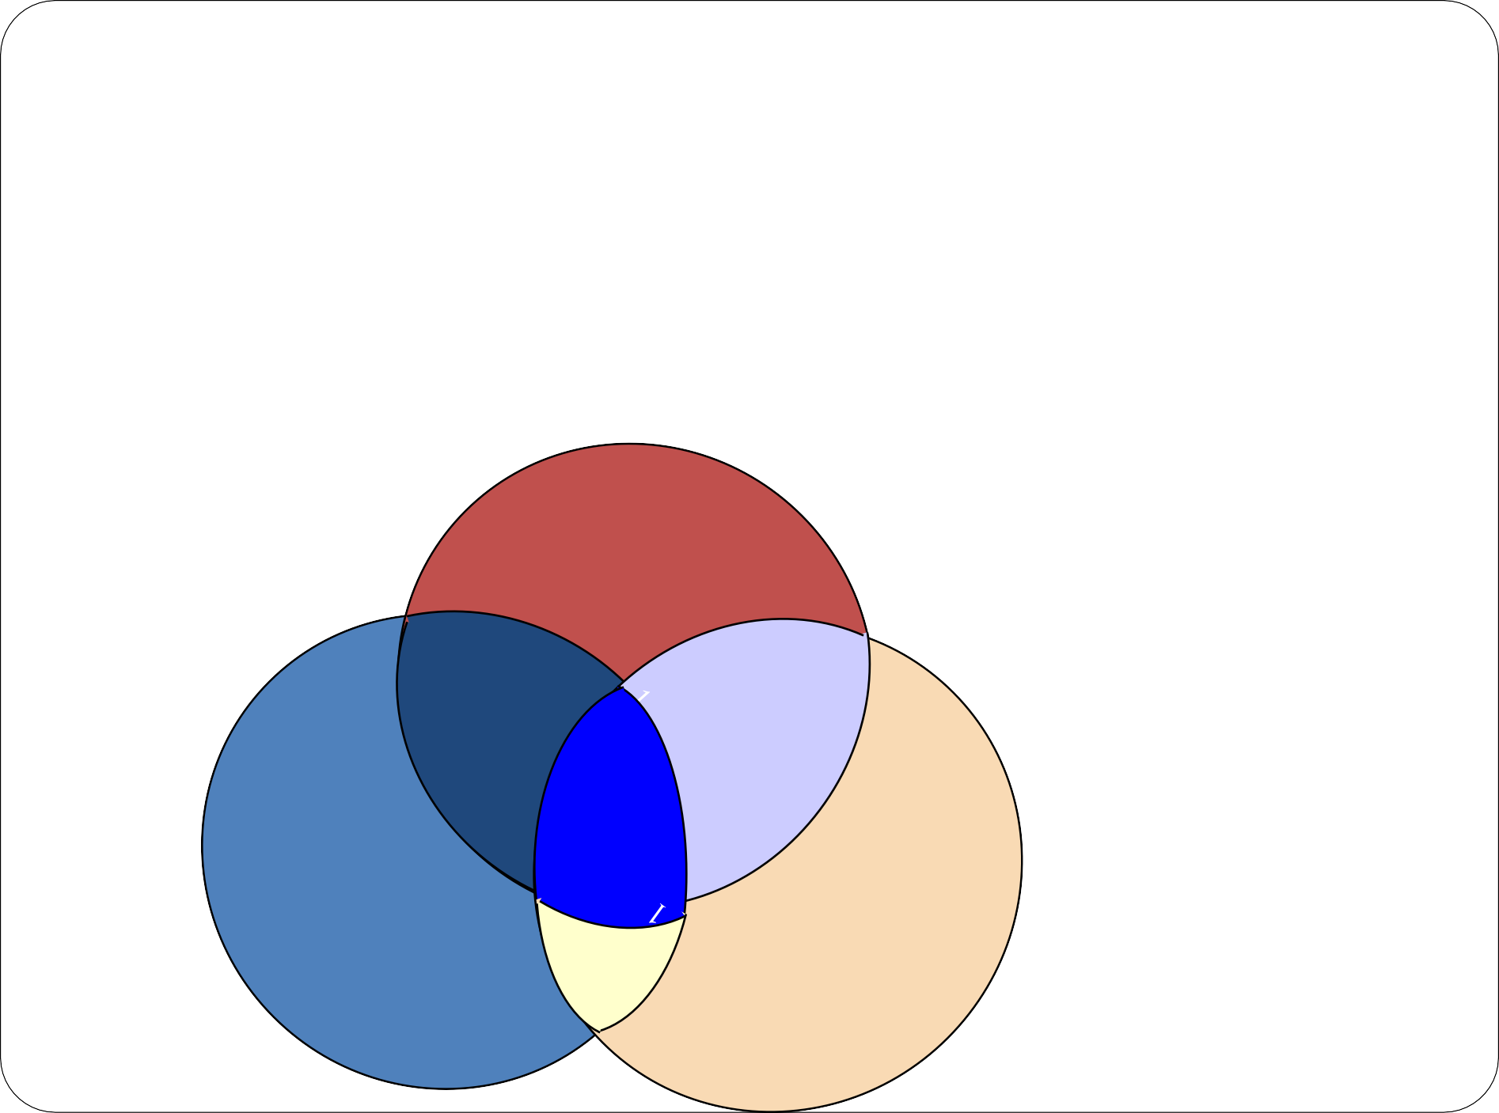
Regression Parameters in Venn diagram
The slope β^{ˆ}₂ is interpreted as the factor by whichY changes if X2 changes by one unit after taking out the impact of other independent variables.
β₂, X2’s contribution in
explaining Y: 1+3 or 1 ?
β3, X₃ ’s contribution in
explaining Y: 2+3 or 2 ?
Y
β3 = 2
β₂ = 1
X₂ and X₃ together explains, 1+3+2 Note that 3 is not accounted for either for X₂ orX₃
1
2
.
3
X₂
X₃

Slide 25
Example
Now suppose we explain the changes in corporate AAA bond through changes in changes in 10 year Treasury bond and 30 year Treasury bond
Variable |  | Parameter Estimate β (1) | Standard Error (2) | t value H₀:β=0 (3=1/2) | Pr >|t|
Intercept |  | 0.00022661 | 0.00218 | -0.05 | 0.9609
10 yr treasury bond |  | 0.57237 | 0.04456 | 8.09 | < 0.0001
30 yr treasury bond |  | 0.29655 | 0.04987 | 5.95 | < 0.0001

Slide 26
The first step in using Capital Asset Pricing Model (CAPM) is to estimate the
stock’s beta using the market model. The market model can be written as
R_{it} = α_{i} + β_{i}R_{mt} + u_{it}
where R_{it} is the excess return for i^{th} security at time t, R_{mt} is the excess return on a proxy for the market portfolio at time t, and u_{t} is a random error term. The coefficient beta in this case is also the CAPM beta for i^{th} security.
Suppose that you had estimated the above equation over 62 daily observations and found that the estimated value of beta for a stock, β^ was 1.147. The standard error associated with this coefficient is estimated to be 0.0548. An analyst has told you that this security closely follows the market, but that it is no riskier, on average, than the market.

Slide 27
Write down null and alternate hypotheses to examine the security is more risky than the market? Given the above data, what do you conclude? Are the analyst’s claims empirically verified?
H_{a}: β > 1. t-stat =
1.147−1
0.0548 ^{=2.68}
As t-stat is greater than 2, p-value would be less than 0.05 and hence we reject the null. The security is riskier than market.

Slide 28
Suppose you ran a regression with 200 firms’ data to evaluate the effect of various firm- specific factors on the returns of the 200 firms. The specific regression estimated is as follows:
R_{i} = β₀ + β₁S_{i} + β₂MB_{i} + β₃PE_{i} + β₄ BETA_{i} + u_{i}
Where: R_{i} : the percentage annual return for the stock
S_{i} : the size of firm I measured in terms of sales revenue
MB_{i}: the market to book ratio of the firm
BETA_{i} the stock’s CAPM beta coefficient

The result of the estimated regression with standard errors in parentheses:

R^ = 0.080 + 0.801 S + 0.321 MB + 0.164 PE – 0.084 BETA


Calculate the t-ratios.
What do you conclude about the effect of each variable on the returns of the security?
On the basis of results, what variables would you consider deleting from the regression?
If a stock’s beta increased from 1 to 1.2, what would be the expected effect on the stock’s return? Is the sign on beta as you would have expected?
I
i i i i
(0.064) (0.147) (0.136) (0.420) (0.120)

Slide 29
R^ = 0.080 + 0.801 S + 0.321 MB + 0.164 PE – 0.084 BETA
I i
i
i
i
(0.064)
1.25
(0.147)
5.45
(0.136)
2.36
(0.420)
0.39
(0.120)
0.7
SE
t-stat
Size and Market-to-Book ratio are significant in explaining the returns but not PE and BETA.
PE and BETA are not useful in the presence of Size and Market-to-Book ratio in explaining the returns.
If BETA increases by one unit then stock returns will go down by 0.084. As BETA moves from 1 to 1.2 (20% increase) then stock returns will go down by 0.084*0.2 = 0.012
A priori, we expect BETA will have positive coefficient as one expects higher return for bearing higher risk. However, in this hypothetical example, the effect of BETA is already captured by Size and MB ratios, hence BETA is insignificant.

Slide 30
Quick Recap
Linearity of the model (correct fn form, additive)
Mean of residual = 0; Normality of residuals (Optional if large data)
Const. variance of Error (Homoscedasticity)
Independence of Error terms (No-autocorrelation)
Absence of serious multicollinearity
Variability in Xs >0
The X variables and residuals are uncorrelated

Slide 31




Goodness of Fit – Model selection criteria

Slide 32
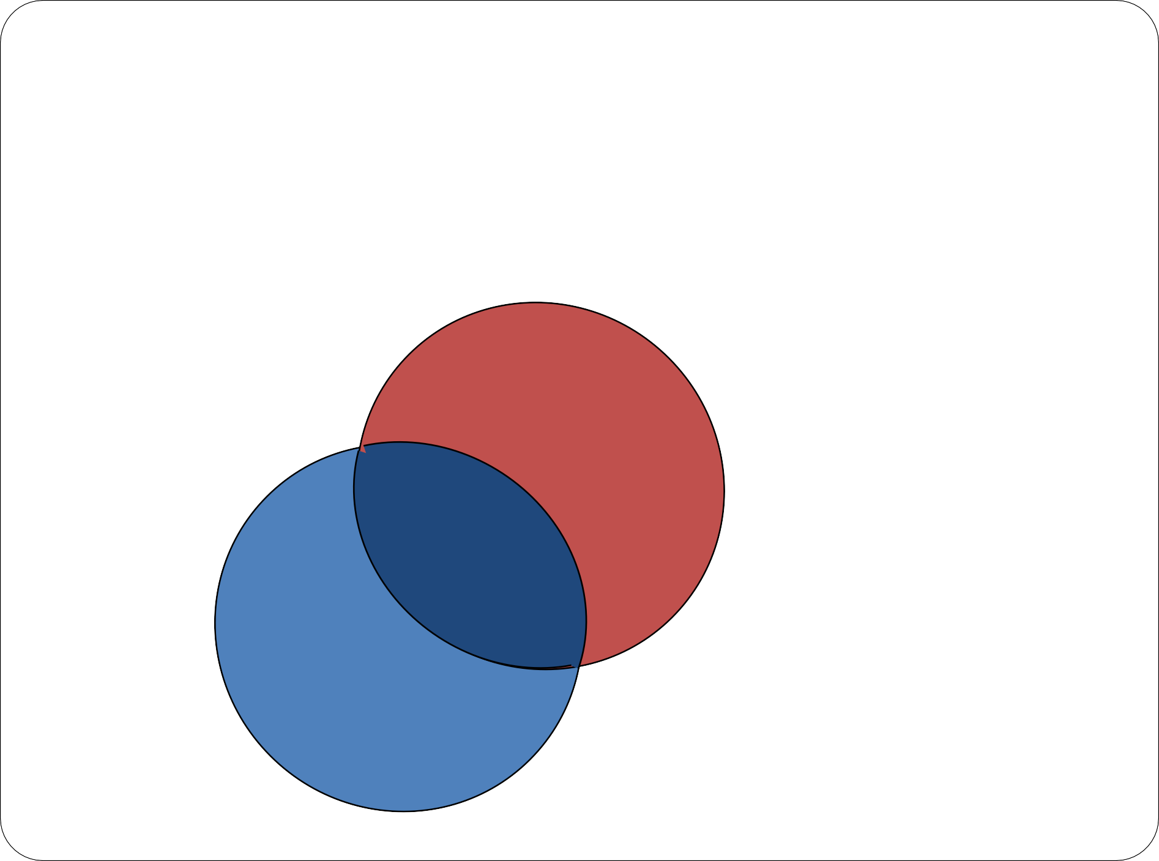
Explanatory Power of Regression
Variations in Y not explained by the X and will account for Error
Variations in X not used in explaining variation in Y
Y
Variations in Y explained by X or variations in X used in explaining variation in Y
X

Slide 33
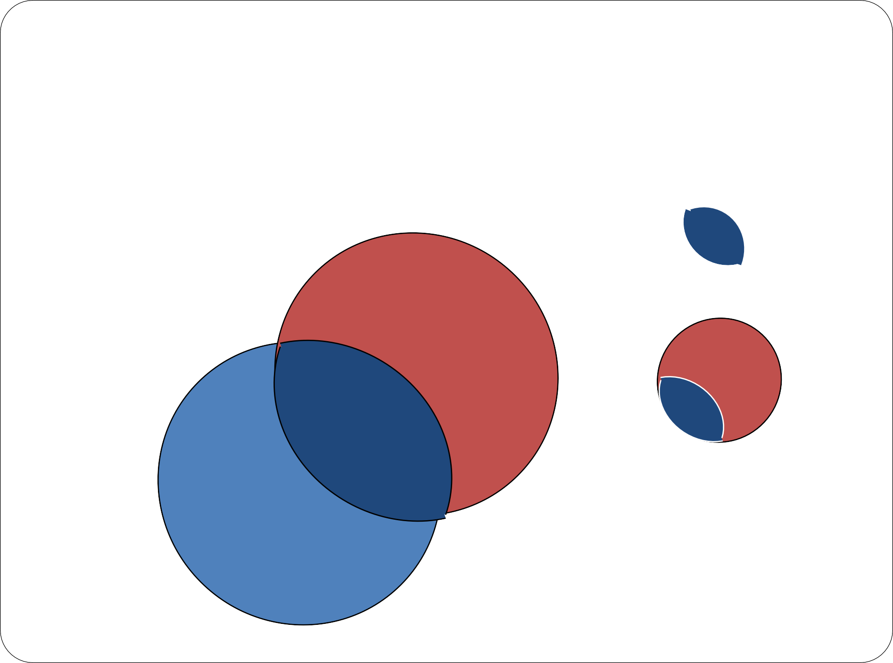
Explanatory Power of Regression
Y
_{R}2
=
--------------------------
X

Slide 34
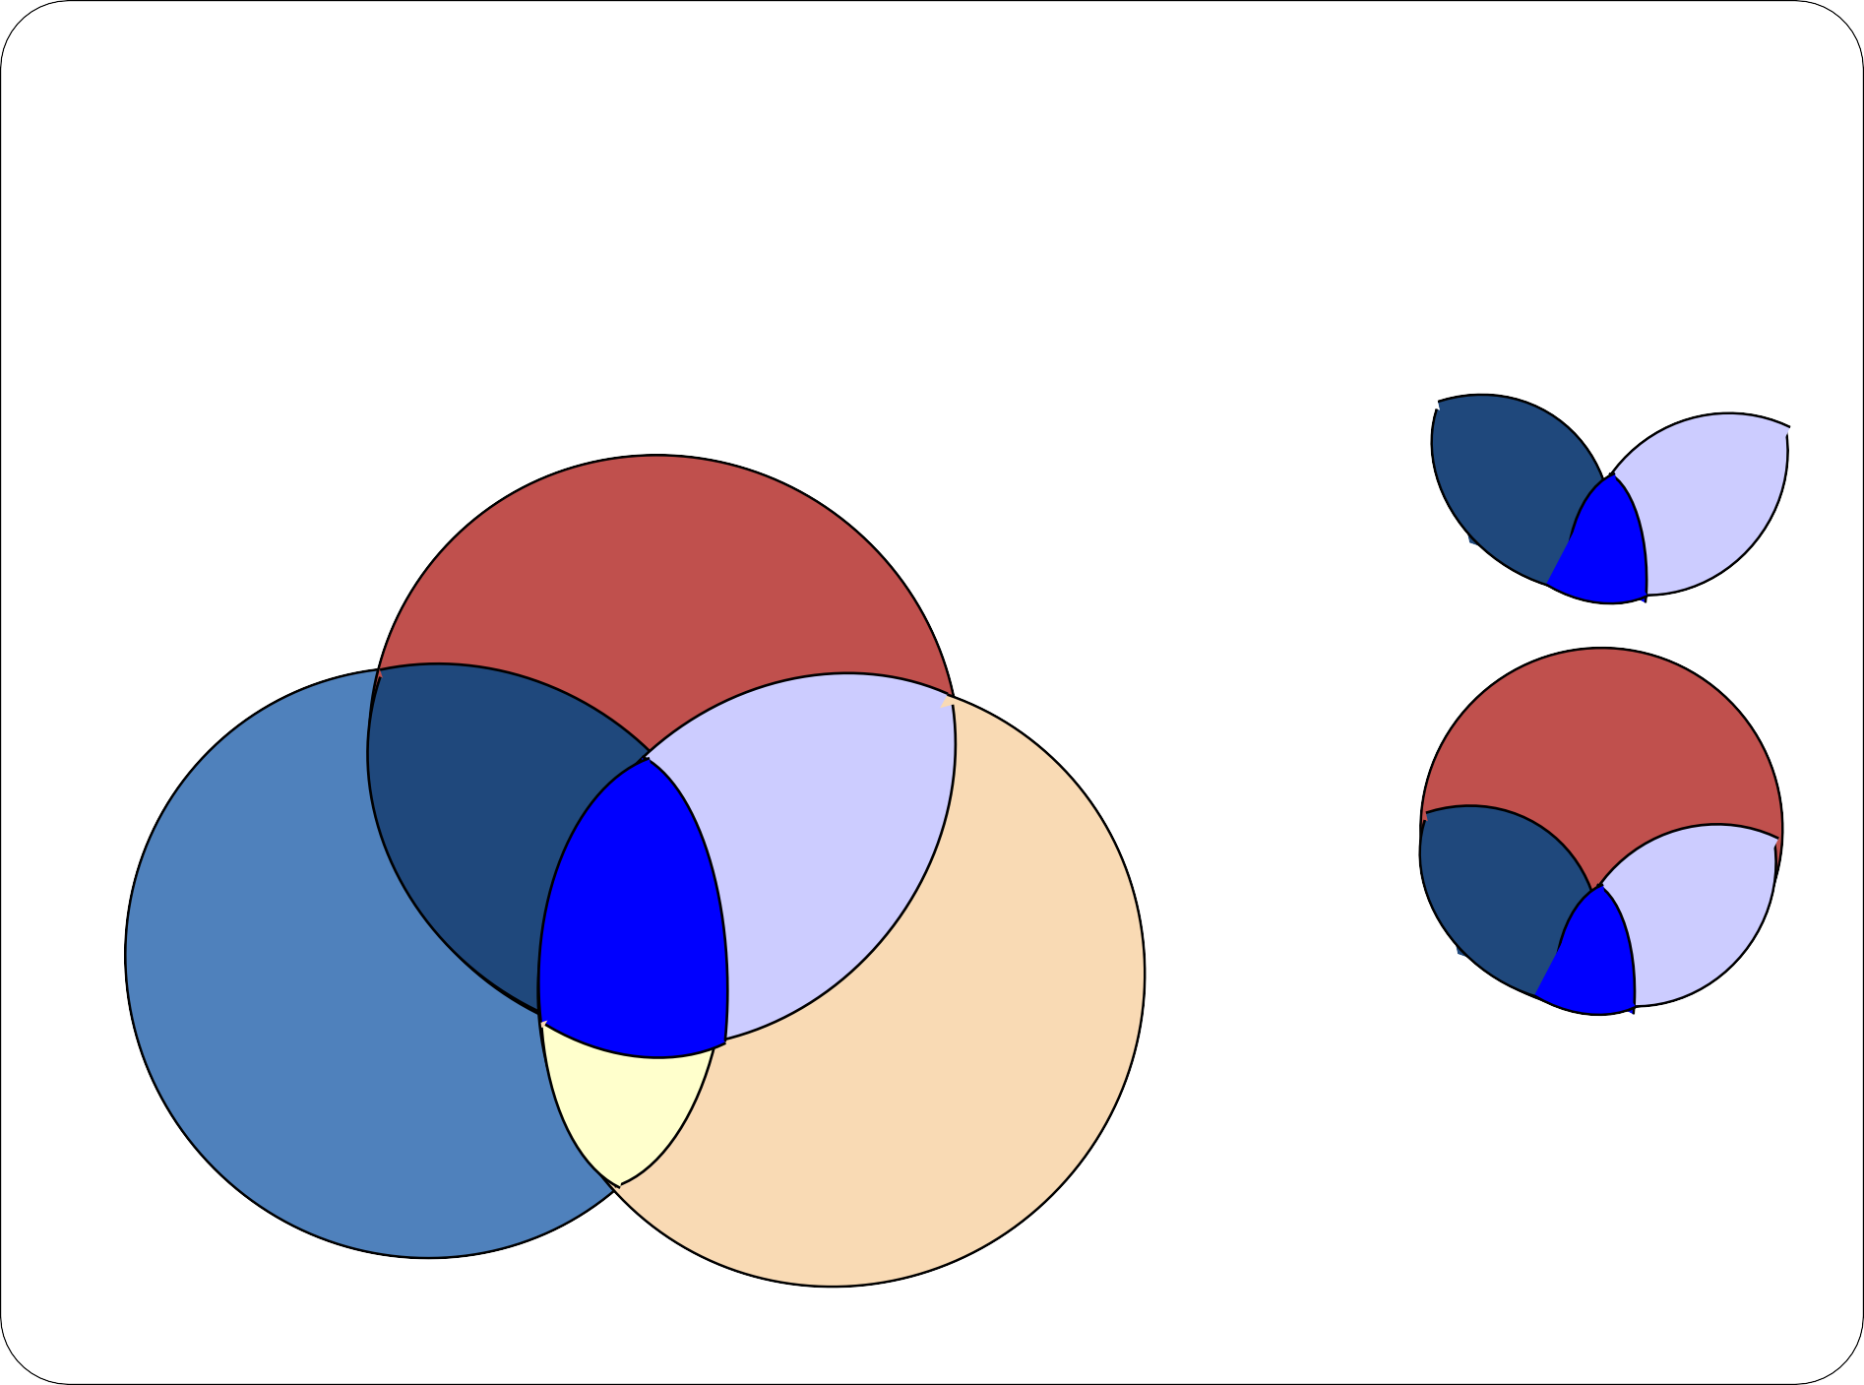
Explanatory Power of Regression
Y
X
Z
ESS R²=
TSS

Slide 35

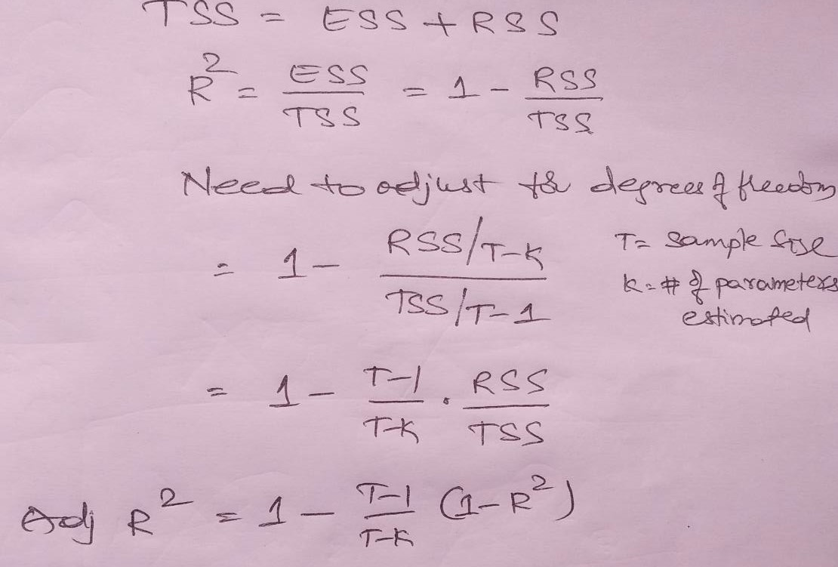
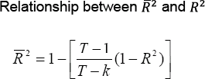
Problems with R-squared as a goodness of fit measure
Model 2 R- squared value cannot be less than that of Model 1
Adjusted R-squared

Slide 36
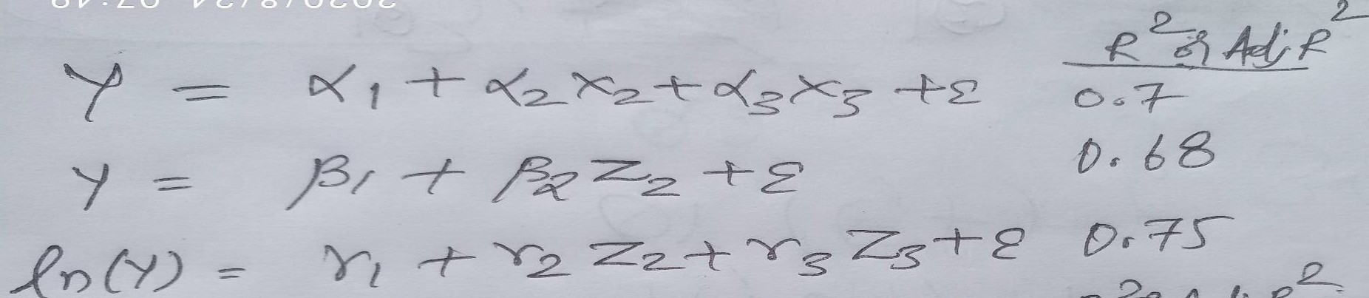
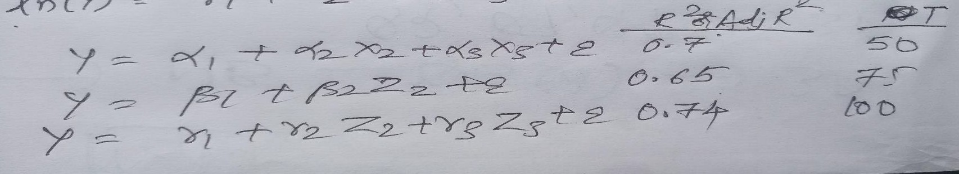
Choose the best model
You can’t choose between 1 and 3, as the dependent variable is
different.
You can’t compare these three models as sample size is different.
You can use AdjR² only when dependent variable and sample size are same between models.

Slide 37
Consequences of Variable Misspecification
 |  | True Model
 |  | Y = β₁ + β₂ X ₂ + u | Y = β₁ + β₂ X ₂ + β₃ X ₃ + u
Fitted Model | Y^{ˆ} = b₁ + b₂ X ₂
 | Y^{ˆ} = b₁ + b₂ X ₂ b₃ X ₃
Correct specification,
no problems
Correct specification,
no problems

Slide 38
OMISSION OF A RELEVANT VARIABLE
Consequences of Variable Misspecification
 |  | True Model
 |  | Y = β₁ + β₂ X ₂ + u | Y = β₁ + β₂ X ₂ + β₃ X ₃ + u
Fitted Model | Y^{ˆ} = b₁ + b₂ X ₂ | Correct specification, no problems | Coefficients are biased, Standard errors are invalid.
 | Y^{ˆ} = b₁ + b₂ X ₂ b₃ X ₃ |  | Correct specification, no problems
The omission of a relevant explanatory variable causes the regression coefficients to be biased and the standard errors to
be invalid.

Slide 39
VARIABLE MISSPECIFICATION II: INCLUSION OF AN IRRELEVANT VARIABLE
Consequences of Variable Misspecification
 |  | True Model
 |  | Y = β₁ + β₂ X ₂ + u | Y = β₁ + β₂ X ₂ + β₃ X ₃ + u
Fitted Model | Y^{ˆ} = b₁ + b₂ X ₂ | Correct specification, no problems | Coefficients are biased (in general). Standard errors are invalid.
 | Y^{ˆ} = b₁ + b₂ X ₂ b₃ X ₃ | Coefficients are unbiased (in general), but inefficient. Standard errors are valid (in general) | Correct specification, no problems

Slide 40
Degree of Multicollinearity - Estimation
No Multicollinearity
  The regression coefficients would appear to be identical to separate bivariate regressions.
  Ideal case.
Perfect Multicollinearity
  Some variable X_{i} is a perfect linear combination of one or more other variables X_{j.}
  One can’t differentiate between the coefficients of correlated variables and a model cannot
be estimated under such circumstances.

Slide 41
Degree of Multicollinearity - Estimation
A high degree of Multicollinearity
  Estimation possible….but the precision of the estimates are poor → standard errors are large ----→ t-stats are smaller → Unable to reject null hypotheses. However R² tends to be high and can’t attribute the explanation to individual variables.
Moderate degree of Multicollinearity
  Estimation of individual coefficients is possible with reasonable precision.


Slide 42
Multicollinearity : Practical consequences
Although unbiased, OLS estimates have high variances
confidence intervals are wider
t ratios tend to be insignificant
Even though t’s are low, R² is often quite high
Small changes in the sample can cause big changes in the estimated parameters.

Slide 43
Remedies for Multicollinearity
Dropping the ‘problematic’ variables
combining cross section and time series data
A priori information – domain.
transforming variables (trend deviations & first differences)
Adding more data
  But not easy always to get more
Using fancy methods like “ridge regression” / “Principal Components”

Slide 44
1.The following model for stock returns is estimated but you think may be a problem with it. that there
By calculating the t-ratios, and considering their significance and by looking at the value of R² or otherwise, suggest what the problem might be:
_{R}^
= 0.638 + 0.402 X – 0.891 X R²=0.96; Adjusted R²=0.89
I
2 3 ;
(0.436) (0.291) (0.763)
How might you go about solving the perceived problem?

