Slide 1
Advanced Leadership and Change Management
Session-3&4
Motivation
Prof. Anupama Sharma

Slide 2

What is Motivation
Motivation
  The processes that account for an individual’s intensity, direction, and persistence of effort towards attaining a goal.
Key Elements
1. Intensity: How hard a person tries;
2. Direction: Toward beneficial goal;
3. Persistence: How long a person tries.

Slide 3
Current Challenges of Motivating Employees
Layoffs, restructuring
  1. Damaged trust, commitment.
Flatter organizations
  1. Fewer supervisors to monitor performance.
Changing workforce
  1. Younger employees have different needs;
  2. Diverse workforce.

Slide 4
Classification of Theories
Content Theories: Focus on identifying “what” are the motivators; theories of Maslow, Alderfer, Herzberg.
Process Theories: Identify “how” of motivation, i.e. the cognitive process underlying motivation; theories of Vroom, Lawler & Porter, Adams, Locke.

Slide 5

Early Theories of Motivation
1. Maslow’s Hierarchy of Needs Theory
2. McGregor’s Theory X and Theory Y
3. Herzberg’s Two-Factor Theory
(Motivation-Hygiene Theory)
4. McClellan’s Theory of Needs
(Three Needs Theory)
Notes:
There are number of theories of motivation that help us gain a better understanding of the concept. Some of the earlier theories are not entirely valid anymore but they are still used by many managers.

Slide 6
Maslow’s Hierarchy of Needs Theory
Notes:
The first theory was developed by Abraham Maslow in the 1950’s. His theory states that with every individual there is a hierarchy of five needs. As each need is met or satisfied the next need becomes dominant. His theory posits that individuals are stuck in their existing need level until it is satisfied and then the can move on to the next level. For example, until their safety needs are met they will not be able to move on to the social level.

Slide 7
Douglas McGregor’s X & Y
Theory X
Theory Y
1. Inherent dislike for work and will attempt to avoid it.
2. Must be coerced, controlled or threatened with punishment.
1. View work as being as natural as rest or play.
2. Will exercise self-direction and self-control if committed to objectives.
Notes:
Douglas McGregor added to the motivation work done in the 1950’s and developed the theory called Theory X, Theory Y. He believed that there are two distinct views of human beings that managers hold. The Theory X view is basically negative and holds that workers have little ambition, dislike work and avoid responsibility. The Theory Y view is in contrast to X and sets forth that workers tend to be self-directed, enjoy work and accept responsibility. Managers will modify their behavior toward employees based on what view they hold about them.

Slide 8
Herzberg’s Two-Factor Theory
Bottom Line: Satisfaction and dissatisfaction are not opposites of the same thing!
Hygiene Factors
Salary
Work Conditions
Company Policies
Separate Constructs
  -Hygiene Factors -Extrinsic and Related to Dissatisfaction
  - Motivation Factors -
  Intrinsic and Related to Satisfaction
Motivators
Achievement
Responsibility
Growth
Advancement

Slide 9
Herzberg’s Two-Factor Theory
Not Dissatisfied
Satisfied
Hygiene Factors
Motivation Factors
Quality of supervision
Pay
Company policies
Physical working conditions
Relationships
Job security
Promotional opportunities
Opportunities for personal growth
Recognition
Responsibility
Achievement
Dissatisfied
Not Satisfied
Notes:
Herzberg’s Two-Factor theory is another one of the earlier developed theories. This theory sets forth that satisfaction and dissatisfaction are not the opposites, but two separate ideas. There are a set of factors that when present will help to avoid dissatisfaction in workers. This group is called the hygiene factors and includes such things as salary, working conditions and company policies. There is another set of factors that when present will help to cause satisfaction in workers. This group is called motivators and includes things such as growth, responsibility and achievement. These sets are distinct and the presence of hygiene factors does not cause satisfaction, it just helps avoid dissatisfaction.

Slide 10
McClelland's Theory of Needs
Need for Achievement (nAch)
  The drive to excel.
Need for Power (nPow)
The need to make others behave in a way they would not have behaved otherwise.
Need for Affiliation (nAff)
The desire for friendly and close interpersonal relationships.
Notes:
The final earlier theory of needs we will look at is McClelland’s need theory. He bases his theory on the idea that people are motivated in the workplace by three main needs. The first need is the need for achievement or the drive to excel in relation to a set of defined standards. The second is the need for power, to make others behave in a way that they would not have behaved otherwise. The final need addressed in this theory is the need for affiliation. Affiliation looks at the relationship aspect and the desire for close relationships. People will have varying levels of these needs which make this theory difficult to measure.

Slide 11

McClelland's High Achievers
High achievers prefer jobs with:
  1. Personal responsibility;
  2. Feedback;
  3. Intermediate degree of risk (50/50).
High achievers are not necessarily good managers.
High nPow and low nAff is related to managerial success.
Notes:
The need that has received the most attention by researchers is the need for achievement. Achievers will carefully measure the odds and try to take on activities that are challenging, but not too high-risk. They tend to be motivated in jobs that are more individualistic in nature and provide regular and effective feedback.
Achievers tend to not make good managers because they have more of a personal focus. Strong managers have a higher level of need for power and a lower level of need for affiliation as they are trying to motivate a team to move towards a given direction.

Slide 12

Contemporary Theories of Motivation
1. Self-Determination Theory
2. Goal-Setting Theory
3. Self-Efficacy Theory
4. Equity Theory
5. Expectancy Theory
Notes:
There are a number of contemporary theories of motivation that have utilized the older theories to provide us with a deeper understanding of motivation in the workplace.

Slide 13
Self-Determination Theory
1. People prefer to have control over their actions so when they feel they are forced to do something they previously enjoyed, motivation will decrease.
2. One example is the Cognitive Evaluation Theory proposes that the
introduction of extrinsic rewards for work (pay) that was previously
intrinsically rewarding tends to decrease overall motivation.
3. Verbal rewards increase intrinsic motivation, while tangible rewards
undermine it.
Notes:
The self-determination theory states that people prefer to have control over their actions. So when they are required to do something the previously freely chose, it will diminish their motivation.
An example is the Cognitive Evaluation Theory that sets forth that in the workplace intrinsic and extrinsic rewards are not independent of one another. In fact, the presence of extrinsic rewards may decrease the intrinsic rewards. In addition to extrinsic rewards managers need to realize the importance of using goal setting and verbal rewards as a method to increase motivation.

Slide 14
Goal-Setting Theory
Goals increase performance when the goals are:
  1. Specific;
  2. Difficult, but accepted by employees;
  3. Accompanied by feedback (especially self-generated feedback).
Other factors in goal-setting theory:
  1. Goal Commitment – public goals better!;
  2. Task Characteristics – simple & familiar better.
Notes:
Edwin Locke developed what is called the goal-setting theory. The idea behind this theory is that goals which are specific and effectively difficult can lead to higher performance if they include self-generated feedback. A difficult goal will help the individual to focus and direct attention as well as energize them to work harder. The difficulty of the goal will increase persistence and force people to be more effective and efficient.
The relationship between goals and performance depends on how committed the individual is to the goal as well as how specific the tasks are. Most of the research has been done in the United States so the applicability of this theory to other cultures is suspect.

Slide 15
Effective Goal Setting
Specific
Relevant
Challenging
Task
Effort
Task
Performance
Commitment
Participation
Feedback

Slide 16

Self-Efficacy or Social Cognitive/Learning Theory
Individual’s belief that he or she is capable of performing a
task.
Self-efficacy increased by:
  1. Enactive mastery – gain experience;
  2. Vicarious modeling – see someone else do the task;
  3. Verbal persuasion – someone convinces you that you
  have the skills;
  4. Arousal – get energized.
Notes:
Another theory of motivation is the self-efficacy theory developed by Albert Bandura. This theory is based on an individual’s belief that he or she is capable of performing a task. This theory is a complement to the goal-setting theory as it incorporates goals into the process. Higher efficacy is related to greater confidence, greater persistence in the face of difficulties and responding to negative feedback with working harder, not shutting down.

Slide 17
Reinforcement Theory
Based on the idea that behavior is a function of it consequences.
Behavior that results in pleasant consequences (reward) is likely to be
repeated .
Behavior that results in unpleasant consequences is less likely to be
repeated .
Notes:
Another theory of motivation is the self-efficacy theory developed by Albert Bandura. This theory is based on an individual’s belief that he or she is capable of performing a task. This theory is a complement to the goal-setting theory as it incorporates goals into the process. Higher efficacy is related to greater confidence, greater persistence in the face of difficulties and responding to negative feedback with working harder, not shutting down.

Slide 19
Equity Theory / Organizational Justice
Employees weigh what they put into a job situation (input) against what they get from it (outcome).
They compare their input-outcome ratio with the input-outcome ratio of relevant others.
Look for comparators who resemble in terms of
  1. Tenure/age;
  2. Qualification;
  3. Gender.
My Output
My Input
Your Output
Your Input
Notes:
Adam’s equity theory utilizes perception theory that we looked at in previous chapters. The idea is that employees compare their ratios of outcomes to inputs of others they see as relevant. When the see the ratios as equal there is a perceived state of equity and no tension arises. However, when they perceive the ratios to be unequal they may experience anger or guilt depending on the result of the equity analysis and then tension can arise. This tension can motivate people to act in a way to bring the situation into a more equitable state.

Slide 20
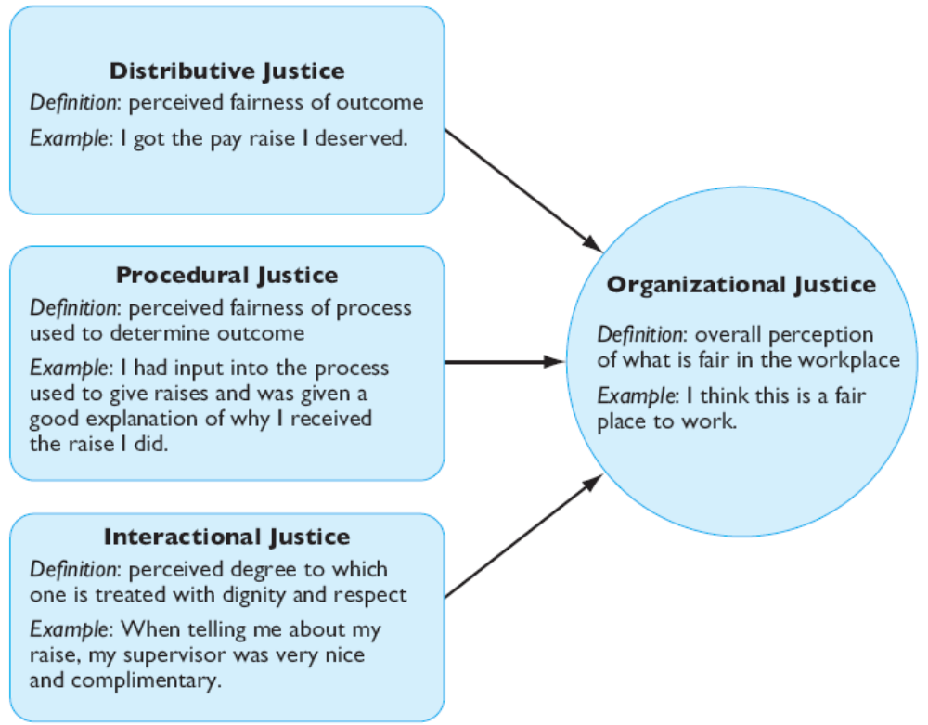
Equity Theory: Forms of Justice
Traditional Focus of
Equity Theory
Importance of Procedural Justice
When Less or No Distributive Justice
Informational Justice
Notes:
Increasingly we think of equity as organizational justice, a larger perception of what is fair in the workplace. Employees perceive their organizations as just when they see that what they receive matches what they have put in. One key element of organizational justice is an individual’s perception of justice. In other words, fairness or equity can be subjective, residing in our perception. What one person sees as unfair, another may see as perfectly appropriate.
The second component is procedural justice—the perceived fairness of the process used to determine the distribution of rewards.
The final component is interactional justice, an individual’s perception of the degree to which she is treated with dignity, concern, and respect.
These three components make up an individuals view of justice within the organization.

Slide 21
Choices For Dealing With Inequity
1. Change inputs (slack off);
2. Change outcomes (increase output);
3. Distort/change perceptions of self;
4. Distort/change perceptions of others;
5. Choose a different referent person;
6. Leave the field (quit the job).

Slide 22
Expectancy Theory by Victor Vroom
Focuses on three key relationships:
1. Effort-Performance: perceived probability that exerting effort leads to
successful performance (Expectancy);
2. Performance-Reward: the belief that successful performance leads to
desired outcome (Instrumentality);
3. Rewards-Personal Goals: the attractiveness of organizational outcome
(reward) to the individual (Valence).
Notes:
The most commonly used and widely accepted theory of motivation is Victor Vroom’s Expectancy Theory. This theory argues that the strength of a tendency to act in a certain way is dependent on the strength of the expectation that they will receive a given outcome and that the outcome is desired.
Employees are willing to work harder if they believe that their actions will get them an outcome they desire. For example, employees are willing to work long and hard hours if they know that they will be rewarded through promotion, recognition or pay in response to their hard work.

Slide 23
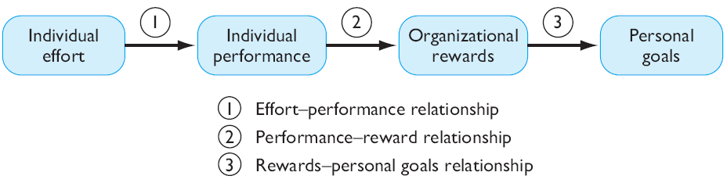
Expectancy Theory by Victor Vroom (Cont’d)

Slide 24
Expectancy Theory of Motivation
E-to-P
Expectancy
P-to-O
Expectancy
Outcomes
& Valences
Outcome 1
+ or -
Effort
Performance
Outcome 2
+ or -
Outcome 3
+ or -

Slide 25
Expectancy theory (cont’d)
Increasing P-to-O Expectancy
1. Measure performance accurately;
2. Describe outcomes of good and poor performance;
3. Explain how rewards are linked to performance.
Increasing Outcome Valences
1. Ensure that rewards are valued;
2. Individualize rewards.

Slide 27
Motivation by Job Design: The JCM
Job Characteristics Model (JCM)
  Hackman and Oldham’s concept that any job can be described through five core job dimensions. It Identifies five job characteristics and their relationship to personal and work outcomes.
    1. Skill variety – Requirements for different tasks in the job;
    2. Task identity – Completion of a whole piece of work;
    3. Task significance – The job’s impact on others;
    4. Autonomy – Level of discretion in decision making;
    5. Feedback – Amount of direct and clear information on performance.

Slide 28
Job Design Theory (cont’d)
Skill Variety
The degree to which a job requires a variety of different activities (how may different skills are used in a given day, week, month?).
Task Identity
The degree to which the job requires completion of a whole and identifiable piece of work (from beginning to end) .
Task Significance
The degree to which the job has a substantial impact on the lives or
work of other people

Slide 29
Job Design Theory (cont’d)
Autonomy
The degree to which the job provides substantial freedom and discretion to the individual in scheduling the work and in determining the procedures to be used in carrying it out.
Feedback
The degree to which carrying out the work activities required by a job results
in the individual obtaining direct and clear information about the effectiveness
of his or her performance.

Slide 30
Job Characteristics Model
  Jobs with skill variety, task identity, task significance, autonomy, and for which feedback of results is given, directly affect three psychological states of employees:
    1. Knowledge of results;
    2. Meaningfulness of work;
    3. Personal feelings of responsibility for results.
  Increases in these psychological states result in increased motivation, performance, and job satisfaction.

Slide 31
Motivation by Job Design: The JCM (cont’d)
  The way elements in a job are organized (job design) impacts motivation,
  satisfaction and performance.
Job Rotation - The periodic shifting of a worker from one task to another.
Job Enlargement - The horizontal expansion of jobs.
Job Enrichment - The vertical expansion of jobs.

Slide 32
Keep in Mind…
Make goals specific and difficult;
Motivation can be increased by raising employee confidence in their own abilities (self-efficacy);
Openly share information on allocation decisions, especially when the outcome is likely to be viewed negatively.
Notes:
Keep in mind that it is important to keep goals specific and difficult enough to be motivating. As employees increase their self-confidence in their own abilities their motivation will increase.
In order to increase perceptions of justice it is important to share information about how resources are allocated.

Slide 33
Implications for Managers
In Order to Motivate Employees
  1. Recognize individual differences;
  2. Use goals and feedback;
  3. Allow employees to participate in decisions that affect them;
  4. Link rewards to performance;
  5. Check the system for equity.

Slide 34
Motivation is Not the Whole Story
P = f(A x M x O)
  Performance is the result of the interaction of:
    1. Ability (A);
    2. Motivation (M) and;
    Opportunity to Perform (O).
https://hbr.org/2017/09/what-motivates-employees-more-rewards-or-punishments

Slide 35
Thank you!

Slide 36
Motivation Practices Resulting from Motivation Theories
Motivation Theories | Find Meaningful Individual Rewards | Tie Rewards to Performance | Redesign Jobs | Provide Feedback | Clarify Expectations & Goals
Need Hierarchies Maslow ERG | x |  | x | x
McClelland’s Needs | x | x | x | x | x
Herzberg’s Two Factor Theory |  |  | x
Expectancy Theory | x | x |  | x | x
Equity-Theory | x | x |  | x | x

