Slide 1

Business Valuation in PE Settings
Indian Institute of Management Rohtak
By
Prof Archana Patro

Slide 2
What is valuation?
Valuation is the process of determining the economic value of a business or company – it reflects both past performance and expectations of future performance. Valuation can be arrived at through objective analysis, but the final price is that at which the seller is willing to sell and the buyer willing to buy.

Slide 3
Why value your enterprise?
Entrepreneurs need to put a value on their business in order to raise finance or equity. Investors need to put a value on the businesses to ensure adequate return on investment.

Slide 4
Valuation Methods
Comparables
Net Present Value (NPV)
Adjusted Present Value (APV)
Venture Capital Method
Real Options
Notes:
The valuation of private companies, especially those in the earlier stages of their life-cycle, is a
difficult and often subjective process.
Given the high leverage and substantial sums of investor capital at
risk, getting the valuation “right” is perhaps more critical than in any other setting
Valuation methodologies can be widely applied to analyze many of the decisions that a firm faces.
Anything that might affect the size or the timing of a firm’s cash flow or changes its riskiness affects
the firm’s value. Whether it is an existing public company or division, an expanding young company,
a new research project, a new production facility, an acquisition target, or a new product launch,
value is the fundamental currency that compares all of an investor’s potential decisions.
This session we will discuss a variety of valuation techniques that can be used in private equity settings.

Slide 5
Comparables
It provides a quick and easy way to obtain a valuation for a firm, companies with similar “value characteristics” are searched for
These value characteristics include risk, growth rate, capital structure, and the size and the timing of the cash flows
these value characteristics are driven by other underlying attributes of the company which can be incorporated in a multiple.
Notes:
look for Sensible measures of valuation.
For ex: Internent business : No of subscribers enrollerd
Biotech firms : no of patents
Industry specific multiples have strong explanatory power for explaining prices then Accounting measures because in young firms accounting multiples very substanitially
Illequidity discount : 25% -30%

Slide 6
Steps in performing comparable company analysis
#1 Find the right comparable companies
The very first thing you should do is look up the company you are trying to value on CapIQ or Bloomberg so you can get a detailed description and industry classification of the business.

Slide 7
#1 Find the right comparable companies
Then screening will be done based on criteria that include:
Industry classification
Geography
Size (revenue, assets, employees)
Growth rate
Margins and profitability

Slide 8
#2 Gather financial information
Once you’ve found the list of companies that you feel are most relevant to the company you’re trying to value it’s time to gather their financial information.
Once again, you will probably be working with Bloomberg Terminal or Capital IQ and you can easily use either of them to import financial information directly into Excel.
The information you need will vary widely by industry and the company’s stage in the business lifecycle. For mature businesses, you will look at metrics like EBITDA and EPS, but for earlier stage companies you may look at Gross Profit or Revenue.
If you don’t have access to an expensive tool like Bloomberg or Capital IQ you can manually gather this information from annual and quarterly reports, but it will be much more time-consuming.

Slide 9
#3 Setup the comps table
In Excel, you now need to create a table that lists all the relevant information about the companies you’re going to analyze.
The main information in comparable company analysis includes:
Company name
Share price
Market capitalization
Net debt
Enterprise value
Revenue
EBITDA
EPS
Analyst estimates
Notes:
Market Capitalization (Market Cap) is the most recent market value of a company’s outstanding shares. The Market Cap is equal to the current share price multiplied by the number of shares outstanding.
Net debt = Short-term debt + Long-term debt – Cash and equivalents
Enterprise Value (EV) Is the measure of a company’s total value. It looks at the entire market value rather than just the equity value, so all ownership interests and asset claims from both debt and equity are included
EV = Common Shares + Preferred Shares + Market Value of Debt + Minority Interest – Cash and Equivalents

Slide 10
#4 Calculate the comparable ratios
With a combination of historical financials and analyst estimates populated in the comps table, it’s time to start calculating the various ratios that will be used to value the company in question.
The main ratios included in a comparable company analysis are:
EV/Revenue
EV/Gross Profit
EV/EBITDA
P/E
P/NAV
P/B

Slide 11
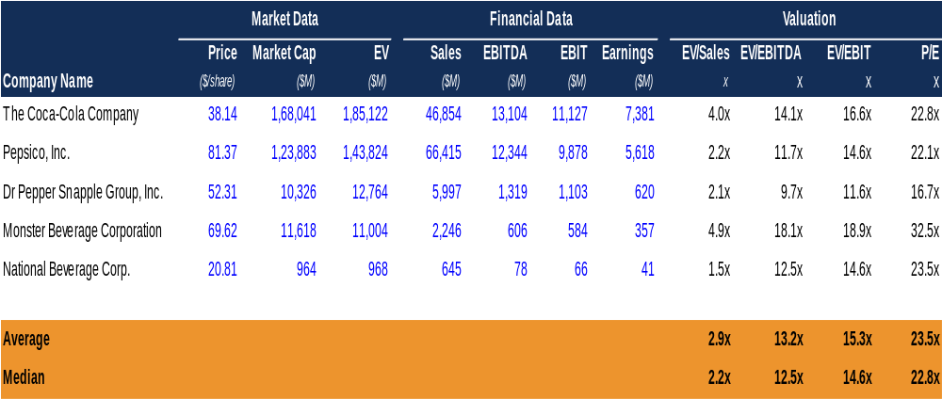
#4 Calculate the comparable ratios

Slide 12
#5 Use the multiples from the comparable companies to value the company in question
Analysts will typically take the average or median of the comparable companies’ multiples and then apply them to the revenue, gross profit, EBITDA, net income, or whatever metrics they included in the comps table.

Slide 13
You Tube Videos
https://www.youtube.com/watch?time_continue=40&v=sFbg4-prkpo&feature=emb_logo
https://www.youtube.com/watch?v=mKBKuuEmzoM

Slide 14
Comparable-Strengths & Weakness
Cons
Private company comparables may be difficult to find and evaluate
If public company comparables are used instead, resulting valuation needs to be adjusted to take into account private company’s illiquidity
Pros
Quick to use
Simple to understand
Commonly used industry
Market based
Notes:
First, it is often
difficult to ascertain what valuations have been assigned to other privately held firms. It may
consequently be impossible to compare our firm to the companies that are the most similar.
Second,
because accounting and other performance information on private firms are often unavailable, key
ratios may not be calculable, or other important impacts on valuation may be missed.
valuations assigned to comparable firms may be misguided
Consider the price-earnings ratio. The earnings (profit after tax)
reflects the capital structure of the company, since earnings are after interest expenses and taxes.
Common sense would therefore tell us that when comparing two companies with similar
characteristics except for substantially different capital structures, it would be more appropriate to
use a multiple based on earnings before interest and taxes (EBIT). By using this latter comparable, we
compensate for the differing capital structures of the two entities. This is because EBIT ignores the
different levels of interest expense incurred by the two companies. (Of course, the use of EBIT
ignores the interest tax shields associated with these capital structures, which we may wish to factor
into the comparisons.)

Slide 15
Comparable-Strengths & Weakness
look for Sensible measures of valuation.
For ex: Internet business : No of subscribers enrollerd
Biotech firms : no of patents
gold exploration company, a typical measure of value is the number of ounces of gold indicated by initial drilling results.
These are just a few examples of non-financial, industry-specific measures that can be used to estimate the value of a firm
Industry specific multiples have strong explanatory power for explaining prices then Accounting measures because in young firms accounting multiples very substantially
Illiquidity discount : 25% -30%

Slide 16
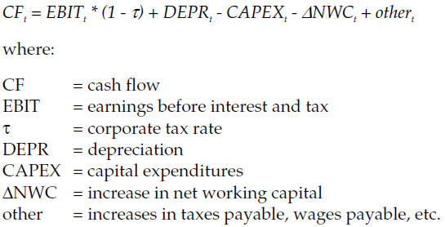

Net Present Value
The NPV method incorporates the benefit of tax shields from tax-deductible interest payments in the discount rate (WACC). To calculate the cash flows we use the equation:
Next, the terminal value is calculated using the following equation with g being the terminal growth rate and r the discount rate:
Notes:
In finance, the terminal value (continuing value or horizon value) of a security is the present value at a future point in time of all future cash flows when we expect stable growth rate forever. ..

Slide 17
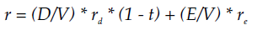

Net Present Value
The NPV of the firm is then calculated as shown in equation:
The discount rate and cost of equity is calculated using equations:

Slide 18
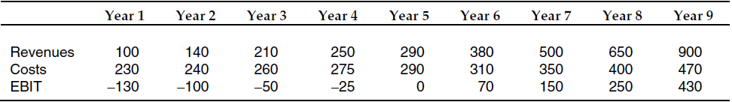
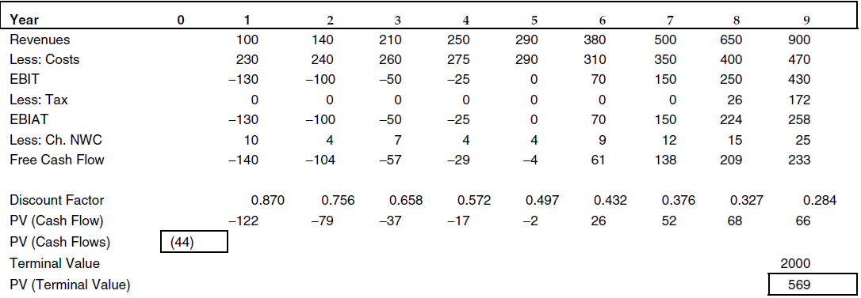

Slide 19
Net Present Value
Pros
Theoretically sound
Cons
Cash flows are difficult to estimate
Private company betas and capital structure can be difficult to find and evaluate
WACC assumes a constant tax rate and capital structure
Cash flows are very sensitive to discount and terminal growth rate assumptions

Slide 20
Adjusted Present Value
APV is preferred over the NPV method where a firm’s capital structure is changing or it has net operating losses (NOLs) that can be used to offset taxable income
Capital structure involves hybrid securities not easily classified as debt or equity
Interest tax shields change over time as company’s tax status changes
The Standard APV Calculations:
  Step 1: Calculate Free Cash Flows (FCFs) to an “all-equity” firm for a period of years until company reached a “steady-state.”
  Step 2: Discount these FCFs at the discount rate of an all equity firm (k).
  Step 3: Calculate a Terminal Value as the present value of a growing perpetuity of FCFs assuming some growth rate in FCFs and discounting by k.
  Step 4: Value tax shields of debt financing separately (trD) and Value tax shields of debt financing separately (trD) and discount by a rate that reflects the riskiness of those cash flows.
  Step 5: Steps 1-4 give you the Enterprise Value. To determine the Equity Value subtract the market value of debt (the present value of interest payments).
Notes:
The NPV method assumes that the capital structure of the firm remains constant at a prespecified
target level. This is inappropriate in situations such as leveraged buyouts, where initially the capital
structure is highly leveraged, but the level of debt is reduced as repayments are made

Slide 21
Free Cash Flow
Free cash flow
Net cash provided by operating activities
Cash payments planned for investments in long-term assets

Slide 22
Adjusted Present Value
Cost of Capital for All-Equity Firm (k)
  k = risk-free rate + β * market risk premium
  Risk-free rate = Long-term bond rate
  beta = “unlevered” beta of comparable firms in the industry
  βU = βL* Eco / [Eco + Dco]
  Market risk premium = 7%
Pros
Theoretically sound
Suitable in situations where capital structure is changing (e.g., leveraged buy-outs)
Suitable in situations where effective tax-rates are changing (in case of NOLs)
Cons
More complicated to calculate
Same disadvantages as NPV method expect the WACC assumptions

Slide 23
Venture Capital Method
The Standard calculations:
  Step 1: Forecast sales or earnings for a period of years
  Step 2: Estimate the time at which the VC will exit the investment (typically through an IPO or sale to strategic buyer).
  Step 3: Value the exit price based on an assumed multiple of earnings or sales or customers, etc. The multiple is typically based on comparable public companies or comparable transactions.
  Step 4: Discount interim cash flows and exit value at rates ranging from 25% - 80%.
  Step 5: Determine the VC’s stake
  Example: MIT.com, Inc.
  Step 1: Forecast Sales or revenues
  Step 2: Assume company exits after 5 years
  Step 3: Assume that the company will have earnings of 5 and it will go public at a multiple of 20x earnings for a value of $100M.
  Step 4: Valuation at 50% Discount Rate
  → Post-money value = $100M/(1.50)5 = $13.2M
  → Pre-money value = $8.2M
Year = 0 | 1 | 2 | 3 | 4 | 5
Earnings = -5 | 0 | 0 | 0 | 0 | 100

Slide 24
Venture Capital Method
Step 5: VC share
  → VC will ask for 5/13 2 = 38 0% equity stake to invest $5M
  → Assume N0= 1M shares outstanding prior to financing. How many new shares, N1, does the VC get?
  → N1/(N0+ N1 ) = s N1 = s/1−s (N0)
  → N1 = 0.612M shares
  → Stock price = $5M/0.612M = $8.17
Pros
Simple to understand
Quick to use
Commonly used
Cons
Relies on terminal values derived from other methods
Oversimplified (large discount rates) 40% and 75%.

Slide 25
Recommendation
When should you use which method? That depends upon the problem

Slide 26
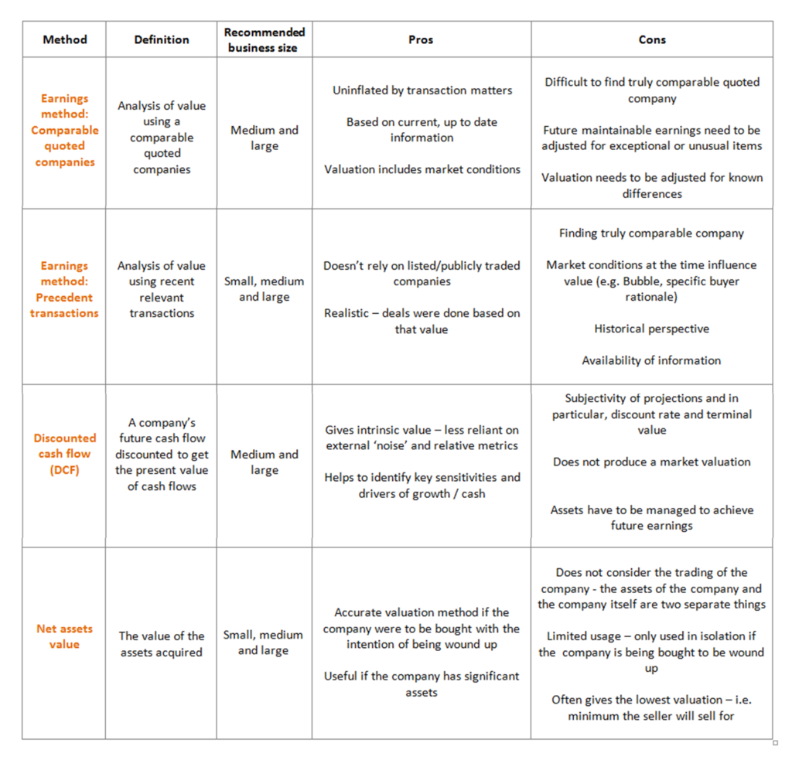

Slide 27
Exit strategies for a New Venture
Indian Institute of Management Rohtak
By
Prof Archana Patro

Slide 28
Why You Need an Exit Strategy?

Slide 29
The Liquidation
Even lifestyle entrepreneurs can decide that enough is enough. One often-overlooked exit strategy is simply to call it quits, close the business doors, and call it a day
If you liquidate, however, any proceeds from the assets must be used to repay creditors. The remainder gets divided among the shareholders--if there are other shareholders, you want to make sure they get their due.

Slide 30
The Liquidation
Pros
It's easy and it's natural. Everything comes to an end.
There's no negotiations involved.
There's no worrying about transfer of control.
Cons
Get real; it's a waste! At most, you get the market value of your company's assets.
Things like client lists, your reputation, and your business relationships may be very valuable, and liquidation just destroys them without an opportunity to recover their value.
Other shareholders may be less than thrilled at how much you're leaving on the table.

Slide 31
Selling to a Friendly Buyer
You see, if you've become emotionally attached to what you've built, even easier than liquidating your business is the option of passing ownership to another true believer who will preserve your legacy. Interested parties might include customers, employees, children or other family members.

Slide 32
Selling to a Friendly Buyer
Pros
You know them. They know you. There's less due diligence required.
Your buyer will most likely preserve what's important to you about the business.
If management buys the business, they have a commitment to making it work.
Selling to family makes good on that regrettable offhand promise made 30 years ago, "Someday, son/daughter, all this will be yours."
Cons
You can get so attached to being bought by someone nice that you leave too much money on the table.
If you sell to a friend, they'll be peeved when they discover they just bought the liability for that decade's worth of taxes you forgot to pay.
Selling to family can tear the company apart with jealousies and promotions that put emotion way ahead of business needs.

Slide 33
The Acquisition.
Acquisition is one of the most common exit strategies: You find another business that wants to buy yours and sell, sell, sell.
If you choose the right acquirer, your value can far exceed what would be reasonable based on your income. How do you select the right company? Look for strategic fit: Which acquirer can buy you to expand into a new market, or offer a new product to their existing customers?

Slide 34
The Acquisition
Pros
If you have strategic value to an acquirer, they may pay far more than you're worth to anyone else.
If you get multiple acquirers involved in a bidding war, you can ratchet your price to the stratosphere.
Cons
If you organize your company around a specific be-acquired target, that may prevent you from becoming attractive to other acquirers.
Acquisitions are messy and often difficult when cultures and systems clash in the merged company.
Acquisitions can come with noncompete agreements and other strings that can make you rich, but make your life unpleasant for a time.

Slide 35
Initial Public Offering (IPO)
Definition: A company’s first equity issue made available to the public.
This issue occurs when a privately held company decides to go public
Also called an “unseasoned new issue.”

Slide 36
Why do companies go public?
New capital
  Almost all companies go public primarily because they need money to expand the business
Future capital
  Once public, firms have greater and easier access to capital in the future
Mergers and acquisitions
  Its easier for other companies to notice and evaluate a public firm for potential synergies
  IPOs are often used to finance acquisitions

Slide 37
Disadvantages of the IPO
Expensive
  A typical firm may spend about 15-25% of the money raised on direct expenses
Reporting responsibilities
  Public companies must continuously file reports with the SEBI and the stock exchange they list on
Loss of control
  Ownership is transferred to outsiders who can take control and even fire the entrepreneur

Slide 38
Outline of the IPO process:
Select an underwriter/Investment Bank(BRLM-Book running lead manager)
Register IPO with the SEBI (IPO filing)
Print prospectus(Draft Red herring Prospectus)DRPH
Present roadshow
Price the securities
Sell the securities

Slide 39
1. Select an underwriter
An underwriter is an investment banking firm that acts as an intermediary between a company selling securities and the investing public
The underwriter is the principal player in the IPO
Typically, the underwriter buys the securities for less than the offering price and accepts the risk of not being able to sell them

Slide 40
What criteria are important in choosing an investment banker
Reputation and experience in this industry
Existing mix of institutional and retail (i.e., individual) clients
Support in the post-IPO secondary market
  Reputation of analyst covering the stock

Slide 41
Types of underwriting
Firm commitment underwriting:
  The underwriter buys the entire issue, assuming full financial responsibility for any unsold shares
  Most prevalent type of underwriting in the U. S.
Best efforts underwriting:
  The underwriter sells as much of the issue as possible, but can return any unsold shares to the issuer without financial responsibility

Slide 42
Leading IPO Underwriters
Goldman Sachs
Morgan Stanley
Merrill Lynch

Slide 43
The IPO Process, Part 1 – The Pitch
the company selects banks for book runner roles and picks other banks to be co-managers, based on its relationships with them, their pitches, and what the banks have done for them in the past.

Slide 44
Part 2 – The Kick-Off Meeting
Everyone involved in the IPO – company management, auditors, accountants, the underwriting banks, and lawyers from all sides – attends this meeting.
Notes:
ou spend the day discussing the offering, the required registration forms, figure out who’s doing what, and determining the timing for the filing.
And then you have similar all-hands meetings like this throughout the rest of the process.
It’s actually quite boring for you as a junior banker attending these because you don’t participate too much – you’re mostly just there to take notes.

Slide 45
Ongoing Due Diligence
Common tasks here include:
Customer Calls
Industry / Market Due Diligence
Legal and IP Due Diligence – Lawyers handle most of this – it consists of reviewing contracts, registrations, and other documents.
Financial and Tax Due Diligence – Accountants do most of this and comb through historical financial statements, tax returns, and so on, and look for irregularities
Notes:
After that initial kick-off meeting, all the bankers, accountants, and lawyers involved need to do a lot of due diligence on the company to make sure that their registration statements are accurate.
This is probably the most interesting task, because sometimes you hear crazy / interesting things from customers that you’d never learn about otherwise.
You’ll have to research the market, speak with experts, and figure out where it might be headed in the future.

Slide 46
2. Register IPO with SEBI
The firm must prepare a registration statement and file it with the SEBI
The registration statement discloses all material information concerning the corporation making a public offering

Slide 47
Part 4 – Pre-Selling the Offering
Pre-IPO analyst meeting -educate bankers and analysts on the company and “teach” them how to sell it to investors.
red herring” (preliminary prospectus)
Companies are encouraged to wait until the SEBI responds to the S-1 with comments before printing the red herring.
This document may omit the offering price, underwriting discounts / commissions, discounts / commissions to dealers, the amount of the proceeds, and so on – it’s just about selling the company’s story to investors.
Notes:
Based on feedback from these meetings and their own internal valuations, banks set a price range for the offering. After all this pre-marketing work is done, banks amend the S-1 filing with a revised price range based on feedback from investors.
Sometimes there are dramatic shifts in the price range, but it’s more common to see small moves in one direction or the other.

Slide 48
3. Print prospectus
The prospectus is a legal document describing details of the issuing corporation and the proposed offering to potential investors
Contains much of the information in the registration statement
The preliminary prospectus is sometimes called a “red herring”

Slide 49
4. Present road-show
The road-show is presented to institutional investors around the country
The road-show allows firms to raise interest in the company and thus the price
Allows the firm and its underwriters to gather information from potential purchasers
Notes:
Senior management team, investment banker, and lawyer visit potential institutional investors
Usually travel to ten to twenty cities in a two-week period, making three to five presentations each day.
Management can’t say anything that is not in prospectus, because company is in “quiet period.”

Slide 50
Road shows
marketing tool to attract investors.
The company doing the 'show' puts together a team of executives to give financial information, such as a business outlook for the firm, why it's doing an IPO, growth on investment, a possible sales price for the stock, and answer questions from analysts and investors.
Notes:
And now for the fun, exhausting part of the process: management gets to travel all over to meet with investors and market the company for 1-2 weeks.
Sometimes management teams make themselves very open and accessible and go out of their way to win over investors and answer questions.
Mark Zuckerberg took the exact opposite approach, mostly because he could afford to – he could show up to 0 meetings and investors would still be falling all over themselves to get shares.
For normal companies, though, this process is extremely important because orders are also taken at this time – investors can state how many shares they want and what price they’re willing to pay.
Management gets daily updates on what the orders are looking like, and the banks involved in the process all try to one-up each other by claiming that they won the biggest orders from investors.

Slide 51
Why are roadshows important?
Roadshows are considered critical to the success of an IPO, as companies need to impress institutional investors so that at least a few of them are willing to invest.

Slide 52
Who attends roadshows?
The average investor is left out. Only institutional and big-money investors are invited to attend the presentations

Slide 53
Are there rules governing roadshows?
Yes. A roadshow can only take place after a firm has registered astatement of planning to offer securities with the Securities Exchange Commission(SEBI)

Slide 54
5. Price the securities
How much to charge for giving away a part of the firm is very important to the issuers
The securities are priced based on the value of the company and expected demand for the securities
Price discovery: Fixed price/Book building
Notes:
Once this document is in place, pre-marketing starts and usually lasts around 2 weeks.
Research analysts meet with institutional investors 1 on 1 and tell them about the company, and sales teams at banks maintain close contact with investors and figure out what they think – do they like the sector? The company itself? What price will they pay?

Slide 55
Book Building Process
No of Shares to allot 1,000,000
Price Band :60-85
Price | Bid | Cumulative Bid
85 | 250,000 | 250,000
80 | 300,000 | 550,000
75 | 450,000 | 1,000,000
70 | 650,000 | 1,650,000
65 | 555,000 | 2,205,000
60 | 665,000 | 2,870,000
Notes:
What is the issue price

Slide 56
Book Building Process
No of Shares to allot 1,000,000
Price Band :60-85
Price | Bid | Cumulative Bid
85 | 250,000 | 250,000
80 | 300,000 | 550,000
75 | 450,000 | 1,000,000
70 | 650,000 | 1,650,000
65 | 555,000 | 2,205,000
60 | 665,000 | 2,870,000
Notes:
bankers want a higher share price so they can earn higher fees, shareholders who are selling obviously want a higher price, and the company wants as high a price as possible to maximize their cash proceeds.
But if the price range is set too high, bankers may have to revise it downward, which sends a negative signal to the market.

Slide 57
The Pricing Meeting
Once the roadshow is over and the order book is closed, the management team will meet with bankers and decide on the final price of the deal based on the orders received.
If a deal is over-subscribed, the company will price the company at the high end of the range and will do the opposite for under-subscribed deals

Slide 58
Part 7 – Allocation
Once the deal is priced, the syndicate team of the banks will allocate shares to investors.

Slide 59
6. Sell the securities
A full-fledged selling effort gets under way on the effective date of the registration statement
A final prospectus must accompany the delivery of securities

Slide 60
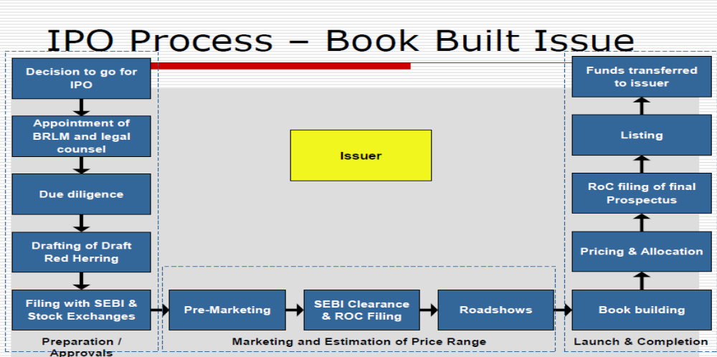

Slide 61
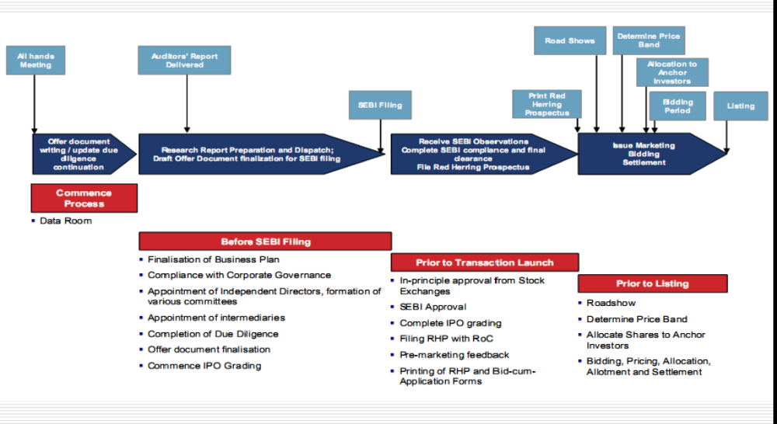

Slide 62
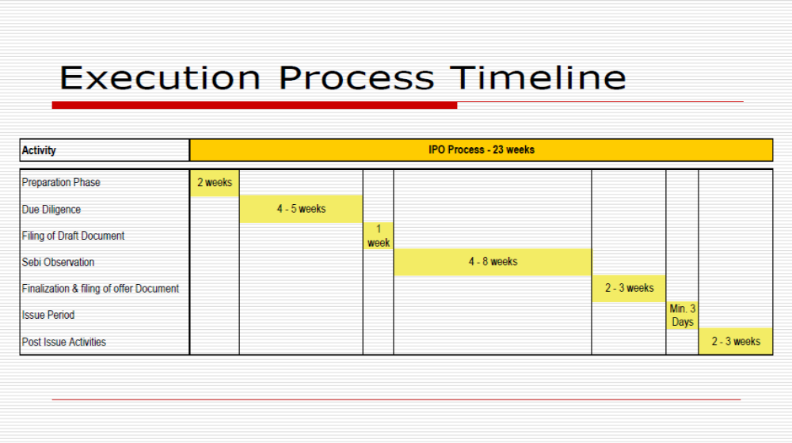

Slide 63
How Much Do Banks Earn From All This?
IPO fees typically range from 3 – 7% depending on the size of the company, how well-known it is, and how much extra work and risk banks have to take on to sell it.
For a $100 million offering, banks could potentially make$7 million
So Facebook is only paying bankers a 1.1% fee on its offering, which will still equal$176 million when all is said and done.

Slide 64
KEY TAKEAWAYS
A business exit strategy is an entrepreneur's strategic plan to sell his or her ownership in a company to investors or another company.
Exit strategies include acquisition, merger, IPO, or shutting down operations.
. An exit strategy gives a business owner a way to reduce or liquidate his stake in a business and, if the business is successful, make a substantial profit.
If the business is not successful, an exit strategy (or "exit plan") enables the entrepreneur to limit losses.

Slide 65
Thank you

