Slide 1
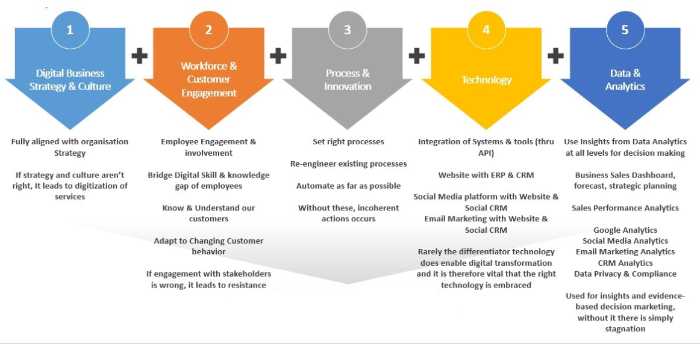

Slide 2
Demystifying Deep Tech

Slide 3
Deep Tech
Deep-tech innovations are defined as disruptive solutions built around unique, protected or hard-to-reproduce technological or scientific advances.
Big Data
Blockchain
Social Networks
AR/VR
IoT
AI
ML
3D printing
Digital Twin
Space Tech
Nanotech
Biotech
Robotics
Autonomous Vehicles

Slide 4
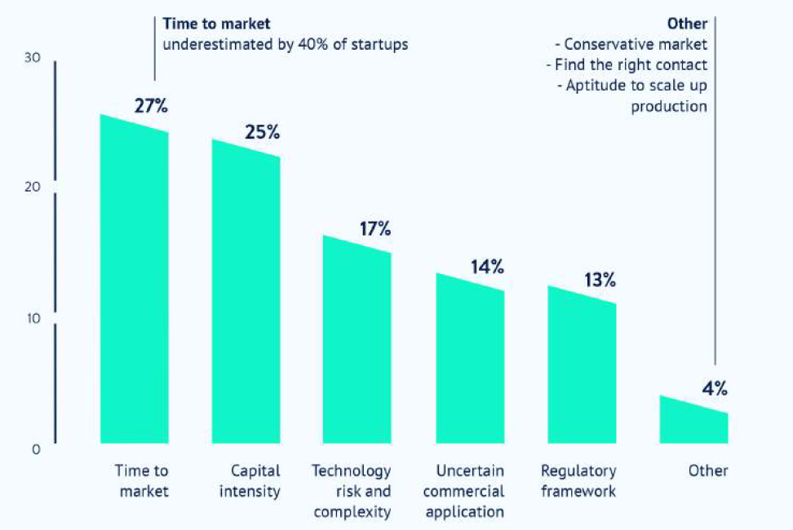
Deep Tech - Challenges

Slide 5
Deep Tech – Critical Resources
Resources:
  Funding (80%)
  Market access (61%)
  Technical expertise (39%)
  Business expertise (26%)

Slide 6
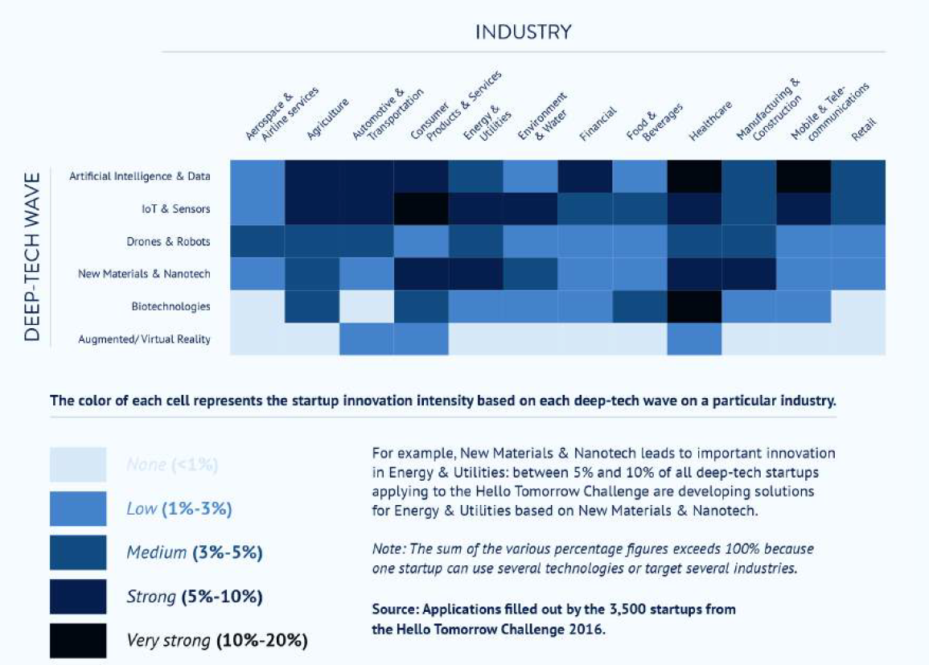

Slide 7
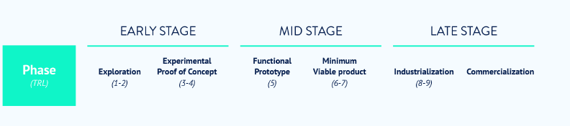
Deep Tech - Phases

Slide 8
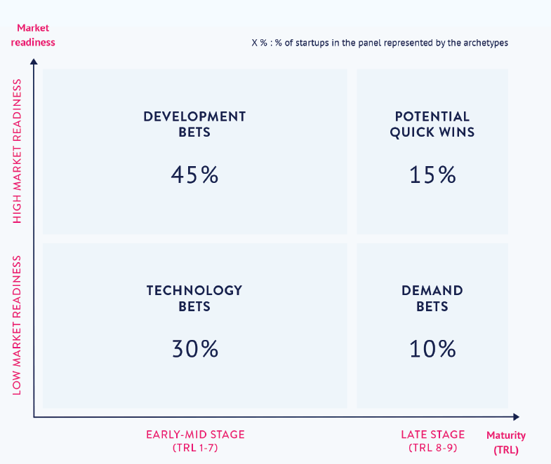
Deep Tech – Critical Resources
technical expertise
overcoming technological uncertainty
funding
market access
talent
long development time
technological uncertainty
distribution network
market resistance to change

Slide 9
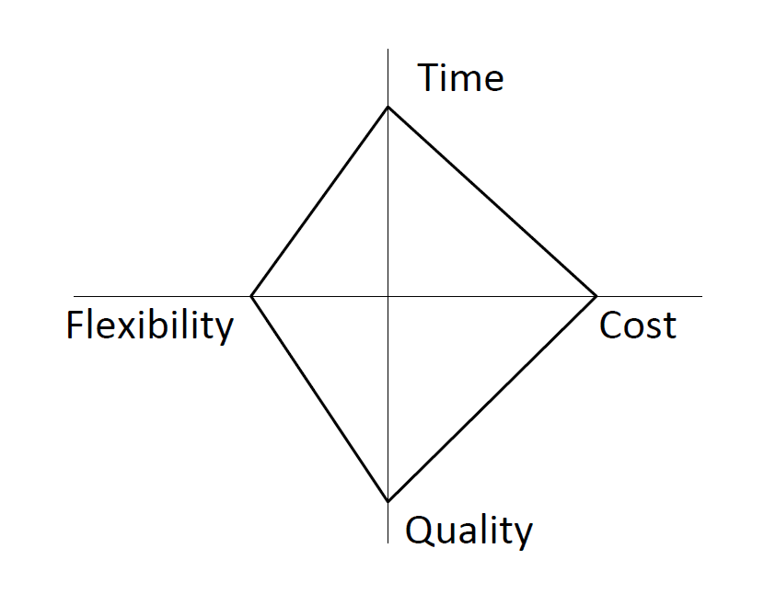
The Devil’s Quadrangle
“improving a process along one dimension may very well weaken its performance along another”

Slide 10
Netflix Leading with Data:
The Emergence of Data-Driven Video

Slide 11
Case Questions
In its competition with Netflix, where did Blockbuster go wrong? How was the use of customer data a key differentiator? How might Blockbuster have better positioned itself against Netflix?
What are the core competencies of Netflix’s current business model (primarily DVD-by-mail with an online component)? Assess the value of Netflix’s business as described in the case.
What effects will the rise of the VOD market likely have on Netflix’s business model? How does VOD threaten Netflix’s business? What opportunities does it present?
Which of Netflix’s current competencies can it best leverage as a competitive advantage in VOD? Which might be liabilities? (For this question, refer to the “Comparing Value Drivers in the Video Rental Market” section.)
What kind of partnerships should Netflix prioritize: partnerships with content providers or with hardware/device manufacturers?

Slide 12
Why Blockbuster Lost
Q1
Slow & Inadequate Response
  “No Late Fees” program was misleading
  “Total Access” program was not well integrated – customers had to maintain separate accounts for the Web-based system and the store
  Debuted in 2006!
Structural Issues
  Stores were franchise-based and Web site was maintained by corporate
  Capex requirements for starting a separate Web-based logistics system to deliver DVDs by mail
Lack of Information Systems
  Lack of knowledge about its customers’ preferences and behaviors
  Lack of an appropriate CRM system

Slide 13
Case Questions
In its competition with Netflix, where did Blockbuster go wrong? How was the use of customer data a key differentiator? How might Blockbuster have better positioned itself against Netflix?
What are the core competencies of Netflix’s current business model (primarily DVD-by-mail with an online component)? Assess the value of Netflix’s business as described in the case.
What effects will the rise of the VOD market likely have on Netflix’s business model? How does VOD threaten Netflix’s business? What opportunities does it present?
Which of Netflix’s current competencies can it best leverage as a competitive advantage in VOD? Which might be liabilities? (For this question, refer to the “Comparing Value Drivers in the Video Rental Market” section.)
What kind of partnerships should Netflix prioritize: partnerships with content providers or with hardware/device manufacturers?

Slide 14
Why Netflix Won
Q2
Netflix’s core capabilities
Flexibility
Subscription model – no late fees!
Customers could rent and watch movies on their own schedules
Selection / Logistics
No physical stores allowed deep selection in a wide variety of genres
Focus on logistics allowed Netflix to not only have a broad selection across genres and deep selection among popular movies, but also to efficiently get films to customers
Customer Insights
Queuing system on Web site allowed customers to have a constant flow of movies
Mail delivery obviated the need to drive to bricks-and-mortar stores
Convenience
Cinematch collaborative filtering algorithms aided the discovery process – better customer experience
Recommendation system and analytics allowed deeper understanding of customer trends, which let Netflix adapt better and more quickly

Slide 15
Case Questions
In its competition with Netflix, where did Blockbuster go wrong? How was the use of customer data a key differentiator? How might Blockbuster have better positioned itself against Netflix?
What are the core competencies of Netflix’s current business model (primarily DVD-by-mail with an online component)? Assess the value of Netflix’s business as described in the case.
What effects will the rise of the VOD market likely have on Netflix’s business model? How does VOD threaten Netflix’s business? What opportunities does it present?
Which of Netflix’s current competencies can it best leverage as a competitive advantage in VOD? Which might be liabilities? (For this question, refer to the “Comparing Value Drivers in the Video Rental Market” section.)
What kind of partnerships should Netflix prioritize: partnerships with content providers or with hardware/device manufacturers?

Slide 16
Impact of VOD Market Growth on Netflix
Business Model
Q3
Impact on Netflix business model
Opportunities
Ability to license its platform
Be the benchmark in movie streaming
Higher impact of Netflix’s existing CRM system
Shift organizational focus from logistic efficiency to technology excellence
Need to invest in owning a platform to provide the service
Growth
of VOD
market
Threats
Shift investment from logistics to technology
Continue to build the Netflix brand as an instant provider of movies from studios to customers’ homes
Continue to invest in customer loyalty and CRM solutions
Current physical distribution channel will become a liability
Competitors like Apple, which has the know-how to sell online and holds a huge customer database and brand equity, will become a threat

Slide 17
Case Questions
In its competition with Netflix, where did Blockbuster go wrong? How was the use of customer data a key differentiator? How might Blockbuster have better positioned itself against Netflix?
What are the core competencies of Netflix’s current business model (primarily DVD-by-mail with an online component)? Assess the value of Netflix’s business as described in the case.
What effects will the rise of the VOD market likely have on Netflix’s business model? How does VOD threaten Netflix’s business? What opportunities does it present?
Which of Netflix’s current competencies can it best leverage as a competitive advantage in VOD? Which might be liabilities? (For this question, refer to the “Comparing Value Drivers in the Video Rental Market” section.)
What kind of partnerships should Netflix prioritize: partnerships with content providers or with hardware/device manufacturers?

Slide 18
Netflix Competitive Advantages for VOD Market
Q4
Netflix’s core competencies to succeed in VOD market
Netflix’s weaknesses for VOD market
Brand equity and customer relationships
Selection
Recommendation tool and customer knowledge
Value in VOD
market
Warehouse /
facilities
Employee overhead

Slide 19
Case Questions
In its competition with Netflix, where did Blockbuster go wrong? How was the use of customer data a key differentiator? How might Blockbuster have better positioned itself against Netflix?
What are the core competencies of Netflix’s current business model (primarily DVD-by-mail with an online component)? Assess the value of Netflix’s business as described in the case.
What effects will the rise of the VOD market likely have on Netflix’s business model? How does VOD threaten Netflix’s business? What opportunities does it present?
Which of Netflix’s current competencies can it best leverage as a competitive advantage in VOD? Which might be liabilities? (For this question, refer to the “Comparing Value Drivers in the Video Rental Market” section.)
What kind of partnerships should Netflix prioritize: partnerships with content providers or with hardware/device manufacturers?

Slide 20
Partnership Prioritization: Parallel Tracking
Q5
Netflix should not limit itself; goal is to be a service provider, not a content producer or a hardware manufacturer.
Don’t compete in areas where Netflix is at point of parity; compete where Netflix has advantages (i.e., recommendation algorithm, user community). Amazon and Apple are strong in delivery and devices but weak in recommendations and user community.
Roll up Roku effort under umbrella of device partnerships; devote resources across all initiatives evenly.
Becoming the service provider and content recommender on all cable platforms is a top priority.
Assume that movie studios and other content producers will want to distribute via Netflix; it is in their best interest.

Slide 21
Partnership Prioritization: Parallel Tracking
Q5
Hardware Partnerships
Roku
TV manufacturers
Software/Platform Partnerships
Movie studios
Independent producers (perhaps via YouTube fulfillment)
Smart phone ecosystems
Television studios / networks
Content Producer Partnerships
Comcast and other cable operators / ISPs
Google (as a YouTube syndicator)
Hotels, airlines, venues, and events
Priority

Slide 22
Big data

Slide 23
Type of Data
Structured
  Tables
Semi-Structured
  XML, JSON
  Clickstream data, Ecommerce, APIs
Unstructured
  Audio, Video, Images, Text, Sensory Data
  IoT Devices, Social Media

Slide 24
Data
Storage
  SQL, NoSQL
Processing
  Hadoop

Slide 25
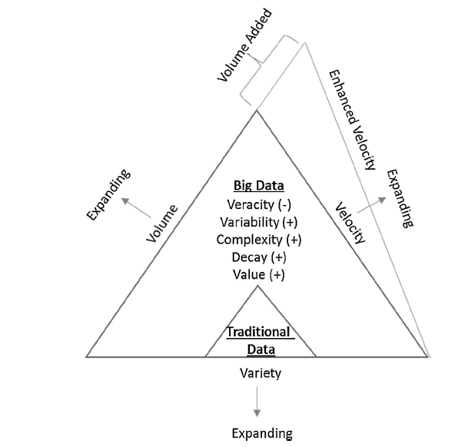
Dimensions of big data
Volume
Velocity
Variety
Veracity
Variability
Complexity
Value
Decay

Slide 26
Evolution of big data and data analytics
1950s to mid-1990s
Big Data 1.0
Big Data 2.0
Big Data 3.0

Slide 27
Big Data 1.0
Web usage mining
Web structure mining
Web content mining

Slide 28
Big Data 2.0
Social Media
  Sentiment Analysis
    Entity, sentence, document level
    Lexicon-based, Machine Learning
  Social Network Analysis
    network structure, connections, nodes,
    network density, network centrality, network flows

Slide 29
Big Data 3.0
IoT Applications
  Streaming Analytics
  Edge Computing

Slide 30
Big data analysis of merchant reviews
Relationships between consumers review activities and the viewers usefulness votes.
Five factors related to consumers review activities
  the review score of the reviewer
  the number of social network friends of the reviewer
  the cumulative number of reviews made by the reviewer
  the number of words in the reviewer’s comment
  the existence of images or photos in the reviewer’s comment.

Slide 31
Impact of Big Data
Personalization marketing
Better Pricing
Cost Reduction
Improved Customer Service

Slide 32
Challenges in big data
Data Quality
Data Security
Privacy
Investment Justification
Data Management
Shortage of Experts

Slide 33
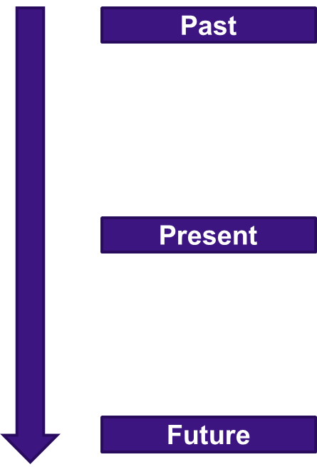
Type of Data Analytics
What happened?
  Descriptive Analytics (Data aggregation, Summary)
  What were our total sales this month?
Why did it happen?
  Diagnostic Analytics (Data discovery, Drill-down)
  Why have sales gone down?
What will happen?
  Predictive Analytics (Regression, Neural Network)
  Forecasting & What If Analysis
What do I want to happen?
  Prescriptive Analytics (Optimization, Recommendation)
  Planning & Targets

Slide 34
Foundations of Databases and Information Management

Slide 35
Business Intelligence (BI)?
Business intelligence (BI) is a broad category of applications, technologies, and processes for gathering, storing, accessing, and analyzing data to help business users make better decisions.
    Business Intelligence is the processes, technologies, and tools that help us change data into
    information, information into knowledge and knowledge into plans that guide organization.

Slide 36
Business Intelligence Infrastructure (1 of 3)
Array of tools for obtaining information from separate systems and from big data
Data warehouse
  Stores current and historical data from many core operational transaction systems
  Consolidates and standardizes information for use across enterprise, but data cannot be altered
  Provides analysis and reporting tools

Slide 37
Business Intelligence Infrastructure (2 of 3)
Data marts
  Subset of data warehouse
  Typically focus on single subject or line of business
Hadoop
  Enables distributed parallel processing of big data across inexpensive computers

Slide 38
Business Intelligence Infrastructure (3 of 3)
In-memory computing
  Used in big data analysis
  Uses computers main memory (R A M) for data storage to avoid delays in retrieving data from disk storage
  Can reduce hours/days of processing to seconds
  Requires optimized hardware
Analytic platforms
  High-speed platforms using both relational and non-relational tools optimized for large datasets

Slide 39
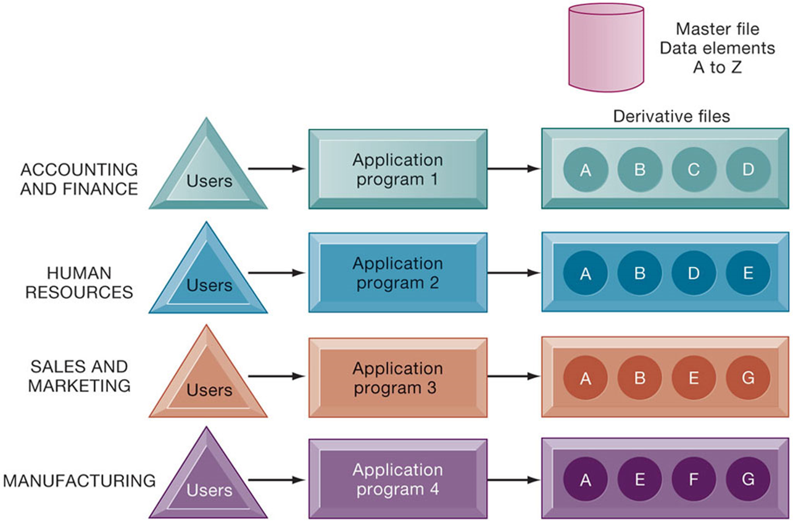
Traditional File Processing

Slide 40
Problems with the Traditional File Environment
Files maintained separately by different departments
Data redundancy
Data inconsistency
Program-data dependence
Lack of flexibility
Poor security
Lack of data sharing and availability

Slide 41
Database Management Systems
Database
  Serves many applications by centralizing data and controlling redundant data
Database management system (D B M S)
  Interfaces between applications and physical data files
  Separates logical and physical views of data
  Solves problems of traditional file environment
    Controls redundancy
    Eliminates inconsistency
    Uncouples programs and data
    Enables organization to centrally manage data and data security

Slide 42
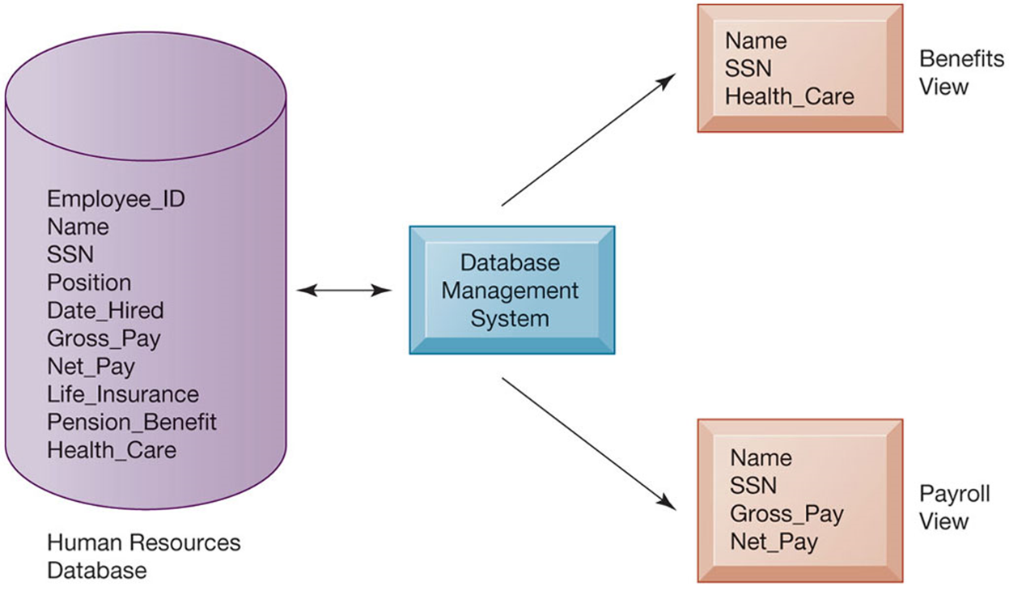
Human Resources Database with Multiple Views

Slide 43
Relational D B M S
Represent data as two-dimensional tables
Each table contains data on entity and attributes
Table: grid of columns and rows
  Rows (tuples): Records for different entities
  Fields (columns): Represents attribute for entity
  Key field: Field used to uniquely identify each record
  Primary key: Field in table used for key fields
  Foreign key: Primary key used in second table as look-up field to identify records from original table

Slide 44
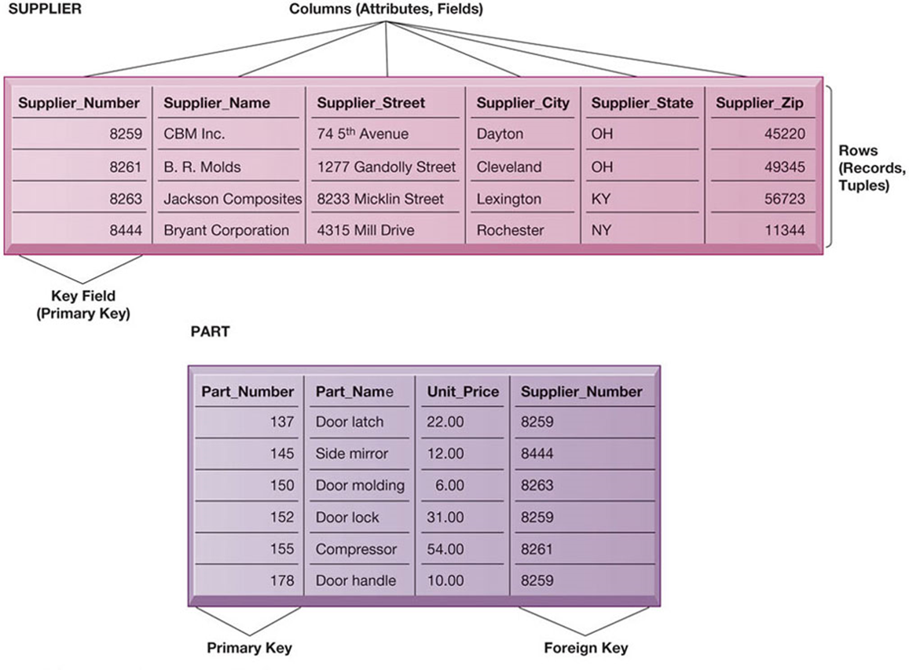
Relational Database Tables

Slide 45
Capabilities of Database Management Systems
Data definition capability
Data dictionary
Querying and reporting
  Data manipulation language
    Structured Query Language (S Q L)
Many D B M S have report generation capabilities for creating polished reports (Microsoft Access)

Slide 46
Designing Databases
Conceptual design vs. physical design
Normalization
  Streamlining complex groupings of data to minimize redundant data elements and awkward many-to-many relationships
Referential integrity
  Rules used by R D B M S to ensure relationships between tables remain consistent
Entity-relationship diagram
A correct data model is essential for a system serving the business well

Slide 47
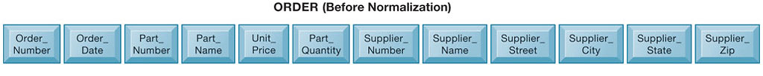
An Unnormalized Relation for Order

Slide 48
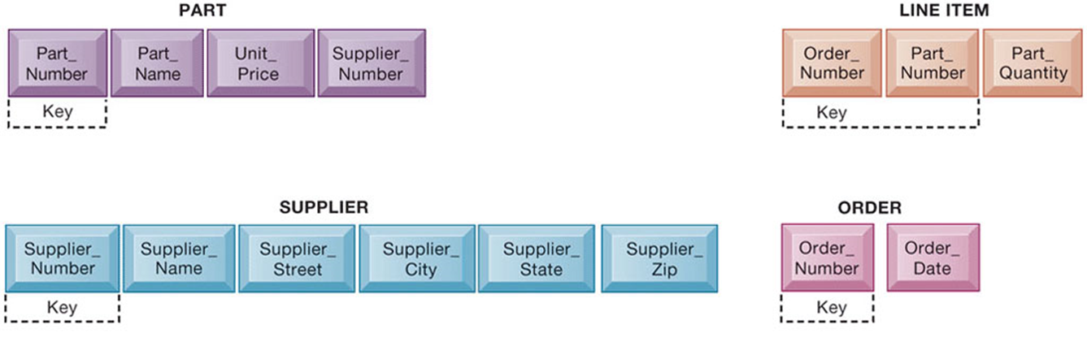
Normalized Tables Created from Order

Slide 49
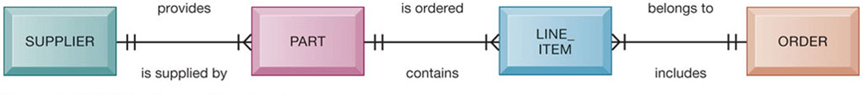
An Entity-Relationship Diagram

Slide 50
Non-Relational Databases and Databases in the Cloud
Non-relational databases: “No S Q L”
  More flexible data model
  Data sets stored across distributed machines
  Easier to scale
  Handle large volumes of unstructured and structured data
Databases in the cloud
  Appeal to start-ups, smaller businesses
  Amazon Relational Database Service, Microsoft S Q L Azure
  Private clouds

Slide 51
Blockchain
Distributed ledgers in a peer-to-peer distributed database
Maintains a growing list of records and transactions shared by all
Encryption used to identify participants and transactions
Used for financial transactions, supply chain, and medical records
Foundation of Bitcoin, and other crypto currencies

Slide 52
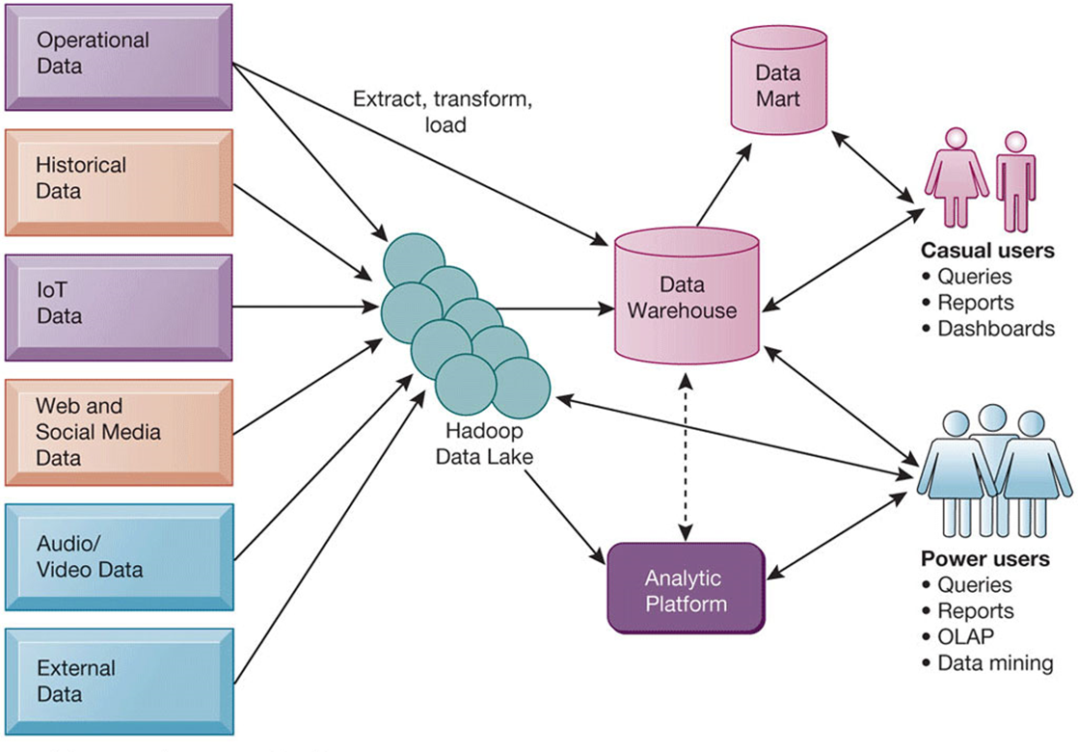
Contemporary Business Intelligence Infrastructure

Slide 53
Analytical Tools: Relationships, Patterns, Trends
Tools for consolidating, analyzing, and providing access to vast amounts of data to help users make better business decisions
  Multidimensional data analysis (O L A P)
  Data mining
  Text mining
  Web mining

Slide 54
Online Analytical Processing (O L A P)
Supports multidimensional data analysis
  Viewing data using multiple dimensions
  Each aspect of information (product, pricing, cost, region, time period) is different dimension
  Example: How many washers sold in the East in June compared with other regions?
O L A P enables rapid, online answers to ad hoc queries

Slide 55
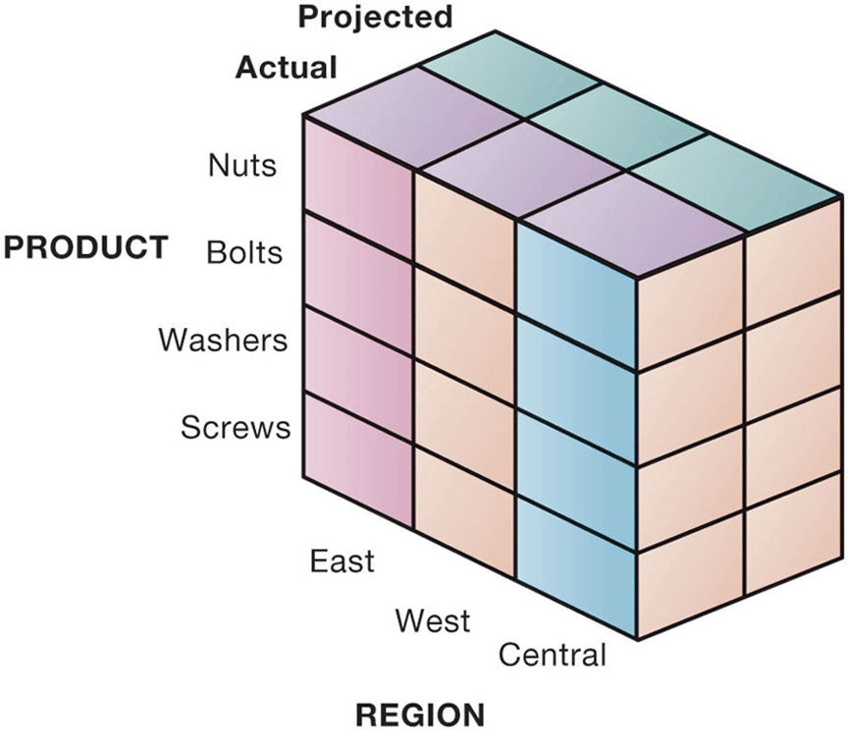
Multidimensional Data Model

Slide 56
Data Mining
Finds hidden patterns, relationships in datasets
  Example: customer buying patterns
Infers rules to predict future behavior
Types of information obtainable from data mining:
  Associations
  Sequences
  Classification
  Clustering
  Forecasting

Slide 57
Text Mining and Web Mining
Text mining
  Extracts key elements from large unstructured data sets
  Sentiment analysis software
Web mining
  Discovery and analysis of useful patterns and information from web
  Web content mining
  Web structure mining
  Web usage mining

Slide 58
Databases and the Web
Many companies use the web to make some internal databases available to customers or partners
Typical configuration includes:
  Web server
  Application server/middleware/C G I scripts
  Database server (hosting D B M S)
Advantages of using the web for database access:
  Ease of use of browser software
  Web interface requires few or no changes to database
  Inexpensive to add web interface to system

Slide 59
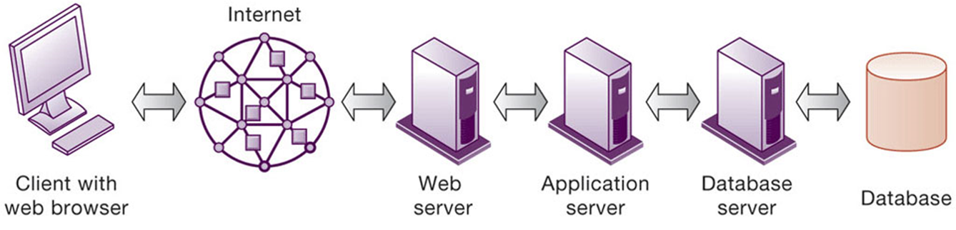
Linking Internal Databases to the Web

Slide 60
Establishing an Information Policy
Firm’s rules, procedures, roles for sharing, managing, standardizing data
Data administration
  Establishes policies and procedures to manage data
Data governance
  Deals with policies and processes for managing availability, usability, integrity, and security of data, especially regarding government regulations
Database administration
  Creating and maintaining database

Slide 61
Ensuring Data Quality
More than 25 percent of critical data in Fortune 1000 company databases are inaccurate or incomplete
Before new database is in place, a firm must:
  Identify and correct faulty data
  Establish better routines for editing data once database in operation
Data quality audit
Data cleansing

Slide 62
Deep Tech
Deep-tech innovations are defined as disruptive solutions built around unique, protected or hard-to-reproduce technological or scientific advances.
Big Data
Blockchain
Social Networks
AR/VR
IoT
AI
ML
3D printing
Digital Twin
Space Tech
Nanotech
Biotech
Robotics
Autonomous Vehicles

Slide 63
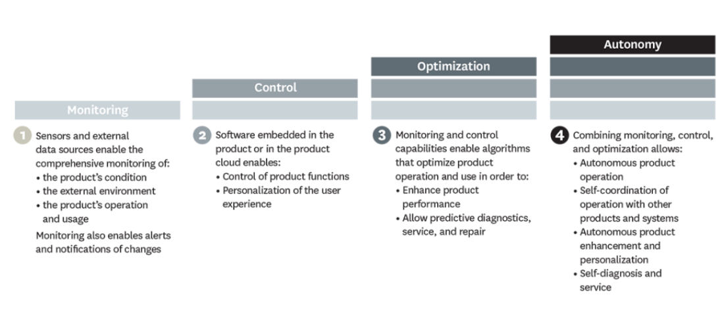

Slide 64
Digital Twins

Slide 65
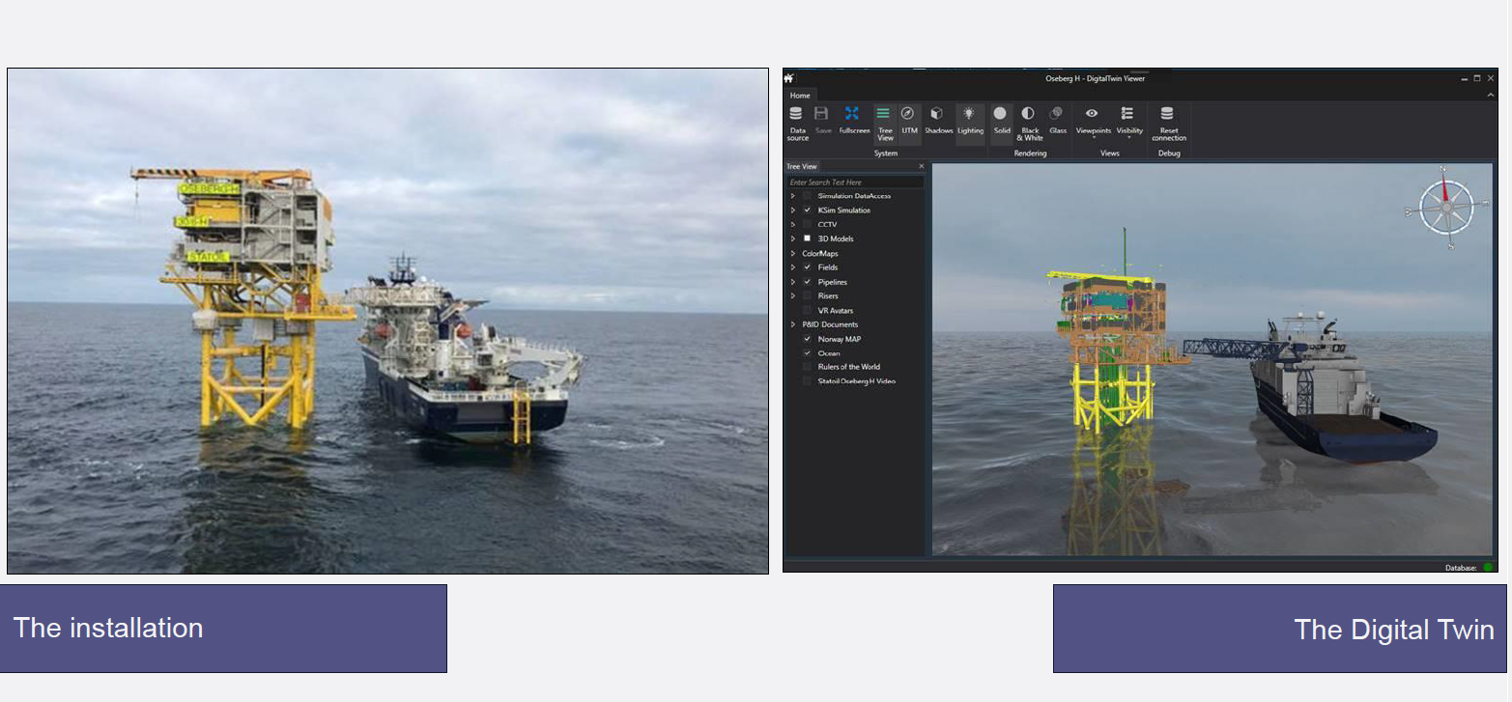
Digital Twins
Superior automated inventory control
Better management
Increased safety
Continuous efficiency improvements

Slide 66
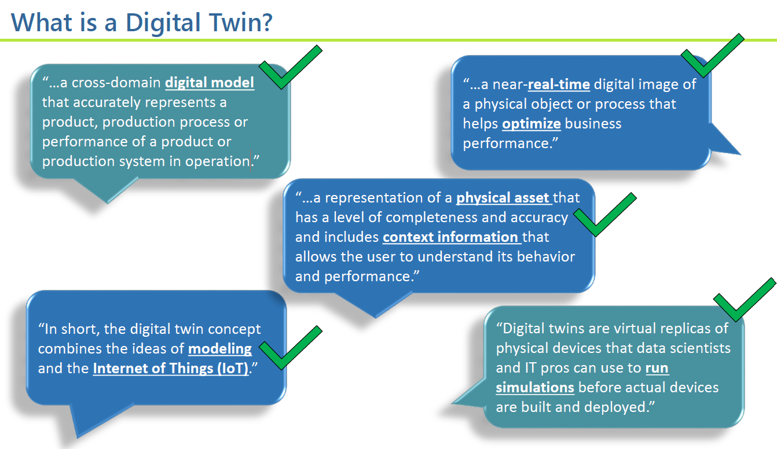
Digital Twins
A

Slide 67
Digital Twins
The scope can be, for example, a single business process like procurement, an entire supply chain including dependencies on suppliers and distribution partners, or the entire company, including its business ecosystem.
Superior automated inventory control
Better management
Increased safety
Continuous efficiency improvements

Slide 68
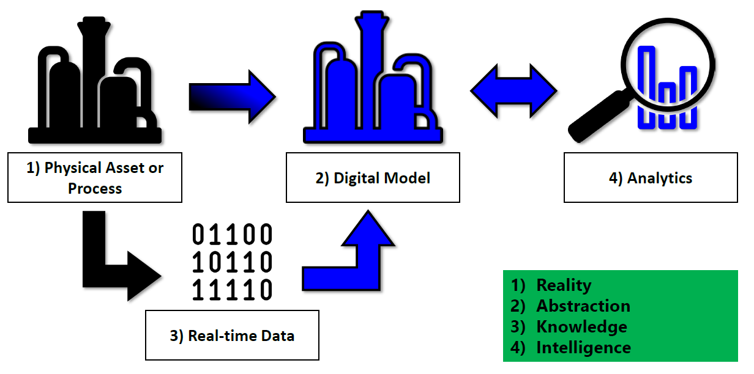
Digital Twins

Slide 69
Digital Twin Model
Reactive
Twin
Analyse
“What If”
Twin
Predictive Twin
Simulate
Plan
Feedback
Initialize
Monitor
Store
Data Twin
Input
Decision
disconnected
Capture
Actuate
Physical Twin
Deployment

Slide 70
Digital Twins
Component twins/parts twins.
  These are the basic unit of digital twins. Here the twin represents the physical, mechanical, and/or electrical characteristics of a component or part.
Asset twins.
  Assets are two or more components working together. These twins represent the interaction of components to create performance data.
System or unit twins.
  These twins reflect the interaction of assets that form a system or unit.
Process twins.
  These twins represent how systems work together. For example, a process twin might represent an entire production facility.

Slide 71
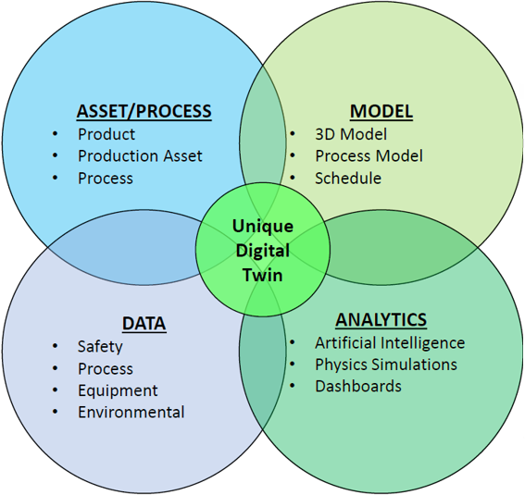
Digital Twins

Slide 72
Type of Data
Historical data.
  Data on the past performance of machines, processes, and systems.
Real-time data.
  Digital twins receive continual updates from equipment sensors and outputs from platforms and systems, like manufacturing equipment, customer service, and purchasing.
Future data.
  This includes machine learning and inputs from engineers.

Slide 73
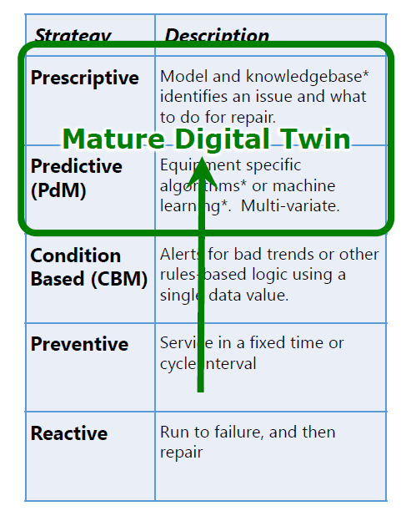
Digital Twins for Predictive Maintenance

Slide 74
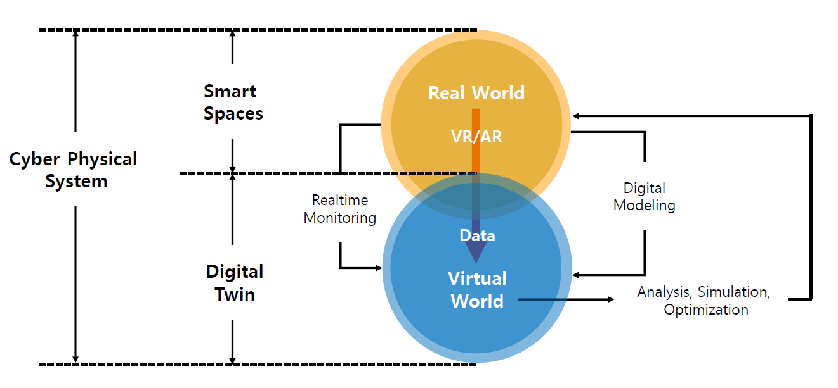
Digital Twins + Smart Spaces

Slide 75
Digital Twins - Benefits
Accelerated risk assessment and production time.
Predictive maintenance.
Real-time remote monitoring.
Better team collaboration.
Better financial decision-making.

Slide 76
Digital Twins - Features
Manage the digital twin lifecycle.
Single source of truth.
Open API.
Visualization and analysis.
Event and process management.
Customer and user perspective.

