Slide 1
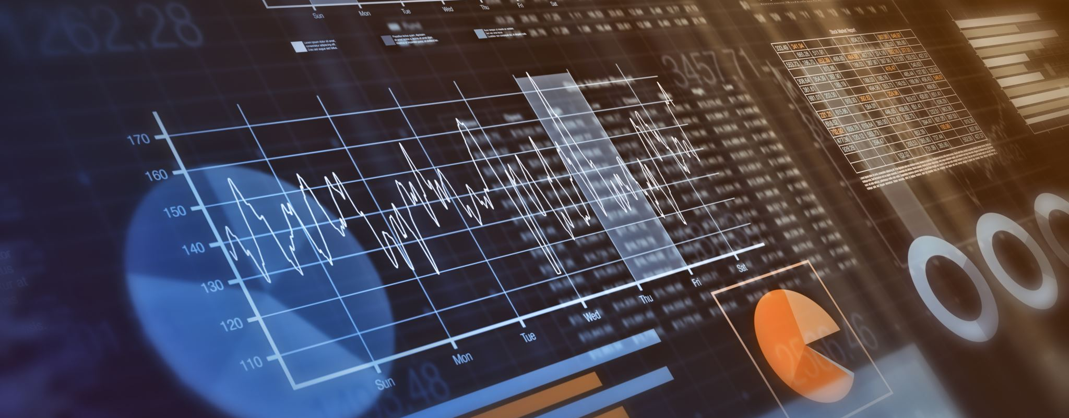
Social Media Analytics
Strategic Digital Marketing & Analytics
(Sessions 27 & 28)
Dr. Harmanjit Singh

Slide 2
AGENDA
IMPORTANT Social Media STATISTICS
ABOUT Social Media Analytics (WHAT, WHY, TYPES)
Social Media Analytics’ TOOLS (HOW TOs)
HOW to ANALYZE Social Media Analytics?
HOW to CREATE Social Media Advertisements?

Slide 3
1. IMPORTANT STATISTICS

Slide 4
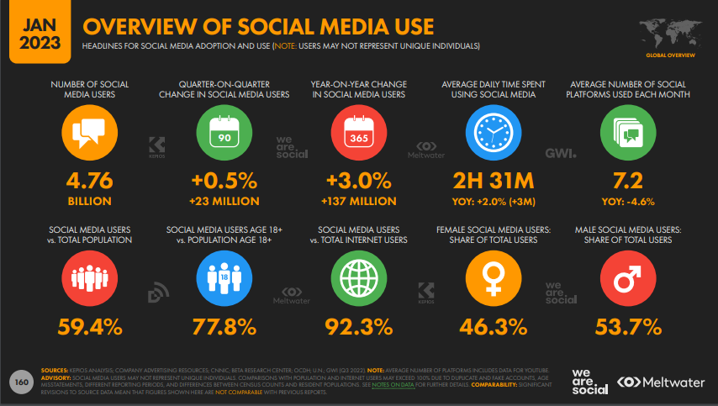

Slide 5
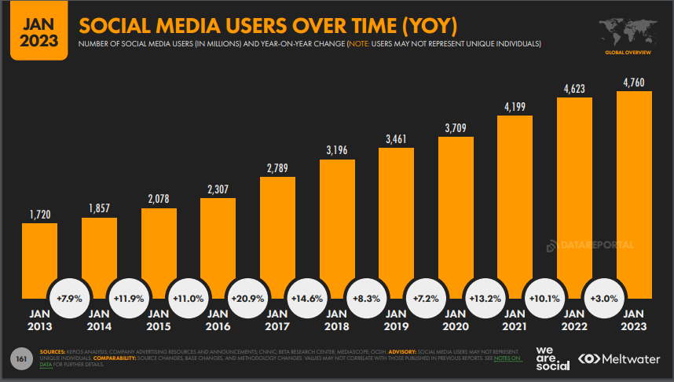

Slide 6
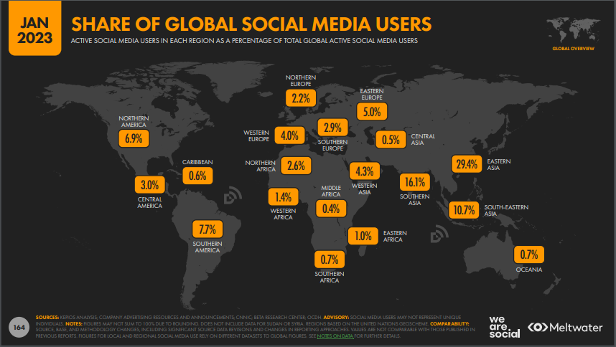

Slide 7
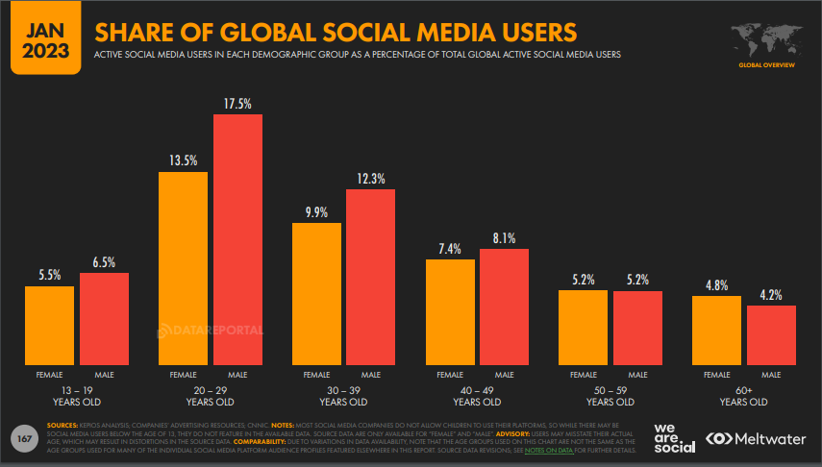

Slide 8
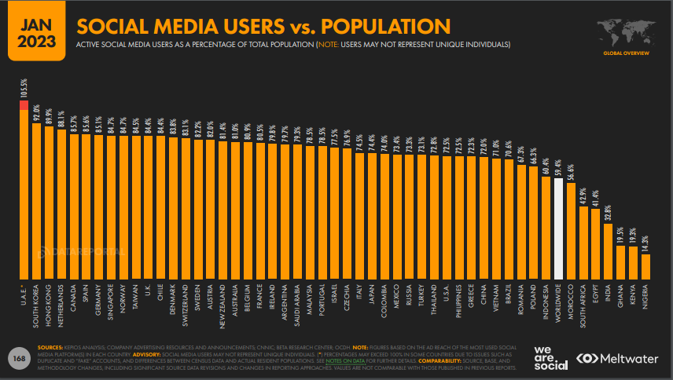

Slide 9
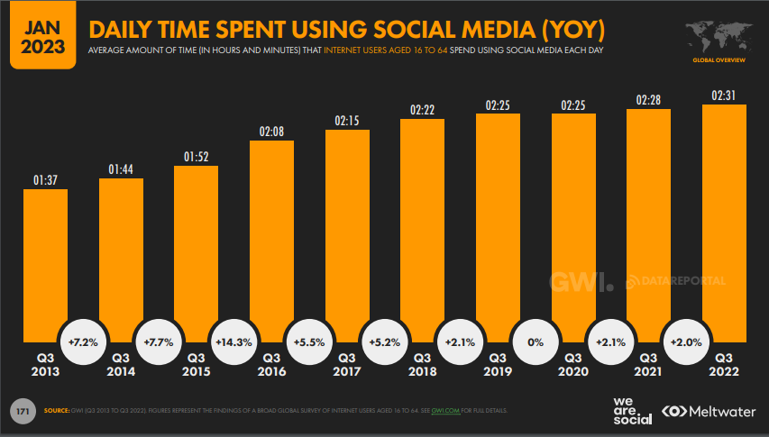

Slide 10
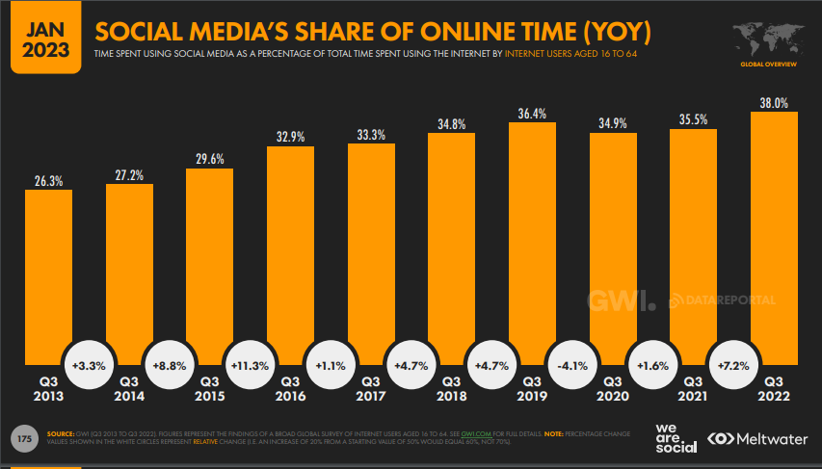

Slide 11
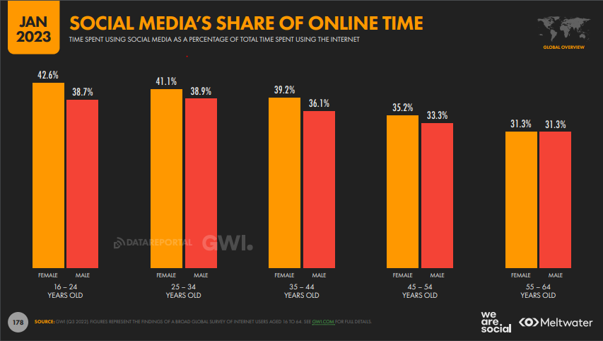

Slide 12
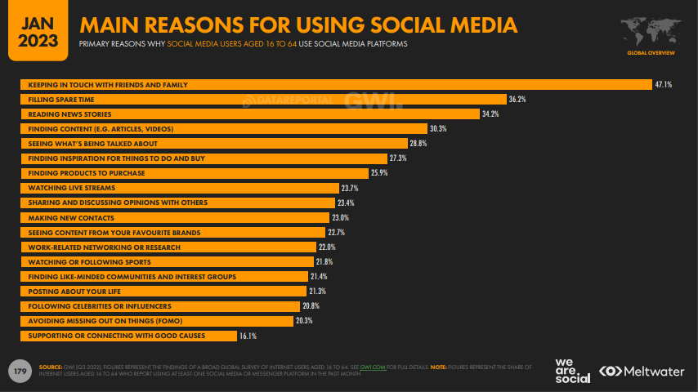

Slide 13
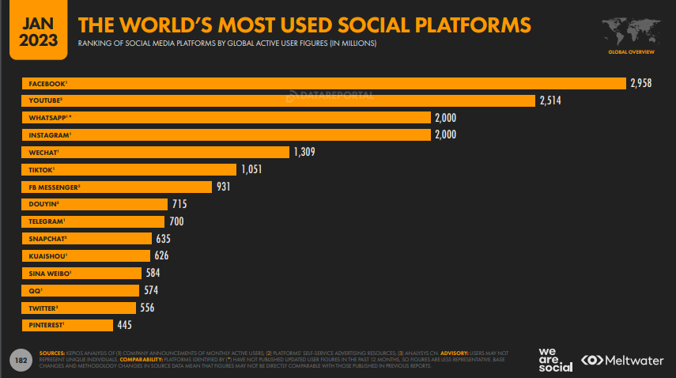

Slide 14
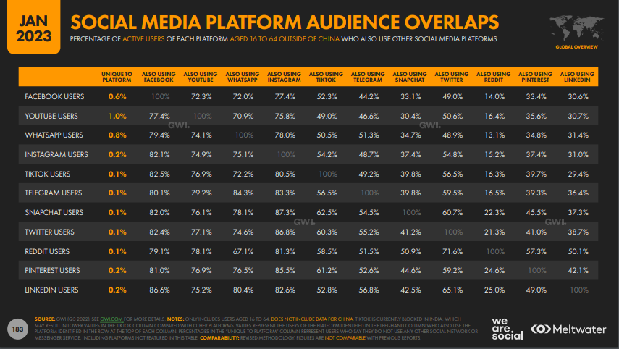

Slide 15
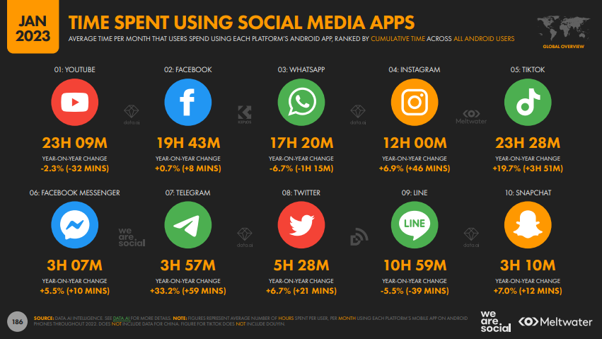

Slide 16
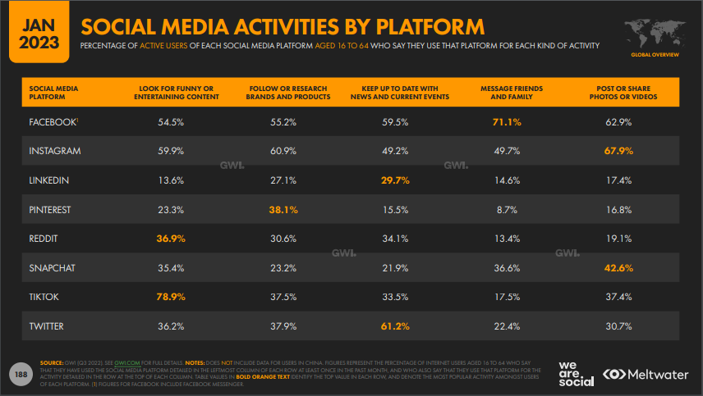

Slide 17
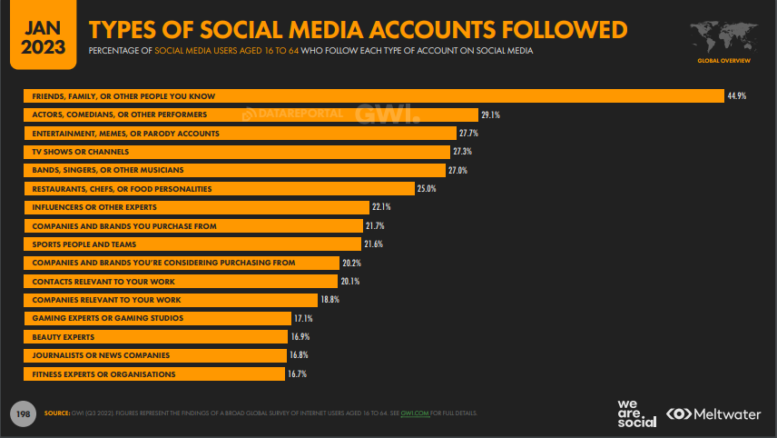

Slide 18
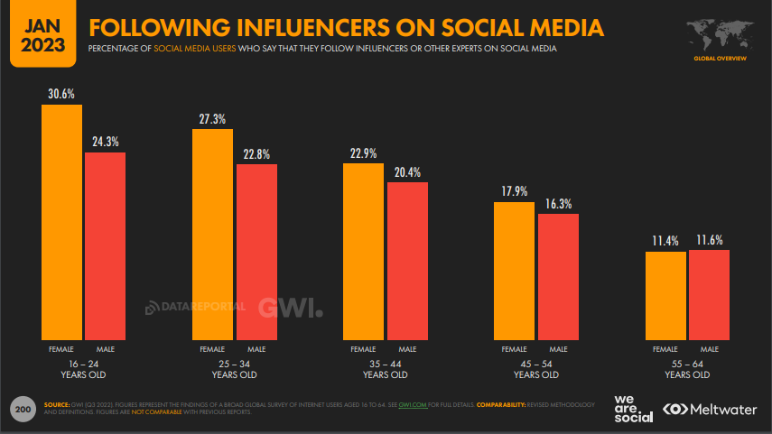

Slide 19
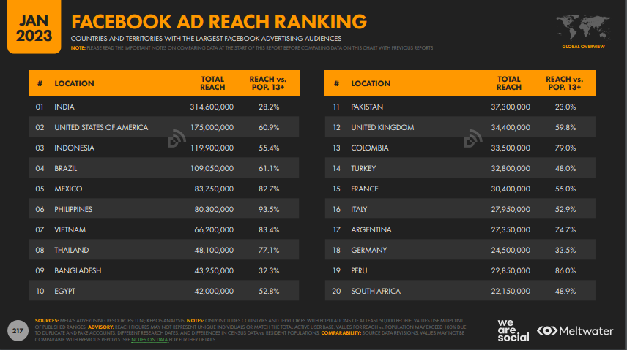

Slide 20
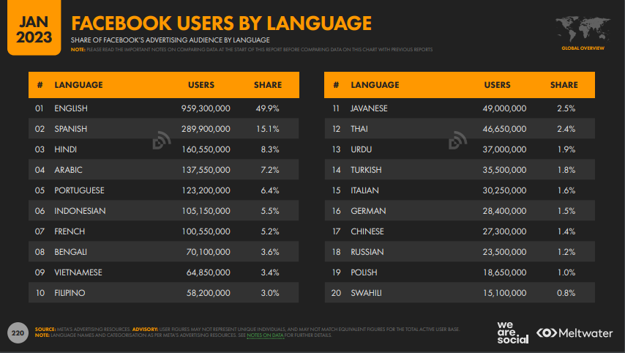

Slide 21
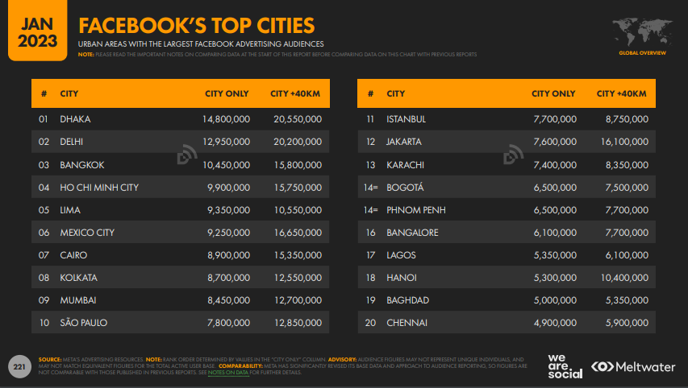

Slide 22
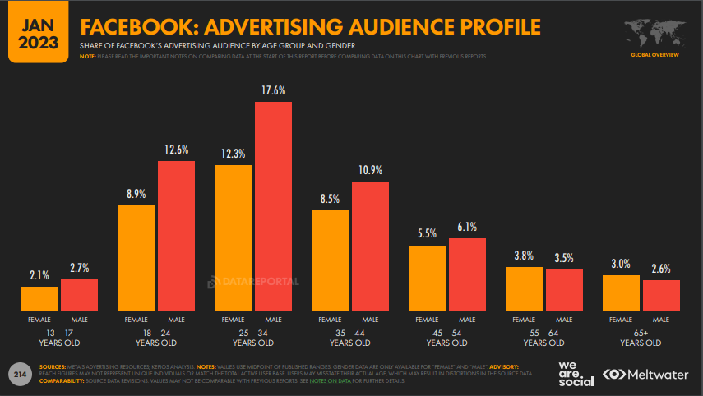

Slide 23
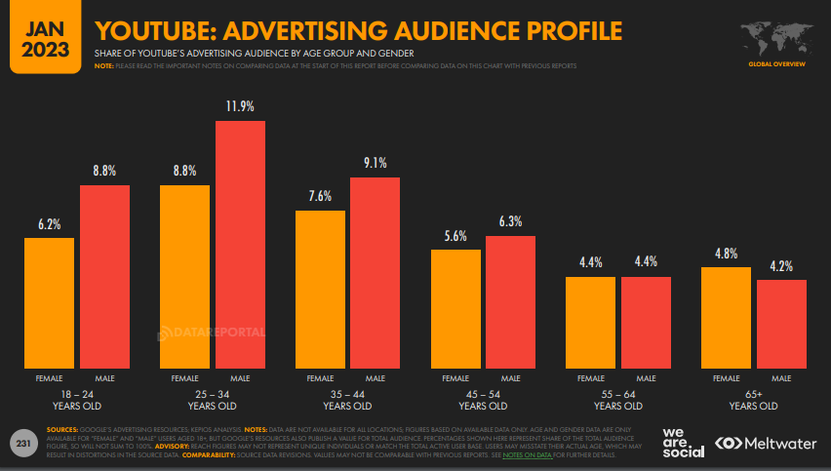

Slide 24
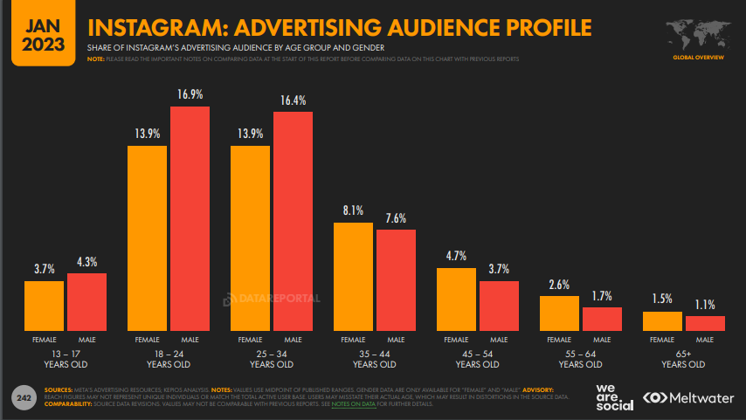

Slide 25
2. ABOUT SOCIAL MEDIA ANALYTICS

Slide 26
WHAT is Social Media Analytics?
Refers to the collection of data and metrics that help you measure your overall social media performance.

Slide 27
Why Social Media Analytics?
TRENDSPOTTING
  PINPOINTING UPCOMING TRENDS: HOT PLATFORMS + TRENDY TOPICS + TYPES OF ADS + TYPES OF CONTENT + INFLUENCERS
BRAND SENTIMENT
  WHAT PEOPE FEEL ABOUT YOUR BRAND (+VE, -VE, NEUTRAL etc.)
PERCEIVED VALUE
  SOCIAL LISTENING
SETTING SOCIAL MEDIA GOALS
  SMART GOALS
PROVING ROI
  UTM TRACKING

Slide 28
Types of Social Media Analytics
PERFORMANCE ANALYSIS
  IMPRESSIONS + REACH + LIKES + COMMENTS + SHARES + VIEWS + CLICKS + SALES
AUDIENCE ANALYSIS
  AGE + GENDER + INCOME + LOCATION + DEVICE + PSYCHOGRAPHICS
COMPETITOR ANALYSIS
  NO. OF FANS + NO. OF ENGAGEMENTS OVERALL + NO. OF ENGAGEMENTS PER POST
PAID ADS ANALYSIS
  NO. OF ACTIVE ADS + CLICKS + CTR + CPC + CPA + CR + Total Ad Spend
INFLUENCER ANALYSIS
  NO. OF POSTS BY INFLUENCERS + TOTAL NO. OF INTERACTIONS PER POST + AUDIENCE SIZE OF EACH INFLUENCER + # USAGE
SENTIMENT ANALYSIS

Slide 29
3. SOCIAL MEDIA ANALYTICS TOOLS

Slide 30
3rd PARTY FREE SOCIAL MEDIA ANALYTICS TOOLS

Slide 31
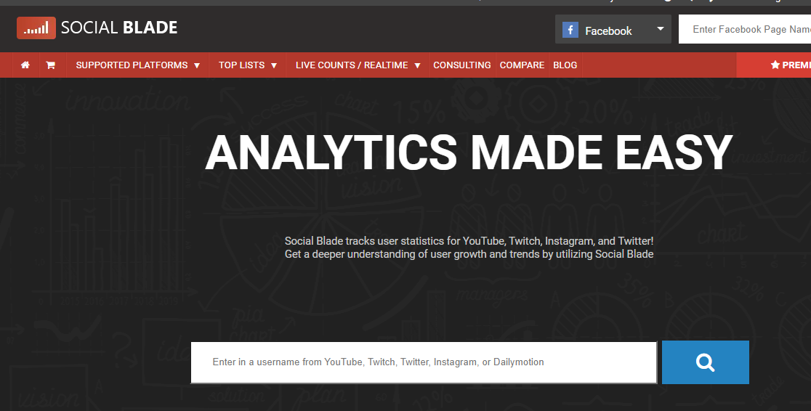

Slide 32


Slide 33
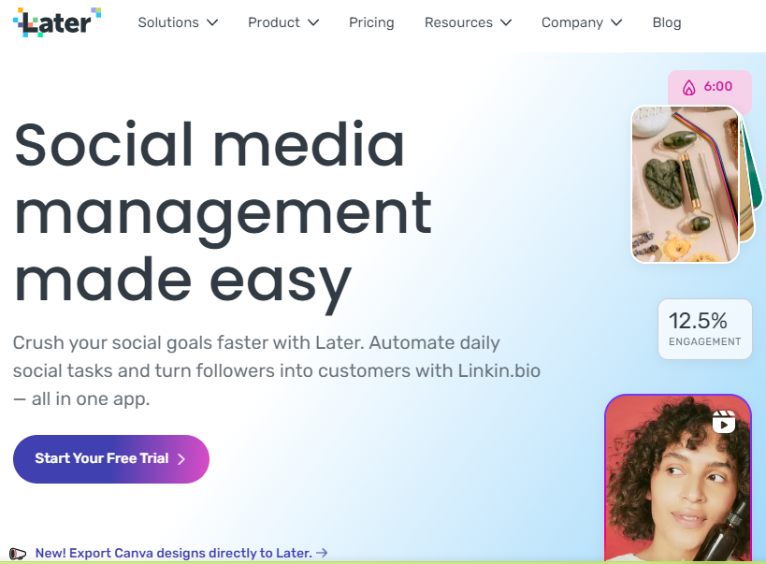

Slide 34
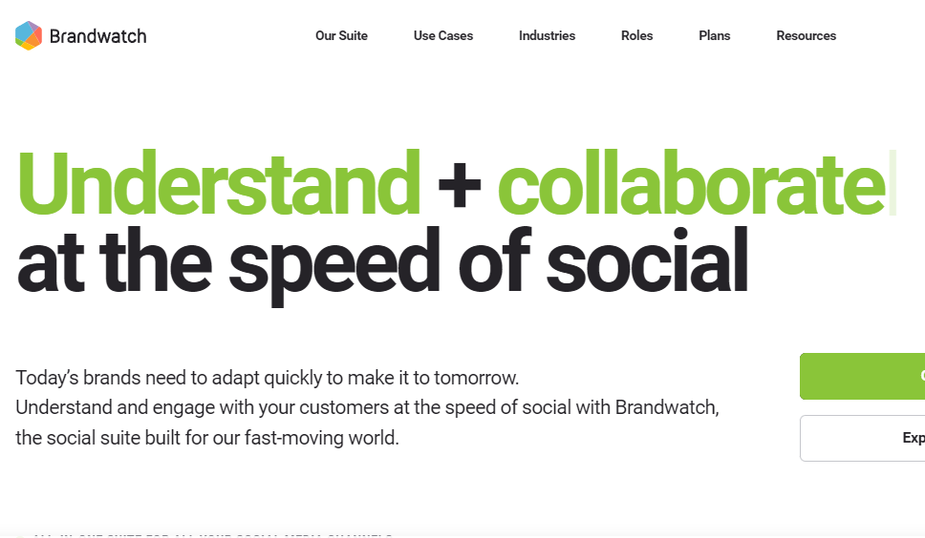

Slide 35
3rd PARTY PAID SOCIAL MEDIA ANALYTICS TOOLS

Slide 36
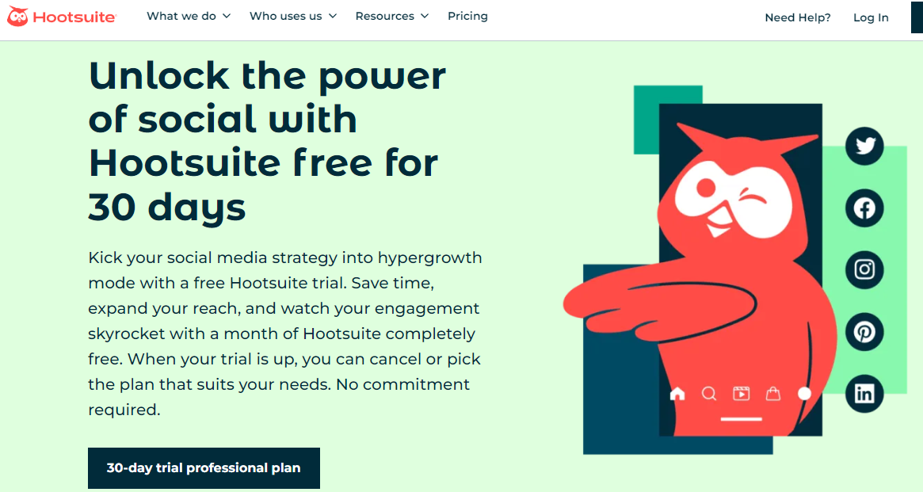

Slide 37
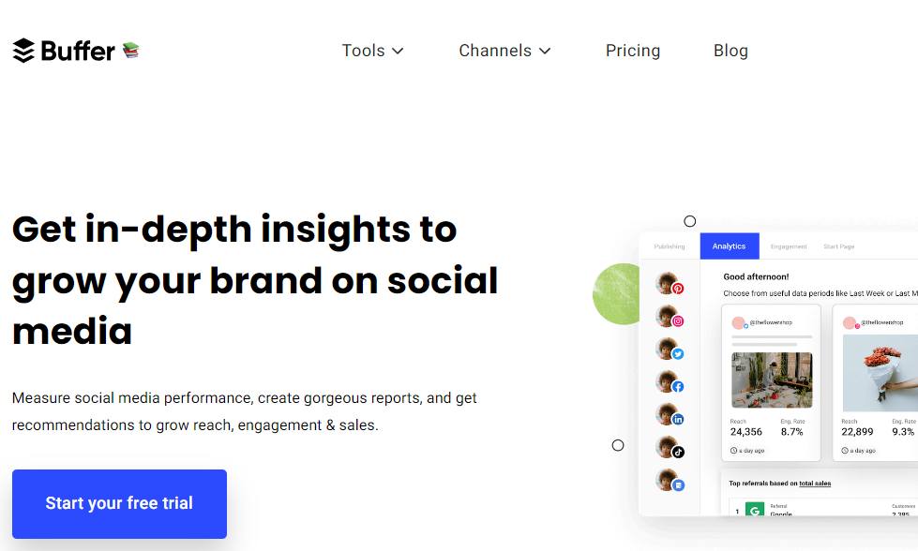

Slide 38
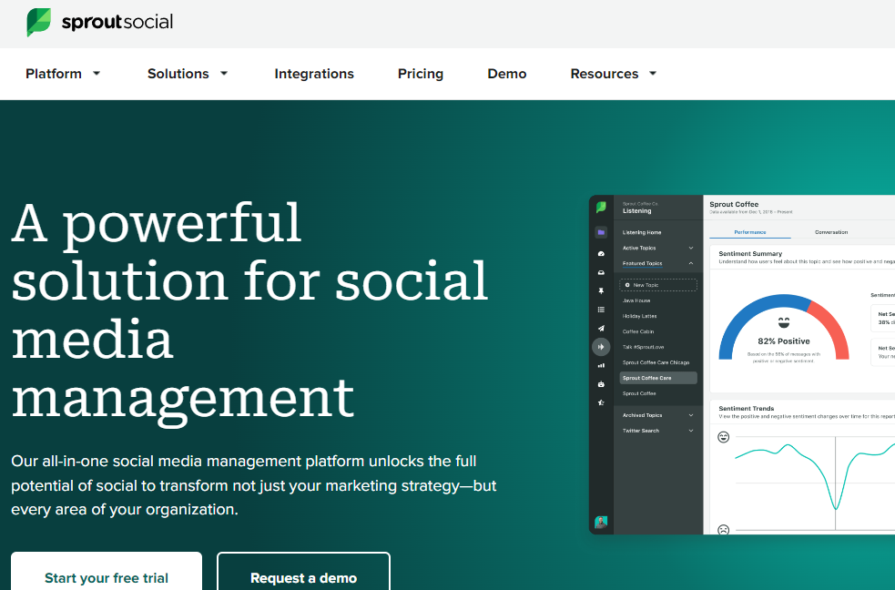

Slide 39
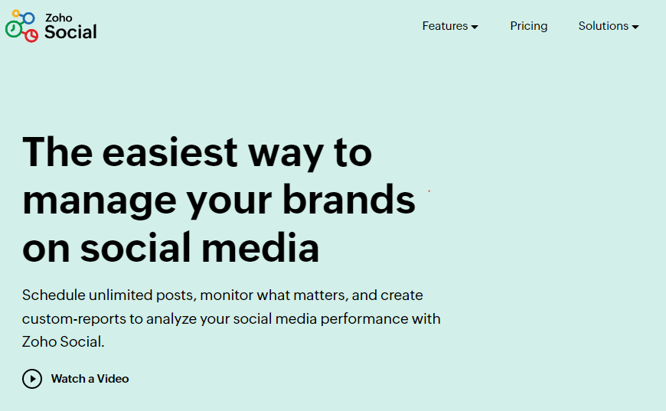

Slide 40
1st PARTY SOCIAL MEDIA ANALYTICS TOOLS

Slide 41
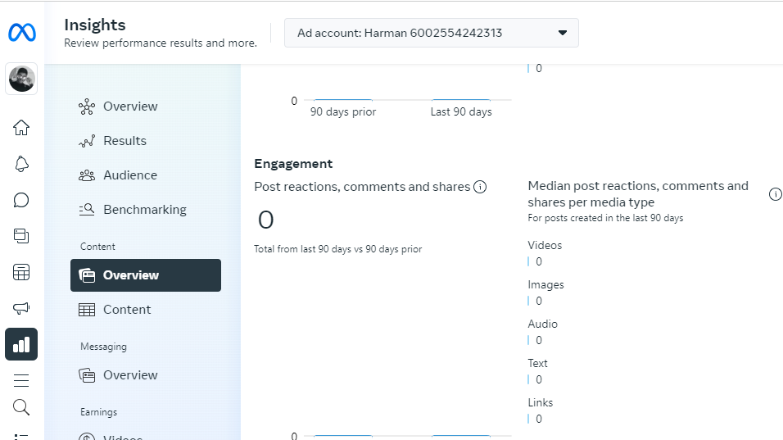

Slide 42
5. SOCIAL MEDIA ADS

Slide 43
Thankyou!

