Slide 1
Building an innovation culture
Session 2
Deepika Gupta
Asst Professor – CSP
IIM Visakhapatnam

Slide 2
Case 2 : You are the idea generator
  You are the student of this program
  Great idea for new venture
  Use Reliance Mart as warehouse
  Use Amazon.com as storefront
  Use Blue Dart as shipping/courier services
  Does viable business opportunity really exist?
  Are there too many unknowns?
  Insights into how people approach and evaluate ideas?
  Do we accept or reject new ideas?
Questions ?
a) What would you do with your business idea – eg: online gift basket, medication service or anything else?
b) What are the problems with the proposed idea?
c) Does idea indicate importance of market research to be done?

Slide 3
Case 2… contd…
What would you do with your new business idea?
  Concierge service – Target for whom?
  Online gift basket – Is there a cost advantage? Shipping costs? Thin margins?
  Medication delivery – Is it legal? Demand? Timing?
  Do nothing? – Does this make sense? Any one can go to Wal-Mart website and order?
  Problems with personal pick up/delivery services in large cities?
  International dispatch? Acceptance of goods? How?

Slide 4
Case 2… contd…
What are the problems with the idea? Support your arguments.
  No experience?
  Market size undetermined
  Lack of market research
  No barriers to entry?
  Segment mismatch?
  Logistical issues – how many times visit Reliance Mart?
  Unsure of potential ?
  Not enough information available? Lack of data
  Some ideas already done?
  Any other idea?

Slide 5
Case 2… contd…
What do you think are the barriers that this idea might encounter?
Risk
Any other opportunity?
Will this idea work?
Can costs increase?
Lack of market research

Slide 6
Case 2… contd… learnings..
  New formed ideas generally get rejected
  Because people look at only half risk reward equation
  Most people focus on perceived risk
  But fail to evaluate the potential returns
  Additional market research option – “Learn as you go”
    Implement the idea and learn in the process
    At times effective than formal market research
    Problems of formal market research with new products introduction or new markets creation

Slide 7
How to screen ideas?
Critical part of new product development
Eliminate unsound ideas
Will the customer in the target market benefit from the product?
What is the size and growth forecast of the target market?
What is the current or expected competitive pressure for the product idea?
Is it technically feasible to manufacture the product?
Will the product be profitable when manufactured and delivered to the customer at the target price?

Slide 8
Concept generation
After idea screening stage, ideas turned into concepts for testing purposes
It is a detailed strategy
Blueprint version of idea
After the idea is developed in every aspect to make it presentable
Develop product innovation and technology strategy (PITS) for business – improve business portfolio
Importance of concept presentation through verbal or drawing sketches, computer simulation etc

Slide 9
Concept testing
It is the process of using surveys
Other qualitative methods
Evaluate consumer acceptance of new product idea
Different from pre-test markets
It is preparation before market profiling is carried out
  Current buying patterns
  Existing segments
  Customers’ view of the available products

Slide 10
How new product development works?
Need advanced and well developed product development department
Skilled workforce
But what about new technology ?
  Need to be incubated
  Require faster deployment
2 ways to bring new technology
  Technology acquisitions – gives short term gains but fast, success is uncertain
  In-house technology development – takes time but sustaining

Slide 11
How to work on technology strategies?
Technology development is a risky and challenging proposition
Need to choose dependence on internal capabilities and external competence
Need to assemble various building blocks of
  Organizational development
  Technology strategy
  Customer insights
Done through internal pursuits (organic) or acquisitions (inorganic) through collaboration, takeovers or joint ventures
Depends on investment objectives and degree of operational dependence between the two organizations

Slide 12
Technology development strategies
Driving
Emergent
Enabling
Passive
Tight operational linkage
Strategic investment objective
Tight operational linkage
Financial strategic objective
Loose operational linkage
Strategic investment objective
Loose operational linkage
Financial strategic objective
Stimulate ecosystem in which the organization operates
Implemented to spearhead technology advancement in identified areas by organization
Parent organization senses an opportunity but difficult to explore
Adopted to reap financial returns from equity market
So what type of technology development strategy is
Marazzo – ?
Driverless tractor -- ?
DiGiSENSE - ?
Biogas plant -?

Slide 13
Some tools …...
5 Cs – culture, capability, creation, connection and collaboration
Application of 7S McKinsey framework
Christensen’s Jobs To Be Done (JTBD) framework
Application of Balanced Scorecard (BSC)

Slide 14
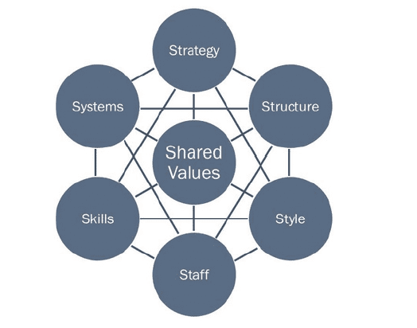
McKinsey 7S framework
Strategy – for competitive advantage
Structure – for flow of information and accountability
Systems – for effective decision making and operational management
Skills- to achieve organizational vision
Style - traits and attributes
Staff – HR requirements
Shared values- employee behaviour and corporate actions

Slide 15
Christensen’s JTBD framework
Job To Be Done Framework
Used to identify customer needs as an opportunity for new areas of technology development
What customer wants is the unit of analysis
It is customer centric approach to form metric for technology development
More important the need less satisfied is the customer and greater opportunity for value creation

Slide 16
Connect with Balanced scorecard(BSC)
Financial perspectives
Customer perspectives
Internal processes perspectives
Learning and growth perspectives
Link with 7S framework and JTBD framework

Slide 17
Balanced Scorecard for a Regional Airline
Simplified Strategy Map | Performance Measures | Targets | Initiatives
Financial | • Market Value • Seat Revenue • Plane Lease Cost | 25% per year 20% per year 5% per year | • Optimize routes • Standardize planes
Customer | • FAA on-time arrival rating • Customer ranking • No. customers | • First in industry • 98% satisfaction • % change | • Quality management • Customer loyalty program
Internal | • On Ground Time • On-Time Departure | • <25 Minutes • 93% | • Cycle time optimization program
Learning | • % Ground crew stockholders • % Ground crew trained | • Year 1, 70% • Year 4, 90% • Year 6, 100% | • Stock ownership plan • Ground crew training
Increase
Profitability
Lower
Cost
Increase
Revenue
More Cust-omers
On-time
Flights
Low
Prices
Improve turnaround
time
Align
Ground
Crews
Copyright © 2019 John Wiley & Sons, Inc. `

Slide 18
Business Model Canvas
Key Partners Key Activities Value Proposition Customer Customer
Relations Segment
Key Resources Channels
FEASIBILITY
DESIRABILITY
Cost structure Revenue streams
VIABILITY

Slide 19
Business model innovation
In value proposition
  Target segment
  Product offering
  Revenue model
In operating model
  In value chain
  Cost model
  Organization

Slide 20
Understanding customers
Integral part of the product development phase
Customer needs used to establish product specifications, generating product concepts and select product concept for further development
5 steps to identify customer needs
  Gather raw data from customers – interviews, focus groups, observe product use, record through videos, audios, notes etc
  Interpret raw data in terms of customer needs
  Organize the needs into a hierarchy
  Establish the relative importance of the needs
  Reflect on results and process

Slide 21
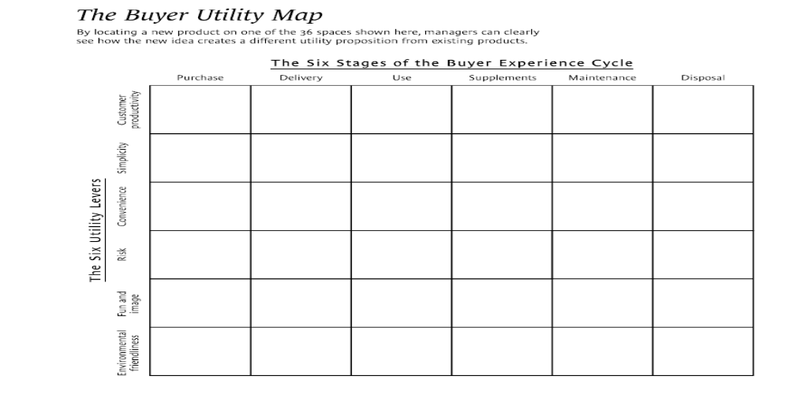
Knowing a winning business idea when you see one by Kim & Mauborgne (2008), HBR

Slide 22
Why new product design and development?`
Bring new product/service to marketplace
  Brought for first time to market
  Can be completely original products or modified/improved existing products
  Be a differentiator ? First mover advantage? Leapfrog? - Decide
Due to
  Customer preferences change
  Competitors threat
  Technological advancements
  Capitalize on new opportunity
  What market wants?
Exceed customer expectations

Slide 23
Design development
Industrial design
Prototype development
  Comprehensive – complete prototype
  Focused – limited number of attributes or features
Computer aided
Continuous improvements required – interaction design
Design development team – product champion, team selection, manage, global in nature, etc
Culture of collaboration – creativity and information sharing

Slide 24
Product use testing
First output of technical development – prototype
Use testing – test prototype under normal operating conditions
Understand complexity of consumer needs
Helps to gain insights into conditions, what if things go wrong??
Types of user testing
  Monadic – New product alone
  Sequential monadic – back to back monadic test
  Paired comparison – say new product and old/competitive product
  Triangular comparison – same as paired but with two competitive products

Slide 25
Major decisions in product testing
Objective setting – what purposes will the test satisfy?
Product related decisions
Sample selection
Location of the product test
Data collection method
Measurement technique

Slide 26
Results of product testing
Whether or not the new product appeals to the target market ?
Whether or not the new product compares favourably with competitive or substantive offerings?
How the product might be improved?
The proportion of testers who have expressed purchase intentions.

Slide 27
Case 3 : PQR Co Ltd..
New product development process
Idea generation
Total Ideas - 45
BASES Idea screening
Ideas Screening - 12
BASES snapshot Concept Test Screen
Dark chocolate with fruit concepts – 5
8 Focus Groups
70% vs. 90% cocoa and 3.5 oz. bar vs. squares in 5 oz stand up pouch – 4

Slide 28
Case 3.. Contd..
New product development process
70% cocoa with health vs. taste (link Swiss heritage) positioning and 3.5 oz. bar vs. squares in 5 oz stand up pouch – 4
Second BASES snapshot Concept Test
BASES II
70% cocoa healthy messaging squares in 5 oz stand up pouch – 1

Slide 29
Case 3… contd…
Definitely would buy | 23%
‘Definites’ % would buy | 80%
‘Definite’ purchases | 80% of 23% = 18.4%
Probably would buy | 40%
‘Probables’ % would buy | 30%
‘Probable’ purchases | 30% of 40% = 12%
Total Trial rate (Definite + Probable) | 18.4% + 12% = 30.4%
US Households (MM) | 120
Penetration % | 92%
Awareness (Medium) | 17%
ACV (Medium) | 65%
Total Trial households (MM) | 120*30.4%*92%*17%* 65% = 3.71

Slide 30
Case 3… contd..
Repeat rate % Households (average) | 33%
Repeat rate occasions | 4
Total repeat volume (households MM) | 3.71*33%* 4 = 4.9
Total Purchases (Trial + Repeat) MM | 3.7 + 4.9 = 8.6
Retail selling price | $ 4.49
Retail sales value (MM) | 4.49 * 8.6 = $ 38.6
Retailer gross margin | 35%
Sales volume (MM) | 38.6 * (1-35%) = $25.1
Applicable hurdle rate | $ 30MM

Slide 31
Product Launch
Prelaunch – build capabilities to compete – train the sales force, build service capability
Preannouncement – promos, advertising – signals to market for arrival
ATAR paradigm – Awareness-Trial-Availability-Repeat purchase
Role of launch stage – maximize the chances of profitably achieving acceptance in target market
Establish demand outcomes based on
  Trial and repurchase
  Customer migration
  Innovation adoption and diffusion

Slide 32
How launch tactics influence demands?
Launch Tactics |  | Influence demand by
Promotion | Advertising | Helps to stimulate trails through awareness and knowledge
 | Coupons | Effective to reinforce awareness where relative advantage is less
 | Publicity | Useful for high usage risk products, new and controversial product technologies
 | Sampling | Help learn via usage, word-of-mouth important
 | Reference Test sites | For potential buyers and helps share experiences
Sales & Distribution support | Shows and demos | To clear uncertainty about product usage etc
 | Technical support | To reduce usage process complexities, support customization
 | Distribution structure | For new target markets, detailed selling etc
 | Coverage intensity | Reduce risk of product usage problems through high availability, display space and other services
 | Distribution incentives | To stimulate availability through active support

Slide 33
How launch tactics influence demands?
Launch Tactics |  | Influence demand by
Pricing | Introductory pricing | Market skimming, penetration if low prices encourage early adopters and speed diffusion
 | Price administration | Leasing, rebates, money-back guarantees reduce economic risks. Tie-in sales and bundling enhance compatibility with established products
Product | Breadth of assortment | Introducing new categories and facilitate customization of industrial products
 | Branding | Positive associations, enhance compatibility, gain trade acceptance
Timing | Product deletion | Helps in faster deletion if new products have higher margins, slow deletion if psychological or switching costs are substantial
 | Pre-announcing | Help build hype for new products, help establish reputation, more time to buyers to learn technology or modify related systems

Slide 34
Another example – TACO BELL !!
New product development – Unique approach
Its innovation team looks to grocery stores, social media and competitors for its inspiration.
Idea generation – development team reviews about 4,500 new product ideas every year.
Concept development and testing – Generated 80 iterations of the Waffle Taco before deciding on the final one. Unfortunately, Taco Bell discontinued the Waffle Taco after only a year, replacing it with the Biscuit Taco.
Product technical design - For the Doritos Locos Taco, the product team discovered a process to evenly distribute seasoning on the shells and contain cheese dust in the production process.
Test marketing – Between 350-500 ideas end up in consumer tests.
Market entry - 8 to 10 products end up on the national menu.

Slide 35
Thank you !!!

