Slide 1

Financial Management for Leaders
IIM Visakhapatnam
Session – 1&2 (Prof. M Shameem Jawed)

Slide 2

M Shameem Jawed
Associate Professor (F&A) & Chairperson PGPMCI, IIM Visakhapatnam
Founding Director - IIMV FIELD & AIC – IIMVFIELD.
EMAIL: msjawed@iimv.ac.in
Education: BTech (Mech. Engg) & PhD (Finance & Accounting)
FPM (PhD) in Finance & Accounting area from IIM Indore.
Previously - Assistant Professor at MDI & Consultant at SunGard (now FIS) 5+ Years
Teaching interests: Corporate Finance, Cost Management, Corporate Governance, Finance, Start-up Financing and Financial Analytics.
Shameem has been training and mentoring Start-ups and handheld them from ideation to implementation phase since the inception of the IIM Visakhapatnam Incubation center in 2018.
Currently, he leads seven flagship Pre-Incubation, Incubation, and Accelerator Programs at IIMV FIELD, and has incubated 144+ startups at FIELD. The focus of the incubator is women-led, technology-led, and social ventures. Incubator is working on developing FinTech & EdTech Labs.
Shameem also lead Ministry of Skill Development and Entrepreneurship (MSDE) sponsored Mahatma Gandhi National fellowship Program, in which 76 trained fellows are working on promotion of skill development in various districts of the country.
Research Interests: https://scholar.google.com/citations?user=Krpct3MAAAAJ&hl=en&oi=ao

Slide 3
Have we heard of these in our organization?
“What’s the ROI on that software your department wants to buy?”
“The CFO says profits are great but money’s tight— everyone needs to conserve cash.”
“I’ve been studying the figures, and it looks as if your sales reps are sacrificing gross margin for revenue. Have you talked to them about that?”
“Our inventory days are creeping upward. We have to find a way to reverse that trend.”

Slide 4
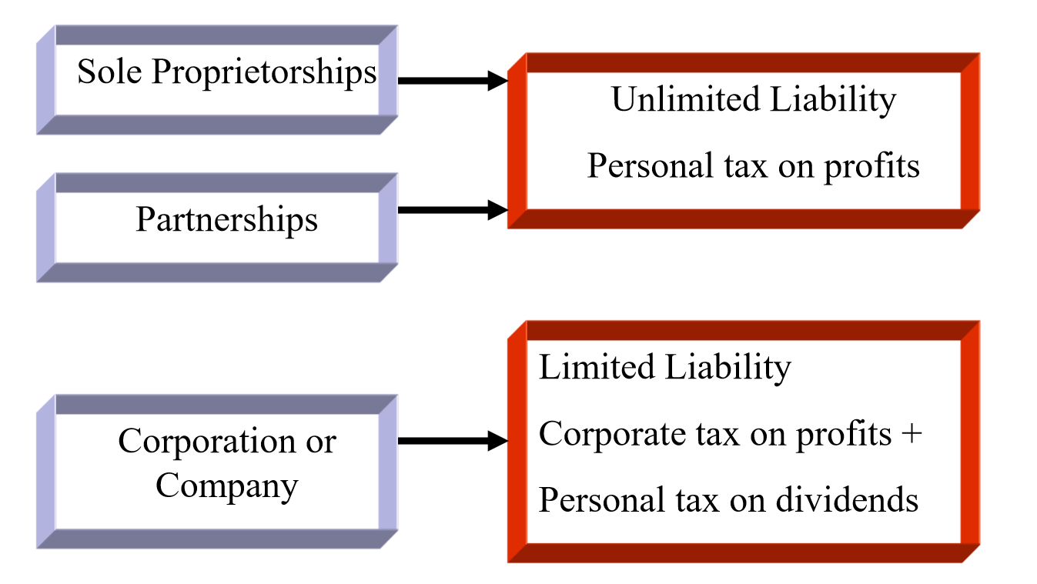
Business Structure

Slide 5
Agenda
This session provides an overview of financial statements but emphasizes on the interpretation and strategic use of financial information in decision-making

Slide 6
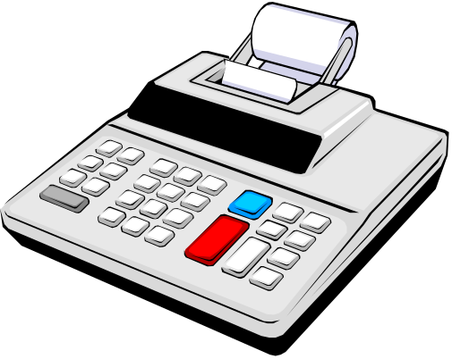
Accounting
The accounting system is a series of steps performed to analyze, record, quantify, accumulate, summarize, classify, report, and interpret economic events and their effects on an organization and to prepare the financial statements.

Slide 7
Accounting as an Aid to Decision Making
Fundamental relationships in the decision-making process:
Accountant’s
analysis &
recording
Financial
Statements
Event
Users

Slide 8
Accounting as an Aid to Decision Making
Accounting information is useful to anyone who makes decisions that have economic results.
  Managers want to know if a new product will be profitable.
  Owners want to know which divisions are productive.
  Investors want to know if a company is a good investment.
  Creditors want to know if they should extend credit, how much to extend, and for how long.
  Government/regulators want to know if financial statements conform to requirements.

Slide 9
Financial and Management Accounting
The primary questions about an organization’s success that decision makers want to know are:
What is the financial picture of the organization on a given day?
How well did the organization do during a given period?

Slide 10

Financial and Management Accounting
  Financial accounting serves external users.
  Management accounting serves internal users, such as top executives, management, and administrators within organizations.

Slide 11
The Annual Report
Annual report - a document prepared by management and distributed to current and potential investors to inform them about the company’s past performance and future prospects.
  The annual report is one of the most common sources of financial information used by investors and managers.

Slide 12
The Annual Report
Typically, along with the key financial statements, any annual report would have:
  a letter from corporate management
  a discussion and analysis of recent economic events by management
  footnotes that explain many elements of the financial statements in more detail
  the report of the independent auditors
  a statement of management’s responsibility for preparation of the financial statements
  other corporate information

Slide 13
The Key Financial Statements
Balance sheet
Income statement
Cash flow statement
Together these financial statements can help you understand what is going on in your company—or in any other business

Slide 14
Balance sheet
The balance sheet shows a company’s financial position at a specific point in time. It provides a snapshot of its assets, liabilities, and equity on a given day.
Assets = Liabilities + Owners’ Equity

Slide 15
The Balance Sheet
Sections of the balance sheet:
Assets - resources of the firm that are expected to increase or cause future cash flows (everything the firm owns)
Liabilities - obligations of the firm to outsiders or claims against its assets by outsiders (debts of the firm)
Owners’ Equity - the residual interest in, or remaining claims against, the firm’s assets after deducting liabilities (rights of the owners)

Slide 16
Assets
Chapter 1
Probable future economic benefits
  Owned by the organisation
  Has current or future value to the organisation
  Has been acquired at a cost that can be measured.
What a business “owns”!
Examples
  Cash, Investments, Buildings, Plant and machinery, Patents and copyrights
Current vs Non-Current Assets & the,
Concept of Depreciation |& Amortization.

Slide 17
Liabilities
Chapter 1
Probable future sacrifices of economic benefits
What a business “owes”
Contractual, statutory, or constructive
Examples
  Loans payable, Warranty obligations, Pensions payable, Income tax payable, Account Payables

Slide 18
Equity
Chapter 1
Residual interest of owners
Examples
  Share capital
  Share premium
  Revenues & Expenses
  Dividends
  Retained profit

Slide 19

Balance Sheet Transactions
The balance sheet is affected by every transaction that an entity encounters.
Each transaction has counterbalancing entries that keep total assets equal to total liabilities and owners’ equity,
- i.e., the balance sheet equation must always be balanced.

Slide 20
Balance Sheet Transactions
Just as the balance sheet equation must always balance, the balance sheet must also always balance.
A balance sheet could be prepared after every transaction, but this practice would be awkward and unnecessary.
  Therefore, balance sheets are usually prepared monthly or on some other periodic schedule.

Slide 21
Income statement
The income statement shows the bottom line. It indicates how much profit or loss was generated over a period of time—usually a month, a quarter, or a Year
Net Income = Revenues – Expenses

Slide 22
Cash flow statement
The cash flow statement tells where the company’s cash came from and where it went.
It shows the relationship between net profit and the change in cash recorded from one balance sheet to the next.
  Operating Activities + Investing Activities + Financing Activities

Slide 23
Cash or Profit, which is more Important?
Let’s understand it with the help of cases:
Case 1: AgriTech Startup at Tech Valley
  Business Model: This startup provides advanced IoT-based monitoring systems for agriculture. It offers its solutions on a subscription basis with significant upfront costs due to hardware installation.
  Sales for the first three months: $20,000, $30,000, and $45,000.
  Cost of Goods Sold (COGS): 60% of sales, attributed to hardware and installation costs.
  Monthly Operating Expenses: $10,000, including software support and staff salaries.
  Sales Terms: Due to government incentives for tech adoption in agriculture, the company offers its solutions on credit terms of 75 days to farmers, with govt. guarantee under Digital India Mission.
  Let’s see their profit and cash positions…!

Slide 24
Cash or Profit, which is more Important? (contd…)
Case 2: E-commerce Platform for Artisan Products at Coastal Hub
  Business Model: This platform curates high-end artisan products and provides a marketplace for luxury goods, benefiting from high visibility and premium pricing.
  Sales for the first three months: $50,000, $75,000, and $95,000.
  Cost of Goods Sold (COGS): 60% of sales, reflecting the procurement of premium artisan products.
  Monthly Operating Expenses: $30,000, primarily due to high marketing spend and platform maintenance costs.
  Let’s see their profit and cash positions…!

Slide 25

How to access the health of a firm using information published in financial statements?
Ratio Analysis

Slide 26
Ratio Analysis: Overview
Ratios facilitate comparison of:
One company over time
One company versus other companies
Ratios are used by:
Lenders to determine creditworthiness
Stockholders to estimate future cash flows and risk
Managers to identify areas of weakness and strength

Slide 27
Income Statement
 | 2023 | 2024E
Sales | $5,834,400 | $7,035,600
COGS except depr. | 4,980,000 | 5,800,000
Other expenses | 720,000 | 612,960
Deprec. | 116,960 | 120,000
Tot. op. costs | 5,816,960 | 6,532,960
EBIT | 17,440 | 502,640
Int. expense | 176,000 | 80,000
EBT | (158,560) | 422,640
Taxes (40%) | (63,424) | 169,056
Net income | ($ 95,136) | $ 253,584

Slide 28
Balance Sheets: Assets
 | 2023 | 2024E
Cash | $ 7,282 | $ 14,000
S-T invest. | 20,000 | 71,632
AR | 632,160 | 878,000
Inventories | 1,287,360 | 1,716,480
Total CA | 1,946,802 | 2,680,112
Net FA | 939,790 | 836,840
Total assets | $2,886,592 | $3,516,952

Slide 29
Balance Sheets: Liabilities & Equity
 | 2023 | 2024E
Accts. payable | $ 324,000 | $ 359,800
Notes payable | 720,000 | 300,000
Accruals | 284,960 | 380,000
Total CL | 1,328,960 | 1,039,800
Long-term debt | 1,000,000 | 500,000
Common stock | 460,000 | 1,680,936
Ret. earnings | 97,632 | 296,216
Total equity | 557,632 | 1,977,152
Total L&E | $2,886,592 | $3,516,952

Slide 30
Other Data
 | 2023 | 2024E
Stock price | $6.00 | $12.17
# of shares | 100,000 | 250,000
EPS | -$0.95 | $1.01
DPS | $0.11 | $0.22
Book val. per sh. | $5.58 | $7.91
Lease payments | $40,000 | $40,000
Tax rate | 0.4 | 0.4

Slide 31
Liquidity Ratios
Can the company meet its short-term obligations using the resources it currently has on hand?

Slide 32
Forecasted Current and Quick Ratios for 2014.
CA
CL
$2,680
$1,040
CR₂₄ = = = 2.58.
CA - Inv.
CL
QR₂₄ (Acid Test Ratio)=
$2,680 - $1,716
$1,040
= = 0.93.

Slide 33
Comments on CR and QR
 | 2024E | 2023 | 2022 | Ind.
CR | 2.58 | 1.46 | 2.3 | 2.7
QR | 0.93 | 0.5 | 0.8 | 1.0
Expected to improve but still below the industry average.
Liquidity position is weak.

Slide 34
Asset Management / Efficiency Ratios
How efficiently does the firm use its assets?
How much tied up in assets for each dollar of sales?

Slide 35
Inventory Turnover Ratio
COGS
Inventories
Inv. Turnover =
= = 3.45.
$5,800 + $120
$1,716
2024E 2023 2022 Ind.
Inv. T. 3.45 4.0 4.0 6.1

Slide 36
Comments on Inventory Turnover
Inventory turnover is below industry average.
Firm might have old inventory, or its control might be poor.
No improvement is currently forecasted.

Slide 37
Days Sales Outstanding (or) Receivable Turnover Days
Receivables
Average sales per day
DSO =
= =
= 45.5 days.
Receivables
Sales/365
$878
$7,036/365

Slide 38
Appraisal of DSO
Firm collects too slowly, and situation is getting worse.
Poor credit policy.
Other important one is
  – Days Payable Outstanding (DPO) = Acc. Payable/COGS per day
2024 2023 2022 Ind.
DSO 45.5 39.5 37.4 32.0

Slide 39
Fixed Assets and Total Assets Turnover Ratios
Fixed assets
turnover
Sales
Net fixed assets
=
= = 8.41.
$7,036
$837
Total assets
turnover
Sales
Total assets
=
= = 2.00.
$7,036
$3,517
(More…)

Slide 40
Fixed Assets and Total Assets Turnover Ratios
FA turnover is expected to exceed industry average. Good.
TA turnover not up to industry average. Caused by excessive current assets (A/R and inventory).
 | 2024E | 2023 | 2022 | Ind.
FA TO | 8.4 | 6.2 | 10.0 | 7.0
TA TO | 2.0 | 2.0 | 2.3 | 2.5

Slide 41
Debt Management Ratios
Company have too much debt?
Can the company’s earnings meet its debt servicing requirements?

Slide 42
Leverage Ratios: Debt Ratio
Total debt
Total assets
Debt ratio =
= = 22.7%.
$300 + $500
$3,517
(More…)

Slide 43
Leverage Ratios: Liabilities-to-Assets Ratio
Total liabilities
Total assets
Liabilities/TA ratio =
=
=43.8%.
$1,039.8 + $500
$3,517
(More…)

Slide 44
Times Interest Earned Ratio
EBIT
Int. expense
TIE =
= = 6.3.
$502.6
$80
(More…)

Slide 45
Debt Management Ratios vs. Industry Averages
2024E 2023 2022 Ind.
D/TA 22.7% 59.6% 35.6% 32.0%
TL/TA 43.8% 80.7% 54.8% 50.0%
TIE 6.3 0.1 3.3 6.2
Recapitalization improved situation.

Slide 46

Debt is good or bad?

Slide 47

Profitability Ratios
What is the company’s rate of return on:
  Sales?
  Assets?

Slide 48
Profit Margins
Net profit margin (PM):
NI
Sales
$253.6
$7,036
PM = = = 3.6%.
Operating profit margin (OM):
EBIT
Sales
$503
$7,036
OM = = = 7.1%.
(More…)

Slide 49
Profit Margins (Continued)
Gross profit margin (GPM):
Sales − COGS
Sales
$7,036 − $5,800
$7,036
GPM = =
$1,236
$7,036
GPM = = 17.6%.

Slide 50
Profit Margins vs. Industry Averages
2024E 2023 2022 Ind.
PM 3.6% -1.6% 2.6% 3.6%
OPM 7.1 0.3 6.1 7.1
GPM 17.6 14.6 16.6 15.5
Very bad in 2023, but projected to
meet or exceed industry average in 2024.

Slide 51
Basic Earning Power (BEP)
EBIT
Total assets
BEP =
= = 14.3%.
$502.6
$3,517
(More…)

Slide 52
Basic Earning Power vs. Industry Average
-BEP removes effect of taxes and financial leverage. Useful for comparison.
-Projected to be below average.
-Room for improvement.
2024E 2023 2022 Ind.
BEP 14.3% 0.6% 14.2% 17.8%

Slide 53
Return on Assets (ROA) and Return on Equity (ROE)
NI
Total assets
ROA =
= = 7.2%.
$253.6
$3,517
(More…)

Slide 54
Return on Assets (ROA) and Return on Equity (ROE)
NI
Common Equity
ROE =
= = 12.8%.
$253.6
$1,977
(More…)

Slide 55
ROA and ROE vs. Industry Averages
2024E 2023 2022 Ind.
ROA 7.2% -3.3% 6.0% 9.0%
ROE 12.8% -17.1% 13.3% 18.0%
Both are below average but improving.

Slide 56
Effects of Debt on ROA and ROE
ROA is lowered by debt-
  Interest expense lowers net income, which also lowers ROA.
ROE is enhanced by debt -
  use of debt lowers equity, and if equity is lowered more than net income, ROE would increase.

Slide 57

Market Value Ratios
Market value ratios incorporate the:
  High current levels of earnings and cash flow increase market value ratios
  High expected growth in earnings and cash flow increases market value ratios
  High risk of expected growth in earnings and cash flow decreases market value ratios

Slide 58
Interpreting Market Based Ratios
P/E: How much investors will pay for $1 of earnings. Higher is better.
M/B: How much paid for $1 of book value. Higher is better.
P/E and M/B are high if ROE is high, risk is low.

Slide 59
Calculate and appraise the
P/E, P/CF, and M/B ratios.
Price = $12.17.
EPS = = = $1.01.
P/E = = = 12.
NI
Shares out.
$253.6
250
Price per share
EPS
$12.17
$1.01

Slide 60
Market Based Ratios (Continued)
Mkt. price per share
Book value per share
M/B =
= = 1.54.
$12.17
$7.91

Slide 61
Comparison with Industry Averages
2024E 2023 2022 Ind.
P/E 12.0 -6.3 9.7 14.2
M/B 1.5 1.1 1.3 2.9

Slide 62
Common Size Balance Sheets:
Divide all items by Total Assets
Assets | 2022 | 2023 | 2024E | Ind.
Cash | 0.6% | 0.3% | 0.4% | 0.3%
ST Inv. | 3.3% | 0.7% | 2.0% | 0.3%
AR | 23.9% | 21.9% | 25.0% | 22.4%
Invent. | 48.7% | 44.6% | 48.8% | 41.2%
Total CA | 76.5% | 67.4% | 76.2% | 64.1%
Net FA | 23.5% | 32.6% | 23.8% | 35.9%
TA | 100.0% | 100.0% | 100.0% | 100.0%

Slide 63
Divide all items by Total Liabilities & Equity
Liab. & Eq. | 2022 | 2023 | 2024E | Ind.
AP | 9.9% | 11.2% | 10.2% | 11.9%
Notes pay. | 13.6% | 24.9% | 8.5% | 2.4%
Accruals | 9.3% | 9.9% | 10.8% | 9.5%
Total CL | 32.8% | 46.0% | 29.6% | 23.7%
LT Debt | 22.0% | 34.6% | 14.2% | 26.3%
Total eq. | 45.2% | 19.3% | 56.2% | 50.0%
Total L&E | 100.0% | 100.0% | 100.0% | 100.0%

Slide 64
Analysis of Common Size Balance Sheets
Computron has higher proportion of inventory and current assets than Industry.
Computron now has more equity (which means LESS debt) than Industry.
Computron has more short-term debt than industry, but less long-term debt than industry.

Slide 65
Common Size Income Statement:
Divide all items by Sales
 | 2022 | 2023 | 2024E | Ind.
Sales | 100.0% | 100.0% | 100.0% | 100.0%
COGS | 83.4% | 85.4% | 82.4% | 84.5%
Depr. | 0.6% | 2.0% | 1.7% | 4.0%
Other exp. | 9.9% | 12.3% | 8.7% | 4.4%
EBIT | 6.1% | 0.3% | 7.1% | 7.1%
Int. Exp. | 1.8% | 3.0% | 1.1% | 1.1%
Pre-tax earn. | 4.3% | -2.7% | 6.0% | 5.9%
Taxes | 1.7% | -1.1% | 2.4% | 2.4%
NI | 2.6% | -1.6% | 3.6% | 3.6%

Slide 66
Analysis of Common Size Income Statements
Computron has lower COGS (86.7) than industry (84.5), but higher other expenses.
Result is that Computron has similar EBIT (7.1) as industry.

Slide 67
Percentage Change Analysis: % Change from First Year (2022)
Income St. | 2022 | 2023 | 2024E
Sales | 0.0% | 70.0% | 105.0%
COGS | 0.0% | 73.9% | 102.5%
Depr. | 0.0% | 518.8% | 534.9%
Other exp. | 0.0% | 111.8% | 80.3%
EBIT | 0.0% | -91.7% | 140.4%
Int. Exp. | 0.0% | 181.6% | 28.0%
EBT | 0.0% | -208.2% | 188.3%
Taxes | 0.0% | -208.2% | 188.3%
NI | 0.0% | -208.2% | 188.3%

Slide 68
Analysis of Percent Change Income Statement
We see that 2024 sales grew 105% from 2022, and that NI grew 188% from 2022.
So Computron has become more profitable.

Slide 69
Percentage Change Balance Sheets: Assets
Assets | 2022 | 2023 | 2024E
Cash | 0.0% | -19.1% | 55.6%
ST Invest. | 0.0% | -58.8% | 47.4%
AR | 0.0% | 80.0% | 150.0%
Invent. | 0.0% | 80.0% | 140.0%
Total CA | 0.0% | 73.2% | 138.4%
Net FA | 0.0% | 172.6% | 142.7%
TA | 0.0% | 96.5% | 139.4%

Slide 70
Percentage Change Balance Sheets: Liabilities & Equity
Liab. & Eq. | 2022 | 2023 | 2024E
AP | 0.0% | 122.5% | 147.1%
Notes pay. | 0.0% | 260.0% | 50.0%
Accruals | 0.0% | 109.5% | 179.4%
Total CL | 0.0% | 175.9% | 115.9%
LT Debt | 0.0% | 209.2% | 54.6%
Total eq. | 0.0% | -16.0% | 197.9%
Total L&E | 0.0% | 96.5% | 139.4%

Slide 71
Analysis of Percent Change Balance Sheets
We see that total assets grew 139%, while sales grew only 105%.
So, asset utilization remains a problem.

Slide 72
Potential Problems and Limitations of Ratio Analysis
Comparison with industry averages is difficult if the firm operates many different divisions.
Seasonal factors can distort ratios.
Window dressing techniques can make statements and ratios look better.
Different accounting and operating practices can distort comparisons.

Slide 73
Qualitative Factors to be considered as well…!
There is greater risk if:
  revenues tied to a single customer
  revenues tied to a single product
  reliance on a single supplier?
  High percentage of business is generated overseas?
What is the competitive situation?
What products are in the pipeline?
What are the legal and regulatory issues?

Slide 74

Wish you BEST for all your future endeavors!!!
I hope you had a Good Learning Experience…!
It was indeed a pleasure learning along with you all…

