Slide 1
Crafting value in the digital era
Notes:
Data, Technologies, Processes, People

Slide 2
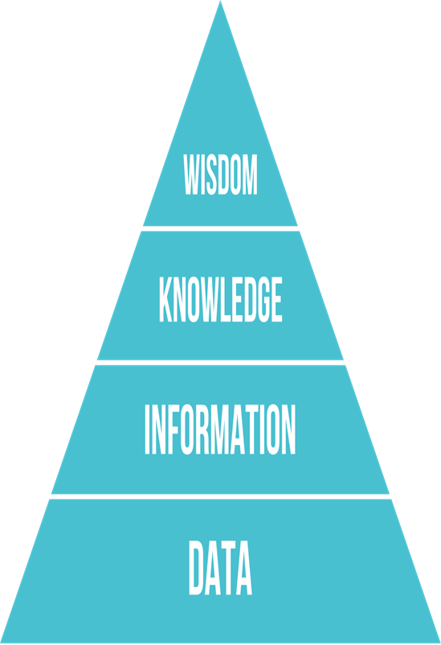
DIKW Pyramid (1 of 4)
Know-why: Wisdom is the ability to increase effectiveness. Makes use of knowledge to create value through correct and well-informed decisions.
Ex. Keep more branded dish detergent compared to other dish detergent to increase profit.
Know-how: Knowledge is applied information that actively guides task execution, problem solving and decision making.
Ex. Brands of dish detergent ->most rapidly selling at that store.
Know-what: Data shaped into a meaningful and useful form. Ex. Total number of bottles of dish detergent sold at a store.
Know-nothing: Streams of raw facts. Discrete facts about events.
Ex. Supermarket or mall checkout counters scans millions of pieces of data from bar codes.

Slide 3
DIKW Pyramid (3 of 4)
Data: Discrete, objective facts or observations, which are unorganized and unprocessed and therefore have no meaning or value because of lack of context and interpretation.
Information: Organized or structured data, which has been processed in such a way that the information now has relevance for a specific purpose or context, and is therefore meaningful, valuable, useful and relevant.
Knowledge: An awareness and understanding of a set of information and ways that information can be made useful to support a specific task or reach a decision

Slide 4
DIKW Pyramid (4 of 4)
Wisdom: The quality of having experience, knowledge, and good judgment – or my favorite…knowledge rightly applied.
  Why is
  Who do
  Appreciation of why
  Ability to create effectiveness
  Adds Value

Slide 5
Business Processes
Business processes
  Flows of material, information, knowledge
  Logically related set of tasks that define how specific business tasks are performed
  May be tied to functional area or be cross-functional
Businesses: Can be seen as collection of business processes
Business processes may be assets or liabilities
Business Process: A collection of inter-related events, activities, and decision points that involve several actors and objects, which collectively lead to an outcome that is of value to a customer.

Slide 6
Examples of Business Processes
Order-to-cash
Quote-to-order
Procure-to-pay
Issue-to-resolution
Application-to-approval
Claim-to-Settlement

Slide 7
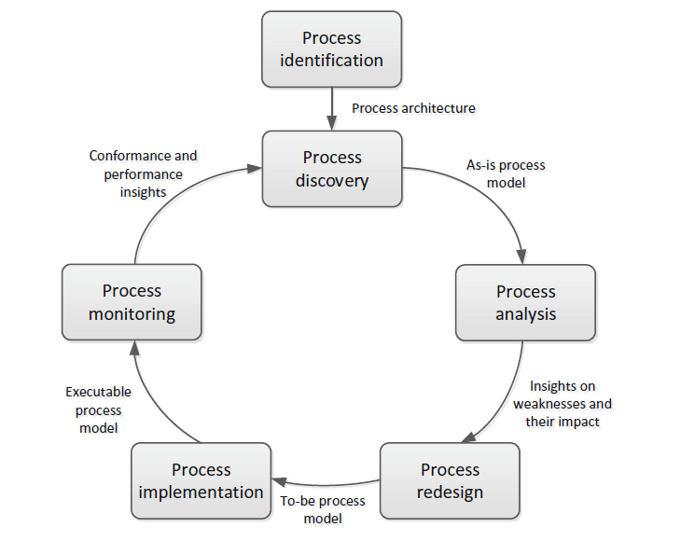
The BPM Lifecycle

Slide 8
How digital technologies can Improves Business Processes
Increasing efficiency of existing processes
  Automating steps that were manual
Enabling entirely new processes
  Changing flow of information
  Replacing sequential steps with parallel steps
  Eliminating delays in decision making
  Supporting new business models
Leveraging new technologies

Slide 9
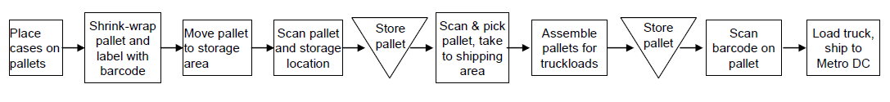
How digital technologies can Improves Business Processes

Slide 10
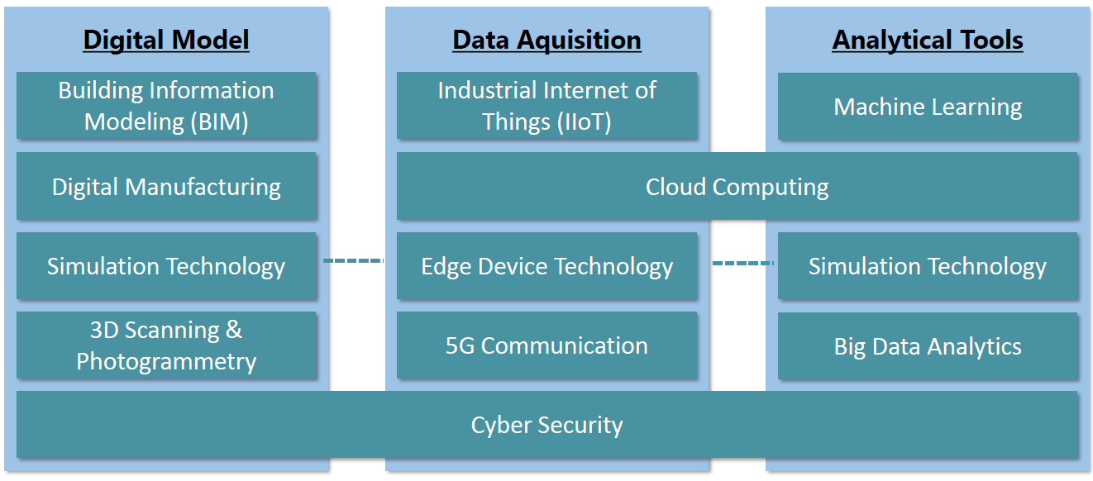
Emerging Technology Enablers
    VR,AR Sensor Technology Streaming Analytics
                Blockchain, GPS, RFID, SOA
Notes:
Smart Space and Robotics, Digital Twin

Slide 11
Collaboration
Collaboration
  Short lived or long term
  Informal or formal (teams)
Growing importance of collaboration
  Changing nature of work
  Growth of professional work—“interaction jobs”
  Changing organization of the firm
  Changing scope of the firm
  Emphasis on innovation
  Changing culture of work

Slide 12
What is Social Business?
Social business
  Use of social networking platforms (internal and external) to engage employees, customers, and suppliers
Aims to deepen interactions and expedite information sharing
“Conversations” to strengthen bonds with customers
Requires information transparency
Seen as way to drive operational efficiency, spur innovation, accelerate decision making

Slide 13
Business Benefits of Collaboration and Teamwork
Investment in collaboration technology can return large rewards, especially in sales and marketing, research and development
Productivity: Sharing knowledge and resolving problems
Quality: Faster resolution of quality issues
Innovation: More ideas for products and services
Customer service: Complaints handled more rapidly
Financial performance: Generated by improvements in factors above

Slide 14
Building a Collaborative Culture and Business Processes
“Command and control” organizations
  No value placed on teamwork or lower-level participation in decisions
Collaborative business culture
  Senior managers rely on teams of employees
  Policies, products, designs, processes, and systems rely on teams
  The managers purpose is to build teams

Slide 15
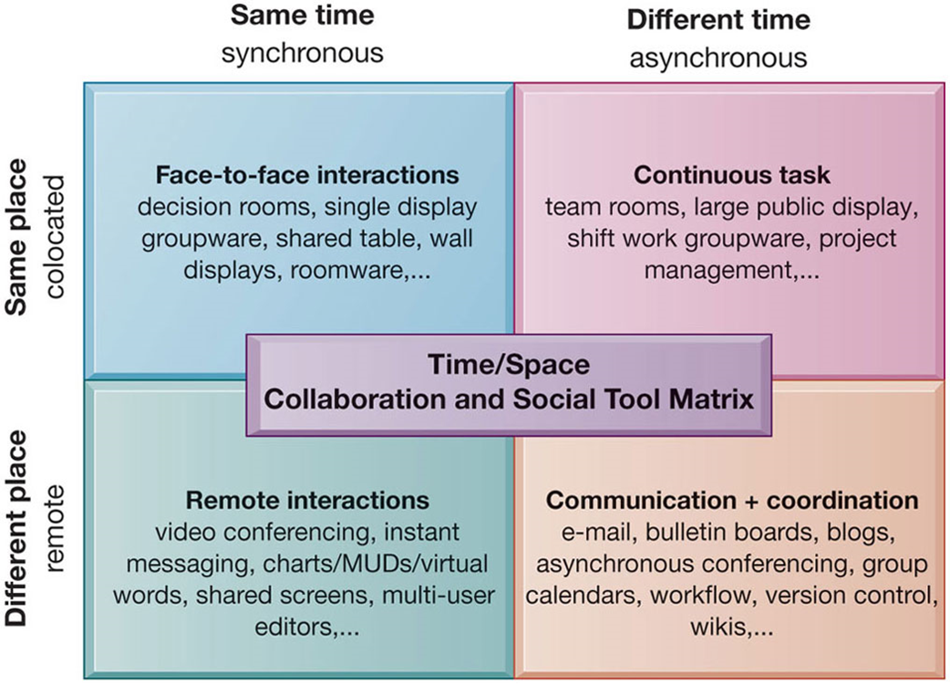
The Time/Space Collaboration and Social Tool Matrix

Slide 16
Organizing the Information Systems Function
I T governance
  Strategies and policies for using I T in the organization
  Decision rights
  Accountability
  Organization of information systems function
    Centralized, decentralized, and so on

Slide 18
What’s Driving Digital Businesses
  IT Innovations
    Cloud computing, Big data, Internet of Things
    Mobile digital platform
    AI and machine learning
  New Business Models
    Online streaming music and video
    On-demand e-commerce services

Slide 19
What’s Driving Digital Businesses
  Firms and Organizations Change
    More collaborative, less emphasis on hierarchy and structure
    Greater emphasis on competencies and skills
    Higher-speed/more accurate decision making based on data and analysis
    More willingness to interact with consumers (social media)
    Better understanding of the importance of I T

Slide 20
Business Objectives
  Firms invest heavily in information systems to achieve six strategic business objectives:
      Operational excellence
      New products, services, and business models
      Customer and supplier intimacy
      Improved decision making
      Competitive advantage
      Survival

Slide 21
Operational Excellence
  Improved efficiency results in higher profits
  Information systems and technologies help improve efficiency and productivity
  Example: Walmart
    Power of combining information systems and best business practices to achieve operational efficiency—and over $485 billion in sales in 2017
    Most efficient retail store in world as result of digital links between suppliers and stores

Slide 22
New Products, Services, and Business Models
  Information systems and technologies enable firms to create new products, services, and business models
  Business model: how a company produces, delivers, and sells its products and services
  Example: Apple
    Transformed old model of music distribution with iTunes
    Constant innovations—iPod, iPhone, iPad, etc.

Slide 23
Customer and Supplier Intimacy
  Customers who are served well become repeat customers who purchase more
    Example: Mandarin Oriental Hotel, Harrah's Hotels And Casinos
    Uses I T to foster an intimate relationship with its customers, keeping track of preferences, etc.
  Close relationships with suppliers result in lower costs
    Examples: Mandarin Oriental Hotel and J C Penney
    J C Penney uses I T to enhance relationship with supplier in Hong Kong

Slide 24
Improved Decision Making (1 of 2)
  Without accurate information:
    Managers must use forecasts, best guesses, luck
    Results in:
      Overproduction, underproduction
      Misallocation of resources
      Poor response times

Slide 25
Improved Decision Making (2 of 2)
  Poor outcomes raise costs, lose customers
  Real-time data improves ability of managers to make decisions.
  Example: Web-based digital dashboard to provide managers with real-time data on customer complaints, network performance, line outages, etc.

Slide 26
Competitive Advantage
  Often results from achieving previous business objectives
  Advantages over competitors
  Charging less for superior products, better performance, and better response to suppliers and customers
  Examples: Apple, Walmart, U P S are industry leaders because they know how to leverage digital information systems for this purpose

Slide 27
Survival
  Businesses may need to invest in information systems out of necessity; simply the cost of doing business
  Keeping up with competitors
    Introduction of chatbots
  Federal and state regulations and reporting requirements

Slide 28
Complementary Assets: Organizational Capital and the Right Business Model (1 of 2)
  Assets required to derive value from a primary investment
  Firms supporting technology investments with investment in complementary assets receive superior returns
  Example: Invest in technology and the people to make it work properly

Slide 29
Complementary Assets: Organizational Capital and the Right Business Model (2 of 2)
  Complementary assets
    Examples of organizational assets
      Appropriate business model
      Efficient business processes
    Examples of managerial assets
      Incentives for management innovation
      Teamwork and collaborative work environments
    Examples of social assets
      The Internet and telecommunications infrastructure
      Technology standards

Slide 30
Notes:
Strategies to Manage Digital Business

Slide 31
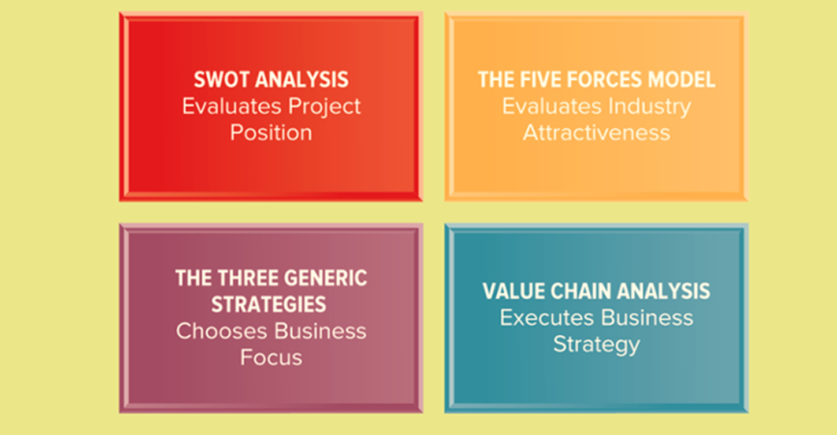
Business Tools for Analyzing Business Strategies

Slide 32
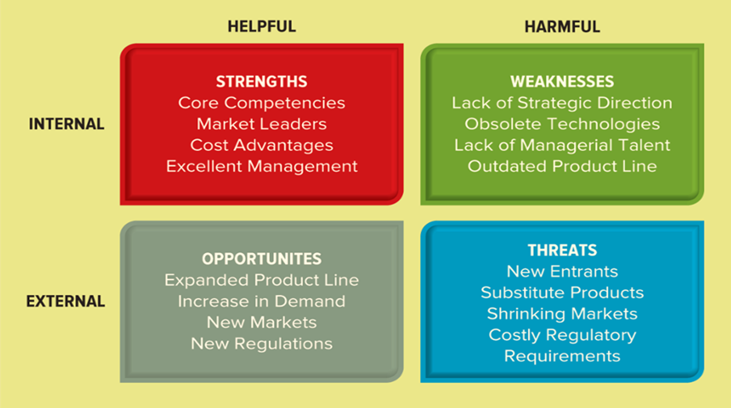
Sample SWOT Analysis
A SWOT analysis evaluates an organization’s strengths, weaknesses, opportunities, and threats to identify significant influences that work for or against business strategies. The framework is used to evaluate a company's competitive position and to develop strategic planning.

Slide 33
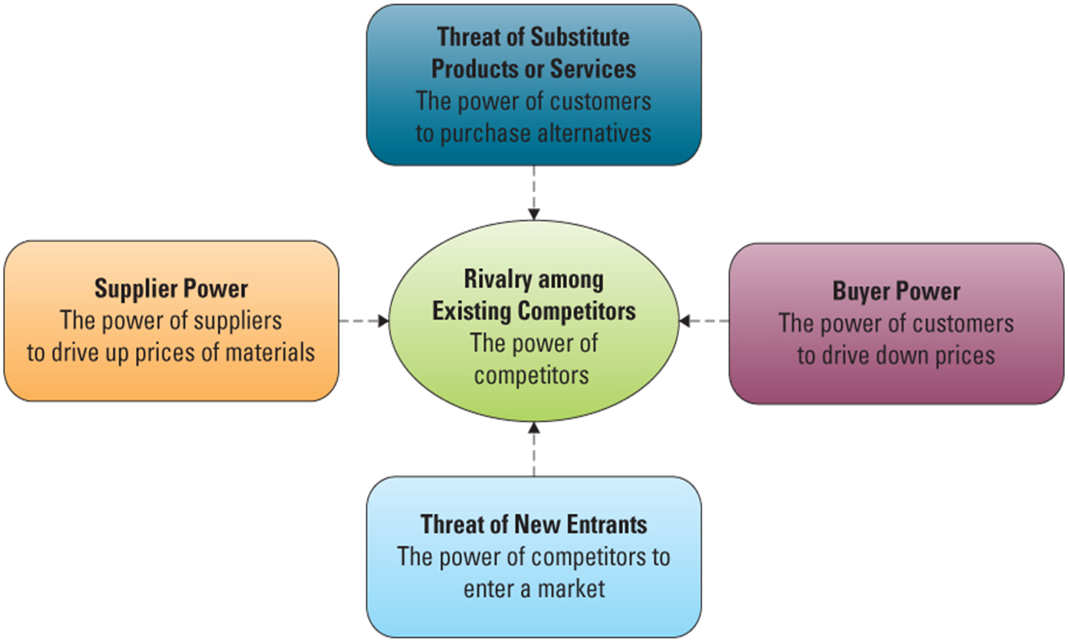
Porter’s Five Forces Model (1 of 5)
The five forces are frequently used to measure competition intensity, attractiveness, and profitability of an industry or market.

Slide 34
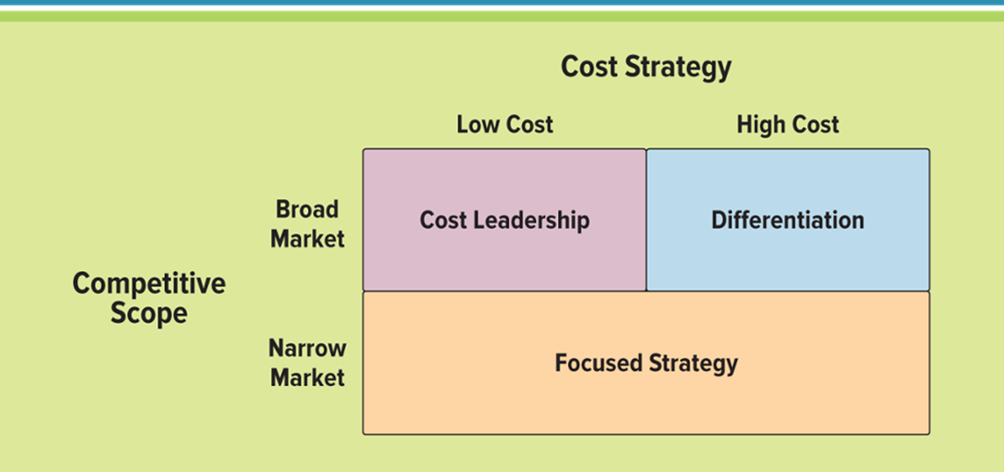
Porter’s Three Generic Strategies
Framework for organisations to identify a potential niche in which they can gain a competitive advantage in any industry.

Slide 35
Digital Strategy Planning Process
Where are we now?
  What is possible?
  What are the best practices?
  Assessment
Where do we want to be?
  Future business direction sets the IS direction
  Gap
How will we get there?
  The Roadmap

Slide 36
Digital Strategy Planning Process
An ongoing process
  to keep current as business and technology changes
Enables technologies to help the organization meet its business objectives

Slide 37
Critical Success Factors (1 of 9)
Areas, for any business, where things must go right
Areas of activity that must receive constant and careful attention
  the current status of performance in each area to be continuously measured
Support the attainment of organisational goals
  goals – end points that an organisation hopes to reach
CSFs are areas in which good performance is necessary to attain the goals
Are generally activities that a firm performs
Specific to the product/market domain
Normally 3 to 6

Slide 38
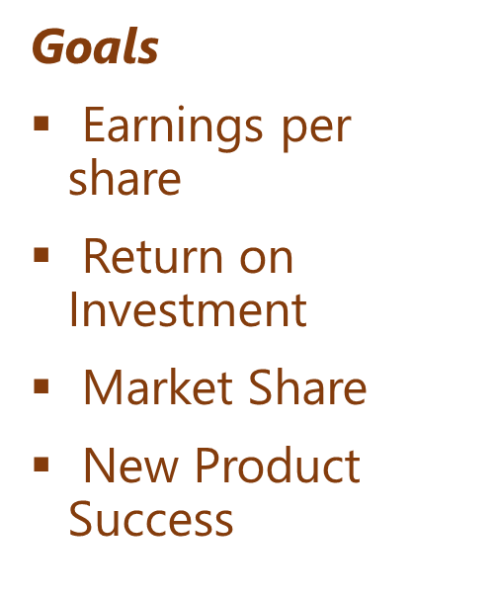

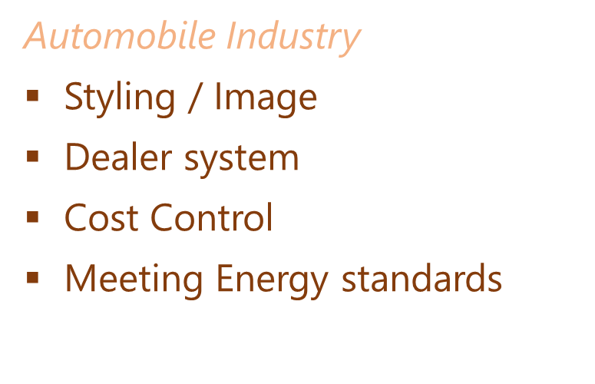
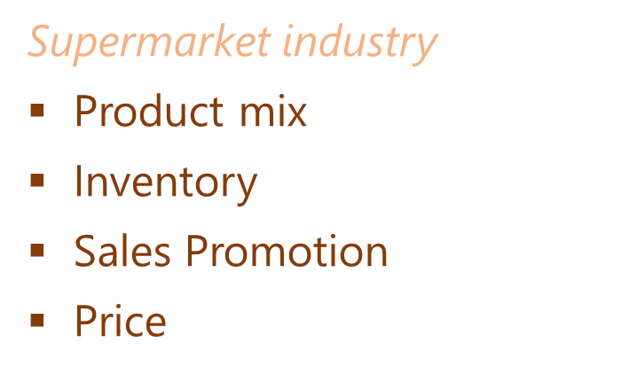
Critical Success Factors (2 of 9)
Organizational Goals – supported by CSFs

Slide 39
Critical Success Factors (3 of 9)
Sources of CSFs
  Industry Level
  Firm specific
  Environmental
  Temporal

Slide 40
Critical Success Factors (4 of 9)
Industry CSFs
  Nature of the industry
  Its inherent characteristics

Slide 41
Critical Success Factors (5 of 9)
Firm level CSFs
  Company’s resulting position in the industry
    its situation, determined by its history, and current competitive strategy
    a small company – needs to establish its niche
    an industry dominated by one firm
      maintain the lead
      all others need to understand the leader’s strategies, and their probable impacts
  Geographic positioning
    retail firm in a rural area
      transportation management will be a CSF

Slide 42
Critical Success Factors (6 of 9)
Environmental CSFs
  Areas where organizations have little control
    needs to accomplish its mission while riding the tides of environmental change
  Fluctuations of the economy
  Government legislative policies
  National politics/Government change
  Population trends
  Demographics
  Regulatory trends
  Energy issues

Slide 43
Critical Success Factors (7 of 9)
Temporal CSFs
  Critical for a particular period of time
  Something out of the ordinary has taken place
  Loss of a large number of executives (due to a plane crash)
    rebuilding the executive leadership team
  Extreme case of over or under-stocking
    inventory Control suddenly a CSF for a CEO
  Lack of skilled personnel

Slide 44
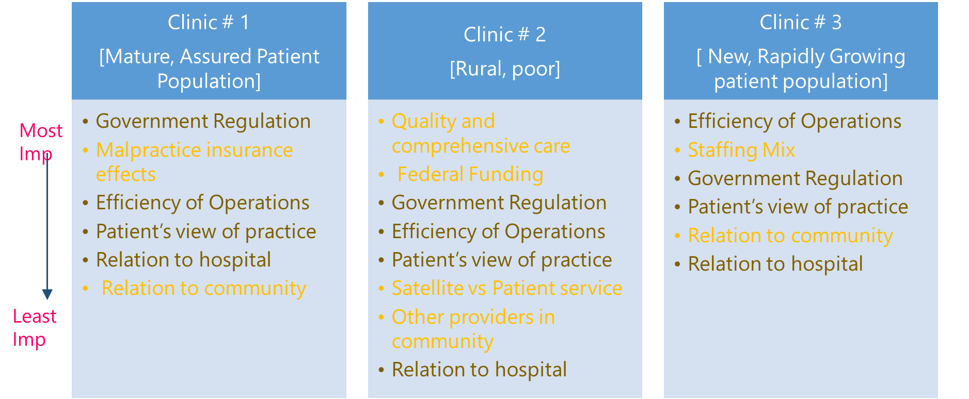
Critical Success Factors (8 of 9)
CSFs for Three Medical Group Practices

Slide 45
Critical Success Factors (9 of 9)
A few more points on CSFs
  A firm’s situation changes over time
  At any time, factors that are crucial to the success of the firm in the period for which he is planning
  IS in constant flux →accommodate changes in organization's strategy, environment or structure
    → changes in an IS an inevitable and predictable part of systems development

Slide 46
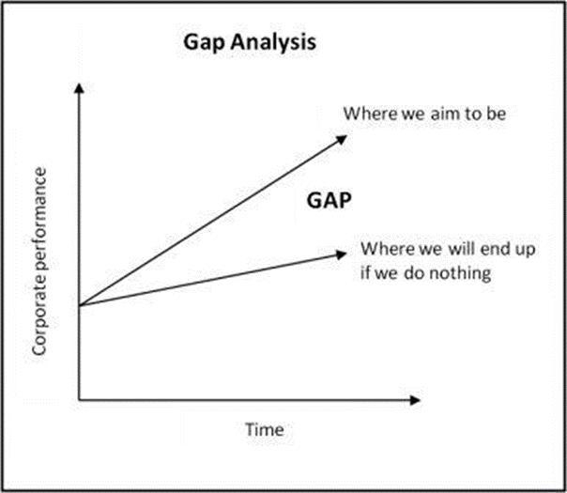
Gap Analysis (1 of 2)
Gaps by Type
Gaps by Function/Processes
Gaps of Integration

Slide 47
Gap Analysis (2 of 2)
Gaps by Type
  Type of IS
  TPS, MIS, DSS
  DSS – most common gap
Gaps by Function/Processes
  Functions:
    Individual business Functions
    Prioritize Functions which are more important
  Processes:
    Core Processes
    Value-addition
Gaps of Integration
  Links between activities not being reflected in the IT application
  SILOs
  Information linkages are not exploited

Slide 48
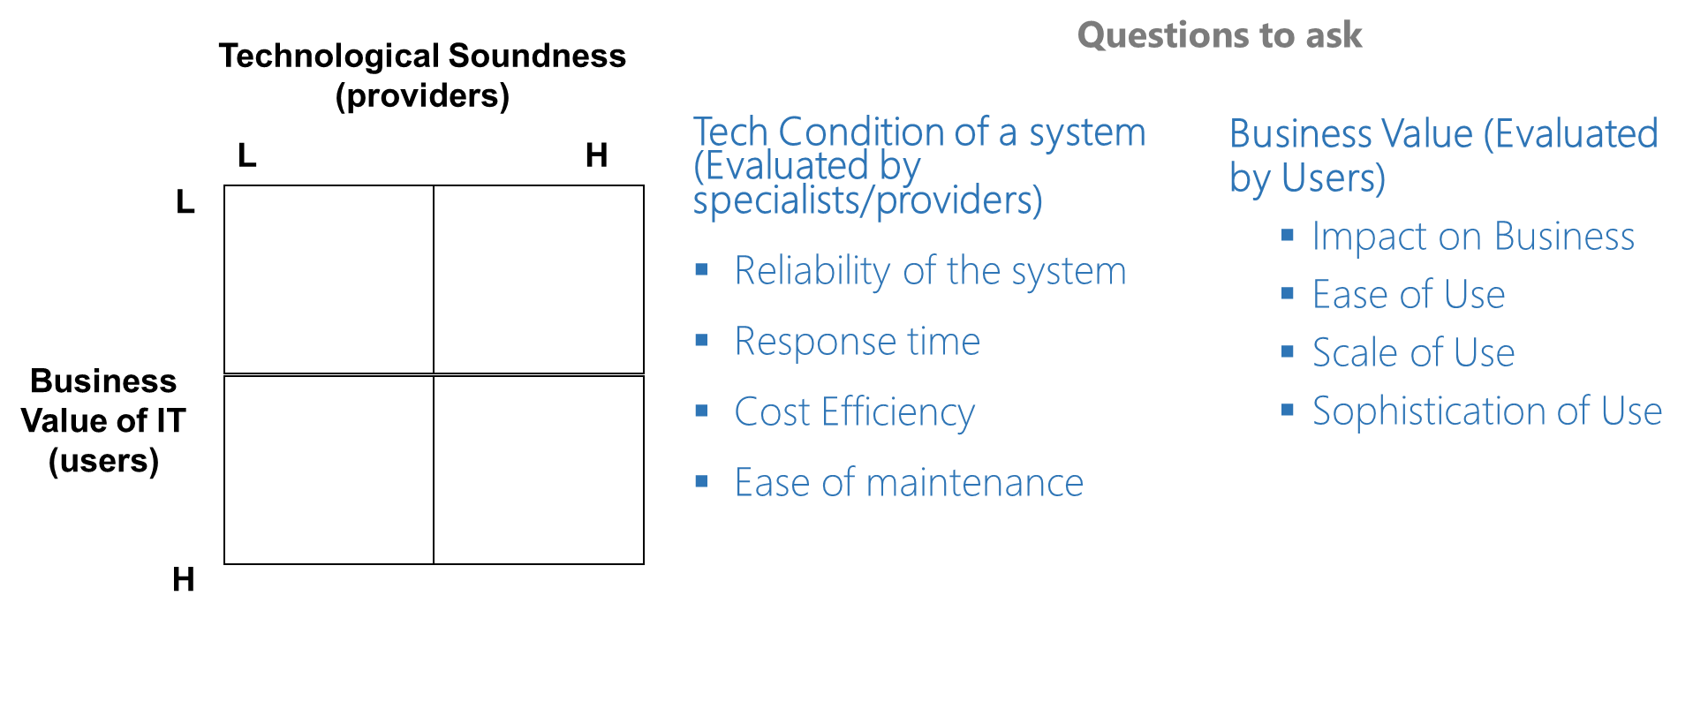
System Audit Matrix (1 of 5)

Slide 49
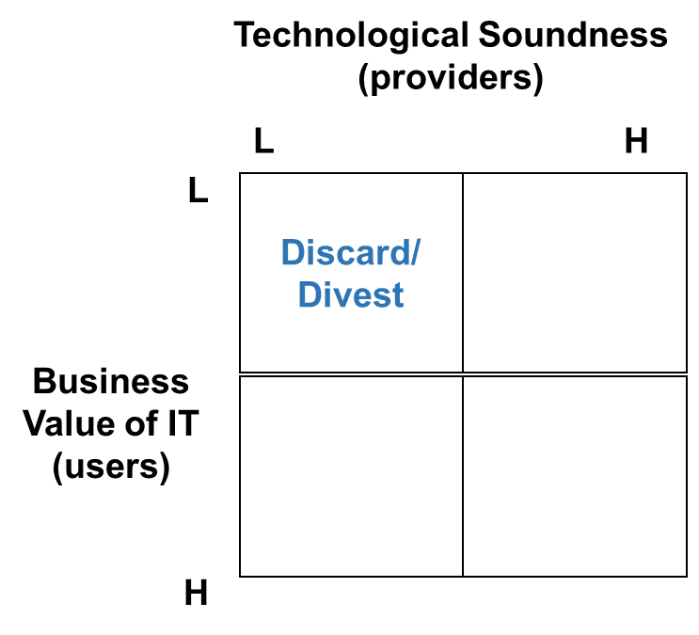
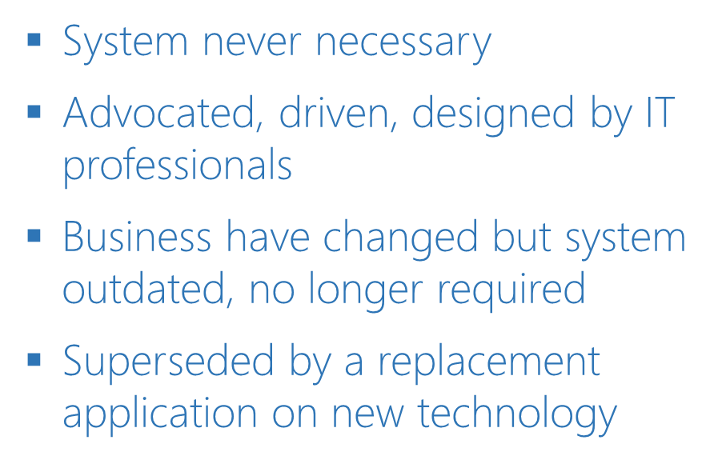
System Audit Matrix (2 of 5)

Slide 50
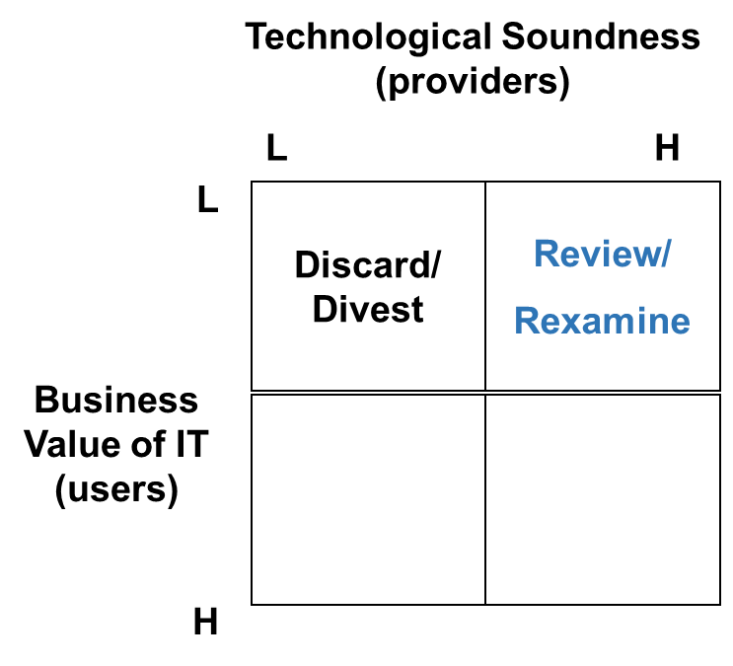
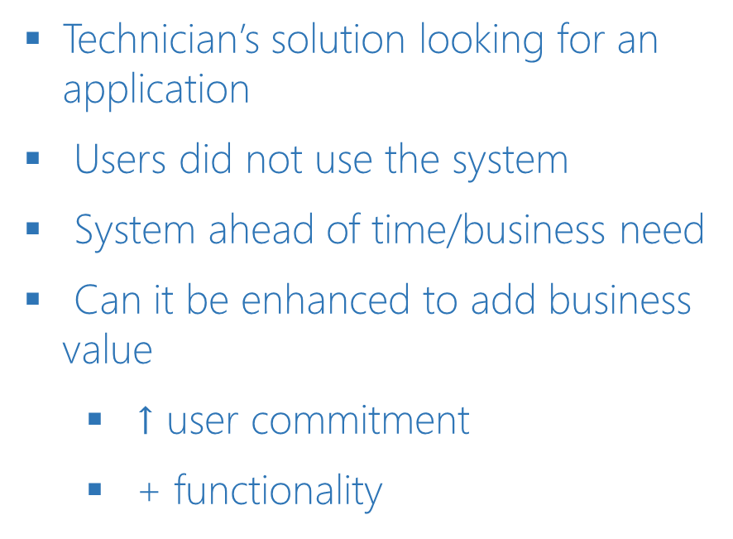
System Audit Matrix (3 of 5)

Slide 51
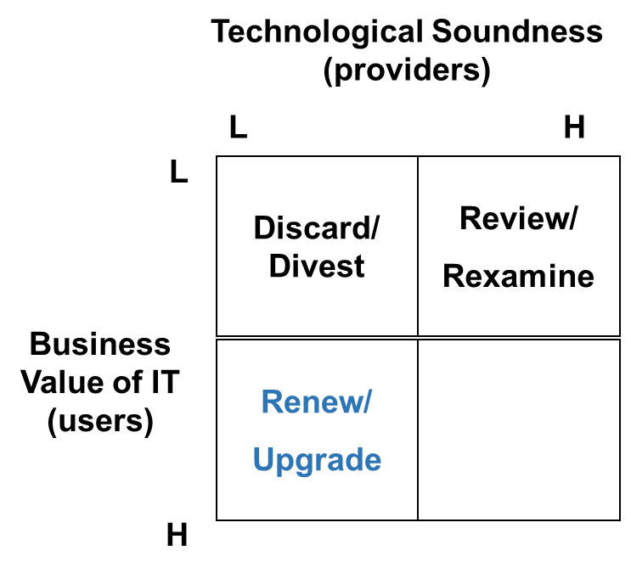
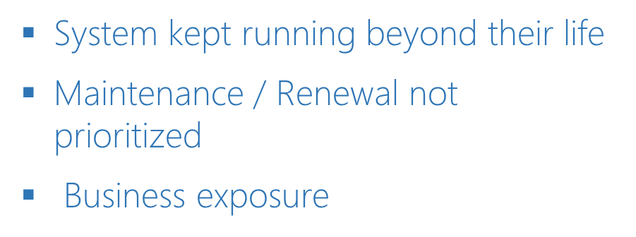
System Audit Matrix (4 of 5)

Slide 52
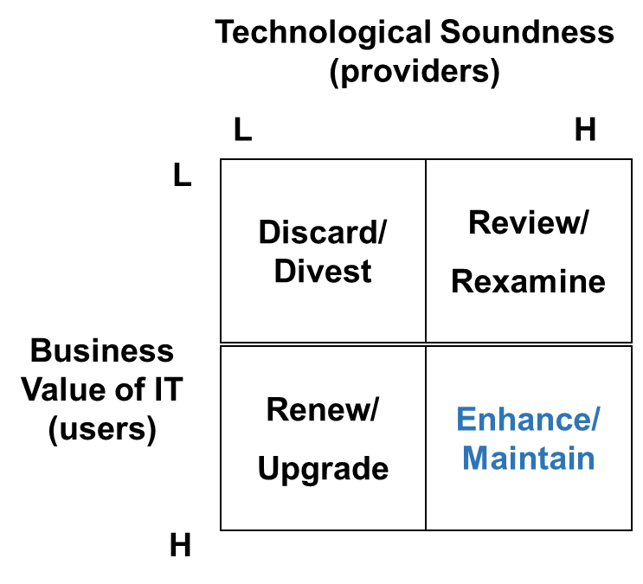
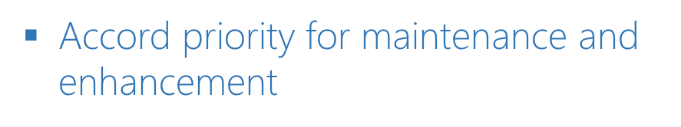
System Audit Matrix (5 of 5)

Slide 53
MDCM Inc.
History and Growth Strategy

Slide 54
MDCM Inc.
Growth strategy change – 1987 – acquisitions
  20+ acquisitions in less than eighty years
  Experience executing integrations?
Horizon 2000
  Changes in strategy execution
  Size and global presence – opportunities

Slide 55
Business Objectives post Horizon 2000
Consolidate to increase scale efficiencies
  Reduce headcount
  Rationalize suppliers
  Combine production facilities
Global focus – one company globally
  Strategy formation for entire company
  Unify brand
Core competencies become focus
  Outsource logistics
Improve customer relationships
  Reorganize business units and sales force
  Maintain close ties in production development

Slide 56
Traditional View of IT
Cost - centre
Reactive to needs of business
IT not involved in planning and strategy – no part in senior management

Slide 57
Aligned IT objectives
Consolidate to increase scale efficiencies
Global focus – one company globally
Core competencies become focus
Improve customer relationships

Slide 58
Consolidate to increase scale efficiencies
Develop enterprise architectures, unify standards, standardize platforms
  Increase scale efficiencies in purchasing
  Greater curve for climbing the learning curve and develop tacit knowledge
Combine IT facilities
  Improve utilization of tech staff and resources
Pool IT resources and capabilities
  Extend overall capabilities & reduce the need for outsourcing

Slide 59
Global focus – one company globally
Manage IT portfolio across the entire company
  Remove redundancies
  Improve decision making
Integrate data and communication networks
  Reduce inefficiencies
Improve communication and collaborative tools
  Lower cost of communication
  Time

Slide 60
Core competencies become focus
  Outsourcing
    Nonstrategic IT services
  Need control over strategic functionalities
    Flexibility

Slide 61
Improve customer relationships
  Develop CRM application

Slide 62
IT Portfolio Management
How do you evaluate and prioritize the projects?
  Value to IT
    1,4,9
  Continuous Improvement
    2, 3
  Quickest Returns
    6,8,11
  Largest Returns
    5, 7, 10, 12
Potential projects
  Unify methodology and technical standards
  Consolidate data centers and networks
  Outsource nonstrategic IT services
  Standardize server hardware and platforms
  Implement enterprise resource planning
  Create employee intranet portal
  Manage supply chain
  Streamline design systems
  Improve collaboration systems
  Begin CRM/create data warehouse
  Implement e-procurement system
  Establish customer self-service portal

Slide 63
Analysis of Projects
Make a Table
Value to Business
  How important or high up the priority the project is?
  Can MDCM continue functioning without the project?
Ability to Succeed (Complexity/Risk)

Slide 64
Ability to Succeed
Low
High
High
Value to Business
Low

Slide 65
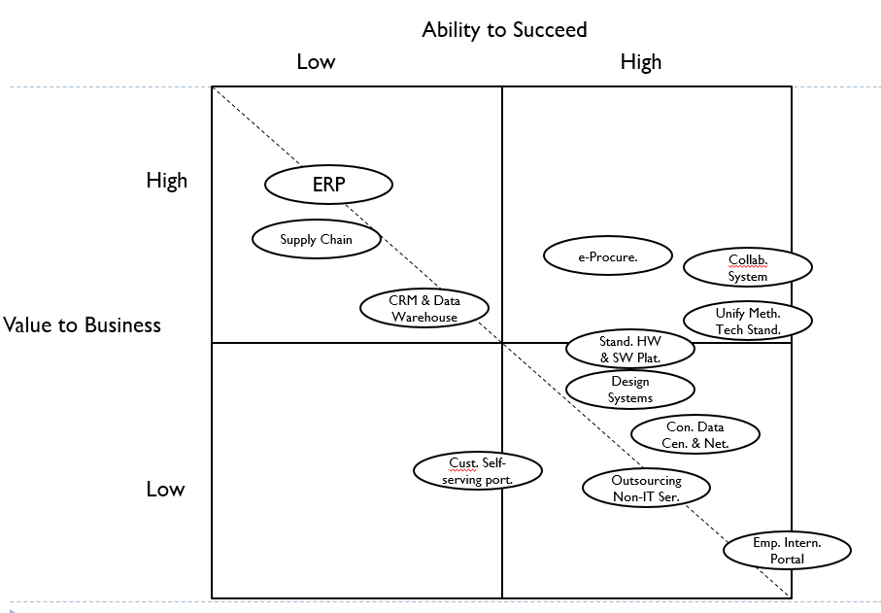

Slide 66
Categorize
  Value to IT
  Continuous Improvement
  Quickest Returns
  Largest Returns
Turnaround time
Dependencies

Slide 67
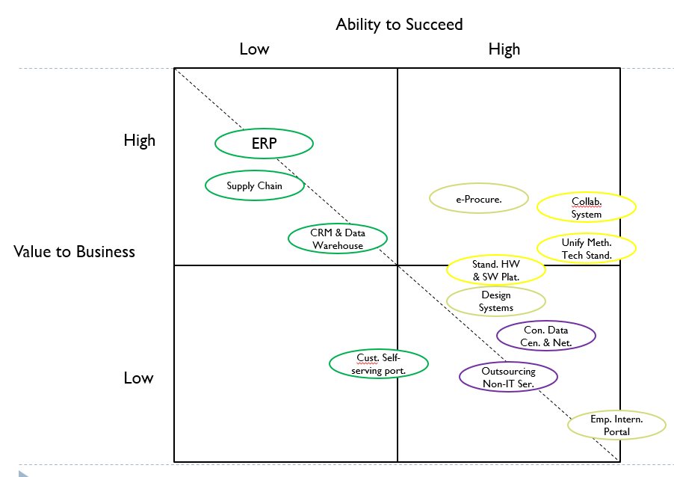

Slide 68
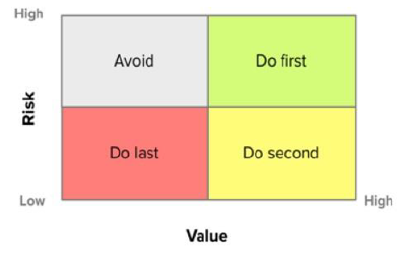

Slide 69
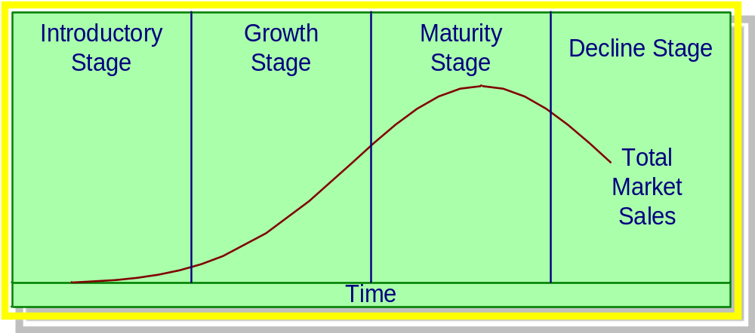
PLM
Product Life Cycle (PLC):
  Describes the advancement of products through identifiable stages of their existence.

Slide 70
The Product Life Cycle Concept is Based on Four Premises
Products have a
limited life.
Profits from a product
vary at different stages
in the life cycle.
Product sales pass through
distinct stages, each with
different marketing
implications.
Products require different
strategies at different
life cycle stages.

Slide 71
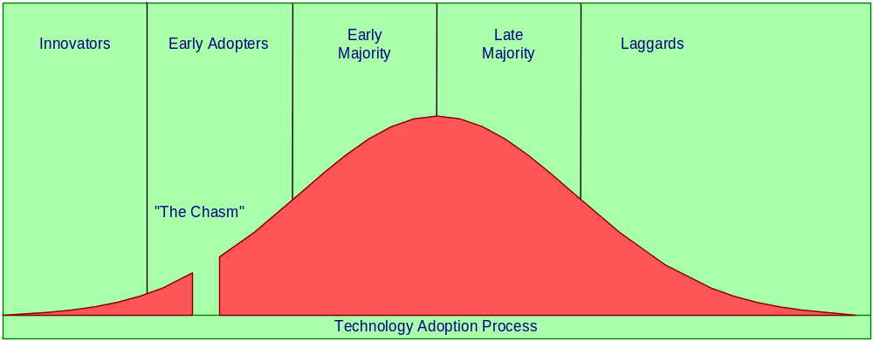
The Diffusion Process
Innovators
(2.5%)
Early Adopters
(13.5%)
Early Majority
(34%)
Late Majority
(34%)
Laggards
(16%)

Slide 72
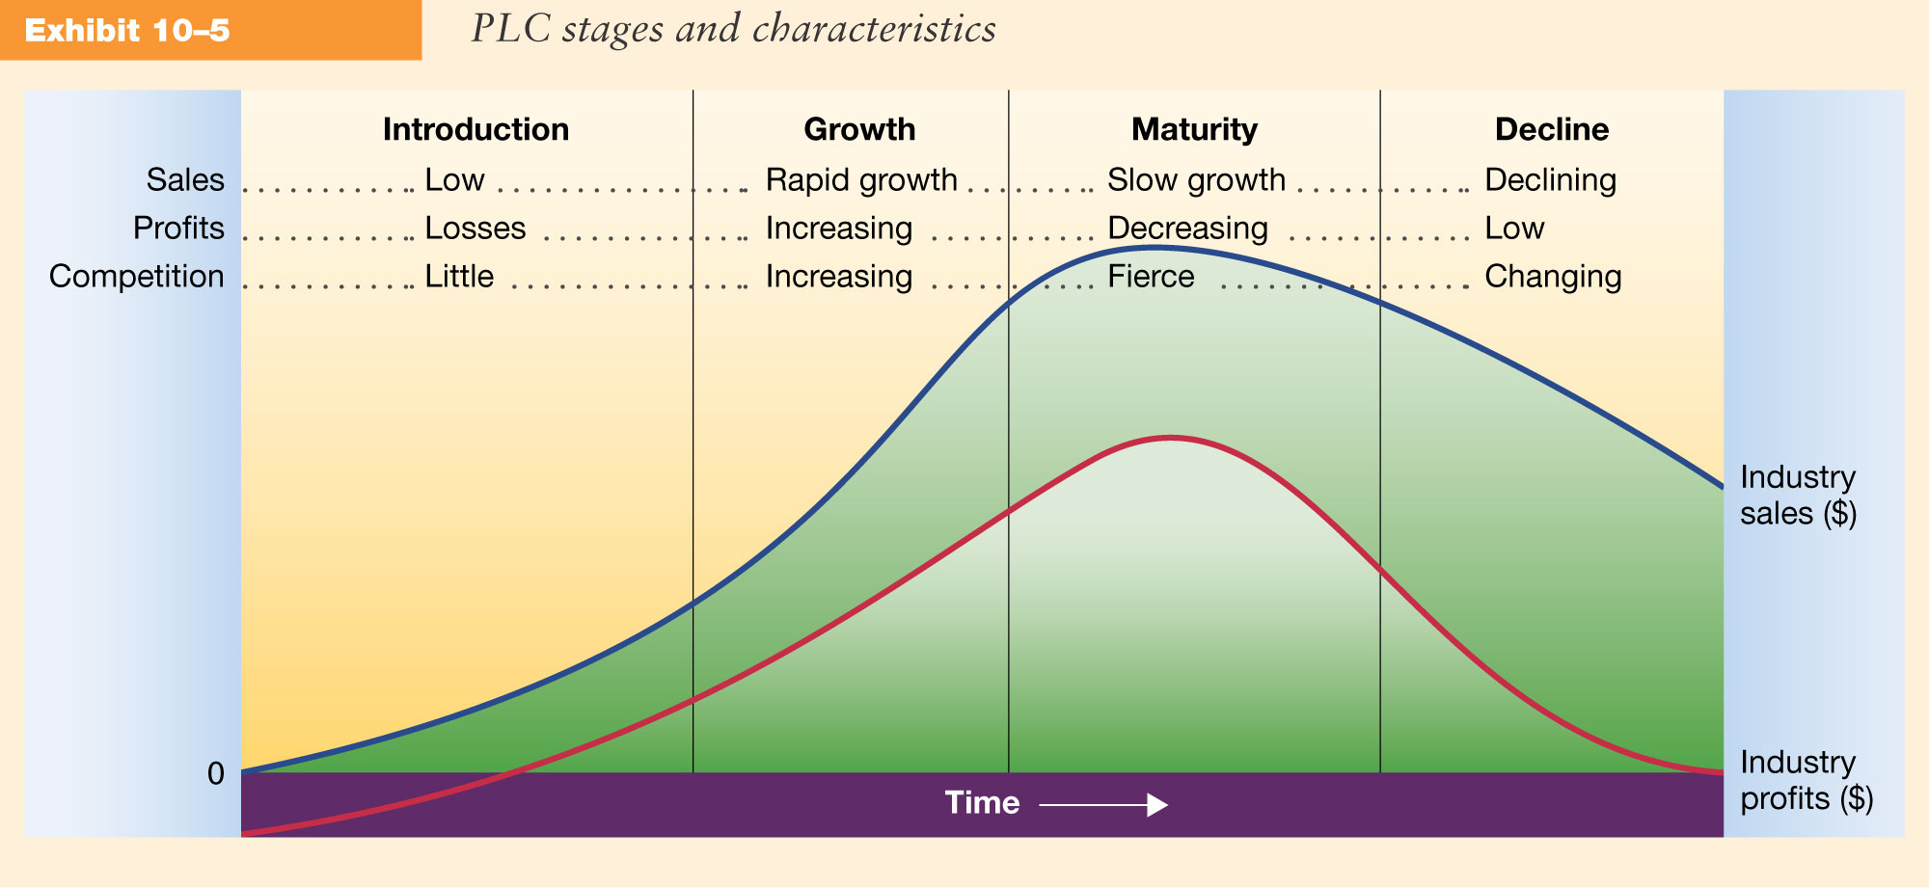
PLC Stages and Characteristics

Slide 73
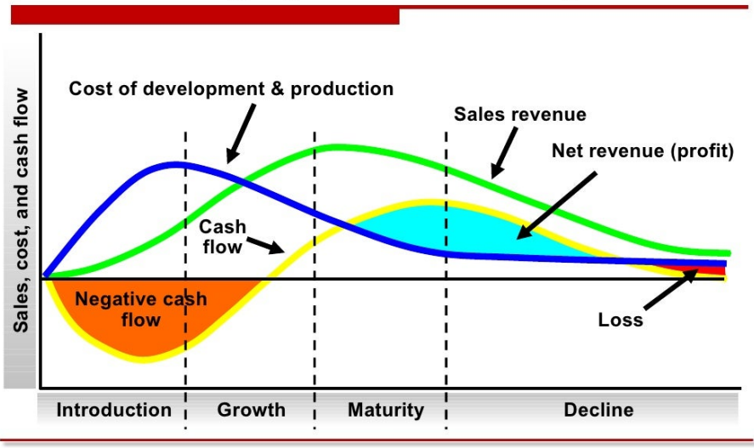
PLC Stages and Characteristics

Slide 74
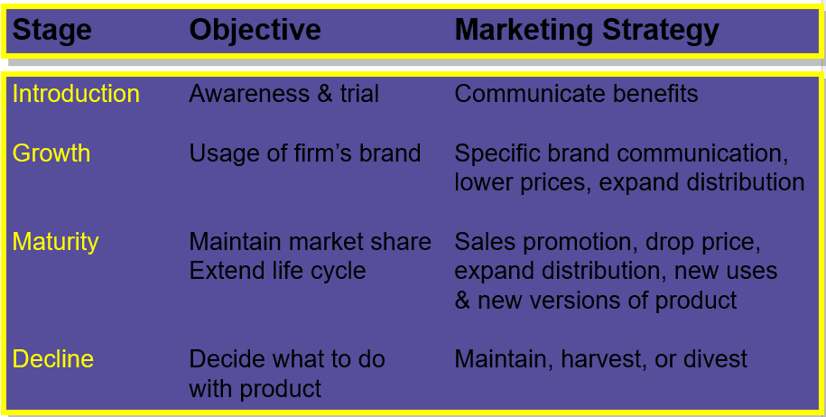
PLC Strategies

Slide 75
Enterprise Architecture
Processes
Products
Data
People
Technologies
Conceptual frameworks that describes how business is constructed
  How organization works?
Identifies primary component and shows relationship between them.
How value is derived from each of them?
Is applicable to any company – Private, Public, NGO, Association, A group
Simplifies the complexity and lays down how business and technology works together

Slide 76
Enterprise Architecture
Business Architecture
  Capturing how business operates, how process do what they do.
  Information and capabilities in the organizational context
  Roles and responsibilities, projects, and products.
Application Architecture
  Portfolio of applications and technology they use.
  IT and business relationship, how IT supports business.
  Defines the software solutions that help business do their job.
Data Architecture
  Cust, preferences, products, prices – Data is everywhere and its complex
  Ways to manage data – Docs, spreadsheets, emails
  Models the sources, formats, management, quality
Infra Architecture
  Defines underlying infrastructure and physical technologies needed to run the business
  Physical machines, routers, storage

Slide 77
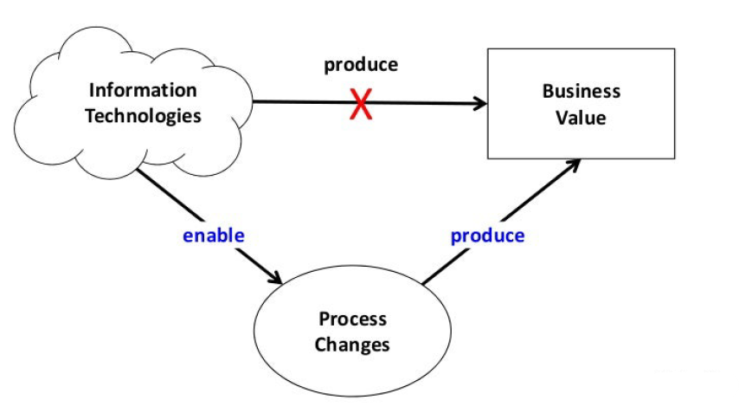
Managing Digital Products and Services
Strategy
  Less about acquiring and implementation
  More about reconfiguring businesses to leverage new information and capabilities
  Integration
Culture
  Get everyone on-board
  Collaboration
  Training, Workshops, Webinars
  Flattening the organization
Talent Management
  Agility
  Upskilling/Reskilling

Slide 78
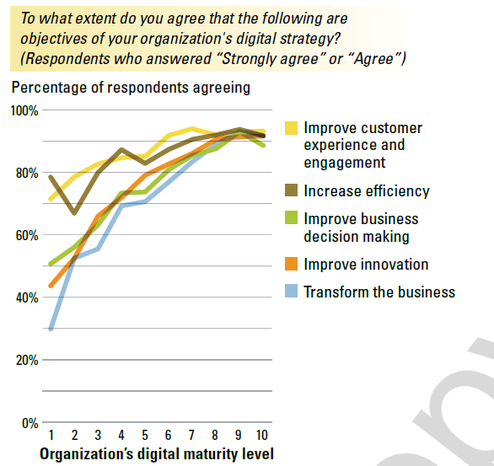
Managing Digital Products and Services

Slide 79
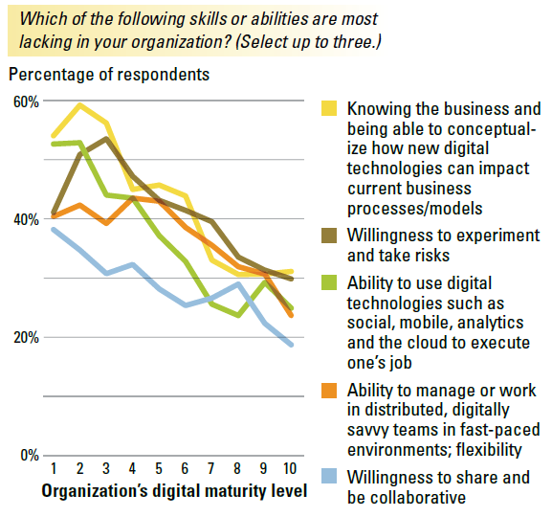
Managing Digital Products and Services

Slide 80
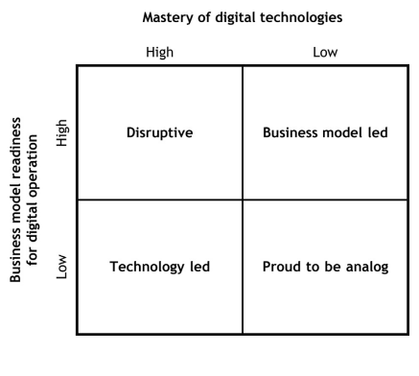
Digital Transformation

Slide 81
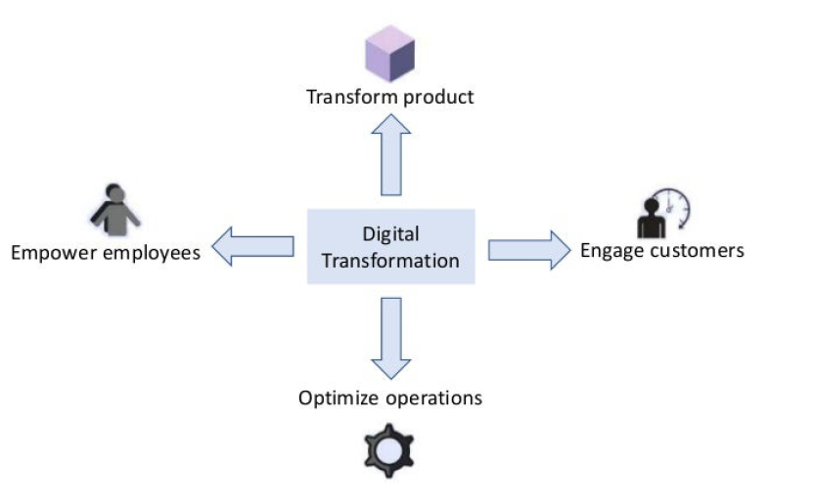
Digital Transformation

