Slide 1
Introduction to
Product Management

Slide 2
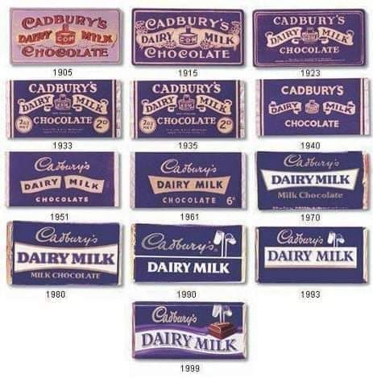
Cadbury Dairy Milk chocolate is made with fresh liquid milk – a glass and a half for every half pound of chocolate to be precise.
Available in more than 23 varieties, like Fruit & Nut, Whole Nut, Snack, Caramello and Breakaway, Cadbury Dairy Milk delights consumers of all ages.
In 2017 we launched Cadbury Dairy Milk in Lickables, a unique liquid chocolaty treat with a twist of Oreo bits and Wheat crispies.

Slide 3
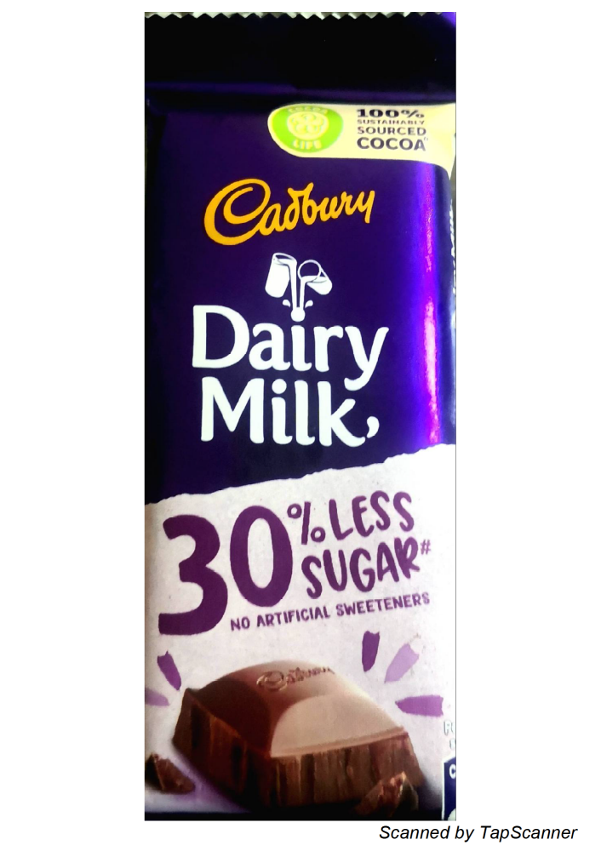
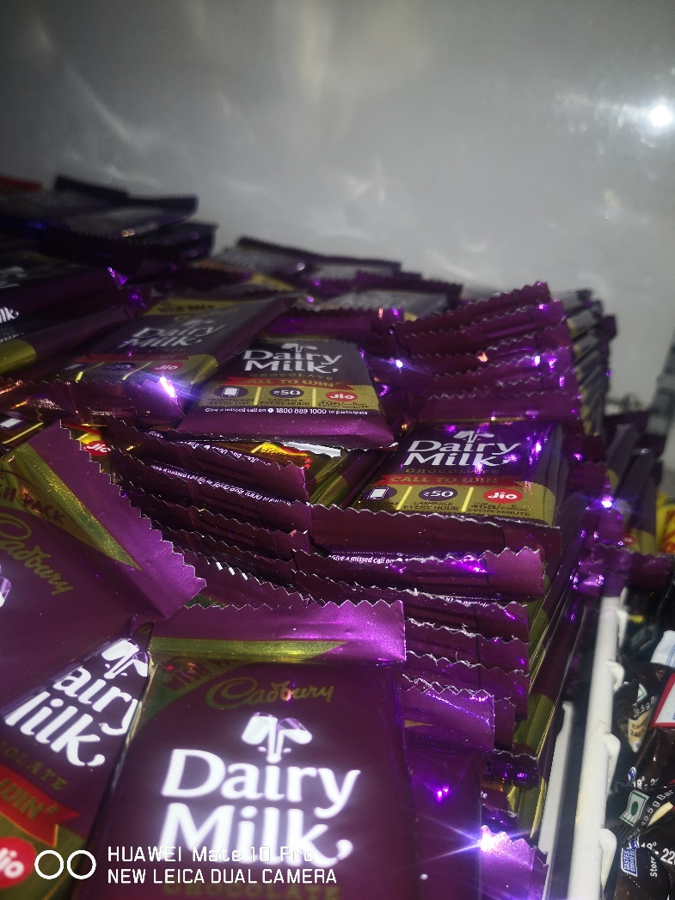
Yesterday??????????

Slide 4
@
manoj.gour@mdim.ac.in
Mobile: 8096884570
Manoj Gour Chintaluri
BSc Osmania, Hyd 1992
PGDRM NMIMS, Mum 1998
PhD GITAM, Vsp 2020
Locations worked across the country, last stint Oman-Muscat
Satyam
HUL
Rallis
Dulux
Mcdowell/ SABMIller
Racold/Ariston/NHI
Airtel/ Docomo

Slide 5
Participants
Name | City | Company-Work ex | Edu | Industry/ Why and what
Raj | Mumbai | 20 years Repro-Print in demand- Inventory less---- Thomas cook Entre-Science- | Bsc Chemistry PG –Digital Mktg | Facilitate me in the current role
Jigar | Hyderabad | 9 years- Health care J&J- Sales Mgr (J&J) 2 years | B Pharm Vignan MBA- Alliance | Career Shift- Mktg –Product Mgt
Vaishal | Gurgaon | Vestige – 7years, Unicity- Health Asso Mgr- PAN – Training- Sales team Distributors. People---/ Customers 250/ 2500/ (Serious Buyers, More Serious Buyers) | Nutrition | Intricate understanding of Product and Brand benefits and features
Parth | Bharuch | 5 years- Gujarat Guardian-Glass- Quality exec-Value chain | BE Mechanical | Diversified portfolio/ Commercial part
Pradeep | Cochin | Kochi Metro Rail- Mktg/ Malayalam -8plus | MBA-Mktg | Career enhancement

Slide 6
Name | City | Company-Work ex | Edu | Industry/ Why and what
Nandakumar | Chennai | ITC 9 years, Consulting- MSME- Micro food | B tech-Food | Entre- Exposure to Prod mgt
Shreshth | Delhi | 9 years- Spice Jet ( Aviation -5 years) Loyalty program Mgt | B tech | Tech side to Commercial side
Surbhi | Sangrur-Punjab | ZS Associates- Brand Analytics-Healthcare domain company – 2 | B tech G lake(Mktg & analytics) | Other aspects of Brand Mgt-Product Mgt
Elizabeth | Trivandrum | Teacher-Lecole 4 years | Bsc/ Msc- Chemistry | Commercial understanding of Prod Mgt
Ravi | Pondicherry | Zynga-Gaming industry 16 | Bsc Vis Com- annamalia Univ | Commercial- appreciation- users

Slide 7
Contents
Understanding Product Management
  Evolution
  Product Vs Services Management
Roles of a Product Manager
  Org structure
  Few JD’s
Discussions

Slide 8
Evolution of Product Management
  Adam Smith- 1776- Production to consumption
  2nd part of the last century
  1920- The great depression
  1950-60- Supply exceeding demand- Consumer & Markets
  Suspecting salesmen-over kill
  1954- Drucker defines-Marketing as the distinguishes function of a business
Indian Context
  License raj
  India- Post liberalization

Slide 9
Evolution
Standardization ------ Customization
Centralization ---------Decentralization
Dependence------------Self Help
Transportation---------Communication
Autocracy---------------Participation
Hierarchy----------------Network
Info-Block---------------Info - overload

Slide 10
Evolution Past Vs Future
Demographics------------Psychographics
Individualism-------------Community-Social
Status ----------------------Object of desire to Activities
Corporation---------------Collaboration
Transactions--------------Transformation
Brand Image--------------Brand Culture

Slide 11
One of the 4 P’s / 7 P’s
  Product/ Price/Place/Promotion
  People/Process & Physical evidence
Product/ Idea/ Service / Concept
  Trigger of a business
    Users- I get more customers for fevicol/ Airtel Mobile?
    Uses- can I develop more uses for fevicol/ Airtel Mobile – Screen -data?
    Usages – can I get the consumer also brush post dinner/ More calling / more services subscription- Cross promo?
  Does it need management ?

Slide 12
Utilization
Evolution?---Customer requirements-Market evolving and changing
Life cycle management
Nokia-Poor Product Management/ Management challenge- Competitor
  Growth
  Enhancement
  More opportunities
    Uses
    Users
    Usages

Slide 13
Are we product managers in life?
What defines us?
How does the evolution happens?
Relate @ different age groups
Do we make an attempt to stand up for what we are?
  Intended actions
  Habits
Social & Psychological Impacts
  Attention seeking
  In the nest
Mature/Brash
Imagery

Slide 14

Readings
Marketing Myopia by Theodore Levitt
Lessons From Product Juggernauts- Jean-Philippe Deschamps and P. Ranganath Nayak

Slide 15



Discussion-

Slide 16
Ponder
Vinit the Product manager of the processed foods division is a hassled individual. While Diwali is a festive season , he dread it on account of the dilemma he faces in and out .
  The Sales head keeps pushing him for promotion support and the budget releases for the year.
  The Marketing director gospel’s to vinit to maintain a balance on ATL Vs BTL.
  The global product management team keeps a vigil on the type of promos’ released on the sauce which is a global brand selling in close to 70 odd countries , while in India the sauce is available since 6 years and has a share of 6%.
  The Pasta which Vinit handles has a market share of 23% plus in the select markets they are available and these markets have an industry weight of 82% . This is available in the country for the past 14 years.
  The last quarter brand audit report has given an indication of reduced ITP by 3% for the pasta brand and 7% for the sauce brand. While Pasta & Sauce are different categories the umbrella brand “Mrs Smiths” is common

Slide 17
Who does Product Management ?

Slide 18
Job Description
Responsibilities
  Drive the strategy and roadmap of the data management capabilities that enable Aera to crawl a wide range of internal and external data sources, understand, harmonize and create a unified cognitive data layer
  Work closely with the domain experts and data scientists and develop intelligent capabilities leveraging the best of human knowledge and artificial intelligence
  Prioritize and create detailed product requirements for all data management related areas
  Work closely with the Engineering & Design team to drive the product requirements and ensure the timely release of the capabilities
  Work closely with other product managers to ensure close alignment and integration with the Aera Cognitive Operating System
  Understand the market demands, target users and use cases intimately and collect feedback on an ongoing basis to understand user pain points and business needs
  Track and assess competition to develop a deep understanding of the market, and help define differentiating and innovative capabilities within Aera
  Collaborate with key stakeholders such as product marketing on the creation of the product materials and resources
  Present product demos and roadmaps to customers and prospects on a regular basis to evangelize and get feedback

Slide 19
About You
  You are a leader - you work with cross-functional teams, break the barriers, and make things happen
  You are passionate - you are your product’s biggest advocate, and its biggest critic. You will ceaselessly pursue excellence and do whatever it takes to deliver a product that users love and that delivers value
  You have a good mix of business and technical skills - you can understand the big picture, and how to make it a reality
  You are pragmatic - you know when to focus on nuanced details, and when to bring a more strategic perspective to the table
  You love to learn - you continually gather new information, ideas, and feedback, and you seek to understand the root of an issue, in order to identify an optimal solution
  You are a master at communication and collaboration - not only can you communicate a compelling vision or a complex concept, but you also know how to motivate a team to collaborate around a problem and work toward a common goal
Requirements
  10+ total years of experience in Product Management, Engineering or Implementation roles
  You have a good understanding of data and analytics space and related products
  Experience with IOT, streaming, Connectivity, Data Integration, ETL & EAI products, Graph Database, Data quality and technologies is a big plus
  Bachelor’s degree in Engineering/Computer Science or a related technical discipline

Slide 20
Product Mgr-2
What You Will Do
Responsible for understanding product requirement, identifying gaps and innovating processes to fill the gaps
Working with teams of software development, sales, support & marketing functions to ensure that the company's offering and services are rolled out for the most beneficial user experience, whether the service is for the doctor or the patient
Responsible for building and developing the healthcare application and platform
Responsible for Product Management
Taking feedback on the product from various stakeholders and using the feedback to further improve the product
Closely involved in supporting and monitoring rollouts, standardizing and continuously improving business processes for future rollouts
Working with UX teams, business teams and technology teams to bridge gaps in understanding of the product or service
Focusing on data driven analysis and prioritization
Plugging into the details of every activity of the company - growth, retention, operation and stability
Thinking about the metrics that needs to be prioritized and to measured
Enjoy working with various stakeholders about trade-offs while balancing current commitments to the roadmap
Having an intense curiosity, a burning desire to change the status quo and know how technology can transform processes
Helping in building the roadmap for the product and services offeredin conjunction with the various stakeholders

Slide 21
Required Candidate profile
B.Tech + MBA full time (MBA from tier 1/2 college) preferred
4 - 5 years of experience post MBA, working along with Business teams in a highly dynamic environment
Exp with B2C product industry preferred
Leadership with the ability to influence various stakeholders
Proven track record of measurable business results
Demonstrated ability to assume sole and independent responsibility for various projects
Success at innovating in a fast paced, very dynamic environment
Strong problem solving, analytical, and quantitative skills
Effective verbal and written communication skills with diverse audiences
Capability to deal with ambiguity

Slide 22
PM- Health Care
Looking for candidates from FMCG, Food & Beverage backgrounds only.
• Defining the New Product strategy for a very well known established brand.
• Understanding the E-Commerce business dynamics and accordingly define the product entry strategy
• Identifying new categories and products with the right fitment with the brand
• Build a strong product pipeline of atleast 100 new products for next one year
• Identify the complete pricing, sourcing, marketing strategy and execution of the same
• Managing the NPD portfolio P&L with a healthy topline and bottomline
• Launch the brands in digital space and define the marketing plans for successful launch across categories
• Own the digital-first brands and launch them in other channels post success stories in digital space.
• Leading consumer studies for insight mining and assisting in the conceptualization of new ideas, assessment of the feasibility of newly identified product /extension concepts/innovations, and go-to market execution for the assigned Brand/Product Portfolio for improved market performance (e.g., market share, profitability etc.).

Slide 23
Edulastic (https://www.edulastic.com), an EdTech startup headquartered in Fremont, CA is looking for a Director for the product delivery at our Bengaluru location to support the strong growth the company is experiencing. This is high visibility and a key role where that will be responsible for identifying and leading organizational initiatives that impact the product roadmap, delivery, and quality. You will work across multiple teams within product management, SaaS operations, and engineering to create a cohesive organization with well-orchestrated execution.
Responsibilities
Manage key organizational and engineering initiatives by partnering with key stakeholders across product management, engineering, quality engineering, and customer support
Own the production SaaS operations to ensure 99.99% uptime and work with multiple teams to resolve any critical issues in a timely manner
Communicate status in a timely, effective, and efficient manner to various stakeholders of the organization to keep them updated on engineering initiatives and program status.
Build and maintain strong cross-functional relationships and alignment with partners across the teams
Setup and monitor delivery metrics and use data & metrics to drive key decisions
Highlight risks and issues and proactively work with stakeholders to resolve them
Qualifications
Proven experience as Product Delivery between 5-10 years
Outstanding leadership and organizational skills
Excellent communication skills
Superior problem-solving skills
Thorough understanding of program management techniques and methods
Excellent knowledge of performance evaluation and change management principles
Prior software development experience will be a plus

Slide 24
To build & execute strategy which works towards achieving the brand goals of growing consumer preference and driving share of market with profitability.
Job Description
Work on co-creating marketing strategy for the brand and efficiently execute it to drive the share of market along with profitability.
Build brand plans including geography wise plans to achieve national share of market and distribution targets.
Work collaboratively with cross functional teams to conceptualize and execute versus the annual grid plan.
Build communication and advertising in line with the positioning of brand to further drive brand salience and consumer preference.
Work with external creative and other agencies to build 360 IMC campaigns.
Partner with media manager and the media agency to draw up the monthly media plans by state.
Understand the P&L of brand and identify key cost drivers and work towards driving improved margins and profitability of the brand.
Alignment of brand plans and annual grid with category manager and senior management.
To Design and implement all aspects of the GTM for new product launches within the brand

Slide 25
Experience
3+ years of work experience in Sales and Marketing
A proven track record of performance, strong understanding of Indian consumers and business processes!
Skills
Strong project management skills, coordination skills, marketing skills, communication skills.
Equal Opportunity Employer
Colgate is an equal opportunity employer and all qualified applicants will receive consideration for employment without regard to race, color, religion, gender, gender identity, sexual orientation, national origin, ethnicity, age, disability, marital status, veteran status (United States positions), or any other characteristic protected by law.
Are you interested in working for Colgate-Palmolive? You can apply online and attach all relevant documents such as a cover letter and resume or CV. Applications received by e-mail are not considered in the selection process. Become part of our team. We look forward to your application.

Slide 26
This mail comes to you from Teamlease . We have an urgent job opening for Mumbai location
Position : Category Manager (product management)
Division : Construction Chemical
Location : Mumbai
Industry : Chemical
Qualification : Graduate
Experience : 3+ years
Candidate should be have experience in Construction Chemical Industry
Job Role :
Development of new product - Administering the entire lifecycle of a product from inception, feasibility study, through composition changes and
manufacture, to pricing, service and dispatch of final product
Analyse competitive landscape & position products to ensure maximum value capture & develop demand generation strategies to drive existing
products & uncovering/creating new opportunities in new sectors
Planning, developing & executing strategies for effective market penetration with new products
Demand forecasting, inventory planning and ensuring product availability as per the market needs.
Conceptualizing, Planning & Executing of marketing events, campaigns, advertising, audio/video campaigns, promotional activities, market
activation to enhance market penetration and sales volume
Developing annual & half yearly marketing plan for advertising, promotion, campaigns and sales aid
Interact with multiple agencies advertising, media, digital & social, print etc.
Serve as day-to-day point of contact for all branches, for any product & marketing related needs & queries.
RoleProduct/Brand Manager
Industry TypeChemicals, PetroChemical, Plastic, Rubber
Functional AreaMarketing, Advertising, MR, PR, Media Planning
Employment TypeFull Time, Permanent
Role CategoryMarketing

Slide 27
Exercise:
Skills are the specific learned abilities that you need to perform a given job well. ... Competencies, on the other hand, are the person's knowledge and behaviors that lead them to be successful in a job
Skills | Competencies
PLC analysis | Colloboration

Slide 28
Skills & Competency- Product Manager
Core Competencies. All product managers must be good at communication, analysis, prioritization, breaking down complexity, vision, and managing a roadmap. ...
Business Acumen. ...
Product Design. ...
User Empathy. ...
Data Analysis. ...
Which Skills Are Most Important? ...
Identify Opportunities. ...
Identify Weaknesses.
Communication skills
Technical expertise
Business skills
Research skills
Analytical skills
Interpersonal skills
Marketing skills
Delegation skills
Strategic thinking
Prioritization skills

