Slide 1
Building an innovation culture
Session 1
Deepika Gupta
Asst Professor – CSP
IIM Visakhapatnam

Slide 2
Factors influencing business performance
Organizational factors
  Size, structure, culture, manufacturing capabilities etc
Marketing factors
  Use of market research, customer service, product quality
Managerial factors
  Communication, attitudes, leadership styles
Environmental factors
  Rate of technological changes, nature of competition, intensity of competition
Strategic factors
  Long term objectives, strategic time horizon, product-market strategy
All factors impact competitive successes

Slide 3
What is innovation?
Various definitions
A new idea, method or device, a novelty (Website)
A mindset, a pervasive attitude or a way of thinking focused beyond the present into the future vision (Kuczmarski)
Art of welcoming risk (Journal of Consumer Marketing)

Slide 4
Innovation strategy
Where? to innovate
  Nature of organization
  Product/ service
  Department?
Innovation is called new for
  Company
  Market or industry
  Whole world

Slide 5
Types of innovation
On the basis of degree of change – radical and incremental
On the basis of object – product, service, business model (where in the value chain), process and technology innovations
On the basis of subject – organizational, social and environmental
On the basis of novelty – sustaining and disruptive
On the basis of trigger – market pull and technology push
On the basis of resources – closed and open

Slide 6
More on innovation
Grassroot innovation – created at bottom of pyramid – due to necessity, hardship and challenges – agriculture
Jugaad innovation – low cost solution to any problem in intelligent way
Sustaining innovation – incremental in nature to sustain existing product
Inclusive innovation – consumers who had been excluded from mainstream development
Efficiency innovation – transform expensive products into affordable ones
Reverse innovation – innovate in emerging markets and then market in developed markets – Coca Cola – Minute Maid Pulpy

Slide 7
Innovation process
Creative Individuals
Firms’ architecture and external linkages
Firms’ operating functions and activities
Firms develop knowledge prosses and products
Scientific and technological developments inevitably lead to knowledge inputs
Societal changes and market needs lead to demands and opportunities

Slide 8
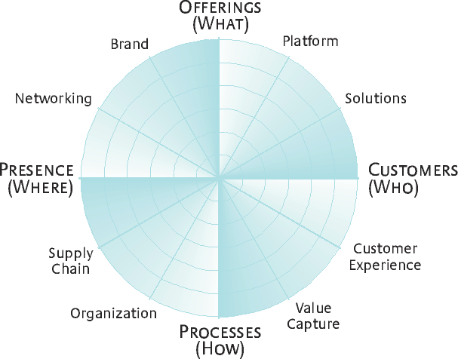
How, What, Where, Who to innovate?

Slide 9
Virtuous circle of innovation
Organization’s reputation for innovation
Attraction of creative people
Organizational encouragement of creativity and innovation
A willingness within the organization to accept new ideas
Development of innovative products
High morale and retention of creative people
High morale and retention of creative people

Slide 10
Case I : XYZ Ltd.
  No major crisis in the company
  A matured industry
  CEO trying to effect gradual change only
  Firm has benefited from benefit of ‘discipline and structure’
  Company has been successful as of now – awards etc
  Employees not feel the need of change immediately
  Innovation = ideas that work (company’s definition)
  Failure not tolerated
  Track record of consistent results – no risk taking behaviour
  How to create innovative culture?
  Why innovation important?

Slide 11
Case I.. .contd…
Creating innovative culture…
  Focus needs to be on both innovation and CULTURE
  Understanding culture is difficult
  Culture can exist in artefacts, beliefs and values.
Understanding these can be difficult and shall take time.

Slide 12
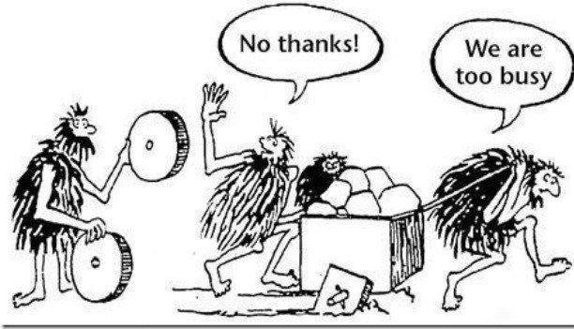
Case I …contd..
Take advantage of the changed structures, no-meeting zones, innovation Fridays
Attend events on innovation
Recognize and share success of others
Doing nothing is not helpful

Slide 13
Case I …contd…
Why innovation required?
  To increase performance
  To make employee innovative
  To make company innovative compliant
Different forms of organizational culture
Clan type – collaborative, friendly and sharing
Adhocracy type – creative, dynamic and entrepreneurial*
Market type – competitive and result oriented
Hierarchy type – controlling, formalized and structured

Slide 14
Innovation concepts include
Product innovation
Process innovation
Service innovation
Business model innovation
Design-led innovation
Concept of ambidextrous organization
Leads to concepts of co-creation, open innovation, open strategy

Slide 15
New product development – Steps (dynamic)
Define your product (Idea generation) – fuzzy ideas
Identify market needs (Screening)
  What is the target market for the proposed product?
  What is the benefit of the new product?
  What are market’s frustrations for existing product ?
  Will the new product fit into the current market?
  What sets this product apart from its competitors?
Establish time frames (Design, develop, screening, testing)
Analyse markets and build on business model/strategy (technicality)
Test products (pre-launch testing, pricing)
Launch products
Regular review and feedback – sustainability

Slide 16
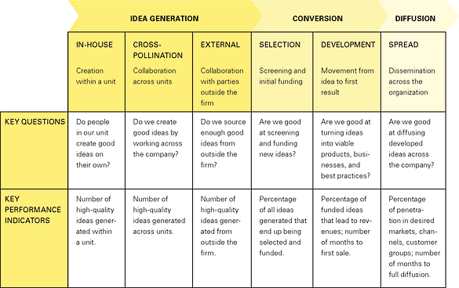
Innovation value chain

Slide 17
Idea generation
  Generate ideas very difficult
  Easy to critique or reject ideas
  Not easy to find receptive and kinder audience
  This is how the business ideas and models are refined
  When a creative idea is told – there’s death stare !
  So important to
    Position your idea
    Address first round of resistance
  If people don’t understand ideas or can’t relate to - resistance

Slide 18
Ideas based on various problems
  To find and solve customer problems
  Difficult but fun and exiting work !!
  Each situation is different – say toy company?
  Identify problems, screen them and develop concept statements
  How to gather problems?
    Internal records
    Direct inputs from technical, marketing, other departments
  How to solve them?
    Problem analysis
    Methodologies – interviewing, focus groups, observation, role playing, scenario analysis
    Solve by group creativity, brainstorming, disciplines panel

Slide 19
Idea generation – strategies to reduce resistance
  Connect/relate the idea to existing strategy
  Once connected, can be validated
  Make analogies to existing products/ services/processes
  Associate new / unfamiliar ideas to things well understood
  What successful model does your idea relate to?
  Discuss how idea would meet needs of key stakeholder
  But you may still face some resistance !!!

Slide 20
So, what do companies do??
  Open innovation
    New ideas from external partners
    Eg – P&G, Henkel, Lego, Bosch
  Exposing employees to external partners help in new ideas – Connect and Develop programmes
    But will this affect current productivity?
  Networking and external ties boost flow of ideas
  Devote significant time and attention to sustain relationships
  Need skilled networkers
  Cultivate broad external network
  Discourage ‘networking for networking’s sake’
  Prioritize absorbing and applying what employees learn and diffuse knowledge internally
  Consider opportunity costs and time consumed

Slide 21
How to screen ideas?
Critical part of new product development
Eliminate unsound ideas
Will the customer in the target market benefit from the product?
What is the size and growth forecast of the target market?
What is the current or expected competitive pressure for the product idea?
Is it technically feasible to manufacture the product?
Will the product be profitable when manufactured and delivered to the customer at the target price?

Slide 22
Case 2 : You are the idea generator
  You are the student of this program
  Great idea for new venture
  Use Reliance Mart as warehouse
  Use Amazon.com as storefront
  Use Blue Dart as shipping/courier services
  Does viable business opportunity really exist?
  Are there too many unknowns?
  Insights into how people approach and evaluate ideas?
  Do we accept or reject new ideas?
Questions ?
a) What would you do with your business idea – eg: online gift basket, medication service or anything else?
b) What are the problems with the proposed idea?
c) Does idea indicate importance of market research to be done?

Slide 23
Case 2… contd…
What would you do with your new business idea?
  Concierge service – Target for whom?
  Online gift basket – Is there a cost advantage? Shipping costs? Thin margins?
  Medication delivery – Is it legal? Demand? Timing?
  Do nothing? – Does this make sense? Any one can go to Wal-Mart website and order?
  Problems with personal pick up/delivery services in large cities?
  International dispatch? Acceptance of goods? How?

Slide 24
Case 2… contd…
What are the problems with the idea? Support your arguments.
  No experience?
  Market size undetermined
  Lack of market research
  No barriers to entry?
  Segment mismatch?
  Logistical issues – how many times visit Reliance Mart?
  Unsure of potential ?
  Not enough information available? Lack of data
  Some ideas already done?
  Any other idea?

Slide 25
Case 2… contd…
What do you think are the barriers that this idea might encounter?
Risk
Any other opportunity?
Will this idea work?
Can costs increase?
Lack of market research

Slide 26
Case 2… contd… learnings..
  New formed ideas generally get rejected
  Because people look at only half risk reward equation
  Most people focus on perceived risk
  But fail to evaluate the potential returns
  Additional market research option – “Learn as you go”
    Implement the idea and learn in the process
    At times effective than formal market research
    Problems of formal market research with new products introduction or new markets creation

Slide 27
