Slide 1
Emerging Digital technologies - Neurotech; AR/VR, Cloud, AI/ML, blockchain, ,automation

Slide 2
Keeping track of technologies ,
Frameworks to think about technology,
Fundamentals of different emerging digital technologies
Product management & emerging digital technologies
Product architecture

Slide 3



What are the top most technological inventions as you ?

Slide 4
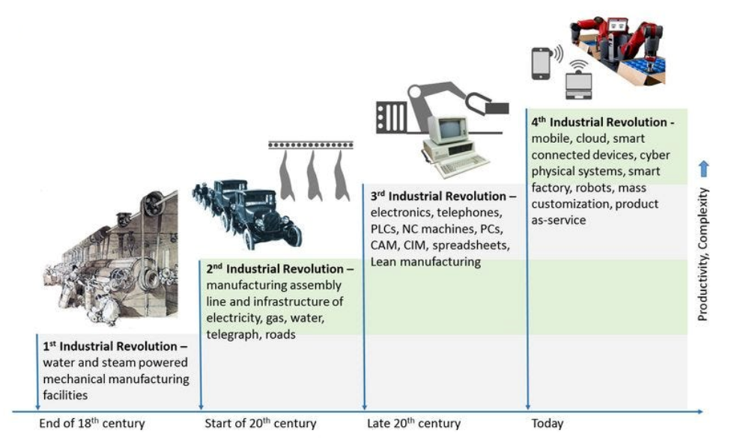

Slide 5
Technology Not Just For the sake of technology

Slide 6


Raised 120 million USD in from Google ventures and Kleiner Perkin

Slide 8
Used all the buzz word, from apps, QR codes, Cloud, to sustainability & recycling,
made an over-engineered product to solve a problem that probably might have not existed in first place itself !
Can you think of any example in your sector ?

Slide 9
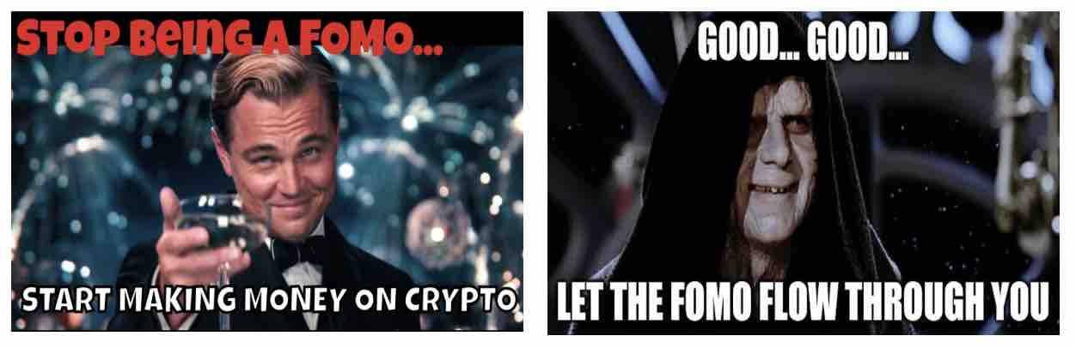
https://phemex.com/blogs/what-is-the-fomo-meme

Slide 10
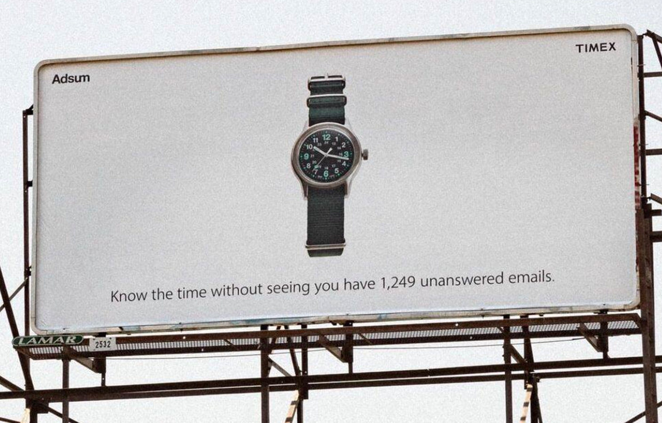
https://www.businessinsider.in/tech/news/timex-takes-a-witty-swipe-at-apple-watches-with-a-new-billboard-know-the-time-without-seeing-you-have-1249-unanswered-emails/articleshow/93622092.cms

Slide 11
On a serious note..

Slide 12
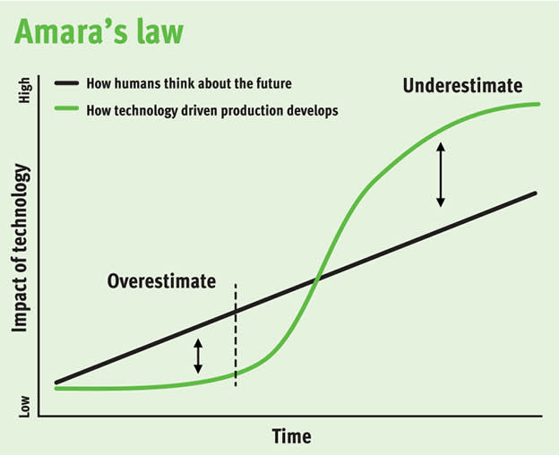
“we tend to overestimate the effect of a technology in the short run and underestimate the effect in the long run”
Do you agree ?
https://community.freetrade.io/t/ceres-cwr-share-chat/13626/45?page=3

Slide 13
How the world is changing

Slide 14
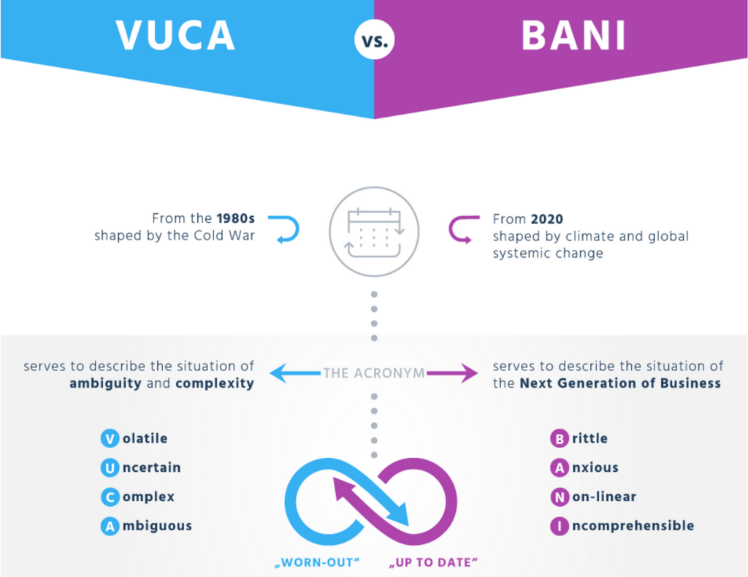

Slide 15
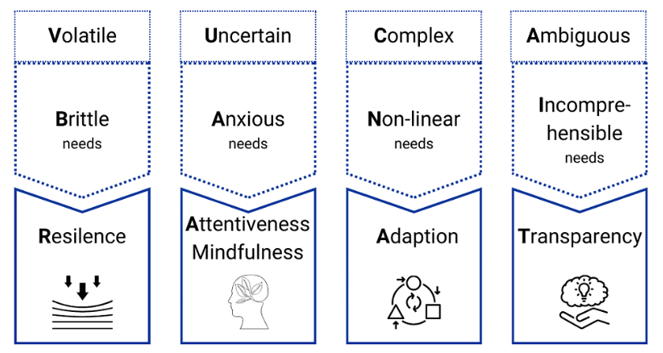

Slide 16
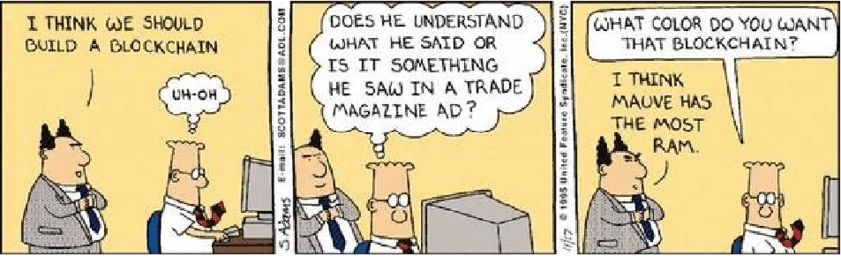
As a busy practitioner, how can one keep track of all the new buzzwords and emerging technologies
https://www.linkedin.com/pulse/being-asked-blockchain-technology-lets-learn-from-dilbert-steibli/

Slide 18
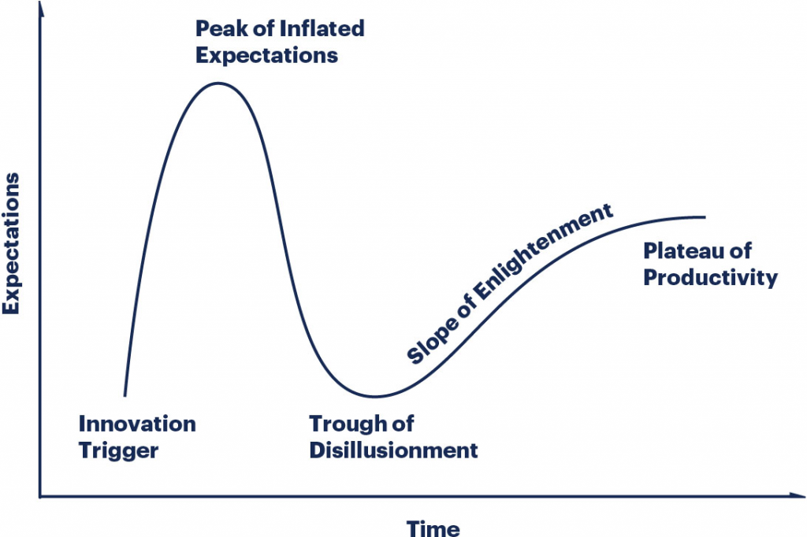

Slide 19
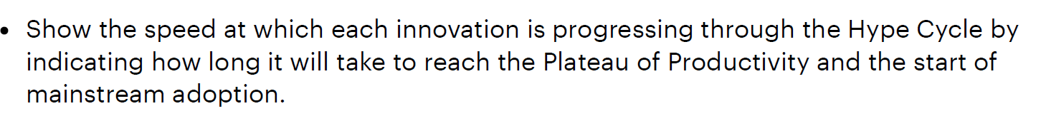
The Hype Cycle is a graphical depiction of a common pattern that arises with each new technology or other innovation. Although many of Gartner’s Hype Cycles focus on specific technologies or innovations, the same pattern of hype and disillusionment applies to higher level concepts such as IT methodologies and management disciplines.

Slide 20
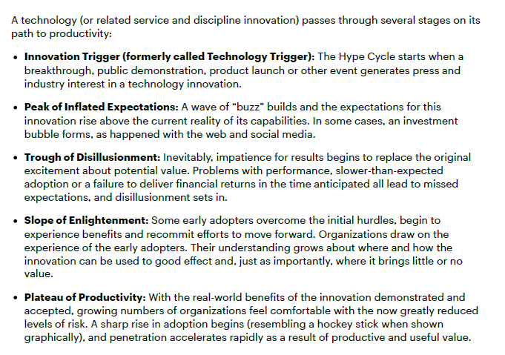

Slide 21
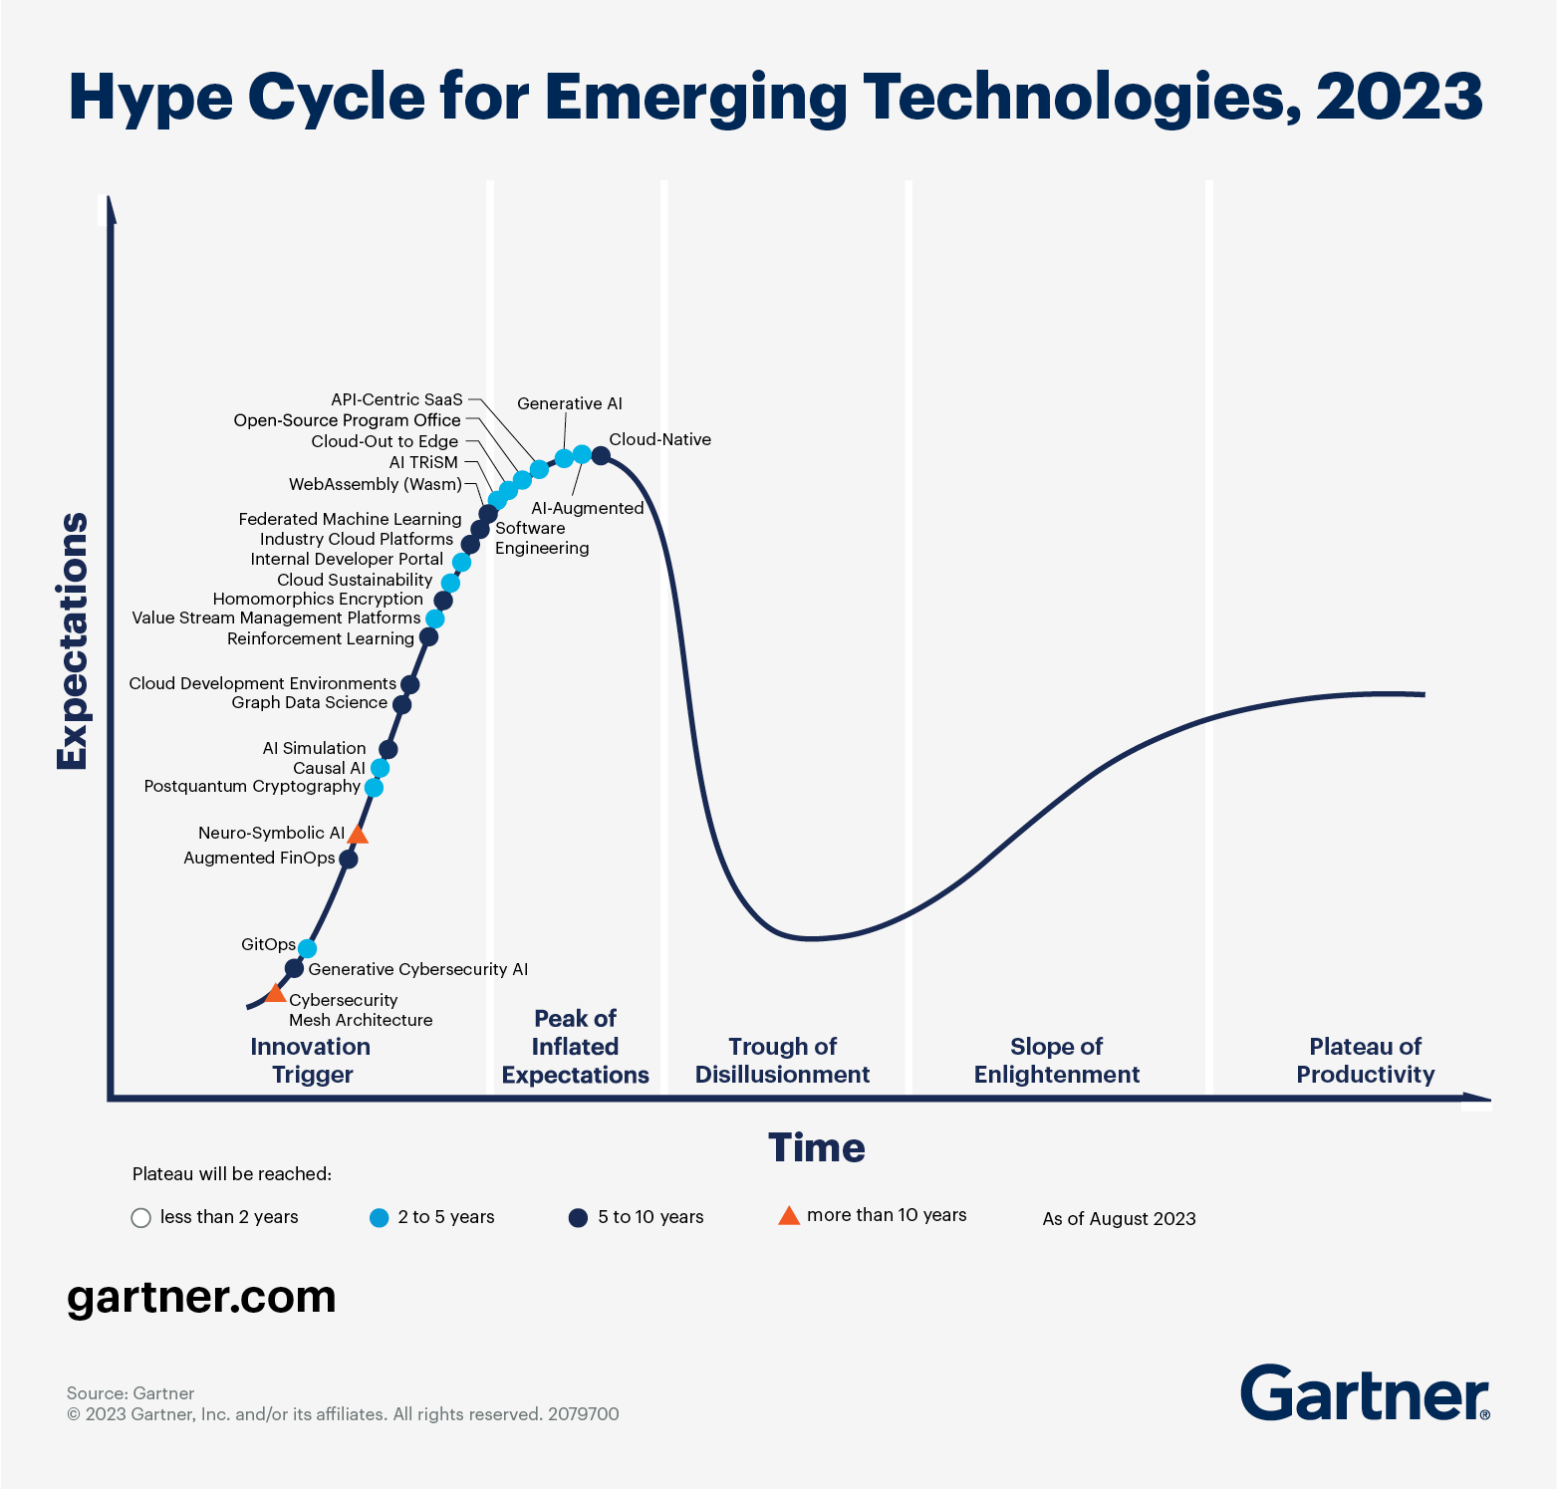

Slide 22
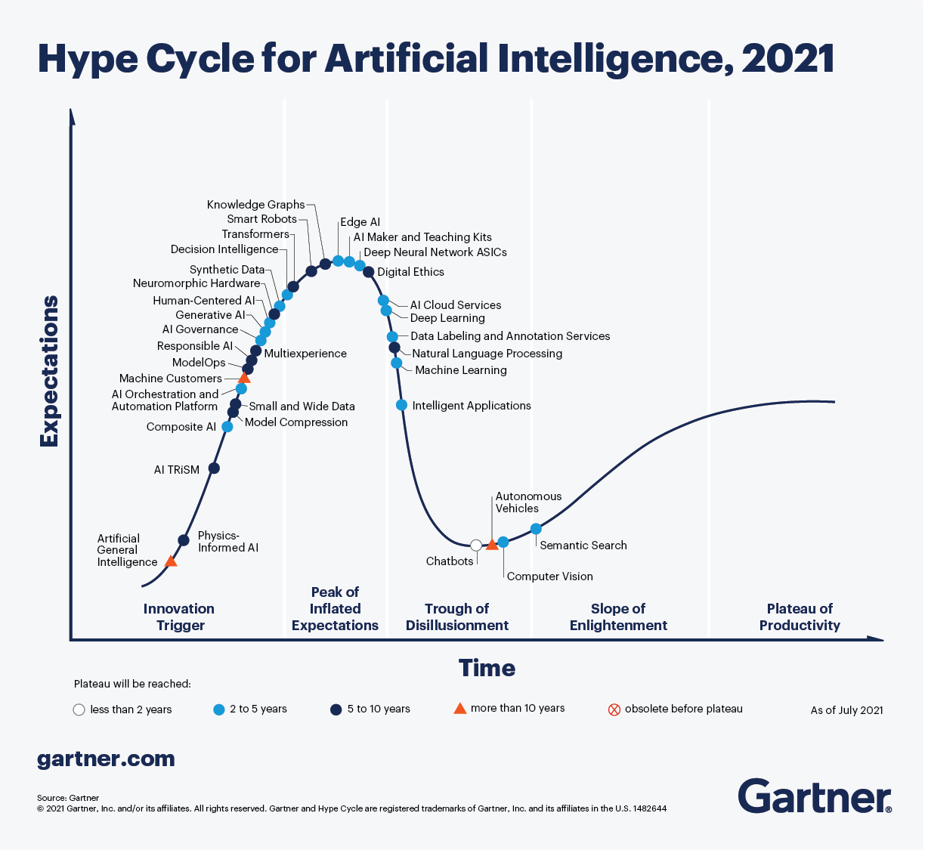

Slide 23
Post CLASS SUGGESTION -
PLEASE Explore the HYPE CYCLE relevant to you

Slide 24
Technology–Organization–Environment (TOE) Framework

Slide 25
One of the strengths of the TOE framework is that it provides a holistic perspective on technology adoption and implementation. Rather than focusing solely on the technology itself or the organizational context, the framework recognizes that both internal and external factors are important in shaping technology adoption and use.
Another strength of the TOE framework is its flexibility. The framework can be applied to a wide range of technologies and organizational contexts, making it a useful tool for researchers and practitioners in a variety of fields.

Slide 26
Technology
Technology refers to the characteristics of the technology itself, including its functionality, complexity, compatibility with existing systems, and ease of use.

Slide 27
Organization
Organization refers to the internal context in which the technology is used, including factors such as the organization's size, structure, culture, and resources.

Slide 28
Environment
Environment refers to the external context in which the organization operates, including factors such as market conditions, regulatory requirements, and social and cultural norms.

Slide 29
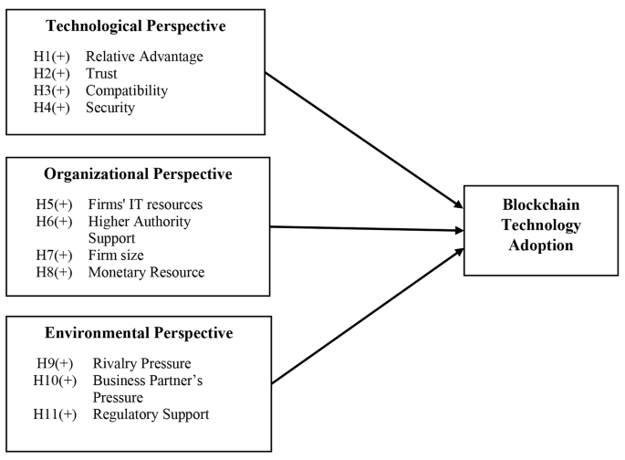

Slide 31
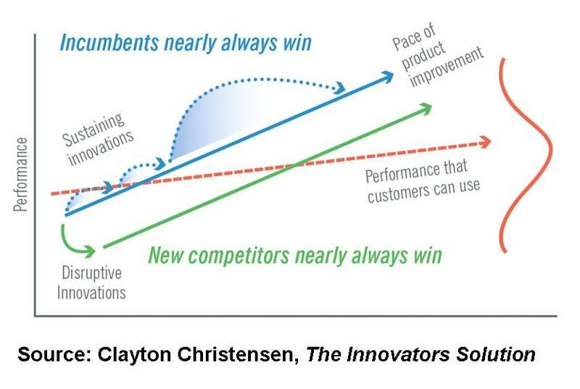

Slide 32
Key points
Trajectory of technological progress often slopes up much faster than ability of customer to utilize it !
Basis of competition changes usually from Functionality -> Reliability -> Speed /Convenience/Customization

Slide 33
When an organization builds a new system using emerging technologies , the system may be
Used or not used
  Which may lead to positive or negative outcomes
Outcomes will have
First-order effects
Second-order effects
Third-order effects

Slide 34
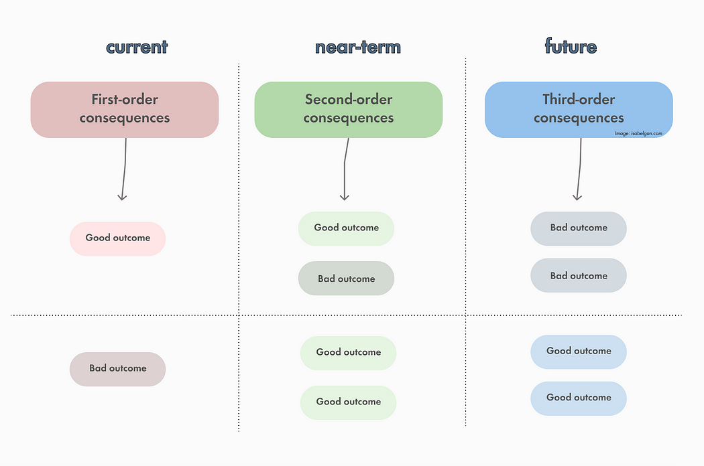
https://medium.com/mental-models-product/mental-models-product-5-second-order-thinking-893e510c428c

Slide 35
Digital payment Solutions - post demonetisation / Covid 19

Slide 36
1st order – fast and cheap alternative solution to shortage of cash , more convenient, Solved safety concerns related with cash handling.

Slide 37
2’nd order – Faster adoption of Smart phones at BOP , Rise of frauds / Cyber crimes

Slide 38
3rd order – Privacy concerns ! , New Business models ? Are toffee companies really struggling due to solution to No Change problem ?
UPI Going international
Predatory Lending apps !

Slide 39
What do you think would be first , second and third order effect of generative AI

Slide 40
Moat !

Slide 41
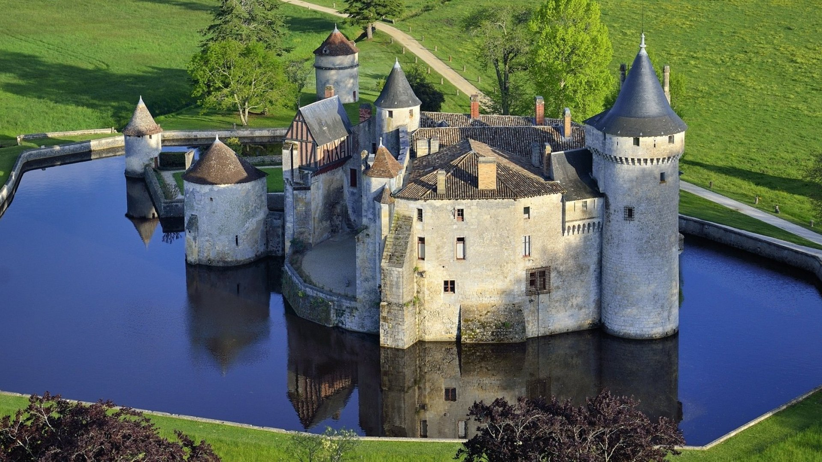
Competitive moat / or as Warren Buffett Calls it “economic moat” is business' ability to maintain competitive advantages in order to protect its long-term profits and market share from competing firms . (Defensibility)

Slide 42
Can Technology be a moat ?

Slide 43
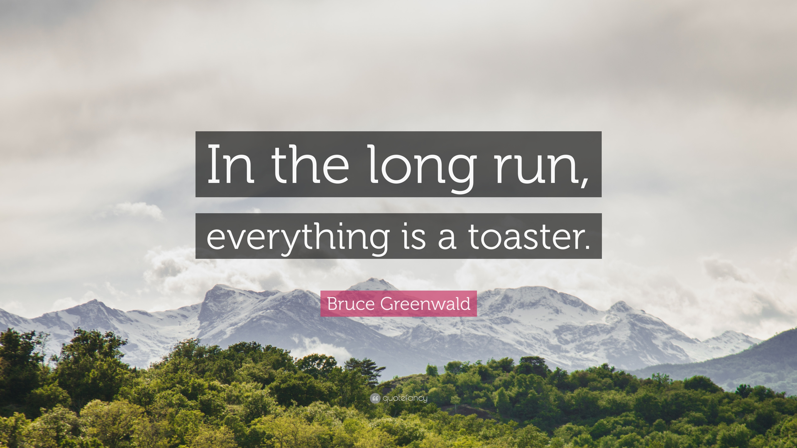

Slide 44
In the long-term, all technology becomes commoditized.
All tech moats are temporary,

Slide 45
How is long term Defensibility created in a Business

Slide 46
Economies of scale
Brand
Embedding
Network effects

Slide 47
Network Effect !
70% of the value created by tech companies since the Internet became a thing in 1994
Product or Service becomes more valuable as usage increases.
Value increase - > N , N² , 2^{N} (Reed’s Law)
Saturation levels
Not to be confused with viral effects. Viral is about getting new users (for free), while network effect is about creating defensibility

