Slide 1

Role of Product and Brand Management in Contemporary Marketing Planning
Session 1-2, EDP-PBM

Slide 2




Who is a PM and what do they do?
Myths:
Project Manager is Product Manager
PMs are “in-charge”
PMs are evangelists of the product.
UX
Technology
PM
Roadmap
PRD
Product Backlog
Business

Slide 3
How does PM’s role vary by company?
Big Tech
  Amazon – (https://www.amazon.jobs/en/principles)
  Google – (https://about.google/philosophy/)
  Microsoft
Start-ups
Non-Tech

Slide 4

Product
Physical goods
Services
Events
Experiences
Persons
Places
Properties
Organizations
Information
Ideas

Slide 5
Demand
Negative demand
Nonexistent demand
Latent demand
Declining demand
Irregular demand
Full demand
Overfull demand
Unwholesome demand
Notes:
Dislike the products, and may even pay to avoid it.
Unaware of or uninterested in the product
Strong need that can not be satisfied by an existing product.
Begin to buy the product less frequently.
Purchase vary on a seasonal basis.
Adequately buying all products.
More customers would like to buy than can be satisfied.
May be attracted to it that have undesirable social consequences.

Slide 6

Demand
Price | Quantity
120 | 3
110 | 4
100 | 5
90 | 6
80 | 7
70 | 9
60 | 14
50 | 20
40 | 23
>40 | 23.5
New versus Mature Marketing?
Effective demand
Potential demand
Negative demand
Nonexistent demand
Latent demand
Declining demand
Irregular demand
Full demand
Overfull demand
Unwholesome demand
Price
Quantity
Fig. Simple Demand Curve

Slide 7
Product levels
Potential product
Augmented product
Installation
Expected product
Packaging
Generic product
Brand name
Features
Core product
Delivery and Credit
Core benefit or service
After-sales services
Quality
Styling
Warranty
Fig. Levels of Product

Slide 8
Product Classification
Convenience goods
Shopping goods
Specialty goods
Marketing strategies:
Convenience = Undifferentiated (Cost leadership)
Shopping = Differentiated
Specialty = Concentrated (Focus)

Slide 9
Classifying New Products
Relative advantage
Compatibility
Complexity
Divisibility
Communicability
Notes:
Divisibility: Extent to which it is possible to try an innovation before coming to a final adoption/rejection decision and it can have a significant influence upon attitudes towards a new product.

Slide 10
New Product/Service Development
New-to-the-world
New product lines
Additional to existing product lines
Improvements and revisions to existing products
Repositioning
Cost reductions
Notes:
Product augmentation is a marketing strategy that brands and businesses use to distinguish their products and offers from those of competitors and to make them more valuable than what competitors are offering. To the customer, it is like getting more value for their money.

Slide 11

Products versus Brands
Differences may be
Rational and tangible or
Symbolic, emotional, and intangibles.
Key Differences
Remember:
A brand is perceptual entity; something that resides in the minds of consumers.
The key to branding is that consumers perceive differences among brands in a product category.

Slide 12
The Product Manager
PM Responsibilities
  Defining products
  Identifying and evaluating opportunities
  Specifying requirements
  Prototypes and stories
  Product requirements document (PRD)
  Negotiating resources, Setting Priorities
  Bundling, Launching and Improving Products

Slide 13
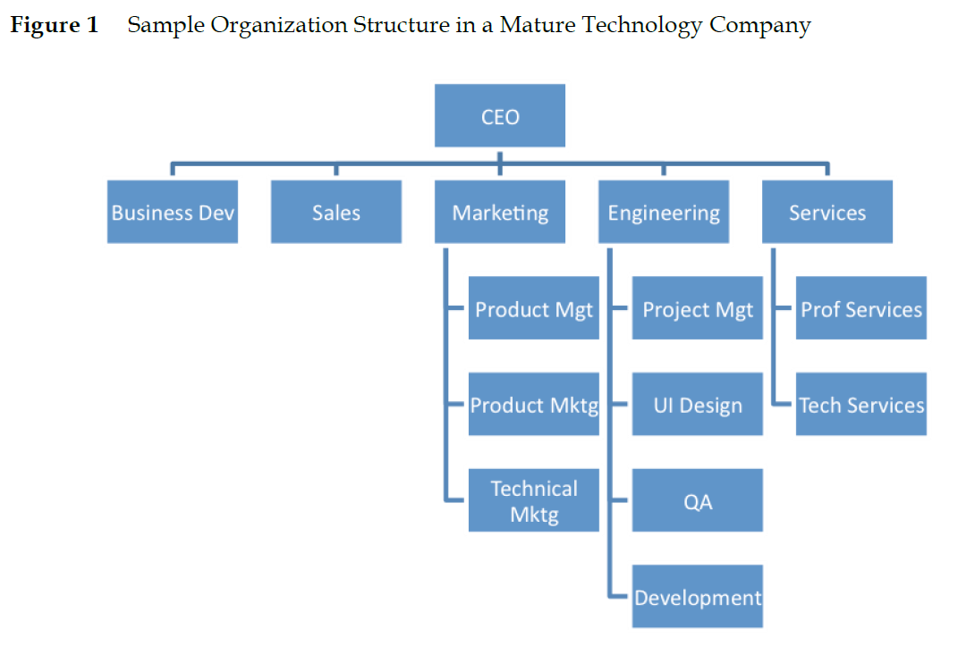
The Product Team and Organization Structure
Source: Bussgang et al. (2015)

Slide 14
Relationships with other Functions
Sales
Business development
Customer service or Operations

Slide 15
Importance of Context
Startups versus More Mature Companies
Enterprise (B2B) versus Consumer Focus (B2C)
Level of Decision Making Centralization
Scale of Deployments
Development Philosophy
Business versus Engineering Emphasis

Slide 16
Attributes of a Strong Product Manager
The Ability to influence and lead
Resilience and tolerance for ambiguity
Business judgement and market knowledge
Strong process skills and detail orientation
Fluency with technology and its implications on product design and business
Design/UX instincts
Key Attributes???

Slide 17

10 Key Skills of Product Manager
Hardcore Skills
Problem-solving
User understanding
Soft Skills
Leadership without authority
Team work
Passion for technology
Eye for Right Design
Analytical skills
Ability to take feedback
Prioritization
Project management skills

Slide 18
New Product Development Process
Concept Generation
Concept Screening
Business Analysis
Concept Testing
Prototype Development and Testing
Program Development
Test Marketing
Market Introduction
Monitoring and Evaluation
Sunk Investment Increases
Costs of Incremental Research Increase
Risk Reduction

Slide 19
New Product Development Process
Concept Generation
Sources?
Common error?
PURPOSE
Concept Screening
Business Analysis
Target market?
Financial impact on existing items?
Likelihood of technical success?
Impact on manufacturing and services?
Financial projection.
Concept Testing
Prototype Development and Testing
Timeline?
Program Development
Test Marketing
Market Introduction
“Few concepts make it to prototype development; fewer reach commercialization, and even fewer succeed as established products…”
Monitoring and Evaluation
Sunk Investment Increases
Costs of Incremental Research Increase
Risk Reduction

Slide 20
NPD - Risks
Technological risk
Marketing risk
Manufacturing and operating risk
Financial risk

Slide 21
Product Positioning
Consumer analysis
  Benefit-segment fit
Competitor analysis

Slide 22
Benefit Segmentation
SEGMENTS
SEGMENT 1
SEGMENT 2
SEGMENT 3
BENEFIT 1
BENEFITS
BENEFIT 2
BENEFIT 3

Slide 23
Product Differentiation Analysis
PRODUCTS
PRODUCT 1
PRODUCT 2
PRODUCT 3
BENEFIT 1
BENEFITS
BENEFIT 2
BENEFIT 3

Slide 24
Positioning
Segmentation Analysis
Differentiation Analysis
PLUS
1 | 2 | 3
4 | 5 | 6
A | B
C | D
“FIT”
Target Segment
Possibilities
Package of Benefits
Combination Possibilities

Slide 25
The Process of Positioning
Market Analysis
Segmentation
Target Market Selection
Implications for Marketing Strategy
Product
Price
Channels
Communications
Internal Corporate Analysis
Positioning
Competitive Analysis
Differentiation
Package of Benefits Selection

Slide 26
Product Company Fit
Company
Existing Resources
Customers
Channels
Programs
Personal skills
Capital
Product
Make
Required Resources
Buy
Customers
Channels
Programs
Personal skills
Capital

Slide 27
Product Market Fit
Customer Needs
Actual and Perceived
Product
Strengths and Weaknesses
Applications of Product Benefits

Slide 28


Slide 29


