Slide 1
Sequoia Airlines

Slide 2
Sequoia Airlines
Sequoia Airlines is a well-established regional airline serving
  California,
  Nevada,
  Arizona,
  Utah.
Sequoia competes on the basis of:
  Price,
  Frequency of flight service,
  Ability to meet schedules,
  Baggage handling,
  Service delivery through flight attendants

Slide 3
Sequoia Airlines
Maintaining its flight-attendant staff at desired levels has been difficult in the past, however, and many times, it has had to ask flight attendants to work overtime because of worker shortages.
This has resulted in:
  Excessive personnel costs
  Morale problems among the attendants.
  Turnover rate is higher-than-industry-average
  Experienced attendants being hired away by competitors

Slide 4
Sequoia Airlines
Data analysis was performed on the 6-month data of flight attendants hiring and firing for the upcoming time period.
Month | Demand (attendant hours)
July | 14000
August | 16000
September | 13000
October | 12000
November | 18000
December | 20000

Slide 5
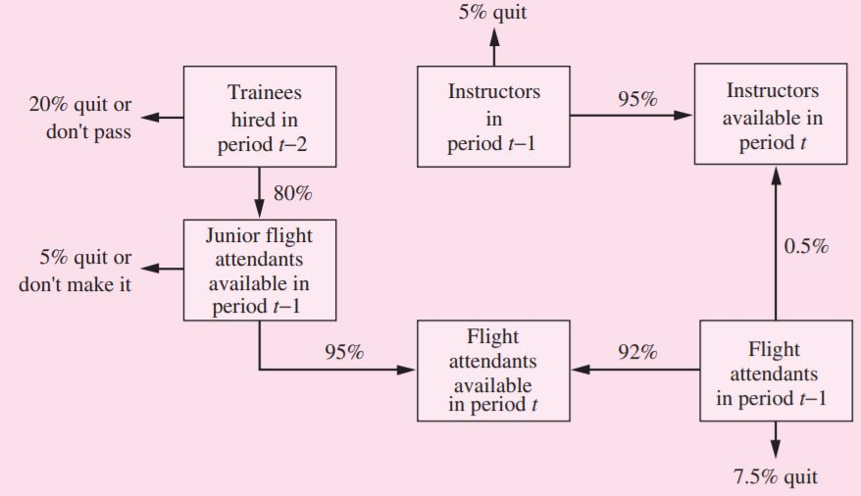
Sequoia Airlines
Sequoia’s training program for new personnel requires an entire month of classroom preparation before they are assigned to regular flight service. As junior flight attendants, they remain on probationary status for 1 additional month.

Slide 6
Sequoia Airlines
During the training period, each new employee is paid $750.
Junior flight attendant works an average of 140 hours per month and is paid a salary of $1,050 during the probationary period.
Experienced flight attendants works an average of 125 hours per month and is paid a salary of $1,400 per month.
Each instructor receives a salary of $1,500 per month.

Slide 7
Sequoia Airlines
There are at most 5 trainees per instructor.
Instructors not needed in a particular month (i.e., surplus) may be used as flight attendants.
The proportion of junior flight attendant hours not exceed 25 percent of any month’s total (i.e., junior plus experienced) attendant hours.
In May, Sequoia hired 10 new employees to enter the training program,
In June, it hired 10 more.
At the beginning of June, there were 120 experienced flight attendants and 6 instructors on Sequoia’s staff.

Slide 8
Sequoia Airlines
For the forecast period (i.e., July–December), determine the number of new trainees who must be hired at the beginning of each month so that total personnel costs for the flight-attendant staff and training program are minimized?
How would you deal with the problem?

Slide 9
Thank You

