Slide 1
Designing Digital Communication Strategies
Sumeet Gupta
Notes:
on Analytics

Slide 2
Outline
Understanding appropriate Social Media
  Video Case: Facebook
Social Vs Digital Strategies
  Video Case: Zynga
Social Impact of Evolving Digital Landscape
  Video Case: United Breaks Guitars

Slide 3
Discussion Points
How to choose appropriate digital platforms for digital communication?
How are Social Strategies different from Digital Communication Strategies?
How can business take advantage of their Social Media Presence through Social Strategies?
What are the mechanics of Viral Marketing

Slide 4
Understanding Social Media Platforms

Slide 5
Facebook Stats
Around 750 million active users
94 million from US alone, half of whom log every day
770 billion page visits
Half of this comes from users aged 18-34
Source: Sashittal et al. (2012), Business Horizons

Slide 6
Case: Facebook
Why do people use Facebook and what do they do when they are there?
How does social linkages drive business?

Slide 7
Activities on Social Media
Breadth – Related to people connecting with others
Display – People contributing all types of content
Search – People viewing content
Interaction – Private Communication
Platform – Third-party applications that use some of the data form the online social network platform

Slide 8
Why People Use Facebook?
To voyeuristically Peer into Other’s Lives
To create a distinctive identity for themselves
To act on inner Narcissistic Tendencies
Source: Sashittal et al. (2012), Business Horizons

Slide 9
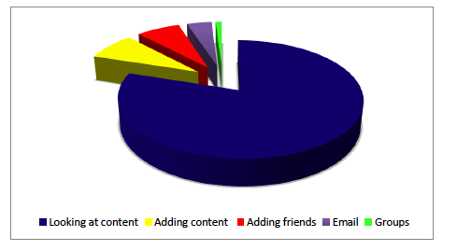
What do people do on Facebook?

Slide 10
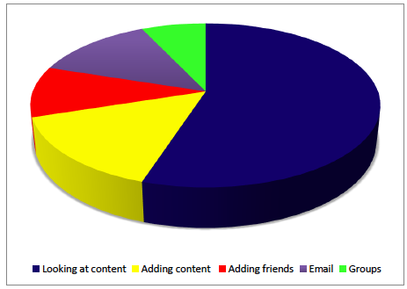
What do people do on Mixi?

Slide 11
Research
Only 5-10% of users produce content on Facebook
Why companies use facebook? (Regus 2010)
  To attract new business: 40%
  To communicate with contacts: 51%
  To communicate with customers: 51%
  Gather Business Intelligence: 58%
Business use in Europe (InSites Consulting, 2011)
  50% of social network users are connected to brands
  36% have commented on a brand
  42% dialogued with the brand
  53% reacted to comments from the brand
  51% consulted information

Slide 12
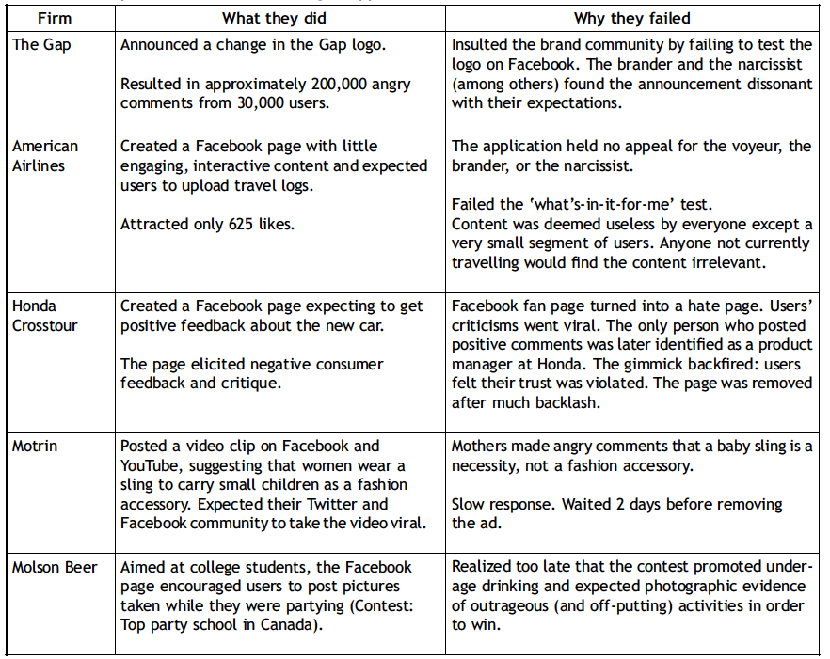
Facebook Marketing Disappointments
Source: Sashittal et al. (2012), Business Horizons

Slide 13
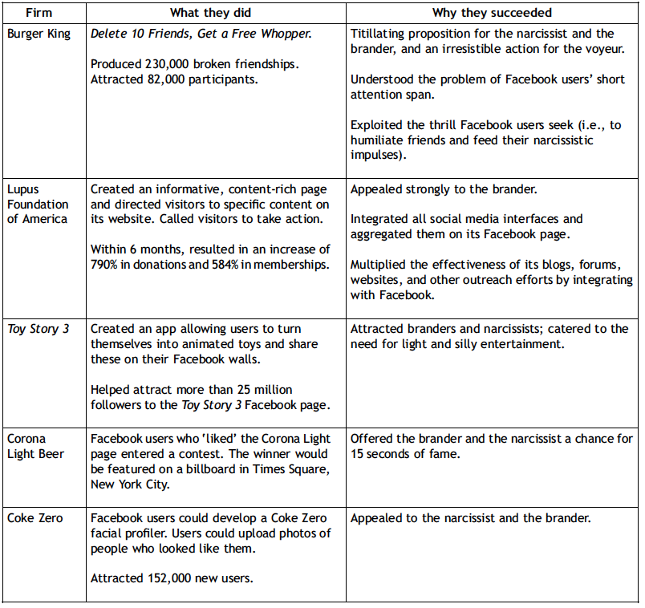
Facebook Marketing Success
Source: Sashittal et al. (2012), Business Horizons

Slide 14
Harnessing Power of Facebook
Marketers are more likely to engage Facebook users and reach brand-related objectives via Facebook as a medium if they outline the following:
  How to create entertaining content as central to their Facebook-related initiatives
  How to co-produce content with Facebook users as the main vehicle for engagement
Source: Sashittal et al. (2012), Business Horizons

Slide 15
Harnessing Power of Facebook
Marketers are more likely to reach brand-related objectives via Facebook if the entertainment content is co-produced with target customers and includes the following attributes:
  Includes user-centered interactions (i.e., focuses on users’ narratives versus brand benefits)
  Appeals to users’ needs for voyeuristic and titillating values (versus information about the brands or products)
  Produces an emotional, visceral response from users (versus a cognitive, rational response)
  Centers on users’ fantasies (i.e., imaginary versus real-world narratives)
  Helps users develop a distinct Facebook identity (Brand ME)
  Helps users star in their own fantasy show on Facebook as a TV channel (i.e., users are able to deploy emerging content to carve out distinct identities among their wider social networks
Source: Sashittal et al. (2012), Business Horizons

Slide 16
Social Vs Digital Strategy

Slide 17
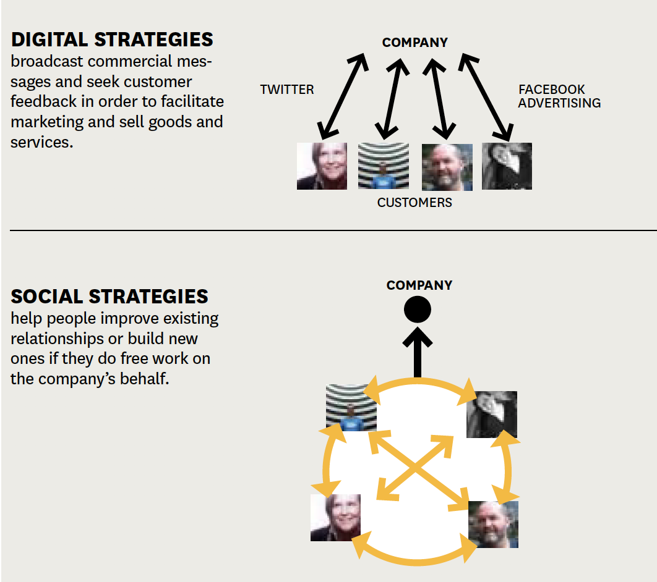
Digital Vs Social Strategy
The prime advantage of a social strategy over a purely digital one is in tapping into how people really want to connect – with other people, not with a a company.
A business with a successful social strategy helps people form and strengthen relationships in ways that also benefit the company.

Slide 18
Why companies fail?
They fail to identify the appropriate strategy that enhances relationships among people and help them meet strangers

Slide 19
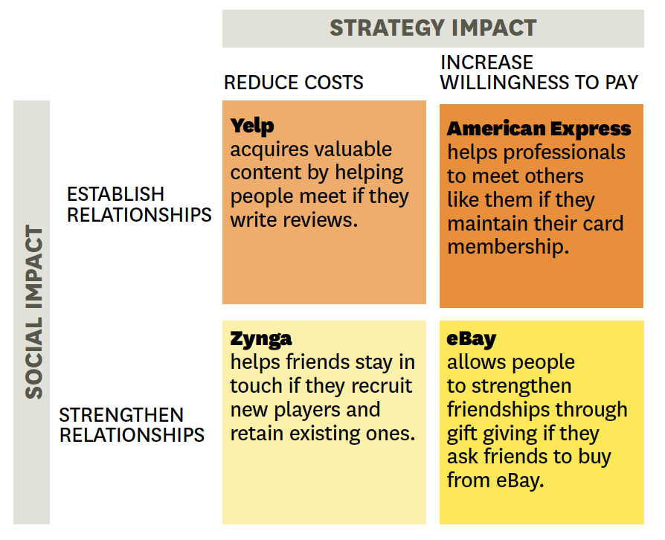
Making Social Strategies Work
Here's how four companies have successfully implemented their social strategies. Each firm reduces costs of increases customers' willingness to pay by helping people establish or strengthen relationships if they do free work on the company's behalf.

Slide 20
Leveraging social platforms for companies
A Viable social strategy that increases company’s profitability by improving interactions among people if they undertake a set of corporate functions

Slide 21
Case: Zynga
How do Social Games Work?
Why do people play social games?
What are the basic game mechanics and social mechanics in Zynga farms, such as farmville and cityville?
What impact do these mechanics have on (i) game experience, (ii) player’s social relationships, (iii) Zynga profitability
What factors account for Zynga’s rapid growth and subsequent problems?

Slide 22
Mechanics of Viral Marketing

Slide 23
Case: United Breaks Guitars
Evaluate United’s Response to Dave Carroll’s Video? Did the airline handle the incident well?
What was the motivation behind Dave’s posting the video? Why did Dave Carroll decline the offer from United?
Why was this video seen by so many people, so quickly? What it takes for an idea to propagate through a social network.
In general, how should corporations prepare for challenge posed by user-generated video and other material disseminated on social media?

Slide 24
What leads Viral Content to Propagate
Pass-along appeal of the content
  Relational Utility – Does it have value for a network of friends?
  Likeability – Is it fun, engaging, novel, cute? Does it have expressive value?
Properties of the Medium of Propagation
  No. of friends (contacts reached per posting)
  Proportion of friends likely to pass along video
  Cycle time
  No. of Friends (x) who watch the video in n cycles: (1-x^{n-1}) / (1-x)

Slide 25


