Slide 1
Understanding Changing Consumer Behavior and Media
Sumeet Gupta
Notes:
on Analytics

Slide 2
Outline
Background on Display Advertising and Search Engine Advertising
  How AdExchanges work?
  Issues with Display Advertising
Case: Hubspot - Inbound Marketing and Web 2.0

Slide 3
Display and Search Engine Advertising

Slide 4
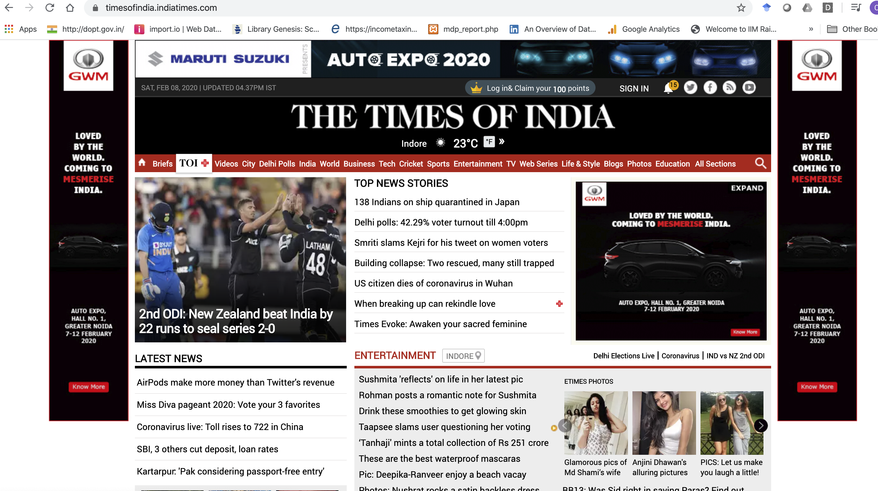
Display Advertising

Slide 5
Designing a Campaign
Objective – What do we want to achieve with the campaign?
Target – What is our audience and where can we find it?
Media – What media do we wish to advertise in?
Payment Models – Which model is aligned with our goals?
Format – What is the most efficient format for achieving our goals?

Slide 6
Objective
Brand Awareness / Consideration
Purchase intent
Purchase
Repeat Business / Loyalty
Ue
Opinion and Recommendation
Conversation

Slide 7
Target
Information from DoubleClick as to who are likely to see our ads

Slide 8
Media
Digital Press
Generalist portals
Vertical portals
Social Networks
Ad Networks
Ad Exchanges

Slide 9
Payment Models
CPM (Cost per thousand impressions)
CPC (Cost per click)
CPA (Cost per Acquisition) or CPL (Cost per lead)
CPV (Cost per View)

Slide 10
Formats
Display
  Built-in formats
  Scalable formats
  Floating formats
  Special formats
Video
  Integrated Video
  Pre-roll video
  Overalay

Slide 11
User Search
Organic or Natural Results
Paid Results – SEO is used to optimize these results

Slide 12
Types of Searches
Search for a particular official website of a company, person or association
Search for information
Search to carry out a transaction

Slide 13
Importance of Paid Search
Flexibility: Sponsored links can be tailored to short-term needs
Relevance: Can be targeted to particular users, based on interests, location, language and demographics
Immediacy: Can deliver results very quickly
Source of Relevant Information: Can provide information quickly as to which keywords work best for business; which ad copy work etc
E.g. Google Adwords, MS adcenter, Yahoo Search Marketing

Slide 14
Basic SEM Concepts
Clickthrough rate (CTR)
  No. of clicks/No. of impressions
Actual Cost per Click (Actual CPC)
Cost per Conversion
  Total cost paid to the search engine / No. or sales (or registrations) generated

Slide 15
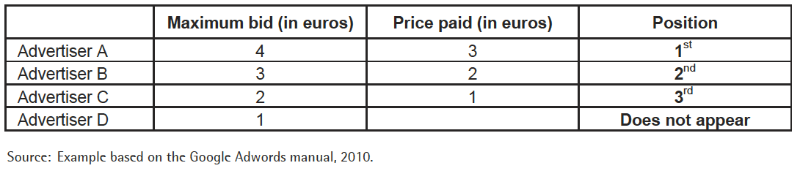
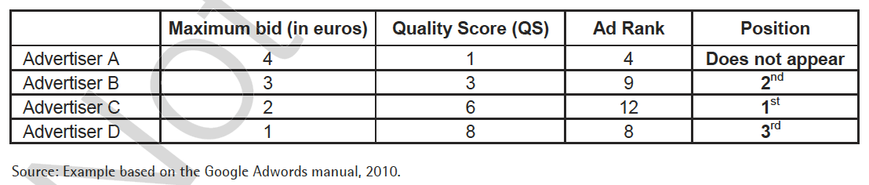
Basic SEM Concepts

Slide 16
How Ad Exchanges Work?

Slide 17
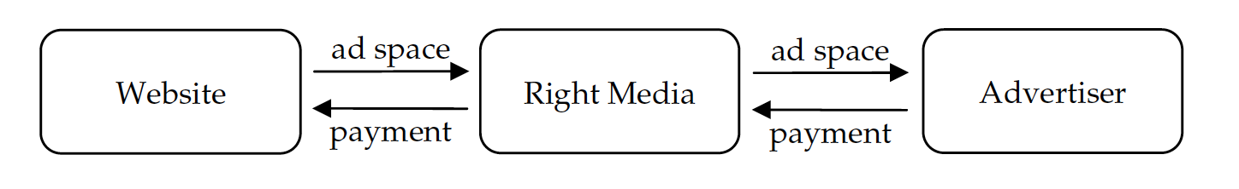
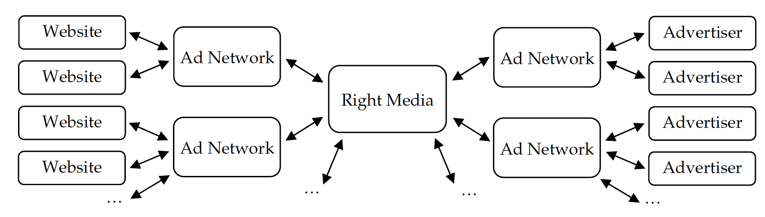
Ad Exchange

Slide 18
A
Each advertiser rates its own ads
Each publisher selects which ads may appear on its site
Community classifies ads
Right Media classifies ads
P
C
R

Slide 19
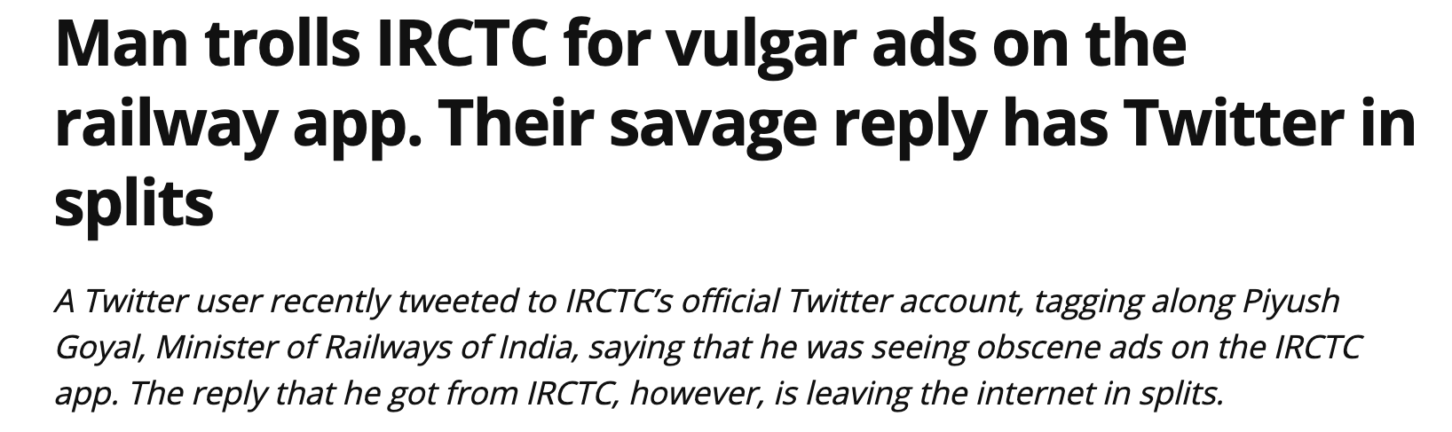
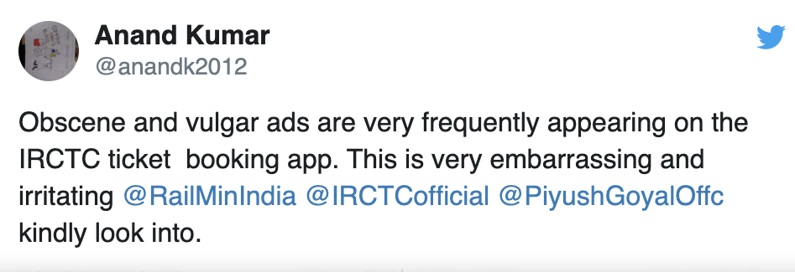
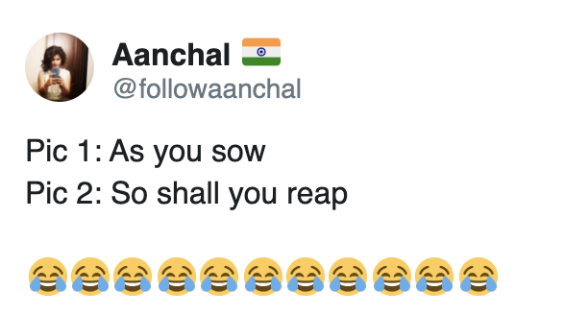
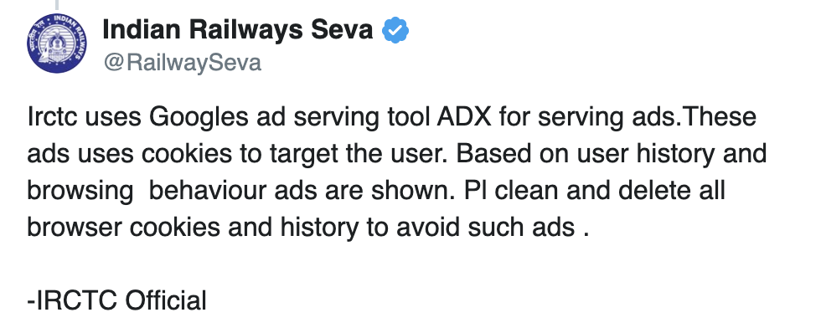
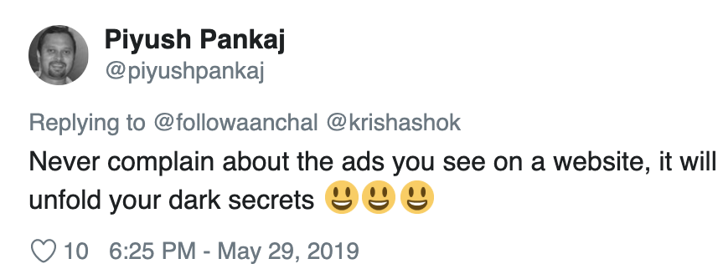

Slide 20
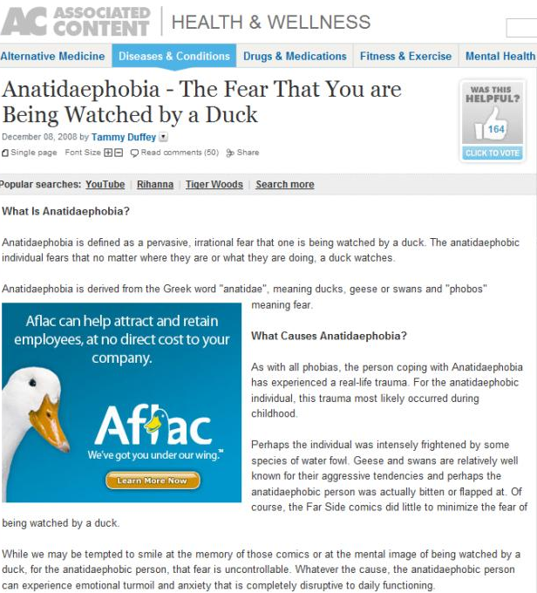

Slide 21
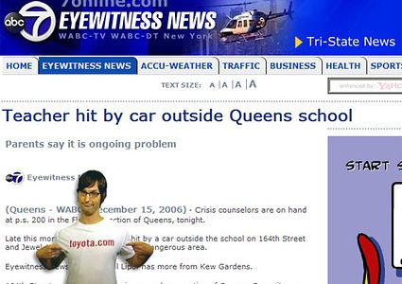

Slide 22
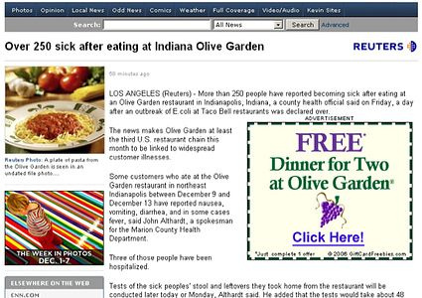

Slide 23
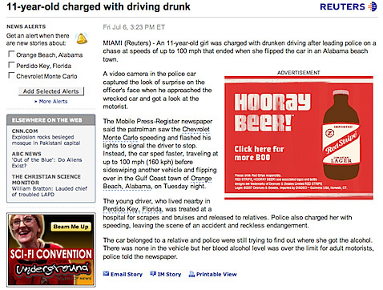

Slide 24
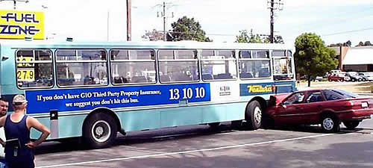

Slide 25
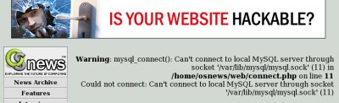

Slide 26
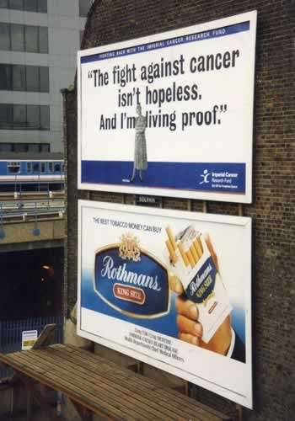

Slide 27
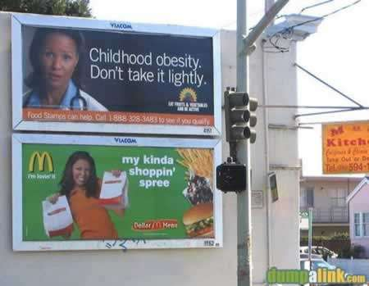

Slide 28
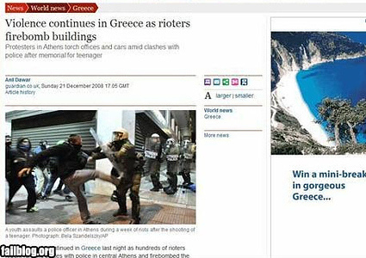

Slide 29
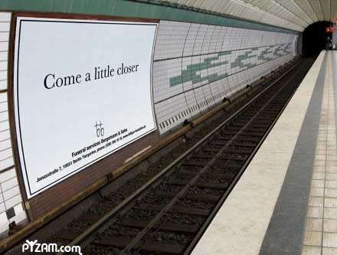

Slide 30
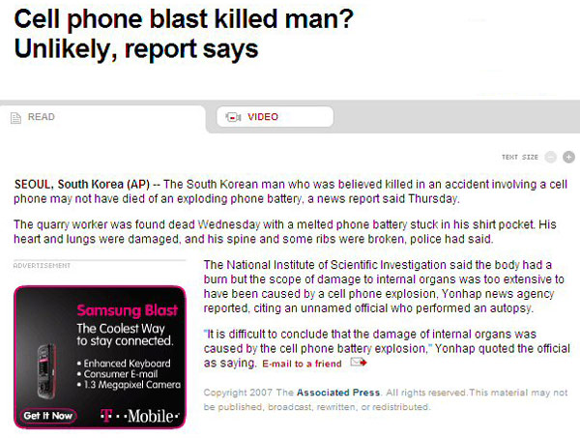

Slide 31
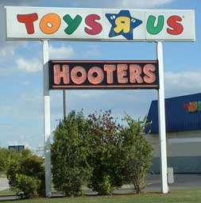

Slide 32
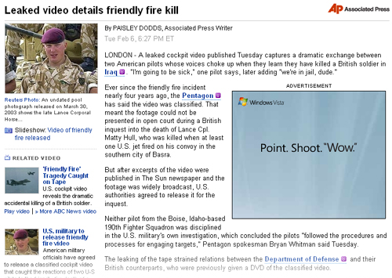

Slide 33
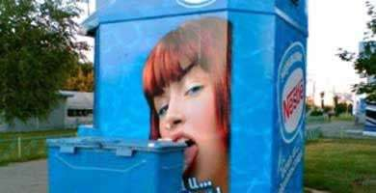

Slide 34
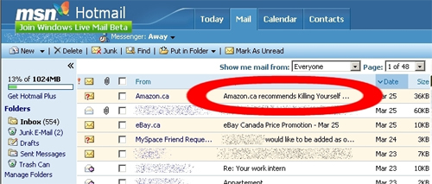

Slide 35
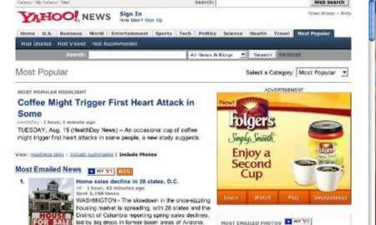

Slide 36


Slide 37
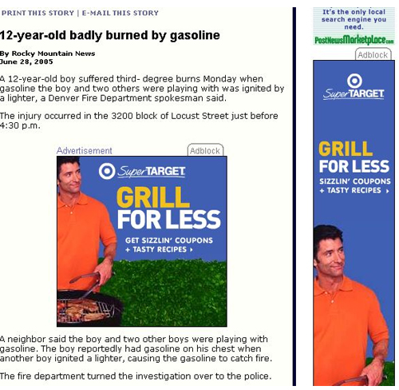

Slide 38
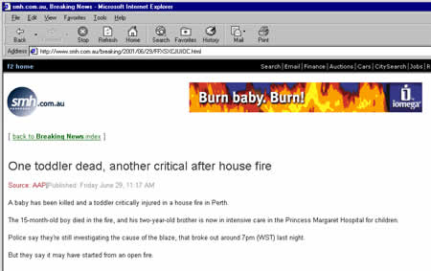

Slide 39


Slide 40
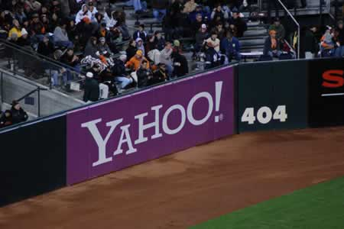

Slide 41
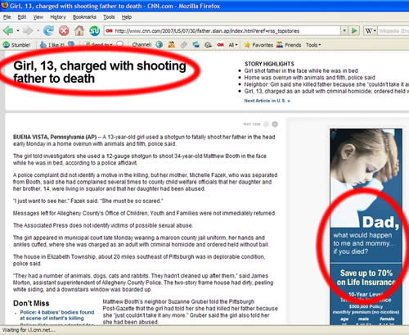

Slide 42
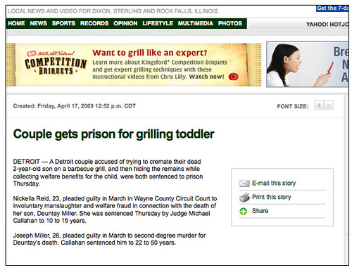

Slide 43
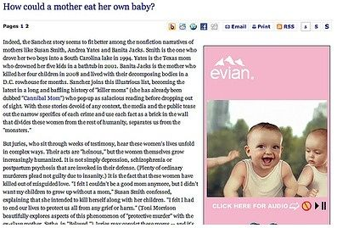

Slide 44


Slide 45
Hubspot: Inbound Marketing and Web 2.0

Slide 46
Inbound Marketing
Marketing Strategies and Practices that pulled prospective customers towards a business and its products, through the use of Web 2.0 tools and applications like blogging, search engine optimisation, and social media.

Slide 47
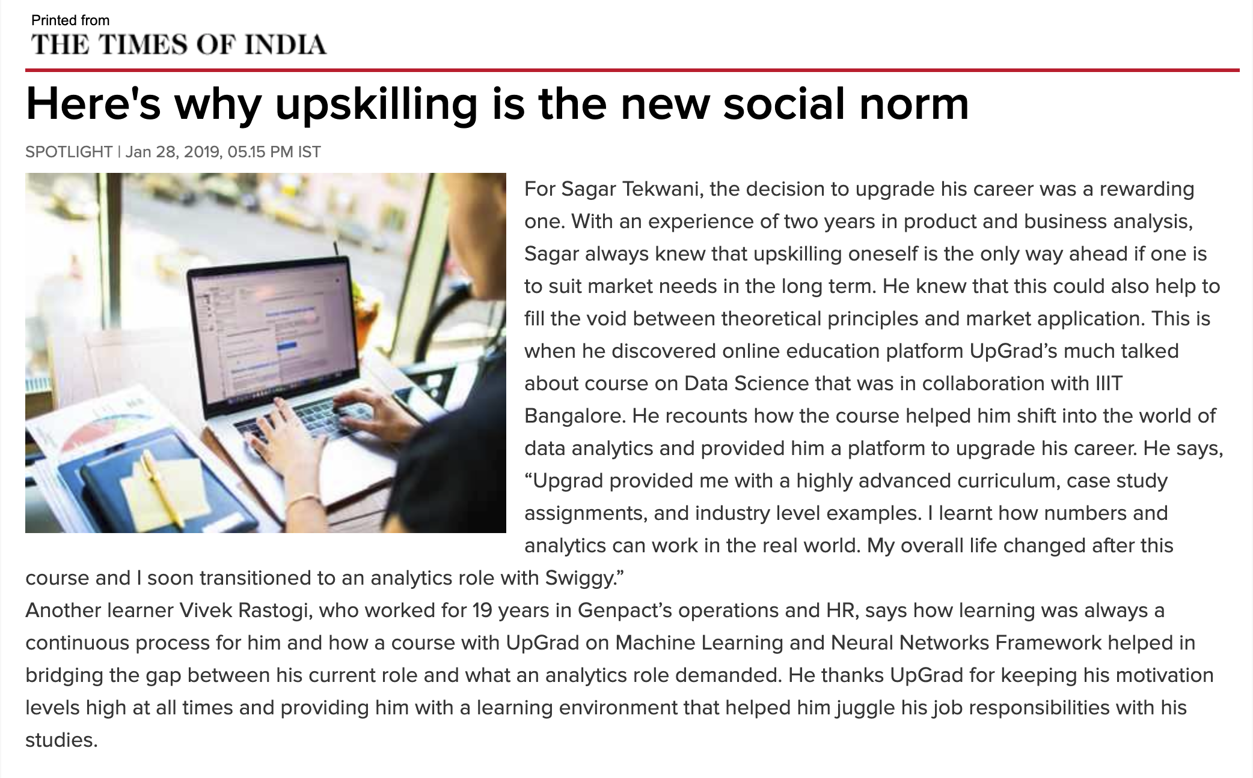
Advertorial
https://timesofindia.indiatimes.com/spotlight/upskilling-becomes-the-social-norm-upgrad-powers-3-lakh-careers/articleshowprint/67524797.cms

Slide 48
Objectives
Unearthing the benefits and risks involved with inbound marketing and comparing and contrasting it with outbound marketing
Analyzing the customer lifetime value of different customer groups to inform segmentation and targeting decisions and to develop strategies to reduce acquisition cost and increase retention
Matching product strategy and pricing strategy to a target market
Assessing whether HubSpot can scale their business using inbound marketing techniques

Slide 49
Case Questions
Do you agree with HubSpot that the 'rules of marketing' have changed? If so, how? Is inbound marketing the answer? Why or why not?
Is HubSpot finding and serving the right set of customers? Given its position as a start-up company, should it widen its focus to serve any customer that comes its way? Or narrow their target, by focussing exclusively on either Owner Ollies or Marketer Marys? Or by focusing exclusively on either B2B or B2C customers?
HubSpot as begun to differential its products as it has learned more about its customers. Should it do more? Should its pricing strategy change too? Does the software-as-as-service (SaaS) pricing model work for both Marketer Marys and Owner Ollies? Should HubSpot try to immediately capture more value for either of these customers?
Are Halligan and Shah being too stubborn by not doing any outbound marketing? Or should they continue to practice what they preach by focussing on inbound marketing alone?
Halligan and Shan want HubSpot to be to marketing, what salesforce.com is to sales. What would your plan of action be to make this happen? Why would you take these actions? What keeps you up at night about your plan?

Slide 50


