Slide 1
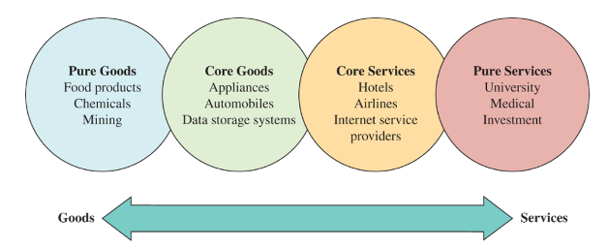
The Goods-Services Continuum
Goods are physical items produced by business organisation
Services are activities that provide some combinations of time, location, form and psychological value

Slide 2
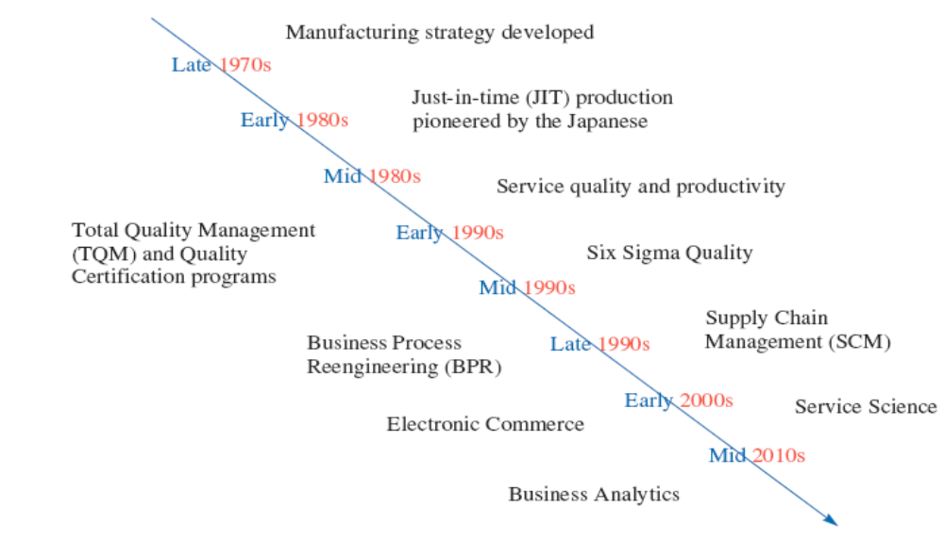
Timeline of Major OSCM Concepts

Slide 3
Performance Measures
Evaluation and measurement of the firm’s current and past performance
Future goals as expressed by the firm’s strategy
Types of Measures:
Financial
External
Internal

Slide 4
Financial Measures
Absolute Performance: Revenue, Profit, Costs, Net Income etc
Performance relative to assets: Accounting Ratios
Survival Strength: Cash Flow

Slide 5
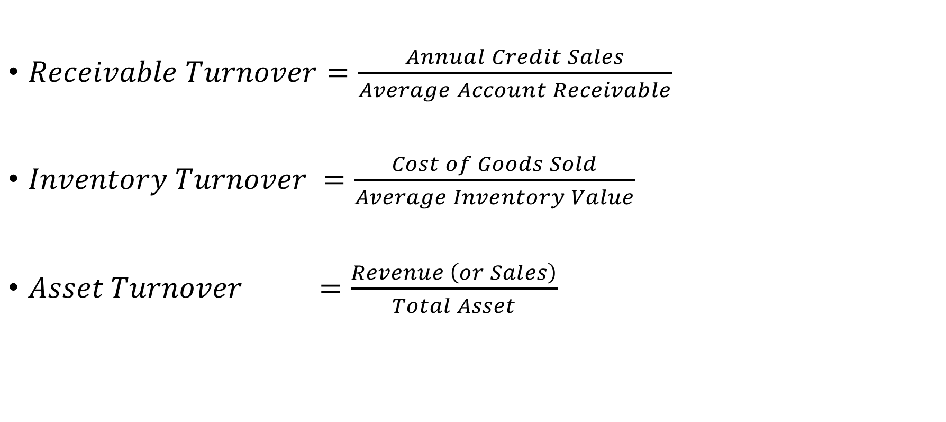
Accounting Ratios
$Receivable Turnover=\frac{Annual Credit Sales}{Average Account Receivable}$
$Inventory Turnover =\frac{Cost of Goods Sold}{Average Inventory Value}$
$Asset Turnover =\frac{Revenue \left(or Sales\right)}{Total Asset}$

Slide 6
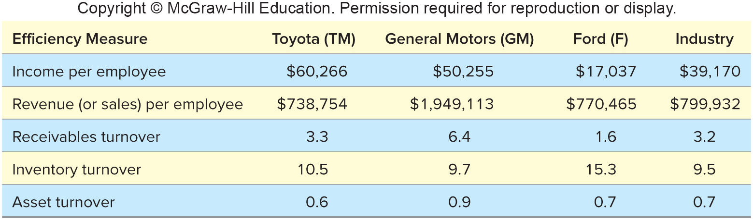
An example:

Slide 7
Another Example
Company Name | Ashok Leyland Ltd. | Mahindra & Mahindra Ltd. | Maruti Suzuki India Ltd. | Tata Motors Ltd.
Income per employee | 9.57162 | 12.21827 | NA | 11.5544
PAT per employees | 0.54565 | 1.04528 | NA | NA
Receivables Turnover | 24.78171388 | 15.85192308 | 61.43716216 | 17.42238125
Inventory turnover | 9.825770752 | 14.30889573 | 20.26698739 | 9.847522529
Assets Turnover | 1.661539763 | 1.086195099 | 1.466619711 | 0.90911762

Slide 8
External Measures
A firm must attract and retain customers by providing goods and services that meet or exceed their expectations
Four critical attributes of customer expectations are:
Cost
Response time
Variety
Quality

Slide 9
Internal Measures
Internal measures are the predictor of customer satisfaction
Cost: Efficient processes, less failure
Response time : Capacity to ensure minimum wait time,
Variety : Product designs to ensure higher SKUs
Quality : Features, performance, reliability, serviceability, aesthetics

Slide 10
Demand Management:
Customer Order Decoupling Points
Long
Low
Engineer-
to-order (ETO)
Make-to-order
(MTO)
Lead
Time
Volume
Assemble-
to-order
(ATO)
Make-
to-stock
(MTS)
Short
High
Raw
materials
Work-in-process
parts and components
Finished
goods
Suppliers
Decoupling Point

Slide 11
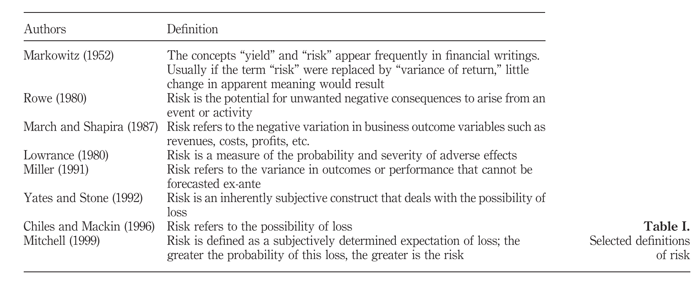
Risk
Rao, S., & Goldsby, T. J. (2009). Supply chain risks: a review and typology. The International Journal of Logistics Management, 20(1), 97–123. https://doi.org/10.1108/09574090910954864

Slide 12
Assessing Risk Associated with OSCM Strategy
All strategies have an inherent level of risk
  Uncertainty in the environment causes supply chain planners to evaluate the relative riskiness of their strategies
Supply chain risk: the likelihood of a disruption that would impact the ability of a company to continuously supply products or services
  Supply chain coordination risks are associated with the day-to-day management of the supply chain
  Disruption risks are caused by natural or manmade disasters

Slide 13
Risk Mitigation Strategies
Risk | Risk Mitigation Strategy
Natural disaster | Contingency planning (alternate sites, etc.) insurance
Country risks | Hedge currency, produce/source locally
Supplier failure | Use multiple suppliers
Network provider failure | Support redundant digital networks
Regulatory risk | Up-front and continuing research; good legal advice, compliance
Commodity price risks | Multisource, commodity hedging

Slide 14
Risk Mitigation Strategies Continued
Risk | Risk Mitigation Strategy
Logistics failure | Safety stock, detailed tracking and alternate suppliers
Inventory risks | Pool inventory, safety stock
Major quality failure | Carefully select and monitor suppliers
Loss of customers | Service/product innovation
Theft and vandalism | Insurance, security precautions, knowledge of likely risks, patent protection, etc.

