Slide 1
Market Segmentation and Product Differentiation Strategies
Session Instructor
Dr. Ankit Kesharwani
Assistant Professor, IIM Rohtak

Slide 2
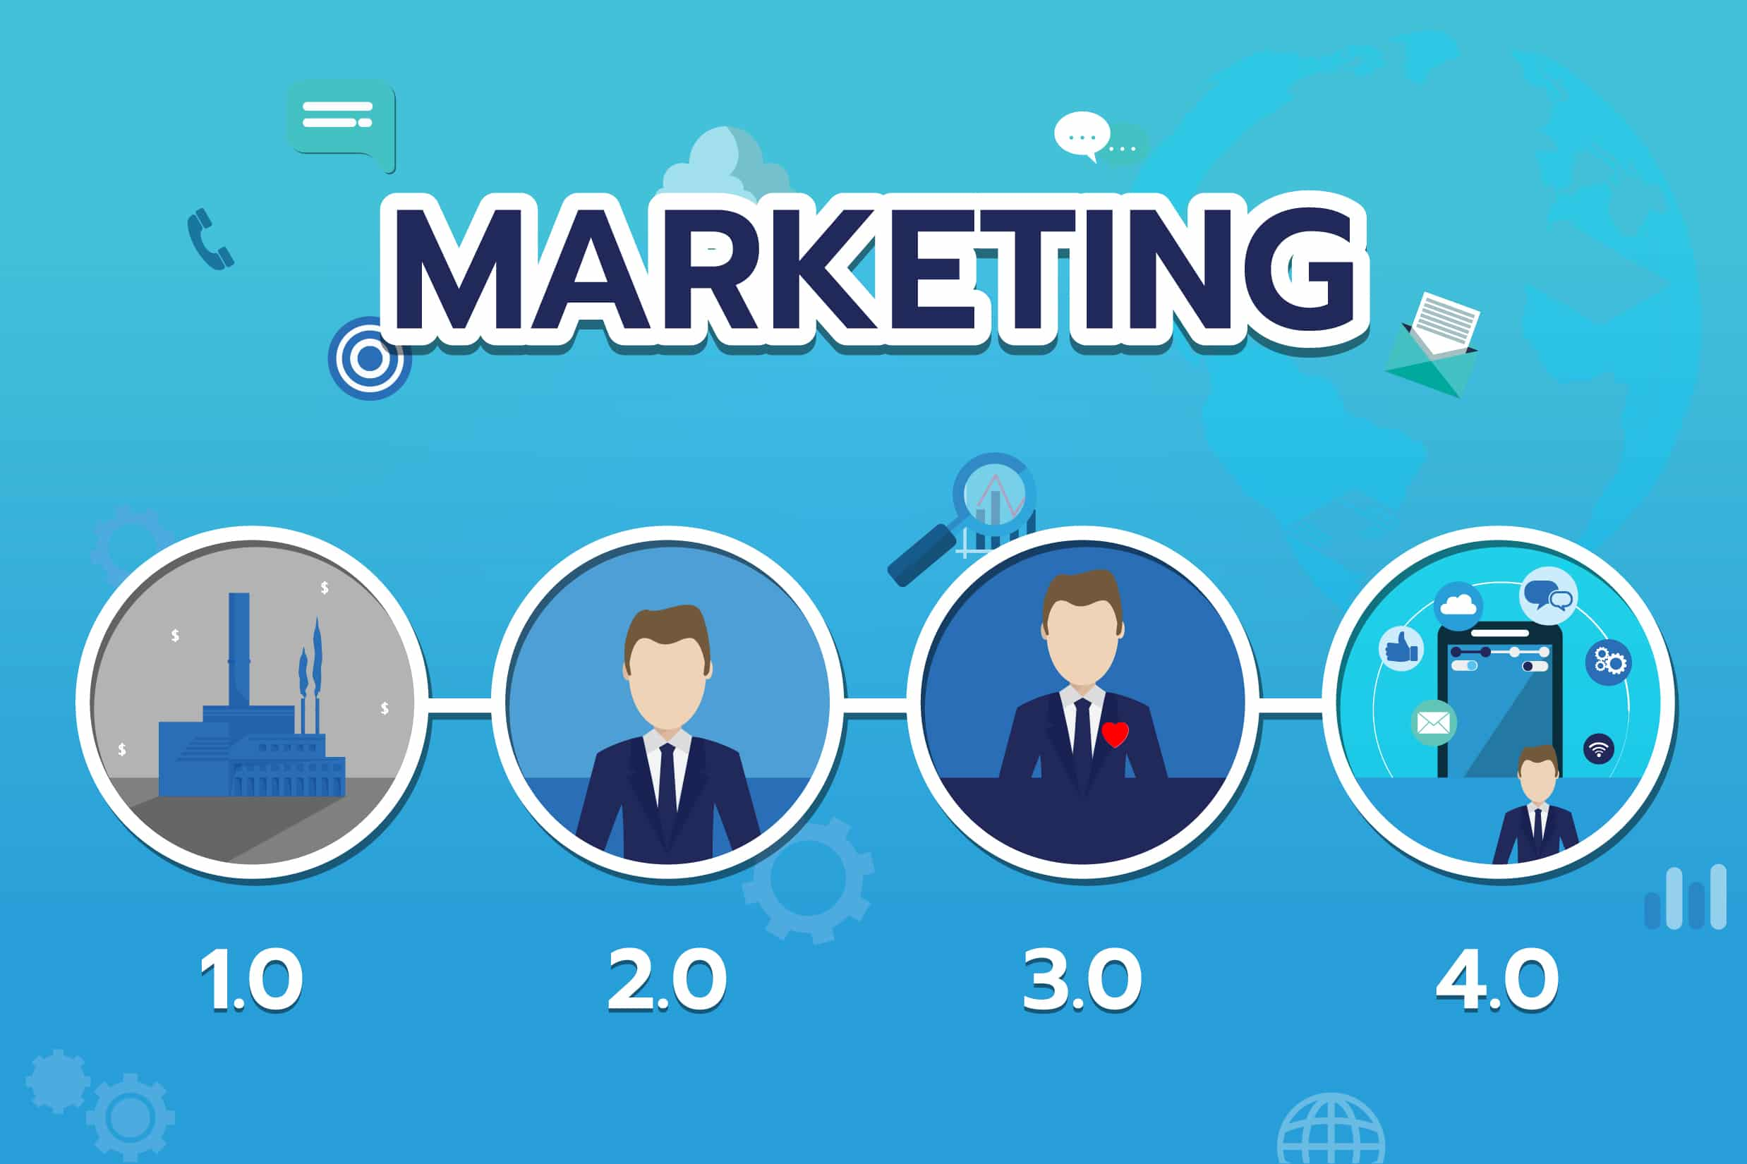

Slide 3
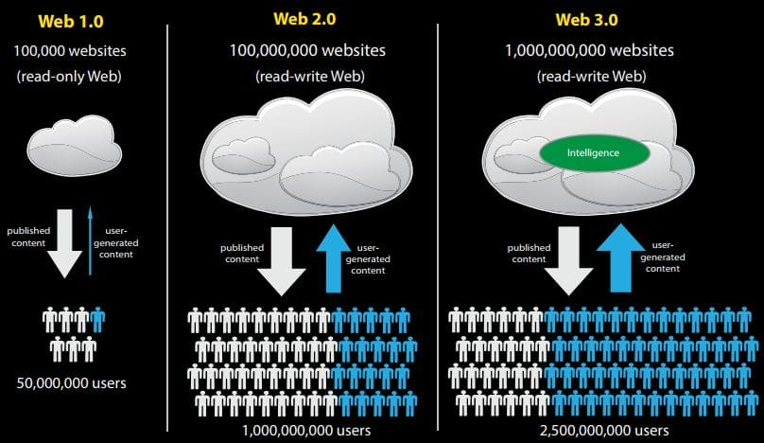

Slide 4
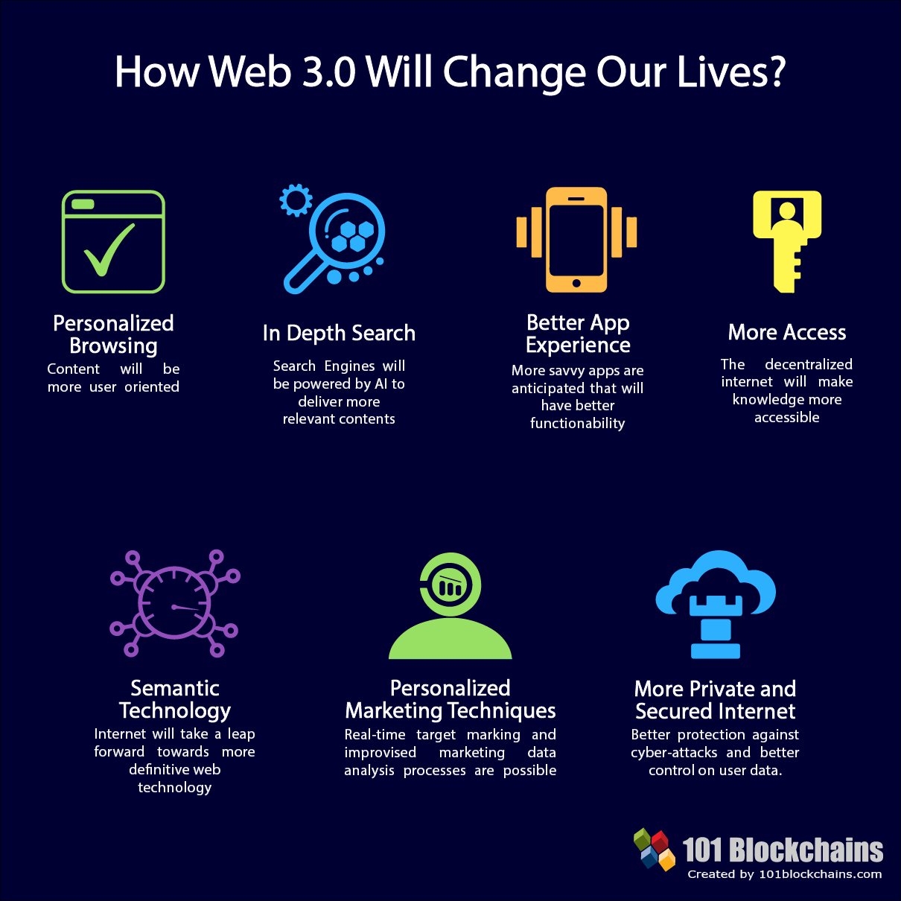

Slide 5


Slide 6
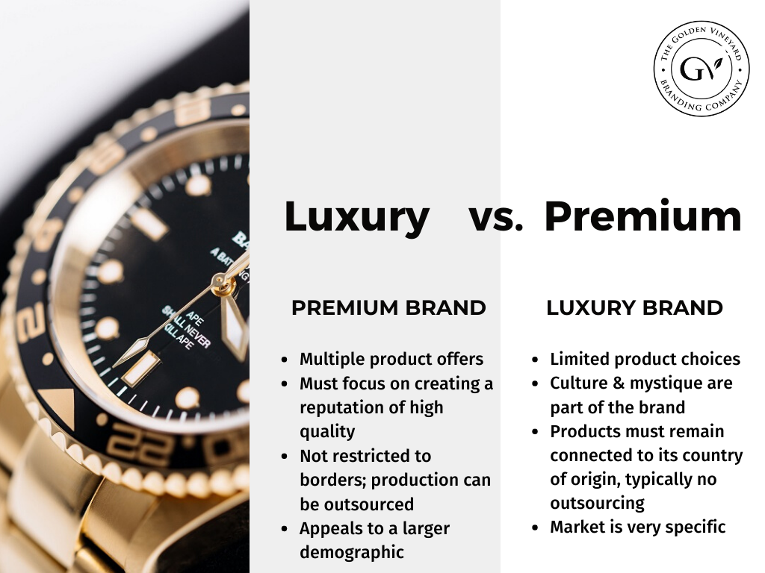

Slide 7
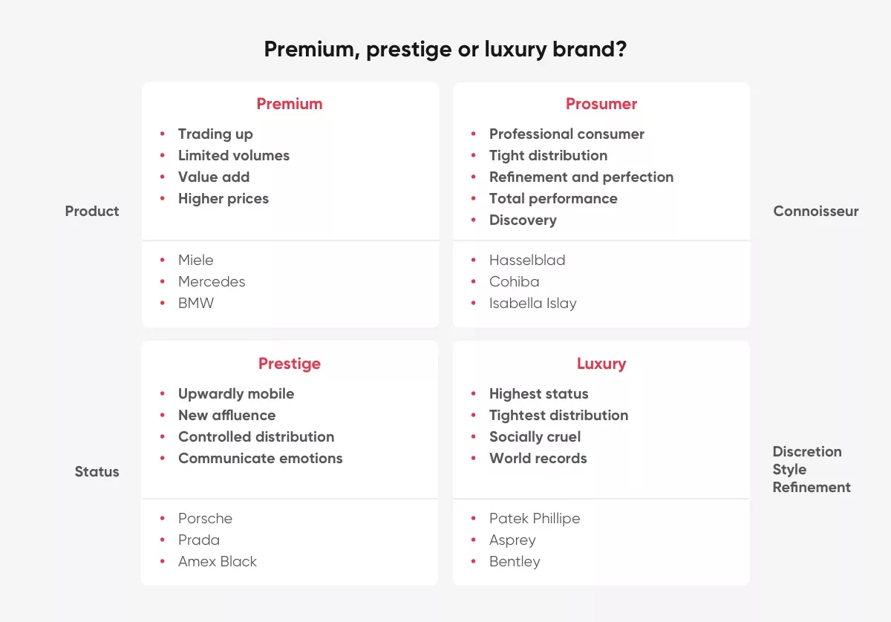

Slide 8
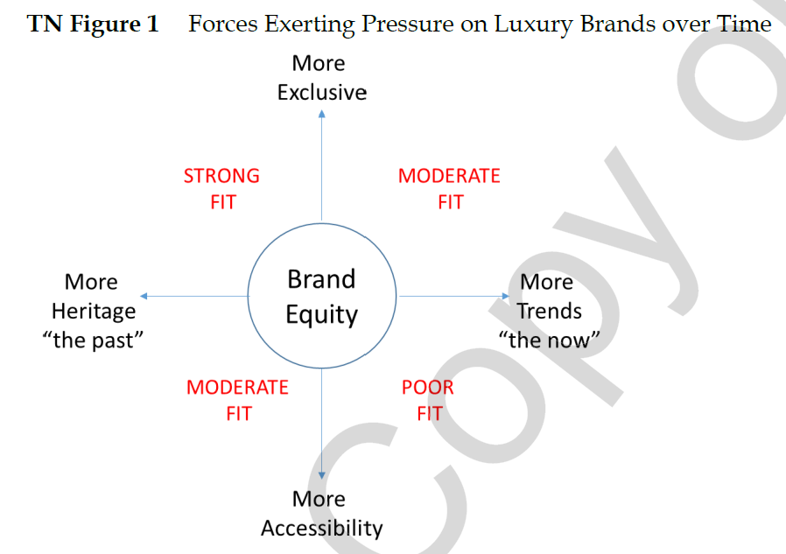

Slide 9
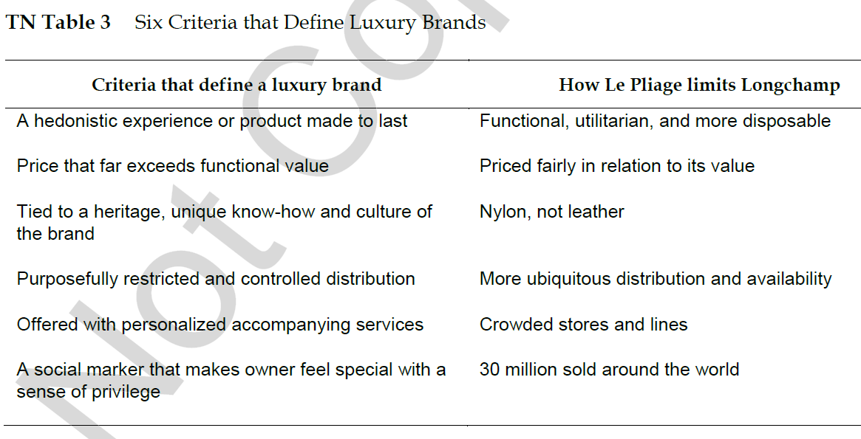

Slide 10
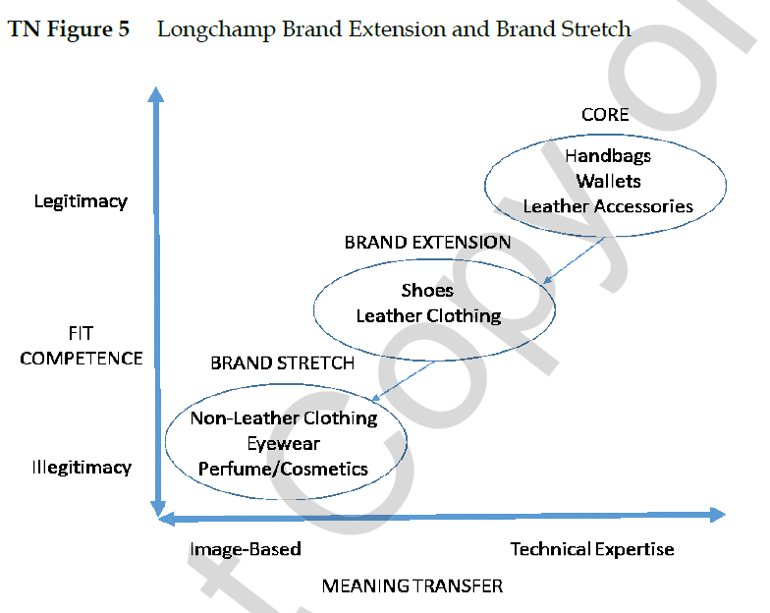

Slide 11
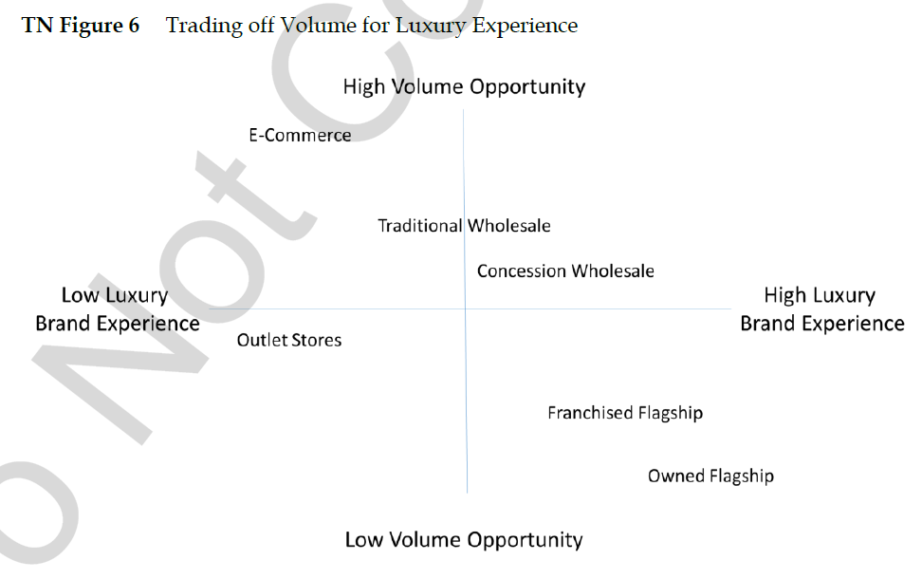

Slide 12
Do All Industry Have Similar Strategy Setup?

Slide 13
Should a single-use pen manufacturing firm with a margin of 2% invest in expansive CRM software?

Slide 14
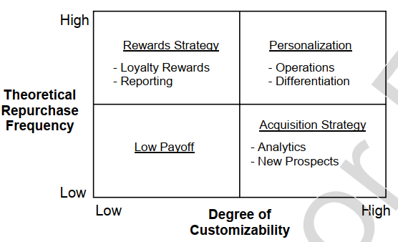

Slide 15
Blue Stationary Pens
Budget Homes / Apartments
Customized Stationary Pens
Premium Apartments
Green / Red Stationary Pens
Pradhan Mantri Awas Yojana
Customized Limited-edition Pens
Luxury Villas

Slide 20
Phases
Need recognition
Discovery
Consideration
Action
Advocacy
Customer thoughts & feelings
Customer actions
Touchpoints and platforms
Role of commn.
KPIs

Slide 21







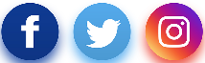

Phases
Need recognition
Discovery
Consideration
Action
Advocacy
If I subscribe, I am not bound by anything. I can let it go anytime?
Second hand cars is a risk. God knows in what condition the car is. But I can save money.
If I have to buy a new car, the down payment is going to take a toll on me. Then the EMIs.
Subscription? How can I subscribe to a car. Complicated.
I will give subscription a shot. Let me see how it goes.
I have friends who think buying a car is the only option.
Having a car is convenient for long drives and weekend trips
But an owned car says a lot about the person.
I may save money through sharing. But is it safe?
Subscription is a new cool thing. Why own a car?
Customer thoughts & feelings
I can even look at pre-owned cars. My friend bought one.
Subscription looks expensive
How do I share if I want to?
I need a car in this city.
My wife can also use it
Check out specs like mileage, power
Make a booking on the app
Extending subscription
Refer friends
Online search for the latest models
Driving classes, refresher courses
Online search for subscription, reviews
Visit the XXX website, download the app
Explore the sharing option on the app
Customer actions
Journey
starts
Look at pre-owned car websites
EMI calculation online, talk to the bank for loan
Read reviews
Visit second hand outlets like True Value
Comparing subscription charges with EMI
Test drive a preferred model
Touchpoints and platforms
Online test drive booking, car dealer outlets
Blogs on subscription, influencers on social
Referral
Customer care
Customer care
Role of commn.
Build emotional brand associations
Make XXX an option that’s more rewarding than ownership
Support and guidance
Promote referrals
KPIs
Brand awareness, search volume, website visits, fun and progressive brand imagery
Search volume, website visits, app download, conversion rate
Net Promoter Scores,
positive sentiment online
Number of referrals, conversion rate

Slide 22
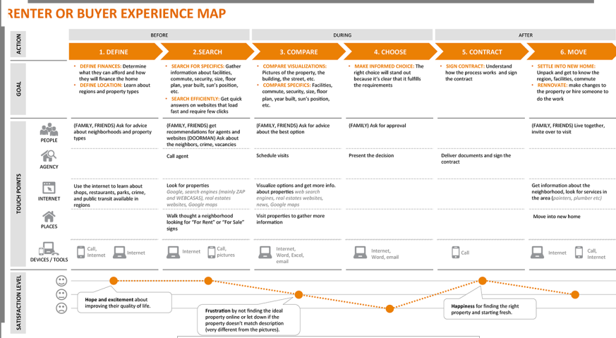

Slide 23
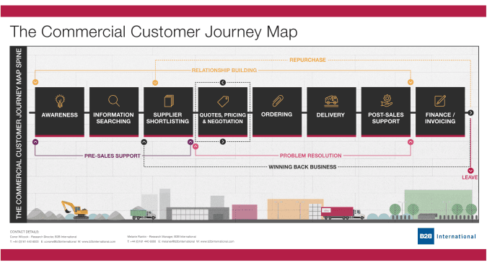

Slide 24
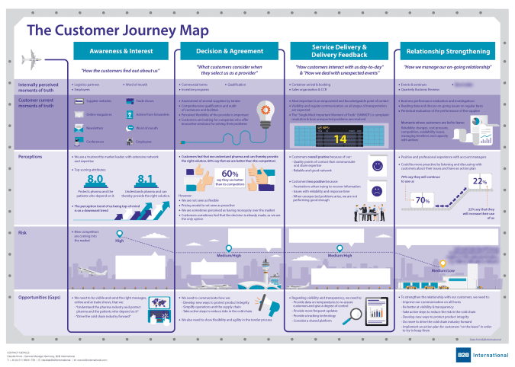

Slide 25
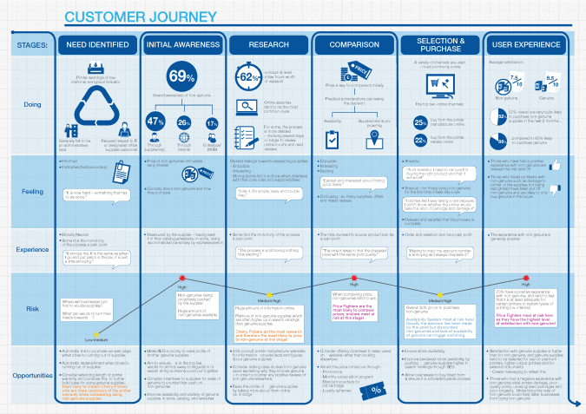

Slide 26
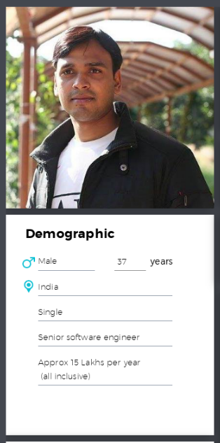
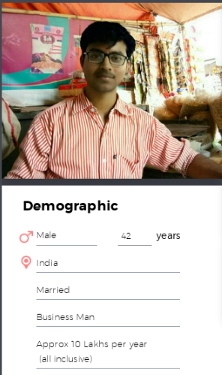
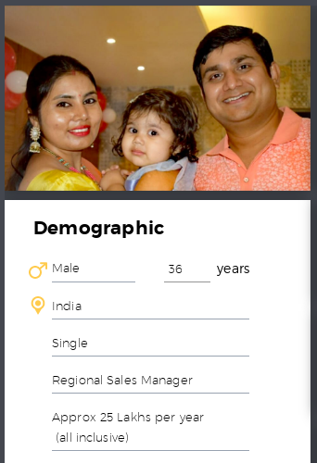

Ritesh Tiwari
Anand Keshri
Ajay Mishra

Slide 27
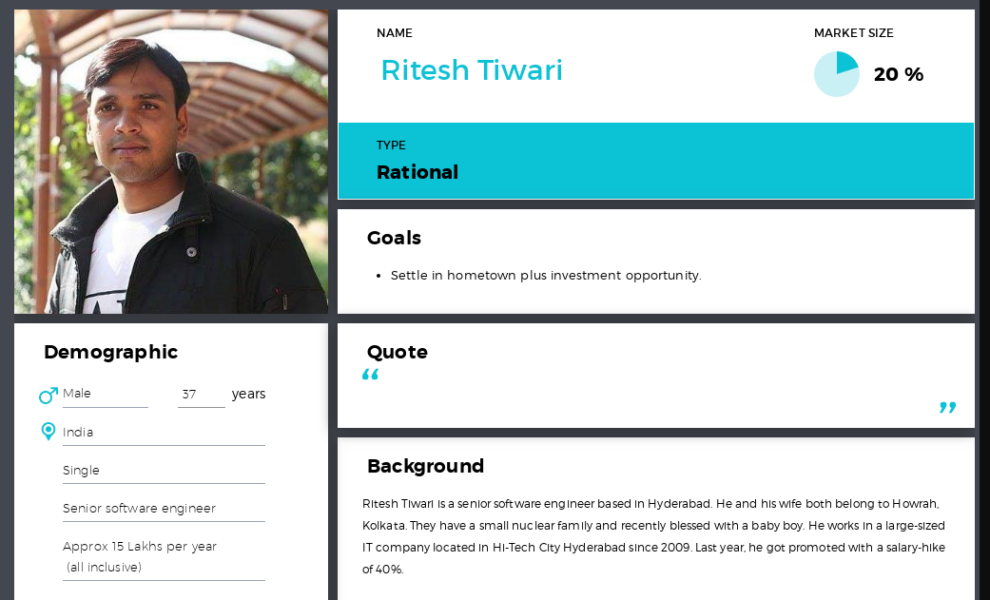
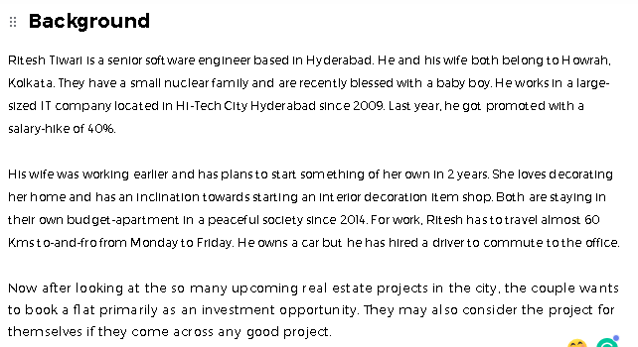

Slide 28
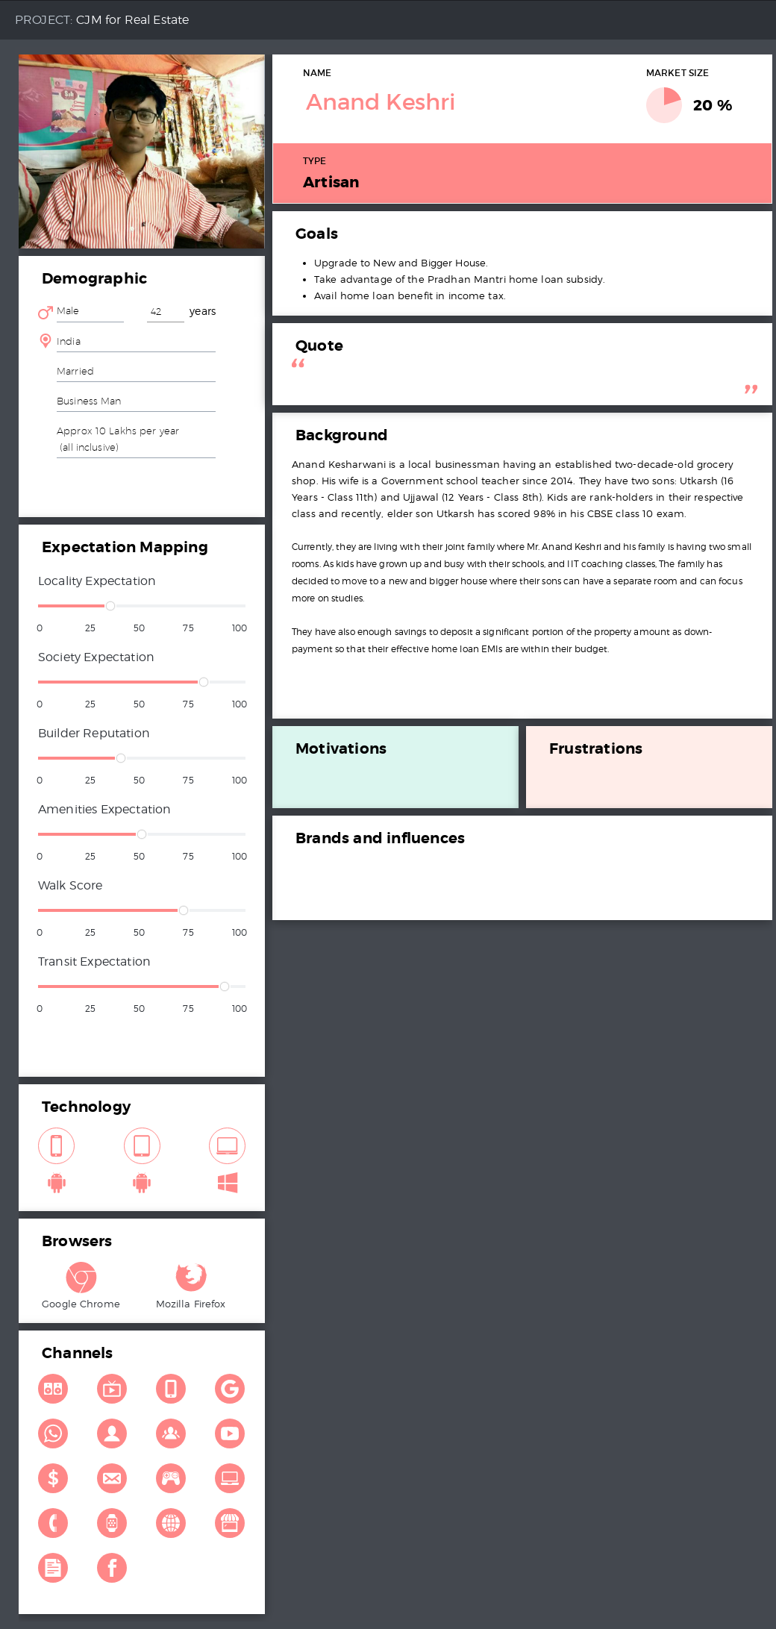

Slide 29
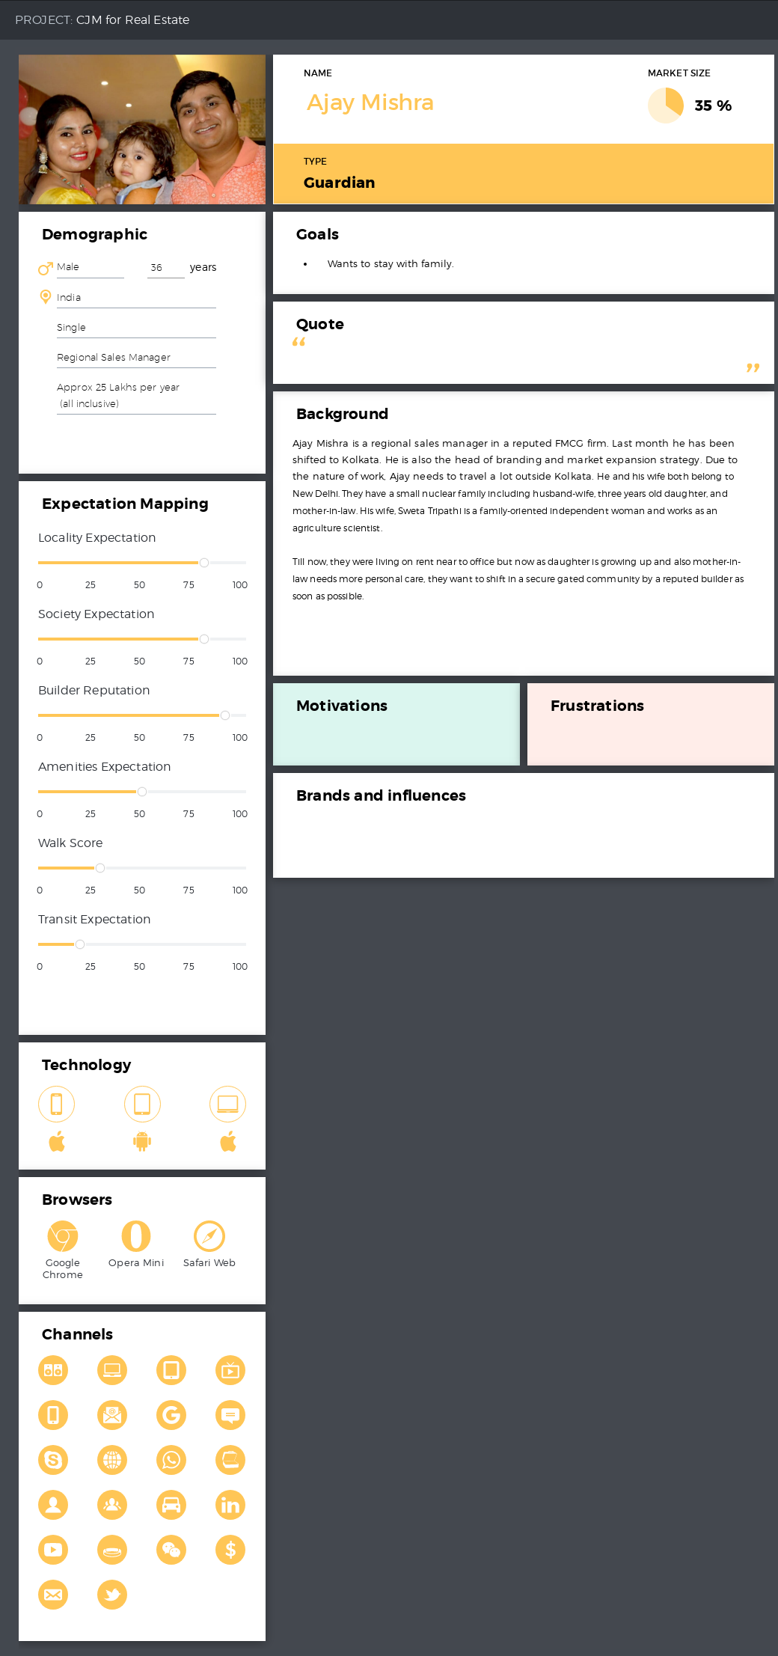

Slide 31
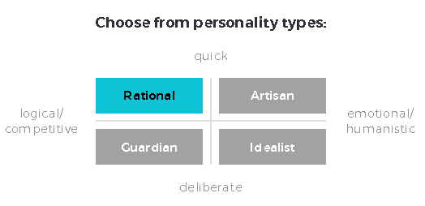

Slide 33
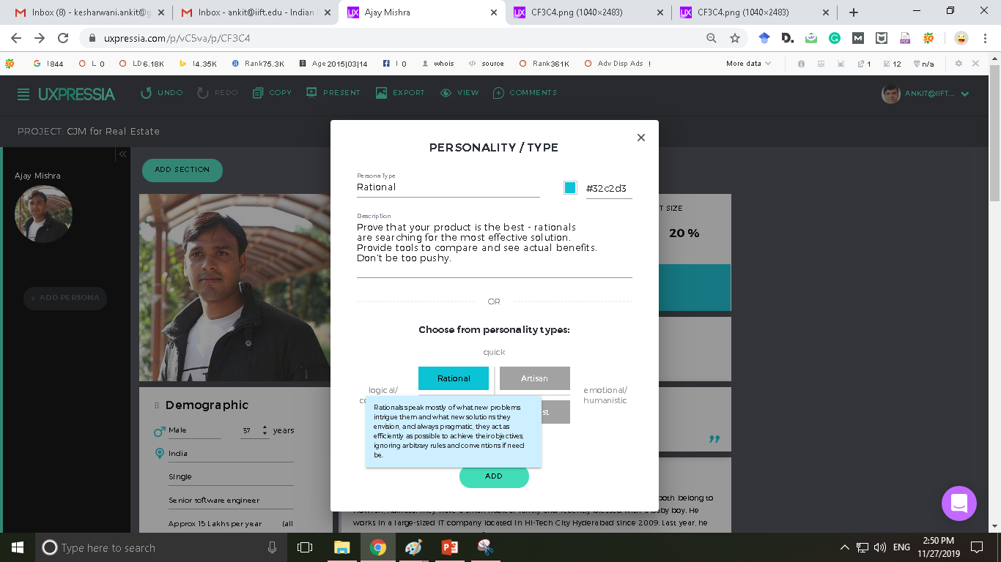
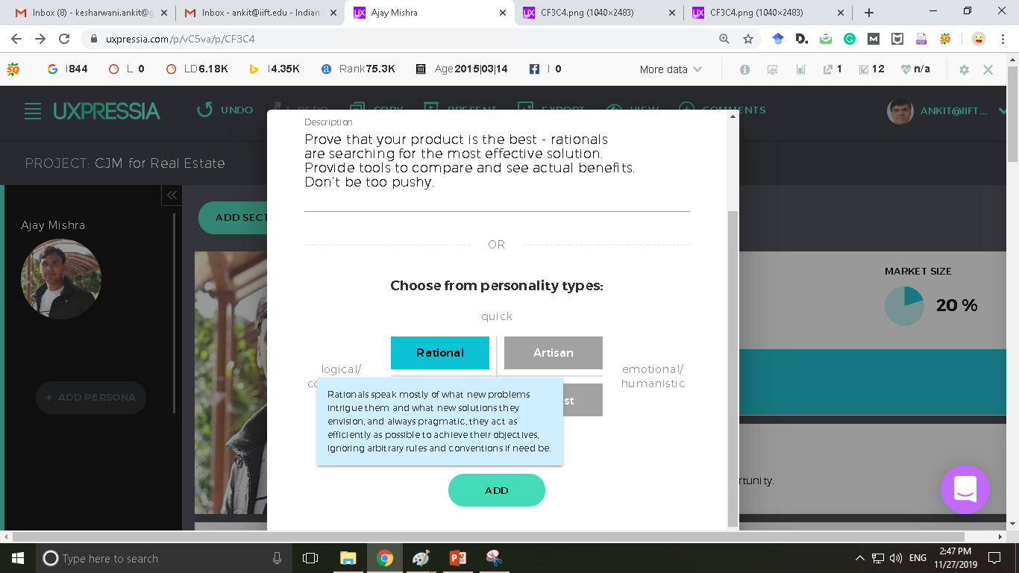

Slide 34
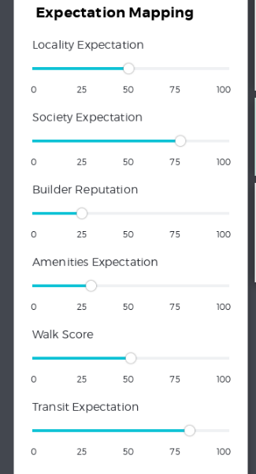
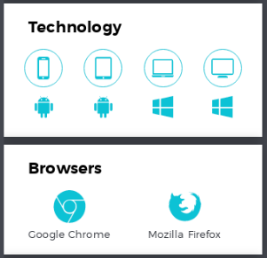

Slide 35
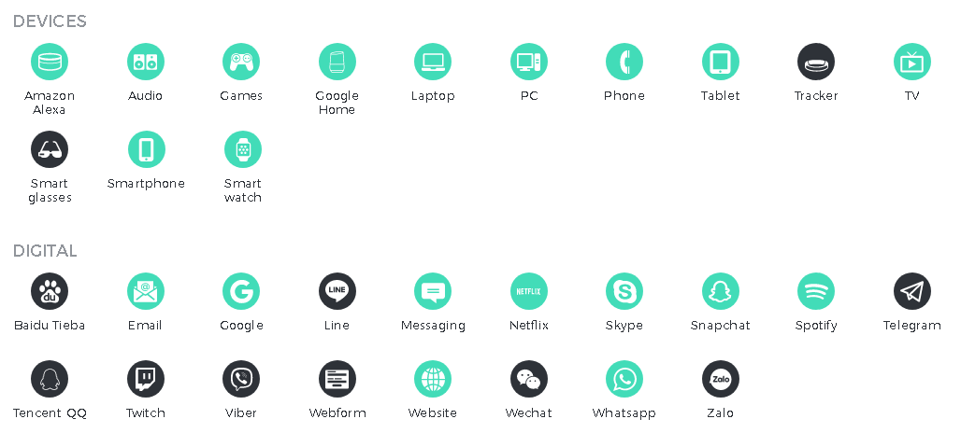
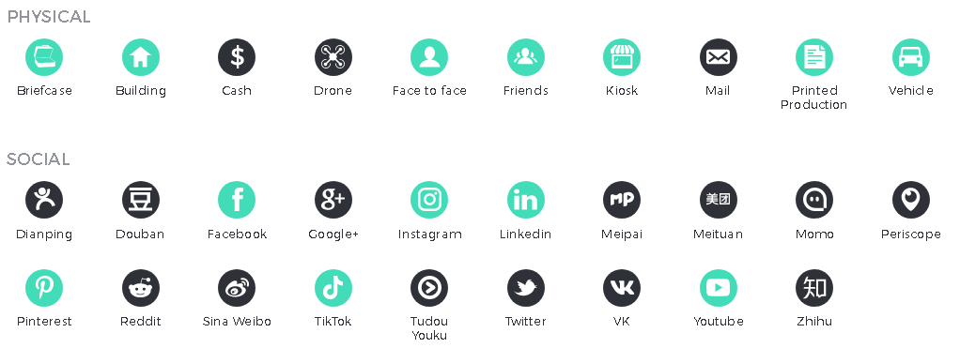

Slide 37
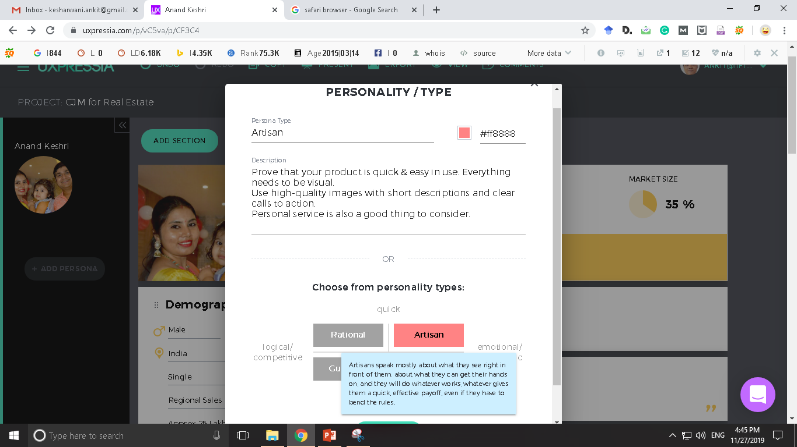

Slide 38
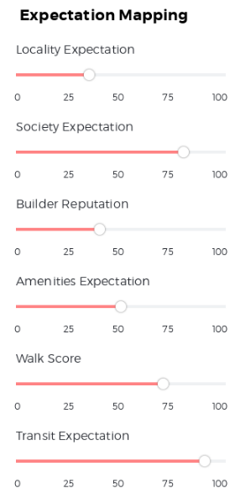
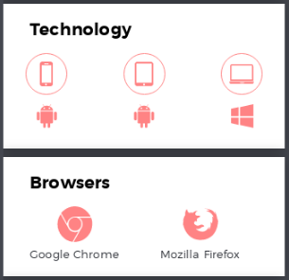

Slide 39
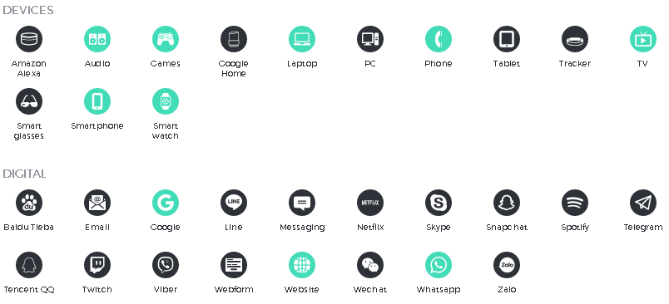
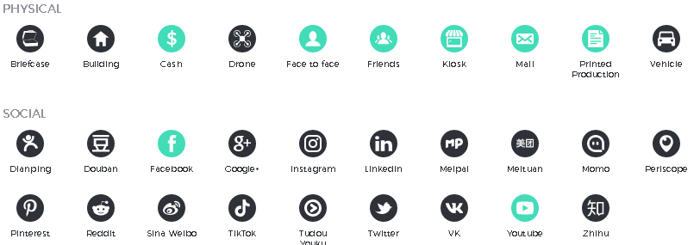

Slide 41
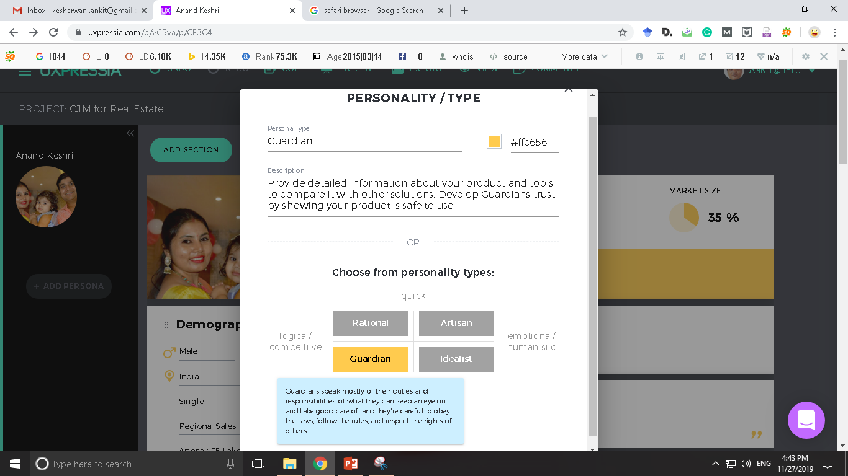

Slide 42
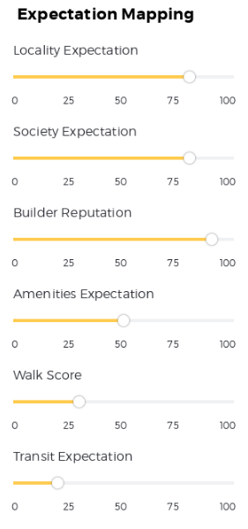
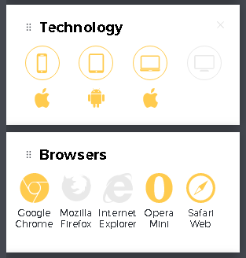

Slide 43
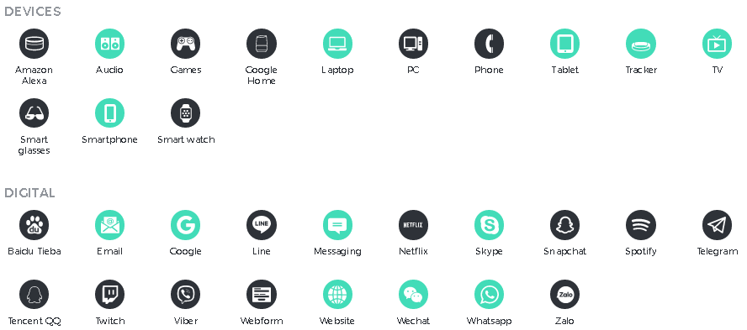
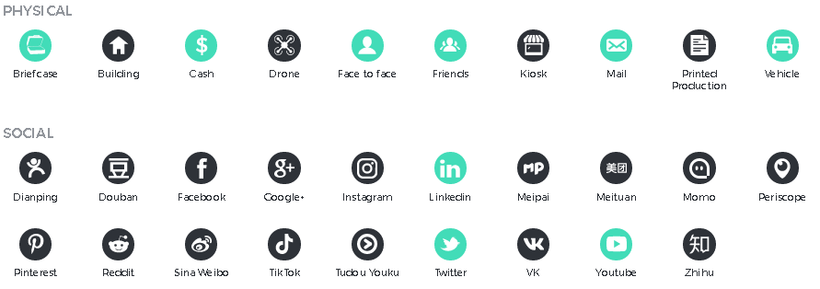

Slide 44


Slide 45
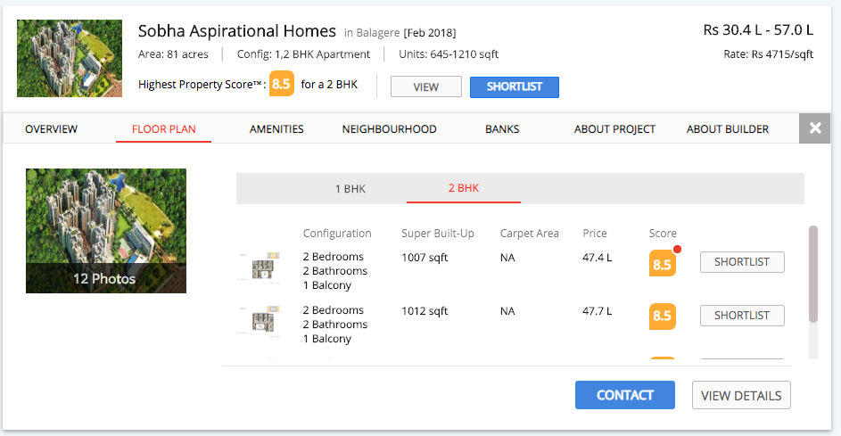

Slide 46
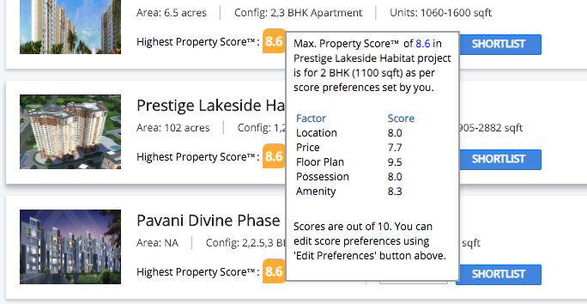

Slide 47
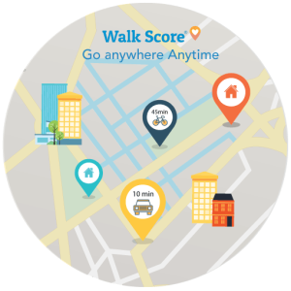
https://www.usabilitydynamics.com/product/wp-property-walkscore

Slide 48
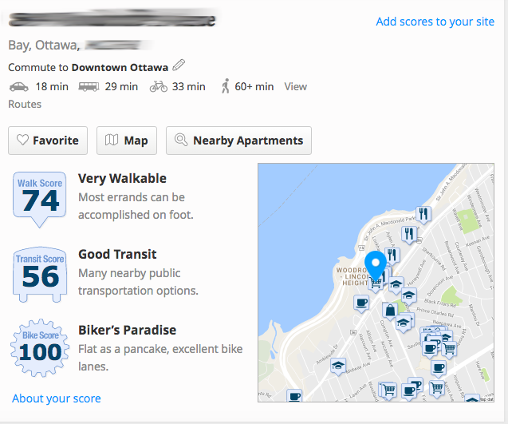

Slide 49
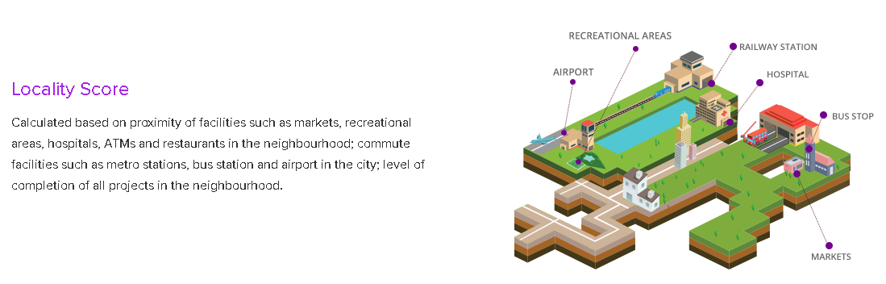
https://www.proptiger.com/buzz/livability-score

Slide 50
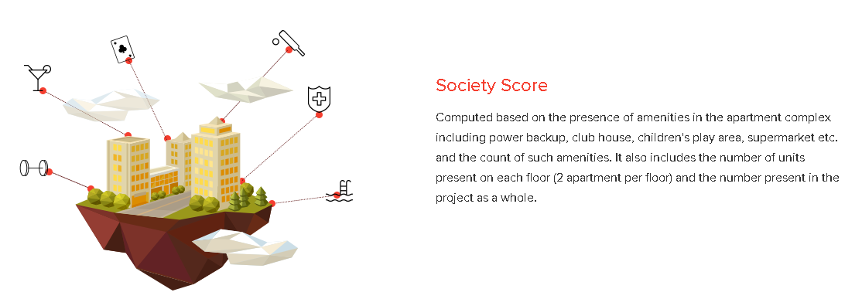
https://www.proptiger.com/buzz/livability-score

Slide 51
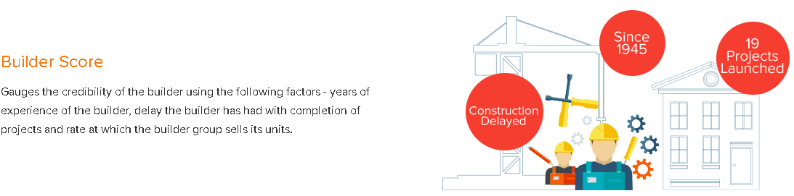
https://www.proptiger.com/buzz/livability-score

Slide 52

https://www.proptiger.com/buzz/livability-score

Slide 53
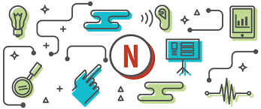

Slide 54
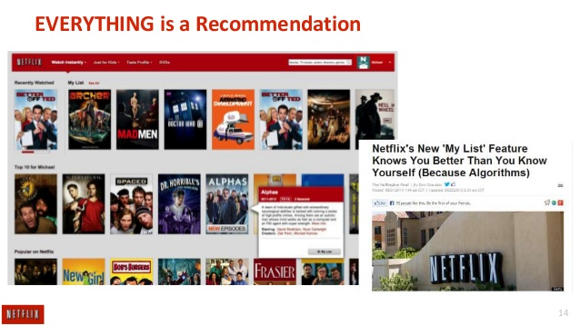

Slide 55
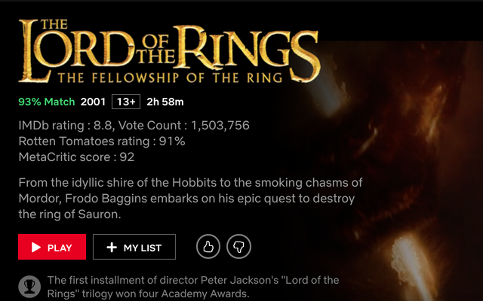

Slide 56
Lessons from Netflix
Just like “NETFLIX RECOMMENDATION ALGORITHM”, serve customized results based on “LIFESTYLE MATCH SCORE”.
This score should reflect the potential property types that potential buyer is ACTUALLY looking for.
Even the IMAGES being served along with the search result should be guided by the ALGORITHM which matches with the buyer’s decision-making criteria.

Slide 57
Ajay Mishra
Anand Keshri
Ritesh Tiwari

Slide 58
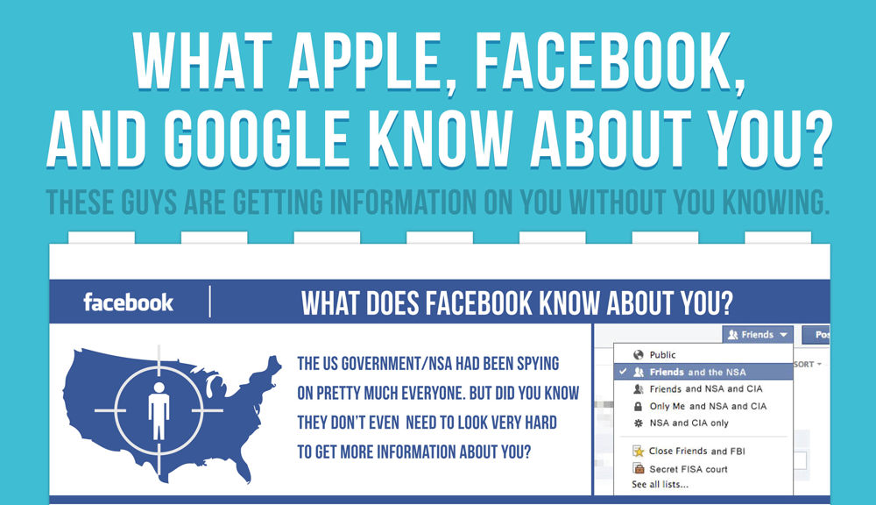

Slide 59
Are you ready? Here is all the data Facebook and Google have on you
https://www.theguardian.com/commentisfree/2018/mar/28/all-the-data-facebook-google-has-on-you-privacy
https://tinyurl.com/GoogleMyActivities

Slide 60


Slide 61


Slide 62


Slide 63




Slide 64


Slide 65


Slide 66


Slide 67


Slide 68


Slide 69


Slide 70


Slide 71


Slide 72


Slide 73



Slide 74


Slide 75


Slide 76
“…marketing that engages the consumers’ senses and affect their perception, judgement, and behavior.”
- Dr Aradhna Krishna (2010)
Ross School of Business, University of Michigan
Krishna, A. (2010). Sensory marketing: Research on the sensuality of products.
New York: Routledge.

Slide 77



Slide 78


Slide 79


Slide 80




Slide 81


Slide 82


Slide 83


Slide 84


Slide 85

Multi-Sensory Evaluation

Slide 86


Slide 87


Slide 88


Slide 89
Draw Multi-Sensory Evaluation Charts for the followings:
Landline Vs. QWERTY Phone vs Smart Phone
Online classes vs offline classes
Novel vs. Kindle book vs Audible
Movie Watching: OTT vs Multiplex vs VR

Slide 90
Touch / Haptics
Touch is the first senses to be developed in the “womb” itself.
Scientist says – Touch increases the Oxytocin level - higher oxytocin levels have also shown to lead to greater generosity / bonding towards strangers.
“The only way to make sure a product is worth buying is to actually touch it”
Need For Touch (NFT) scale (Peck and Childers, 2003).
Evolution of “”Webrooming” and “Showrooming”.
Humans touching the products e.g. Samples / Trial piece.
Law of Contagion / Law of Sympathetic Magic

Slide 91
Smell / Olfactory
The physiological connection between smell and memory.
Nobel prize - 2004 - Buck and Axel - Identified scent receptors in humans for the first time, and importantly, showed that humans have a family of some 1,000 different genes that encode distinct scent receptors (as a comparison, vision has merely four distinct receptors).
Memories triggered by scent retrieval cues were rated as more emotional than those evoked by the other types of cues.
Ambient scent increased recall and recognition of brands seen.
Dual decoding theory of memory retrieval (e.g. scent may help cut through the information clutter).

Slide 92
Hear / Audition
“Music is perpetual, and only the hearing is intermittent.”
Role of jingles in brand recall.
Instrumental music relaxes the brain and enjoy the moment.
Local language vs Foreign language / English
Role of music in advertising

Slide 93
Taste / Consumption
““…if we let something linger in our mouth, feel its texture, smell its bouquet, roll it around on the tongue, then chew it slowly so that we can hear its echoes, what we're really doing is savoring it, using several senses in a gustatory free-for-all…”.
Sweet shops
Guiltless gluttony
Milk chocolate / Soya Chocolates
Cadbury’s – “Kuch Meeta ho Jaye” campaign.
Food ingredient contents – health consciousness
E-Cigarttes

Slide 94
See / Vision
“Beauty lies in the eyes of the beholder”
First consumption happen through “eyes” only.
Apparel industry
Packaging attractiveness
Advertising effectiveness – Behind the scene of ads creation
Product aesthetics often commands brand equity.

Slide 95


Slide 96


Slide 97


