Slide 2
STP

Slide 3
What we will do today
What are the different levels of market segmentation?
How a company actually segments a market?
What are the requirements for effective segmentation?
What is Targeting?
What is Positioning?

Slide 4
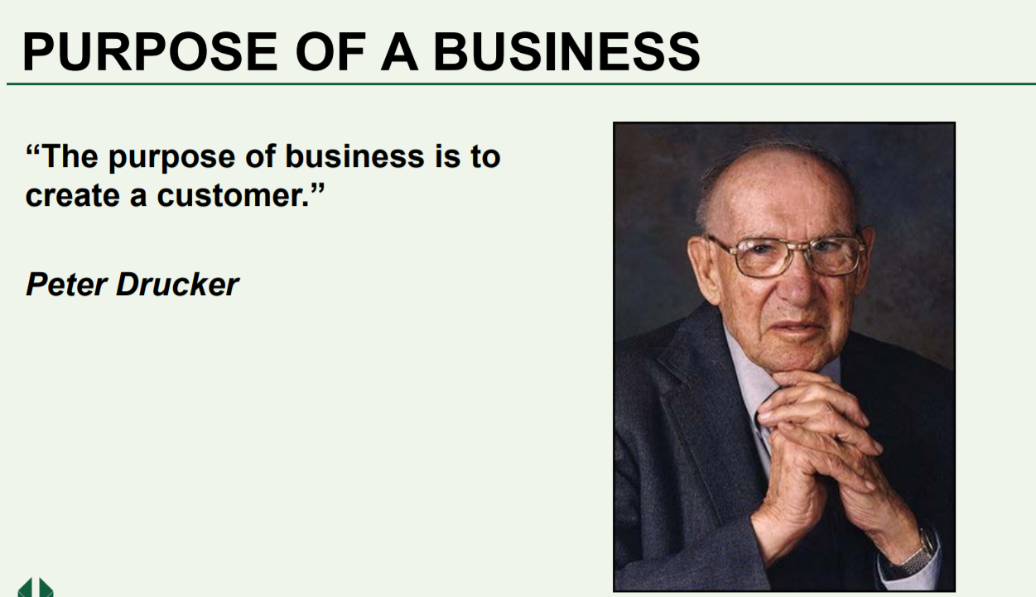

Slide 5
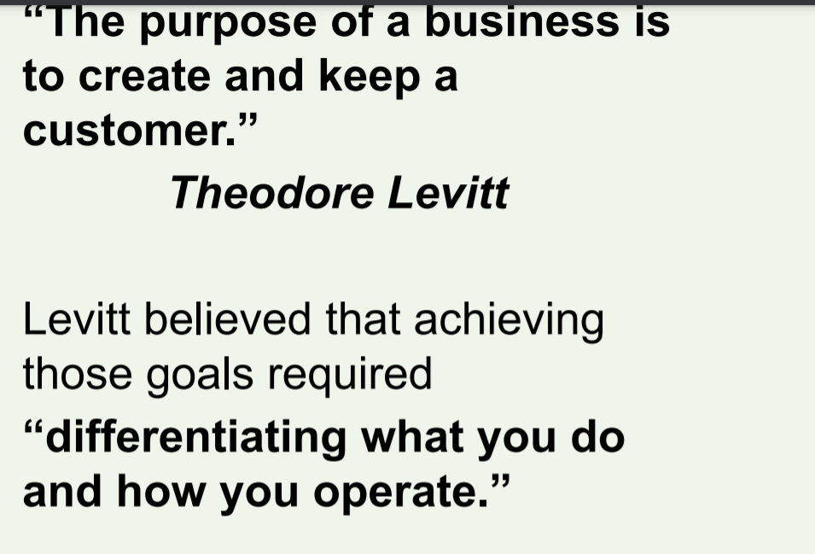

Slide 6
Marketing Myopia (Short sightedness)
Kodak lost much of its share to Sony cameras when digital cameras boomed and Kodak didn’t plan for it.
Nokia losing its marketing share to android and IOS.
Yahoo (worth $100 billion dollars in 2000) lost to Google and was bought by Verizon at approx. $5 billion (2016).

Slide 7
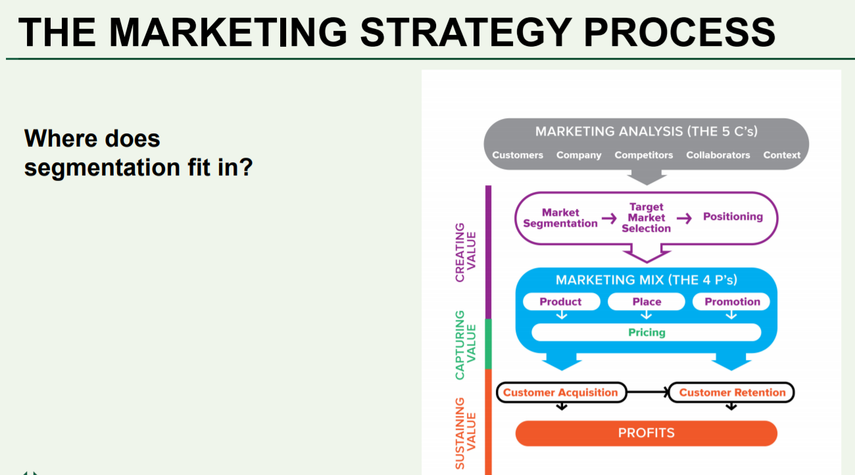

Slide 8
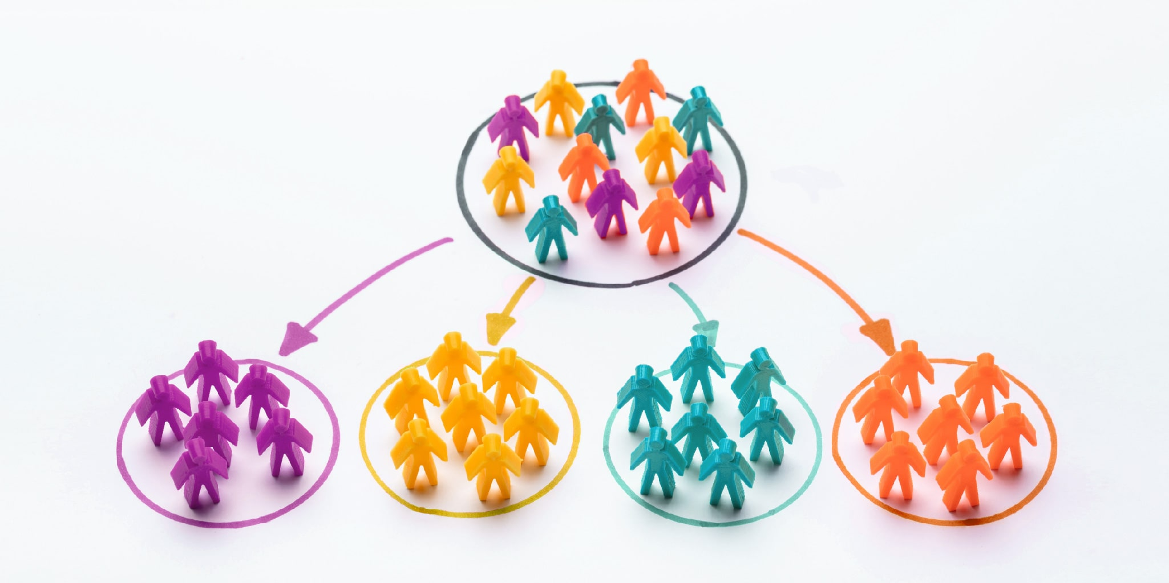
Segmentation ( divide larger markets into groups with similar demands and respond similarly to marketing stimuli)

Slide 9
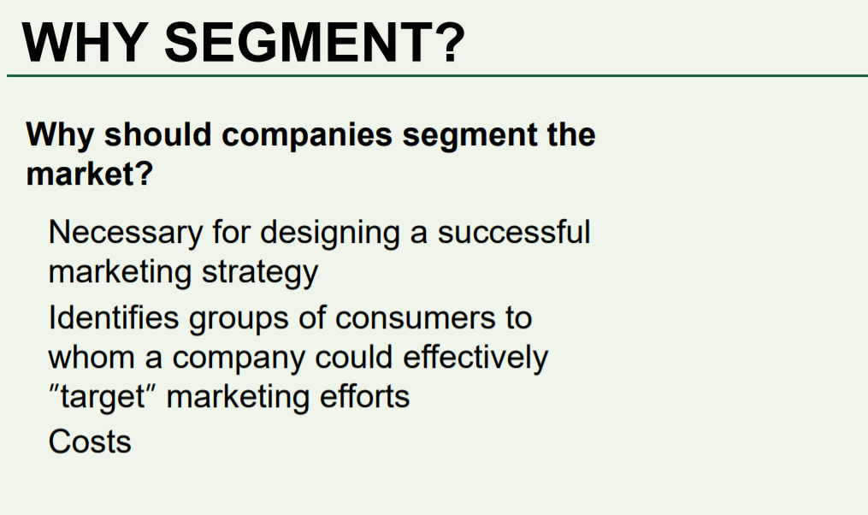

Slide 10
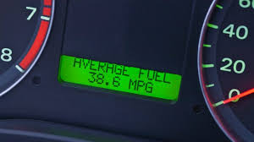
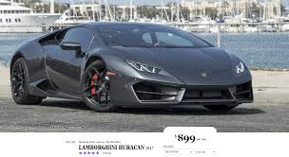
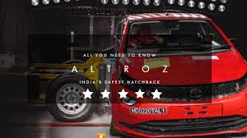
Segmentation Process
Understand the benefits consumers seek (i.e. Need) – What matters to you while buying an automobile?

Slide 11
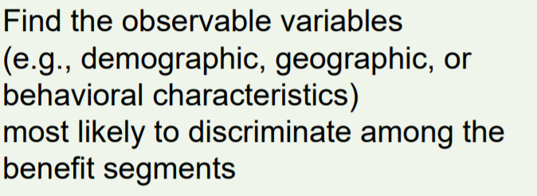
Segmentation Process

Slide 12
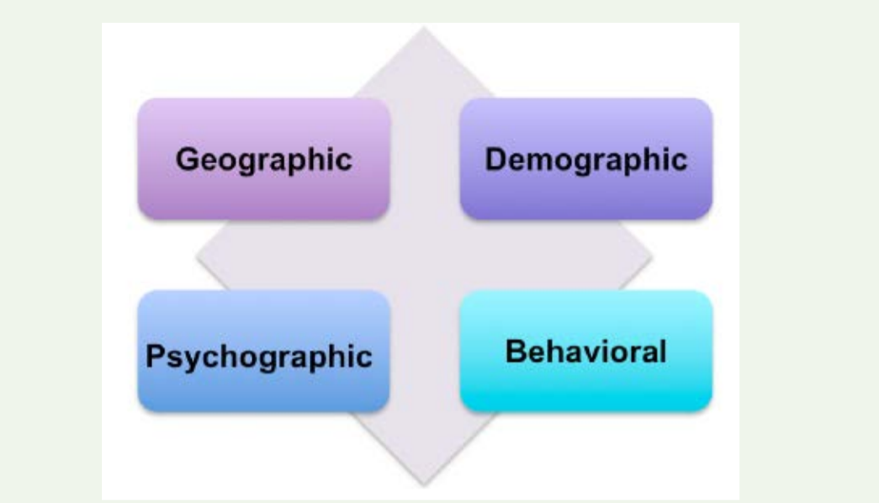

Slide 13
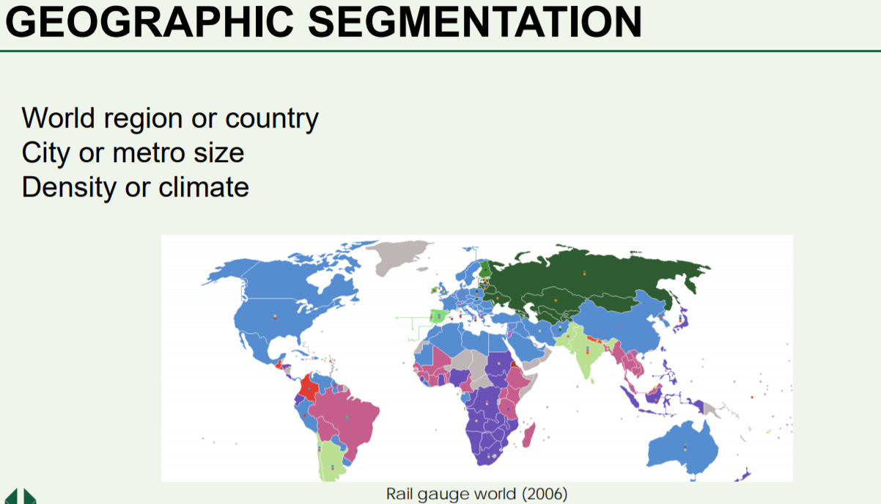

Slide 14
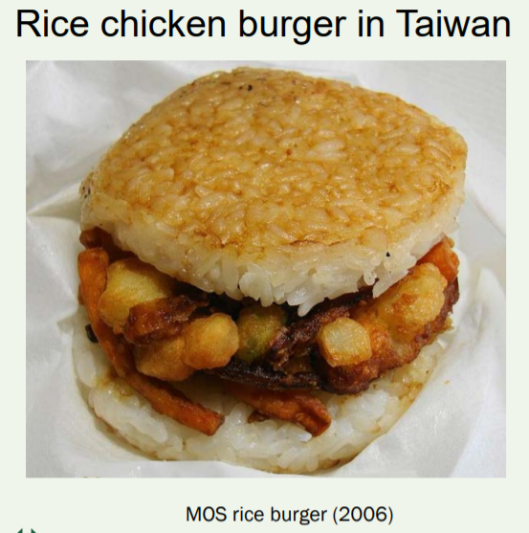
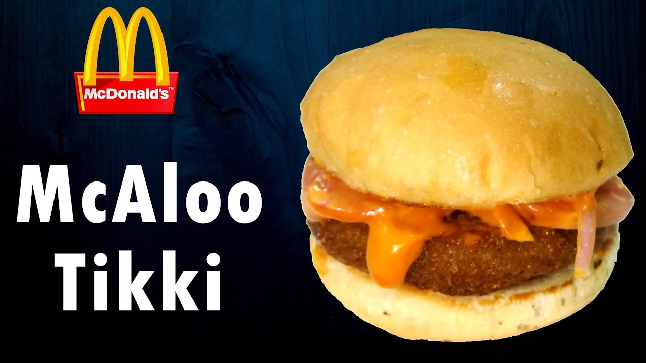
McDonald Geographic Segmentation

Slide 15
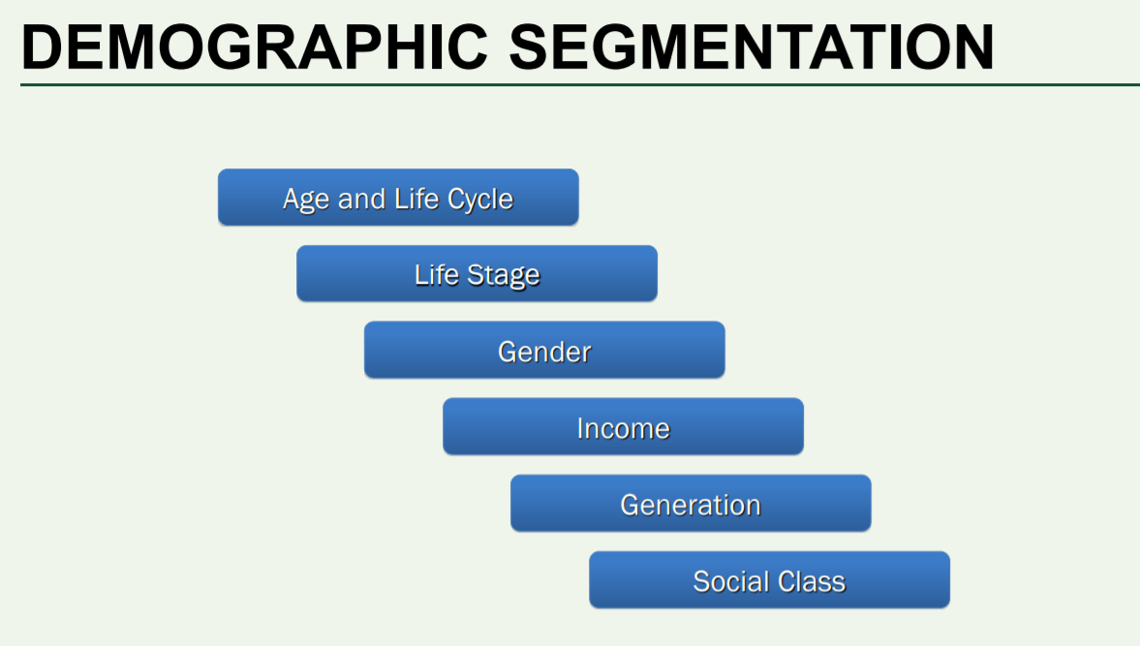

Slide 16
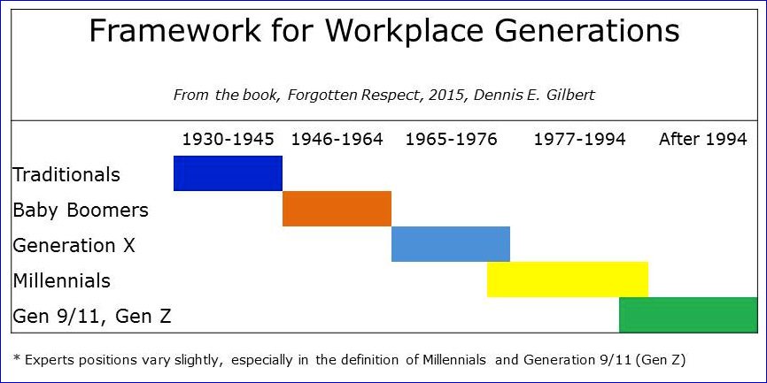


Age, Generation and Life Cycle

Slide 17
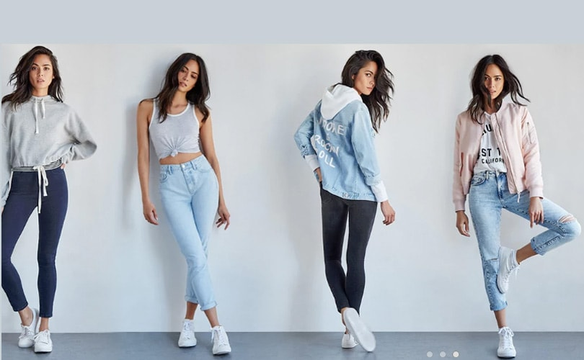
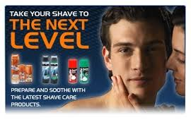
Gender

Slide 18
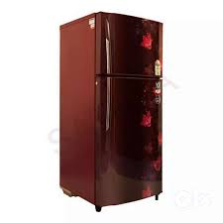
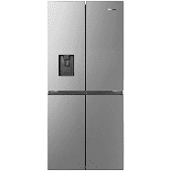
Social Class
Social class segmentation identifies individuals based on a combination of socioeconomic such as education, occupation, income, and family background related to these factors.
https://www.youtube.com/watch?v=xNzXze5Yza8
https://www.youtube.com/watch?v=sMRq0JOQZ4g

Slide 19
Psychographic Segmentation
Why consumers behave the way they do, what is of high priority to them, or how they rank the importance of specific buying criteria?
Personality
Social Status
Life Style
Values
VALS

Slide 20

Personality
Market researchers can conduct a segmentation based on personality to form a group of people with similar personality traits. New products/services can be launched to cater to various personalities and new features also can be developed for the analyzed personalities. A few defined personalities are: creative, emotional, friendly, opinionated, introvert, extrovert, saviors etc. help organizations to filter their customers in a systematic manner.

Slide 21
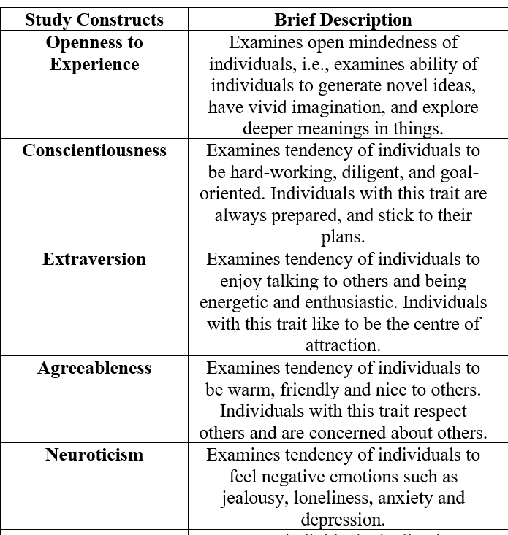
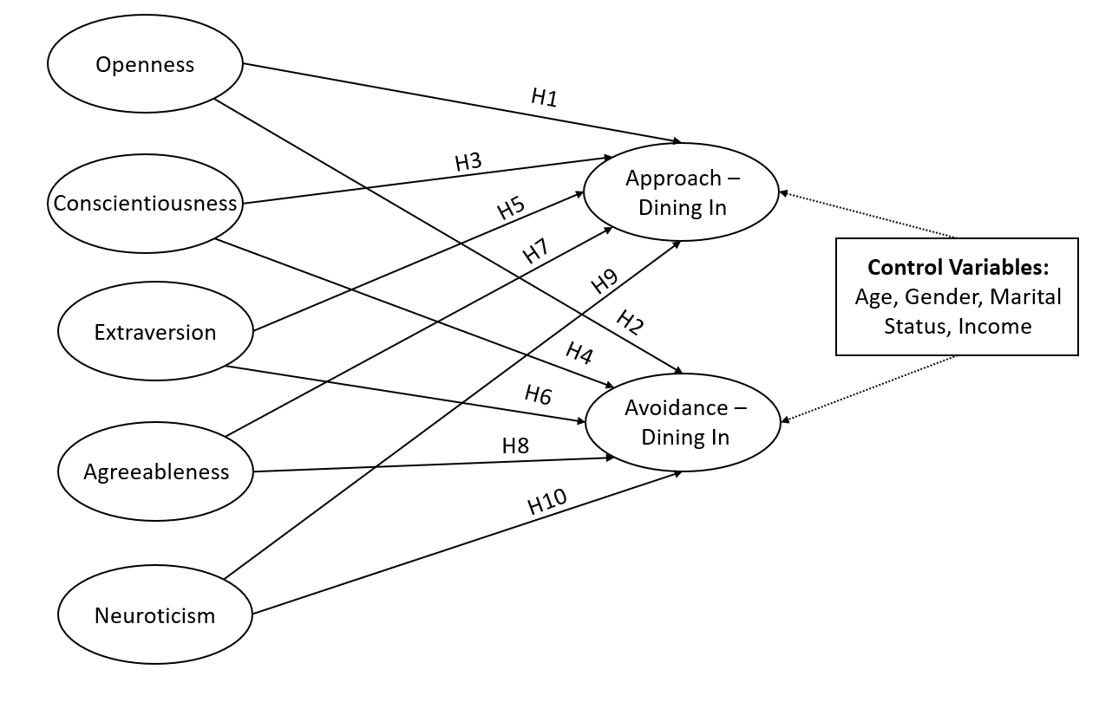

Slide 22
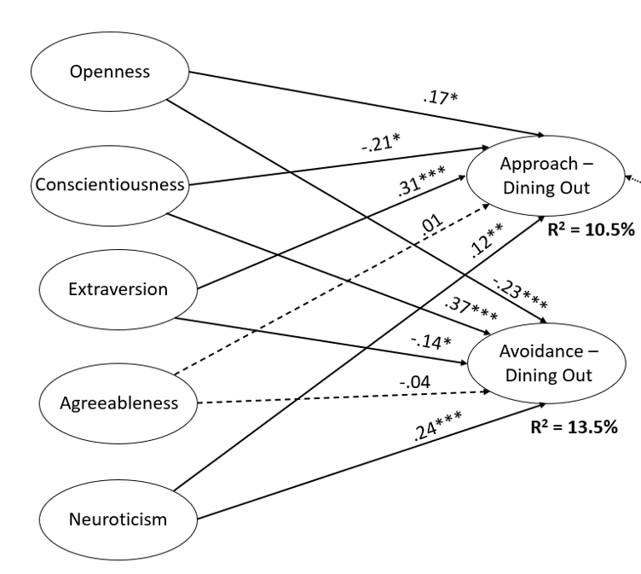

Slide 23
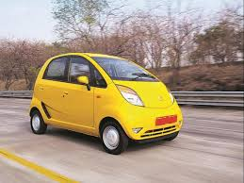
Social Status
Social status segmentation is not only about income level, social background but also about where the customers are currently in life. For example, are your customer high schoolers, university students, married, or single? This can be the current customers’ social status or social status they aiming to be.

Slide 24
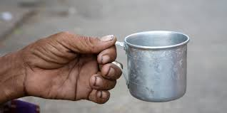
Lifestyle
Lifestyle refers to the customers’ lifestyle patterns. How do they start and end their day? What do they do on the weekend and how do they spend their free time. With a good understanding of consumer lifestyle and habits, marketers can curate marketing messages that speak at the right time.

Slide 25
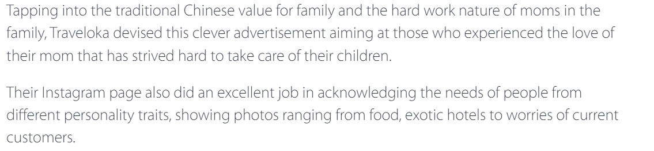
Value-Example
https://www.youtube.com/watch?time_continue=138&v=-DfbuNrlRM8&feature=emb_logo

Slide 26
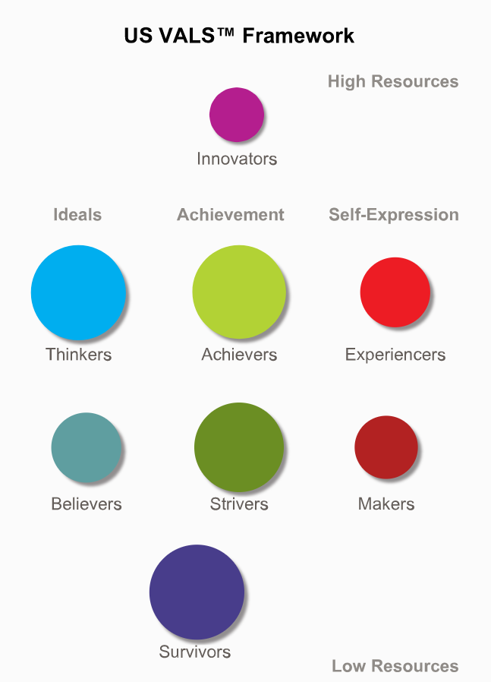
Values, Attitudes and Lifestyle (VALS)

Slide 27
http://www.strategicbusinessinsights.com/vals/presurvey.shtml

Slide 28
Motivations (Ideals, Achievement, Self-expression)
Consumers who are primarily motivated by ideals are guided by knowledge and principles.
Consumers who are primarily motivated by achievement look for products and services that demonstrate success to their peers.
Consumers who are primarily motivated by self-expression desire social or physical activity, variety, and risk.

Slide 29
Resources
A person's tendency to consume goods and services extends beyond age, income, and education. Energy, self-confidence, intellectualism, novelty seeking, innovativeness, impulsiveness, leadership, and vanity play a critical role. These psychological traits in conjunction with key demographics determine an individual's resources.

Slide 30
Innovators
Innovators are successful, sophisticated, take-charge people with high self-esteem. Because they have such abundant resources, they exhibit all three primary motivations in varying degrees. They are change leaders and are the most receptive to new ideas and technologies. Innovators are very active consumers, and their purchases reflect cultivated tastes for upscale, niche products and services. Image is important to Innovators, not as evidence of status or power but as an expression of their taste, independence, and personality. Innovators are among the established and emerging leaders in business and government, yet they continue to seek challenges. Their lives are characterized by variety. Their possessions and recreation reflect a cultivated taste for the finer things in life.

Slide 31
Thinkers
Thinkers are motivated by ideals. They are mature, satisfied, comfortable, and reflective people who value order, knowledge, and responsibility. They tend to be well educated and actively seek out information in the decision-making process. They are well informed about world and national events and are alert to opportunities to broaden their knowledge. Thinkers have a moderate respect for the status quo institutions of authority and social decorum but are open to consider new ideas. Although their incomes allow them many choices, Thinkers are conservative, practical consumers; they look for durability, functionality, and value in the products they buy

Slide 32
Achievers
Motivated by the desire for achievement, Achievers have goal-oriented lifestyles and a deep commitment to career and family. Their social lives reflect this focus and are structured around family, their place of worship, and work. Achievers live conventional lives, are politically conservative, and respect authority and the status quo. They value consensus, predictability, and stability over risk, intimacy, and self-discovery. With many wants and needs, Achievers are active in the consumer marketplace. Image is important to Achievers; they favor established, prestige products and services that demonstrate success to their peers. Because of their busy lives, they are often interested in a variety of timesaving devices.

Slide 33
Experiencers
Experiencers are motivated by self-expression. As young, enthusiastic, and impulsive consumers, Experiencers quickly become enthusiastic about new possibilities but are equally quick to cool. They seek variety and excitement, savoring the new, the offbeat, and the risky. Their energy finds an outlet in exercise, sports, outdoor recreation, and social activities. Experiencers are avid consumers and spend a comparatively high proportion of their income on fashion, entertainment, and socializing. Their purchases reflect the emphasis they place on looking good and having “cool” stuff.

Slide 34
Believers
Like Thinkers, Believers are motivated by ideals. They are conservative, conventional people with concrete beliefs based on traditional, established codes: family, religion, community, and the nation. Many Believers express moral codes that are deeply rooted and literally interpreted. They follow established routines, organized in large part around home, family, community, and social or religious organizations to which they belong. As consumers, Believers are predictable; they choose familiar products and established brands. They favor American products and are generally loyal customers.

Slide 35
Strivers
Strivers are trendy and fun loving. Because they are motivated by achievement, Strivers are concerned about the opinions and approval of others. Money defines success for Strivers, who don’t have enough of it to meet their desires. They favor stylish products that emulate the purchases of people with greater material wealth. Many see themselves as having a job rather than a career, and a lack of skills and focus often prevents them from moving ahead. Strivers are active consumers because shopping is both a social activity and an opportunity to demonstrate to peers their ability to buy. As consumers, they are as impulsive as their financial circumstance will allow.

Slide 36
Makers
Like Experiencers, Makers are motivated by self-expression. They express themselves and experience the world by working on it—building a house, raising children, fixing a car, or canning vegetables—and have enough skill and energy to carry out their projects successfully. Makers are practical people who have constructive skills and value self-sufficiency. They live within a traditional context of family, practical work, and physical recreation and have little interest in what lies outside that context. Makers are suspicious of new ideas and large institutions such as big business. They are respectful of government authority and organized labor but resentful of government intrusion on individual rights. They are unimpressed by material possessions other than those with a practical or functional purpose. Because they prefer value to luxury, they buy basic products.

Slide 37
Survivors
Survivors live narrowly focused lives. With few resources with which to cope, they often believe that the world is changing too quickly. They are comfortable with the familiar and are primarily concerned with safety and security. Because they must focus on meeting needs rather than fulfilling desires, Survivors do not show a strong primary motivation. Survivors are cautious consumers. They represent a very modest market for most products and services. They are loyal to favorite brands, especially if they can purchase them at a discount.

Slide 38
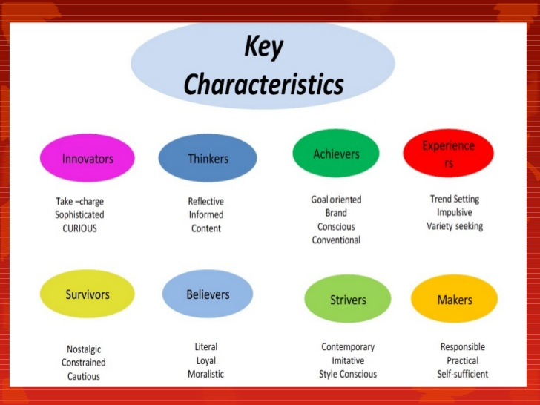

Slide 39
Behavioural Segmentation
Behavioral segmentation divides people and organization into groups according to how they behave with or act toward products.
Benefit Segmentation- grouping people on the basis of benefits they seek from a product
Example: What benefits you seek in a toothpaste?

Slide 40
Benefit Segmentation
https://www.youtube.com/watch?v=o49pq2_A-_o
https://www.youtube.com/watch?v=tHvlNLGYwW8
Freshen Breath and whitening teeth
Tooth Sensitivity
Tooth Decay

Slide 41
Behavioural Segmentation (Usage Rates)
How often certain consumer use certain products? Heavy users, light users, non users
High rollers, or people who spend a lot of money, are considered “VIPs.” VIPs people get special treatment, including a personal “host” who looks after their needs during their casino visits.
They are also keenly interested in nonusers and how they can be persuaded to use products.

Slide 42
Behavioural Segmentation (How people use Products?)
AVON Skin So soft
https://www.youtube.com/watch?v=MhWytOZ2IV4
But after Avon discovered that some people were using it as a mosquito repellant, the company began marketing it for that purpose. Eventually, Avon created a separate product called Skin So Soft Bug Guard.

Slide 43
Behavioural Segmentation (How people use Products?)
GLAD- Seal and wrap (1000uses.com)
https://www.youtube.com/watch?v=ErGrTA_DV3w

Slide 44
Main questions answered?
Geographic segmentation. Where are our customers located, and how can we reach them? What products do they buy based on their locations?
Demographic segmentation. How do the ages, races, and ethnic backgrounds of our customers affect what they buy?
Psychographic segmentation. What do our customers think about and value? How do they live their lives?
Behavioral segmentation. What benefits do customers want, and how do they use our product?

Slide 45
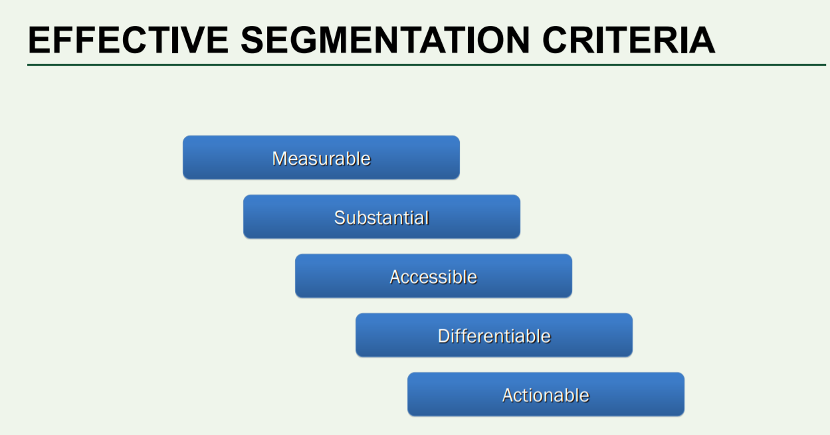

Slide 46
Measurable
Size, purchasing power, and profiles of segment can be measured
women
men
Forgetful people

Slide 47

Accessible
A company should be able to reach them though advertising media as well as distribution channels.

Slide 48
Substantial
Segments should be large enough. i.e. Profitable to serve.
Example: Making basketball shoes for NBA players of height 5’ 4’’.

Slide 49
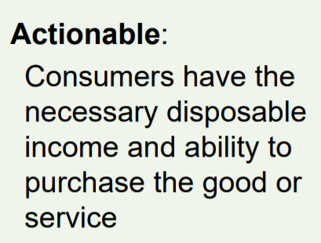
Actionable

Slide 50
Differential
Segments are more similar in characterises and behaviour (response to marketing stimuli), then they are to consumers in other segments.

Slide 51
Question to the Class?
Do marketers create segments or identify segments?

Slide 52
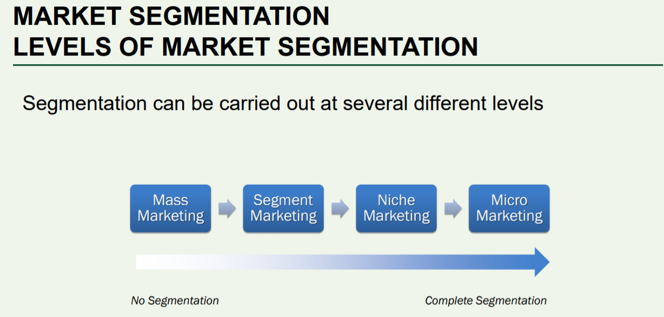

Slide 53
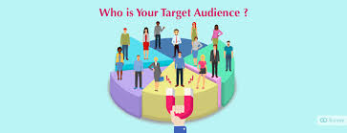
Targeting
a particular group of consumers at which a product or service is aimed.

Slide 54
Sizeable
Suppose you are an automobile manufacturer who produces mid range cars.
Europe
China

Slide 55
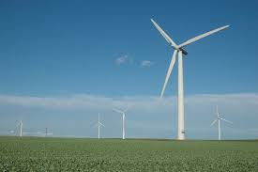
Other features of a Target Market
It should be growing
Not swamped by competitors (IBM sold its computer division to Lenovo)
You have the Resources to Compete in it
It fits in your firm objective and mission
(https://www.youtube.com/watch?v=zEND9KG67PM)

Slide 56


Slide 57
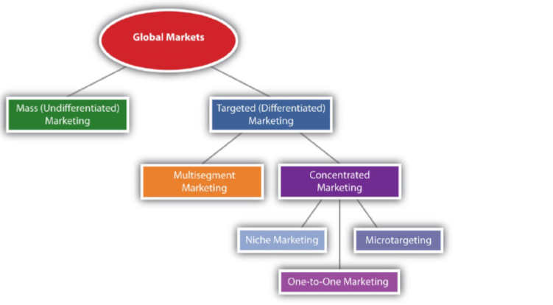
Choosing the number of markets to segment

Slide 58
Sizeable
Growing
Less Competition
Meets your firms objective and mission
s1
s4
s7
s1
Filter
s2
s5
s8
s3
s8
s3
s6
s9
s6

Slide 59
Multi-segment Marketing
Marriott Courtyard. Targeted at over-the-road travelers.
Ritz-Carlton Hotels. Targeted at luxury travelers.
Marriott Conference Centers. Targeted at businesses hosting small- and midsized meetings.
Marriott ExecuStay. Targeted at executives needing month-long accommodations.
Marriott Vacation Clubs. Targeted at travelers seeking to buy timeshares.

Slide 60
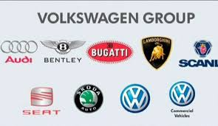
Benefits of Multi-segment marketing
Dealing with economic downturns
Dealing with changing demographics
Dealing with product life cycle issues

Slide 61
Concentrated Marketing
Concentrated marketing involves targeting a very select group of customers.

Slide 62
Sizeable
Growing
Less Competition
Meets your firms objective and mission
s1
s4
s7
s1
LOW RESOURCES
Filter
Filter
s8
s2
s5
s8
s3
s8
s3
s6
s9
s6

Slide 63
Advantages
This type of marketing can be a great success for those companies who have limited resources. These companies cannot expand after a certain level and need a concentrated efforts for a selected niche.
This marketing approach is effective for those companies which are skilled and specialized in manufacturing products.
Those companies adopt concentration strategy can better identify customer needs and wants due to its one are fewer segments and one can better satisfy customers’ needs and wants.

Slide 64
Disadvantages
Totally dependent on a single niche market segment
High developed and specialized market plan is required to implement
Concentrated marketing companies should be more flexible and respond to the changing consumer behavior in the target market.

Slide 65
Positioning

Slide 66
Positioning
Act of designing the company’s offerings and image to occupy a distinctive space in the mind of the target market.
Positioning involves tailoring your product so that it stands out from the competition and people want to buy it.

Slide 67
Realization
Focusing on particular segments- Targeting
Build perception of your product in the mind of the selected segments- Positioning

Slide 68
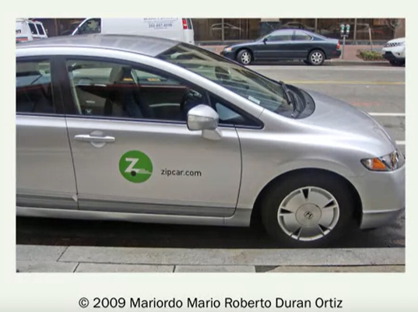
ZipCar
Old-Age, Own a car, Conservative
Young-Age, Do not own a car, Savior
Ad- “Wheels when you want
Them”.

Slide 69
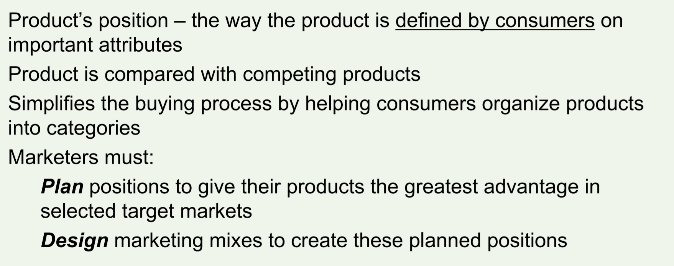
Creating Positioning

Slide 70
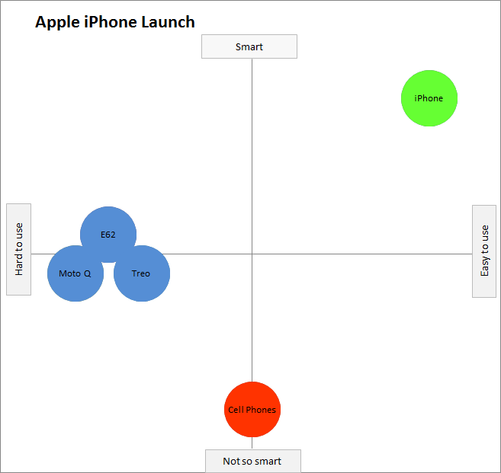

Slide 71
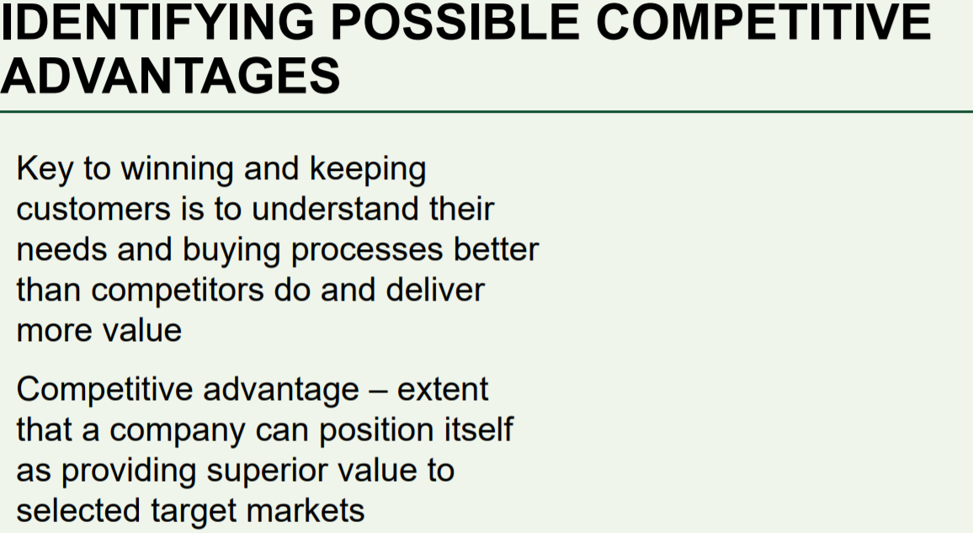

Slide 72
Zip Car’s Competitive Advantage
Zip | Ola | Uber
Strengths- Available everywhere; Cost effective; Drive check in | Strengths- Available everywhere; Cost effective. | Strengths- Available Everywhere, Cheaper than Ola
 | Weakness- Not self-drive sometimes bad experience with the driver | Weakness- Not self-drive sometimes bad experience with the driver
Target- Young consumers who do not own a car and personality trait Savior | Target- everyone | Target- everyone
Position myself according to points of parity and points of differentiation

Slide 73

Positioning- Example
https://www.youtube.com/watch?v=AOXv-6W634k

Slide 74

Tata

Slide 75
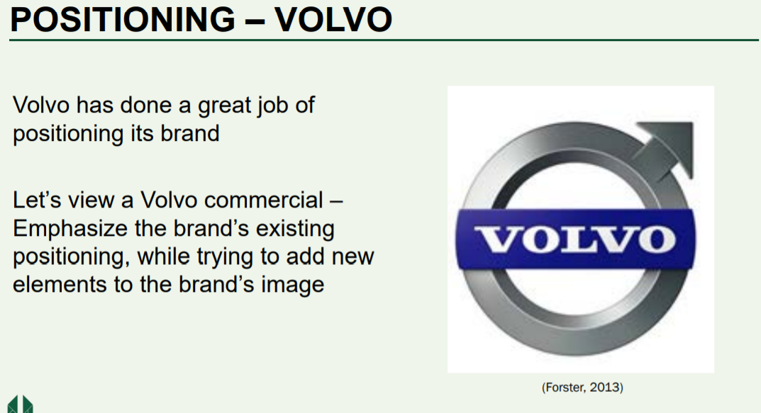

Slide 76
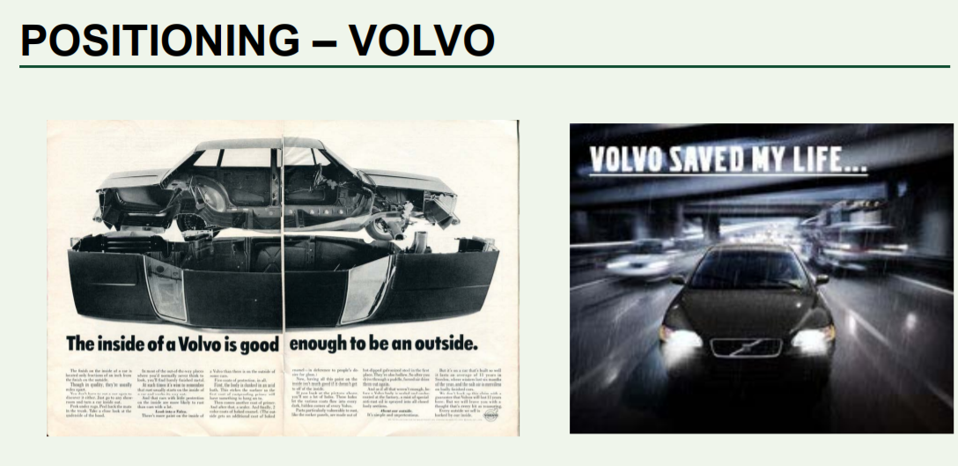

Slide 77

Positioning- Video

Slide 78
New Positioning
https://www.youtube.com/watch?v=IfLhjHXyKWU

Slide 79


Slide 80
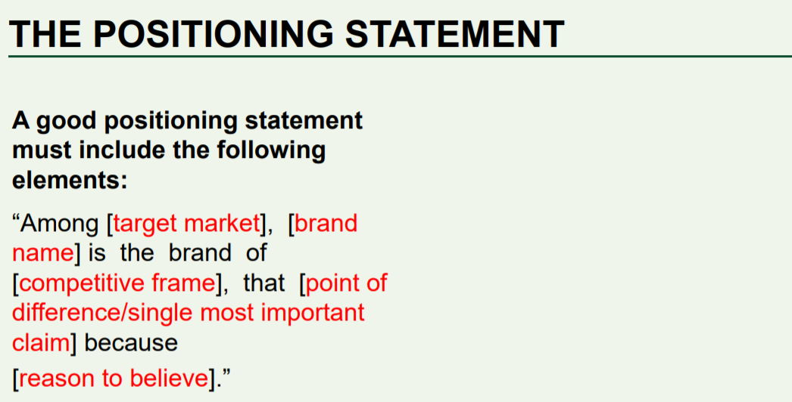

Slide 81
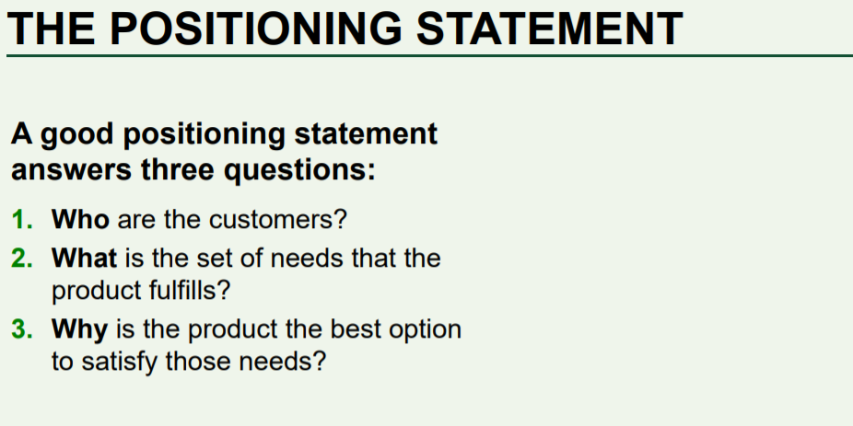

Slide 82
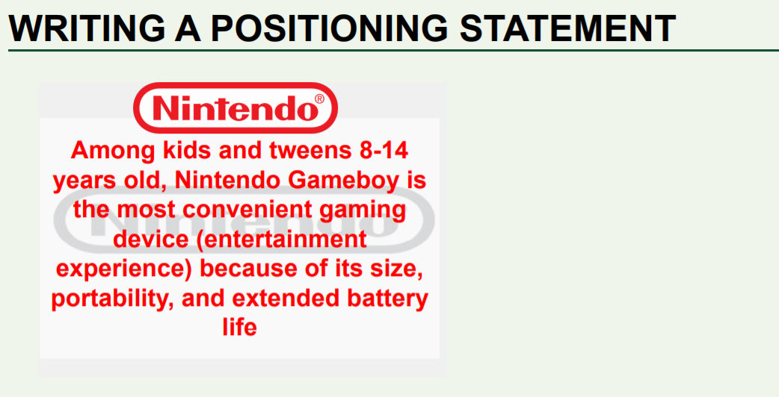

Slide 83
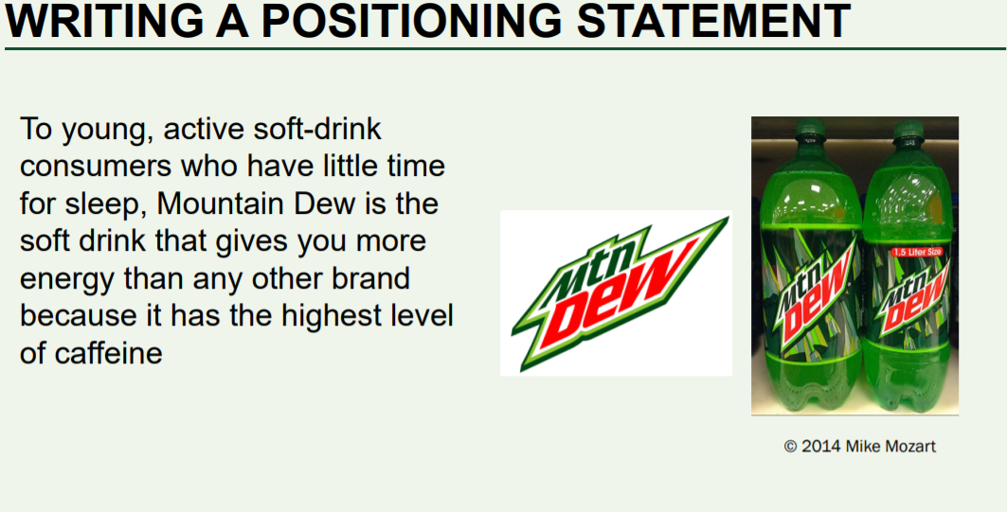

Slide 84
