Slide 1
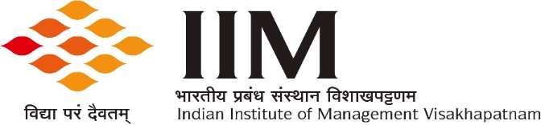
Search Marketing

Slide 2
If the Search Engine is not there?

Slide 3
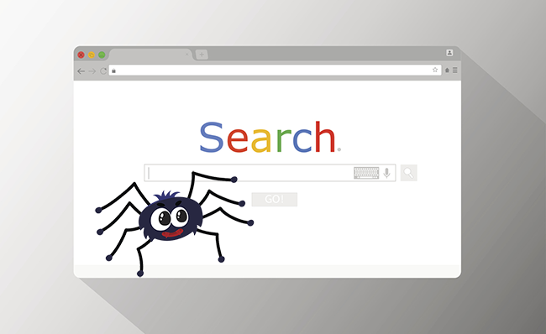
How Search Works
Crawl
Index
Rank

Slide 4
How Google Search Work?
https://www.youtube.com/watch?v=0eKVizvYSUQ

Slide 5
Google Algorithm (E-A-T: expertise, authority, trust)
Panda (February 24, 2011): Quality of content
Penguin (April 24, 2012): Backlinks/ Spamming, Black hat SEO
Google Pay Day (June 2013): Misleading content (loan, Schemes)
Humming Bird (August 22, 2013): Relevance of the query
Pigeon (July 24, 2014): Proximity
Mobilegeddon (April 21, 2015): Mobile friendly
RankBrain (October 26, 2015): Synonyms, implied words, Search history
Fred (2018): Placement of Ads
Medic (May 4, 2018): Life-altering decisions
Bert (October 22, 2019): NLP for context

Slide 6
Updates
April 2023 Reviews Update: in-depth research
March 2023 Core Update
February 2023 Product Reviews Update: EWOM Quality
December 2022 Link Spam Update: AI
December 2022 Helpful Content Update: EAT to EEAT
October 2022 Spam Update
https://status.search.google.com/products/rGHU1u87FJnkP6W2GwMi/history

Slide 7
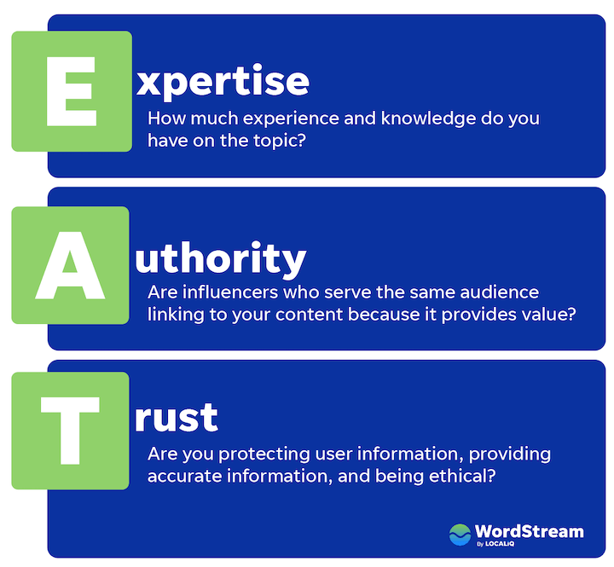
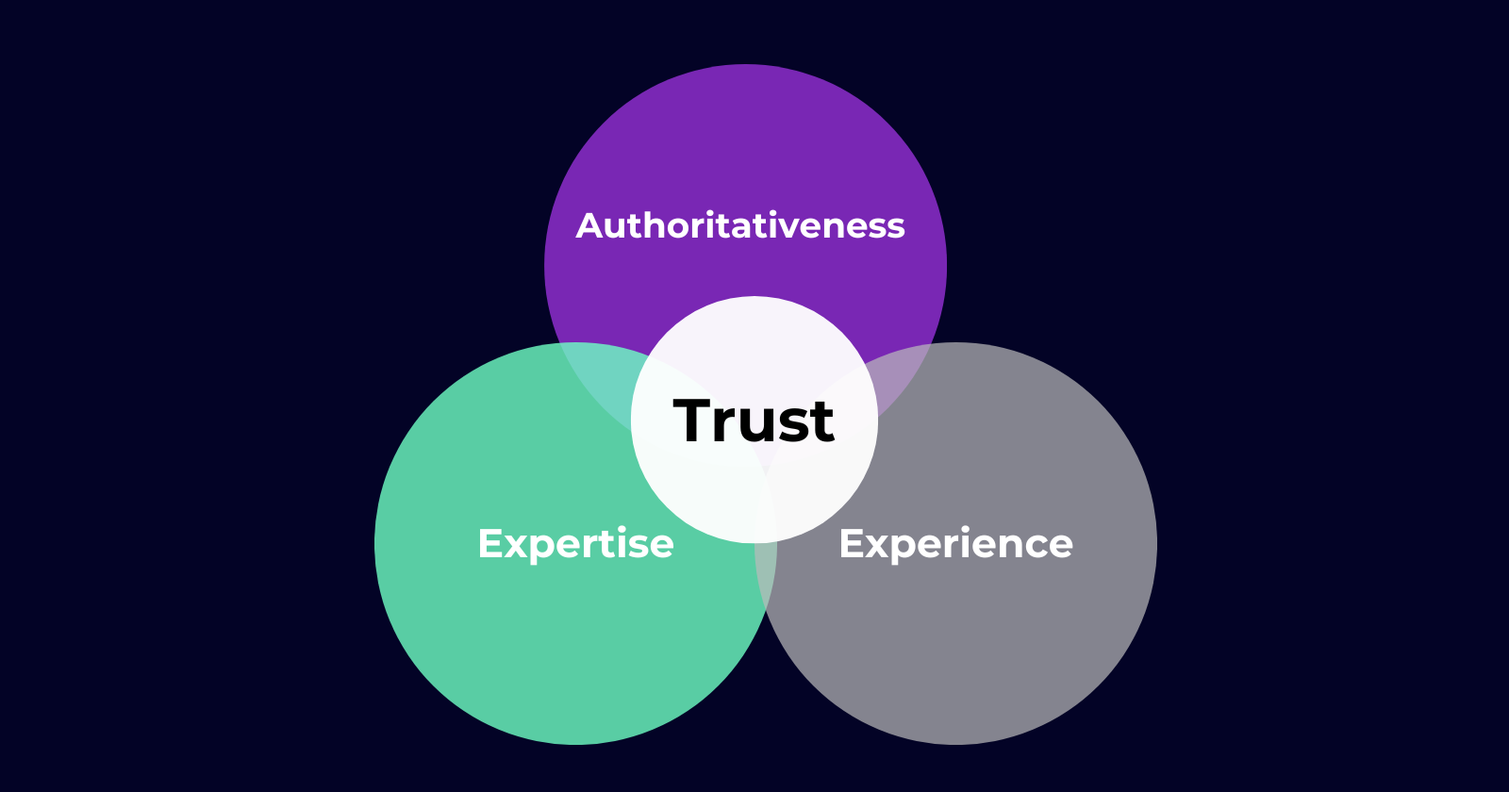

Slide 8
Factors Affecting Search Results
Keywords
Location
Backlink
Relevance
CTR
Bounce rate
Behavior
Search History

Slide 9
Search Marketing
Search Marketing
Search Engine Marketing
Search Engine Optimization

Slide 10


Slide 11
Keyword Research

Slide 12
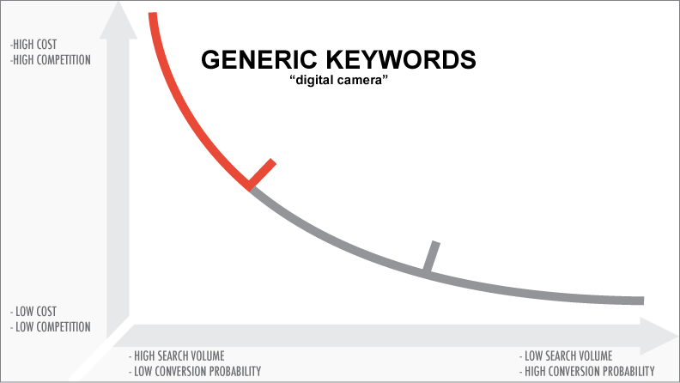
Types of Keywords:

Slide 13
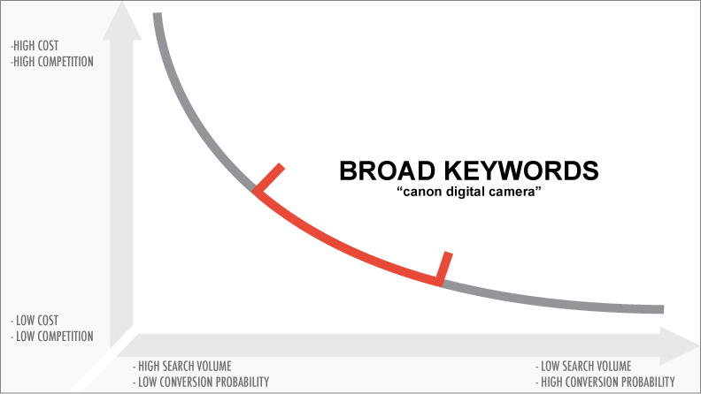

Slide 14
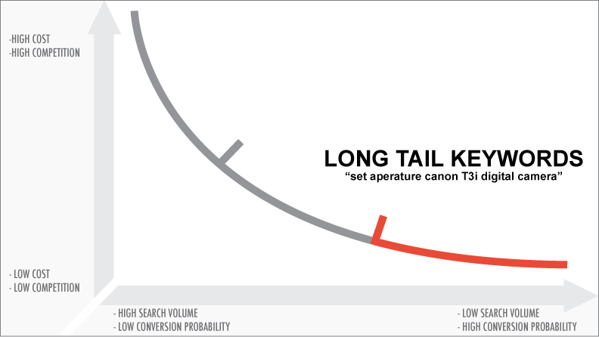

Slide 15
Primary Research
https://www.menti.com/

Slide 16
Secondary Research Tools
https://app.neilpatel.com/en/ubersuggest/keyword_ideas?keyword=digital%20marketing&locId=2840&lang=en
https://keywordtool.io/
https://trends.google.com/trends/?geo=US
https://keywordsheeter.com/
https://chrome.google.com/webstore/detail/ubersuggest-seo-and-keywo/nmpgaoofmjlimabncmnmnopjabbflegf?hl=en
https://chrome.google.com/webstore/detail/mozbar/eakacpaijcpapndcfffdgphdiccmpknp?hl=en

Slide 17
Continue……………
https://www.wordstream.com/keywords
https://www.wordtracker.com/
https://ads.google.com/intl/en_in/home/tools/keyword-planner/
https://ahrefs.com/keyword-generator

Slide 18
Try these too
Semrush
Soovle
Jaaxy
Google Search Console
SECockpit
Moz Keyword Explorer
Keywords Everywhere
Keyword Snatcher
KWFinder
QuestionDB
erpstat

Slide 19
Related Search in Google

