Slide 1
TALENT DEVELOPMENT AND MANAGEMENT - I
SPHRi

Slide 2

SPHRi Exam Content

Slide 3
Functional Area
Identifying and developing relevant individual and organizational competencies
Developing and using a talent management strategy to sustain long- term, effective alignment with organizational strategies to achieve human capital objectives;
Establishing a learning environment in which continuous professional development includes staying current in HR practices.
Using a set of systematic and planned activities designed by the organization to help people develop the necessary skills to meet current and future organizational needs and objectives.
Creating an organizational environment that encourages and retains the employees.

Slide 4
Talent Development and Management
Organizational Development
Performance Management
Talent Development
Employee Relations

Slide 5
Human Resource Development
Organisational Development
Organisational Change
Learning Organisation
Knowledge Management

Slide 6
HRD - Definition
Human Resource Development (HRD) is a process of developing and unleashing expertise for the purpose of improving individual, team, work process, and organizational system performance through organizational development (OD) and personnel training and development for the purpose of improving performance. OD primarily focuses at the organizational level and connects with individuals, while Training & Development primarily focuses on individuals and connects with the organization.
Individual and organizational learning
Individual and organizational performance

Slide 7
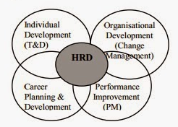
Human Resource Development

Slide 8
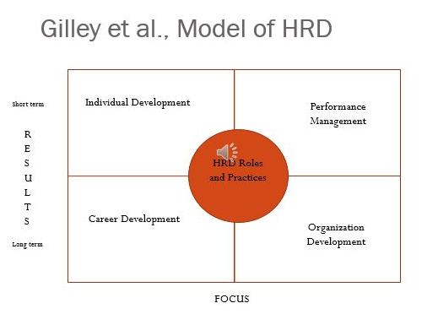
Model of HRD

Slide 9
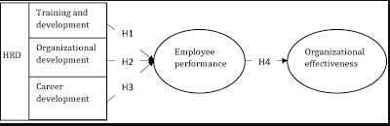
HRD Process

Slide 10
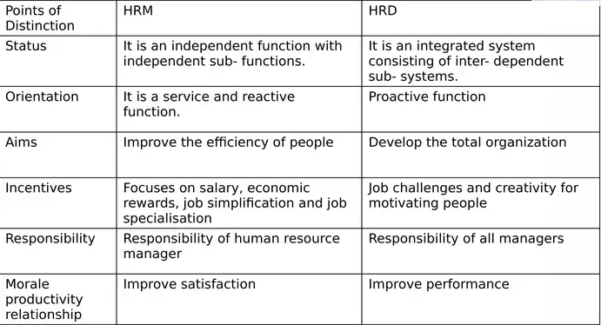
Difference HRM vs HRD

Slide 11
Human Resource Development
Organisational Development
Organisational Change
Learning Organisation
Knowledge Management

Slide 12
Organisational Development (OD)
Organisational Development concerns system planned change, targets humans and processes of organisations and intends to build the capacity to adapt and renew organisations

Slide 13
Features of Organisational Development
Organisation Development is an effort that is :
Planned
Organisation-wide
Managed from the top
Increase organisation effectiveness and health
Through planned interventions in the organisation’s “processes” using behavioural science knowledge

Slide 14

Process of OD
Entering and Contracting
Diagnosing Organizations, Groups, and Jobs
Collecting, Analysing, and Feeding Back Diagnostic Information
Designing Interventions
Leading and Managing Change

Slide 15
1. Entering and Contracting
The entering and contracting processes constitute the initial activities of the OD process. They set the parameters for the phases of planned change that follow: diagnosing, planning and implementing change, and evaluating and institutionalizing it.
Organizational entry involves clarifying the organizational issue or presenting problem, determining the relevant client, and selecting and OD practitioner. Developing an OD contract focuses on making a good decision about whether to proceed and allows both the client and the OD practitioner to clarify expectations about how the change process will unfold.

Slide 16
2. Diagnosing Organizations, Groups, and Jobs
Organization-level diagnostic model consists of environmental inputs; a set of design components called a strategic orientation; and a variety of outputs, such as performance, productivity, and stakeholder satisfaction. Diagnosis involves understanding each of the parts in the model and then assessing howl the elements of the strategic orientation align with each other and with the input. Organization effectiveness is likely to be high when there is good alignment.
Group diagnostic models take the organization’s design as the primary input; examine goal clarity, task structure, group composition, performance norm, and group functioning as the key design components; and list group performance and member quality of work life as the outputs. As with any open-systems model, the alignment of the parts is the key to understanding effectiveness.
At the individual job level organization design, group design, and personal characteristics of individuals occupying jobs are the salient input. Individual jobs have five key dimensions: skill variety, task significance, task identity, autonomy, and feedback that work together to produce outputs of work satisfaction and work quality

Slide 17
3. Collecting, Analyzing, and Feeding Back Diagnostic Information
The four major techniques for gathering diagnostic data are questionnaires, interviews, observations, and unobtrusive measure (from secondary sources, such as company records and archives). Benchmarking is a useful data collecting method to examine the best practices of other organizations and make changes in operations based on what is learned.
Data analysis techniques fall into two broad classes: qualitative and quantitative. Qualitative techniques generally are easier to use because they do not rely on numerical data. That fact also makes them easier to understand and interpret.
Quantitative techniques, on the other hand, can provide more accurate reading of the organizational problem.
Data feedback is concerned with identifying the content of the data to be feedback and designing a feedback process that ensures ownership of the data. Feeding back data is a central activity in almost any OD program. If members own the data, they will be motivated to solve organizational problems.

Slide 18
4. Designing Interventions
An intervention is a set of planned activities intended to help an organization improve its performance and effectiveness. Effective interventions are designed to fit the needs of the organization, are based on causal knowledge of intended outcomes, and transfer competence to manage change to organization members.
Intervention design involves understanding situational contingencies such as individual differences among organization members and dimensions of the change process itself.
Four key organizational factor-readiness for change, capability to change, culture context, and the capabilities of the change agent-affect the design and implementation of almost any intervention.

Slide 19

Organisational Development Process

Slide 20
Human Resource Development
Organisational Development
Organisational Change
Learning Organisation
Knowledge Management

Slide 21

Effective Change Management

Slide 22

Kurt Lewin Change Process Theory
Unfreezing stage: Getting people to accept that the change will occur. Ending things that resist change is vital at this stage
Moving stage: Getting people to accept the new, desired state
Refreezing stage: When the new ideal becomes a regular part of the organization

Slide 23

Organisational Development Process

Slide 24

Kurt Lewin Change Process

Slide 25

John Kotter’s, Eight Step Leading Change Model

Slide 26

Comparison of Change models

Slide 27
Human Resource Development
Organisational Development
Organisational Change
Learning Organisation
Knowledge Management

Slide 28
Learning Organisation
A learning organization is a place where employees excel at creating, acquiring, and transferring knowledge. There are three building blocks :
Supportive learning environment
Concrete learning processes and practices
Leadership behavior that reinforces learning.
Such learning organizations would be able to adapt to the unpredictable more quickly than their competitors could

Slide 29
Key features in Learning Organization
Employees share learning with each other and use a job as a basis for applying and creating knowledge.
Systems are developed for creating, capturing, and sharing knowledge
Employees are encouraged to think in new ways, see relationships and feedback loops, and test assumptions.
Learning is rewarded, promoted, and supported by managers and company objectives.
Employees are free to take risks, innovate, explore new ideas, try new processes, and develop new products and services.
System and environment focus on ensuring the development and well-being of every employee.

Slide 30

The Five Disciplines

Slide 31
Five Disciplines
System thinking is a conceptual framework that makes patterns clearer and helps one see how things interrelate and how to change them.
Mental models are our deeply ingrained assumptions that influence how we understand the world and how we take action.
Personal mastery is the high level of proficiency in a subject or skill area.
Team learning is aligning and developing the capacity of a team to create the results its member’s desire.
Shared vision is a look into the future that fosters genuine commitment and is shared by all who need to possess it.

Slide 32

Event vs Systems Thinking

Slide 33

Mental Models

Slide 34

Fifth Discipline – Learning Organisation

Slide 35

Organizational Learning vs. Learning Organization

Slide 36
Human Resource Development
Organisational Development
Organisational Change
Learning Organisation
Knowledge Management

Slide 37
Knowledge Management
Knowledge Management (KM) is a discipline that promotes an integrated approach to identifying, capturing, evaluating, retrieving, and sharing all of an enterprise's information assets. These assets may include databases, documents, policies, procedures, and previously un-captured expertise and experience of individual works

Slide 38

Knowledge Management Cycle

Slide 39
SECI Concepts
Socialization is the process where tacit knowledge it transmitted between people..
Externalization process allows tacit knowledge to be morphed into explicit knowledge. Through interaction between an individual and other groups in the organization, the individual’s tacit knowledge is expressed through whatever terms are possible, such as metaphors and stories.
Combination -Knowledge throughout the organization is collected and compiled into a more effective form of explicit knowledge, allowing the more refined forms to be distributed throughout the organization. An example would be a team in a tech firm whose job is to publish reports of successful products made throughout the company.
Internalization is the collective tacit knowledge of the organization is morphed from its explicit knowledge through internalization

Slide 40

SECI Model of Knowledge Management

Slide 41

Knowledge Management Model

Slide 42

Knowledge Assets

Slide 43
HR Roles in Organizational Development
HR should become a partner with senior and line managers in strategy execution, helping to move planning from the conference room to the marketplace.
It should become an expert in the way work is organized and executed, delivering administrative efficiency to ensure that costs are reduced while quality is maintained.
It should become a champion for employees, vigorously representing their concerns to senior management and at the same time working to increase employee contribution; that is, employees’ commitment to the organization and their ability to deliver results.
HR should become an agent of continuous transformation; shaping processes and a culture that together improve an organization’s capacity for change

Slide 44
Questions

