Slide 1

INTRODUCTORY
SESSION
SPHRi

Slide 2

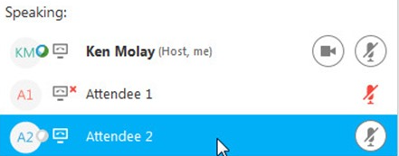
Webex Options
When in doubt raise the hand option
Unmute microphone while speaking and mute when not needed

Slide 3
Introduction
Welcome to the batch 09 of SPHRi
Brief Introduction about yourself
- Industry
- Location
- If taken any HRCI exams before

Slide 4
HRCI Certification
SPHRi Exam
Structure of SPHRi Exam
Uptop Student Portal
Class Information

Slide 5
How Certification Differs from a Certificate Program
Compared with certificate programs, certification has three main advantages:
requires specific work experience, competency and education
requires recertification, which makes sure that you stay current in the HR profession through continuing education
allows you to put the letters after your name

Slide 6
Certification holders
More than 500,000 HR professionals in over 100 countries have earned HRCI credentials as a mark of high distinction and honour in the human resource management field
• Vice President and above: 8 percent
• Director-level: 21 percent
• Manager-level: 33 percent
• Specialist: 38 percent

Slide 7

HRCI Certification

Slide 8
HRCI Certification
SPHRi Exam
Structure of SPHRi Exam
Uptop Student Portal
Class Information

Slide 9
SPHRi Exam
Exam time: 2 hours 30 mins
Exam length: 105 scored questions (mostly multiple-choice) + 25 pretest questions
Pass score is 500 of 700
Online and Computer-based exam at a Pearson VUE testing center

Slide 10
Exam Pass Rates
aPHR 86%
PHR 71%
SPHR 60%
GPHR 77%
PHRca 74%
aPHRi 83%
PHRi 76%
SPHRi 81%
HRCI Exam Pass Rates as of December 31, 2020

Slide 11
HRCI Certification Holders
aPHR 7,692
PHR 71,130
SPHR 47,903
GPHR 2,805
PHRca 1,858
aPHRi 413
PHRi 2,144
SPHRi 1,759
Number of HRCI Certification Holders as of January 12, 2021

Slide 12

Pearson VUE

Slide 13

Time Remaining

Slide 14

Flag for Review

Slide 15

Review Screen

Slide 16

End Review

Slide 17

Calculator

Slide 18

Comments

Slide 19

Progress Indicator

Slide 20

Scrollbar

Slide 21
HRCI Certification
SPHRi Exam
Structure of SPHRi Exam
Uptop Student Portal
Class Information

Slide 22
Structure of Exam
Traditional multiple choice
Multiple choice, multiple response
Fill in the blank
Drag and drop
Scenarios

Slide 23

Multiple Choice Question

Slide 24

Multiple Choice Multiple Response

Slide 25
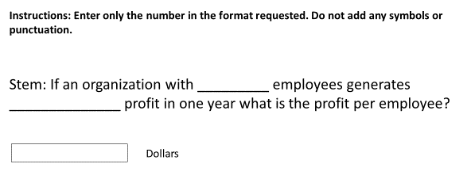
Fill in the blanks

Slide 26

Drag and Drop

Slide 27
Scenario based questions
You have been recently hired as the HR manager within a unit of your organisation that hasn't met its production goals. Your director has made a decision "No training programs will be conducted until the numbers improve". How would you respond:
Training is an important way for employee to position themselves for promotional opportunities, and the employees in this unit may need a ticket out of this underperforming unit
You would like to have the opportunity to determine where the gap is between the actual and desired performance, to see whether training might be an effective way of addressing the bottom-line performance issues.
You believe strongly that you should at least be given the opportunity to engage in training initiatives unless those efforts prove to be ineffective
Removing training opportunities could damage employee morale even more.

Slide 28
Classification of Questions
All questions are classified based on one of the following cognitive levels:
Knowledge/comprehension: recalling factual material, such as definitions
Application/problem solving: applying familiar principles or generalizations to solve real-life problems
Synthesis/evaluation: combining different elements and using critical thinking skills to solve a complex problem

Slide 29
SPHRi Exam Contents
01 | Business Leadership (31%)
02 | Talent Development and Management (27%)
03 | HR Service Delivery (24%)
04 | Measurement and Analysis (18%)

Slide 30
HRCI Certification
SPHRi Exam
Structure of SPHRi Exam
Uptop Student Portal
Class Information

Slide 31

Student Portal
Study materials and class presentations
Recordings
Forum for doubt clarification
Weekly Quiz

Slide 32
HRCI Certification
SPHRi Exam
Structure of SPHRi Exam
Uptop Student Portal
Class Information

Slide 33
Class Offering
Weekend class
Study materials
Recordings

Slide 34
Class Link
Class link would be provided in the student portal
My sessions

Slide 35
Class Timings
9:00 AM to 12 PM
Divided into two halves
1st half from 9:00 to 10:15 AM
15 mins break - 10:15 to 10:30 AM
2nd half from 10:30 to 11:45 AM

Slide 36
Questions

