Slide 1
INTRODUCTORY SESSION
SPHRi

Slide 2
Introduction
Welcome to the batch 03 of SPHRi
Brief Introduction about yourself
- Industry
- Location
- If taken any HRCI exams before

Slide 3
HRCI Advantage
World class organisation - Established in 1976, HRCI is the largest HR certification organization in the world. It delivers nearly 45 years of history
Connects you to an exclusive network of - Nearly 140,000 certified HR thought leaders work in more than 100 countries and territories.

Slide 4
Certificate holders
More than 500,000 HR professionals in over 100 countries have earned HRCI credentials as a mark of high distinction and honour in the human resource management field
• Vice President and above: 8 percent
• Director-level: 21 percent
• Manager-level: 33 percent
• Specialist: 38 percent

Slide 5

HRCI Certification

Slide 6
SPHRi Exam
Exam time: 2 hours 30 mins
Exam length: 105 scored questions (mostly multiple-choice) + 25 pretest questions
Pass score is 500 of 700
Computer-based exam at a Pearson VUE testing center or at your home or office using OnVUE

Slide 7
Exam Pass Rates
aPHR 83%
PHR 69%
SPHR 60%
GPHR 69%
PHRca 70%
aPHRi 86%
PHRi 78%
SPHRi 83%
HRCI Exam Pass Rates as of December 31, 2019

Slide 8
HRCI Credential Holders
aPHR 6,294
PHR 73,170
SPHR 49,300
GPHR 2,883
PHRca 1,729
aPHRi 295
PHRi 2,081
SPHRi 1,515
Number of HRCI Certification Holders as of February 15, 2020

Slide 9

Pearson VUE

Slide 10
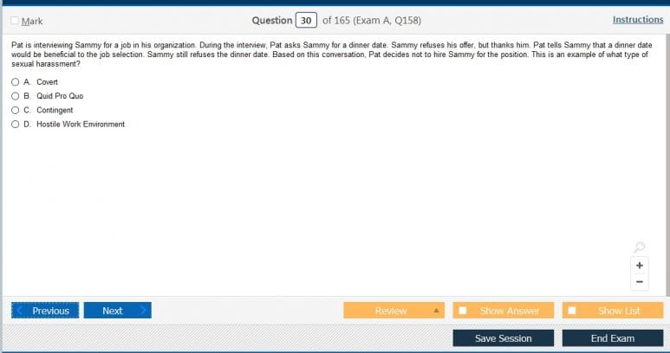
HRCI Exam screen

Slide 11
Structure of Exam
Traditional multiple choice
Multiple choice, multiple response
Fill in the blank
Drag and drop
Scenarios

Slide 12

Multiple Choice Question

Slide 13
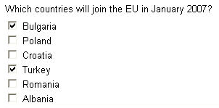
Multiple Choice Multiple Response

Slide 14

Fill in the blanks

Slide 15

Drag and Drop

Slide 16
Classification of Questions
All questions are classified based on one of the following cognitive levels:
Knowledge/comprehension: recalling factual material, such as definitions
Application/problem solving: applying familiar principles or generalizations to solve real-life problems
Synthesis/evaluation: combining different elements and using critical thinking skills to solve a complex problem

Slide 17
Exam Contents
01 | Business Leadership (31%)
02 | Talent Development and Management (27%)
03 | HR Service Delivery (24%)
04 | Measurement and Analysis (18%)

Slide 18
Class Offering
Weekly classes
Weekly Quiz
Study materials
Recordings

Slide 19

Student Portal
Study materials and class presentations
Recordings
Forum for doubt clarification
Weekly Quiz

Slide 20
Questions

