Slide 1
SOCIAL MEDIA MARKETING STRATEGY
SDMA – IV

Slide 2
Session Agenda
What is social media marketing?
Where does social media marketing fit into an organization’s overall planning framework?
What are the phases of social media marketing maturity?
What are the steps in social media marketing planning?
Key challenges in social media marketing

Slide 3
Where Does SMM Planning Fit?
Business plan
  Marketing plan
    IMC plan
      SMM plan
Plans are blueprints for marketing strategy formulation and implementation.
The plan serves as a road map to guide the firm, allocate resources, and make decisions.

Slide 4
Phases of social media marketing
Trial
Transition
Strategic

Slide 5
Steps in Social Media Marketing Planning

Slide 6
7 Steps of SMM Planning
Conduct a situation analysis
State objectives
Gather target audience insight
Select social zones and vehicles
Create an experience strategy
Establish an activation plan
Execute and measure campaign

Slide 7
Step 1: Situation analysis
Review the firm’s environmental and SWOT analyses.
Review the firm’s objectives, strategies, and marketing goals.
Review the existing marketing plan and any other information that can be obtained about the company and its brands.

Slide 8
… Situation analysis
Are there linkages between direct strategy and social?
What activities can be tied to social media?
What resources can be directed to social?
Is the organization prepared for social?
Who are our customers? Are they social users?
Who are our competitors? What social media activities are they using?
What key trends may affect our decisions?

Slide 9
Step 2: Objectives and Budgeting
Task (what is to be accomplished)
Measurable quantity (how much)
Time frame (by when)
Notes:
Ensures accountability
Demonstrates financial contribution of marketing efforts
Helps us to work smarter and more efficiently

Slide 10
Develop SMART objectives
Specific
Measurable
Action oriented
Realistic
Time-lined
Notes:
􏰀 Increase market share
􏰀 Increase the number of comments on a blog
􏰀 Increase sales revenue
􏰀 Reduce costs
􏰀 Achieve branding goals
􏰀 Increase database size
􏰀 Achieve customer relationship management goals
􏰀 Improve supply chain management

Slide 11
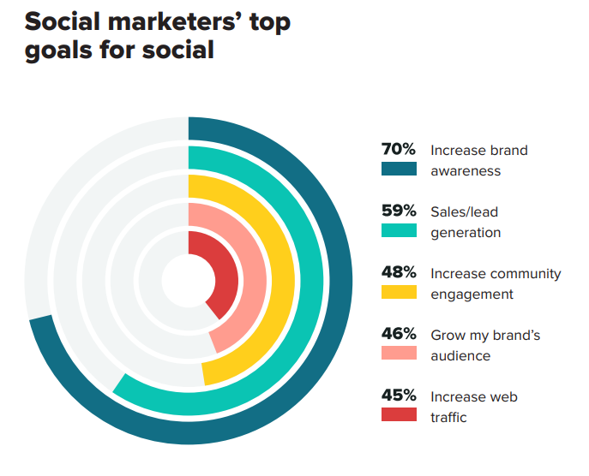

Slide 12
Step 3: Gather Target Audience Insight
Which segments should we select to target?
In which zones and communities do they participate?
How do they use social media?
What is important to them?

Slide 13
Step 4: Select Social Zones
Considering our objectives, budget, overall direct strategy and segment insight, which zones should be used and how?
e.g., include:
  Social networks
  Social publishing
  Social streaming
  Social blogging

Slide 14
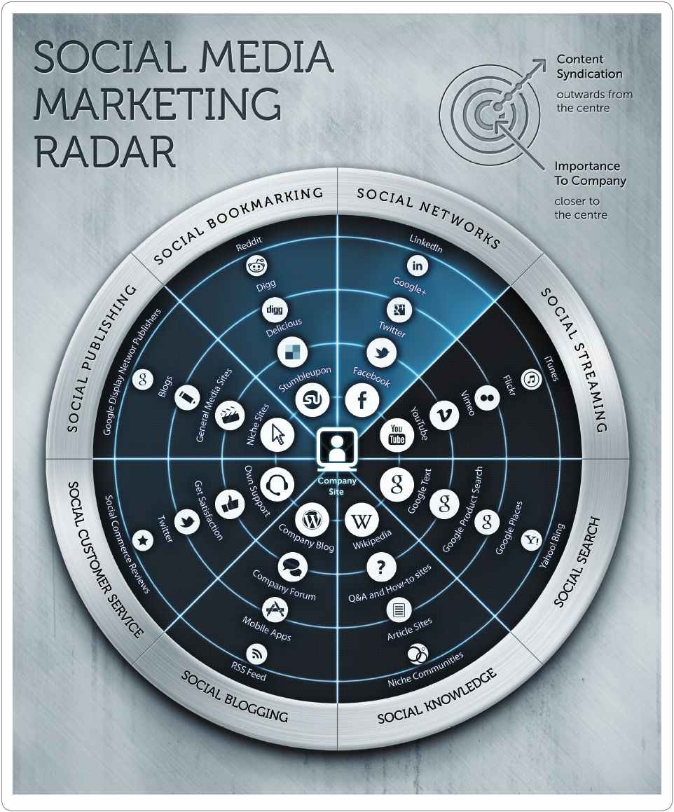
Source: Smart Insights (2015)
Notes:
Social networks. In most countries, the core social platforms where people interact through social networks are Facebook, Instagram and Snapchat for consumer audiences, LinkedIn for business audiences and Twitter for both.
Social publishing and news.Nearlyallnewspapersandmagazines,whetherbroadorniche,now have an online presence with the option to participate through comments on articles, blogs or communities.
Social commenting in blogs. A company blog can form the hub of your social media strategy and you can look at tapping into others’ blogs, whether company or personal or through blog outreach.
Socialnichecommunities.Thesearecommunitiesandforumsindependentofthemainnetworks.
Social customer service. Services such as GetSatisfactionTM(www.getsatisfaction.com), as well as companies’ own customer-support forums, are increasingly important for responding to customer
complaints, particularly in some sectors such as mobile phone and network providers.
Social knowledge. The seare reference social networks such as Yahoo!Answers, Quora TMand Wikipedia. They show how any business can engage its audience by solving their problems and
subtly showing how products have helped others.
Social bookmarking. Bookmarking sites such as DeliciousTM(www.del.icio.us.com) are today relatively unimportant.
Social streaming. Rich and streaming media sites including photos(e.g.Pinterest), video and podcasting.
Social search. When Google+ was launched search engines incorporated more social features such as voting for sites via a Google+1. With the wane in popularity of Google+ in recent years, these
features are seen less commonly today.
Social commerce. Mainly relevant for the retail and travel sectors, social commerce involves reviews and ratings on products and sharing of coupons on deals.

Slide 15
Step 5: Developing an Experience Strategy
What are the campaign goals and/or communication tasks? Here the planner reviews these decisions and provides a succinct overview of the goals.
What is unique and special about brand’s position in the marketplace? Campaign work should leverage the brand‘s positioning strategy.
What experiences are possible given target market needs and motives, the available channels, and the creative assets? How can we design these experiences to maximize device portability and access?
What content will be needed? Comments? Questions and polls? Video? Images? Stories? Apps?
How will experience engagement be extended and shared throughout the social channels?

Slide 16
Step 6: Activation Plan
How do we make the plan happen?
Who is responsible?
What is the timing?
What budget is needed to accomplish each objective?
How do we ensure the plan is consistent with our larger objectives?

Slide 17
Step 7: Measure and Manage
What metrics will allow us to assess effectiveness?
How will we collect the data to assess?

Slide 18
Characteristics of a Good Plan
Understands the marketplace
Establish clear measurable objectives
Define performance targets
Identify a customer group
Explains what customers want
Develops strategies tied to marketing objectives (4 Ps)
Includes measurement plan

Slide 19
Before you begin keep in mind
A plan
  Tells a story
  Identifies the characters, place and time
  Tells how current situation came to be
  Defines what must happen for a good outcome
  Establishes challenges and what must be done to overcome
  Clarifies the desired outcome
  Specifies measures of success (metrics!)

Slide 20
Social Media Policy Components
Standards of conduct
Disclosure requirements
Standards for posting corporate information

Slide 21
Challenges in social media marketing

Slide 22
Challenges in social media marketing
Customer engagement
  Repeated interactions through the customer lifecycle prompted by online and offline communications aimed at strengthening the long-term emotional, psychological and physical investment a customer has with a brand.
Media Fragmentation
  Describes a trend towards increasing choice and consumption of a range of media in terms of different channels such as web and mobile
  Media fragmentation implies increased difficulty in reaching target audiences.
Notes:
Involvement. Forrester says that online this includes website visits, time spent, pages viewed.
Interaction. This is contributed comments to blogs, quantity/frequency of written reviews and online comments as well as comments expressed in customer service. (We could add the recency, frequency and category of product purchases, and also ongoing engagement in email marketing programmes, as discussed later in this chapter; all are important here.)
Intimacy. This is sentiment tracking on third-party sites including blogs and reviews, as well as opinions expressed in customer service calls.
Influence. This is advocacy indicated by measures such as likelihood to recommend, brand affinity and content forwarded to friends.

Slide 23
Thank you

