Slide 1



IIM VISAKHAPATNAM
Session Topic
Social Media Marketing
By:
Farheen Rahman
Senior Manager-
New Business @ Metrix
farheenarahman777@gmail.com
+91- 80510 04735
2024-2025

Slide 2
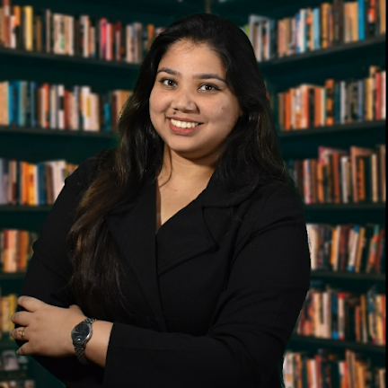



About the Speaker
“
I am currently looking after New Business Vertical for Metrix. I have worked and collaborated across industries including Automotive, E-commerce and Consulting at Tata Motors Limited, IndiaMART, Gartner Inc., EY, JustDial and ACS Technologies in areas of Go To Market, Digital Transformation, Client Handling, Product Management and Digital marketing across all platforms.
”
Education Background
Corporate Competition
Lecture Series
Executive Development Programme in Digital Marketing from XLRI Jamshedpur
O
O
IIM Jammu- Executive Batch (2 batches)
IIM Vishakhapatnam- Executive Batch (3 Batches)
Tata Motors Sales Team- Mid and Senior Level Managers of Tata Motors East Sales Team (130 participants)
IIM Jammu- MBA final year
IIM Vishakhapatnam- MBA Final Year
IIM Ranchi- MBA final year
BIT Mesra- B. tech & MBA
SOIL Gurgaon- Industry Mentor
KCC Institutes- BBA, BCA, BJMC
Skill Development Coach- GP colleges under Govt. of Jharkhand for placement and related trainings since 2017
Personal Interview trainer, Super 70, Maxel Leadership Council to train MBA aspirants on WAT and PI to convert IIM calls
National Level:
Tata Motors Mindrovers 2018 (PPO) TAS In-house by Tata Group 2021; Pinnacle by Aditya Birla Fashion & Retail 2017;
E-Hackathon, Tata Motors 2020
State Level:
Startup Pitch , Govt. of Jharkhand- 2018
Campus Level:
Nestle 4P Challengers 2018,
RPG Bizzards 2018
O
MBA in Marketing and Finance from IIM Ranchi
O
B.E. in Civil Engineering from BIT Mesra (Gold Medalist)
O
O
O
Class XII : JVM Shyamali (AFMI Gold Medal)
Class X : District 2nd Topper
O
2024-2025

Slide 3

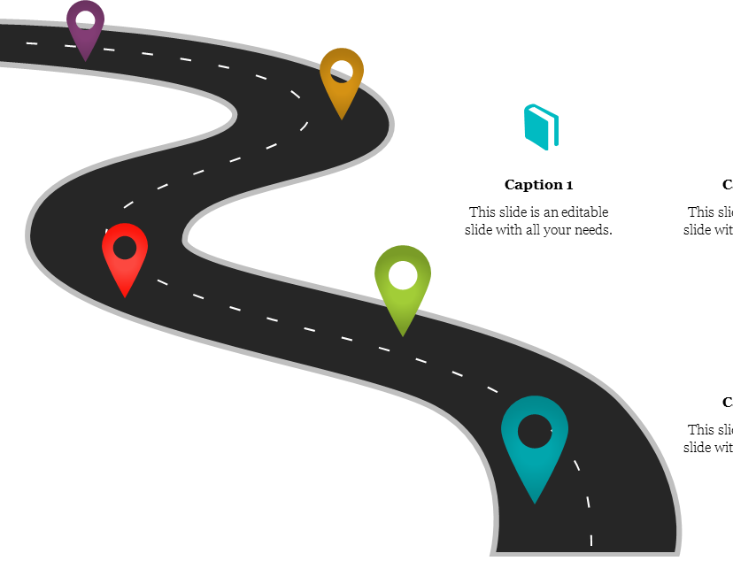

Roadmap
ONE: Understanding FB, LinkedIn and Ad structure
Understanding ad set up across each platform
Social Media Analytics and Campaign Optimisation
Quick Recap
Please feel free to ask questions after each topic.
Avoid advanced questions in the beginning
Understanding Campaign
Understanding Ad copy
Understanding Ad Structure
Ad Set up
2024-2025

Slide 4
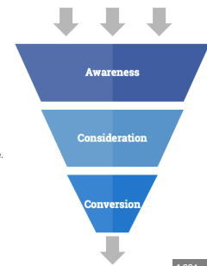
Advertising: Know your Objective first
Brand Awareness + Reach
Traffic+ App Installs+ Video Views + lead generation+ Post engagement+ page likes + event responses+ messages
Conversions + Catalogue Sales + Store Traffic
2024-2025

Slide 5

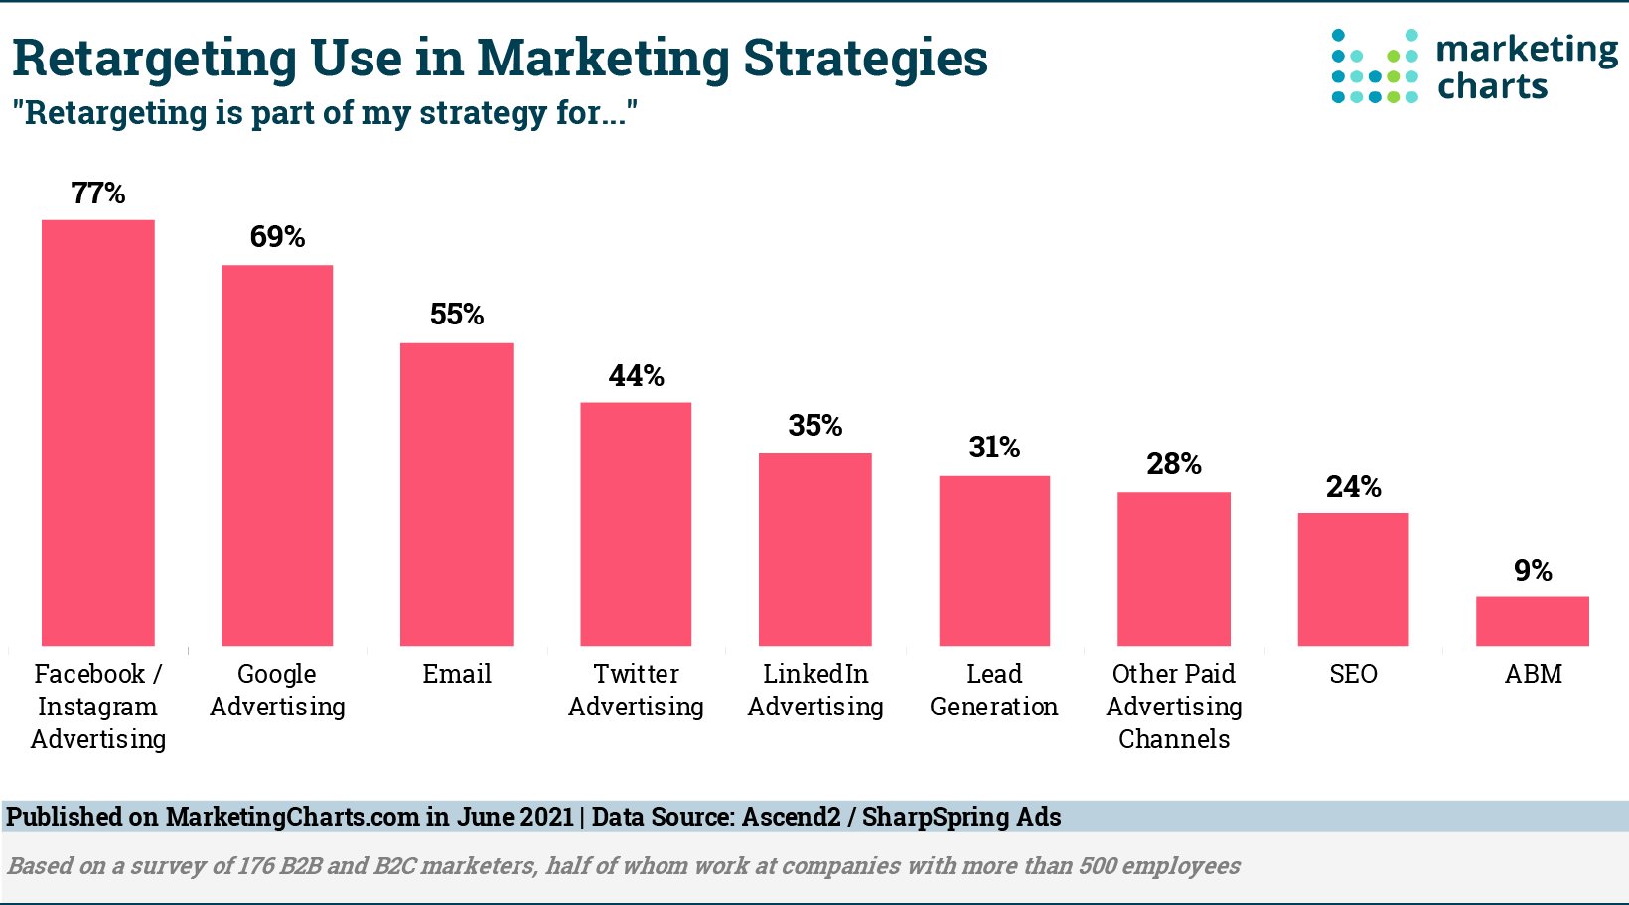
Advertising on Facebook and Instagram in Detail
START FROM SCRATCH:
>>Start with Brand awareness and website traffic campaign
>> Use Pixels on website for Lookalike and Custom audiences
>> After sufficient brand awareness & frequency, go for Lead generation or any other consideration campaign.
2024-2025

Slide 6
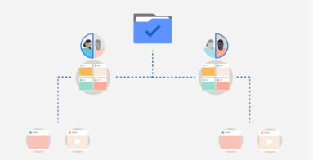
Facebook: Understand the CAMPAIGN
Objective, Campaign name, special ad, campaign buying type (Auction/Reservation), campaign spending limit, Advantage campaign budget, A/B test
CAMPAIGN
Ad set name, (objective-wise customized options and goals), cost per goal/ Bid control, budget and schedule, Audience controls, Advantage+ audience, placements, Advantage+ placements
AD SET LEVEL
Ad name, Ad creative, Tracking
AD LEVEL
2024-2025

Slide 7
Facebook: Understand the CAMPAIGN
Objective:
AWARENESS: Reach, Brand awareness, video views
TRAFFIC: Link clicks, Landing page views, Instagram profile visits, drive traffic to messenger/insta/whatsapp, calls
ENAGAGEMENTS: Get responses|| post enagagement, conversions, calls
LEADS: Instant forms, messenger and insta, conversions (on website)
APP PROMOTION: App installs and App events
SALES: Conversions, calls, catalogue sales, messenger/whatsapp/insta
Make your own table of industry-wise use cases of which types of ads will fit where.
SAMPLE: LEADS (Sales for-)
Instant forms: Real estate, CV like Truck
Conversions (on website): Educational institutes
Messenger and Insta: In store visits, Event management
2024-2025

Slide 8
USE CASES
WHICH TYPE OF AD WOULD YOU RUN FOR
send people to your website to read a blog post or look at your menu.
TRAFFIC
increase your page fans, add social proof to a post, or increase sign-ups to a Facebook event.
ENAGAGEMENT
if you want prospective customers to be able to easily submit their details but your website doesn't have a sign-up form or isn't optimized for mobile.
LEAD GEN
WHAT IF YOU HAVE ONE?
people to have an opportunity to chat with you or ask questions prior to making a purchase or taking the next step toward working with you.
SALES/ ENGAGEMENT
2024-2025

Slide 9
Facebook: Understand the CAMPAIGN
BUYING TYPE
Auction Vs Reservation? When to choose what?
Auction : Default mode
reservation should be used for only two advertising goals: Brand Recognition and Engagement
Scheduling is limited in reservation as compared to auction
Min reservation is at 200K & planning till next 6 months can be done
Pros : upfront reservation of target group reach, with a fixed CPM rate VS in auction, cost per 1000 views/impressions (CPM) is dynamic, as an advertiser takes part in an auction every time;
The Auction model offers greater flexibility and instant campaign launch, but you’re not able to forecast your results, The Reservation model, in turn, allows precise ad spend planning and control over the ad frequency, and yet, it has its limitations such as a minimum number of people that needs to be reserved. The choice between the two ad buying models will largely depend on your specific business goals and the advertiser’s preferences.
2024-2025

Slide 10
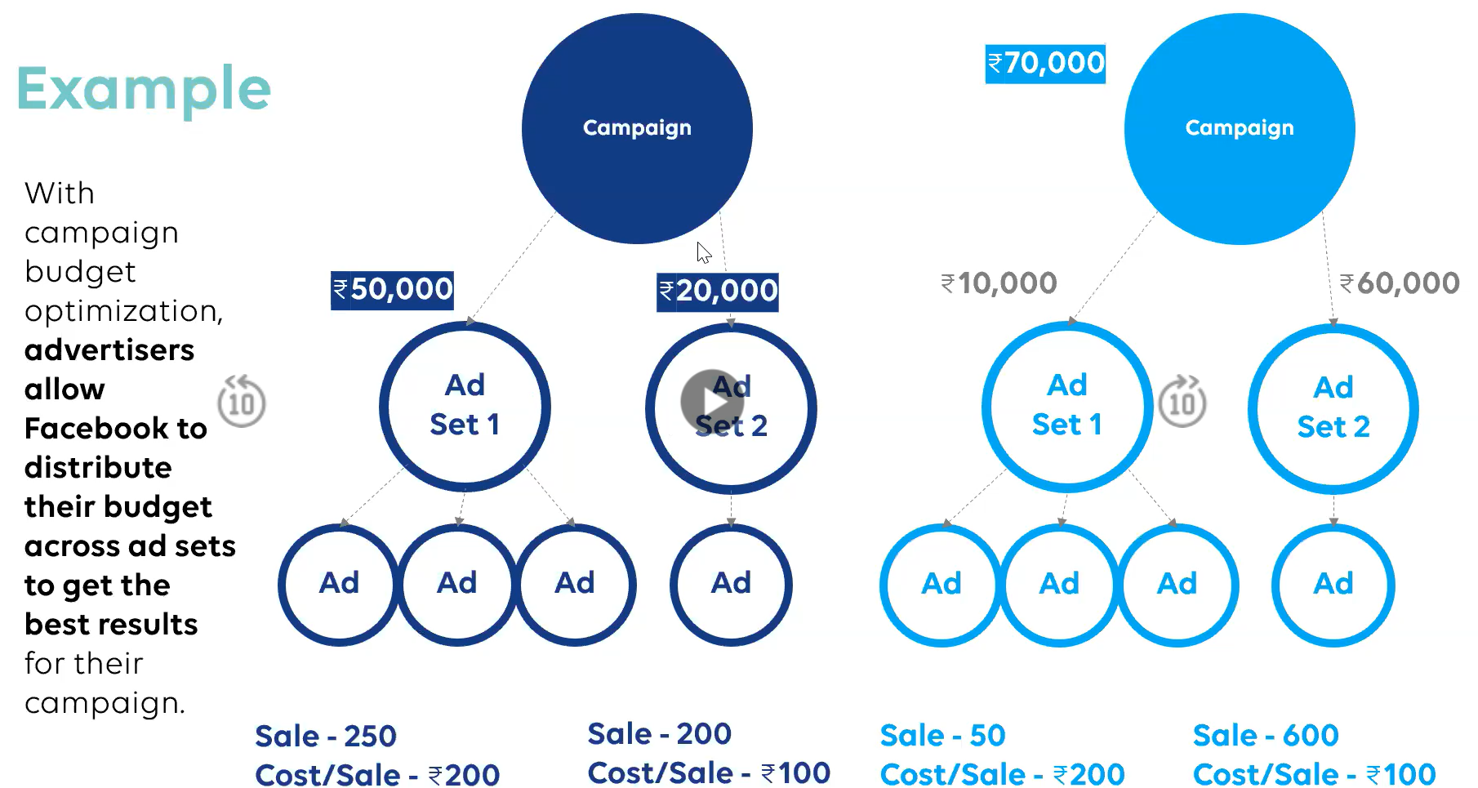
Facebook: Understand the CAMPAIGN
CORRECT TIMELY SO THAT YOU DO NOT REGRET LATER!
Ad set 2
2024-2025

Slide 11
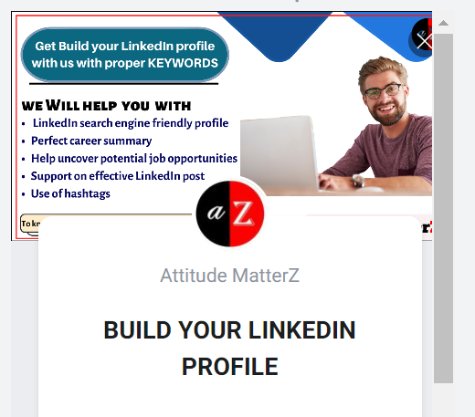
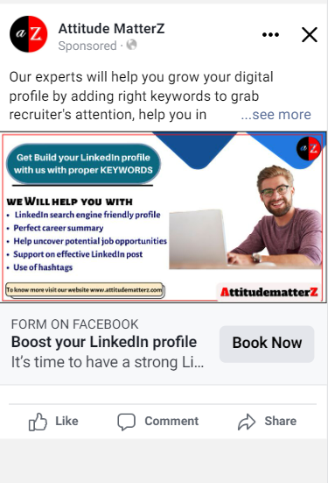
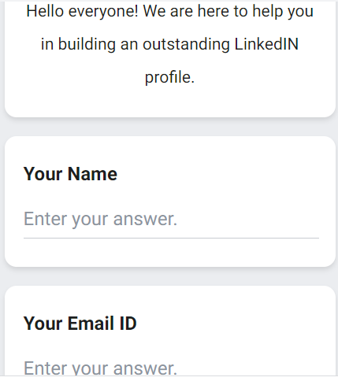
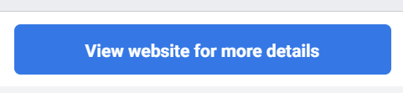
Facebook: Understand Ad COPY
An ad for a service – “LinkedIn profile building for working professionals” for A2Z.
Lead Generation form
Page name
Ad
Primary Text
Ad media
Directly related to objective
Headline
CTA
Description
2024-2025

Slide 12
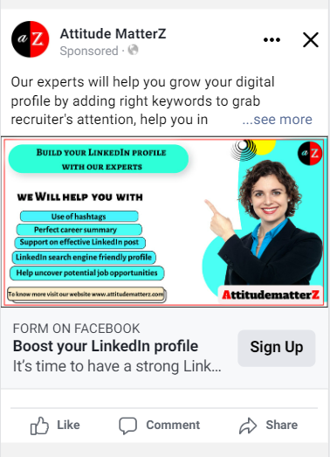
Facebook: Understand Ad COPY
Create multiple ad copies to test which one performs better
Create multiple testings for audiences/location/placements/ time of day/day of week
Healthy practice:
Have atleast 3 Primary text, 2 Headlines, 3 CTA, and 4-5 media copy
2024-2025

Slide 13
Facebook: Understanding AD SET
Ad set name, (objective-wise customized options and goals), cost per goal/ Bid control, budget and schedule, Audience controls, Advantage+ audience, placements, Advantage+ placements
Cost per goal/ Bid Control
Budget & Schedule
Creating Audiences
Choosing right placements
2024-2025

Slide 14
Facebook: Understanding AD SET
Cost cap sets a maximum cost per optimization event, while bid cap sets a maximum bid limit for each ad set.
Cost per goal/ Bid Control
COST CAP VS BID CAP | PROS | CONS
Cost Cap | Helps you control your costs and stay within your budget. Allows you to optimize for a specific result at a predictable cost. Gives you more control over your bidding strategy. | May limit your reach and the number of results you get. Can be less effective for campaigns with a flexible budget. Requires more monitoring and adjustment than bid cap.
Bid Cap | Can help you get the lowest cost per result possible. Allows Facebook to optimize your campaign for the best results. Can be more effective for campaigns with a flexible budget. | Can result in higher costs if not managed properly. May not be as effective for campaigns with a fixed budget. Gives you less control over your bidding strategy.
2024-2025

Slide 15
Facebook: Understanding AD SET
Budget & Schedule
Daily Budget
Lifetime budget
Discuss the cost planning template
Show Detailed audience targeting
Create a custom audience panel (use template too)
Discuss Look alike
Creating Audiences
Choosing right placements
There are 15+ total ad placements across the following platforms: Facebook, Instagram, Audience Network, and Messenger. Not all objectives support all placements.
Guide: https://www.facebook.com/business/help/279271845888065?id=369787570424415
2024-2025

Slide 16
Facebook: Understanding AD SET
Placements : Selection
S. no | Type | Usual result type | Use cases
1 | Facebook Feed | higher click-through rate and lower cost-per-conversion | they’re better for enticing people who are not yet familiar with your brand or company
2 | Instagram feed | best results in terms of cost, ROI and engagement — brands’ average engagement rates are 10X higher on Instagram than on Facebook. | non-intrusive way to reach your target audience because the ads look like normal Instagram posts.
3 | FB Marketplace | more affordable than Google ads, doesn’t yield as many interested users as more established rivals like Amazon and eBay, | targets users with purchase intent; ideal ad placement for local services and brick-and-mortar businesses.
4 | Apps (Audience Network Native, Banner, and Interstitial) | amplify your reach beyond Facebook (16% more); low cost per click (CPC), cost per lead (CPL), and cost per thousand impressions (CPM) | Conversion rates are lower due to driving unqualified traffic, which leads to higher CPAs.
5 | Instagram Explore | More than 50% of Instagram accounts use Explore to discover brands every month. | You can only select this placement along with the Instagram Feed placement.
2024-2025

Slide 17
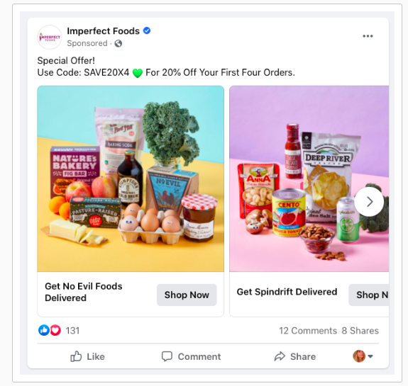
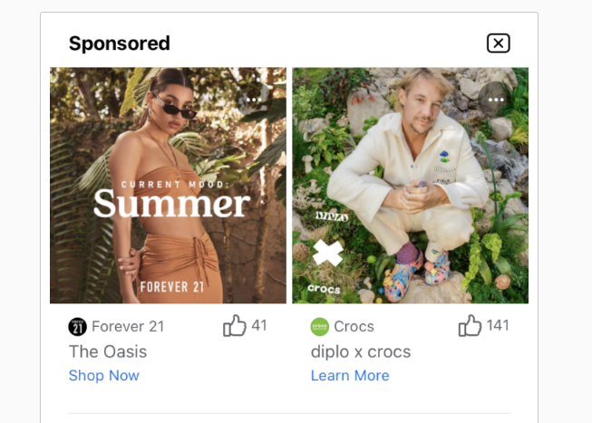
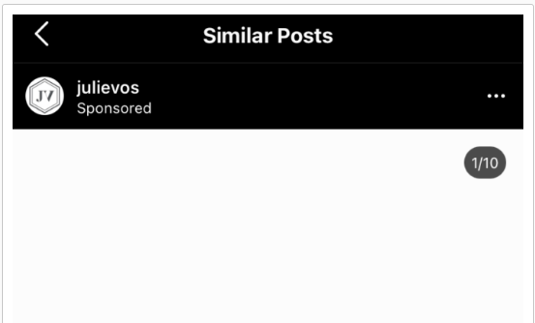
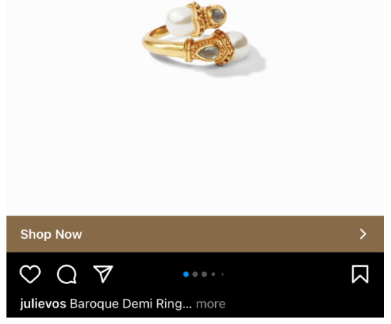
Facebook: Understanding AD SET
Facebook Feed
Facebook Market place
Insta Explore
Facebook video feed viewership rates is less than in-stream videos.
2024-2025

Slide 18
AD SET UP
Set Up an Ad for Tata Trucks 407
Brief:
We need to tap applications like LPG Cylinder, Construction materials haulage and other generic ones.
Campaign
Lead Gen: Instant forms : Switch on AB test
3 ad sets : LPG+ Construction+ Others (Budget at ad set level)
Audience targeting: Use CRM custom list of past customers in each case and create a look alike
Location: Target Hubs: LPG association locations, Nearby gas agencies, nearby major transport across a state. (If such details are unavailable at your end>> you may start with a Pan India targeting)
Lifetime budget
Placement: Facebook feed along with facebook right column, Facebook Business explore, Facebook reels, Facebook in stream videos (Not Instagram)
Ad Set
Ad Level
A combination of video testimonial ads showing usage & an image ad can be run. For generic application, a carousel can be run showing use cases
2024-2025

Slide 19
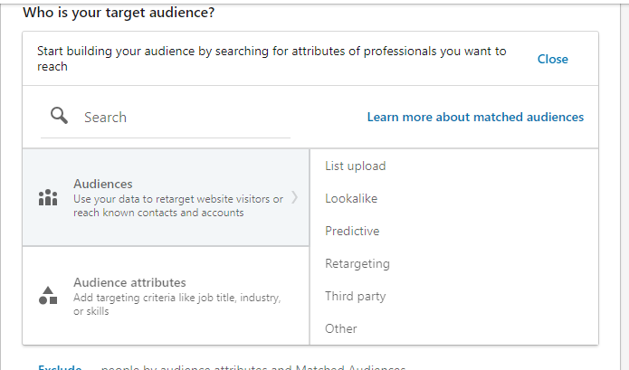
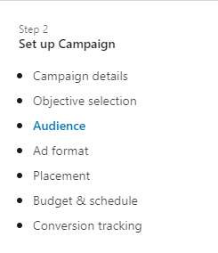
LinkedIn Advertising
Switch to interface
Switch to interface
2024-2025

Slide 20
THANK YOU!
farheenarahman777@gmail.com
+91- 80510 04735
2024-2025

