Slide 1
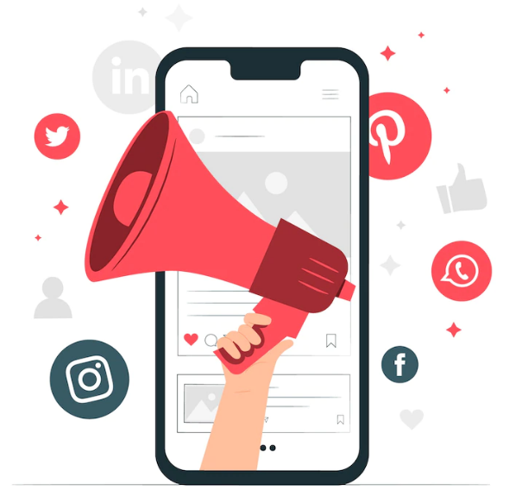


IIM VISAKHAPATNAM
Session Topic
Social Media Marketing
By:
Farheen Rahman
Senior Manager- Growth
Metrix Research
farheenarahman777@gmail.com
+91- 80510 04735
2024-2025

Slide 2
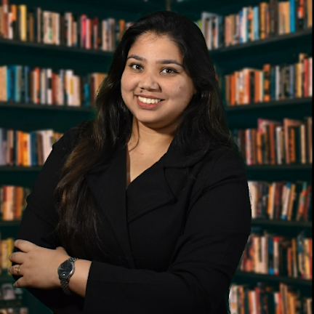



About the Speaker
“
I am currently looking after New Business Vertical for Metrix. I have worked and collaborated across industries including Automotive, E-commerce and Consulting at Tata Motors Limited, IndiaMART, Gartner Inc., EY, JustDial and ACS Technologies in areas of Go To Market, Digital Transformation, Client Handling, Product Management and Digital marketing across all platforms.
”
Education Background
Corporate Competition
Lecture Series
Executive Development Programme in Digital Marketing from XLRI Jamshedpur
O
O
IIM Jammu- Executive Batch (2 batches)
IIM Vishakhapatnam- Executive Batch (5 Batches)
Tata Motors Sales Team- Mid and Senior Level Managers of Tata Motors East Sales Team (130 participants)
IIM Jammu- MBA final year
IIM Vishakhapatnam- MBA Final Year (2 Batches)
IIM Ranchi- MBA final year
BIT Mesra- B. tech & MBA
SOIL Gurgaon- Industry Mentor
KCC Institutes- BBA, BCA, BJMC
Skill Development Coach- GP colleges under Govt. of Jharkhand for placement and related trainings since 2017
Personal Interview trainer, Super 70, Maxel Leadership Council to train MBA aspirants on WAT and PI to convert IIM calls
National Level:
Tata Motors Mindrovers 2018 (PPO) TAS In-house by Tata Group 2021; Pinnacle by Aditya Birla Fashion & Retail 2017;
E-Hackathon, Tata Motors 2020
State Level:
Startup Pitch , Govt. of Jharkhand- 2018
Campus Level:
Nestle 4P Challengers 2018,
RPG Bizzards 2018
O
MBA in Marketing and Finance from IIM Ranchi
O
B.E. in Civil Engineering from BIT Mesra (Gold Medalist)
O
O
O
Class XII : JVM Shyamali (AFMI Gold Medal)
Class X : District 2nd Topper
O
2024-2025

Slide 3

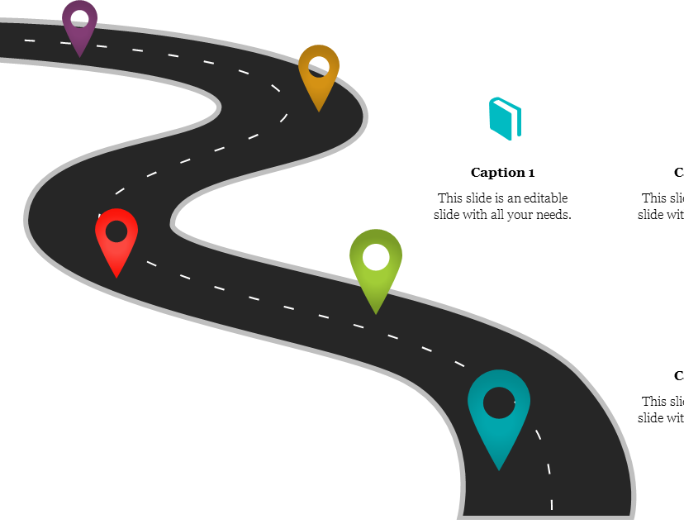

Roadmap
ONE: Understanding FB, LinkedIn and Ad structure
Understanding ad set up across each platform
Social Media Analytics and Campaign Optimisation
Social Media Marketing Stats
Please feel free to ask questions after each topic.
Avoid advanced questions in the beginning
E-commerce journey : D2C
LinkedIn Advertising
Elements of SMM
LinkedIn high quality lead extraction
2024-2025

Slide 4
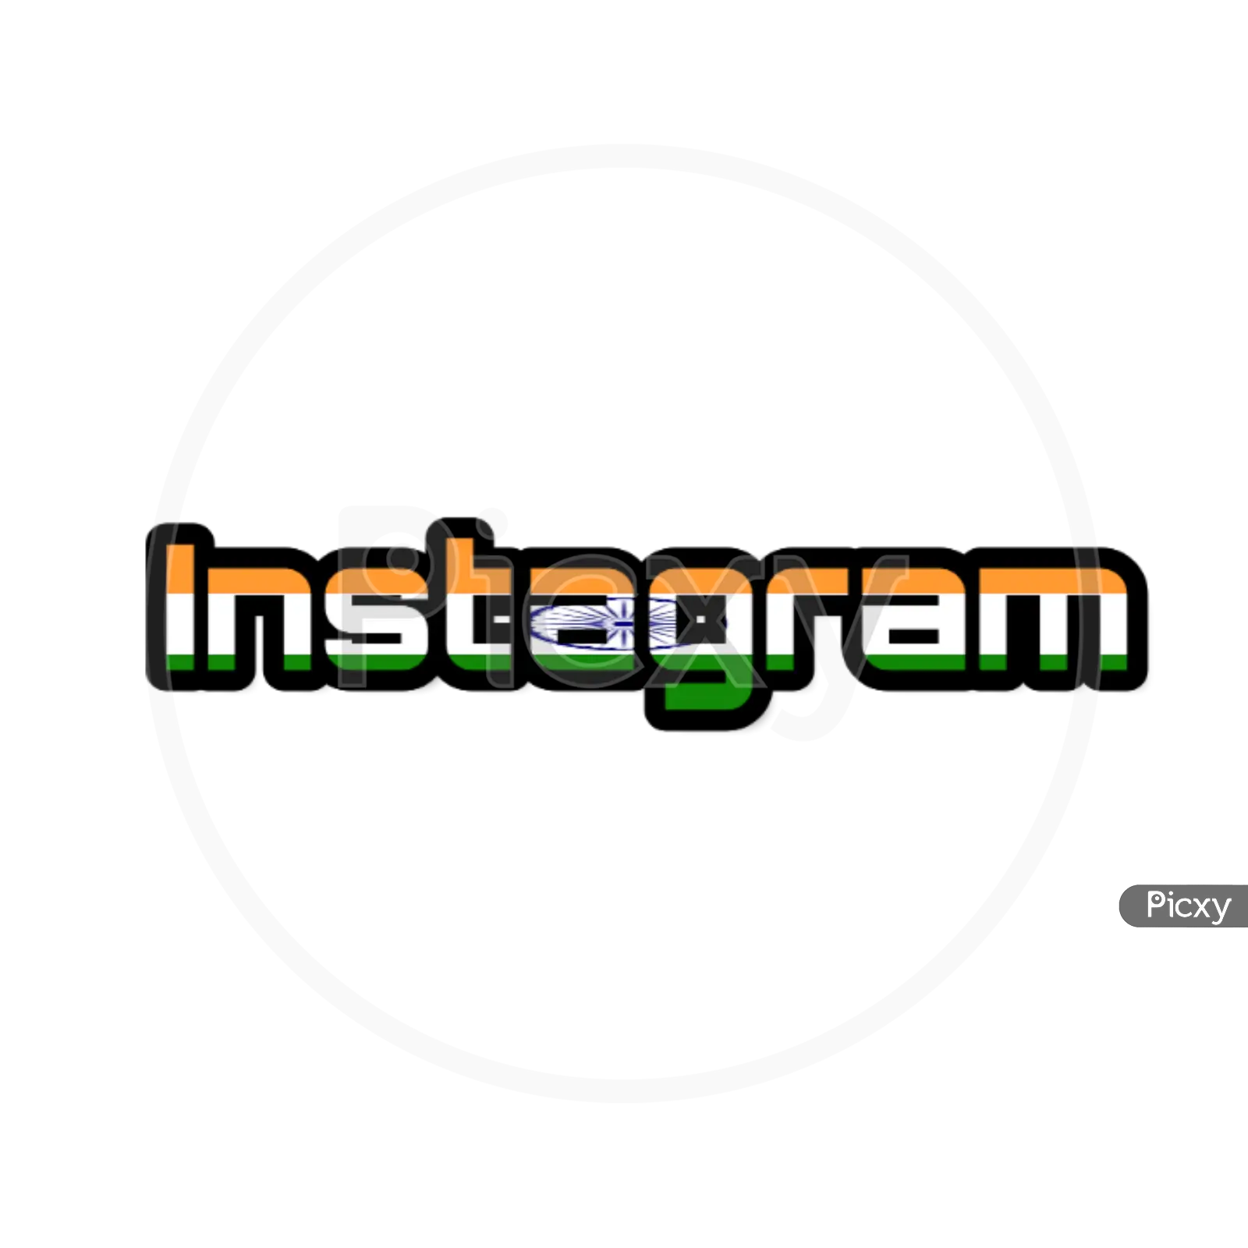

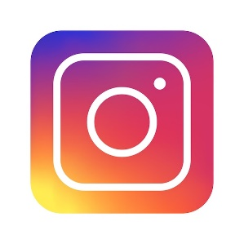


Warm up with some great Stats!
In the US alone 51% of total advertising spend was used on digital ads and India will follow the trend
In 2024, there are estimated to be 5.2 billion total social media users worldwide and the average of 2.25 hours spent per day (91% mobile)
India has the most Instagram users in the world
>> 362 Mn users followed by US at169 Mn (201 Vs 157 in 2 years)
>>India is also Instagram’s fastest-growing market
Facebook users click on 12 Facebook ads on average every month
81% of Insta users say use Instagram to research products and services
Nearly 80% of X/Twitter users feel more positive about a business when they get a response to their tweet.
4 out of 5 people on LinkedIn have potential to drive business decisions
2024-2025

Slide 5
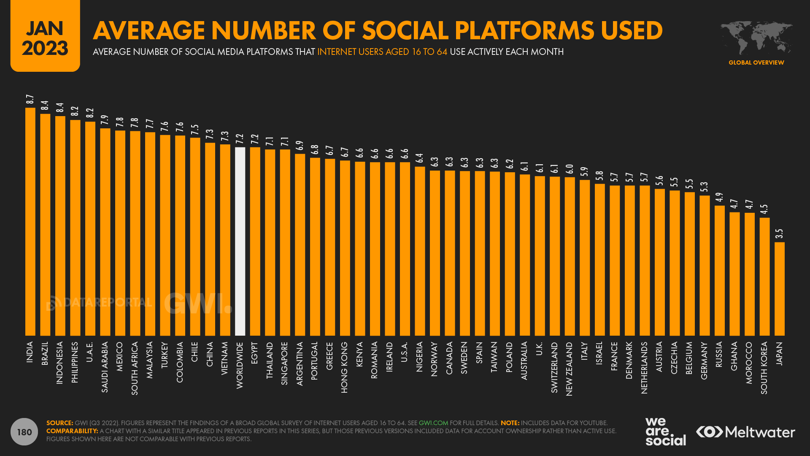
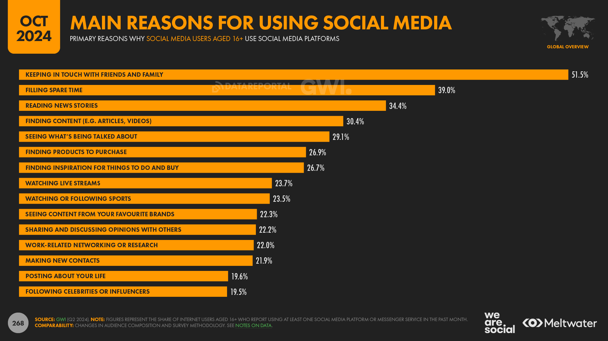
Can you believe it?
2024-2025

Slide 6
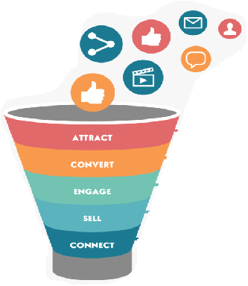

Let us do a quick RECAP
Digital Marketing Funnel Terminologies
Definition
Conversion metrices
How many times was my ad shown
CPM, CPV
Impressions
How many of these ads were viewable
vCPM, vCPV
V- Impression
CTR, PPC
How many people clicked on ads / unique or duplicate
Clicks
How many of them filled lead form
CPL
Leads
How many could tele-calling agency contact
Calling rate
Contacted leads
Interested leads
How many are interested if < 90 days(C0) if < 180 days Prospect
CPE
2024-2025

Slide 7
Typical user Journey of purchase from e-comm website OR app
Impressions
Click
Landing page
100000
5000
4500
CTR= 5000/100000
=5%
Buy Now
Add to Cart
Browse
550
1500
Budget= Rs. 6000/-
CPM= 6000/ (100000/1000) = 6000/100 = Rs.60
CPC= 6000/5000 = Rs. 1.2
CPS= 6000/500 = Rs. 12
THANK YOU
500
2024-2025

Slide 8
Understand the numbers before taking a business decision
Budget= Rs. 6000/-
CPM= 6000/ (100000/1000) = 6000/100 = Rs.60
CPC= 6000/5000 = Rs. 1.2
CPS= 6000/500 = Rs. 12
Revenue= (Consider product price =50/-)
= 500*50
=25000/-
Ad charges= Rs. 6000
Ad creative= Rs. 1000
Ad set up (agency)= 25% * 6000
=Rs. 1500
Total cost (excluding website maintenance)= Rs. 8500
Can there be Another formula for Conversions?
ROI= {Total revenue- Total spend(All)} / Total Spend
= (25000-8500)/8500 = 1.94
ROAS= {Total revenue/ Total Ad Spend}*100%
= (25000/6000)= 416%
Remember: GOOD ROAS Depends on Profit Margin
PROFIT
2024-2025

Slide 9
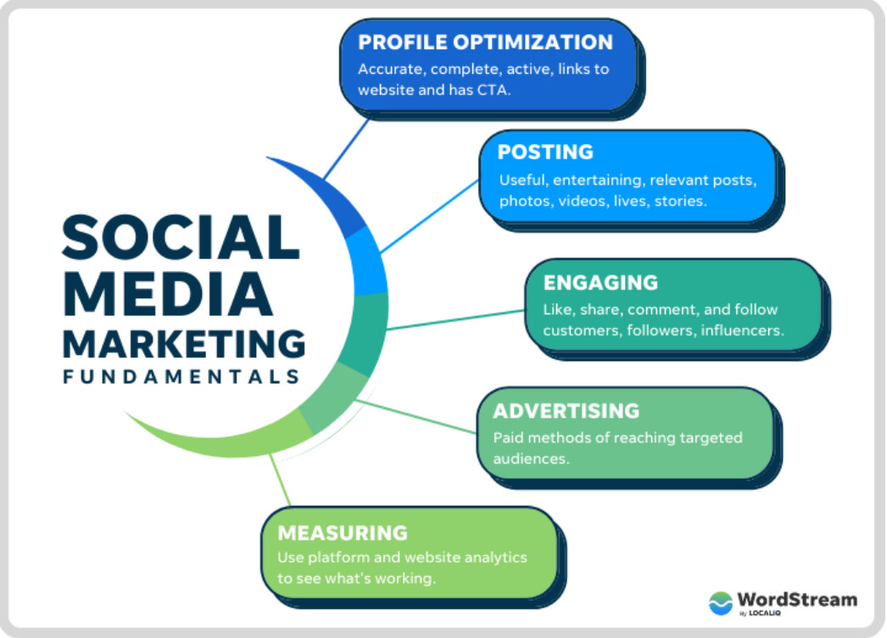
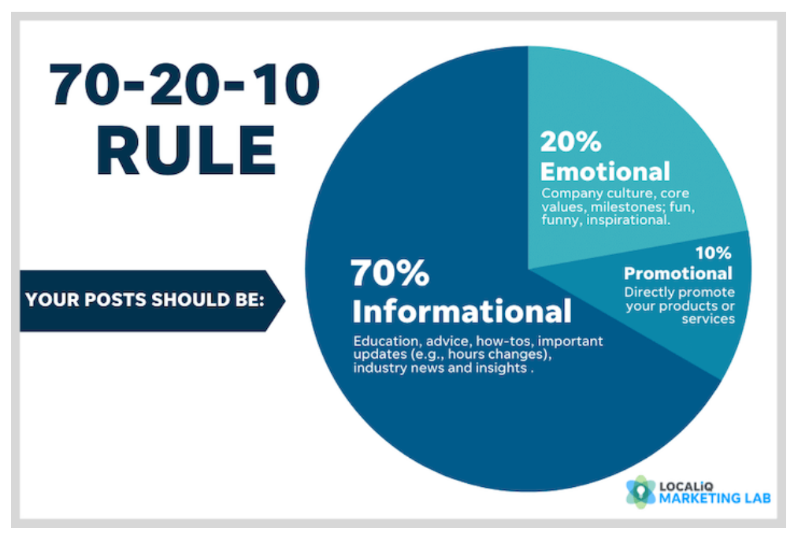
SMM- Elements
1
2
3
4
Discuss the engagement Formula*
E= 1(L)+ 3(C)+9 (S)
5
*As per Germin8
2024-2025

Slide 10


SMM- Elements
Issues:
>> Followers and likes
>> Page Name optimization
>> Page URL optimization
>> Photographs, Bio, etc.
2024-2025

Slide 11
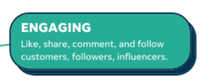
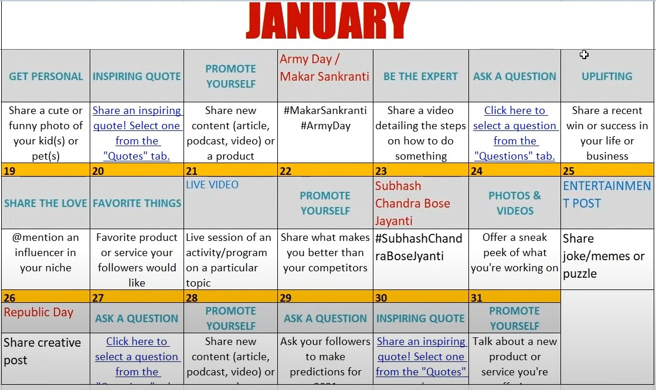
Social Media Calendar
Discuss the Tata Motors ILCV Facebook Page and its growth.
Discuss Engagement Formula
2024-2025

Slide 12
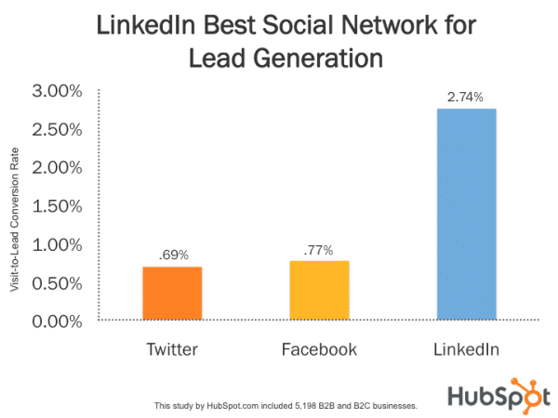
NOW IS THE BEST TIME TO BE ACTIVE ON LINKEDIN IN INDIA!
100 Mn users in India earlier in 2023 which has rose to 130 Mn users in 2024 || 73% YoY student signups
4 out of 5 people on LinkedIn have potential to drive business decisions. Almost 25% of LinkedIn users are senior-level influencers: decision-makers, business builders, and C-level executives.
LinkedIn is 277% more effective at generating leads than Facebook and Twitter.
79% of marketers see LinkedIn as a very good source of leads, B2B marketers, who report that 80% of their social media leads come from LinkedIn, with 40% seeing LinkedIn as their most effective channel for driving high quality leads.
2024-2025

Slide 13
Some more facts
People trust their friends and connections more than brands. According to Edelman, employee advocacy-related leads convert 7x more often than other leads.
If you are a D2C E-commerce brand, LinkedIn advertisement is NOT for you!
LinkedIn ads would cost atleast 5X of Facebook ads
Funnel management (Link LinkedIn to a CRM) is a must to get maximize results
Remarketing via upload list proves to give the best ROI (Insights Tag to be integrated from Day 1)
Tip: Always Exclude Job Hunters from your LinkedIn campaign
2024-2025

Slide 14
LinkedIn for Professionals- Profile hygiene:
Profile optimization is a must!
Profile Headline and Job Title are used to search: Please ensure the relevant keywords are added
Profile level should be minimum at intermediate level
Display all the achievements and work that has been done in points (helps in candidates shortlisting)
Profile photograph and banner should be professional and customized
Ensure the creator mode is ON
Your “Open to Work” status is visible to your HR and Managers :P
2024-2025

Slide 15
LinkedIn for Professionals- Engagement hygiene:
Post consistency is the king. (Even AI generated and scheduled works: Sad but true)
Try keeping 1 post genre to get a top LinkedIn voice badge (It gets reviewed every 6 months)
Use 100 free invites every week: 2*50 invites (Use personalized messages & keep tweaking base messages)
Do NOT use automation tools
Engage with 5/6 posts a day (SSI Improvement)
Do not leave messages unattended for more than 48 hours
Use polls to generate engagement
Try commenting in at least 2 debates a week- immediate connection invites
2024-2025

Slide 16
Harvest Impressions: Here is how
For a generic post (any post type), LinkedIn would show it on the feed of 5-7% of your follower base.
How to increase your post impressions?
Improve your Social Selling Index.
Profile optimization
Connect with right network
Engage with Insights
Building relationships (Engage with every connection request, message, job request: Even if the answer is NO!)
Challenge:
Post “consistently” on LinkedIn for a month. Finish each day at inbox zero—no unanswered invites, no unanswered messages. Watch your LinkedIn performance head up.
Ensure to have a close network of people who would like, comment and repost in the initial 45 minutes of posting. Reply back to each comment.
2024-2025

Slide 17
Increase LinkedIn followers
PROFILE
PAGE
All strategies described above
+
Creator mode ON
+
Try taking a Sales Navigator 1 month trial to send out to a large number of connection invites
Remember:
LinkedIn allows 30K first degree connections
ORGANIC:
Admins can cumulatively use 250 credits per month to reach their first degree connections to increase followings
Employees as well as admins can send Page URL asking their connections to join LinkedIn via messages (No limit)
Organize/sponsor a contest to get LinkedIn followers
INORGANIC:
Do not buy followers!
Inactive followers will decrease every month
Best is to run follower ad under Engagement campaigns
2024-2025

Slide 18
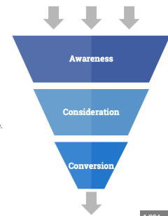
Advertising: Know your Objective first
Brand Awareness + Reach
Traffic+ App Installs+ Video Views + lead generation+ Post engagement+ page likes + event responses+ messages
Conversions + Catalogue Sales + Store Traffic
2024-2025

Slide 19

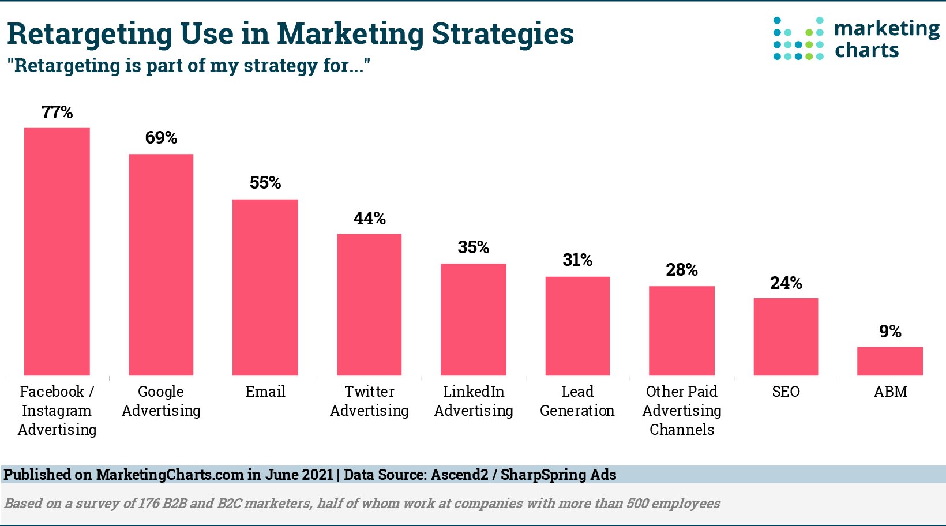
Advertising on Facebook and Instagram in Detail
START FROM SCRATCH:
>>Start with Brand awareness and website traffic campaign
>> Use Pixels on website for Lookalike and Custom audiences
>> After sufficient brand awareness & frequency, go for Lead generation or any other consideration campaign.
2024-2025

Slide 20
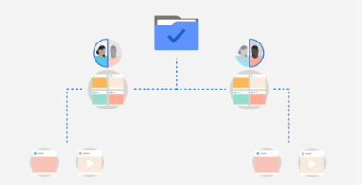
Understanding of Ad structure
Levels | Settings
Campaign Level | Objective Name Budget optimization & Bidding strategy A/B test
Ad Set Level | Name Page selection Audience creation or selection Ad placements Schedule Budget optimization & Bidding strategy
Ad level | Name Ad format Create ad and preview Advanced options like pixels/app events
Refer here for details
Ad Structure
2024-2025

Slide 21
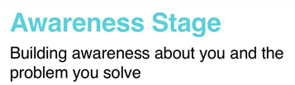
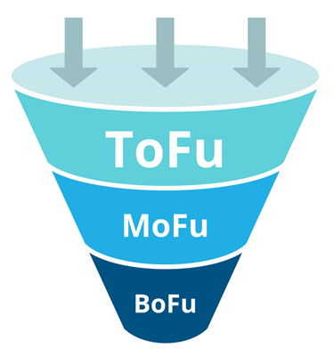
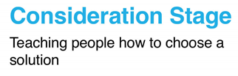

CAMPAIGN STRATEGY SHEET
CAMPAIGN STRATEGY SHEET - SAMPLE
Basic Digital Marketing Funnel
Objective
Possible campaign type
Possible Targeting selections
Bidding strategies
Maximum views/ Impressions/reach/ awareness>>Buzz
Display ad campaign/ Video campaign if there is a story to tell/ Discovery ads on social media or GDN/ Search Campaign
Demographic/ Affinity/ Topic/ Placement/ Custom Affinity
Manual CPC/ Max CPV/
CPM
Involve/ consider/ lie in option choices/ engagement/ pay attention to your product, idea, solution
Remarketing (Video or Display) / Intent based video ads/ Social Media ads (Influencers)/ Search Ads or PPC
In market/ Similar Audience/ Life events/ Custom Affinity
CPC- Manual or enhanced, CPL
Sign up/ buy/ provide details if interested/
Remarketing (Display or video) / Video ads for conversion/ RLSA ads/ Search Ads
In market/ Similar Audience/ Custom Intent
Target CPA, Target RoAS
2024-2025

Slide 22
THANK YOU!
farheenarahman777@gmail.com
+91- 80510 04735
2024-2025

