Slide 1
Strategy management

Slide 2
Topics
Strategy Management
  What is strategy?
Industry-level Analysis
  How can the industry be analyzed?
Value-Chain Analysis
  What is value chain?
  How can the value additions be analyzed systematically?
Business and Corporate Analysis
  How can a coherent corporate-level strategy be formulated based on above?
  How can HR strategy be aligned with corporate strategy?
  Where can analytics help?
  Where does IR come?

Slide 3
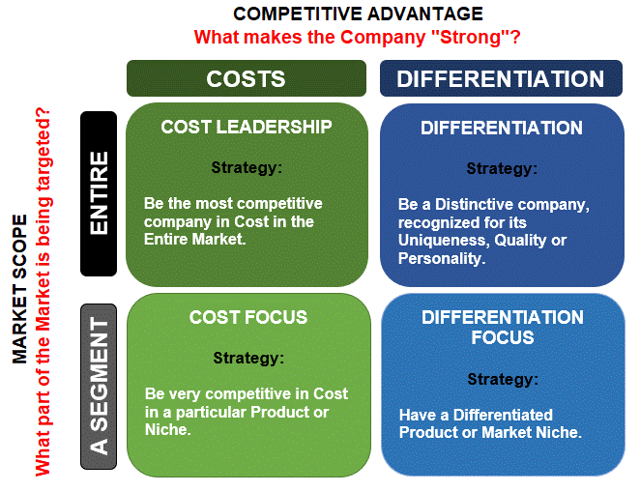
Porter’s generic strategies
Source: https://www.researchgate.net/figure/Porters-generic-strategies-Consuunt-2021_fig1_355351264

Slide 4
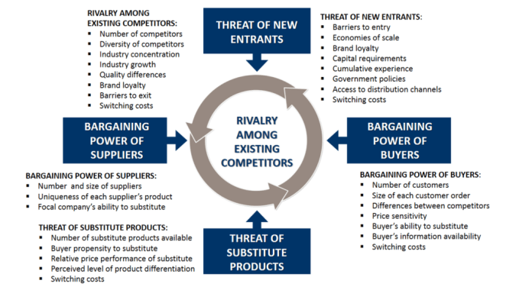
Porter’s five forces
Source: https://www.business-to-you.com/porters-five-forces/

Slide 5
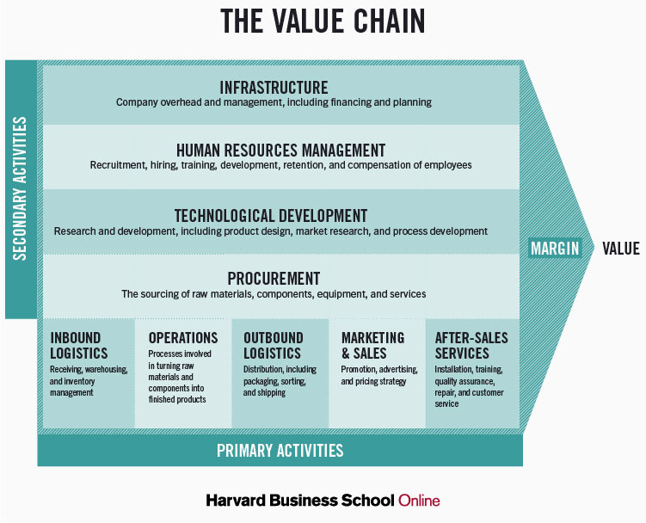
Value chain analysis
Source: https://online.hbs.edu/blog/post/what-is-value-chain-analysis

Slide 6
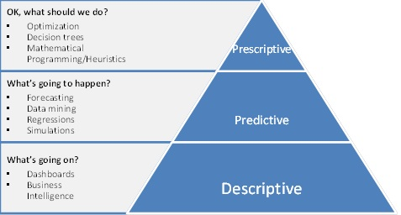
Types of Analysis and tools
Source: https://nicoleparmar.com/moving-from-descriptive-to-predictive-and-prescriptive-analytics/

Slide 7
McCune Contracting
Organization: McCune Contracting, Oilfield Services Provider
Protagonist: Rachel Banning, Recruiting and Marketing Manager
Dilemma: Strengthen recruitment processes to provide adequate manpower
Context: Turnaround season was two weeks away

Slide 11
McCune Contracting
What is the industry environment of McCune Contracting?
What is the value chain analysis of McCune Contracting?
What is the role of HR department in McCune Contracting’s value chain?
What should be the strategy for McCune Contracting?
Are the information and analytics system of McCune Contracting’s HR Department aligned with effective implementation of this strategy?
How can Rachel help in the same?
Are their IR issues involved?

Slide 12
Labour Codes
The Government has consolidated all Labour Acts into four broad codes:
  Code on Wages, 2019
  Occupational Safety, Health and Working Conditions Code, 2020
  Code on Social Security, 2020
  Industrial Relations Code, 2020
Source: https://vvgnli.gov.in/en/ppts-on-labour-codes

Slide 13
Code on Wages
Aims to regulate wages and bonus payments in all industries
Subsumes the following Acts:
  Equal remuneration Act, 1976
  Minimum Wages Act, 1948
  Payment of Bonus Act, 1965
  Payment of Wages Act, 1936
Source: https://vvgnli.gov.in/en/ppts-on-labour-codes

Slide 14
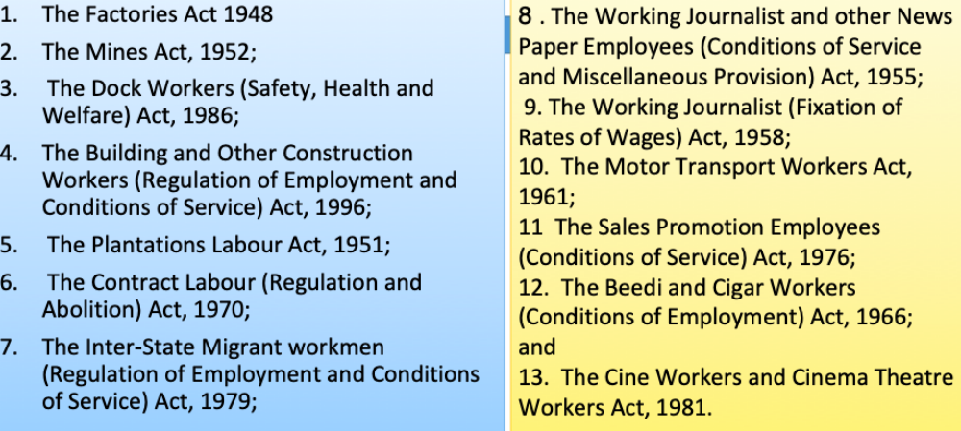
OSH Code
Consolidates 13 Acts
The Acts are:
Source: https://vvgnli.gov.in/en/ppts-on-labour-codes

Slide 15
  Code on Social Security
Aims to provide social security, defined as income security and access to health care, to all employees irrespective of employment status
Subsumes the following Acts:
  The Employees’ Compensation Act, 1923
  The Employees’ State Insurance Act, 1948
  The Employees Provident Fund and Miscellaneous Provisions Act, 1952
  The Employment Exchanges (Compulsory Notification of Vacancies) Act, 1959
  The Maternity Benefit Act, 1961
  The Payment of Gratuity Act, 1972
  The Cine Workers Welfare Fund Act, 1981
  The Building and Other Construction Workers Welfare Cess Act, 1996
  The Unorganised Workers’ Social Security Act, 2008
Source: https://vvgnli.gov.in/en/ppts-on-labour-codes

Slide 16
  Industrial Relations Code
Aims to minimize conflict between employers and employees industries
Subsumes the following Acts:
  Trade Unions Act, 1926
  Industrial Employment (Standing Orders) Act, 1946
  Industrial Disputes Act, 1947
Source: https://vvgnli.gov.in/en/ppts-on-labour-codes

Slide 17
  Analytics and ir
  Benchmarks and regular data collection on proper metrics can help ensure compliance with labour laws
  Analytics can ensure uniformity in communication to employees and provide updates on timely resolution of complaints
  Improved workforce planning can reduce the need for layoffs and other workforce rationalization practices
  Chatbots can be used to form basic levels of employee grievance resolutions freeing HR professionals for more complicated tasks
  Sentiment analysis can help analyze grievance letters and other data to proactively identify pain points

