Slide 1

SHRAA4
CAREER PROGRESSION AND WORKFORCE DEPLOYMENT
DR. Munmun goswami
(29-Oct-2023)

Slide 2
Career Progression

Slide 3
Case Study
Workplace Ostracism, Complacency and Career Plateau – the career impediment of a dignified clerk
Workplace ostracism
Career adaptability
The importance of career planning
Whose onus is it
  Individual?
  HR?
  Organization?

Slide 4
Career
Property of organization or occupation
Long-term scenario
Status of a professional
Involvement in one’s work
Stability in one’s work pattern

Slide 5
…CONTD.
Promotion – do well, move up
Transfer – to a different kind of job, to a different location with same kind of job
Demotion – not perform well, go down the ladder
Termination – goodbye

Slide 6
Career Progression
Moving ahead in one’s profession
Hierarchically, from lower level to upper level
  Performance -> Merit
  Seniority -> Experience
Career path – the line of movement (flexible) of an employee in their tenure in the organization
Career development – handled by the organization

Slide 7
Career Planning
Individual
What is the best way to progress? Is it
  Who you know
  Your skills
  Being in the right time at the right place
Being authentic, resilient, putting yourself out there
Be innovative, creative, without harming others (negatively affecting others)

Slide 8
Career Development
Organization
  It is the career planning for employees, from the organizational perspective
  Certain interventions by the organization, certain initiatives for your growth and development
  Formal structured activity,
  Planned and implemented by the organization,
  To help acquire the skills and experiences,
  To successfully perform current and future tasks
Your role as HR
  Understand employee careers
  Influence those careers
  Modify the KSAO (knowledge, skills, attitudes, objectives) as per environmental needs
  Aid employees to develop accordingly, in alignment with environmental needs

Slide 9
…CONTD.
So, ownership is at the individual level
BUT
HR need to facilitate this process
  Ensure the skillsets developed (by employee) matches the skillsets required (by organization)
So, Ensure
  How individuals are going to plan their career
  How they are going to get a job and move back in the career
  Associated rewards for their growth
  What kind of developmental interventions are required
  What kind of activities need to plan (to develop employees)
  Organizational culture alignment
  Develop policies
MATCHING ORGANIZATIONAL NEEDS WITH INDIVIDUAL NEEDS

Slide 10
External Environment
How important is it?
  Covid19 pandemic
  Russia-Ukraine war
  Israel-Hamas war
  Natural calamities
  Rise of AI
  Disruptive technologies
As HR, you need to keep abridged to the external environmental factors and their impact on the task/ job
Address the skill demands-supply gap/ training needs analysis and fulfill it

Slide 11
Changing Employment Relations
Stability vs. flexibility
Job-for-life vs. job-till-it-aligns-personal-needs
Loyalty to job vs. loyalty to profession
Job security vs. career security

Slide 12
Workforce Deployment Metrics

Slide 13
Workforce Planning
Deploy
  (the) Right People
  (with) Right Skills
  (in the) Right Roles
  (in the) Right Place
  (at the) Right Time
  And (at the) Right Cost

Slide 14
Workforce Planning Metrices
These are information about the workforce, which can be tracked, analyzed and leveraged
  To proactively plan for future

Slide 15
Workforce Deployment
Staff scheduling
Flexible multi-channel and back-office forecasting
Optimization to find best possible employee schedule
Leverages employee skillsets while balancing
  Workload
  Budget objectives
  Payroll limitations
  Employee availability
  Workplace rules
  Performance standards

Slide 16
Key Metrices
Employees per Manager
Employees Service Profiling
Workforce Age Profiling
Workforce Service Profiling
Churn Over Index
Separation Clearance Time

Slide 17
Employees per Manager
Span of control
  Time allocation – how much time manager actually spends in their own work versus time spent managing others
  Process standardization – how much of the work process is formalized/ standardized
  Work variety – how similar or different work is for individual direct reportee
  Team skills – how much experience and training do team members job require
Typical ratios
  4:1 for direct reports to
  20:1 for administrative
  10:1 for workers
Ultimately, it varies from industry to industry

Slide 18
Some Critical Ratio on Span of control
Manager
to
Subordinate ratio
For Head
[Ratio 1:10 to 15]
Ex – Regional VP, HR Head
For Senior Level
[Ratio 1:5 to 7 ]
For Junior Manager Level
[Ratio- 1:4 to 5]
For Mid Level
[Ratio 1:5 to 8 ]

Slide 19
Employee Profiling

Slide 20
Employees Service Profiling
Identify right candidates for a particular job profile
Profiling of existing employees (how)
  Understand role and its requirements
  Cross-check for internal matching
Profiling for new hires (how)
  Job posting
  Online assessment
  Interview process
Can be done through
  Psychometric tests
  Personality tests
  Social media profiling

Slide 21
Use
Analyze your current Workforce
To identify the skill levels you employ
The kind of interaction/function they perform
Create the template for perfect candidate
For selection or any prediction
Specify the level of commitment etc.
Review the application based on the template
Review according to the template
Technical & Behavioral
Specify the minimum level of qualification
Specify the minimum experience
Helps in identifying the root causes
Helps in shortlisting
Design an open ended questionnaire/MCQ type
Create a Red/Yellow/Green colored tag for the employee
Who is Happy who is UNHAPPY
For Future Pipeline
Take proactive actions
Design data driven policies

Slide 22
STEPS
1. Have a clear understanding about what you want to achieve and why by setting out clear objectives.
2. Conduct an internal stakeholder mapping exercise using a stakeholder models
  Such as the power/ interest matrix
    Identify those employees with influence and interest.
3. Identify all existing data and employee insight that your organization holds.
  For example
    Employee engagement surveys,
    Demographical information,
    Comments on internal social media such as blogs, community pages and online forums.
4. Collate all internal feedback including employee complaints, information from pulse groups, face-to-face events, sessions as well as feedback to managers.

Slide 23
…CONTD.
5. Speak to your employees and listen to feedback.
  Visit different sites,
  Talk to different employees to
    Find out more about their thoughts and attitudes towards their role, the organization and specific projects.
6. From all the information gathered
  Identify common themes
  Trends and attitudes in order to create 5-6 common employee groups
  To broadly describe people who work in your organization.
7. Create a character profile
  For each of the groups to provide a short summary or biography
  It develops typologies the people in this group.

Slide 24
…CONTD.
8. Test the employee profiles with senior leadership
  To establish understanding of the profiles and
  How to use them to connect and
  facilitate dialogue with different employees
9. Use these profiles
  To develop a targeted and strategic internal communications plan
  To reach employees across your organization.
10. Update these employee profile groups on a regular basis.
  You could review them annually or
  Each time you do your employee engagement survey.

Slide 25
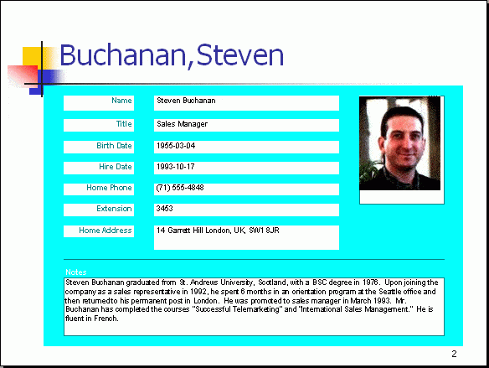
Employee Profile

Slide 26
Workforce Age Profiling
Helps identify / get a clear picture of the age of the workforce
  Each age group has different priorities and needs (human needs theory, levinson’s theory)
Helps plan retirements/ recruitment/ retaining
Brings out patterns and trends across the workforce
Helps workforce planning (for future)

Slide 27
Churn over Rate

Slide 28
Churn Over Index
Percentage of employees leaving an organization over a specific period.
Turnover rate = No. of separations during the time period X 100
Average number of employees during the period
Monthly churn rate = No. of employees quitting that month _ X 100
Average number of employees that month
Employees leave
  Voluntarily – resignation, retirement
  Involuntarily – layoff, terminate
Churn over can also be calculated in form of
  The value of Recurring Business lost
  The % of Recurring value lost

Slide 29
…CONTD.
Why is it important?
  Costs involved in hiring (time, process, training, adjustment)
  Helps understand shortcomings of the hiring process itself
  Helps benchmark
How to reduce/ lower churn over rate?
  Adopt hiring best practices (person-culture fit, person-organization fit)
  Celebrate achievements
  Lucrative compensation and benefits

Slide 30
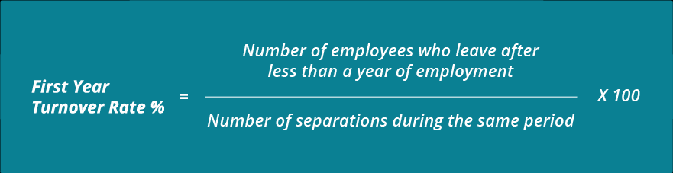
…CONTD.
Competitive Attrition rate
  % of people churning out voluntarily
Focus on
  New Hire Turnover rate
  It is a healthy sign if New hire are staying log

Slide 31
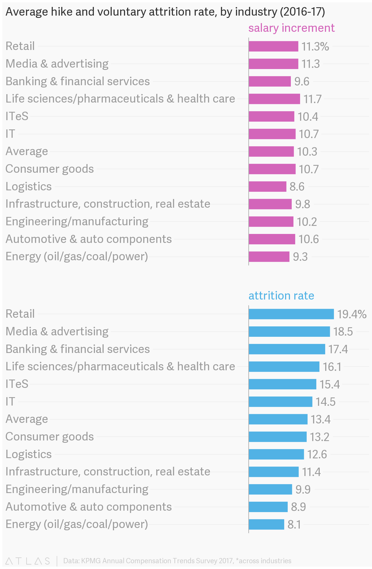
Salary Hike % Attrition Rate

Slide 32
A healthy turnover rate
Compare after calculating the turnover rate of your company
  If your company’s turnover rate is in the average rate within your industry
  If your turnover rate is higher than your industry average, it probably means your management is not as effective as it could be.
Analyze your turnover rate
To better understand your employee turnover, all you have to do is answer three questions:
  “Who are the employees who leave?”
  “When do they leave?”
  “Why they are leaving?”

Slide 33
Who are leaving?
Even if your turnover rate is lower than your industry’s average,
There’s no reason to celebrate unless you can identify who leaves you.
If your top performers are leaving, then you should take immediate action, otherwise your company’s performance will flag.
On the other hand, if your low performers are leaving, celebrate you could stand to gain by enjoying better employee engagement, productivity and profits.

Slide 34
When are people leaving?
Keeping track of when people leave can be very useful.
  For example, your new hire turnover rate can offer a lot of insight.
    First, it can tell you whether your recruitment methods are working??
    If a significant number of your new employees leave because they found their job duties different
    Perhaps you should consider reviewing your job descriptions.
    Investing more time and money developing your orientation process could help too

Slide 35
Why are employees leaving?
When you know why your employees leave, you can change your company’s management style or policies in response.
On-Stay interviews – Help in proactively identifying the root causes
Exit interviews are a useful way to see whether people give similar reasons for leaving, or whether they offer useful suggestions for how you can improve.
For example,
  Employees often say they decided to resign because their input and effort were not appreciated.
  If you hear these kinds of comments in your exit interviews or in performance reviews, HR should work with managers to consider changing PMS

Slide 36
Costs associated with Turnover
Turnover disrupts the flow of a functioning workforce.
When an employee leaves there can be a significant knowledge gap left
More work for the remaining team members.
Recruiting and training a new employee requires staff time and money.
Every time a business replaces a salaried employee, it costs on average 6 to 9 months in salary
For a manager making $40,000 a year, that's $20,000 to $30,000 in recruiting and training expenses, along with other intangibles

Slide 37
Implications for Managers
Differentiate your employees by:
  Job level
  Department
  Location
  Age group
  Gender
  Length of service
Determine where the voluntary turnover rate spikes and if the turnover is acceptable and unacceptable

Slide 38
Separation Clearance Time

Slide 39
Separation Clearance Time
Time taken to complete the exit process for separating employees
Clearly define process and timelines (Exit Policy)
  Notice period
  Paperwork to be completed
  Handing over office materials (keys, IDs, etc.)
  Clearance from other departments
  Exit interview
  Clear dues – FNF (full and final settlement) (either side)

Slide 40
Separation Clearance Time
Generate a data base for the employees based on their contract type
It helps is tracking the separation to clearance time.
It helps in saving the penalties
It helps in keeping the brand image

Slide 41
Few Important Ratios (followed periodically)
Revenue per employee
Operating income per employee
EBITA per employee
General Admin cost per employee
Income per employee

Slide 42
Revenue Per Employee
Revenue per employee measures the amount of business generated by 01 employee.
This is a measure of performance of human resources of a company.
It is an indicator of productivity of company’s personnel
But revenue per employee will vary in different industries according to intensity of labor.
  ROE is less in labor-intensive industries.
  On the other hand higher in the high tech
Calculation
  Revenue per Employee = Sales Revenue / Number of Employees

Slide 43
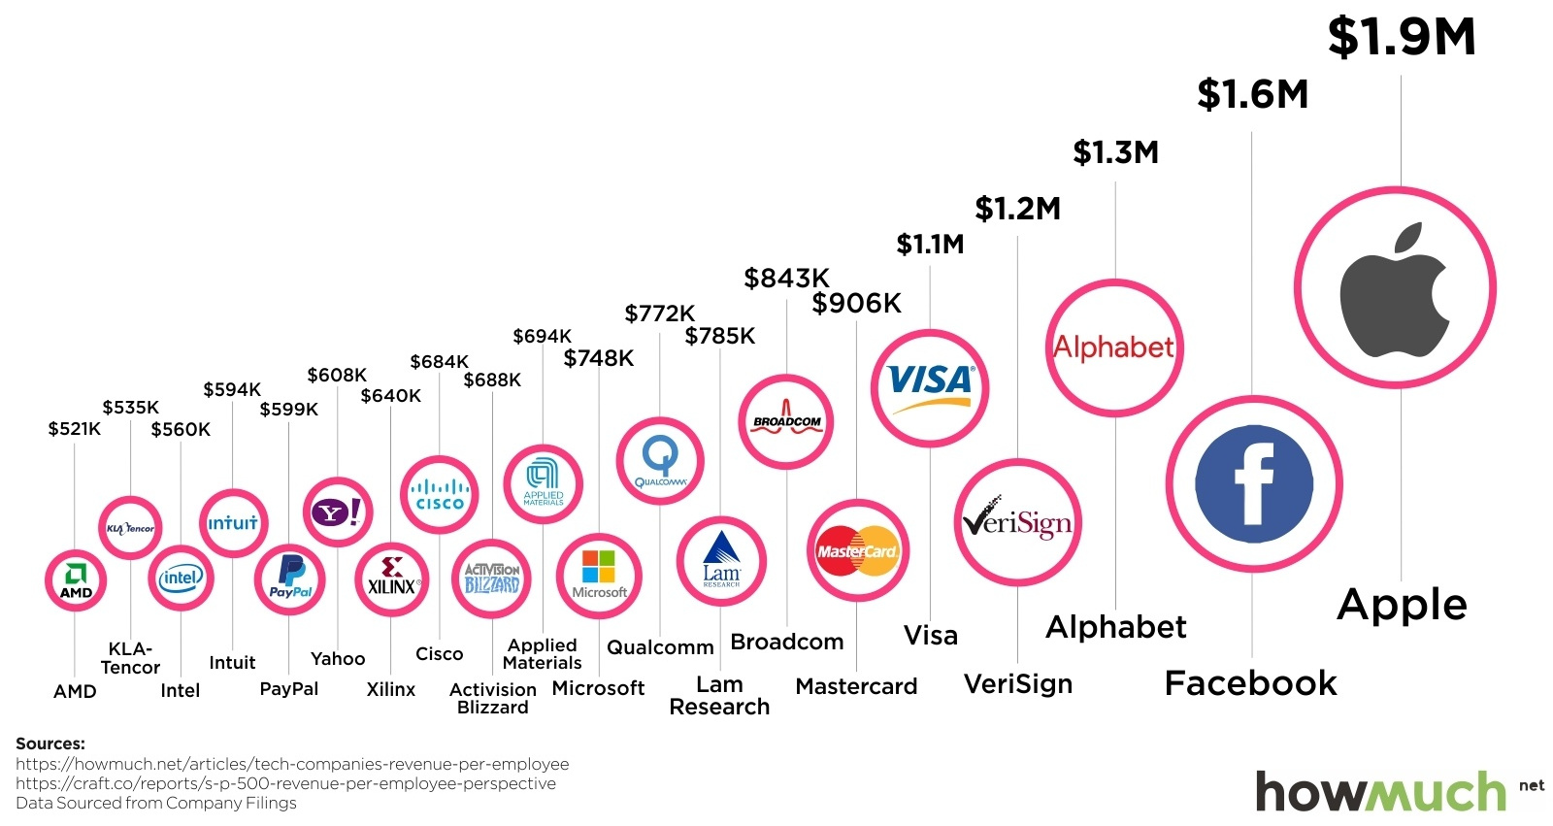
Revenue Per Employee

Slide 44
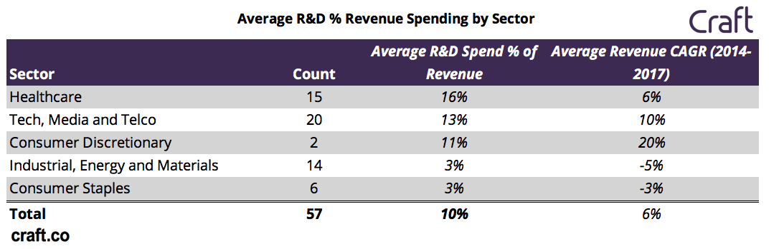
Revenue across Sectors

Slide 45
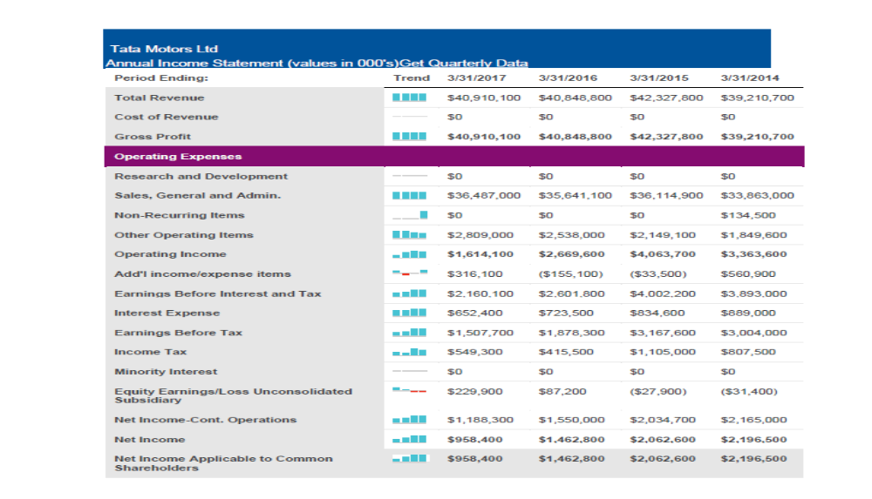

Slide 46
What do the ratio tell us?
Revenue per employee isn’t a leading indicator of success, but a lagging one.
It’s also a composite metric that is negatively impacted by significant
  Waves of hiring,
  Sales team ramp time,
  Product and company maturity in a market and many other factors.
All of this means revenue per employee isn’t a metric to optimize for
You need to look for the trend analysis

Slide 47
Strategic Planning and Forecasting
HR metrics for it
  ROI = anticipated benefits – total developmental costs X 100
  total developmental costs of the program
  ROI = return on investment

Slide 48
THANK YOU!
You may contact me at : munmun.goswami@iimrohtak.ac.in

Slide 49
CASES

Slide 50
Case 1
Sarika has task to identify the important attributes to design a selection algorithm to choose the best fit candidate.
Listed out a few variables like, age, gender, work experience, college category, marital status, aptitude test score, applicant’s academic grades (CGPA) and the distance between home-town and posted branch.
She is not sure if all the attributes are equally important or not.
Questions –
  How will you help Sarika to develop an algorithm for choosing the right candidates based on the significant attributes?? Which statistical tools will be helpful in this situation?
  How will you analyze the results of the output and what recommendations would you provide to the management for selecting the right candidate?

Slide 51
Case 1 Solution
Identify Dependent and Independent Variables
  Dependent Variable: Selection
  Independent Variable: Age, Gender, Work Experience, College Category, Marital Status, Aptitude Test Score and Distance from Home
Identify Method of Analysis
  Dependent variable is categorical and binary, hence, the modelling algorithm to be used in Logistic Regression
Data Pre-Processing
  Check Datatypes
  Check for null or NA values
Sarika should consider the scores of aptitude test, work experience and college category while selecting the new employees. The demographic variables like age, gender, marital status, distance between office and home does not make any difference.

Slide 52
Case 2
Minzi wants to categorize employees in different group based on their engagement and performance level, so that she could customize the groups for different kinds of activities.
She is trying to make a rationale for categorizing people based on their engagement and performance score based on their demographics profile.
She needs to justify the effectiveness of various development programs before and after the development initiative.
Questions –
  Can you help Minzi by using appropriate statistical technique?
  Provide appropriate recommendations based on the results.

Slide 53
Case 2 Solution
To analyze effectiveness of the development programs, we need to identify a statistical tool that can compare both effectiveness and performance pre and post the program
This can be done using Paired Sample T Test
Hypothesis:
  H0: Difference between means before and after = 0

Slide 54
Case 3
Health Freak Pvt. Ltd is facing a serious challenge of being biased towards company promotion policy.
At the hiring level, women’s participation is 45% of total workforce. However, as they grow in the career hierarchy of leadership, the participation has been very low
The performance indices of female employees have been equally significant as compared to their male colleagues in the past years.
Mr. Kapil wants to take strict actions to build the company’s image about gender diversity and inclusion and rectify this issue.
Questions –
  Is there any flaw in the promotion policy? Can we provide some data- based evidence to support our promotion policy?
  What should Mr. Kapil do now to improve the company image?

Slide 55
Case 3 Solution
To analyze if there was a gender promotion gap in the company, we need determine the significance of relationship between Gender and Promotion, both of which are categorical variables
This can be done using Chi Square Test
Hypothesis
  H0: Gender and Promotion are independent.
  Ha: Gender and Promotion are not independent

Slide 56
CASE 4
Company ABC is a reputed company in the Indian subcontinent. It employs over 2400 employees carrying rich experience across the industry. However, since few months few department heads are complaining about the issue of overburdened managers and their inability to handle people issues of their departments. The industry norm for employee: manager ratio is given below.
  1. For Head position all areas (manager to subordinate ratio) should be in range 1:4 or maximum 1:5
  2. For Mid position all areas (manager to subordinate ratio) should be in range 1:5 or maximum 1:8
  3. For Junior Managers all areas (manager to subordinate ratio) should be in range :1:10 to 1:15
  4. For Senior Managers all areas (manager to subordinate ratio) should be in range 1:5 or maximum 1:7
In order to overcome the problem of people issue HR Head out rightly suggested to implement buddy program in the organization and if necessary reduce the span of control by hiring additional manpower or through internal promotions. HR Head has suggested that employees between the age range of 30 – 40 years can serve as mentors in the buddy program.
Given the large employee size, Mr. Suresh has been hired as an HR Analytics expert to present the clear picture in-front of the management. From his basic understanding he summarized the following objectives as given below.
  1. Find department wise manager-subordinate ratio
  2. Find position wise manager-subordinate ratio
  3. Identify the departments which are in danger zone on manager-subordinate ratio
  4. How many employees qualify as potential mentors. Find potential mentors’ department wise.
  5. Identify the youngest and most aged department in the company
  6. Identify the industry type from which maximum employees have come from.
  7. Identify department wise education scenario.
However, before Mr. Suresh could execute the analysis he fell ill and now the HR head has requested you to address the problem and present the report.

