Slide 1
SHRA4
Creating Dashboard using Tableau
Dr. Munmun Goswami, iim rohtak
(10th December, 2023)

Slide 2
TABLEAU – THE DATA VISUALIZER
Tableau helps to
  transform data into actionable insights.
  visual analytics is quite limitless
  Easy to use, no coding knowledge required
  “Build dashboards and perform ad hoc analyses in just a few clicks”

Slide 3
https://www.tableau.com/products/public/download
Trial version (cloud version)
Enter your email id and other details when asked (registration)
Check email for activation
Set password
Once complete, login directly to Tableau (cloud)
Set a name and time zone

Slide 4
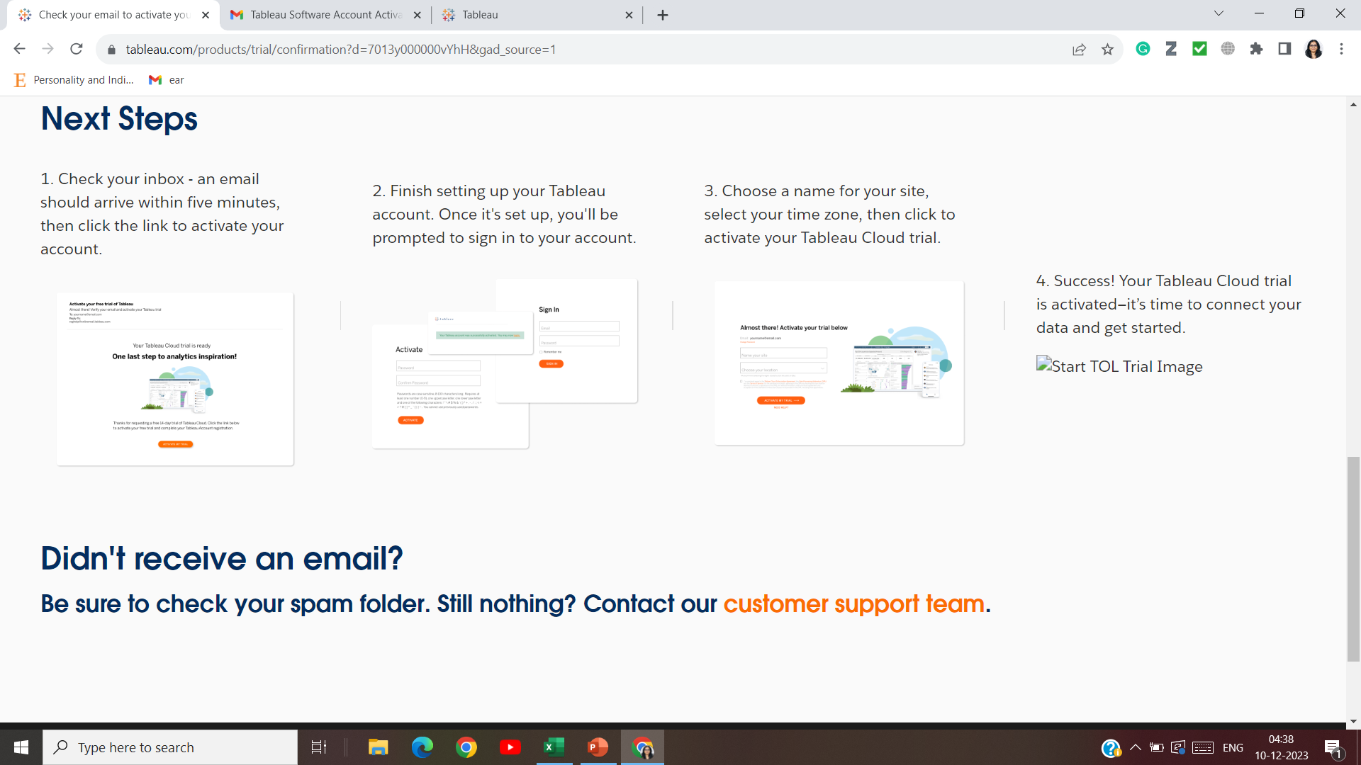

Slide 5
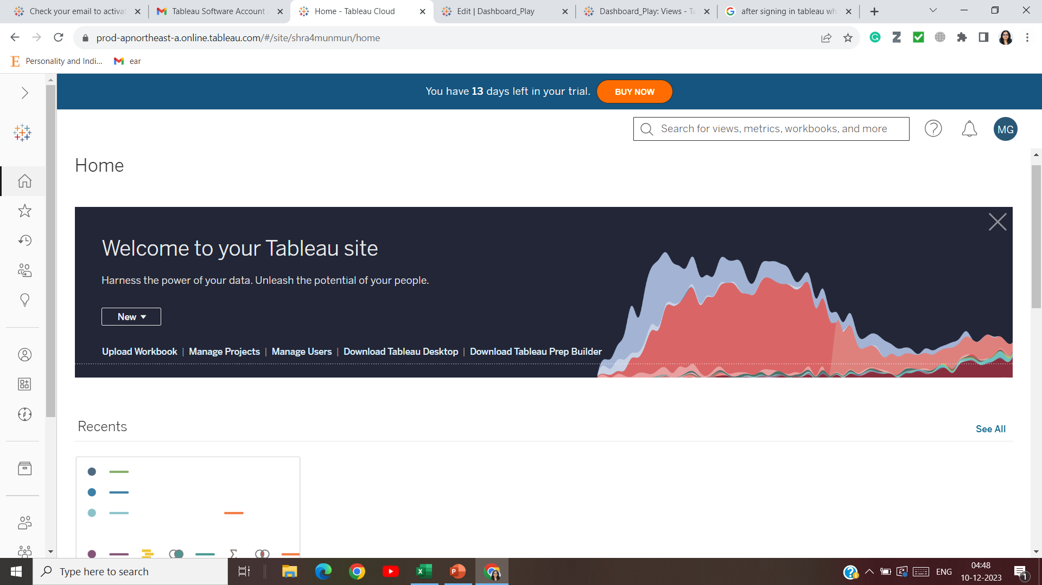

Slide 6
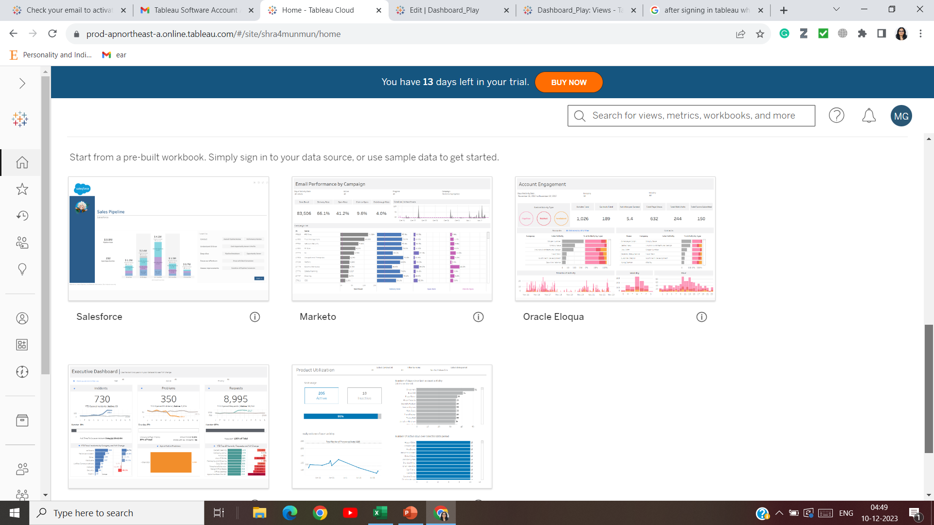

Slide 7
New workbook
Import SHRA datasheet
To save, click “Publish now”

Slide 8
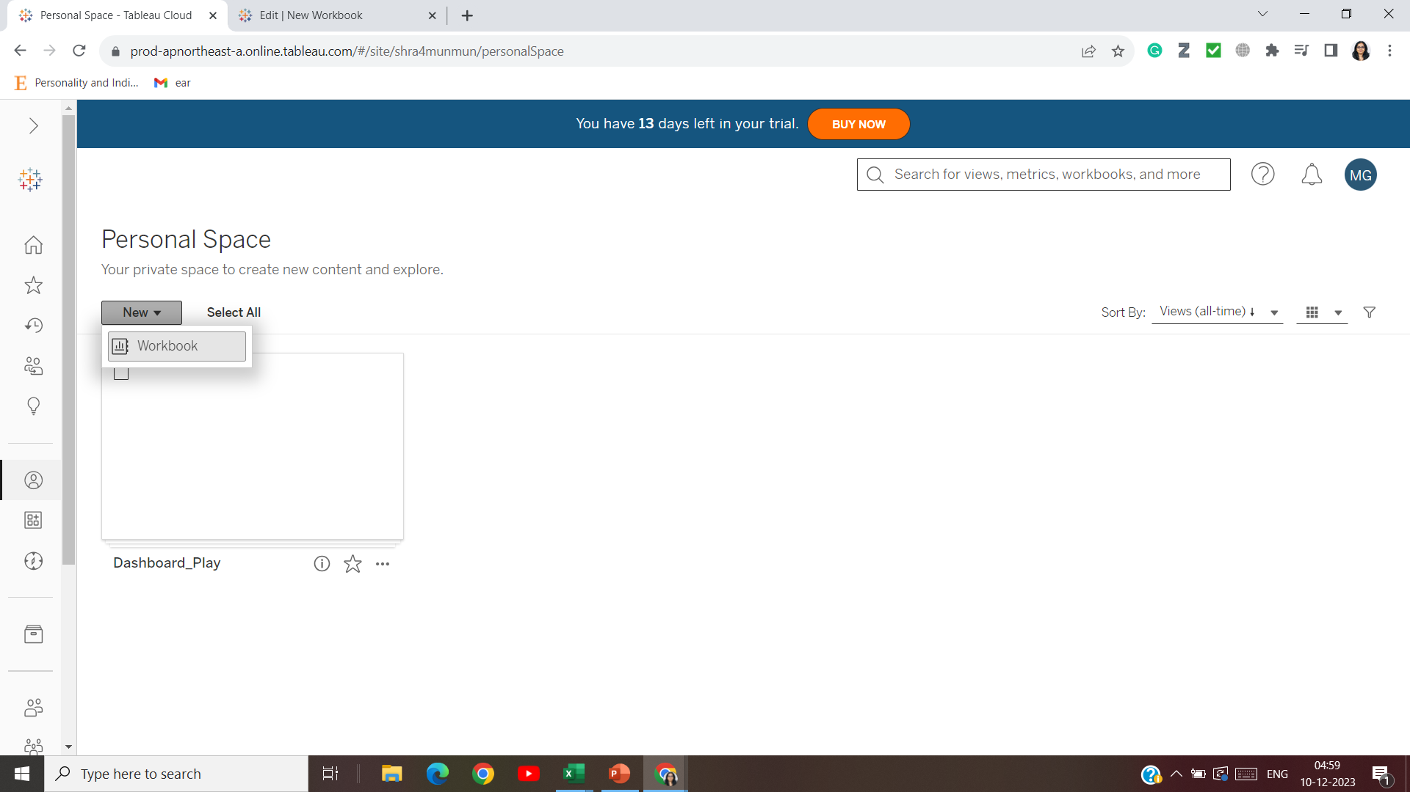

Slide 9
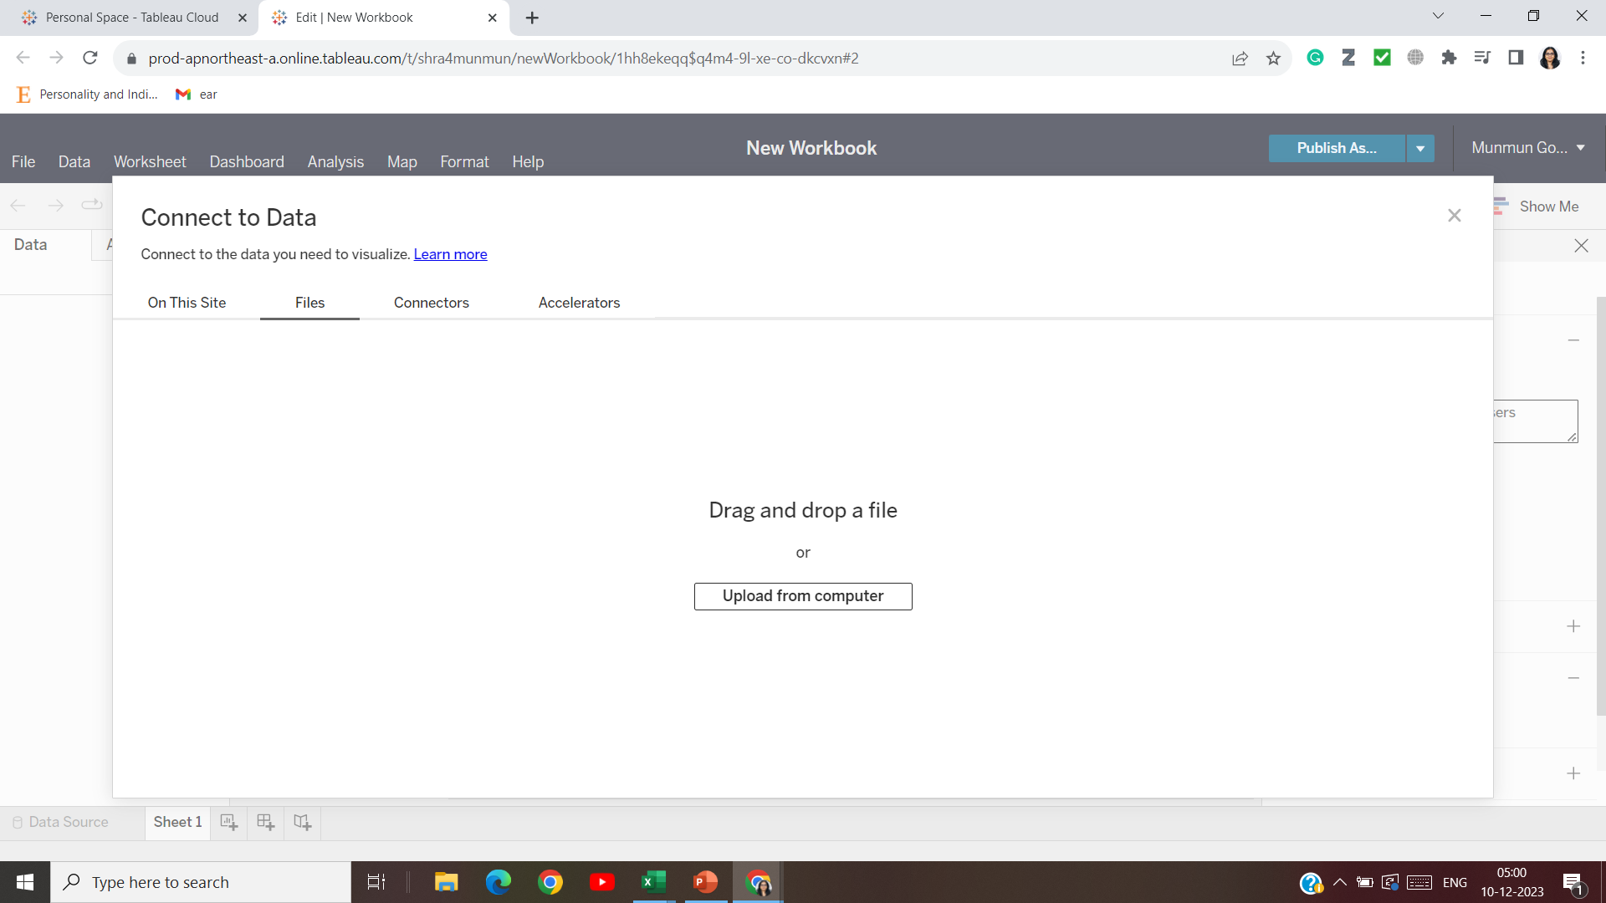

Slide 10
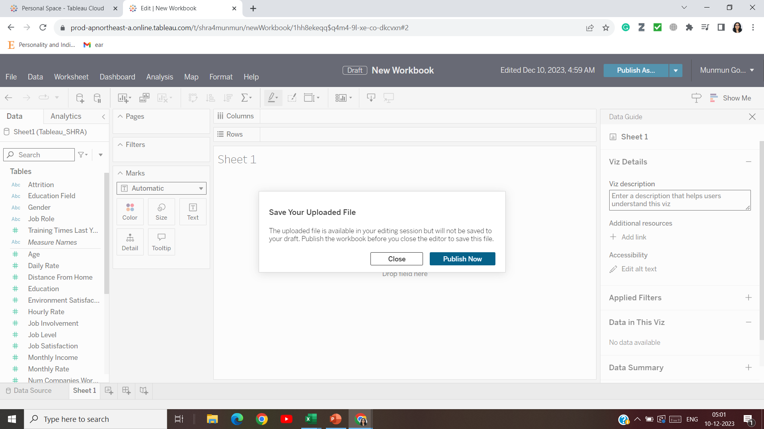

Slide 11
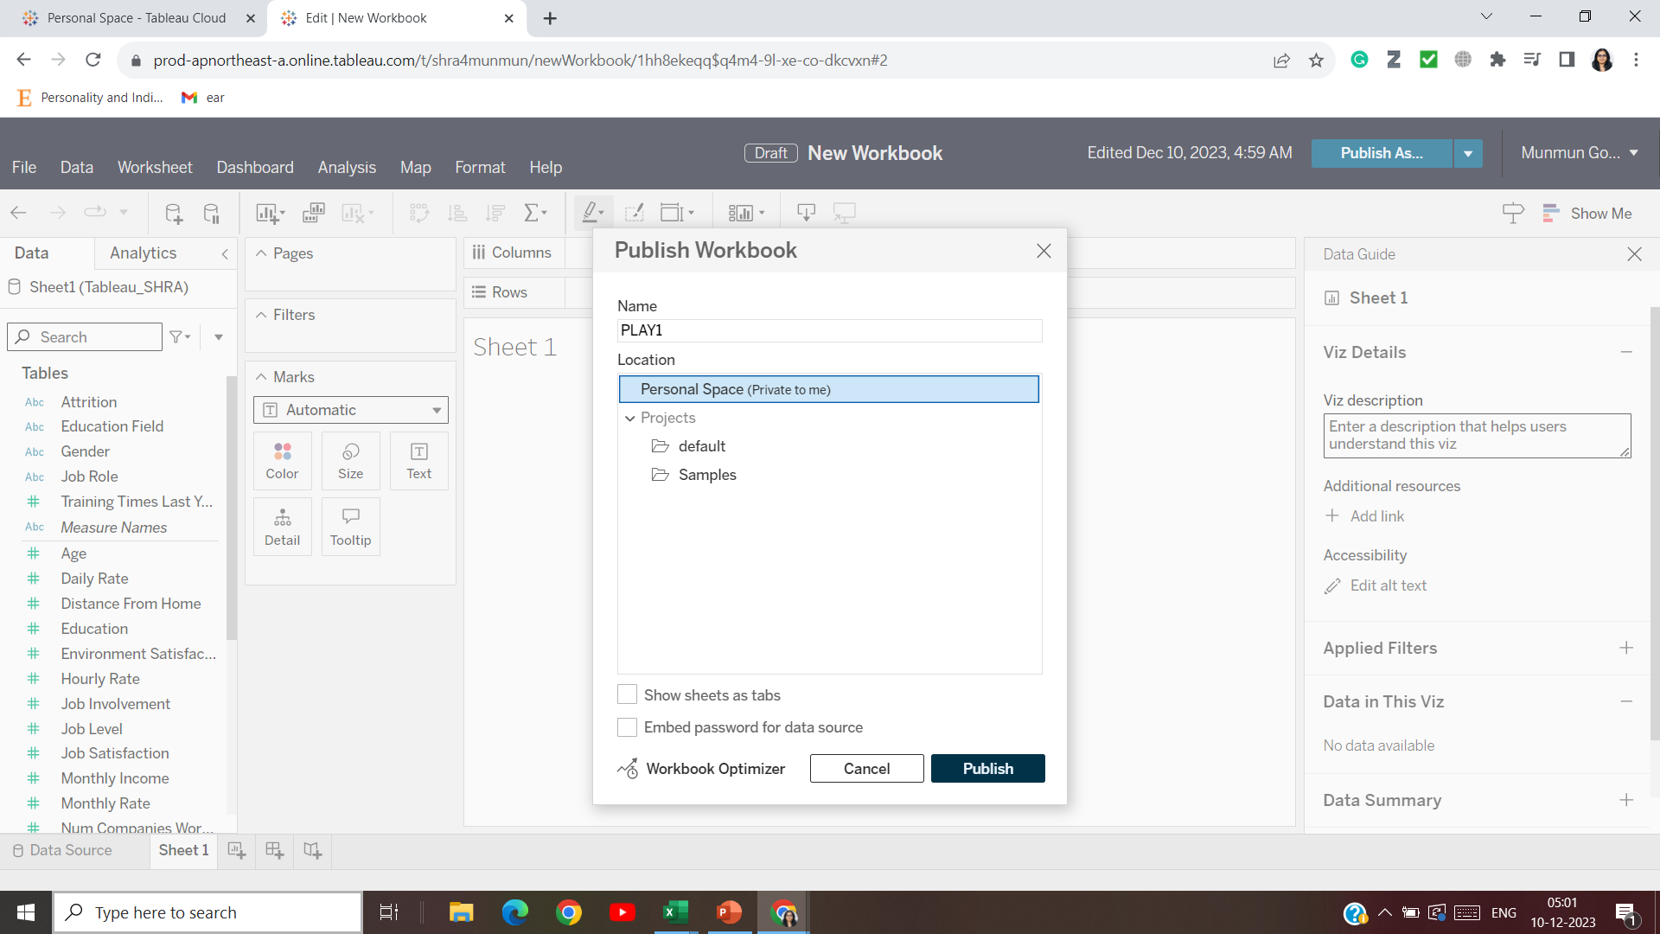

Slide 12
You can change the name of the sheet to ‘KPI’

Slide 13
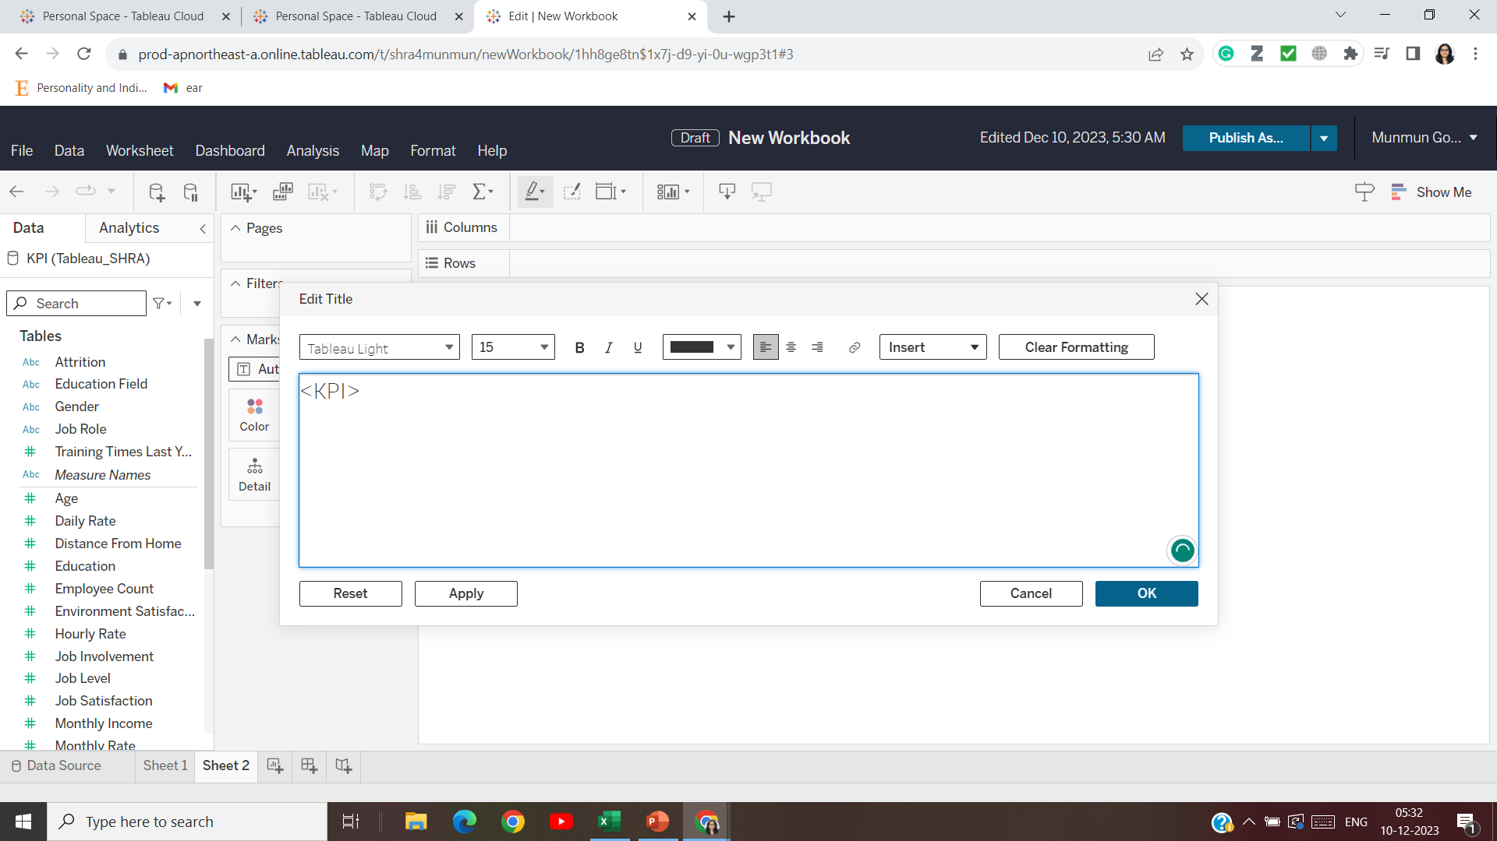

Slide 14
After importing data, scroll down for the sheet count (number of entries), drag to display

Slide 15
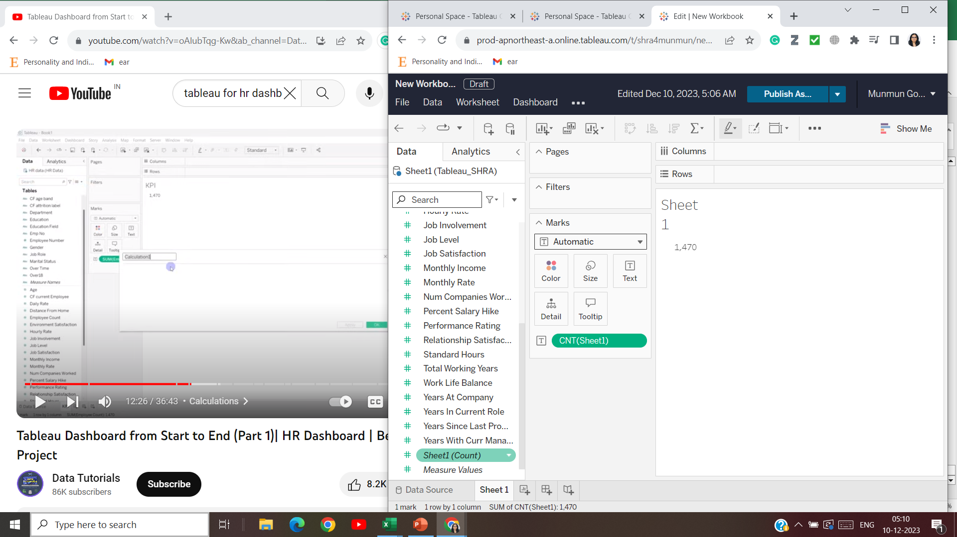

Slide 16
To display attrition data, calculate count of ‘yes’ and ‘no’

Slide 17
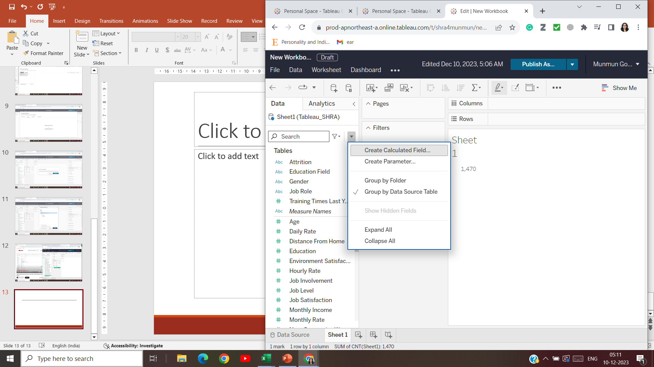

Slide 18
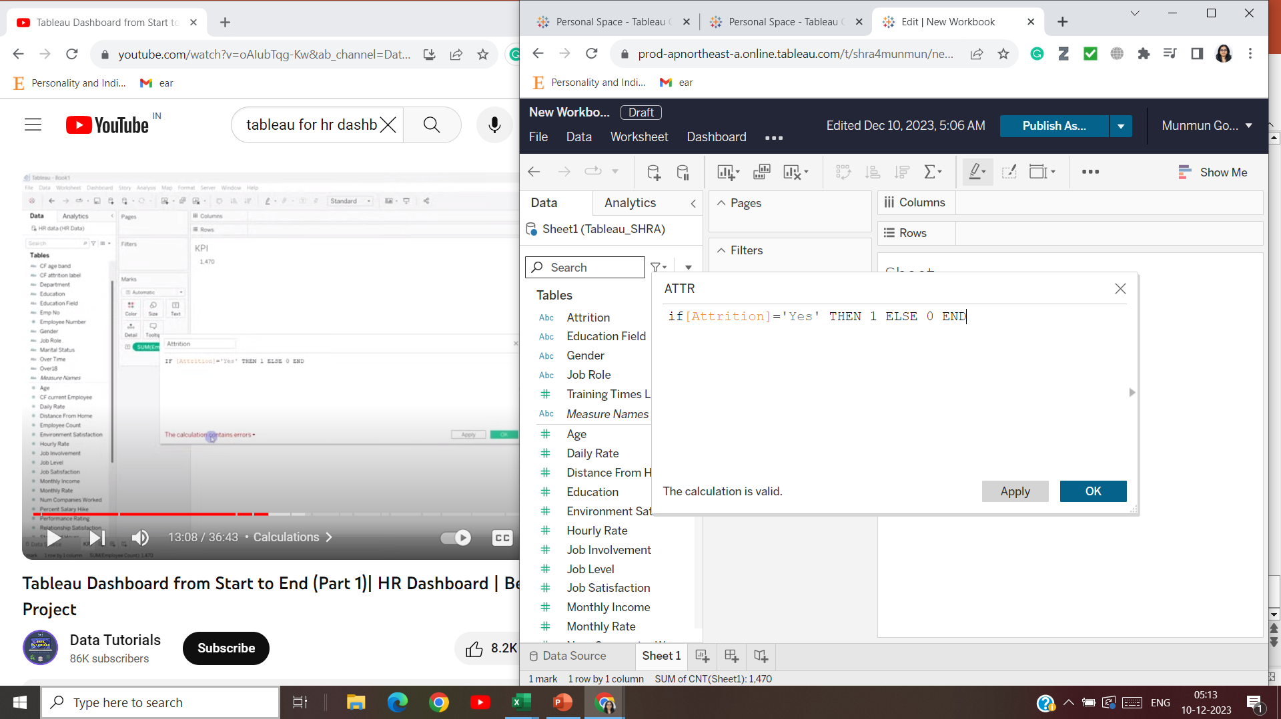

Slide 19
Double click on “ATTR” that you created, to include into the worksheet
Then invert the rows and columns (by changing from ‘standard’ to ‘entire view’)

Slide 20
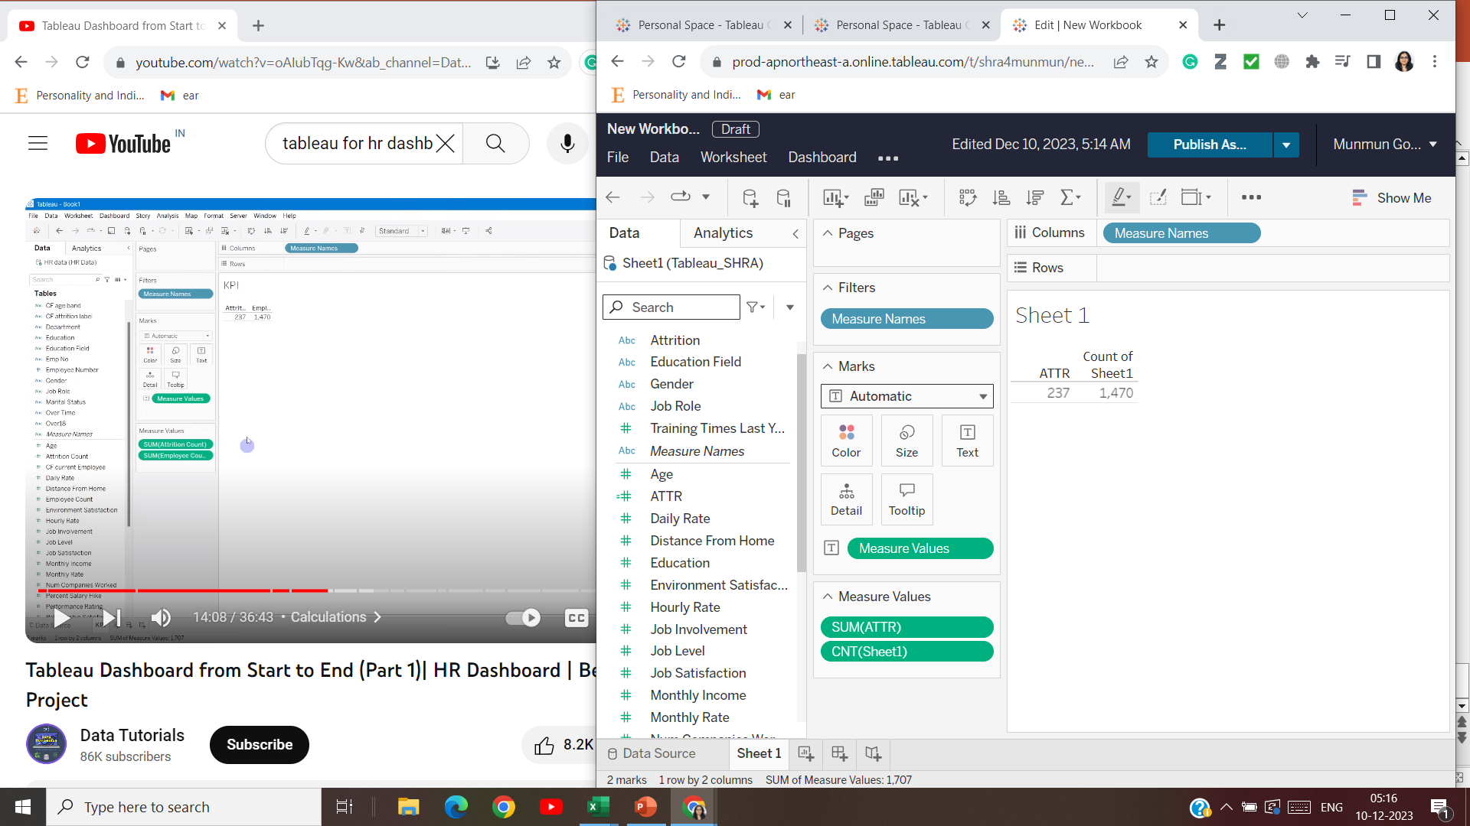

Slide 21
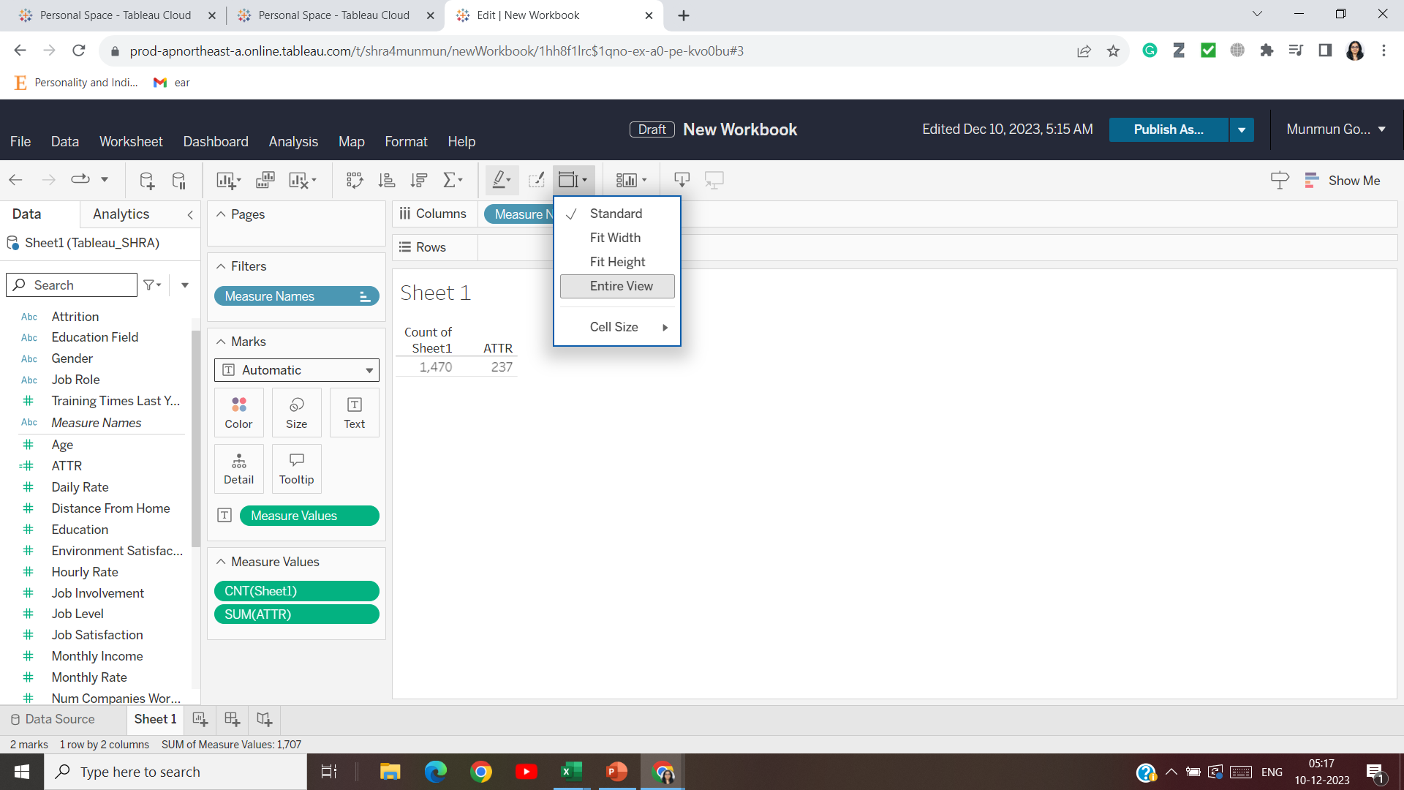

Slide 22
Calculate attrition rate (attrition count/ employee count)

Slide 23
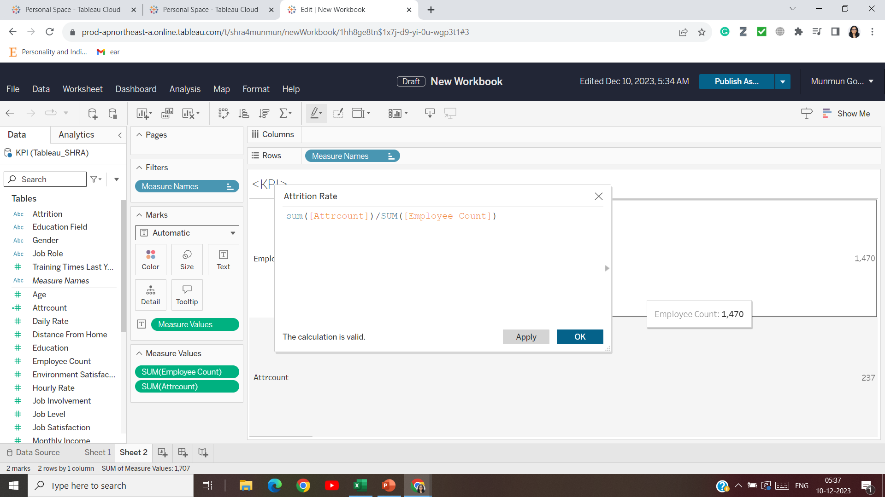

Slide 24
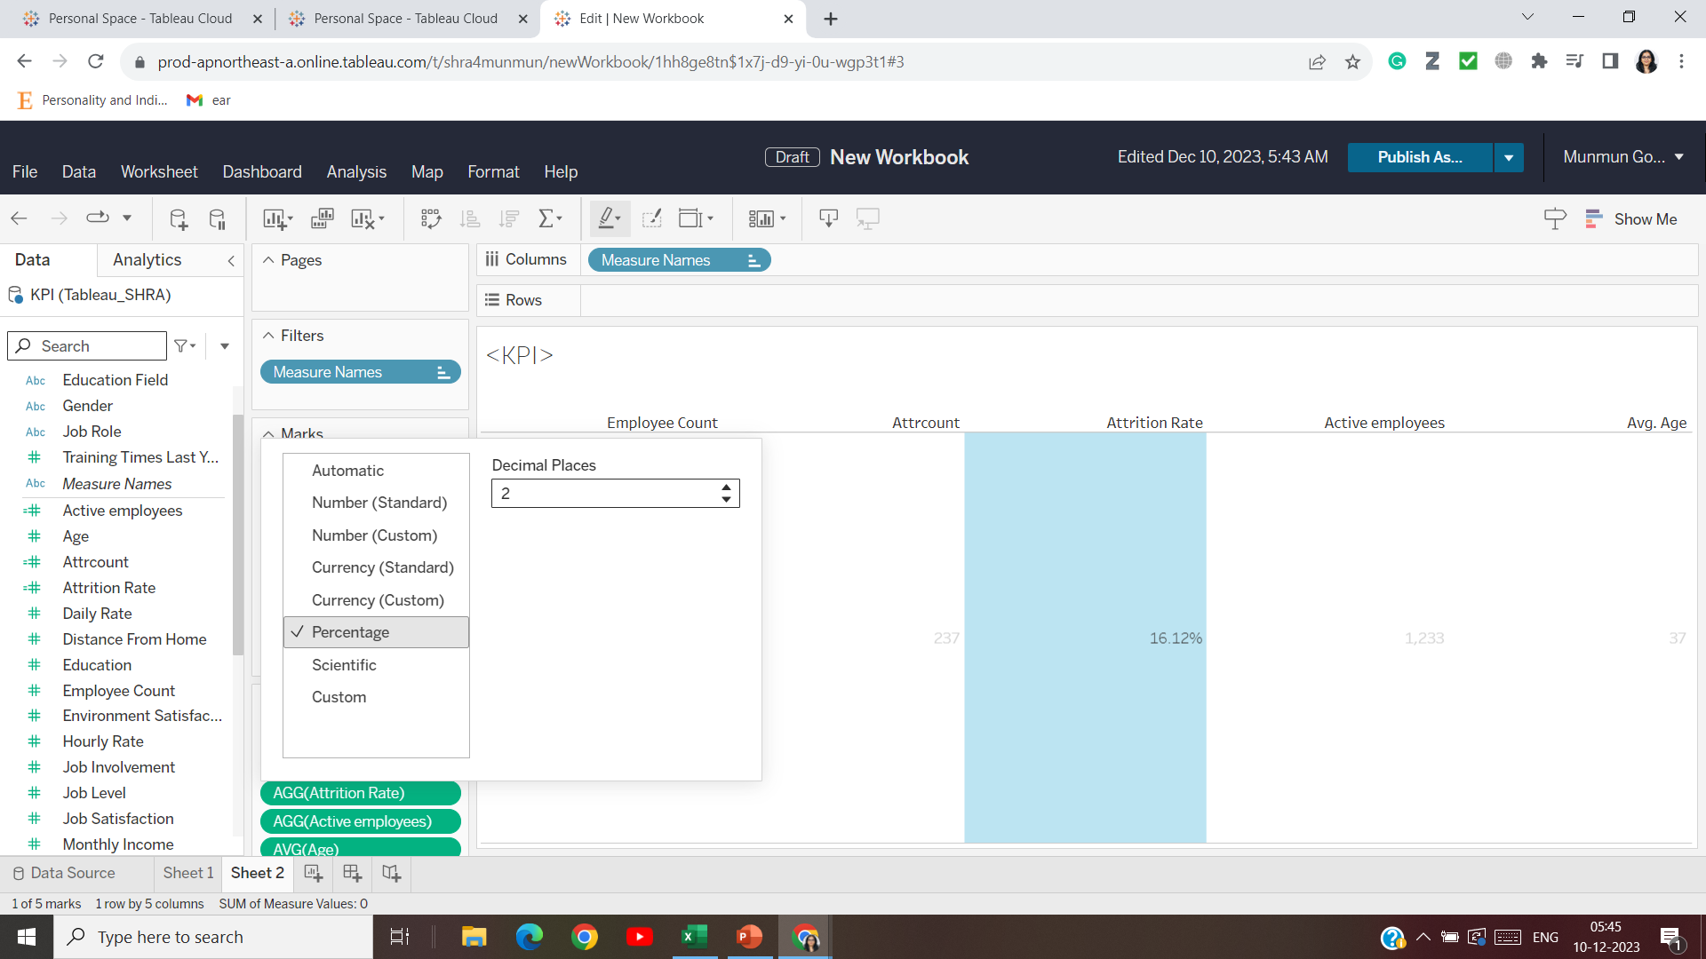

Slide 25
Calculate active employees (attrition count – employee count)

Slide 26
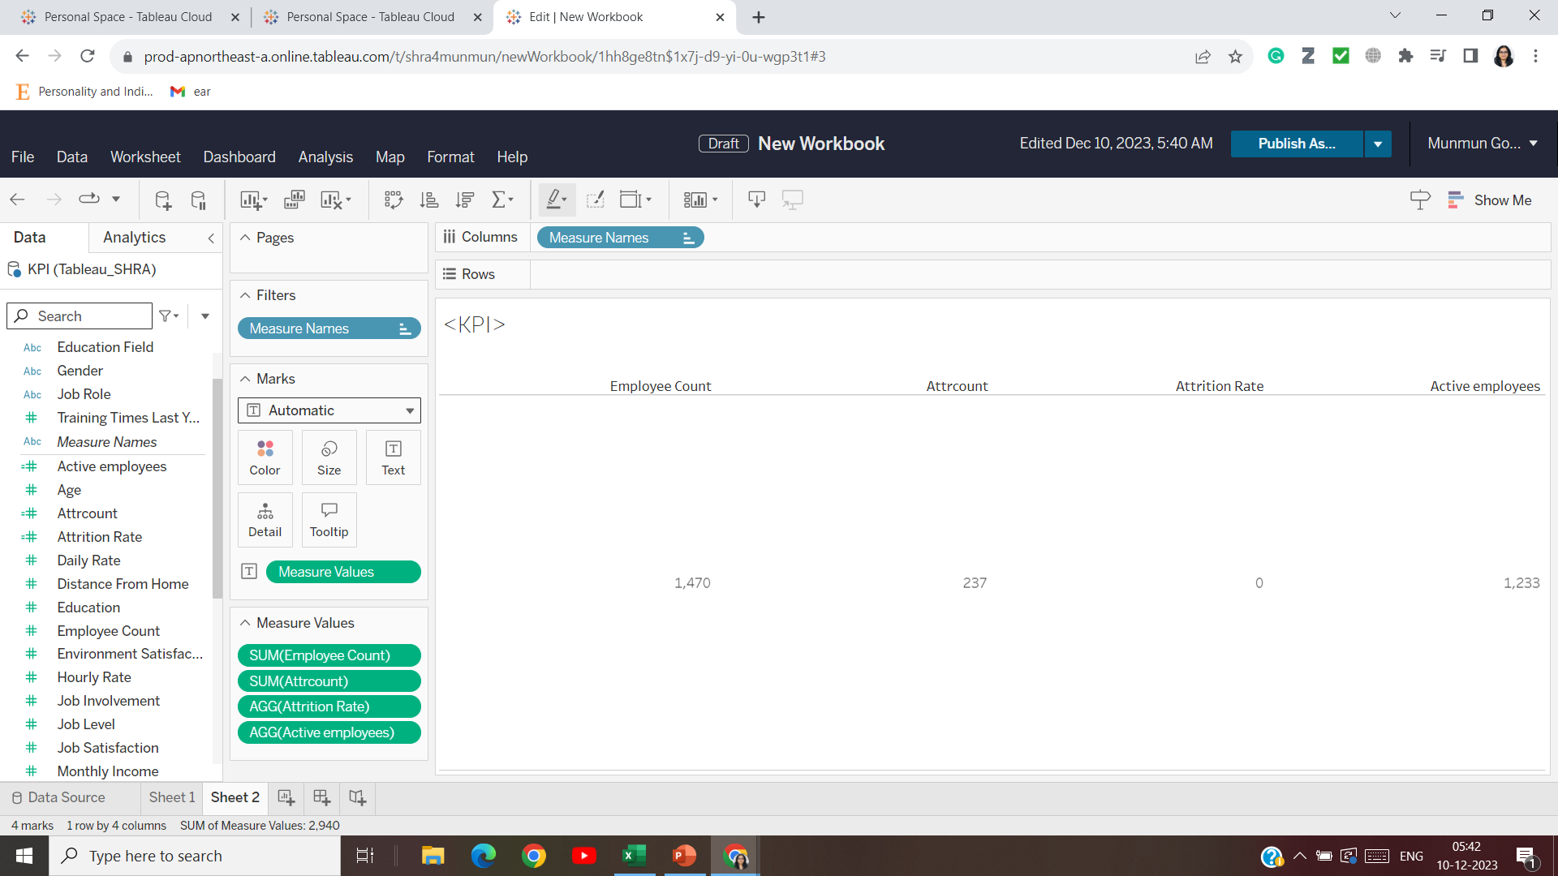

Slide 27
Add the age field (average, not sum)

Slide 28
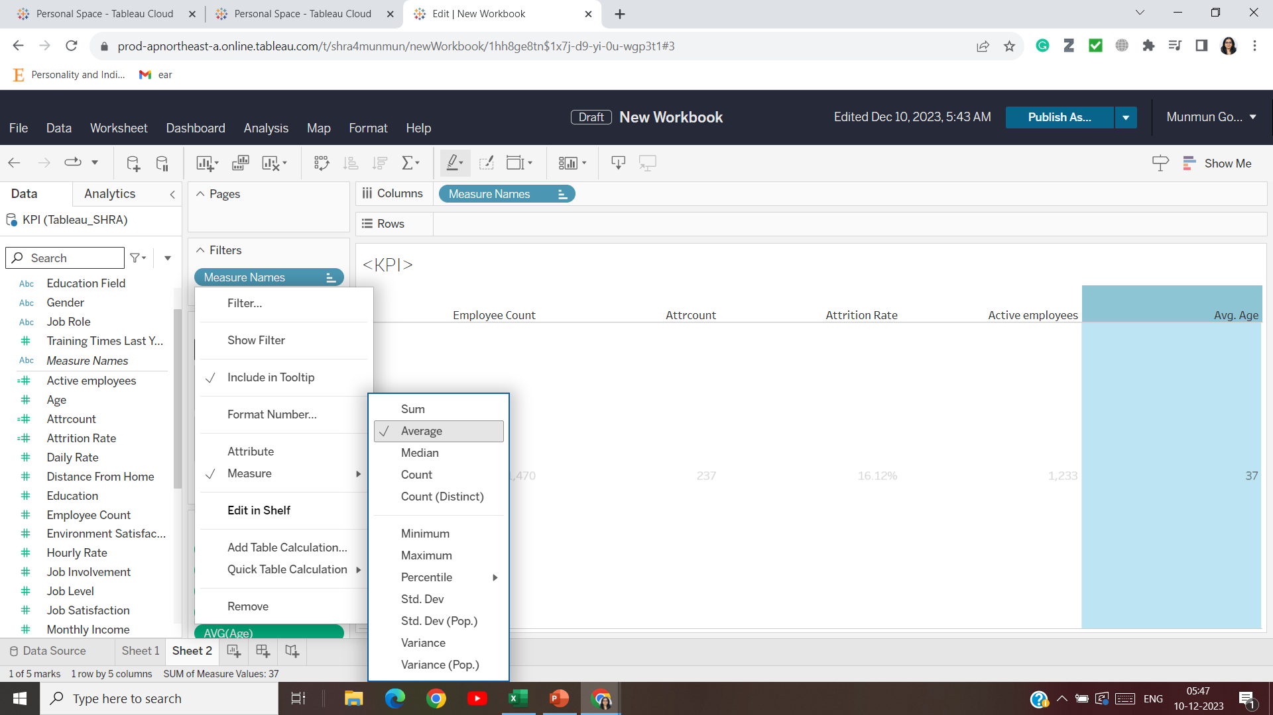

Slide 29
Change to whole numbers (no decimals)

Slide 30
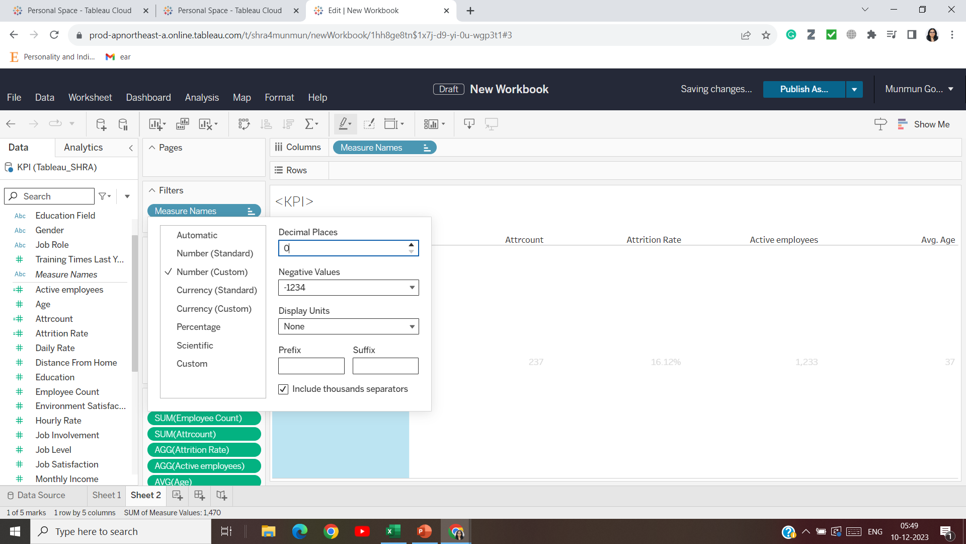

Slide 31
Add education as filter

Slide 32
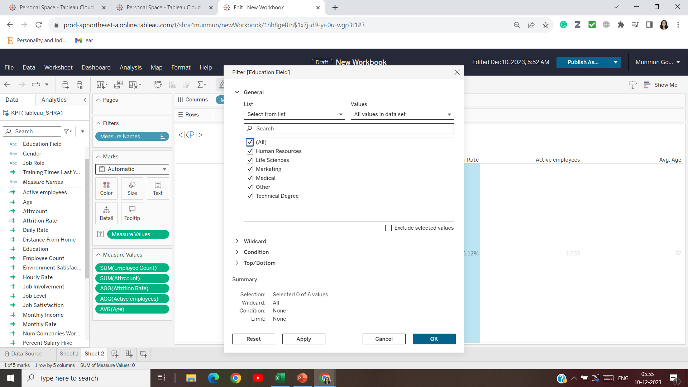

Slide 33
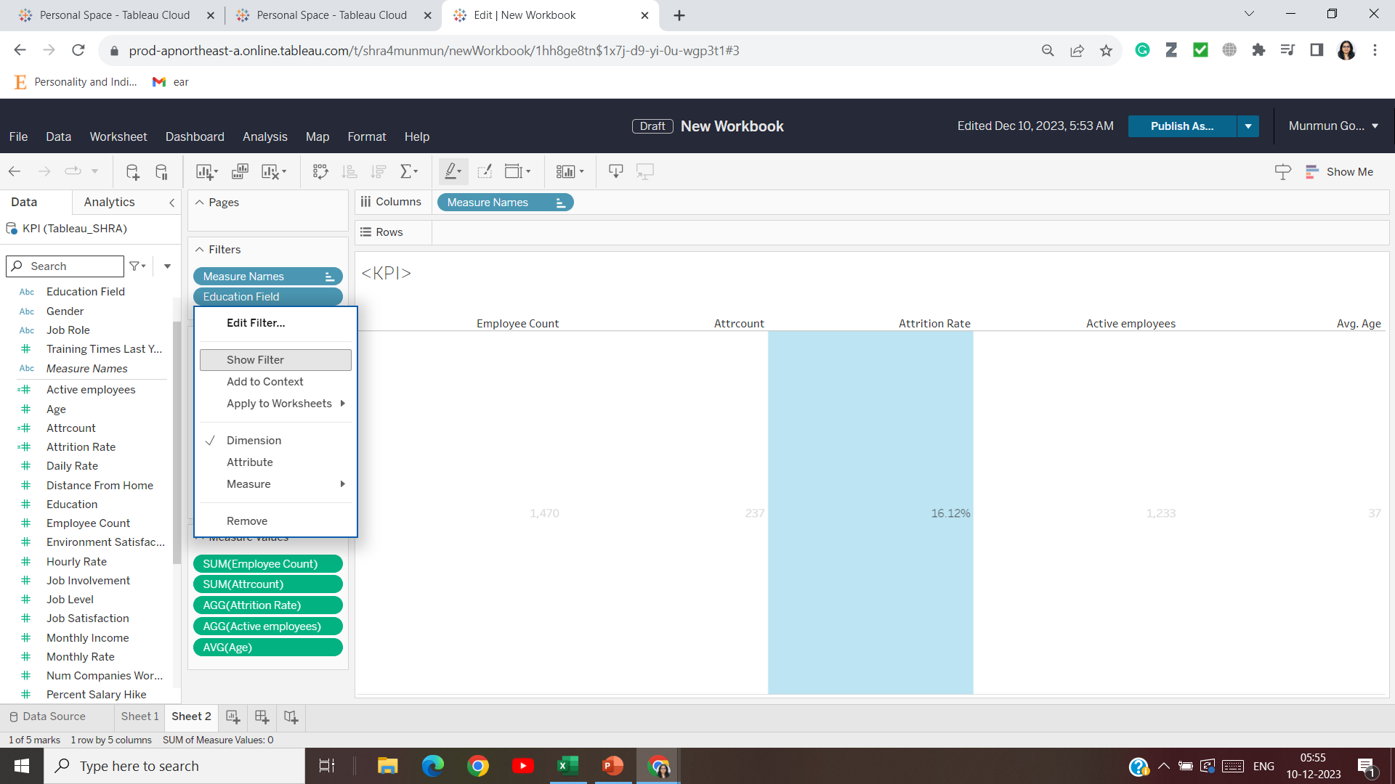

Slide 34
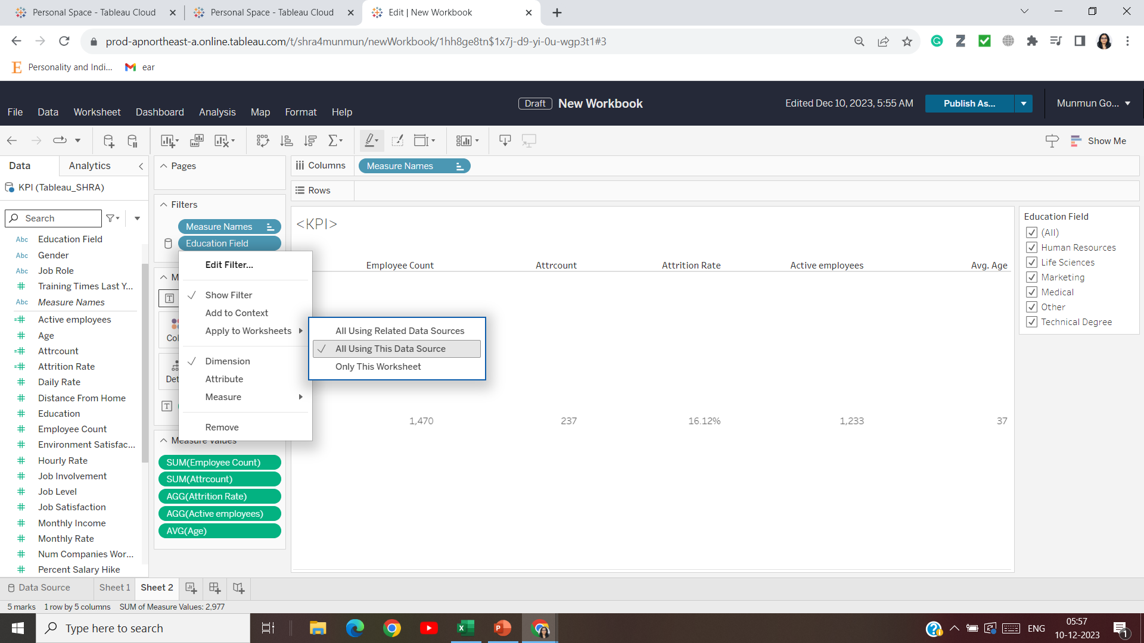

Slide 35
New worksheet to find out attrition by gender

Slide 36
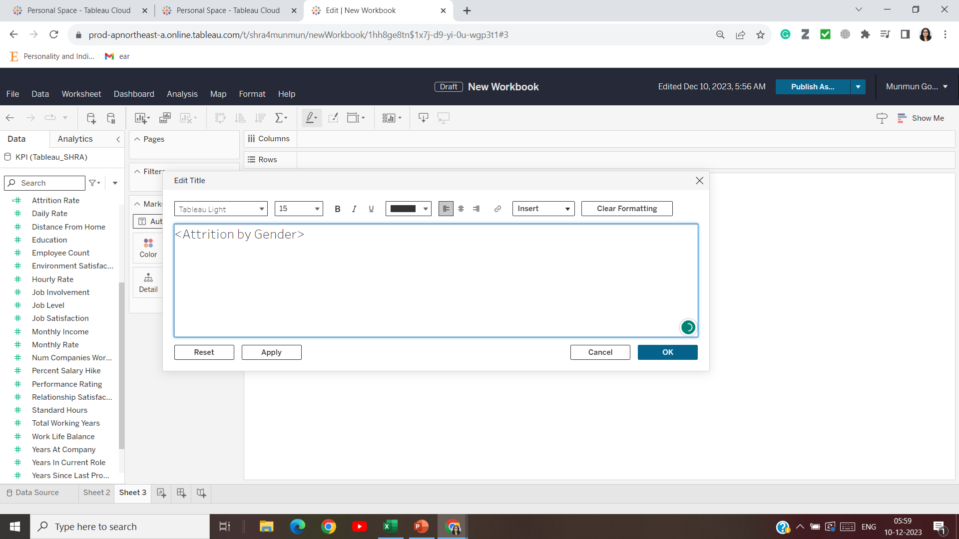

Slide 37
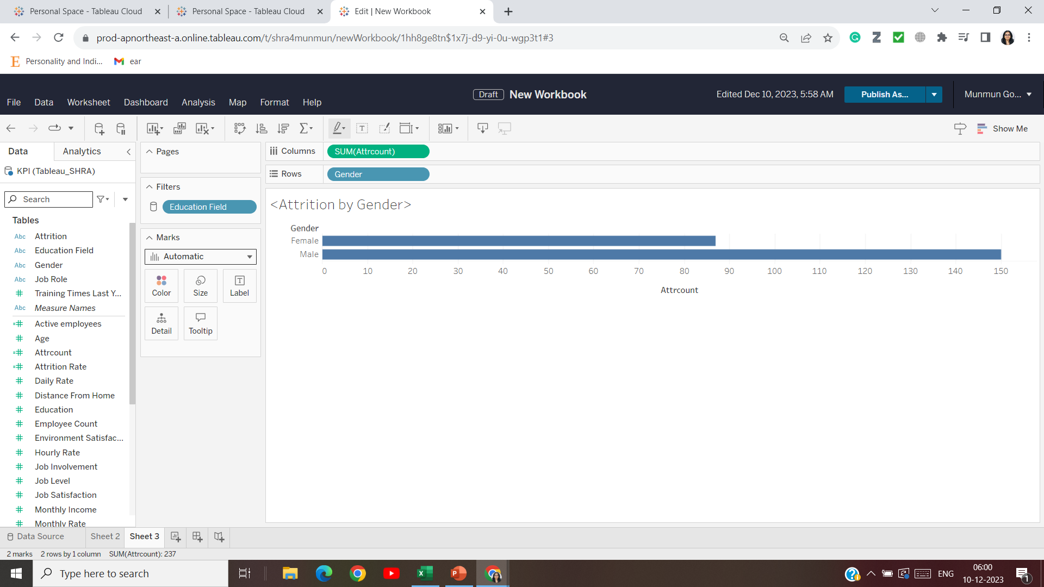

Slide 38
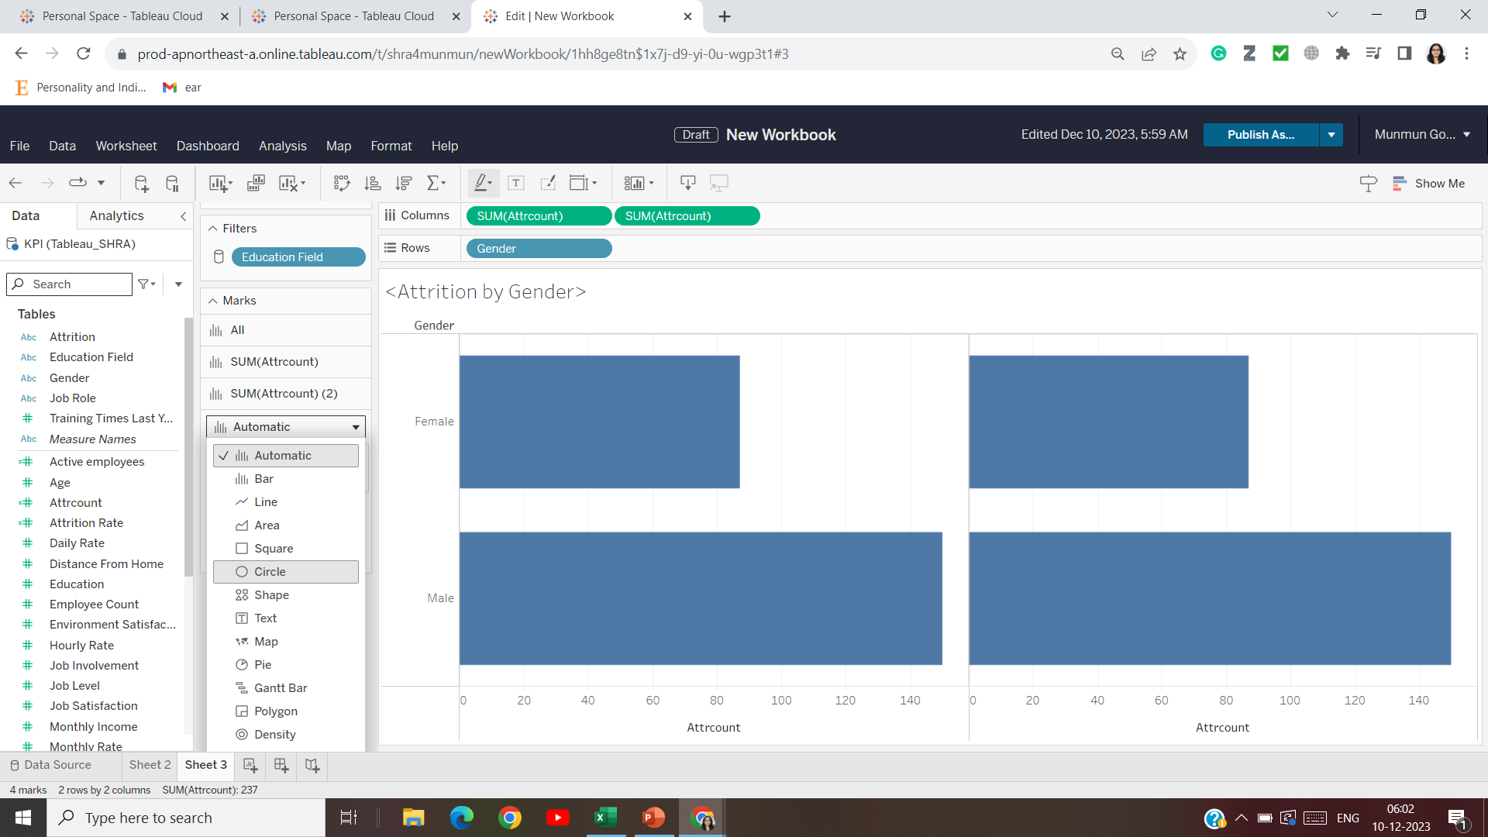

Slide 39
Copy (twice) in column the attrition count, select one as bar chart and the second as circle

Slide 40
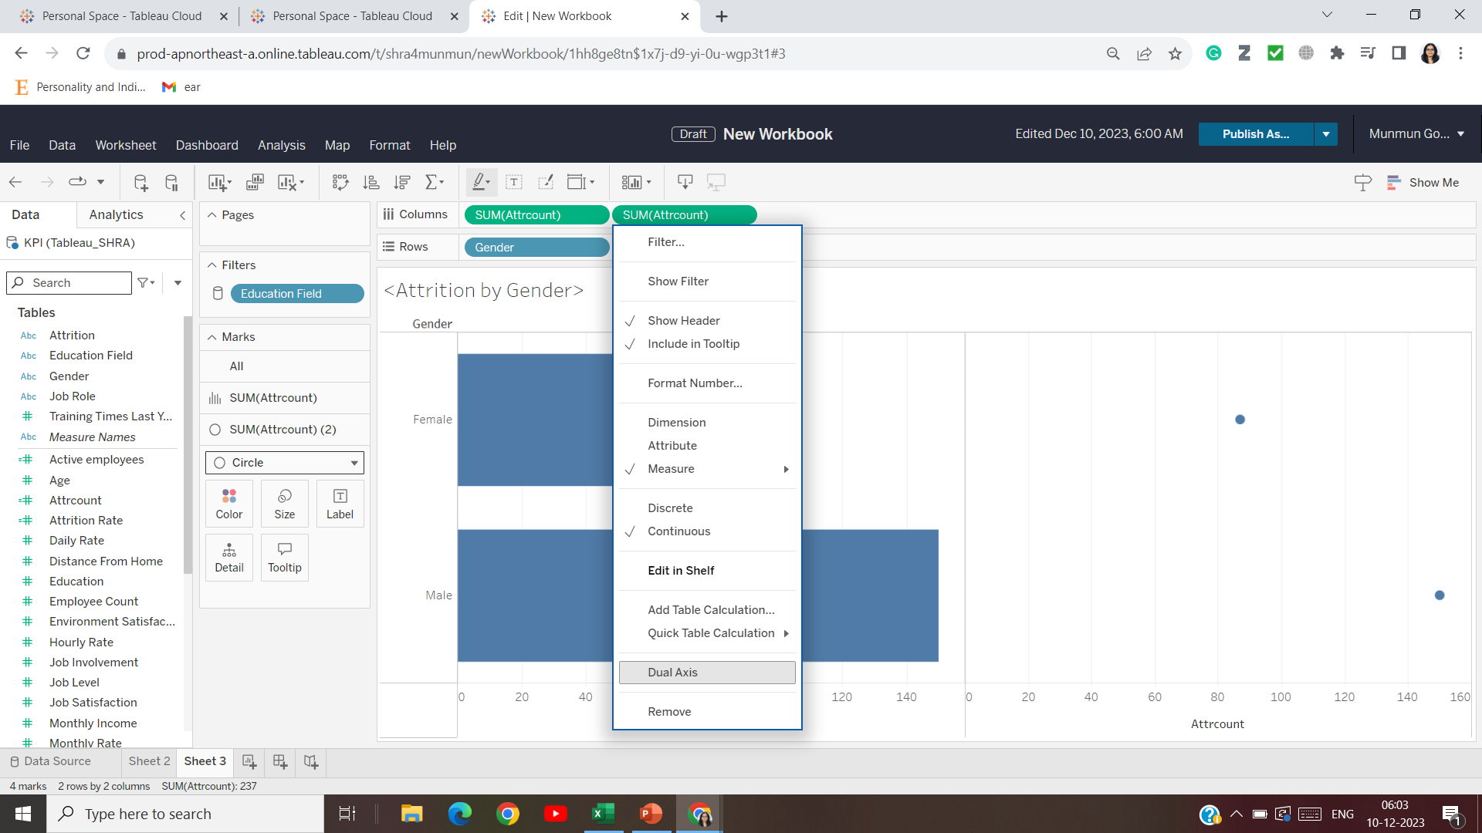

Slide 41
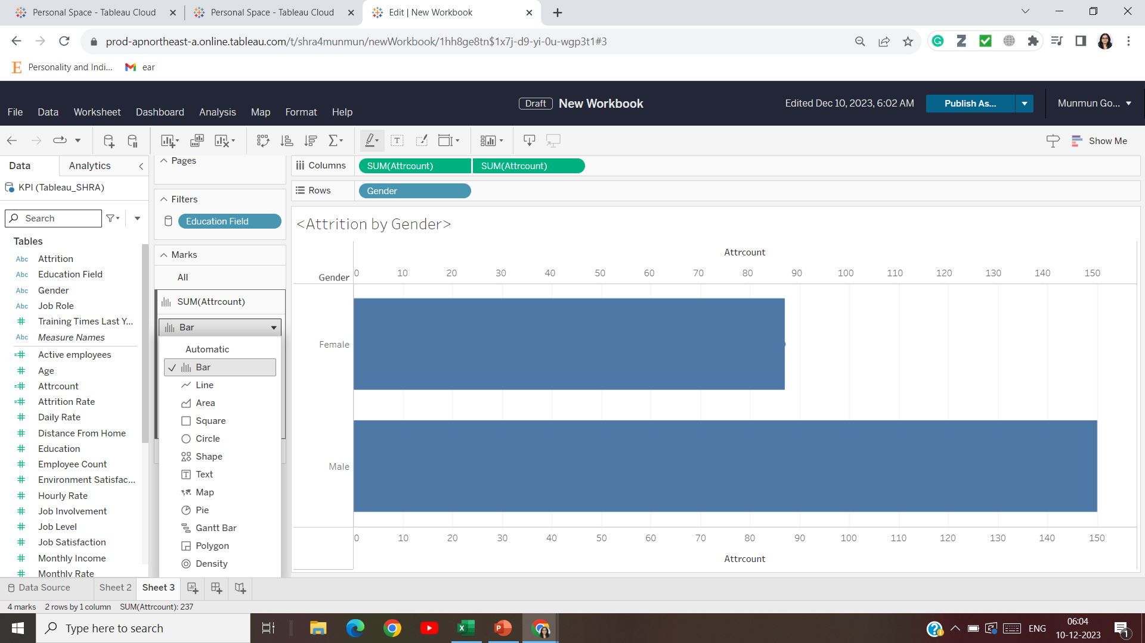

Slide 42
Make it as synchronize axis (Lollypop chart)

Slide 43
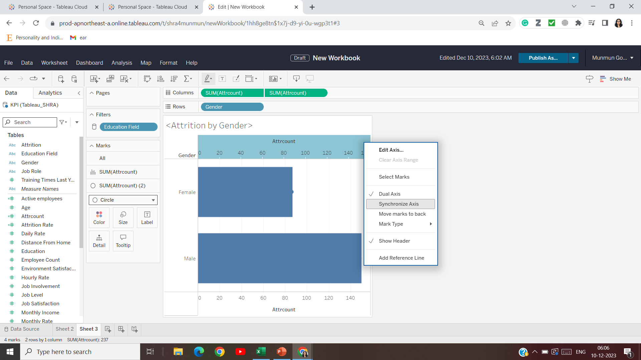

Slide 44
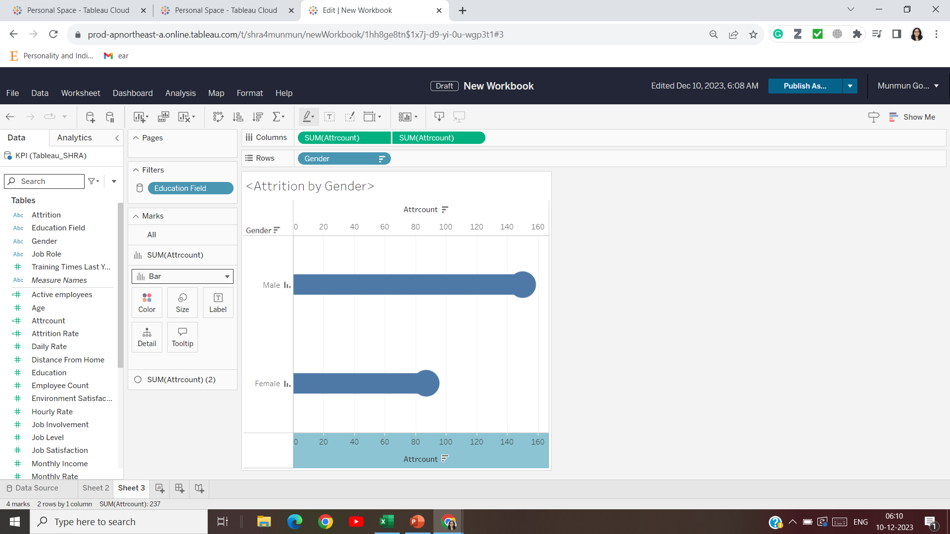

Slide 45
Change color (as per gender)

Slide 46
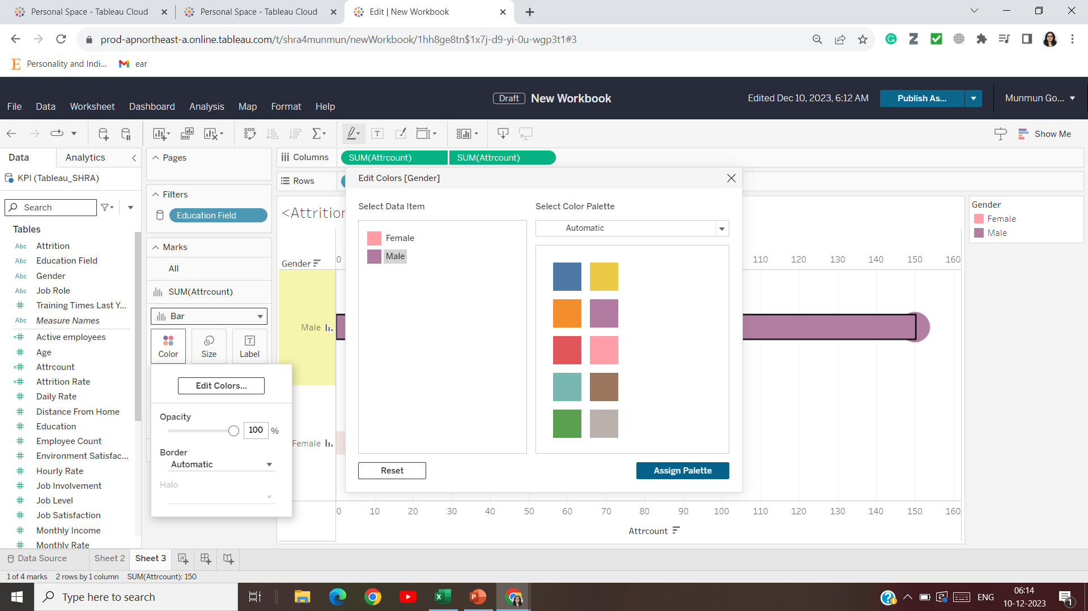

Slide 47
EMPLOYEE BY AGE - (round number bin (range), e.g. 3 taken here)

Slide 48
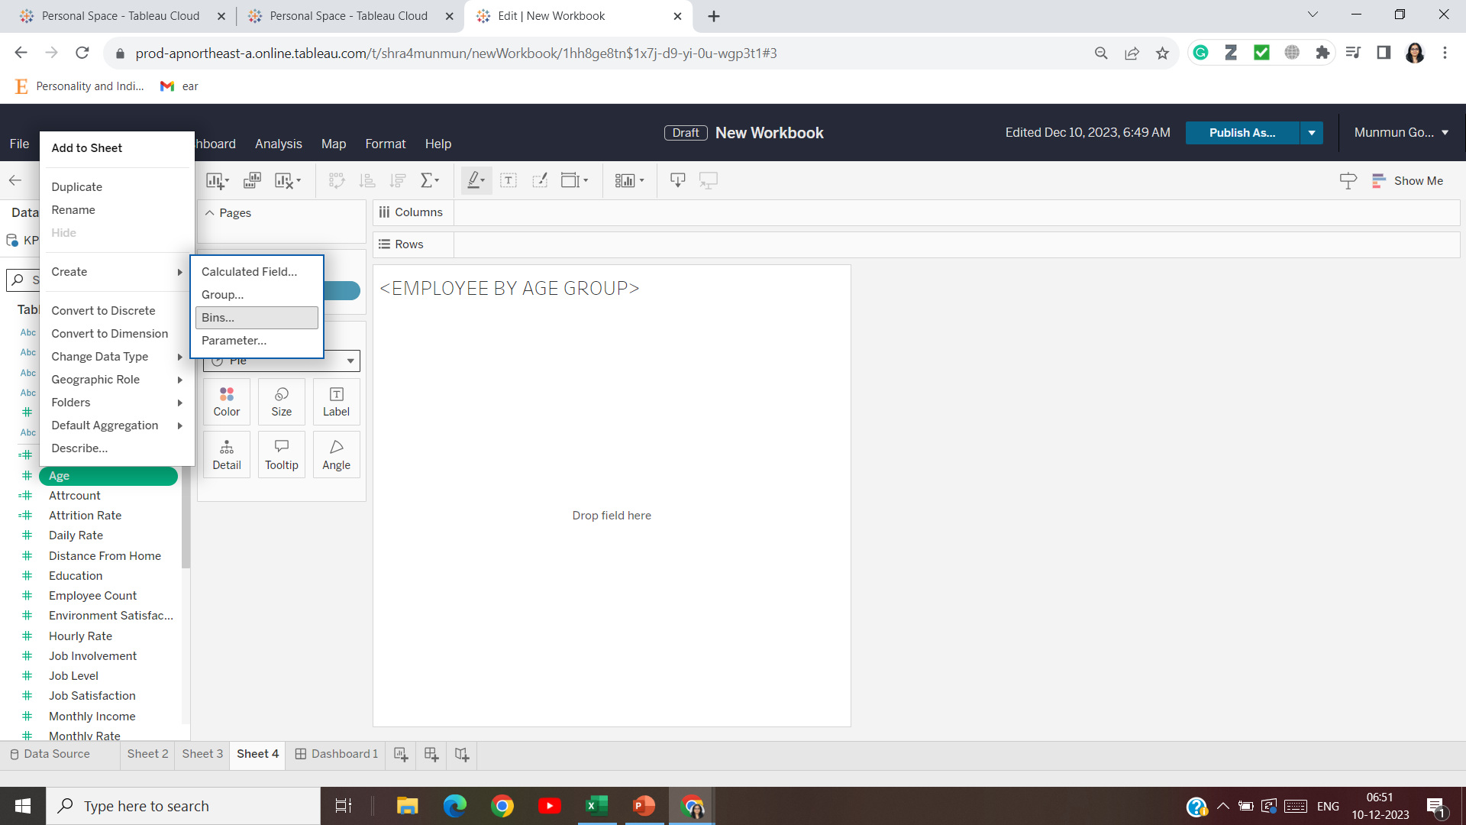

Slide 49
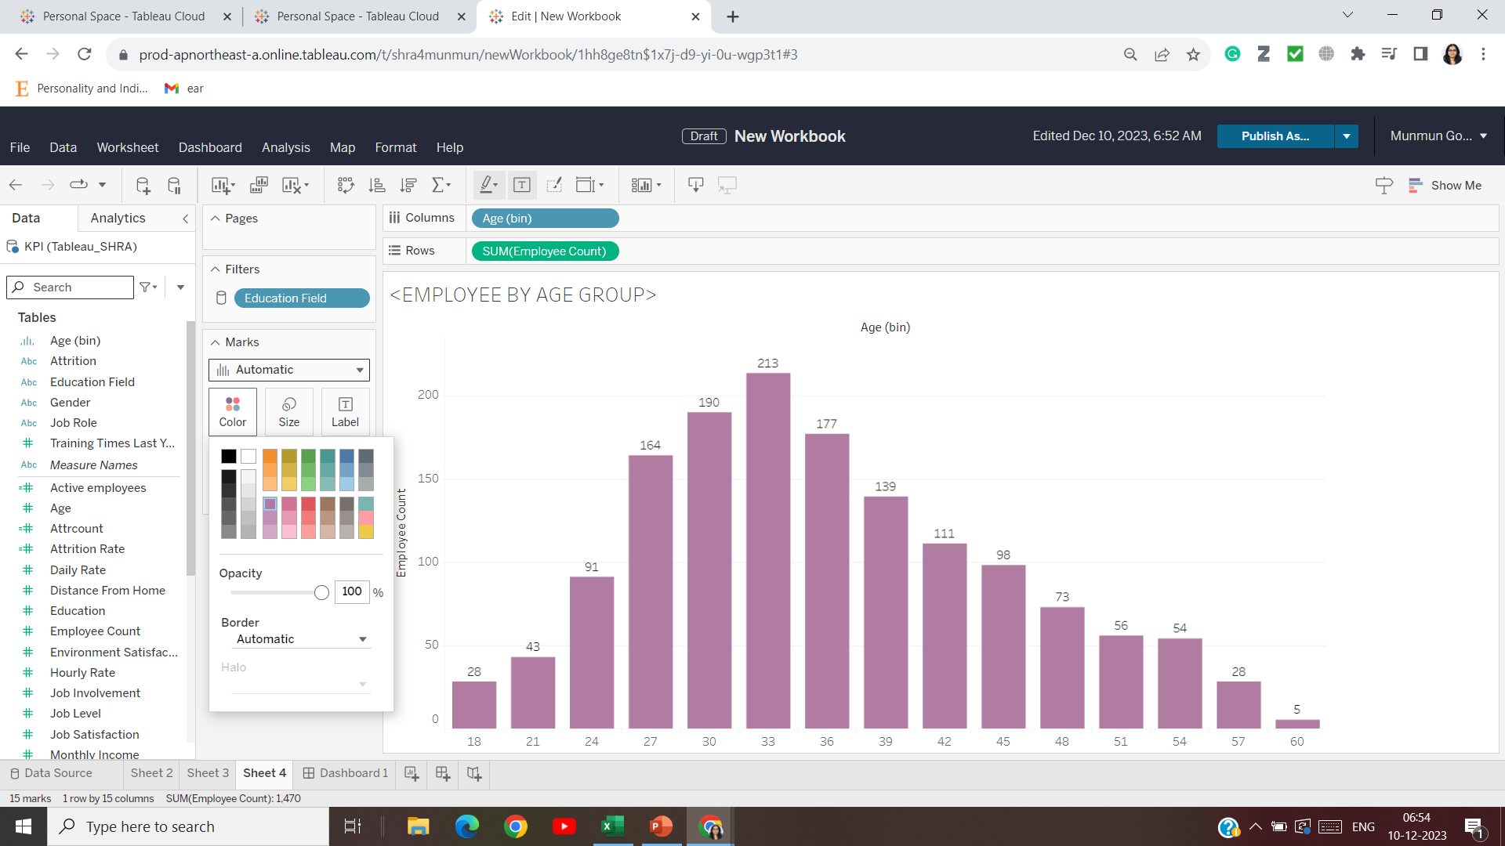

Slide 50
Job satisfaction rating
Job role – rows
Job satisfaction – convert to dimension and then put it in column
Also, add row grand total (analysis -> total -> row grand total)

Slide 51
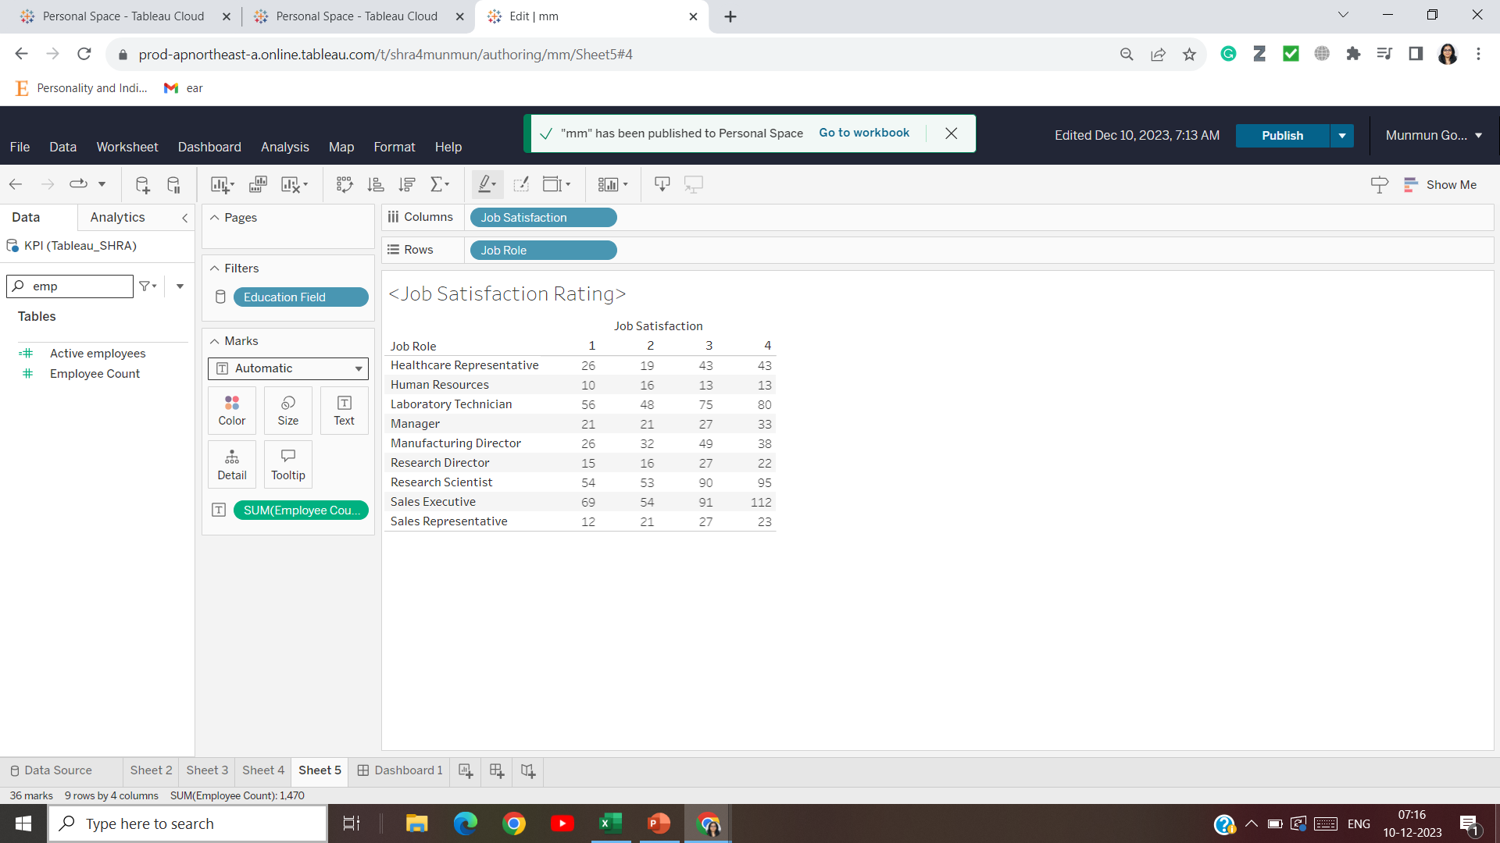

Slide 52


Slide 53
CREATING THE DASHBOARD

Slide 54
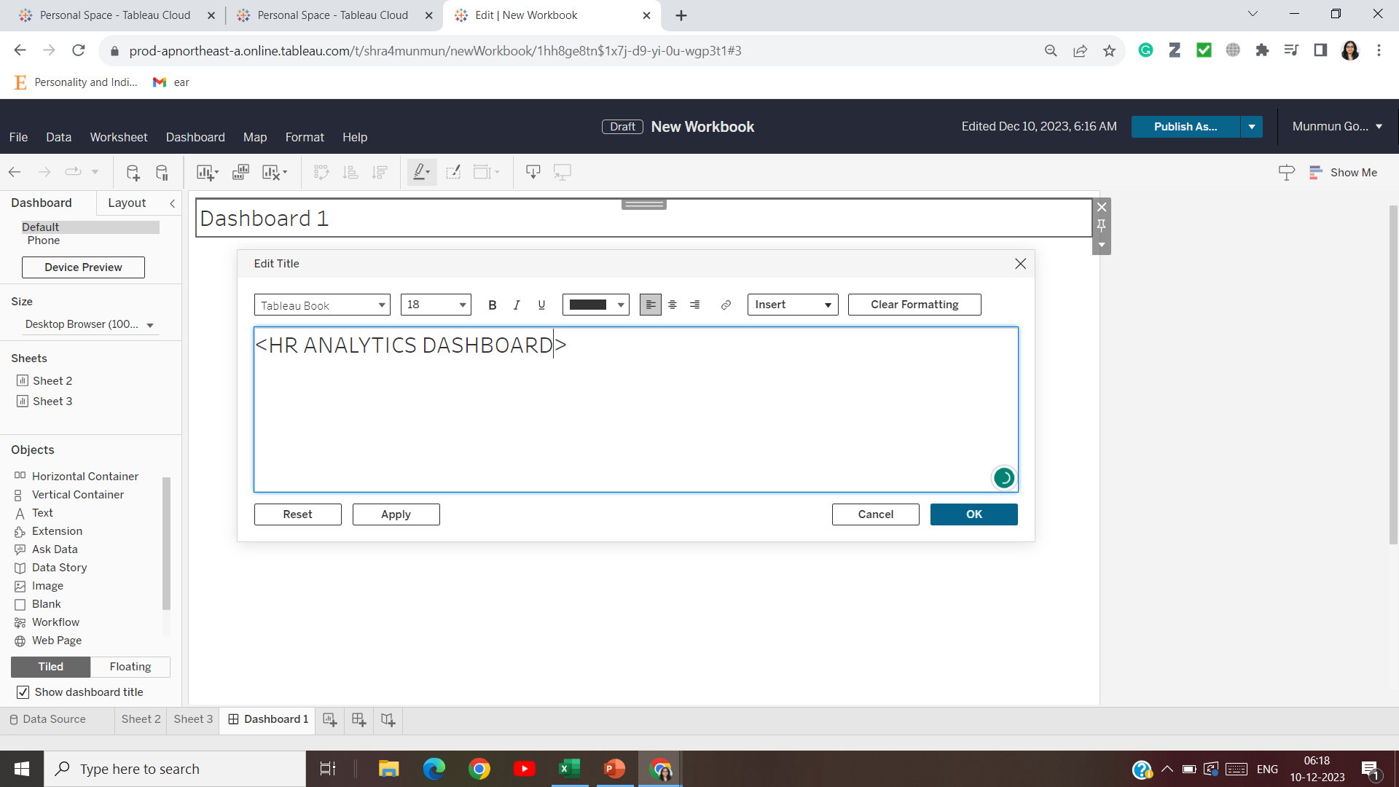

Slide 55
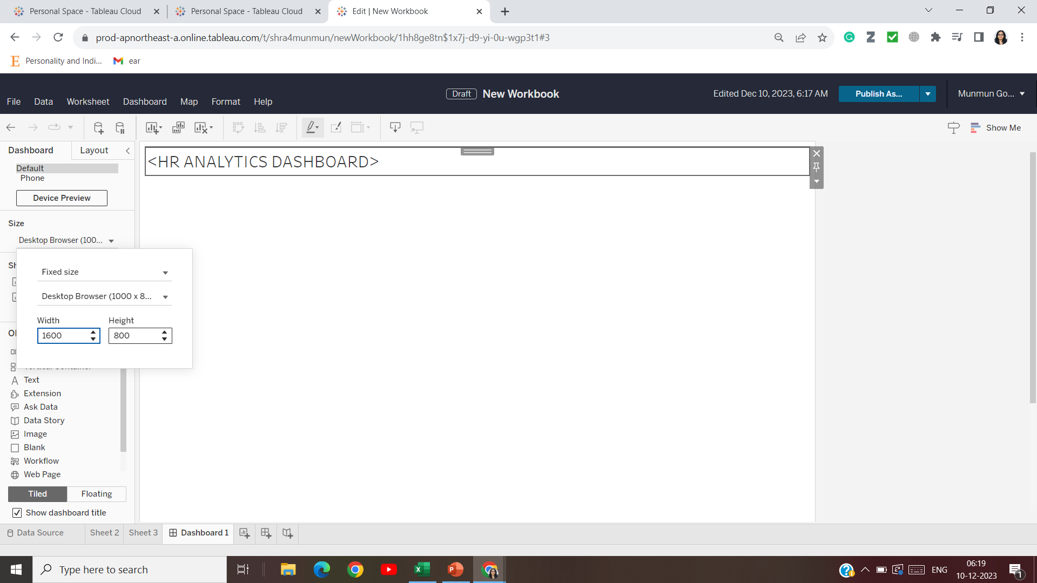

Slide 56
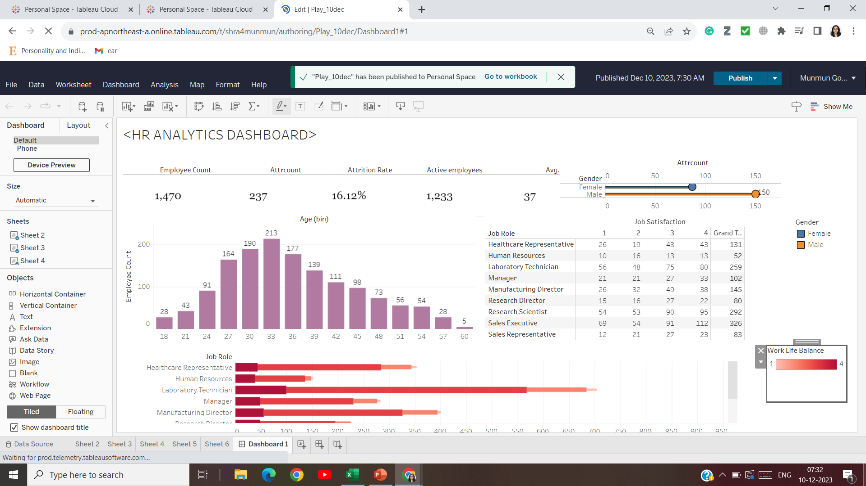

Slide 57
