Slide 1
SEO

Slide 2
Search Marketing
Search Marketing
Search Engine Marketing
Search Engine Optimization

Slide 3


Slide 4
Why SEO
75% B2B Traffic
55% website traffic
81% people search before buying

Slide 5
Search Engine optimization
It takes time
Ongoing process
Has long lasting effect
Its cost effective
Is SEO Dead???

Slide 6

Technique of SEO
White Hat SEO
Black Hat SEO
Gray Hat SEO (95+5)

Slide 7
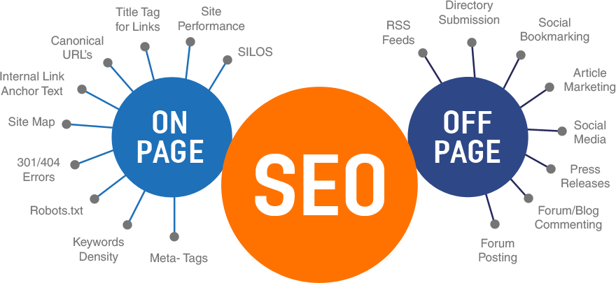
Types
On-page SEO
Off-page SEO
Technical SEO

Slide 8
Elements
Research
Planning and strategy
Implementation
Monitoring
Assessment
Maintenance

Slide 9
Process of SEO
Keyword Research
Competitive Research
Content Strategy for Page Optimization
Calendar and tools
Algorithm Research
Feedback

Slide 10
On-page SEO: Key factors
Content is the Key
Natural
Keyword optimization
User Experience
CTR optimization
Search intent
Engagement
Content centric to User centric

Slide 11
Where to put the keyword
Meta Title
Meta Description
Headline
H Tags
URL
Alt Tag
Formatted
Internal linking
Content

Slide 12
Meta Title (50-60)
SEO META in 1 CLICK
Most relevant keyword
Keyword in first 25-40%
Unique title
Use action words in the title (CTA)/numbers.
Brand name (for visibility)
Not keyword stuffing
Not marketing
Primary keyword (location) Secondary keyword brand name

Slide 13
Meta Description (140-160)
1-2 sentence meaning and Relevant
Targeted Keyword
Readable
CTA at the end of the description
Don’t duplicate it
No question mark
Advertisement of webpage
Google can select the relevant MD
meta description
Learn seo
Learn digital marketing

Slide 14
Preview
https://mangools.com/free-seo-tools/serp-simulator/
https://www.portent.com/serp-preview-tool/

Slide 15
H tags
H1 most notable content closely related to Meta Tag
One H1 should be there, No duplicity
20-70 characters
Use long tail keyword
Answer user intent (how to book ticket online)
Structured content
https://www.nextpit.com/how-to-install-the-play-store
https://www.computerhope.com/issues/ch000505.htm
https://www.screamingfrog.co.uk/seo-spider/

Slide 16
Alt Text
Be accurate
Avoid keyword stuffing
Avoid image of “
Limit is 125 Character
All images does not required text

Slide 17
Internal linking
https://www.upgrad.com/blog/future-scope-of-blockchain-india/

Slide 18
Website content

Slide 19
Technical SEO

Slide 20
URL structure
Less depth is better
Use Keyword
No special character
Use hyphens not underscore
Use lowercase
Dynamic URL : no number
Avoid date
Trailing Slash at end (category)

Slide 21
URL Structure
https://visme.co/blog/seo-report/
https://dashthis.com/blog/how-to-create-the-ultimate-seo-report-for-your-clients/

Slide 22
Robots.txt
Tell search engine where they can go or can’t go
Crowl budget based on authority, size, reputation
https://www.iimv.ac.in/robots.txt
https://developers.google.com/search/docs/advanced/robots/intro

Slide 23
Robots.txt creation
YoastSEO

Slide 24
Sitemap
XML and HTML
https://www.iimv.ac.in/
https://www.iimv.ac.in/phd
https://www.iimv.ac.in/pgp
https://www.iimv.ac.in/pgpex
https://www.iimv.ac.in/contact-us

Slide 25
SITEMAP.XML
https://www.indiatimes.com/sitemap.xml
https://www.indiatimes.com/sitemap.html
https://developers.google.com/search/docs/advanced/sitemaps/overview
For large website
Rich Media
Root Directory
50000 URL (50 MB)

Slide 26
Sitemap Creation
YoastSEO
XMl Sitmap

Slide 27
Mobile friendly
Inspect
https://search.google.com/test/mobile-friendly

Slide 28
Page speed score
https://developers.google.com/speed/pagespeed/insights/

Slide 29
Page load time
https://tools.pingdom.com
https://gtmetrix.com/

Slide 30
How to reduce it
Performance-optimized hosting solution
Hostinger – Best overall value web hosting
Bluehost – Best for WordPress blogs
HostPapa – Best web host for small business websites
A2 Hosting – Best unlimited web hosting
GreenGeeks – Best eco-friendly web hosting
GoDaddy India – Largest international hosting
BigRock – Best local web hosting

Slide 31
Compress and optimize your images
https://wordpress.org/plugins/wp-smushit/
https://tinypng.com/
https://attrock.com/image-compression-tool/
https://squoosh.app/

Slide 32
Reduce your redirects
https://www.screamingfrog.co.uk/

Slide 33
Cache your web pages
https://wordpress.org/plugins/w3-total-cache/

Slide 34
Eliminate unnecessary plugins

Slide 35
Redirects
301: Full link value: Http to Https
302: Temporary

Slide 36
SSL Certification
Google confirmed it
Types:
Domain Validated (DV) Certificates: For sites, such as blogs or small business websites, that don't exchange any customer information.
Organization Validated (OV) Certificates: For sites, such as business websites with forms and lead capture capabilities, that don't exchange sensitive customer information.
Extended Validated (EV) Certificates: For the highest level of security, capable of handling sensitive information such as financial transactions.

Slide 37
How to get it
https://lookup.icann.org/en/lookup
Verify your website’s information through ICANN Lookup.
Generate the Certificate Signing Request (CSR).
Submit your CSR to the Certificate authority to validate your domain.
Install the certificate on your website.

Slide 38
Canonical Tag
https://moz.com/beginners-guide-to-content-marketing
Similar content available at different URL

Slide 39
Domain Authority and Page Authority

Slide 40
Domain Authority
Develop by Moz not by google
0-100 logarithmic scale
Its not absolute but comparative
Based on links

Slide 41
Page Authority
Develop by Moz not by google
0-100 logarithmic scale
Its not absolute but comparative
Based on links
Higher authority page should share your link

Slide 42
tools
Ubersuggest
SEOquake
Mozbar

Slide 43
Sitemap for E-commerce
50000 URL only : Create many sitemap
Yoast

Slide 44
SEO Report
Define your KPIs
Traffic source
Conversion
Growth
Transparency
Trust is the key

