Slide 1
Managing Supply Chain Risk
Session II
Prof. Harpreet Kaur
Assistant Professor
Indian Institute of Management Amritsar

Slide 2

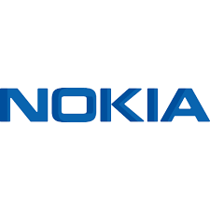


Understanding Supply chain Risk
Multi supplier strategy
These two dramatically different outcomes from one event demonstrate the importance of proactively managing supply- chain risk.
Single supplier strategy
March 17, 2000
Royal Philips Electronics

Slide 3
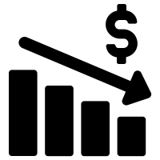




Supply chain Failures
Natural disasters
Labor disputes
They can seriously disrupt or delay material, information and cash flows, any of which can damage sales, increase costs — or both.
Supplier bankruptcy
Acts of war and terrorism
Government Policies

Slide 4
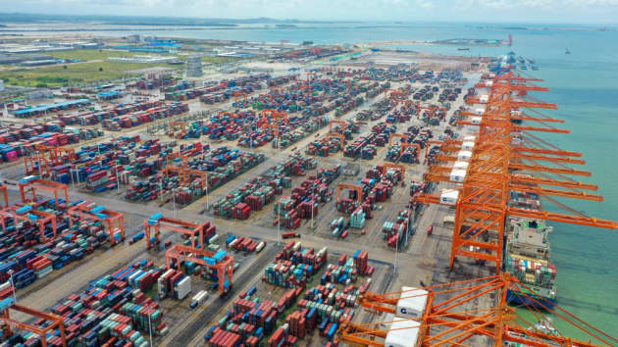
Aerial view of containers sitting stacked at the Qinzhou Port on August 15, 2022 in Qinzhou, Guangxi Zhuang Autonomous Region of China.

Slide 5
KEY CONCERNS SUPPLY CHAIN LEADERS MUST ADDRESS
Are we too dependent on a few global players (Companies or countries) in the way global supply chains are structured?
How can we best prepare for future crisis?
Are global supply chains prioritizing low costs and efficiency at the expense of resilience?
Resilience for Whom: Companies, Global supply chains or countries?

Slide 6
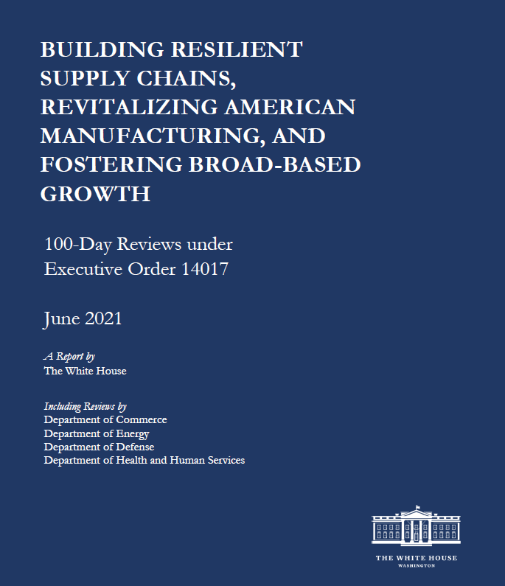
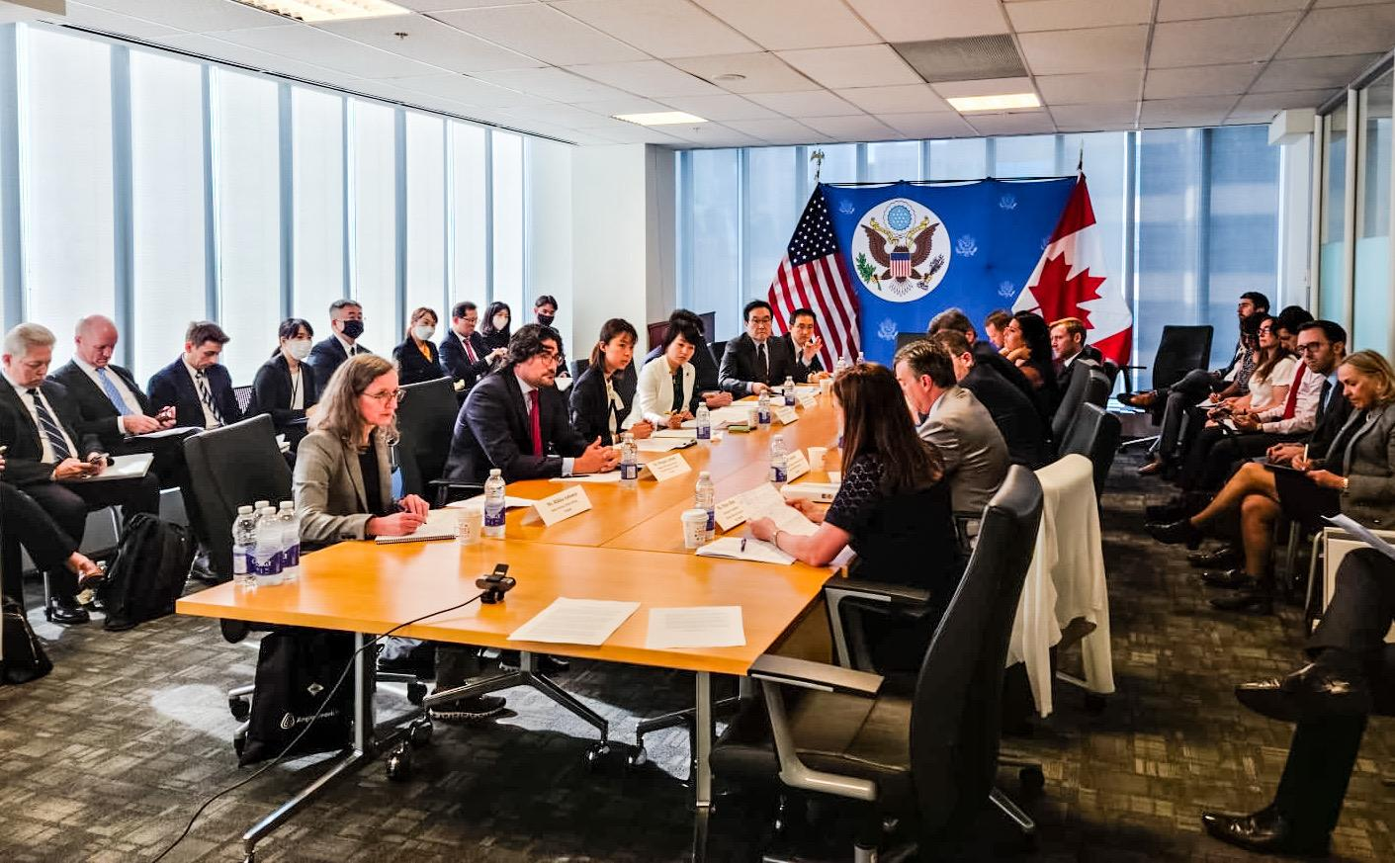
RESILIENCE IS A CORE STRATEGIC PILLAR FOR POLICYMAKERS
The Mineral Security Partnership (MSP) includes Australia, Canada, Finland, France, Germany, Japan, ROK, Sweden, US and the European Commission.

Slide 7
CHAOS IS NORMAL
The world is not predictable
The demands on supply chains are increasing exponentially
more personalized products and services, delivered exactly when and where customers specify, very quickly, at the same low cost.
Supply chains moved from batch quantities to shipping millions of packages a day, many with just one or a few items.
Some companies actually encourage customers to order multiple sizes and colors of the same item, choose the one they like best, and return the rest.
Yet, in the face of this upheaval, supply chains still try to predict what will happen, then optimize performance against plan.

Slide 8
MAJOR DISRUPTIONS IN LAST FEW YEARS
9/11 terrorist attacks
2008 Great Recession
SARS in 2002-2003
2011 Japan earthquake and tsunami
flooding in Thailand later that year
Ebola virus in 2013-2016
U.S.-China trade war
and now the pandemic and post pandemic disruptions

Slide 9
Before companies can devise effective means of reducing supply-chain risks, managers must first understand the universe of risk categories as well as the events and conditions that drive them.
Risk Category | Driver of Risk
Disruptions | Natural disaster Labor dispute Supplier bankruptcy War and terrorism Dependency on a single source of supply as well as the capacity and responsiveness of alternative Suppliers
Delays | High capacity utilization at supply source Inflexibility of supply source Poor quality or yield at supply source Excessive handling due to border crossings or to change in transportation modes
Systems | Information infrastructure breakdown System integration or extensive systems networking E-commerce

Slide 10
Risk Category | Driver of Risk
Forecast | Inaccurate forecasts due to long lead times, seasonality, product variety, short life cycles, small customer base “Bullwhip effect” or information distortion due to sales promotions, incentives, lack of supply-chain visibility and exaggeration of demand in times of product shortage
Intellectual Property | Vertical integration of supply chain Global outsourcing and markets
Procurement | Exchange rate risk Percentage of a key component or raw material procured from a single source Industrywide capacity utilization Long-term versus short-term contracts
Receivables | Number of customers Financial strength of customers
Inventory | Rate of product obsolescence Inventory holding cost Product value Demand and supply uncertainty
Capacity | Cost of capacity Capacity flexibility

Slide 11
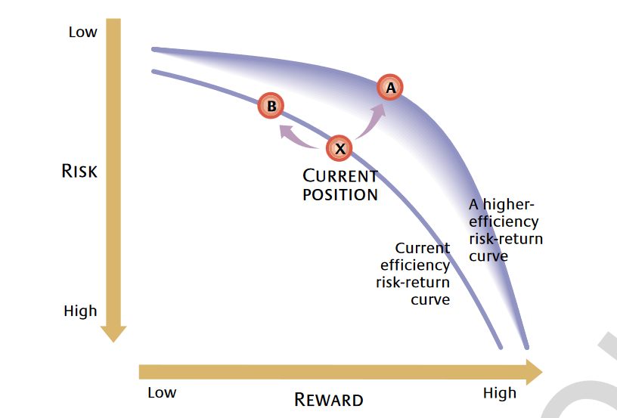
Choosing Supply-Chain Risk/Reward Trade-Offs

Slide 12
Scenario 1
Recent product shortages in a critical component is making you wonder if the supplier would began rationing or allocations?
How you manage this risk?

Slide 13
Scenario 2
You are a leading automobile manufacturer producing in one country and meeting the market demand in other country.
Currency fluctuations often affect the expected profit. You wonder if there is a way you can design your supply chain to manage this risk?

Slide 14
Scenario 3
You are a leading retail giant and share your information system with multiple suppliers. A malware infected your supplier and attached your company-stole your data and your order management system is compromised.
How this risk can be managed?

Slide 15
Different strategies deployed to manage forecasting risk
Consider three different supply chains
Electronics Product
FMCG
Food Grains

Slide 16
Mitigation strategy | Disruption | Delays | Forecast risk | Procurement risk | Receivables risk | Capacity Risk | Inventory risk
Add capacity |  | - - |  | - |  | ++ | -
Add inventory | - | -- |  | - |  | - | ++
Have redundant suppliers | -- |  |  | - |  | + | -
Increase responsiveness |  | -- | -- |  |  |  | --
Increase flexibility | - | -- |  | - |  | -- | -
Aggregate or pool demand |  |  | -- |  |  | -- | --
Increase capability |  | - |  |  |  |  | -
Have more customer accounts |  |  |  |  | --

Slide 17
Balancing Supply-Chain Risk/Reward Relationship
Cost of reserve
Reserve required for risk coverage
Benefit of pooling
Risk covered
Extend of pooling
Risk covered

Slide 18
Tailored Risk Management
Pool reserves
Pool reserves
Decentralize
Decentralize
Reduce cost
Reduce risk
Cost of mitigating risk
Reduce cost
Reduce risk
Level of risk

Slide 19
Stress Testing Your Supply Chain
Exploring “what if” scenarios like those below can help groups identify, understand and prioritize risks, a key prerequisite to tailoring effective risk-mitigation strategies.

Slide 20
Thank you

