Slide 1
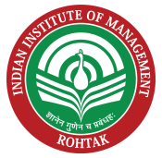
Introduction to SCM

Slide 2
Learning Objectives
Understand Competitive Strategy and Operations strategy
Strategy Formulation Process
How to align Operations strategy to Organizations Strategy
Understand Competitive Strategy and Supply chain strategy
Describe how a company achieves strategic fit
Discuss the importance of expanding the scope of strategic fit across the supply chain.

Slide 3
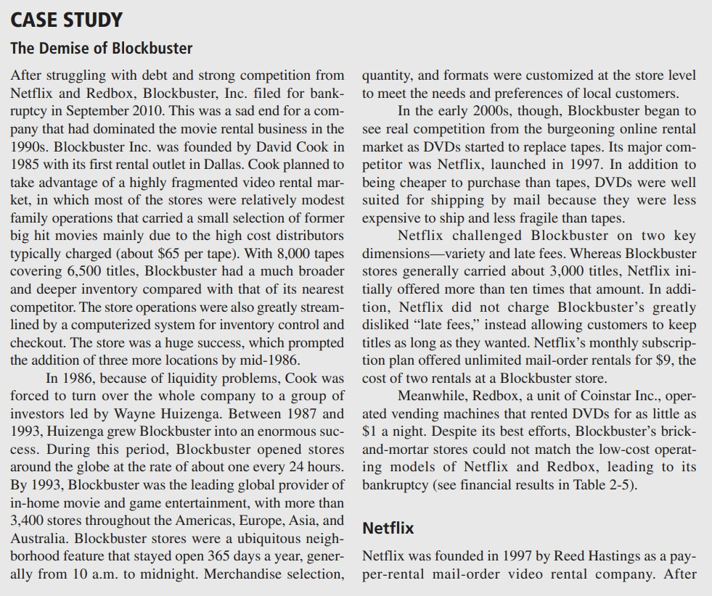

Slide 4
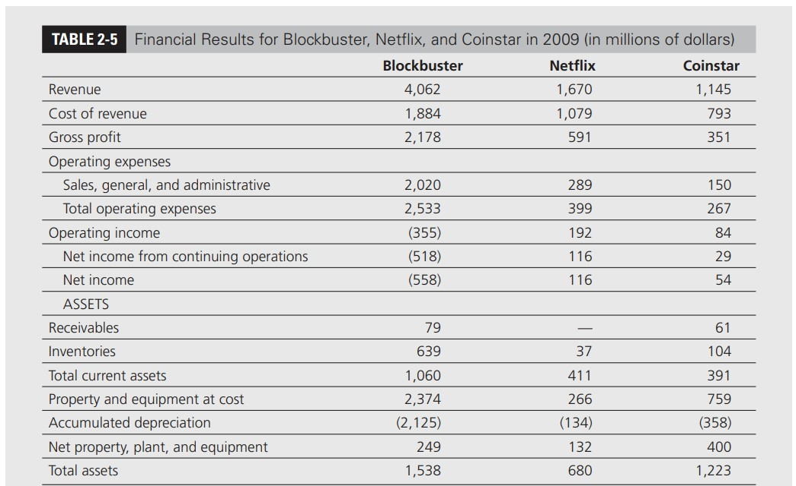

Slide 5
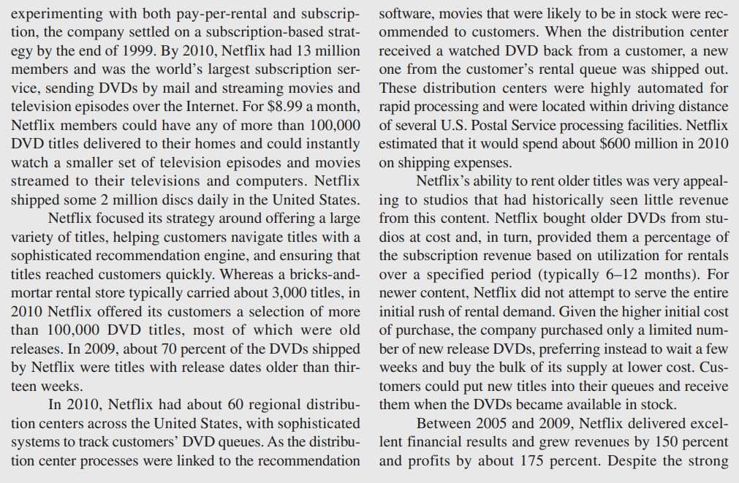

Slide 6
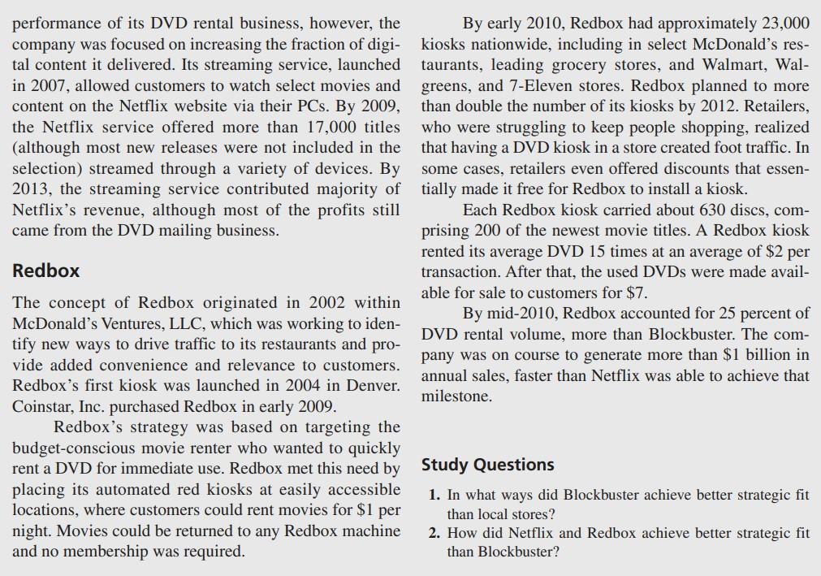

Slide 7
Competitive Strategy
Competitive strategy defines, relative to its competitors
The way company satisfies the customers priorities and needs
  Indigo Vs Jet Airways
  Zara Vs Pantaloons
  Bluenile Vs Zales
  Barnes & Noble Vs Amazon
Business strategy is defined based on product cost, delivery time, variety and quality.

Slide 8
Operations Strategy
  Alignment of key operations decisions with the strategic objectives of a firm
  These decisions are made on the basis of company’s business strategy
    Indigo staff,
    Wall mart location,
    Dell’s raw material etc.

Slide 9
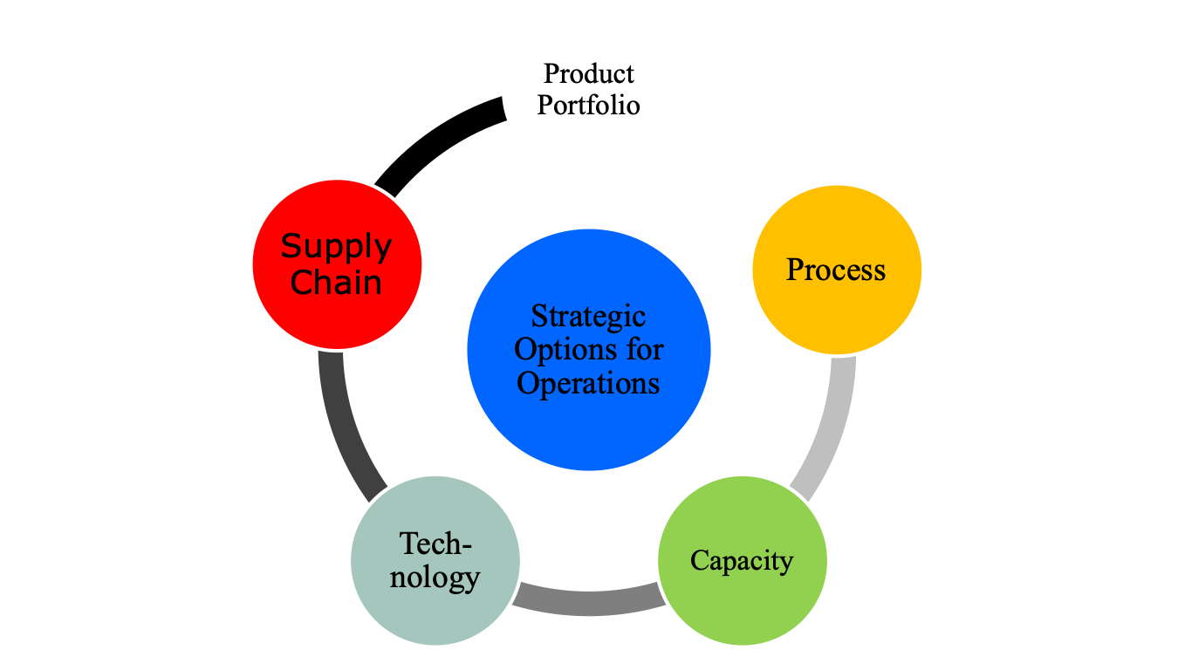
Aligning Operations strategy to Business strategy

Slide 10
Achieving Strategic Fit
Strategic fit means that both competitive and supply chain strategies have aligned goals
All functions of supply chain contributes to success or failure of supply chain.
A company may fail because of a lack of strategic fit

Slide 11
How is Strategic Fit Achieved?
Understanding the customer and supply chain uncertainty
Understanding the supply chain capabilities
Achieving strategic fit

Slide 12
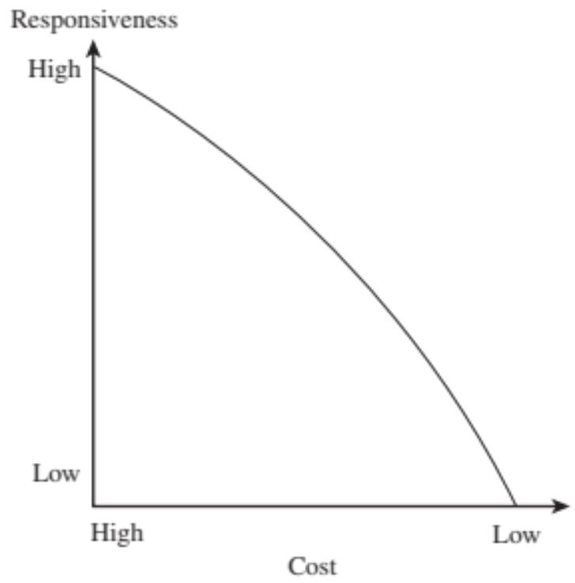
Cost-Responsiveness Efficient Frontier

Slide 13
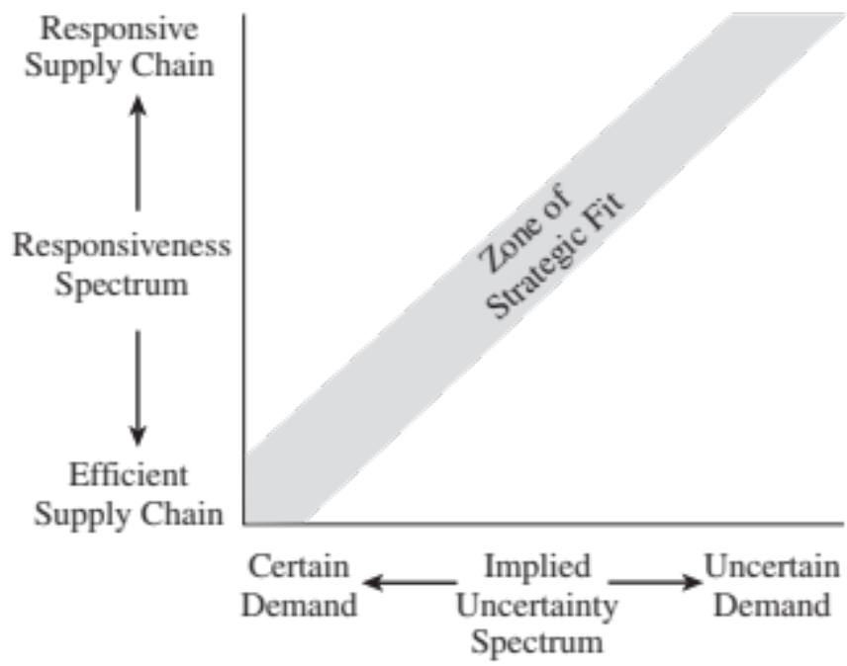
Step 3: Achieving Strategic Fit

Slide 14
Conclusion
Understand Competitive Strategy and Operations strategy
Strategy Formulation Process
Operational Excellence
How to align Operations strategy to Competitive Strategy

Slide 15
Thank You

