Slide 1
Supply chain Networks Design

Slide 2
Role of network in the Supply Chain
Distribution – steps taken to move and store a product from the supplier stage to the customer stage in a supply chain
Supplier
Manufacturer
Distributor
Retailer
Customer

Slide 3
1. Supply chain performance
An individual is in the process of evaluating the performance of three supply chains Sl, S2, and S3. The deciding factors include Operating cost(OC), AI cost (AI), Digitization cost (DC), and Risk cost (RC). The following table provides the relevant data:
Supply Chain OC($) AI($) DC($) RC($)
SC1 6000 1800 4500 1500
SC2 8000 1200 2250 750
SC3 10000 600 1125 600
Use the cost data to develop the comparison matrices. Assess the consistency of the matrices, and determine the choice of best supply chain.

Slide 6
1. Supply chain performance
An individual is in the process of evaluating the performance of three supply chains Sl, S2, and S3. The deciding factors include Operating cost(OC), AI cost (AI), Digitization cost (DC), and Risk cost (RC). The following table provides the relevant data:
Supply Chain OC($) AI($) DC($) RC($)
SC1 6000 1800 4500 1500
SC2 8000 1200 2250 750
SC3 10000 600 1125 600
Use the cost data to develop the comparison matrices. Assess the consistency of the matrices, and determine the choice of best supply chain.

Slide 15
. Kevin and June Park (K and J) are in the process of buying a new house. Three houses, A, B, and C, are available. The Parks have agreed on two criteria for the selection of the house: yard work (Y) and proximity to work (W), and have developed the following comparison matrices.

Slide 23
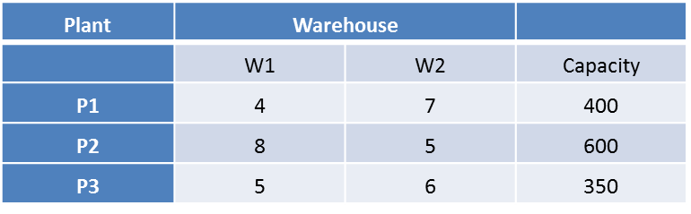
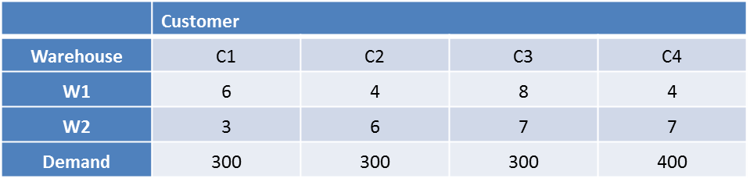
Problem: 3
The distribution system for a company consists three plants, two ware houses, and four customers. Plant capacities and shipping costs per unit from each plant to each warehouse are as follows:
Customer demand and shipping costs per unit from each warehouse to each customer are
Assign the capacities of the plants to customer as well as to warehouse

